Slide 1
Message Queue Basics
&
Applications to Weather Services
David Podeur
Meteo-France

Slide 2
Why use a specific Message Queueing Middleware?
Message queues services brings:
  Data exchange between applications
    Point to point
    Point to multipoint
    Pub/Sub services
  Builtin redundancy features:
    Clustering (Redundancy on LAN)
    Federation (Redundancy on MAN/WAN)
  Builtin security features:
    SSL/TLS

Slide 3
Why is AMQP a fashion topic
Production Ready
AMQP already part of SWIM (We need to be AMQP compliant)

Slide 4
AMQP and RabbitMQ
AMQP is a wire level protocol
You need to choose an implementation for testing
RabbitMQ is one existing implementation
RabbitMQ support several message queue protocols:
  AMQP 0-9-1 (preferred), 0-9 and 0-8
  STOMP
  MQTT
  AMQP 1.0
  HTTP (API)
RabbitMQ has implemented extensions to AMQP
RabbitMQ is supported by Pivotal (commercial support + forums)

Slide 5
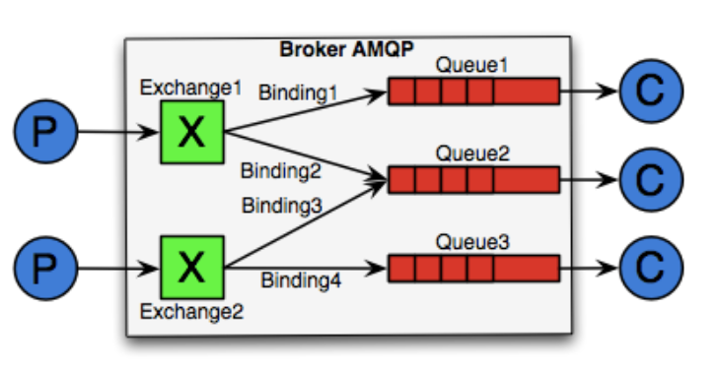
AMQP architecture
Source: https://blog.zenika.com/2010/12/19/introduction-a-rabbitmq-amqp/
All connections are TCP based (no UDP)
Publish is performed to an exchange (not to a queue)
There can be [1:n] Exchanges
Subscription lead to the creation:
  of a queue (if needed)
  of bindings from exchange to queue
No binding => No routing => Message discarded
Once messages are consumed, they disappear

Slide 6
AMQP Message Structure
Example
Raw GRIB2 data
routing key (max = 255 bytes)
Payload
(no max size)
weather.model.arome.highres
routing key (max = 255 bytes)
routing key (max = 255 bytes)
headers
format = grib2
content_type = embedded_message
forecast_range = +30h

Slide 7
RabbitMQ: important settings
Make queues lazy:
  Store messages on disk (predictable response times)
Make queues persistent:
  Allows to route messages even if consumer not connected
Tune prefetch:
  Allows to use all bandwidth even with on high latency WAN
Mind big files
  Be careful when sending send files bigger than a few Kbs
    RAM Impact (files loaded to RAM)
    Transfer times

Slide 8
Tests performed at MF

Slide 9
Milestones (from openWIS project Charter)
Pub/sub on WIS24h cache data, providing data through FTP, getting data throughtAMQP
Pub/sub on French global model (Arpege) global Model, getting link through AMQP (large files demonstration):
  with direct AMQP dissemination
  with AMQP “availability” dissemination providing the customers information that data is ready for downloading (possibly using “metalink” files)
Pub/sub over an AMQP Cluster (Several nodes in a single location to provide High Availability & High throughput)
Pub/sub over an AMQP Federation (Different clusters separated by possibly lossy and high latency WAN links)
Security aspects (use of TLS, messages signatures, certificates)
Study which SLAs could be offered
Provide a candidate architecture how AMQP could coexist with FTP/SFTP based data exchanges

Slide 10
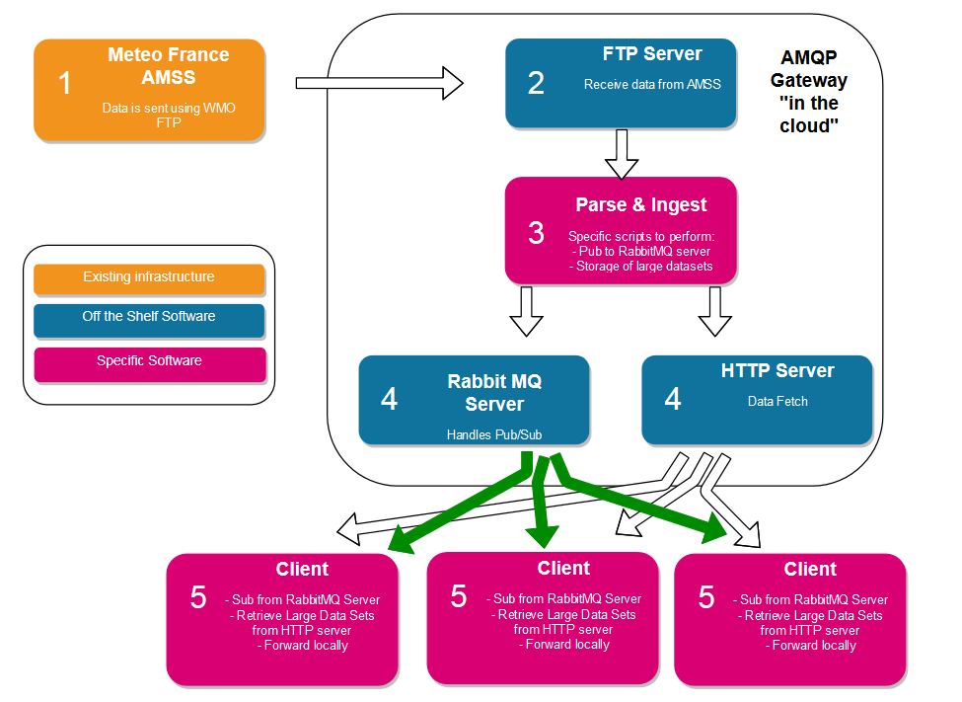
Weather Data specific implementation

Slide 11
Weather Data specific implementation
Small files are embedded in RabbitMQ payload
Messages are directly delivered to end users
Messages are sent in bulk (several messages at once), making it very efficient even on high latency networks
Top priority messages can be handled

Slide 12
Weather Data specific implementation
Larger files are embedded as metalink RabbitMQ payload
Largers messages are stored on alternative locations
Metalink files are sent as RabbitMQ payload:
Client can perform asynchronous download are corresponding data

Slide 13
Weather Data specific implementation
Larger files are embedded as metalink RabbitMQ payload
Metalink example:
<?xml version="1.0" encoding="UTF-8"?>
<metalink xmlns="urn:ietf:params:xml:ns:metalink">
<published>2018-10-25T13:47:38.533703</published>
<file name="2018-10-25_13:47:32.982283.bin">
<size>100000000</size>
<identity>undef</identity>
<version>1.0</version>
<language>undef</language>
<description>
undef
</description>
<hash type="sha-256">b'ea15eed77537f405f48eea8983ad770268460c2e9b321ad57e653b9ea80b3533 /home/explo/ftp/files/2018-10-25_13:47:32.982283.bin\n'</hash>
<url location="fr" priority="1">http://192.168.0.1/cache/2018-10-25_13:47:32.982283.bin</url>
</file>
</metalink>

