Slide 1
TT-eWIS/2018:
Decentralisation vs. shared services
Jeremy Tandy (Chair)

Slide 2
Decentralisation vs. shared services
Draft WIS2.0 implementation approach proposed use of shared services to consolidate WIS Infrastructure – particularly GISCs
Cache-in-the-cloud was not approved at EC-70; nor could a finance model be agreed to underpin shared services
Feedback from Germany indicates that a decentralised approach is a key requirement for WIS 2.0
Historically, decentralised systems are more robust to change as they are extensible
A decentralised system may also better support national / regional technology preference/governance…

Slide 3
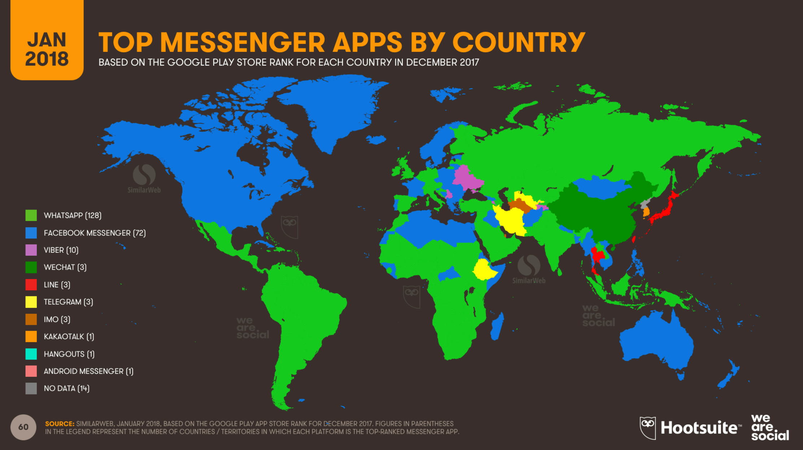

Slide 4
GISC infrastructure
Can WIS 2.0 work with duplicate catalogue and data portal functions at each GISC? (it works for the current WIS – albeit with sync issues)
Shared service would consolidate infrastructure and reduce costs - but (i) it may result in a fragile system, (ii) Members do not appear to want this, and (iii) Members certainly cannot agree how to fund this
Federation/decentralisation seems to be a non-functional requirement…
Equally applicable to the real-time messaging solution
Notes:
the intent was always to retain GISCs, but by sharing infrastructure, enabling them to focus on content (data, services) and help support their affiliated centres.
... centre affiliation and support remains UNCHANGED
... GISCs should prioritise supporting their affiliated centres register their data and services rather than build & operate infrastructure

