Slide 1

GISC Tokyo Cloud Pilot Project
Shuichi Ikeda
ICT division, Japan Meteorological Agency
TT-eWIS 2018, 14th -16th November 2018, Beijing

Slide 2
AMDCN of GISC Tokyo
Advantage
GISC Tokyo
100Mbps
Expensive,
Not high speed In comparison with internet
2Mbps
Disadvantage
2Mbps
NMC Hanoi
Expensive,
Not high speed In comparison with internet
High reliability, Secure,
Guaranteed bandwidth
High reliability, Secure,
Guaranteed bandwidth
Inexpensive,
High speed
Internet
MPLS Network
(NTT_COM)
Security measures,
Best effort
RTH Bangkok
NMC Nay Pyi Taw
NMC Manila
NMC Vientiane
NMC Phonom Penh
Non-direct connection
Non-direct connection

Slide 3
Problems of Tokyo’s AMDCN
Cost
  Expensive.
Communication speed
  Not high communication speed.
Accessibility
  Some countries and Tokyo cannot establish direct links.
Scalability
  Difficult to transmit high volume data, especially satellite and NWP data.

Slide 4
Improvements of Tokyo’s AMDCN
Cost assessments
  From dedicated lines to Internet connections
Upgrade communication speed
  High speed internet connections
Accessibility
  Internet connections
Security
  Virtual Private Network, Secure protocol
Reliability
  Backup systems and connections (when necessary)
Scalability
  Cloud service

Slide 5
The purposes of Cloud Pilot Project
Install cloud service on the internet to exchange information, basically among GISC Tokyo’s AoR and south-east Asia countries who join the radar composite project.
Evaluate cloud service provided by private company in terms of operational (satisfy the manual on GTS?) aspects, and develop an understanding of cloud technology.
Gather opinions in Tokyo’s AoR, and analyze their needs.
Compare costs of dedicated lines and Cloud services, and check reliabilities.

Slide 6

Cloud Pilot Project - data from NCs
NMCs upload their batched FTP files / files to JMA Cloud
JMA Cloud
NMC Bangkok
Internet
NMC Hanoi
GISC Tokyo
NMC Nay Pyi Taw
NMC Manila
Other centres
NMC Phonom Penh
NMC Vientiane
Cloud unpacks uploaded FTP files, and stores raw data on its storage.
Cloud also recompiles data into batched FTP files, and send them to JMA MSS.
Communication Protocol
FTP, FTPS, SFTP, HTTP, HTTPS

Slide 7
Cloud Pilot Project - data to NCs
NMCs download data from JMA Cloud
JMA Cloud
NMC Bangkok
Internet
NMC Hanoi
RJTD0000000N.b
GISC Tokyo
NMC Nay Pyi Taw
NMC Manila
Other centres
NMC Phonom Penh
NMC Vientiane
Cloud unpacks batched FTP, and stores raw data on its storage
Communication Protocol
FTP, FTPS, SFTP, HTTP, HTTPS

Slide 8
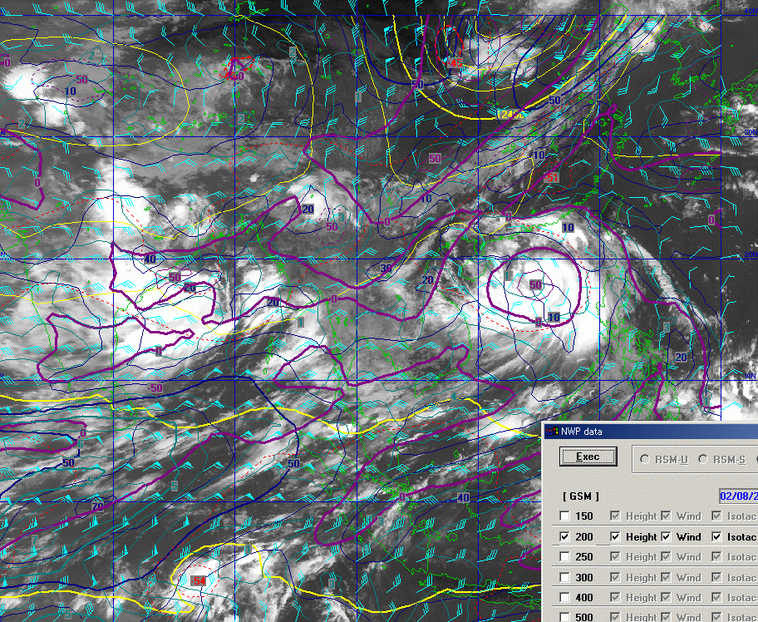
Cloud Pilot Project – Visualization tools
NMCs access to visualization tools on JMA Cloud
JMA Cloud
Cloud unpacks batched FTP, and stores raw data on its storage
NMC Bangkok
Internet
RJTD0000000N.b
NMC Hanoi
GISC Tokyo
NMC Nay Pyi Taw
NMC Manila
Other centres
NMC Phonom Penh
NMC Vientiane
Communication Protocol: HTTP, HTTPS
Cloud offers visualization tools on JMA Cloud.

Slide 9
How to upload/download data to/from GISC Tokyo cloud - FTP -
Pack and send it to JMA MSS
From JMA MSS
Unpack and store
User directories
Unpack and store
pack
User directories
upload
download
Put batched FTP files by FTP
Get batched FTP files by FTP
Finally delete them on user directories
NMCs
GISC Tokyo’s AoR
NMCs
GISC Tokyo’s AoR

Slide 10

How to upload/download data to/from GISC Tokyo cloud - HTTP -
Pack and send it to JMA MSS
From JMA MSS
Unpack and store
Authentication web
move
unpack
Directories for users
upload
download
Put batched FTP files by HTTP(s)
Using curl command with ID and password
Check update information
Get data from cloud web site
NMCs
GISC Tokyo’s AoR
NMCs
GISC Tokyo’s AoR

Slide 11
Summary
Plan to Install cloud service on the internet to exchange information basically among GISC Tokyo’s AoR.
Evaluate cloud services provided by private company in term of operational aspects through this pilot project experience.
Gather opinions of Tokyo’s AoR, and analyze their needs.
Compare the cost of dedicated lines and Cloud service. consider whether current dedicated lines are completely replaced to cloud based connections, and check reliabilities.

Slide 12

Thank you
Merci

