Slide 1

Toward WIS2.0
Shigeharu NISHIKAWA
Japan Meteorological Agency
TT-eWIS2018

Slide 2
Toward WIS2.0
We have to investigate…
  Summary of current WIS1.0
  Clarification of target users,
  User needs and
  Possible use cases
  Latest technology trends

Slide 3
Summary of WIS1.0
WIS era
WIS 1.0 still has some problem…
  WIS Metadata
    Consistency
    Synchronization
  User Account
  UI/UX
  SSO/Federation
  Function
  Filename, File Format
Part A:
GTS
Pub 9
Vol C1
WIS
Metadata
x15
Part B:
DAR
GISC
Cache
WIS
Monitoring
Part C:
Data Management

Slide 4
Summary of WIS1.0
We also have to consider…
  Retirement Legacy Message Switching System / Optimization of GTS (WIS Part A)
  Optimization of GISC cache and Metadata repository (WIS Part B)
Strengthening the foundations for WIS2.0

Slide 5
Clarification of target users
Classification of users
  NMHS (Numerical forecast center, Satellite center including ECMWF, EUMETSAT)
    Observation data (including satellite data, radar data) is indispensable for numerical forecast centers.
  NMHS (Developing country)
    Observation data is indispensable for numerical forecast center.
    The data really wanted by developing countries is not raw data, such as NWP products and satellite images, that can be used for forecasting as they are.
  NMHS (LDCs, SIDSs in poor Internet environment)
  Academic Institution
  The general public
First of all think NMHS as top priority

Slide 6
User needs and possible use cases
Need more discussion about user needs on WIS2.0
Possible user case (see last part of this ppt)
Think ‘topology’ of data sharing arrangements for low-volume data and high-volume data separately
      Low-volume data : SYNOP, TEMP … etc.
      High-volume data : NWP product, satellite data, radar data

Slide 7

Retirement Legacy Message Switching System / Optimization of GTS
Idea : Integration of WIS Part A & B
Incoming/Uplink
Outgoing/Downlink
GISC
DAR : Subscription
NC
NC
Storage
NC
GISC
NC (LDC, SIDS)
IGDDS
DCPC

Slide 8
Retirement Legacy Message Switching System / Optimization of GTS
Is GTS obsolete technology?
Is optimization really necessary?
  >GTS is now just working, but we have to consider…
    Cost-effectiveness
    Its Operation
  >Review the ET-CTS cloud project

Slide 9
Optimization of GISC cache and Metadata repository
Currently each GISC has GISC Cache and Metadata repository.
Is there need to own GISC Cache and Metadata at each GISCs?
  >Two or Three GISC Cache and Metadata repository is enough.
  >Operate with cloud services divided by area and/or cloud suppliers.

Slide 10

WIS2.0 will be…
GTS era
WIS1.0 era
WIS2.0 era
GTS
Part A:
GTS
WIS Information Catalogue
WIS Service Catalogue
Advanced Catalogue Search
WIS Service @GISC
Pub 9
Vol C1
Pub 9
Vol C1
WIS Service @DCPC
WIS
Metadata
WIS Service @NC
Part B:
DAR
WIS Service
GISC
Cache
WIS Information
Cache
WIS
Monitoring
WIS
Monitoring
Data Management
Part C:
Data Management

Slide 11
WIS2.0 will be…
WIS Information Catalogue
WIS Information Cache
  >WIS Metadata & GISC Cache
WIS Service Catalogue
WIS Service
  >Web services, API, Function, etc. for WIS2.0 and its catalogue
Advanced Catalogue Search

Slide 12
WIS2.0 will be…
WIS2.0 = WIS Information + WIS Service
WIS Information (-> data and product)
  WIS Information Cache and WIS Information catalogue will be developed/operated by selected GISCs.
  Record of WIS Information catalogue of AOR will be maintained by each GISCs
WIS Service
  WIS Service catalogue will be developed/operated by selected GISCs.
  Record of WIS Service catalogue of AOR will be maintained by each GISCs
  WIS Service can be developed/operated by any WIS users.
  Service Definition, Service Discovery System
  Coordination for developing WIS Service

Slide 13
Redefinition of WIS Catalogue
WIS Information Catalogue
  Rename from WIS Discovery Metadata
    Already we have
WIS Service Catalogue
  New Catalogue for WIS2.0

Slide 14
WIS Service Catalogue
Service Name
Service Provider
Service Version
Service Information
Service Status (Plan, Develop, Operation)
Service Quality
Access Limitation
…
Collaborate with WIS service users from developing phase

Slide 15

WIS Service Catalogue
3
WIS Service Catalogue
Search Service
1
WIS Service Search
Register Service
User
Service Provider
2
4
Service
Develop/Operate Service
Find Service

Slide 16
Where is WIS Service?
Who prepare WIS Service?
Anywhere / Anyone in WIS
WIS Service
WIS Service
WIS Service
GISC
DCPC
DCPC
WIS Service
WIS Service
WIS Service
WIS Service
GISC
DCPC
NC
DCPC
WIS Service Search

Slide 17
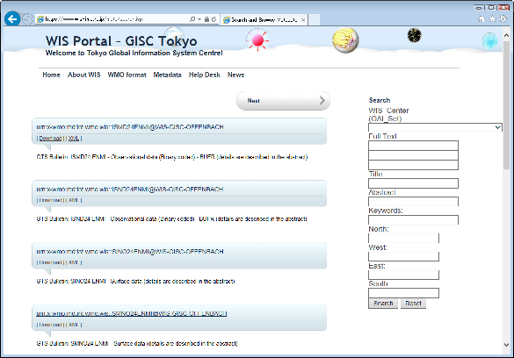

Service Sample (Area Extraction)
Search with
WIS Information catalogue and
WIS Service catalogue
WIS Service : Area Extraction
WIS Service
Data
WIS Service
Search
DCPC
Get Result

Slide 18
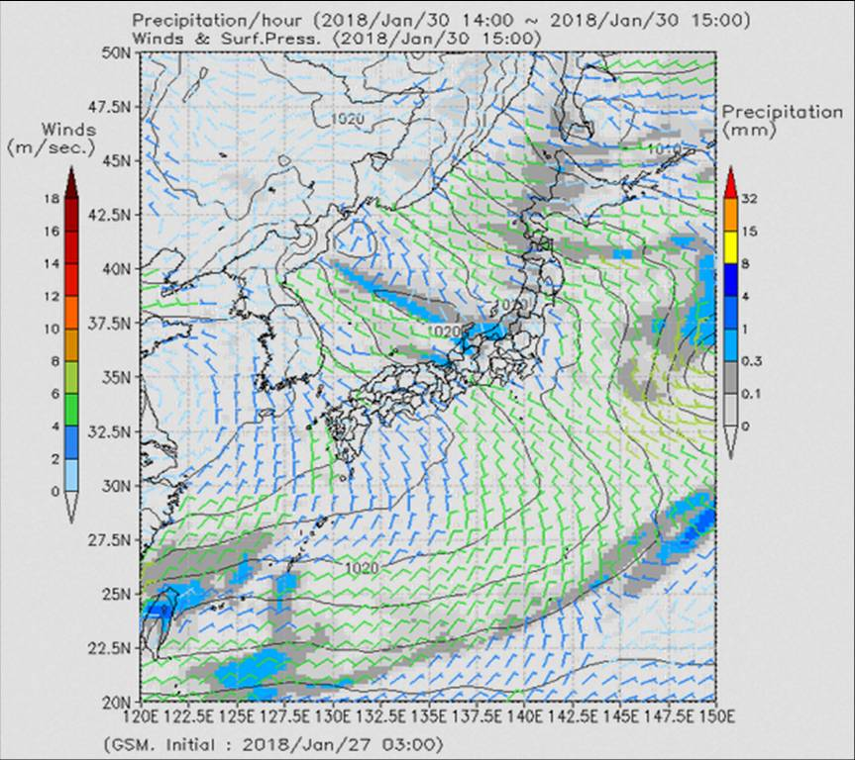
Service Sample (Visualize)
Search with
WIS Information catalogue and
WIS Service catalogue
WIS Service : Area Extraction
WIS Service
WIS Service
Data
WIS Service
Search
DCPC
NC
WIS Service : Visualizer
Get Result

Slide 19
Service Sample (User Sandbox)
“data processing to be hosted adjacent to the data – thereby removing the need to operate one’s own data management infrastructure. ”
--- quote from WIS 2.0 Implementation Approach draft1
WIS Service : Process developed by users / service provider
WIS Service : User Sandbox
NWP center
Develop
WIS Service
High-volume
Data
DCPC
examples:
Satellite data
Radar data
Get Result for data assimilation

Slide 20
Service Sample
(Information Collection)
WIS Service : Collection
Information
WIS Service
Data
GISC
NC, DCPC

Slide 21
Service Sample
(Information Distribution)
WIS Service : Distribution
WIS Service
Data
Information
GISC
NC, DCPC

Slide 22

Thank you
Merci

