Slide 1
TT-eWIS/2018:
Data supply chains
Jeremy Tandy (Chair)

Slide 2
Trust, data policy and access control
“why should I share my data when I don’t know how or if the recipients will control access to the information according to the data policies we set?”
GTS operates on a basis of trust – but we know that data policies are not uniformly implemented
Should WIS 2.0 consider implementing access controls to enforce the data originator’s access/usage policy?
Do we need to implement controls ‘in the network’ to enforce data policy?
Is it sufficient that WIS Centre audits verify that appropriate access controls are in place?

Slide 3
Data supply chains (distributed data policy enforcement)
Omar Baddour pointed out the need for trusted provision of climate observation records
the concern “do I have control over my data” is related to the lack of confidence from Members about cloud technologies - these virtual environments where you don’t physically have the data on your servers
many global centres are interested in helping because they want the data & to protect it from inadvertent loss – incentive; e.g. host the data, use the data, protect the data for future generations
but historical data from developing countries is rarely shared because they do not want to lose control of an information asset whose commercial provision can supplement meagre budgets
can WIS 2.0 provide technology to enforce data policy (Res 40 etc.) and track data usage?

Slide 4
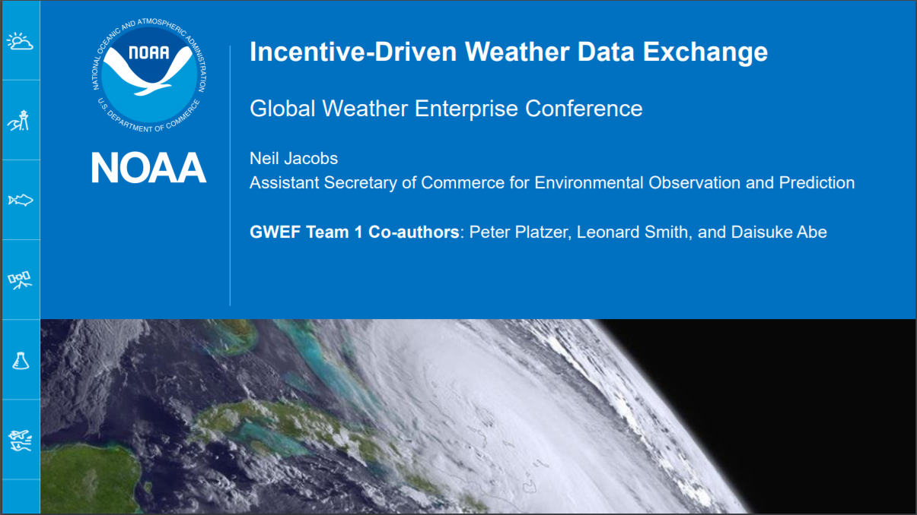
Global Weather Enterprise Conference: WDX
Data sharing - Incentive-based data exchange; Neil Jacobs (NOAA, USA)

Slide 5
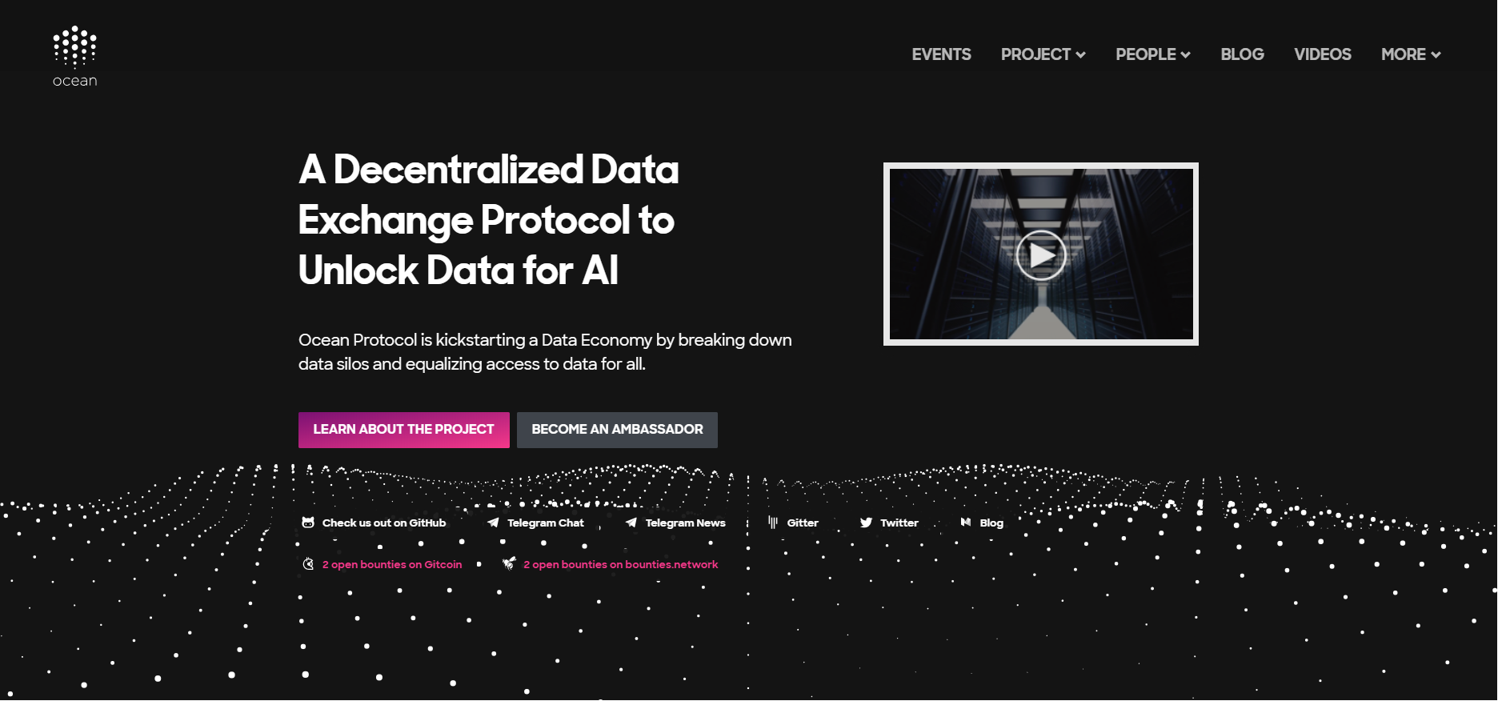
Ocean Protocol: decentralised data exchange

