Slide 1
BUFR demystified
Daniel Lee
Notes:
40 minutes, afterwards 20 minutes questions.

Slide 2
Things used to be so nice…
Temperature? 4th group from the left.
Don't forget – the 0 is the sign here.
Oh yeah, it's tenths of degrees Celsius.
98334 31475 82706 10252 20225 39858 40061 55008 60021 76062 83223
iii iRixhVV Nddff 1snTTT 2snTdTdTd 3pppp 4PPPP 5appp 6RRRtR 7wwW1W2 8NhCLCMCH
sta C/wind Temp DPT StaPres SLP APP Precip Preswx Clouds
…Also, the 1 doesn't mean anything.
Notes:
Come with me into the past.

Slide 3

Things used to be so nice…
Radar:
SDAS KAWN 271800 RRX FFAA 29030 47447 42364 11361 10314 30222
Drifting buoy:
SMVD22 KWBC 011200 RRA BBXX 46014 01121 99392 71240 46/// /0602 10125 40108 53004 91150 22200 00126 11703 70013 333 91203 555 11024 22025
Notes:
After a while you became a magician by knowing the codes, recognising them on the "feel of it", etc. And for every type of observation, there was a different code with different precision, etc.

Slide 4
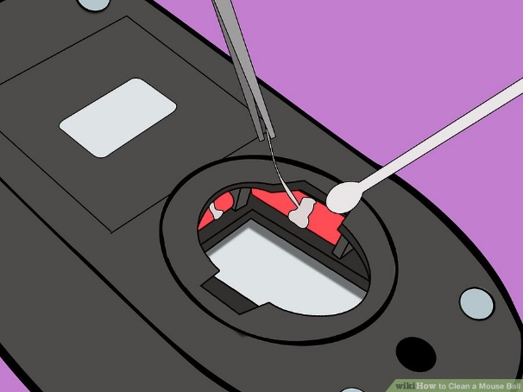
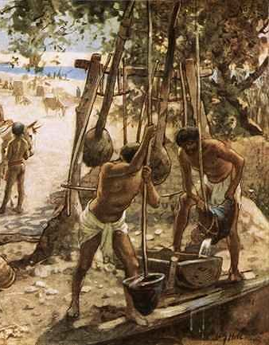
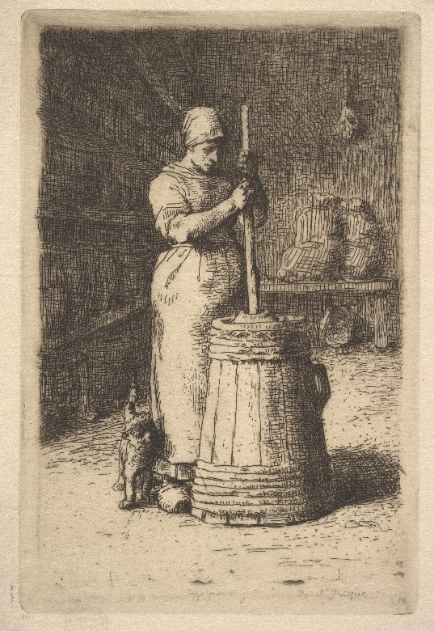
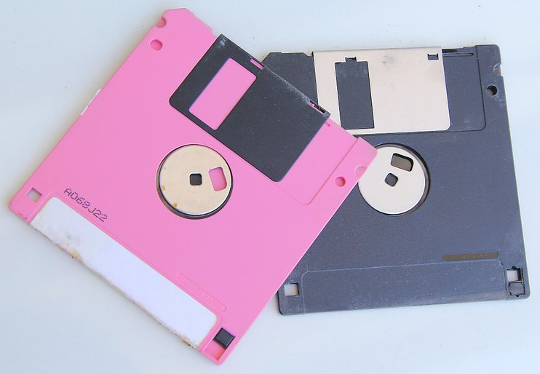

Things used to be so nice…
Notes:
PC vs cloud
Mouse balls rather than lasers – they work on glass!
Floppy disks – make them read-only just by flipping the toggle.
Making our own bricks?
What about churning our own butter?

Slide 5
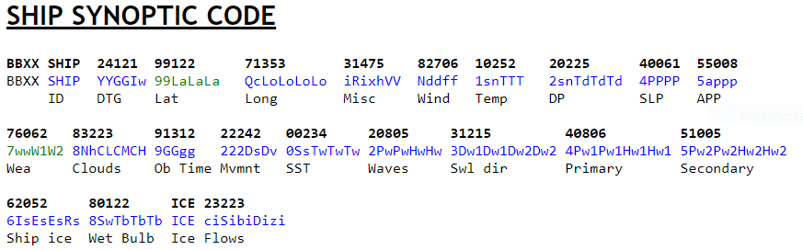
Examples of non-table driven alphanumeric codes
98334 31475 82706 10252 20225 39858 40061 55008 60021 76062 83223
From the US Navy:
Notes:
But there are advantages to change. Remember the previous SYNOP? This is slightly more complex and it's not really easy to understand. It's definitely not self-explanatory (although the other one wasn't either).

Slide 6
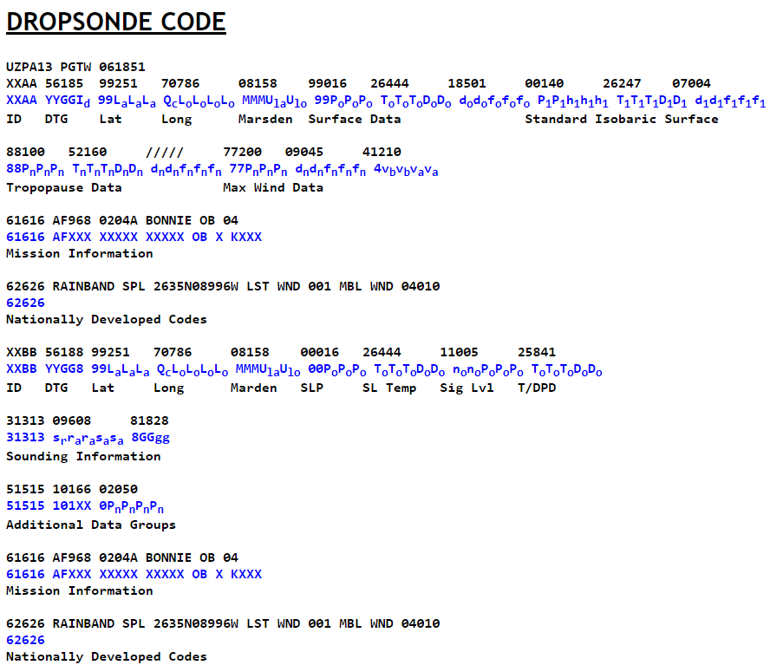
Examples of non-table driven alphanumeric codes
98334 31475 82706 10252 20225 39858 40061 55008 60021 76062 83223
From the US Navy:
Notes:
Seriously? For another observing system I have to learn all these things? And every message has to be structured exactly the same?
Completely new program required for each.

Slide 7
Issues with Traditional ASCII Codes
TAC tied precision and reporting style to an observing type
They were obfuscated and verbose
New specifications required new software and training
There were 48 of them

Slide 8
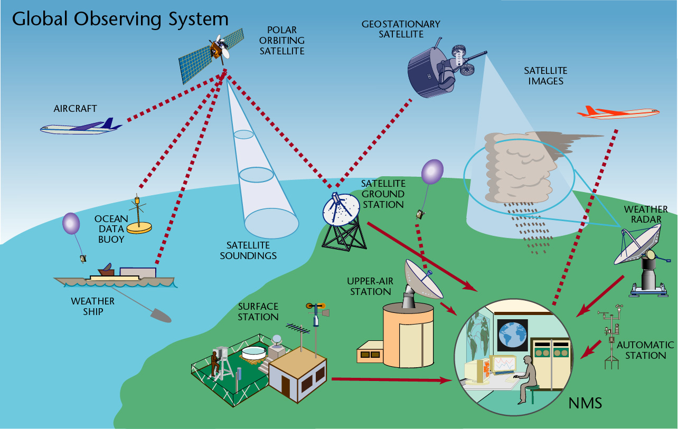
How does this fit with the Global Observing System?

Slide 9
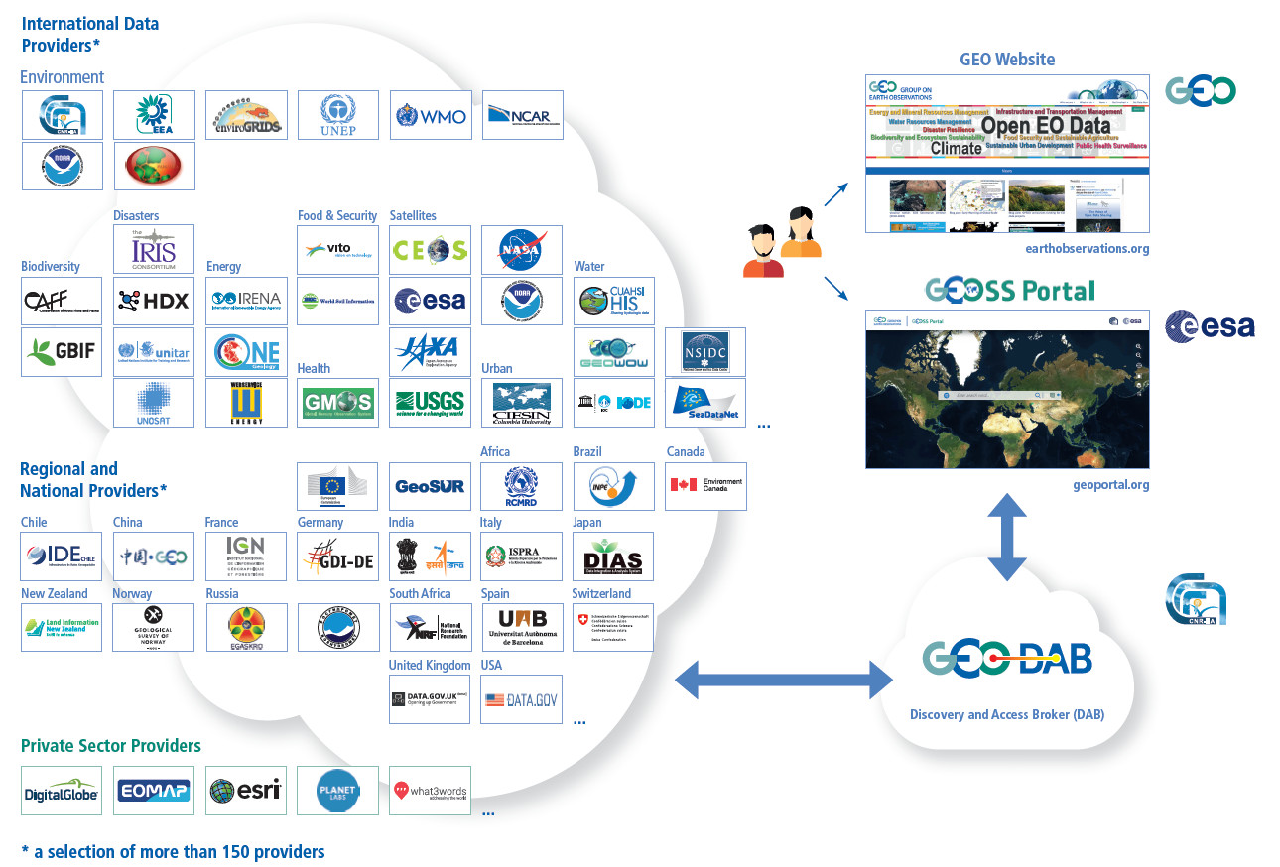
And the Global Earth Observation System of Systems?

Slide 10
It does not.
TAC
(Traditional ASCII Codes)
TDCF
(Table Driven Code Forms)
:(
:)
Notes:
One of these are BUFR, but so you've heard of it, there's also CREX - Character form for the representation and exchange of data.

Slide 11
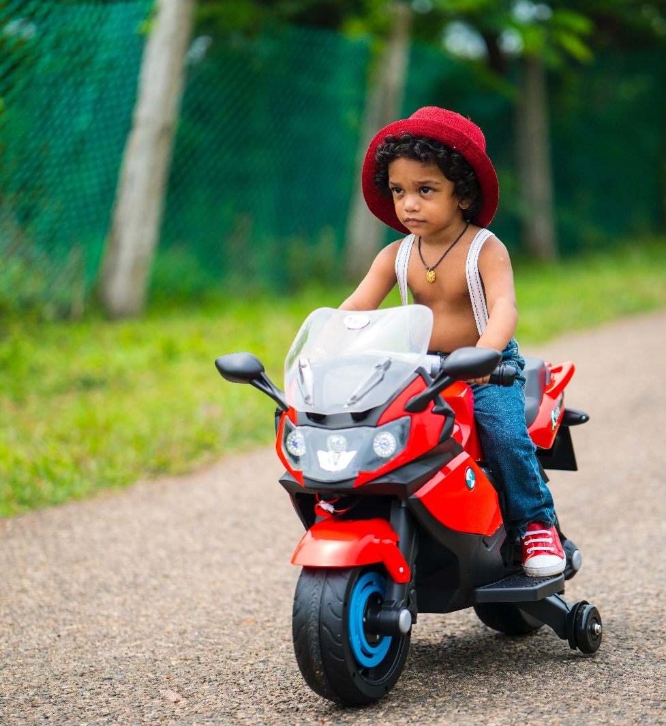
The new kid in town: BUFR
Binary Universal Form for the Representation of meteorological data
  Compact
  Stream-ready
  Low bandwidth
  Controlled vocabulary
  Flexible
Notes:
This sounds like XML, but it's not.
Partly this is because it was before Office nerds took over the world – and lost it.
It's also because XML isn't fit for purpose and binary XML never worked.
New kid in town is here and it's here to stay

Slide 12
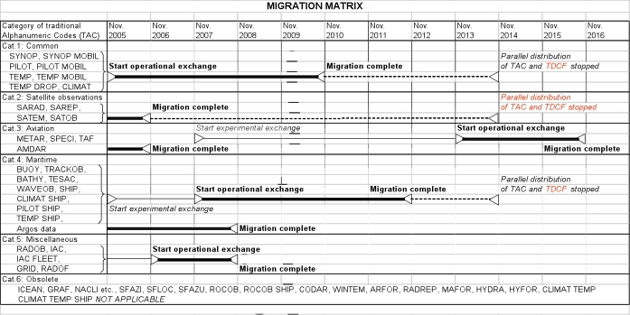
Migration table
Notes:
What you saw so far was a taste of the complex ecosystem of "Traditional ASCII Codes". This is the WMO's migration timeline for all 48 (including one called "etc.").

Slide 13
The key message
The last date on the migration table was 2016
Many countries no longer use the old codes
BUFR is the WMO mandated way forward

Slide 14
What we'll be talking about today
What is BUFR?
How do I use it?
How does it evolve?
Notes:
The intent is like with any tool:
Understand
Use
Influence

Slide 15
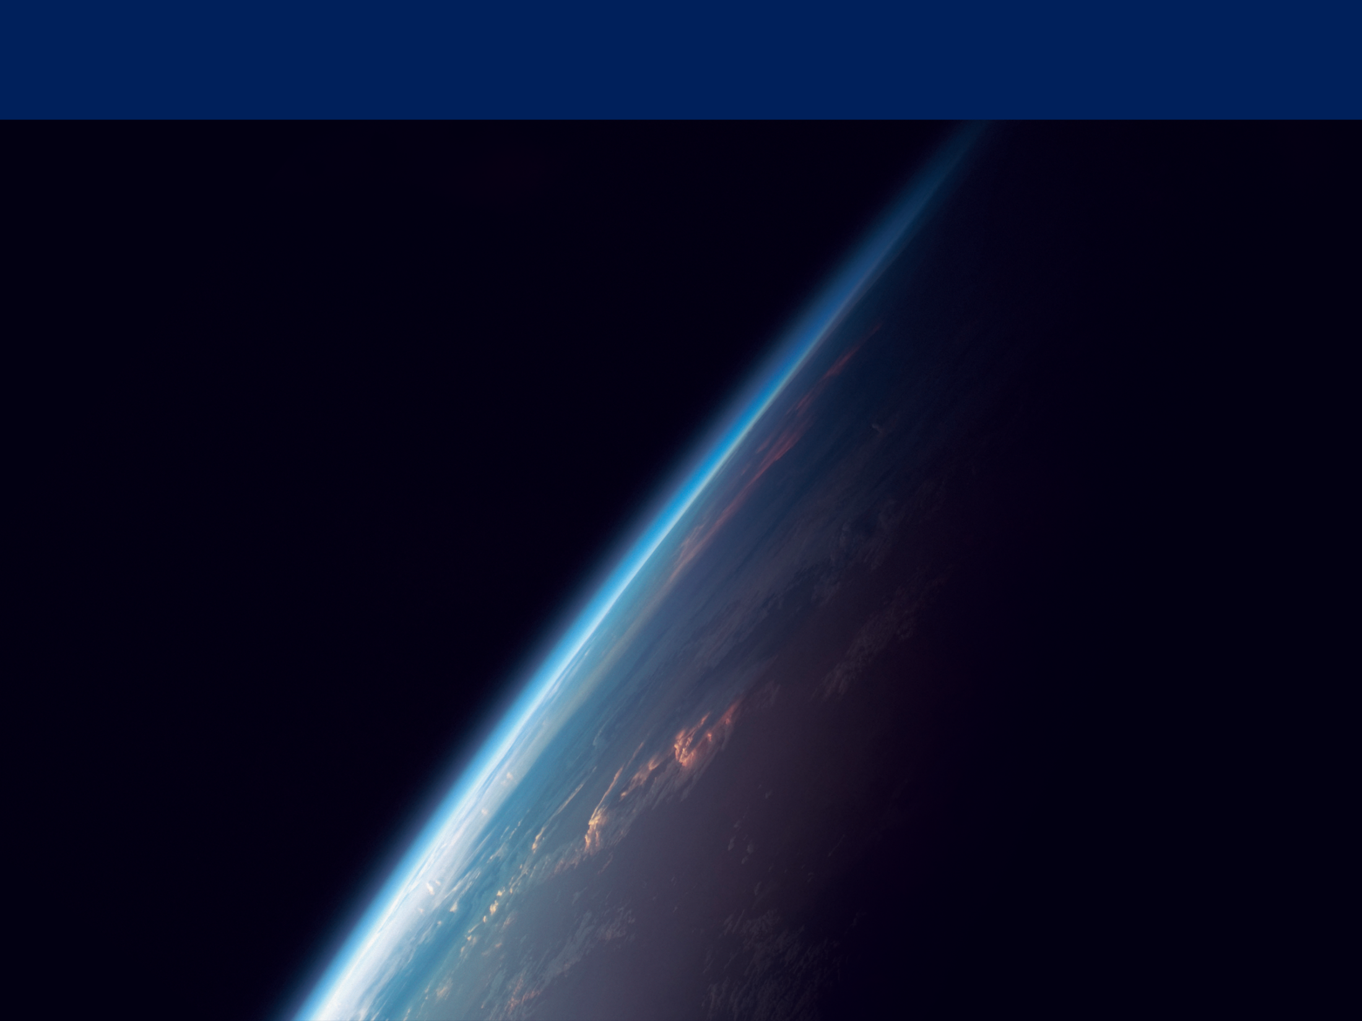
What is BUFR?

Slide 16
Introduction to BUFR: A familiar example
Point of reference: Joint Photographic Experts Group (JPEG) encoding
Caveat: Quick comparison in the interest of time, restricted to JPEG File Interchange Format (JFIF)
  Convert colour representation from RGB to Y′C_{B}C_{R}, consisting of one luma component (Y'), representing brightness, and two chroma components, (C_{B} and C_{R}), representing color (optional).
  Reduce resolution of chroma data (usually by factor 2-3).
  Split image into 8x8 pixel blocks and perform discrete cosine transform (DCT) on each component, as in a Fourier transform.
  Quantize frequency amplitudes into bins.
  Compress resulting data for all blocks with a variant of Huffman encoding.
Notes:
Who works with JPEG? Everyone? Good.
We begin here because everybody works with this all the time so they know how it works.
2 - Colour reduced because people are better at seeing differences in brightness.
3 - This produces a kind of spatial frequency spectrum.
4 – This is the part you can control with your software.

Slide 17
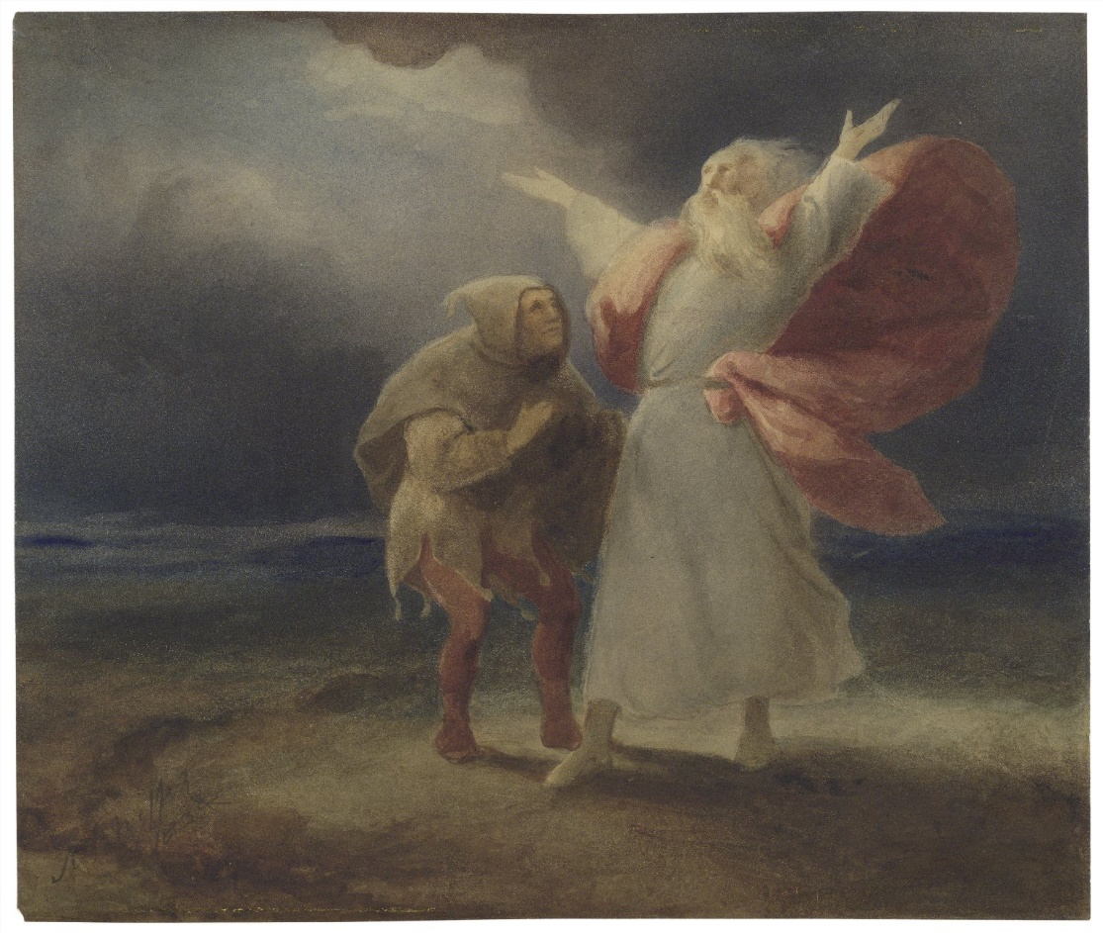
Introduction to BUFR: A familiar example
O, that way madness lies; let me shun that;
No more of that
Notes:
King Lear to the fool says, when contemplating things which cause incredible pain and which will surely make him lose his mind…

Slide 18
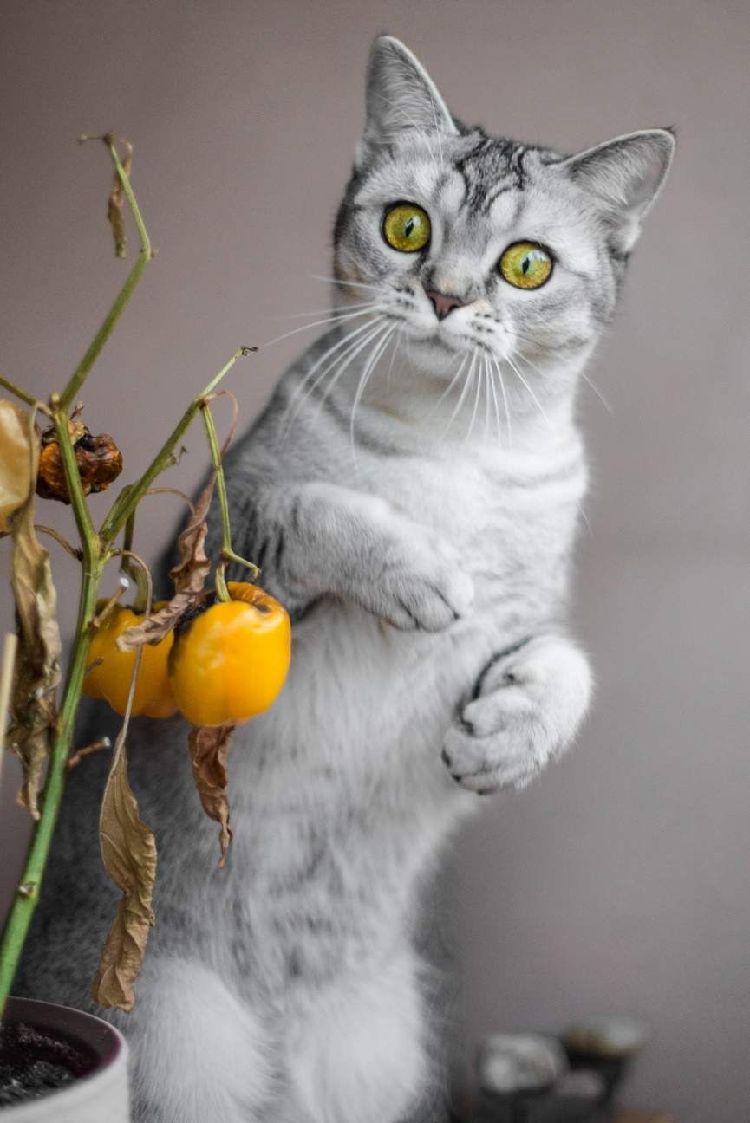
What am I trying to say?
People say "BUFR is obscure because it's binary!"
…But the same holds for JPEG, and nobody complains about that.

Slide 19
What can you express in BUFR?
Enumerated data (flags and code tables)
  Who produced the data?
  What specific variable was measured?
  What is the data quality?
Geophysical variables (arbitrary precision, defined units)
  Concentration
  Temperature
  Motion
  Etc.
Notes:
All of these are examples of things you can express

Slide 20
What features does BUFR offer?
Each variable has a default precision, but you can use the precision of your choice
Quality can be explicitly associated with observed variables
Each message contains a complete set of metadata
Elements can be repeated several times if necessary; the actual number can be determined at runtime
The standard defines simple and efficient compression
It is possible to define custom variables if needed
Notes:
Defining your own variables is dangerous! Don't do this; chances are you don't need to. If you feel like it's necessary, consult somebody at the National Weather Service you work with or the Expert Team at WMO.

Slide 21
The BUFR way
Tables are used to interpret numbers encoded in binary
Every six months, WMO releases a new set of tables to incorporate new developments
New tables are only needed for dealing with new data
This is the basically the same strategy as with TAC, and is similar to what is done e.g. in the CF Conventions

Slide 22
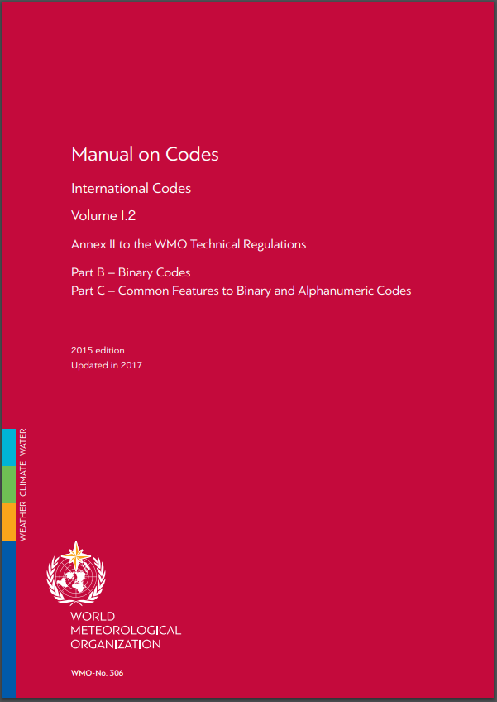
Understanding BUFR
Governed by WMO Manual on Codes (WMO-No. 306)
  Syntax
  Tables of controlled vocabulary
Notes:
This means that any software working with BUFR has to understand the principals behind it (syntax) and know the tables.
Normally tables are looked up on the fly when encoding or decoding BUFR, but this is not always the case. http://www.wmo.int/pages/prog/www/WMOCodes/WMO306_vI2/VolumeI.2.html

Slide 23
BUFR structure
"BUFR" and length of message
Bitstream
BUFR message
Section 0 – Indicator
Who? What? When?
Section 1 – Identification
Local information
Section 2 – Optional
Header
Section 3 – Data description
Actual data
Section 4 – Data
"7777"
Section 5 – End
… other BUFR messages
Notes:
The bitstream might be stored in a file, or transmitted over a radio connection, or tapped out by Morse code. It doesn't matter. There is no "BUFR file" as in a netCDF file.
Every section says how long it is, so you can skip stuff if you don't understand it. The message is also demarcated so you can easily find the beginning of the next one if you receive one which is mangled.

Slide 24
BUFR Section 1: The essentials
Originating centre
Update sequence number (incremented for updates)
Data category and sub-category
Tables used
Timestamp

Slide 25
BUFR Section 3: The essentials
Number of data subsets
Flag (compressed / not compressed)
Descriptors
Notes:
Subsets allow you to transmit
Multiple observations from a station which reports in delayed mode,
Multiple heights reported by a radiosonde
Multiple views from a satellite
Etc.

Slide 26
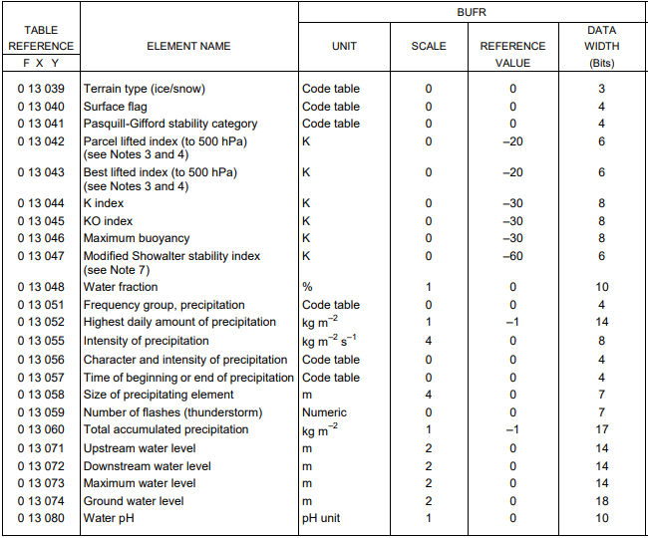
BUFR Section 3: The essentials
F: What kind of descriptor?
Element
Repetition
Operator
Sequence
X: What class of descriptor?
Identification
Instrumentation
Location
Temperature
Radiation
Etc.
Y: Which descriptor?
Notes:
Note: In section 3 you write 1 byte – it's the number containing the FXY identifiers.
In this case, the class is 13 – Hydrographic and hydrological elements
Units for each element are defined.
Scale, reference value and data width are defined as well. Can be modified.

Slide 27
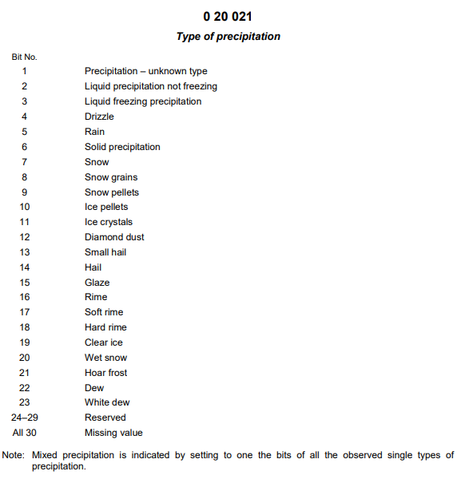
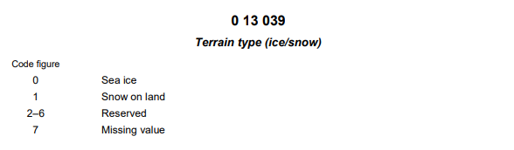
BUFR Section 3: The essentials
Notes:
Example code and flag tables

Slide 28
BUFR Section 3: The essentials
Other types of descriptors:
  Replications
  Operators
  Sequences
Notes:
Replications can be applied to an arbitrary number of following elements
The replication can be static or defined at runtime
Operators can modify the offset, bit width, attach quality data, etc.
Sequences resolve to other descriptors, which can include other sequences.

Slide 29
BUFR Section 4: The essentials
Binary data as defined in section 3
Section 3
Flight number, navigational system, date/time, location, phase of flight
301051 004006 007002 010004 012001 011001 011002 011031 011032 011033 020041
Height in m
Width: 16 bits
Scale: -1
Reference: -40
Height is 134 m
Section 4
01001010111010100101010101010101000100010101010100010101001010010101001001010010100101010101010101111000010101001001
Example gratefully stolen from ECMWF
Notes:
3 01 051 – Would need to be expanded first in order to decode the data

Slide 30
Take-home message
BUFR allows you to encode elements which have been defined by WMO
Each message contains a full set of metadata
The precision can be defined on the fly
You can use existing templates (sequences), your own order of elements, or a mix of those
You can do more with BUFR, but you probably don't want or need to
Notes:
Think of it as a JSON file or something

Slide 31
How do I work with BUFR?

Slide 32
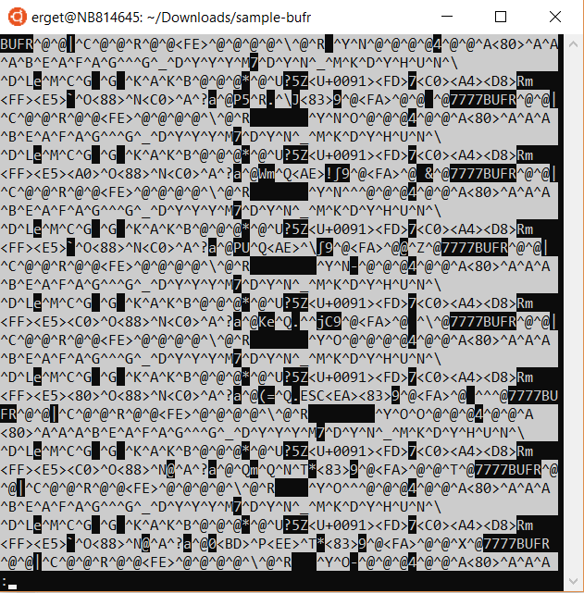
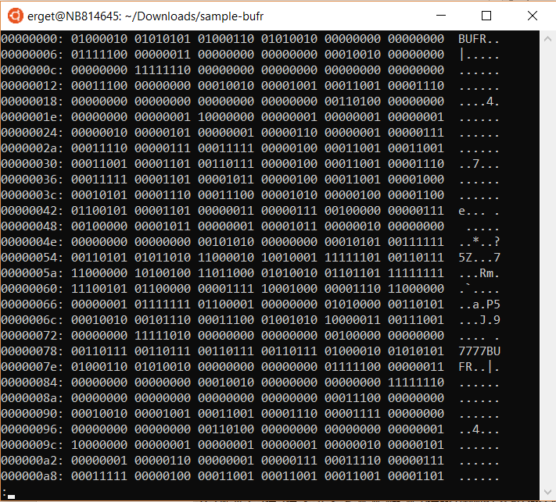
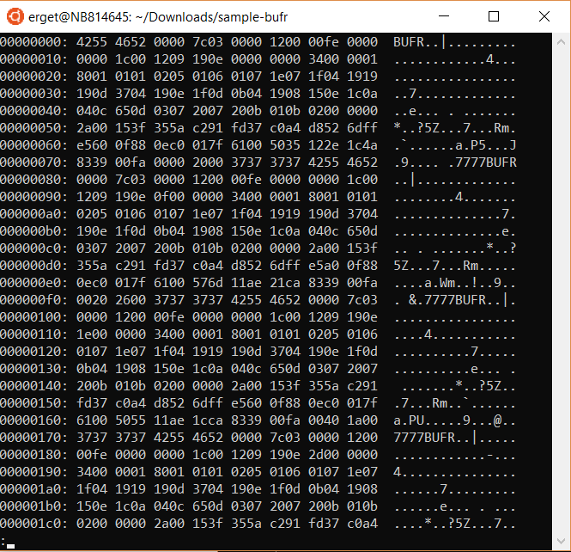
How to read or write BUFR messages
View as text
View as binary
View as hex
Somehow use Excel
Write your own program from scratch
Notes:
Remember our friend King Lear trying to write a JPEG encoder.

Slide 33


Free software
BUFRdisplay
ToolsUI (netCDF Java)
pybufrkit
ecCodes
User friendly
Powerful
Notes:
There is a better way.
Here I mean free as in free speech and free beer.
Lack of Windows support for real programming stuff is unfortunate but a lot of embedded platforms run Linux.

Slide 34
BUFRdisplay
Related to BUFRextract, which can be used to decode BUFR for feeding into other software
Notes:
Showing is better than telling.

Slide 35
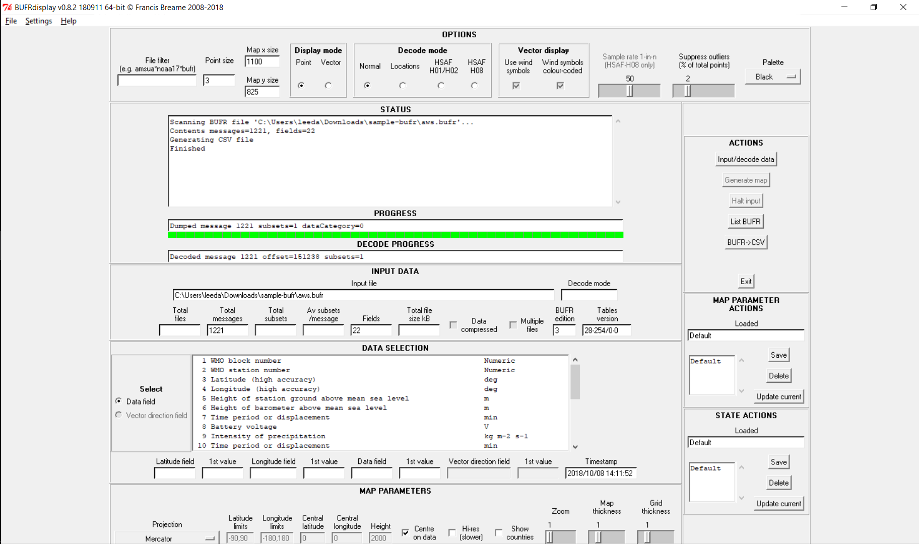
BUFRdisplay
Notes:
You get a nice GUI to manipulate the data.

Slide 36
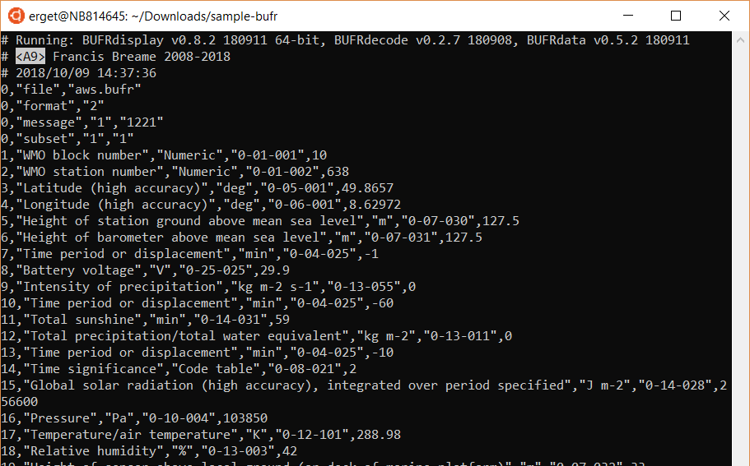
BUFRdisplay
Notes:
You can export to a CSV (watch out though because CSV isn't necessarily good for the nested kinds of data we often have)

Slide 37
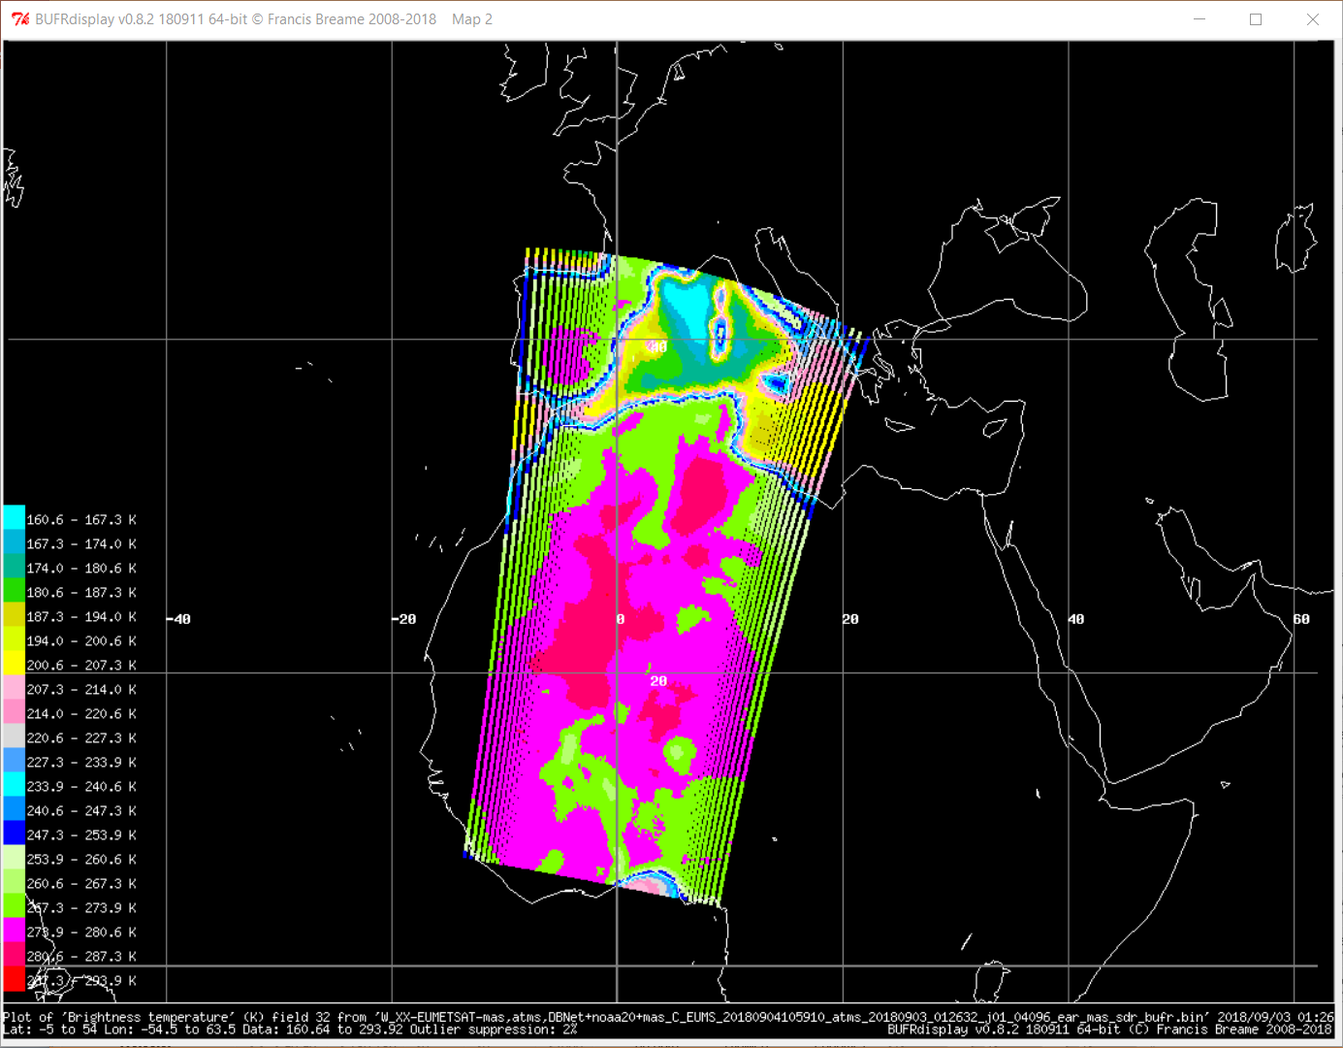
BUFRdisplay
Notes:
Lots of things you can set here to make nice maps.

Slide 38
ToolsUI
Part of the netCDF Java library from Unidata
Can run in Linux and Windows via double-click
Second-class support for viewing BUFR, can only reliably be used to extract metadata and export it as a netCDF

Slide 39
pybufrkit
Command line only
Easy to install using python pip
Rich read/write support
Well tested, fairly well documented
Web app available for testing
Can be integrated easily into Python programs

Slide 40
ecCodes
"Deluxe" library
Python, C, Fortran APIs
Large set of command line tools
Linux native (experimental Windows support)
Tables easy to change at runtime
Organisational support, timely updates

Slide 41
How does BUFR evolve?

Slide 42
Why change BUFR?
New vocabulary needed (e.g. new geophysical variables, new quality information, etc.)
New templates to standardise the way BUFR is encoded
Errors are discovered
Notes:
The third point never occurs because the makers of BUFR are infallible, but they're also immune to hubris so they keep that option open.

Slide 43
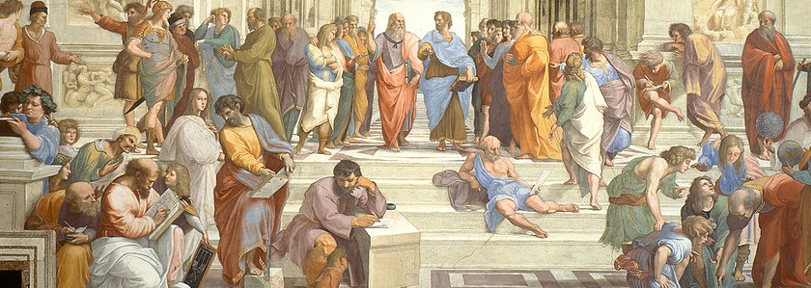
Wise decisions by the elders…
Notes:
So we change BUFR based on our foresight.

Slide 44
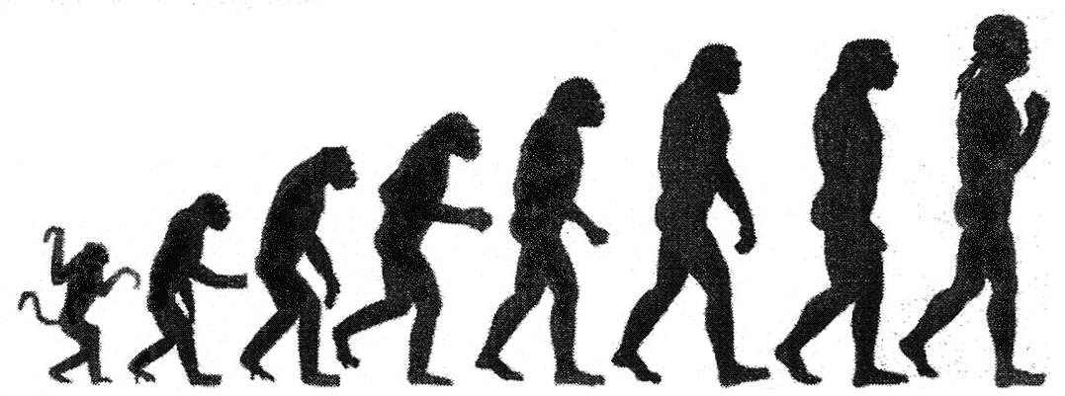
And haphazard evolution
Notes:
And we also try to fix things when we screw them up or discover that we missed something.
You might call it "evolution by intelligent design."

Slide 45
The architects
WMO governs BUFR
Current expert team: Inter-Programme Expert Team on Codes Maintenance (IPET-CM)
  Was IPET-DRMM (Data Representation and Metadata Maintenance), before that IPET-DRC (Data Representation and Codes)…
Annual face-to-face meetings
Notes:
These are the people responsible for maintaining the tables and specifications

Slide 46
How they do it
Two new Master Table Version updates a year
All new entries are validated by at least two independent Centres using different software
Coordination with other communities, e.g. JCOMM, EUMETNET, etc.
Each Originating Centre has avenues for representation, but the working group is not large enough to have members from each Member State
Notes:
So if you need anything, talk to these people.

Slide 47
Why BUFR?
More expressive
Faster to send, write, read
More compact
Flexible
Rich library support
Fast addition of new elements when needed
Mandated by WMO
Notes:
Well, fast if you compare with other communities. It's probably alright this way.

Slide 48
Welcome to the future!
…Questions?

