Slide 1
Climate Data Management Systems
(CDMS)
Status and Strategy
Denis Stuber
Bruce Bannerman
Co-chairs of the Expert Team on Climate Data Management Systems (ET-CDMS)
Notes:
Good morning
This presentation, written by Bruce Bannerman and myself, co-chairs of the Expert Team on Climate Data Management Systems from the OPACE 1 of the CCl-16
is on the Status of the Climate Data Management Systems, CDMS, and its strategy.

Slide 2
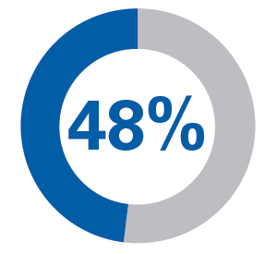

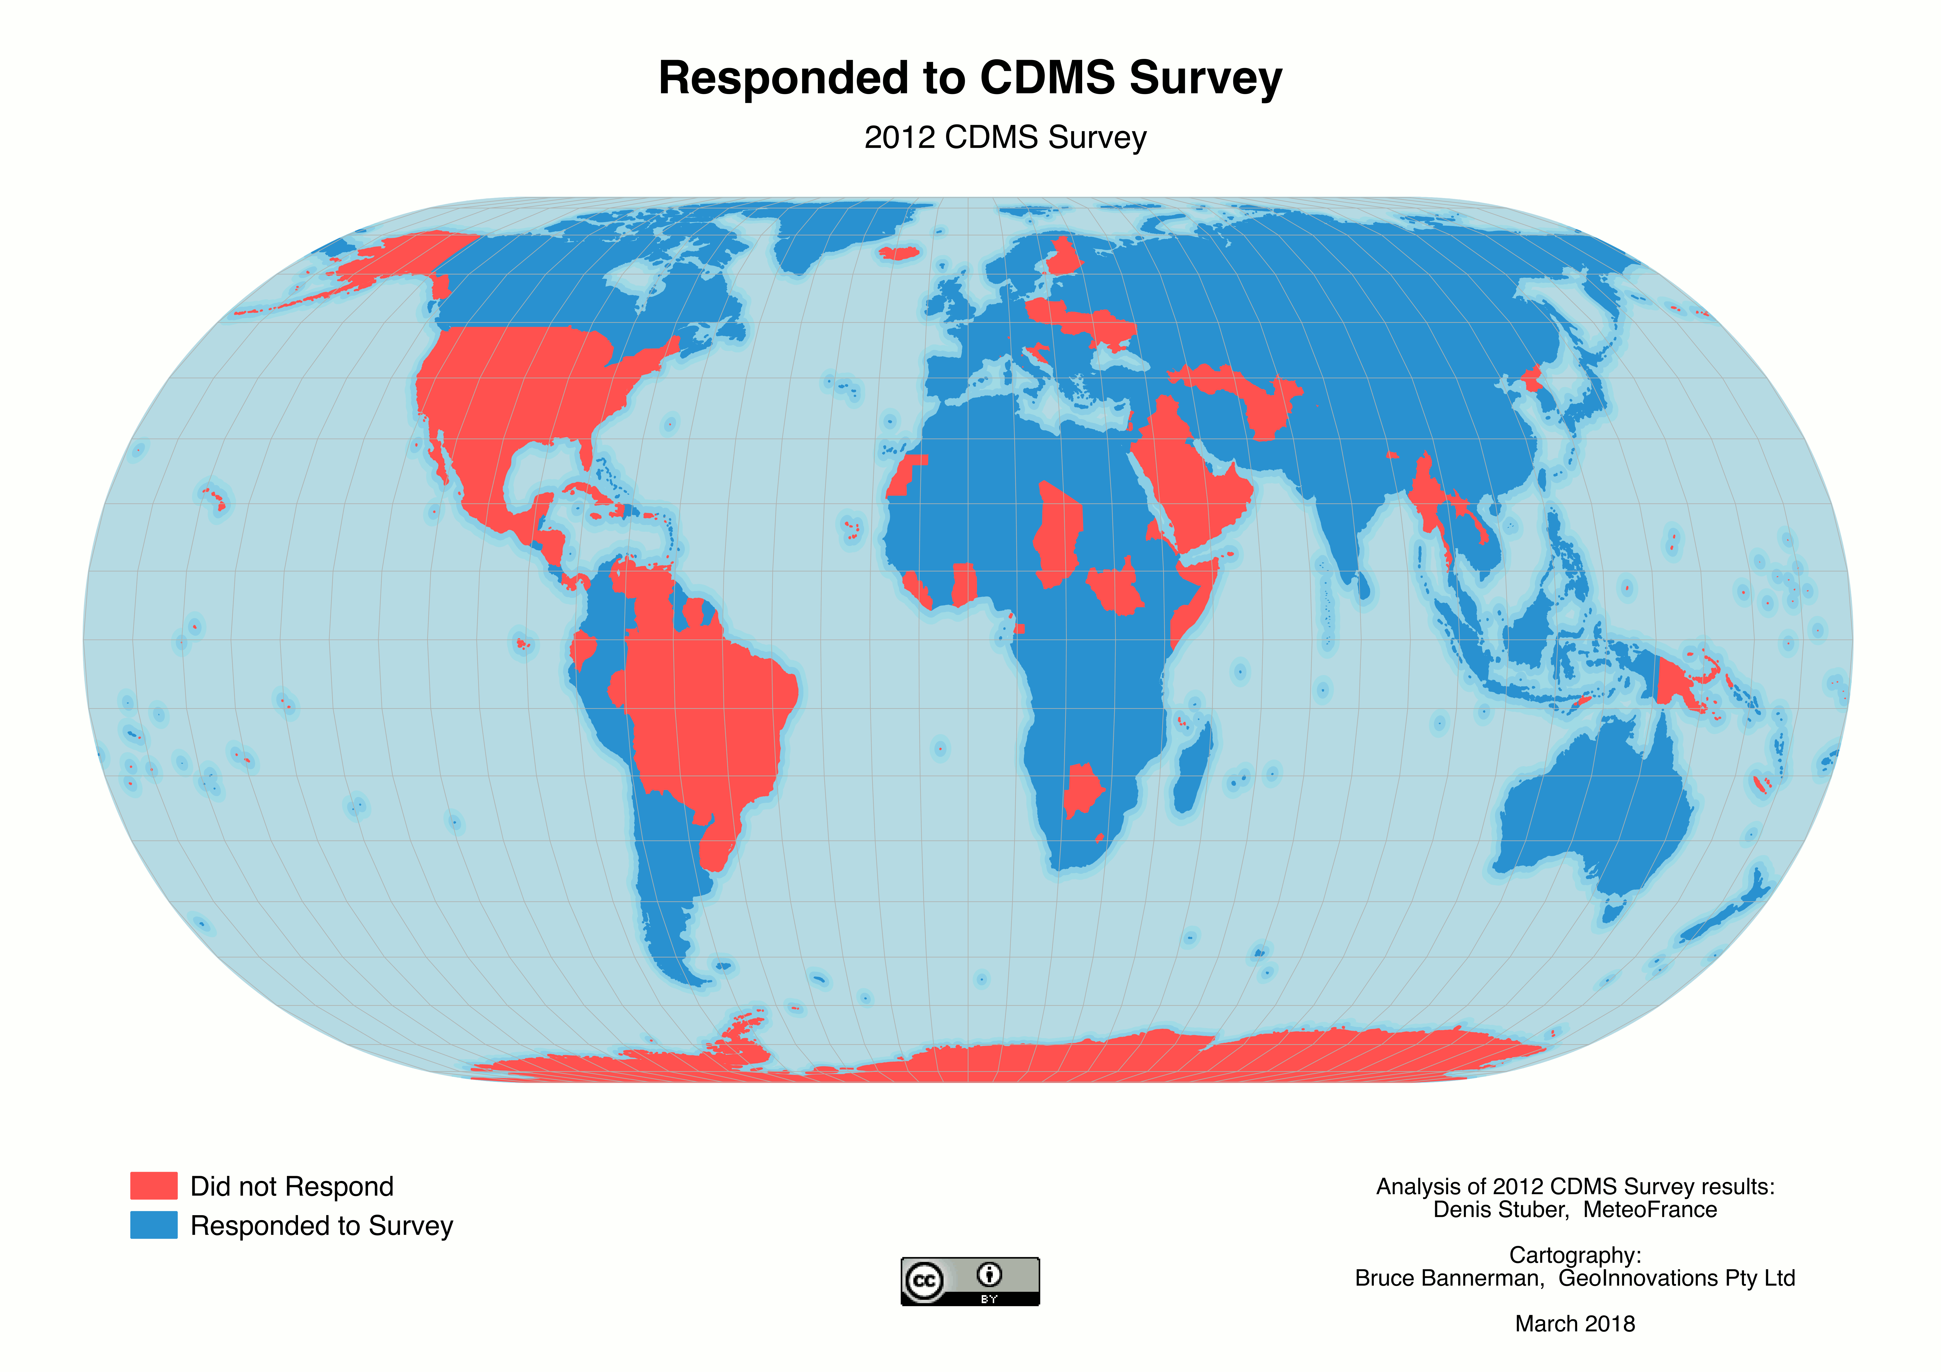


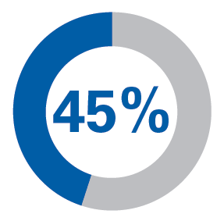

2012 : CDMS Status in NMHS
CCl survey with 72% of response rate :
Have operational issues
Are not operational
Do not use a database
Use a spreadsheet
Have developed their own CDMS
Estimated in 2017 : 89 CDMS
developed for national purposes
Would like to change their CDMS
Notes:
Those figures come from a CCl survey in 2012 where the high rate of 72% of response has been obtained.
The previous survey was launched 23 years ago, in 1995, and got 45 % of responses.
The figures showed that difficulties were important :
At that time 48 % of the system had operational issues with 10% of them were not operational.
25% did not use a database management system, and today, managing a database without such dedicated tool is very, very difficult. 19% were using a spreadsheet
50% wanted to change their CDMS. So they did not feel satisfy from their system.
45% had developed their own CDMS. In 2017 we estimate to 89 different CDMS developed by NMHS.
Which CDMS are used by the other 55 % of NMHS ?
-------------------------------------------------------------------------------------------------------------------
In 2012 Survey, 3 countries answered that they are not using computers for storing and managing climatological data.
DataBase Engine by order of hight utilisation : ORACLE, ACCESS, POSTGRESQL, SQL SERVER.
Operating System 45% of Microsoft the others with LINUX and assimilated

