Slide 1
DCS Workshop Agenda
Time | Who | Title
09:00 | NOAA EUM | Introduction to the workshop and presenting the agenda | 10
09:10 | NOAA | GOES DCS Overview | 20
09:20
09:30 | EUM | EUMETSAT DCS Overview | 20
09:40
09:50 | NOAA Reeves | GOES DCS Customer Interaction/Access & Training Overview Brief | 20
10:00
10:10 | EUM Coyne | EUM DCS Customer Interaction | 20
10:20
10:30 | EUM Burns | CGMS Overview | 10
10:40 | EUM Burns | JMA DCS Overview | 10
10:50 |  | Coffee
11:00
11:10 | EUM Lee | Demystifying BUFR | 40
11:20
11:30
11:40
11:50 |  | Questions | 20
12:00
12:10 |  | Lunch
12:20
00:00
12:40
12:50
13:00 | NOAA EUM | User and Manufacturer round table | 60
13:10 |  | focusing on improving the system
13:20
13:30
13:40
13:50
14:00 | NOAA EUM | Summary of Outcome Actions next events | 30
14:10
14:20
14:30 |  | End of DCS

Slide 2


GOES DCS Overview
SATCOM: GOES DCS Workshop
Wednesday, 10 October 2018
Richard Antoine, GOES DCS Program Manager
Richard.Antoine@noaa.gov

Slide 3
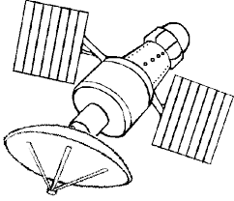
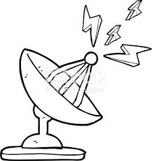
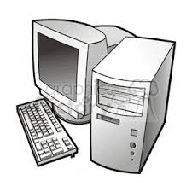

GOES DCS Overview
What is GOES DCS?
A Real Time communication relay system that transmits Environmental Data…..

Slide 4
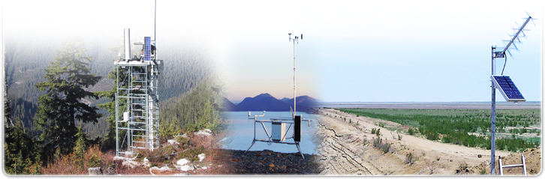
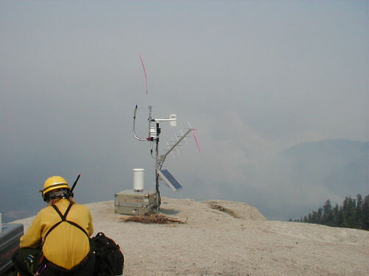
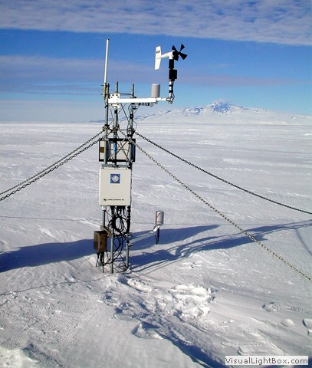
User Segment
Data Collection Platforms (DCPs) transmit to the GOES satellite system

Slide 5
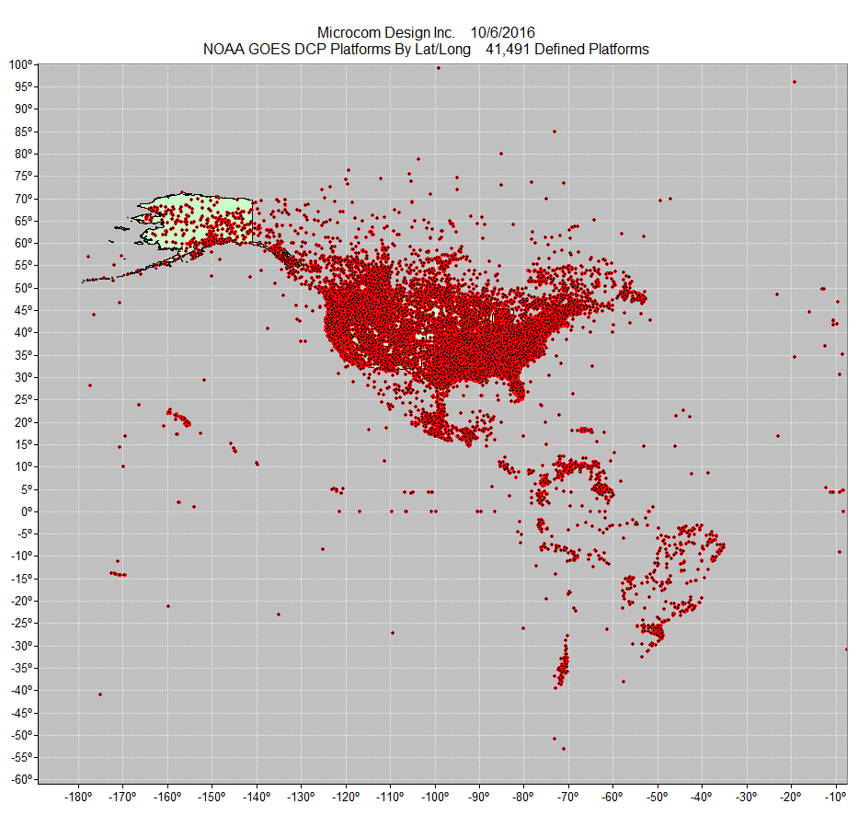
User Segment
Distribution of GOES DCS Platforms

Slide 6
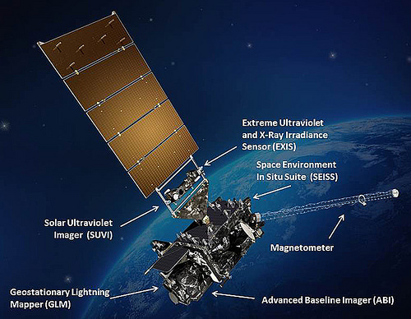
Space Segment
(GOES-R)
Also hosts a DCS Transponder which receives and sends environmental data

Slide 7
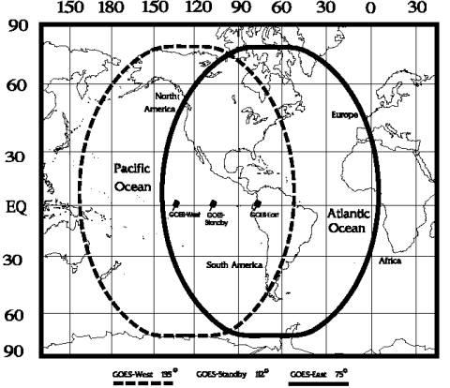
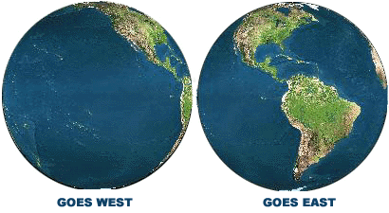
Space Segment
GOES FOOTPRINT

Slide 8
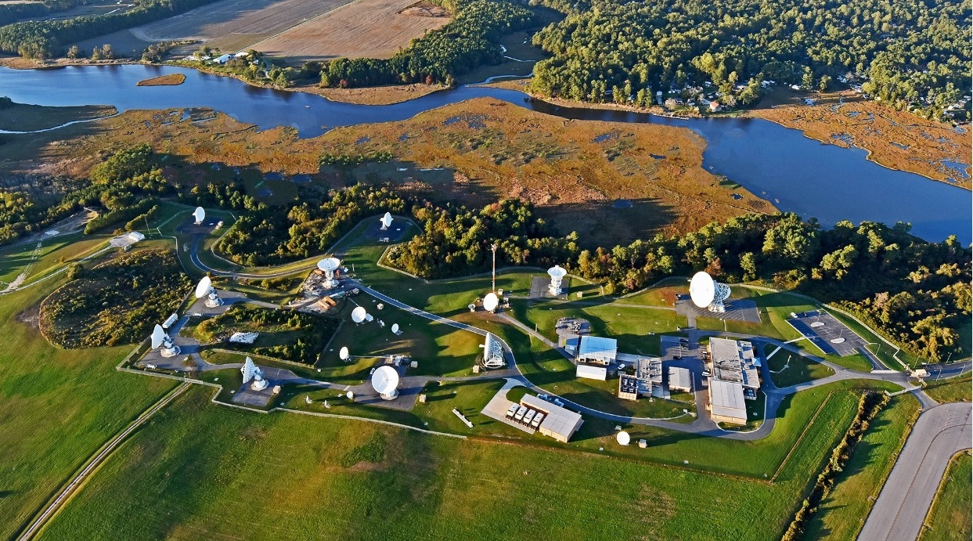
Ground Segment
Wallops Command & Data Acquisition Station (WCDAS) is the primary receive site for the environmental data and also hosts the primary GOES DCS and the back-Up GOES DCS is located at NSOF
Note: DADDS #1 and #2 at WCDAS; #3 and #4 at NSOF

Slide 9
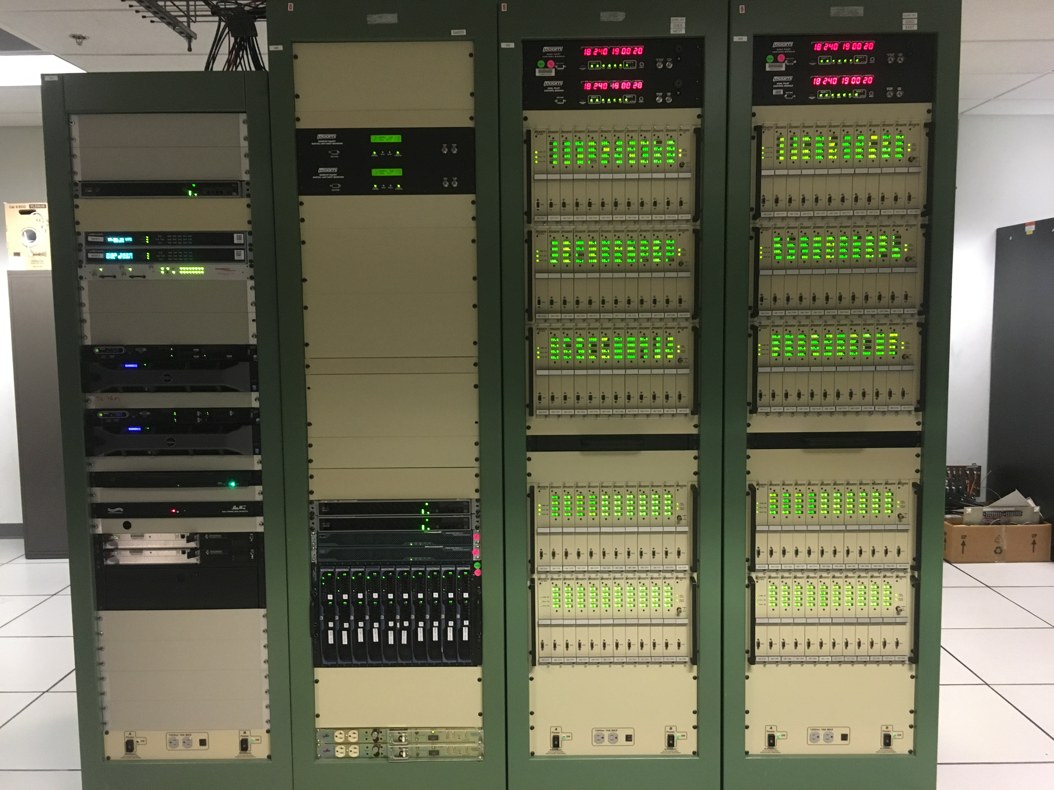
Ground Segment
DCPM
DAMS-NT
This is the GOES DCS ground system!
It is made up of a number of components. Most important are the DAMS-NT that demodulates the data from the satellite and the DADDS which stores and disseminates the user’s data
DADDS

Slide 10
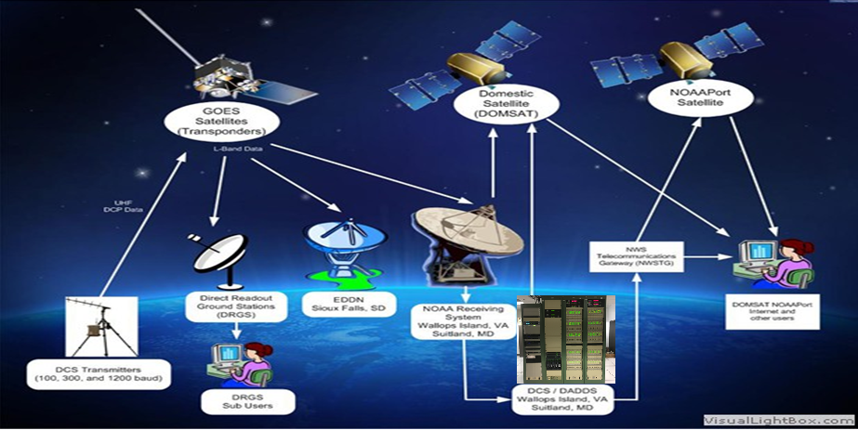
System Overview
Domestic Satellite (DOMSAT)
NOAAPort Satellite
GOES Satellites (Transponders)
NWS Telecommuncations Gateway (NWSTG)
Direct Readout Ground Stations (DRGS)
EDDN
Sioux Falls, SD
DOMSAT NOAAPort, Internet, and other users
NOAA Receiving System
Wallops Island, VA
Suitland, MD
DCS Transmitters
(100, 300, and 1200 baud)
DRGS
Sub Users
DCS / DADDS Wallops Island, VA Suitland, MD

Slide 11
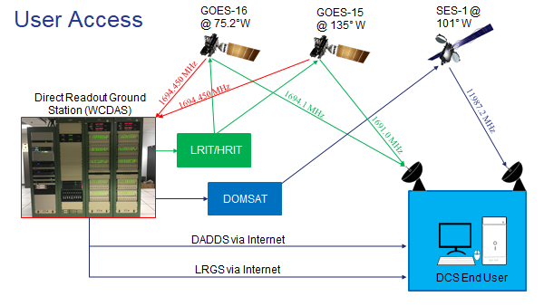

Slide 12
By The Numbers
More than 40,000 transmitters deployed with more than 30,000 transmitters sending data through GOES.
Most transmit every hour, but some are transmitting every half hour, some every 15 minutes. EVERYONE is pushing for more.
Tide Gages monitoring for tsunamis report every 5 or 6 minutes.
Over 850,000 messages per day.
Estimated 8,000,000 (million) observations per day into the global observing system.
Over 650 System User Agreements (nearly 700 user agencies)
Approximately 2000 individual users registered for system access.

Slide 13
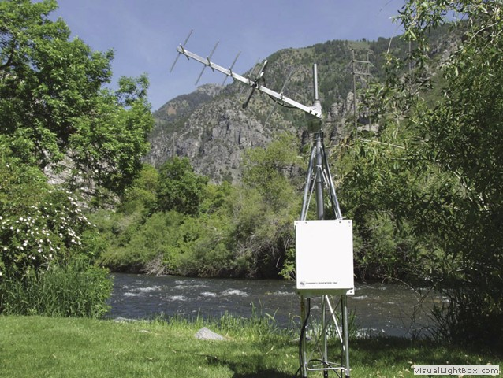
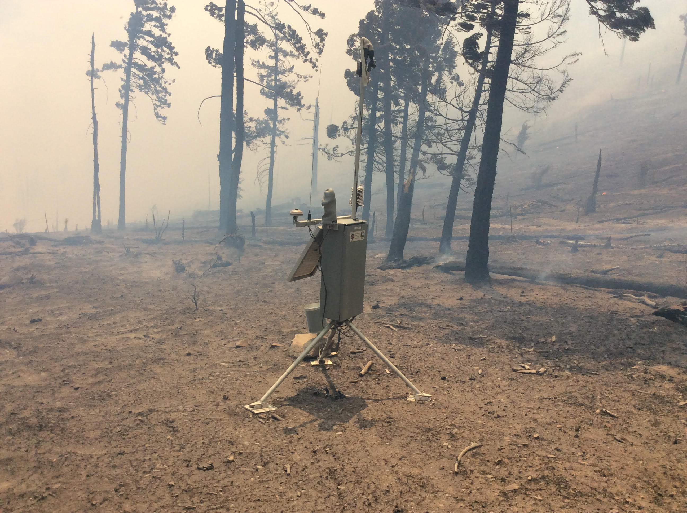
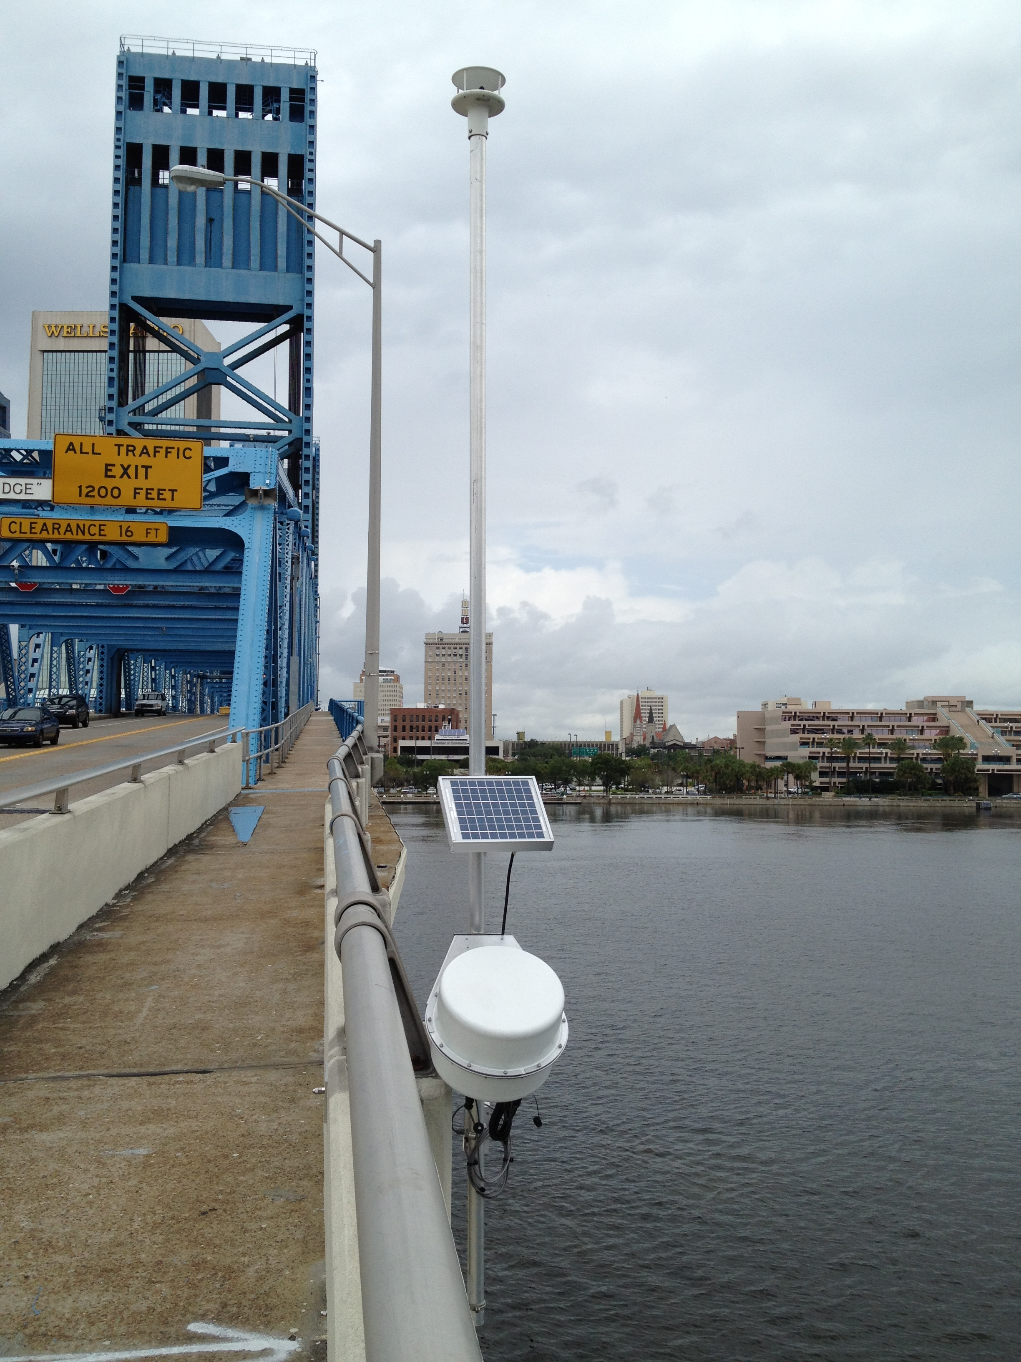
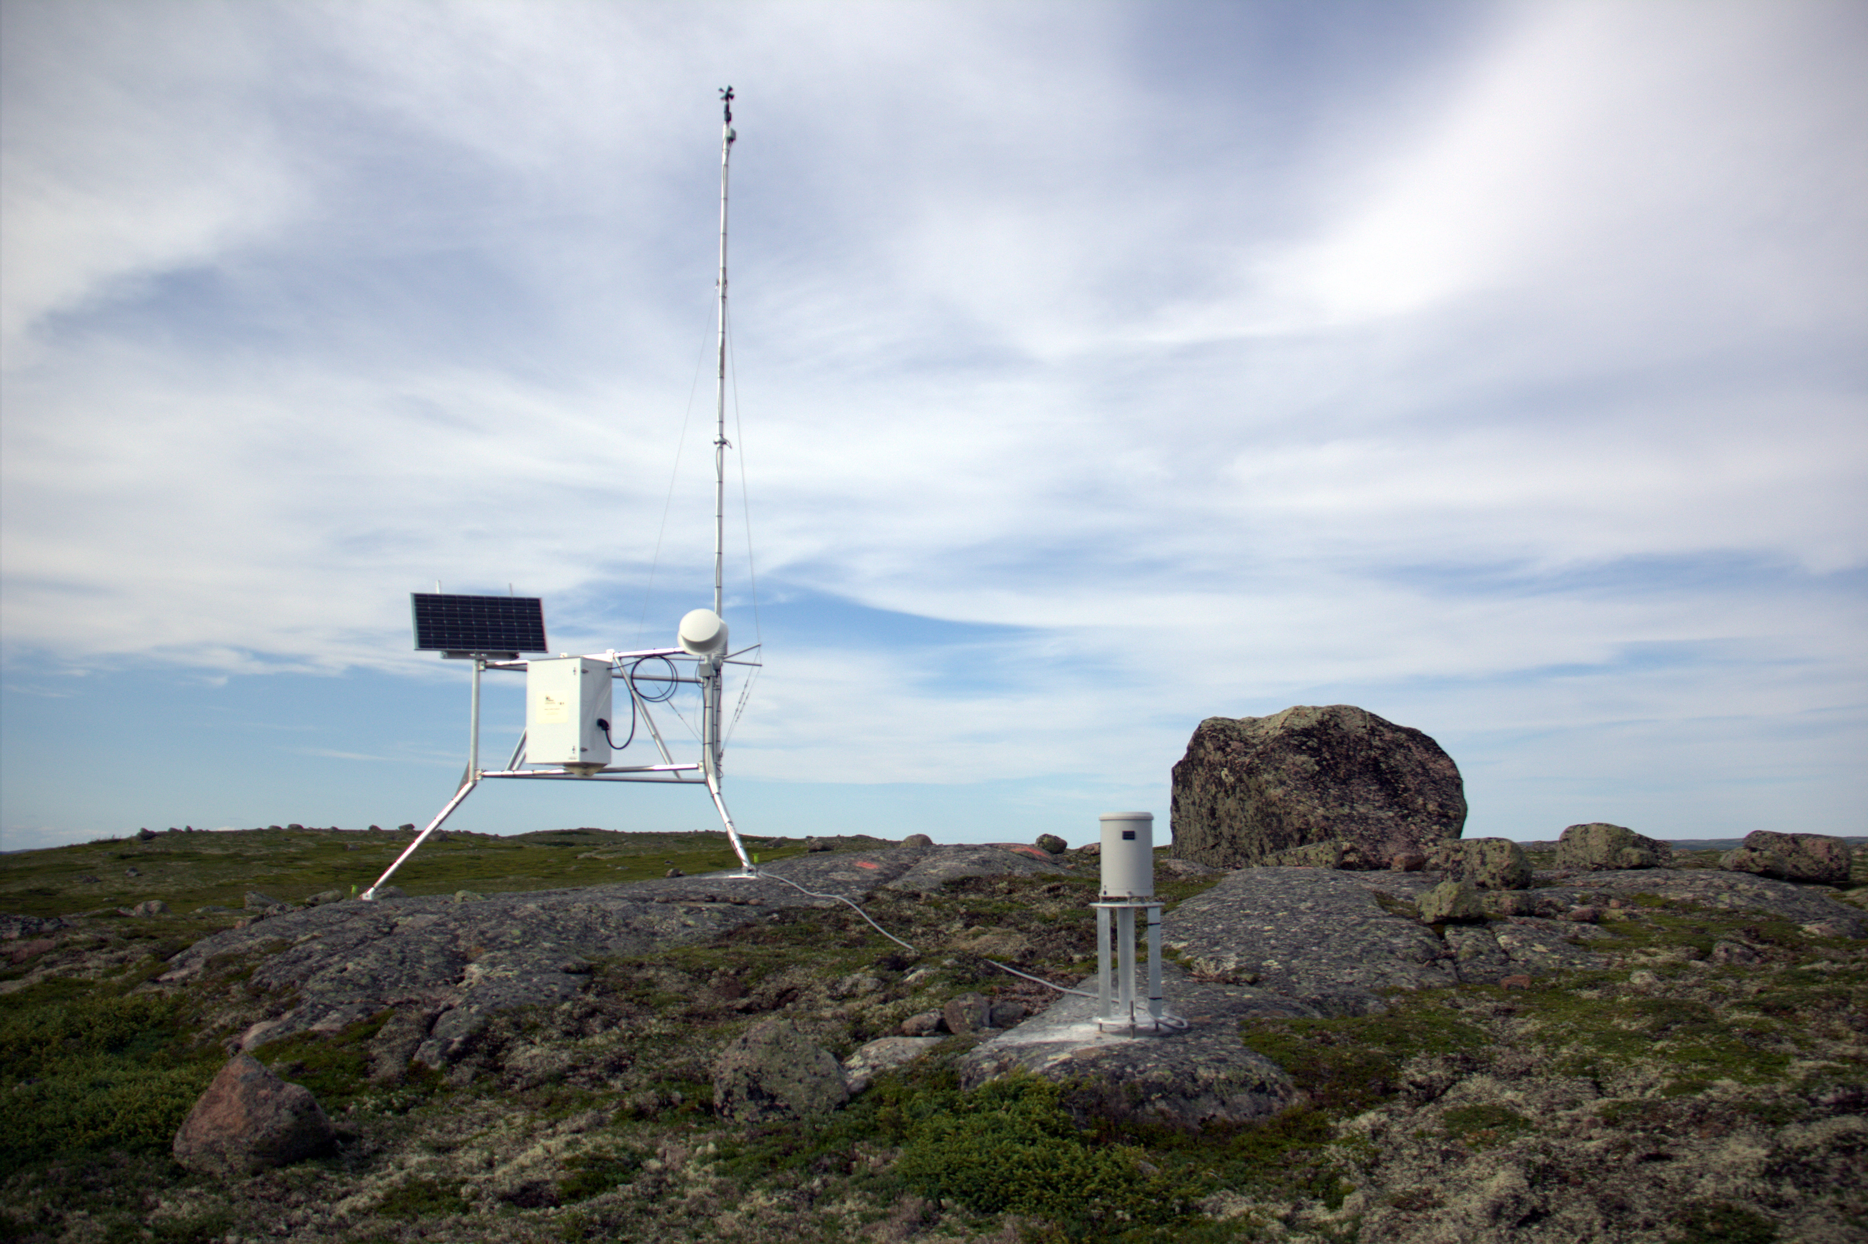
User Applications
Wildland Fire Management
Water Resources
Atmospheric Measurements
Transportation
Tide Levels

Slide 14
User Benefits
Real time access to relevant environmental data: 30 seconds on average
Access to data outside of the customer’s region
Internet access via DADDS interface or LRGS
  Vulnerable vs. weather impacts
  No cost barrier
Direct access if using DRGS or HRIT antennas
  Robust vs. weather impacts

Slide 15
Key GOES DCS Activities Underway
DADDS Refresh – Replacing 10 year old servers and software at Wallops, VA ground station, NSOF and Microcom Development system
Over the Air Two Way Prototype Test – continued effort to provide a command and interrogate capability for remotely located user Data Collection Platforms (DCPs)
DCS Channel Optimization – Develop a migration scheme for CS1 frequency assignment table to CS2 Frequency Assignment Table in order to expand the number of channels available to users

Slide 16

Two Way Communication Development
Goal
  Demonstrate a forward communication path through the GOES-16 satellite
Benefit
  Meet community need for a communications link to remotely located DCPs

Slide 17
DCS Channel Optimization
Objective is to increase the number of communication channels available to users
Approximately 1/3rd of customer DCPs have transitioned to a CS2 transmitter
Determine required number of transitioned DCPs needed in order to assign CS2 channels
Assign newly available channels to users
CS1 1-200 Channels (401.7MHz – 402 MHz)
CS2 1-500 Channels (401.7MHz – 402 MHz)
Note: We must deactivate 100bps channels to fully utilize CS2.
Also looking for Alternate Pilot Channels due to system outside interference.

Slide 18
Questions:
GOES DCS Program Manager: Richard Antoine
Richard.Antoine@noaa.gov
(301) 817-4521

Slide 19
Back Up……..

Slide 20
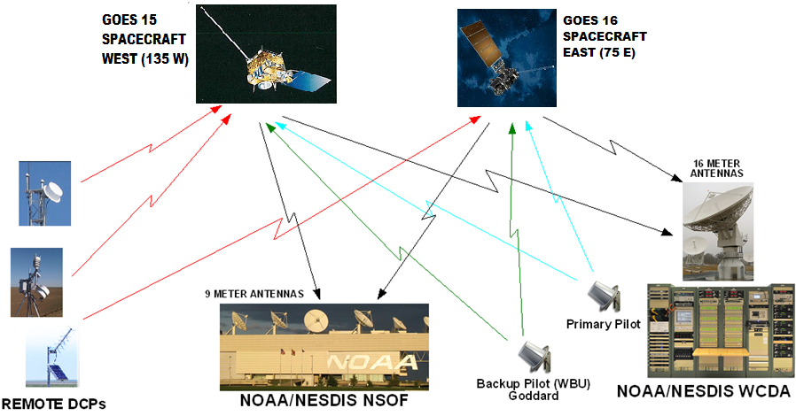
System Overview

Slide 21
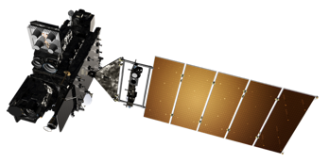
User Access
Internet
DADDS and LRGS
NWSTG
HRIT
DOMSAT
End of Life (14 May 2019)
DRGS

Slide 22
The GOES DCS User Community
NOAA
  National Weather Service
  National Ocean Service
  National Climatic Data Center
  National Data Buoy Center
Department of Defense
  United States Army Corps of Engineers
  United States Air Force
  United States Navy
Department of Interior
  National Interagency Fire Center(NIFC)
  National Forest Service
  Bureau of Land Management
  United States Geological Survey
Department of Interior(cont)
  Bureau of Reclamation
  National Park Service
Department of State ( International Boundary & Water Commission)
States
  California
  Colorado
Many Canadian Environmental agencies
Numerous South and Central American Environmental Agencies

