Slide 1
EUMETSAT DCS User Interactions
Satcom Forum / DCS Workshop
Nicholas Coyne EUMETSAT

Slide 2
Requirements for DCS Use
The EUMETSAT data policy states that for meteorological, geophysical and hydrological data, transmissions using the Meteosat DCS are free.
All data collected by the DCS will be shared on the GTS.
The cost of all the hardware is shouldered by operator but there are no costs to the operator for the use of the DCS.
The operator must use a DCP transmitter that has been certified for use with the Meteosat series of satellites.

Slide 3
Certified Manufactures
Sutron
Microcom
Signal Engineering
SCISYS - Prototype

Slide 4
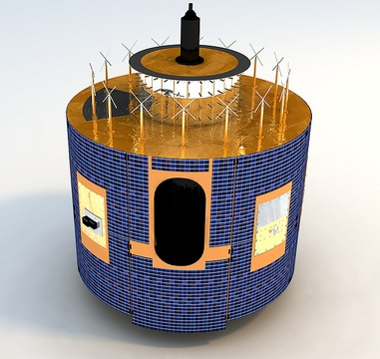
DCS – Users
Number of Operators – 125
Number of Countries – 66 (Europe, Africa, Asia)
Number of allocated Regional DCPs – 1066
Number of DCPs transmitting – 633
Currently there is only one truly International DCP
Notes:
Read Slide

Slide 5
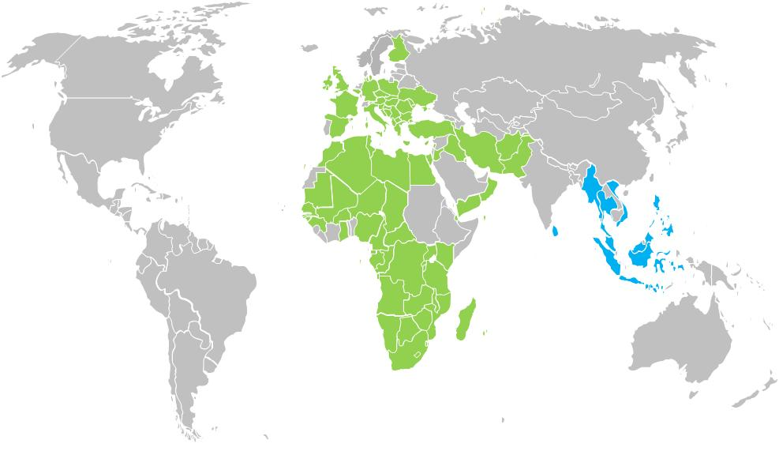
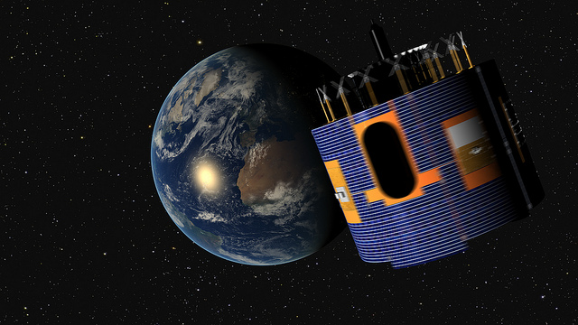
EUMETSAT DCP User by country
Meteosat-11
Meteosat-8
Notes:
Meteosat-7 is purely used for Tsunami Warning System over the Indian Ocean

Slide 6
DCS System Overview – Bandwidth
IDCS
11 channels
@ 3kHz
Regional
44 channels
@ 3kHz
Regional
144 channels
@ 1.5kHz
HRDCP
10 channels
@ 3kHz
402.0355 MHz
402.0685 MHz
402.2005 MHz
402.4345 MHz
Notes:
39 out of 44 3kHz Regional Channels are in Operational (3 reserved for the beacon and 2 are noisy)
14 of the 144 1.5 kHz Regional Channels are in use
10 out of 11 3kHz International Channels are in use
Notes:
We have also recently revised out DCP channel allocation. We have regained some of the original international channels for use as regional. We have also introduced the HRDCP at the top end of the DCP bandwidth with a bandwidth allocation of 3KHz. This will allow future expansion into the currently unused high 1.5kHz Regional channels as more HRDCP are introduced.

Slide 7
Data Access EUMETSAT
Currently we have the following methods for users to access their DCP data
GTS as bulletins
EUMETCast Basic Europe and Africa service as LRIT files
From the EUMETSAT public DCP tool via the WEB page

Slide 8
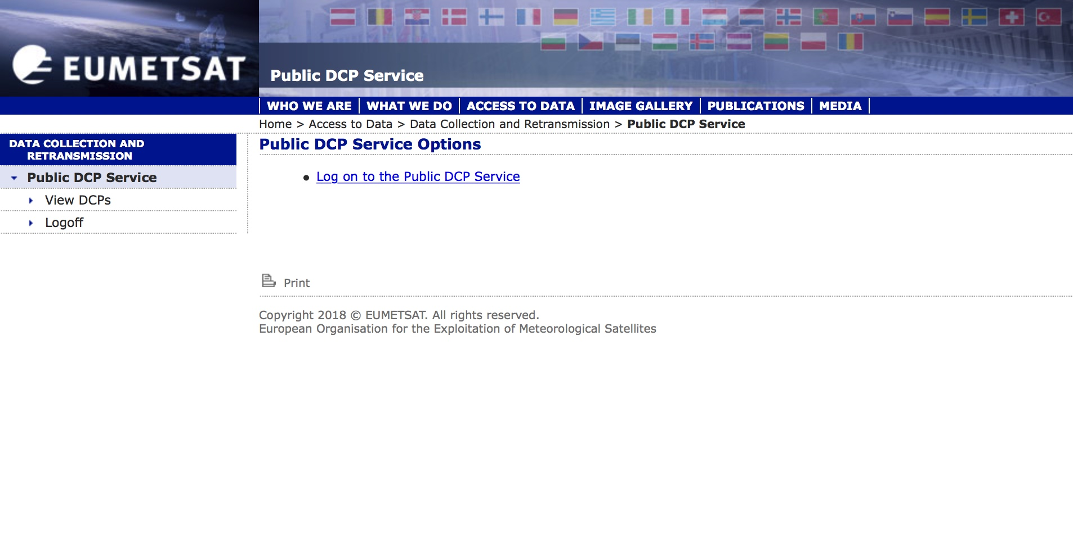
DCP Public Web Tool

Slide 9
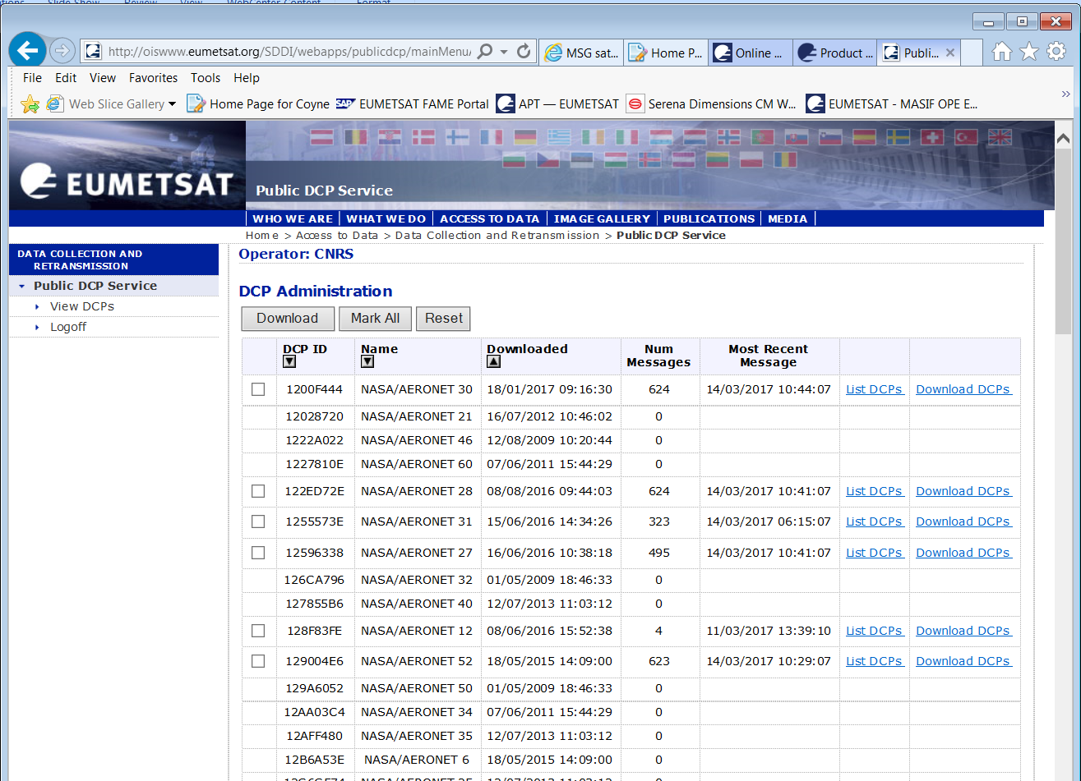
Tool Functionality

Slide 10
DCP Downloads from the tool
Users can download their DCP messages. This download concatenates all the DCP messages from the selected DCP into a single zip file which contains the entire archive for that DCP. This means that the if the operator wants to regularly check and down load their DCPs the need to download a zip file for each DCP. If a user wishes to check each hour it would mean that they would need to retrieve the zip file covering the full archive each time. Each of these files covers 14 days.

Slide 11
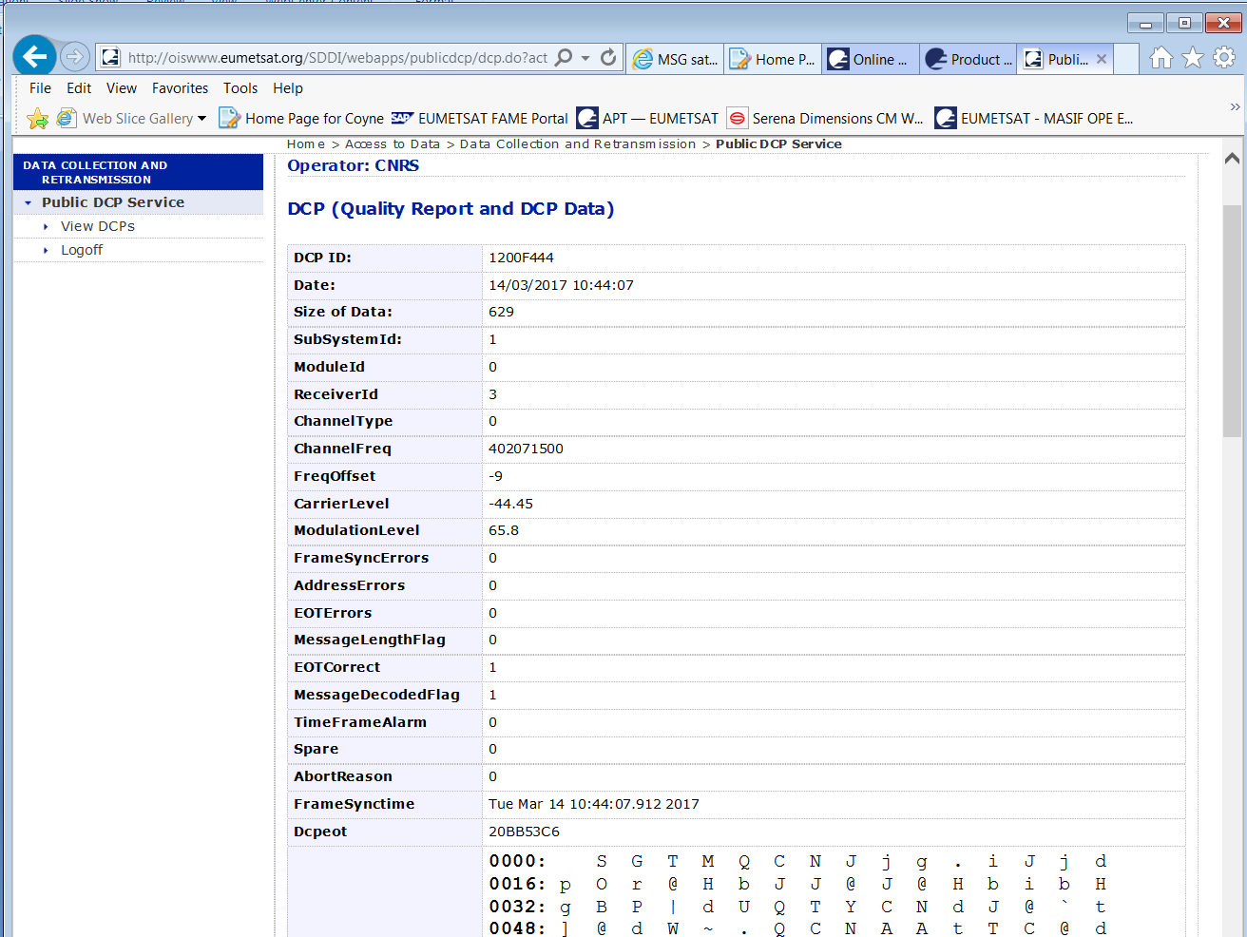
Quality Infomation

Slide 12
Improving
Larger archive:
  The current archive is 14 days. This could easily be extended to a much larger archive. The optimal timeframe could be arrived at after discussions with the users and manufacturers. With the relatively small size of the DCP messages an archive of several months would not be unrealistic.
Push function:
  A repeated request is for push services to allow the user to regularly be supplied with the selected DCP messages. The push method is not the best solution for EUMETSAT for a number of reasons, but the users are keen to have it. This functionality could be met by providing the users with a web plug-in that would allow them to schedule regular downloads.
Time period selection:
  Allow operators to select time periods.
Download selection of multiple DCP reports:
  Users could select one or more DCPs to be downloaded.
Allow users to update the personnel data:
  User contact data could be updated via the web interface
To be able to view their allocation details:
  Users would be able to see their DCP allocations via the web access application.
Allocation Status:
  Users could generate requests for new allocations and monitor the progress of ongoing user allocation requests in TBD pre-defined steps.
Manufacturers database:
  Access information about manufactures in a global manufacturer’s database
DCP supporting documentation:
  Include access to DCP documentation and news items.

Slide 13
Common DCP WEB interface
EUMETSAT has raised the idea of having a common interface between agencies for the internet access to DCP messages. NOAA are currently looking for alternatives. We are currently discussing the requirements. We hope to make the system flexible enough to meet users changing needs. Also to allow manufactures better access.
There will be interactive features that will allow the users to enter and modify their settings.
We would welcome any suggestions.

Slide 14
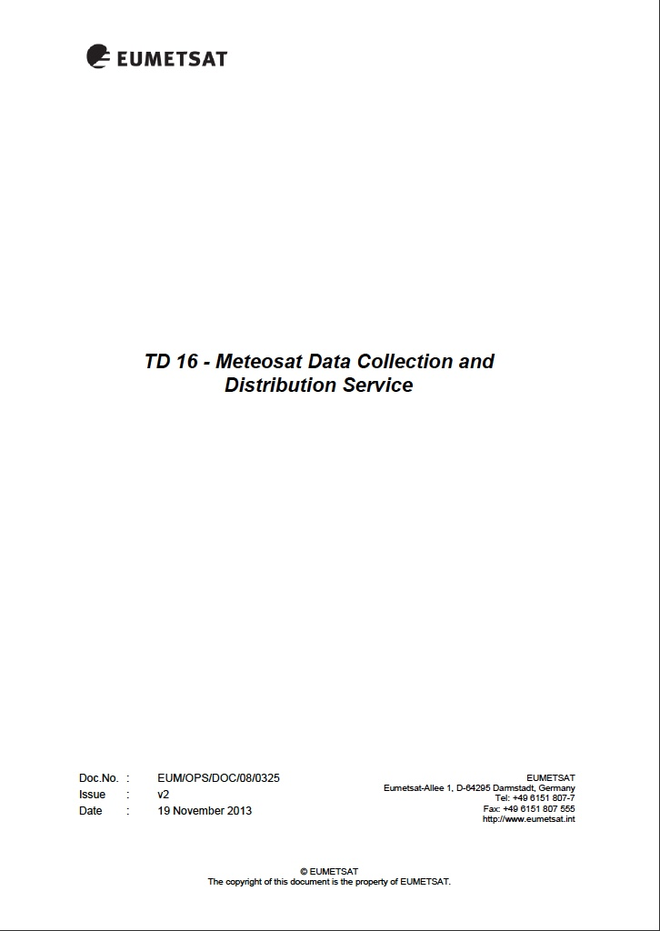
Technical Document Number 16 (TD 16)

Slide 15
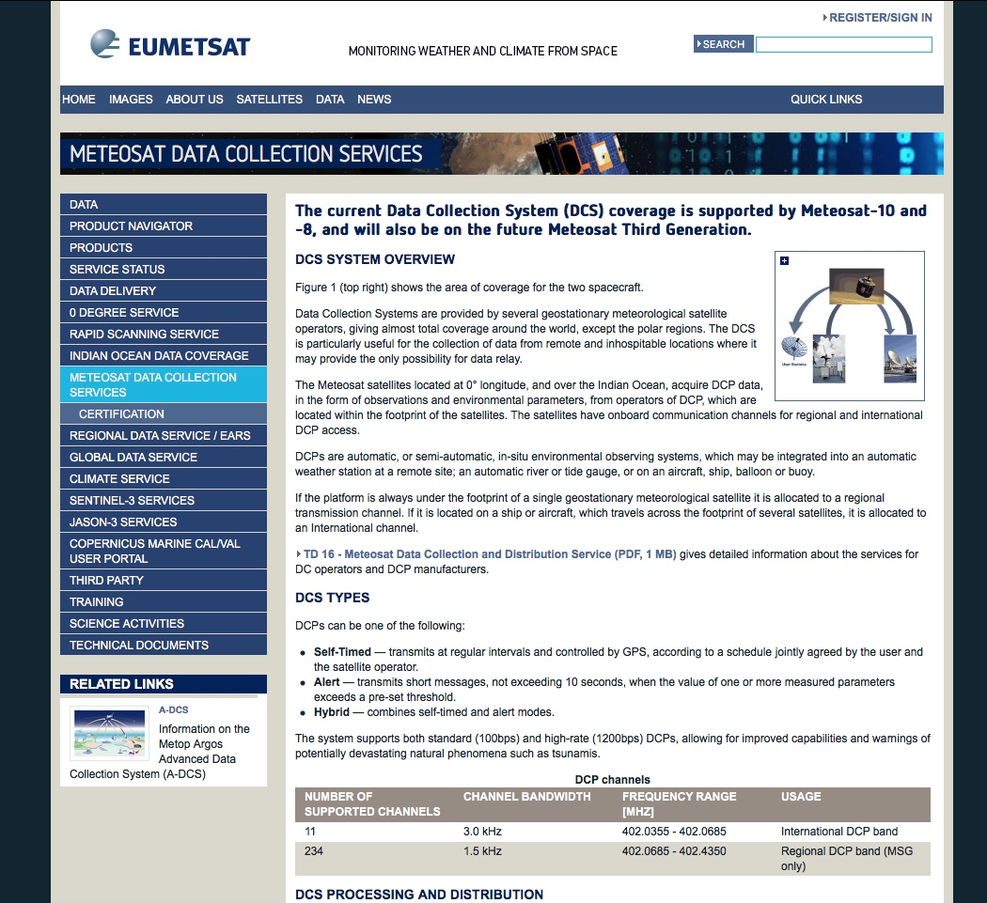
EUMETSAT DCS Web Site
https://www.eumetsat.int/website/home/Data/MeteosatDataCollectionServices/index.html

Slide 16
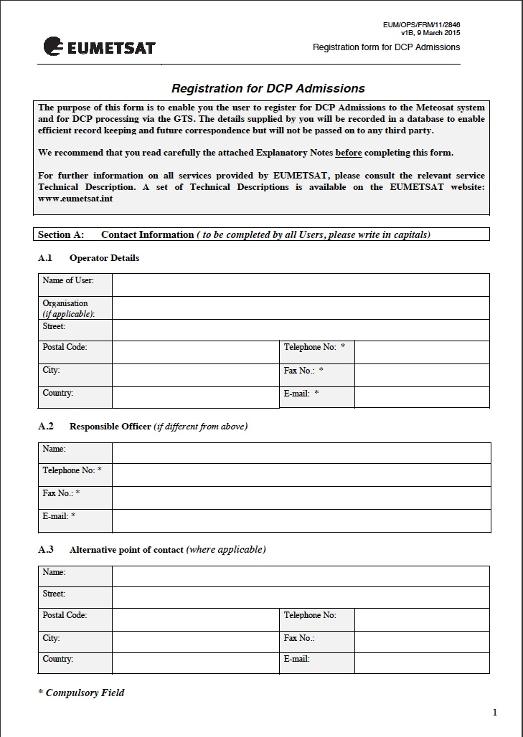
DCP Registration

Slide 17
DCP Extraction Script
EUMETSAT has developed a script to allow the automatic extraction of DCP messages from the LRIT transport files. This script can also extract the individual DCP messages for the zip file currently delivered for the DCP web access.
We are currently planning the best method to deploy this script for our users.

