Slide 1


GOES DCS Customer Interaction/Access Training
SATCOM: GOES DCS Workshop
Wednesday, 10 October 2018
Letecia Reeves, Customer Service Lead
Letecia.Reeves@noaa.gov

Slide 2
Requirements for GOES DCS Use
Must be a government agency or government sponsored
Must be transmitting environmental parameters
Must apply online for a System Use Agreement (SUA) and be approved before transmitting
Must use Certified Transmitters (determined by NOAA to not interfere with the satellites or other users)
Must conform to NOAA System Use Policies
Must be a “good neighbor” to all other users

Slide 3
System Use Agreement (SUA)
Automated application available
  https://dcs1.noaa.gov, dcs2, dcs3, or dcs4
  Complete and submit electronically
Must be renewed regularly
  5 years for both government agencies and non-Govt agencies with a Government sponsor
  1 year for transmitter manufacturers
Signatory on SUA must have authority to correct transmitter or interference issues for the program identified.
Can have multiple users under a single SUA

Slide 4
Channel Allocations
Currently there are 220 channels that are allocated for data transmissions.
Typical channel assignment is at 300 bits per second (baud rate) transmitting once per hour
  With a 10 second transmission window.
  More and more Users are requesting transmissions every 15 minutes for critical data, such as fire weather.
  Applications such as Tsunami Warning and flood monitoring transmit
  every 5 or 6 minutes
Total Data Collection Platforms: 39,564 |  | 100 Baud: | 12
Currently Active: 29,692 |  | 300 Baud: | 37,945
Almost 10k either seasonal or not yet deployed |  | 1200 Baud: | 1,607

Slide 5
Transition to Version II Transmitters
Transition from Version I methodology to Version II transmitters (Narrow Band Transmitter). These are certified to a new standard that allows the transmitter to use a smaller bandwidth, which will eventually double our channel capacity.
10 year transition to Version II transmitters ending on May 31, 2026.
Currently undergoing a channel optimization study to determine how to best map out a plan for creating new channels.
CS1 Transmitters | CS2 Transmitters
20,761 | 17,184

Slide 6
Data Retrieval Methods (Internet)
DCS Administration and Data Distribution System (DADDS): Login to the DADDS to view and export DCP messages.
Local Readout Ground Systems (LRGS): All DCS data can be accessed from these servers by downloading free software available on the DADDS website; and instructions for the NOAA provided software can be downloaded from any of our four DCS web sites.

Slide 7
Data Retrieval Methods (Broadcasts)
Low-Rate Information Transmission (LRIT): The NOAA LRIT system provides digital data, via a broadcast
service, through its GOES East (today) and GOES West (for the next year or so) geostationary satellites
including both the GOES I-M and N-P Series. On the GOES-R series of satellites, the broadcast will be merged
with the Emergency Managers Weather Information Network (EMWIN) service with a combined data rate of
400 Kilobits per Second.
http://www.noaasis.noaa.gov/LRIT/ for more information.
High-Rate Information Transmission (HRIT): HRIT replaced LRIT on GOES-East when GOES-16 became
operational in late 2017. HRIT will replace LRIT on GOES-West when GOES-17 becomes GOES-West at the end of the year.
http://www.goes-r.gov/users/hrit.html for more information.
Direct Readout Ground Station (DRGS): Users with a GOES DRGS can receive their
DCP messages directly from the GOES satellites.

Slide 8
DCS Administration and Data Distribution System (DADDS)
Manages user and data collection platform (DCP) information
  Channel and Time slot information
  User Contact Information
  User Logins
Data Monitoring and Downloads
  Network list capability makes downloads (exports) easier
Dissemination to other circuits
  National Weather Services, Global Telecommunication Gateway (NWSGT)
  DOMSAT (Retiring on May 14, 2019)
  LRIT/HRIT

Slide 9
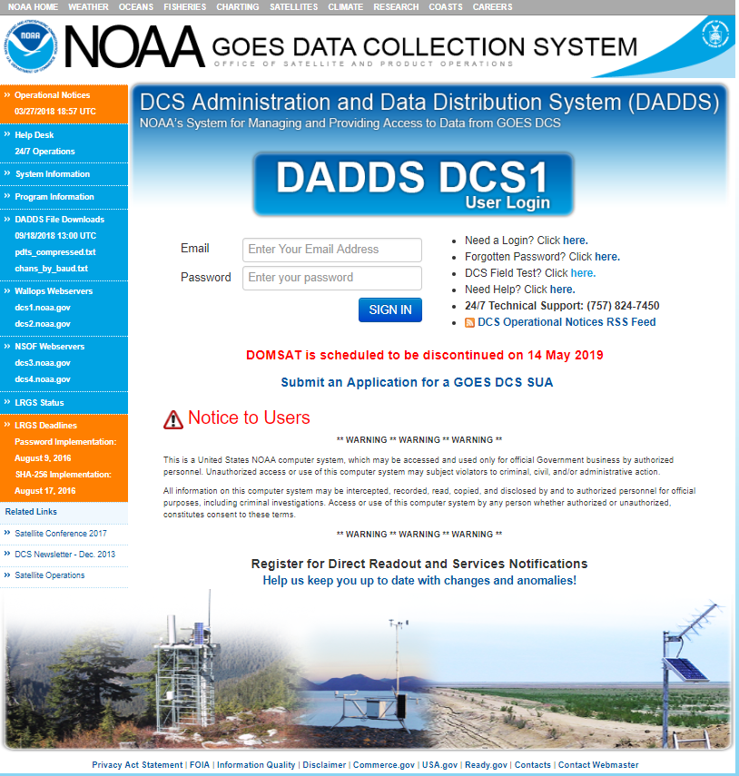
DADDS Webpage
Four individual web servers that simultaneously replicate each other.
https://dcs1.noaa.gov
https://dcs2.noaa.gov
https://dcs3.noaa.gov
https://dcs4.noaa.gov
Notes:
So I to give you a look inside the DADDS website and what it offers our Users. There are four different web servers that replicate each other.

Slide 10
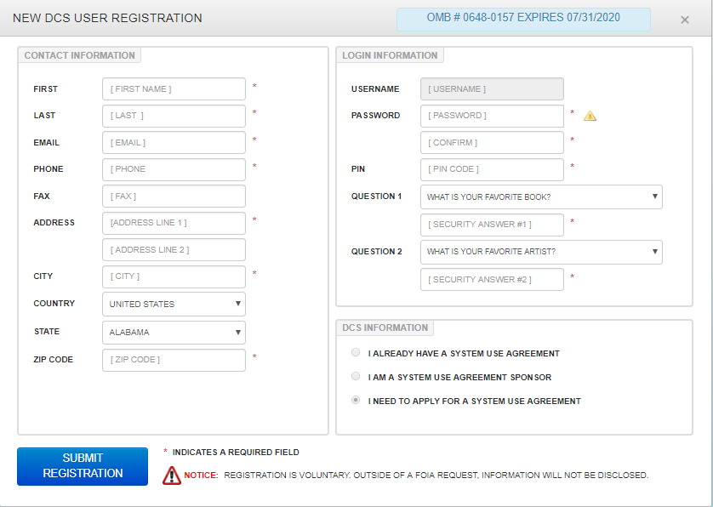
Submitting a SUA
Must first complete registration to have access to submit SUA.

Slide 11
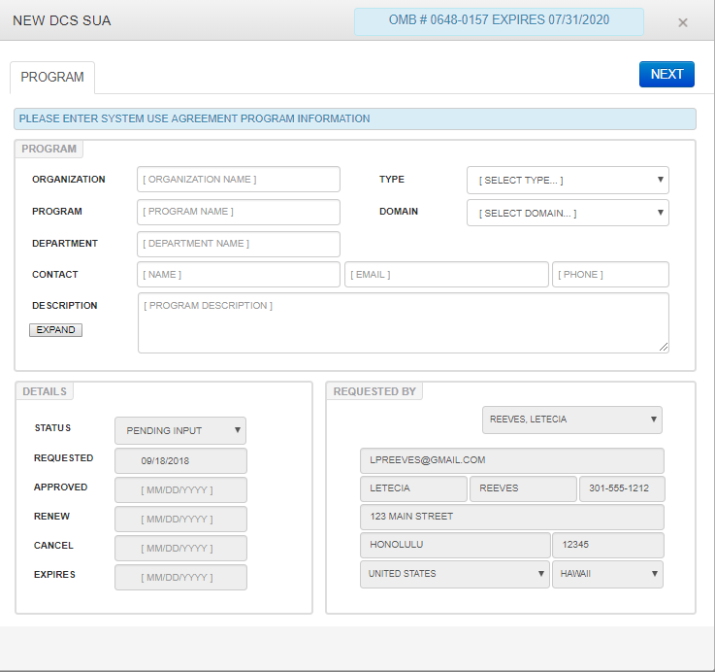
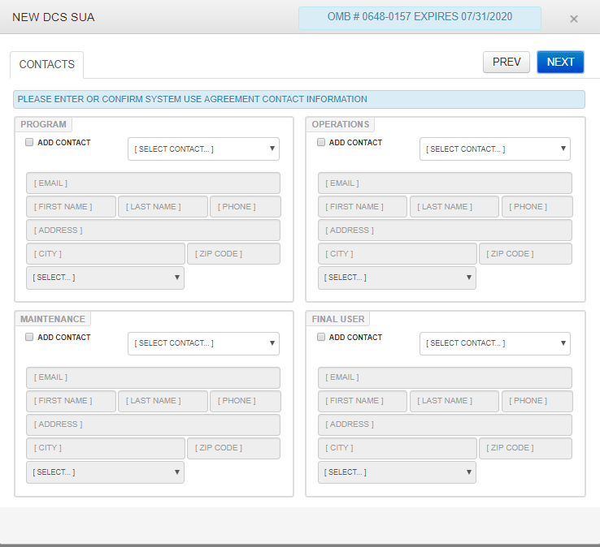
SUA Required Fields

Slide 12
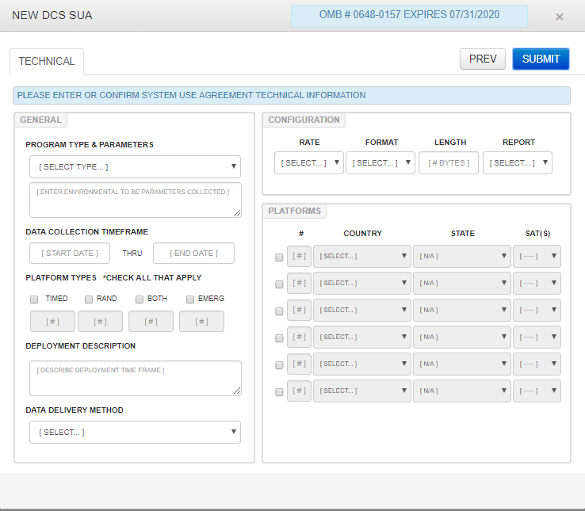
SUA Required Fields
Upon receipt of the SUA, NOAA reviews and begins a three level approval process.

Slide 13
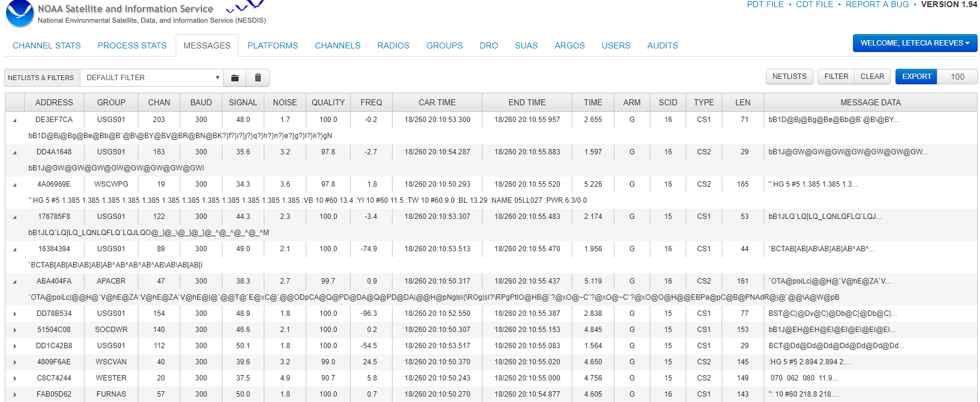
DADDS Message Retrieval and Export
“Messages” tab.
Database houses 25M+ messages received over the past 30 days.
Filter on specific addresses or group code(s).

Slide 14
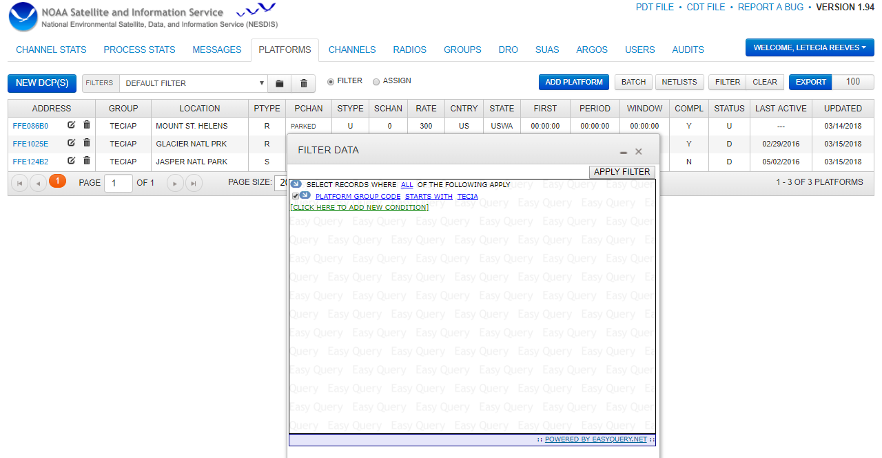
Viewing Assigned DCP Allocations

Slide 15
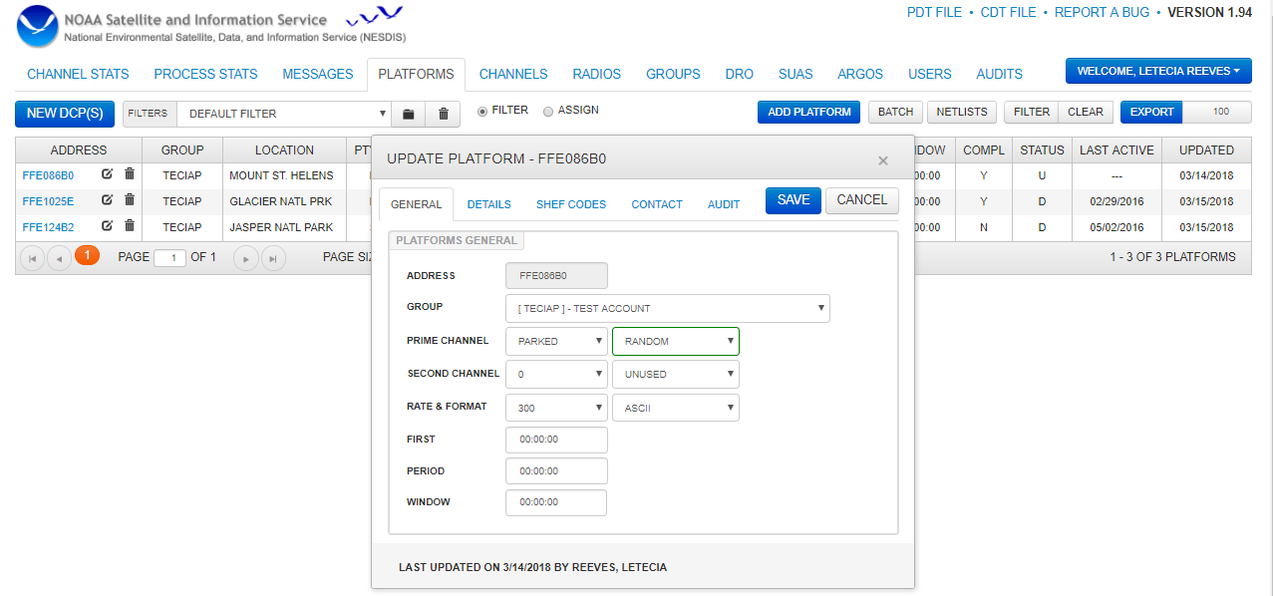
Inside of a Platform Description Table (PDT)
General Tab contains channel assignment information, and cannot be edited by User.

Slide 16
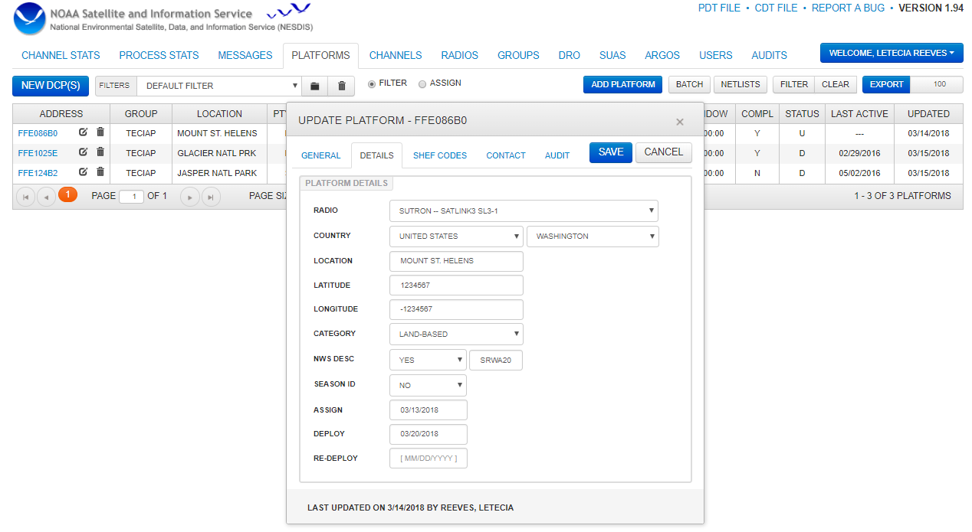
Details Tab in the PDT

Slide 17
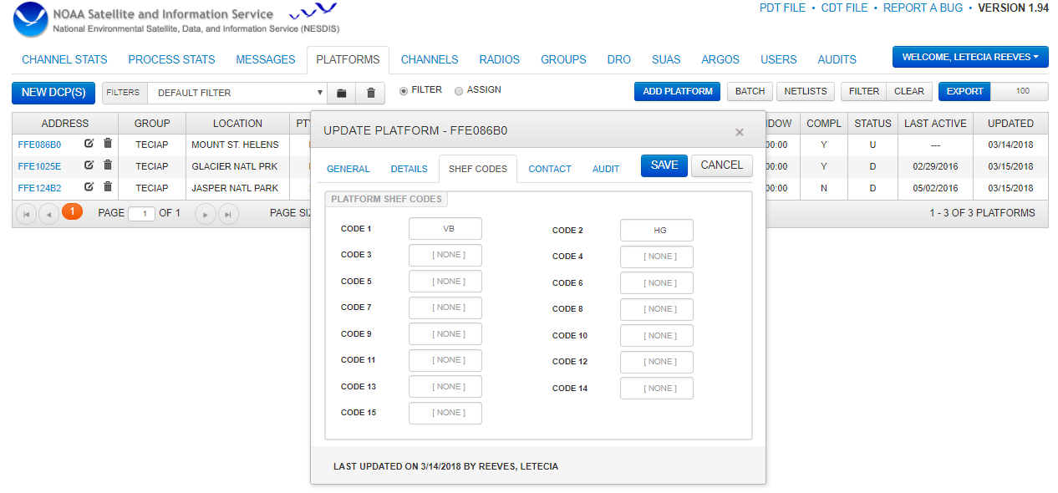
Shef Codes Tab
http://www.noaasis.noaa.gov/DCS/schefcodes.html

Slide 18
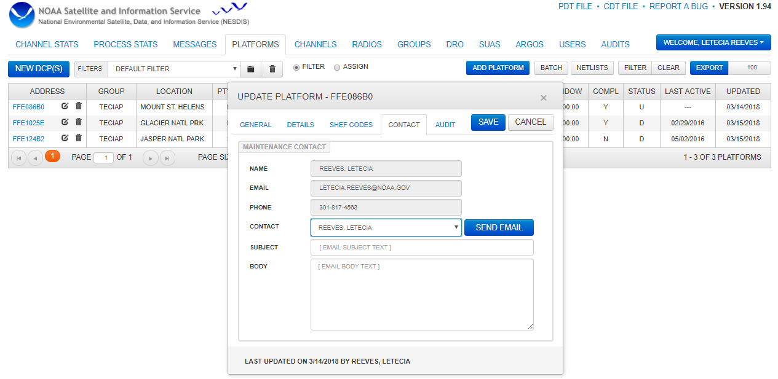
Contacts Tab

Slide 19
Questions?
Thank you for your attention!
Contact me at Letecia.Reeves@noaa.gov
https://noaasis.noaa.gov/DCS

