Slide 1
Coordination Group for Meteorological Satellites (CGMS) Data Collection Services
Satcom Forum / DCS Workshop
Sean Burns EUMETSAT

Slide 2

The Coordination Group for Meteorological Satellites (CGMS)
The objective of the Coordination Group for Meteorological Satellites (CGMS) is the global coordination of the operational meteorological satellite systems, including protection of in orbit assets, contingency planning, improvement of quality of data, support to users, facilitation of shared data access and development of the use of satellite products in key application areas. The coordination is pursued from an end-to-end perspective, through development of multi-lateral coordination and cooperation across all meteorological satellite operators in close coordination with the user community (WMO, IOC-UNESCO and other user entities).
One area that CGMS works closely with meteorological satellite operators is Data Collection Systems including Geostationary and Low Earth Orbit Systems. This presentation will give an overview of the various systems coordinated by CGMS.

Slide 3
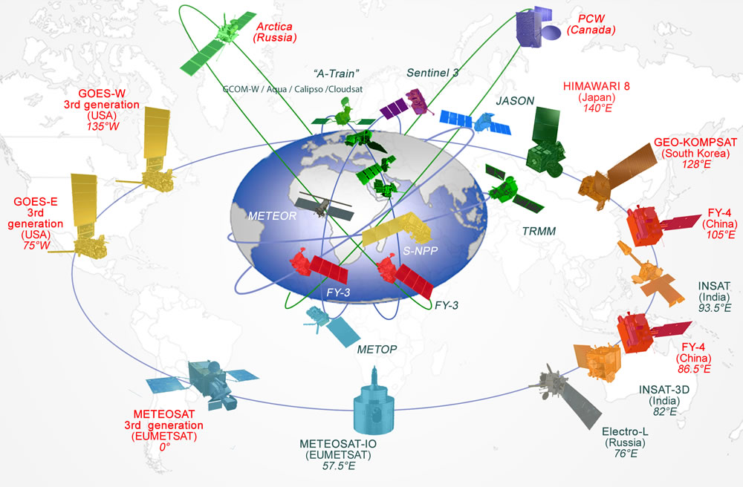
Coordination of Meteorological Satellites

Slide 4
Meteorological Satellites Data Collection Services
DCS are operated by:
  EUMETSAT – Meteosat satellites
  NOAA (USA) – GOES satellites
  Japanese Meteorological Agency (JMA) – Himawari
These DCS are coordinated by the Coordination Group for Meteorological Satellites (CGMS)
DCS are also operated by:
  Chinese Meteorological Administration (CMA) – Fen Yung
  Indian Space Research Organisation (ISRO) – INSAT
  Roshydromet (Russia) – GOMS satellite Elektro L N2

Slide 5
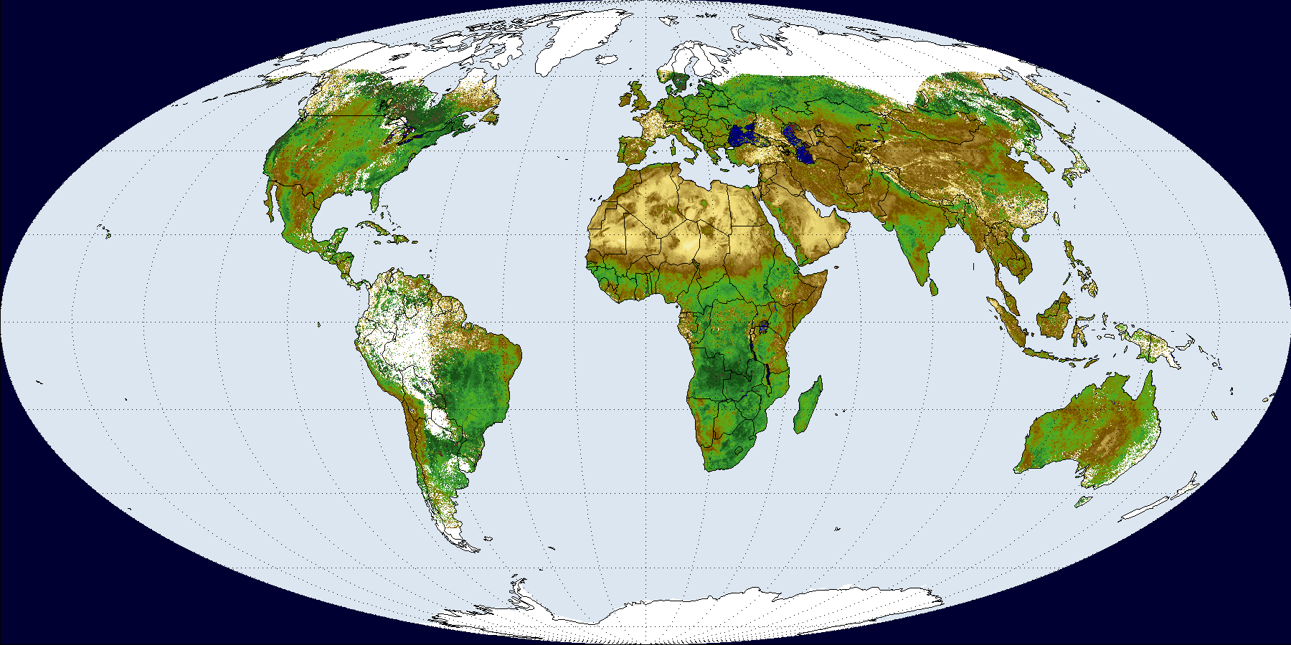



CGMS DCS Systems – Global Coverage
Notes:
EUMETSAT, NOAA, JMA Satellites

Slide 6
DCS System Overview – Bandwidth
Basic partitioning of the band 401-403 MHz for future long-term coordinated use of DCS systems on geostationary and non-geostationary MetSat and EESS systems
Notes:
⁽¹⁾ The following conditions contained in recommends 2 are as follows: in the band 401.899-401.998 MHz the non-geostationary MetSat system Meteor-3M will only operate over the territory of the Russian Federation.
⁽²⁾ The following conditions contained in recommends 4 are valid for the use of the bands 401.1-401.2 MHz and 401.3-401.4 MHz by ARGOS platforms:
maximum e.i.r.p. of –3 dBW;
maximum number of ARGOS active platforms to be deployed in each of the two sub-bands not to exceed 1 000 within the visibility circle of FY-2 and FYGEOSAT series satellites;
maximum duty cycle (ratio of transmission duration over the repetition period) of each platform not to exceed 0.01 (on average 0.6 s over 60 s).
⁽³⁾ The following conditions contained in recommends 5 are as follows: the band 401.5-401.7 MHz can also be used by DCP GSO systems of the Russian Federation, noting that for the sub-band 401.58-401.7 MHz, these systems must be limited to operation over the Russian territory with a maximum e.i.r.p. of 16 dBW.

Slide 7
CGMS Website
https://www.cgms-info.org/index_.php/cgms/index

