Slide 1
Japan Meteorological Agency (JMA) Data Collection Services
Satcom Forum / DCS Workshop
Sean Burns EUMETSAT

Slide 2
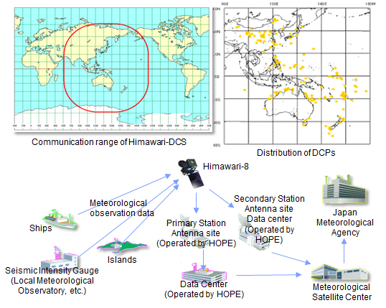
Japan Meteorological Agency DCS
Notes:
The Data Collection System (DCS) is used to collect and relay data via earth-based observation channels (Data Collection Platforms, or DCPs) within the communication range of a geostationary satellite such as Himawari-8.
Observational data measured by DCPs are transmitted to Himawari, which in turn relays them to the ground stations operated by the Himawari Operation Enterprise Corporation (HOPE). Data received at HOPE are demodulated and sent to the Meteorological Satellite Center (MSC) of JMA. Data processed at MSC are handed over to JMA's main telecommunication system, and are then reported to DCP operators over the Global Telecommunication System (GTS) of the World Meteorological Organization (WMO).
For operators without a GTS network connection, JMA reports the collected DCP data by e-mail, and/or posts them on the MSC website in addition to delivery via the GTS. If DCP operators wish, the DCP data collected at MSC through Himawari can be delivered by e-mail to the operators and/or posted on the website managed by MSC. The website is available only to operators with an account and a password issued by JMA.
In addition to the DCP support function, the Himawari-8 DCS supports exchanges of earthquake-related information. The satellite collects seismic intensity data from earthquake observation sites all over Japan. Its DCS also supports dissemination of emergency tsunami/earthquake information within the Himawari-8 communication range.

Slide 3
Japan Meteorological Agency DCS
Himawari-DCS is available to organizations that operate DCPs within the communication range of Himawari, provided that the DCP meets the criteria laid down by JMA. These DCPs are expected to work for the common good internationally in the field, such as conducting activities in the area of meteorological services.
Those wishing to use Himawari-DCS to acquire observed data should obtain consent from JMA. Please note that not all applications can be accepted due to the radio frequency channel availability limitations of Himawari-DCS.

Slide 4
Japan Meteorological Agency DCS
DCPs are expected to transmit their data with a fixed time-interval
    Himawari-DCS employs a time-sharing system to accommodate many DCPs per channel
Radio frequency channels
    Radio frequency channels for DCPs are allocated by JMA within the frequency band 402.0685 - 402.4000 MHz
Mode
    Time-sequential mode (time slots are typically two minutes each)
Data transmission rate
    100 bps (or 300 bps)
Bandwidth
    1.8 kHz (for 100 bps and 300 bps)
Typical equipment required in addition to observing instruments
    A transmitter with 5, 10 or 20 Watts of output and a directional antenna

Slide 5
Japan Meteorological Agency DCS
http://www.jma.go.jp/jma/jma-eng/satellite/nmhs.html

