Slide 1


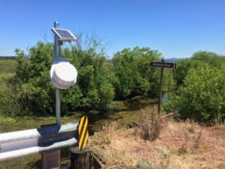
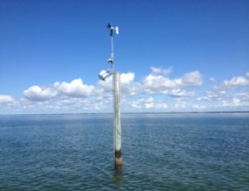
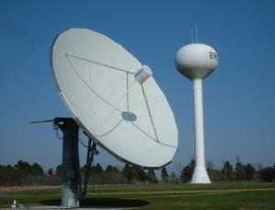
MICROCOM DESIGN
Meteorological Technology World Expo 2018
Satcom Forum

Slide 2
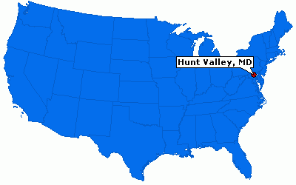
Company Overview
Founded in 1975 – Privately Owned
25 Employees
1150+ m² combined office and manufacturing space
Headquartered in Hunt Valley, Maryland, USA
  Just north of Baltimore, Maryland and Washington DC
  Representatives in Florida, Canada, and Brazil
Launched DCS product line in early 2000’s with DigiTrak demod & GTX-1.0 transmitter.

Slide 3
Technical Summary
Areas of Expertise:
  RF Communications
  Engineering & Computer System Design
  Data Acquisition Software & Real-Time Database Applications
  Environmental Monitoring
Lead Ground System Role for NOAA’s Data Collection System (DCS)
Design Engineering and Manufacturing In-House
GSA Schedules
  IT 70
  PSS 871

Slide 4
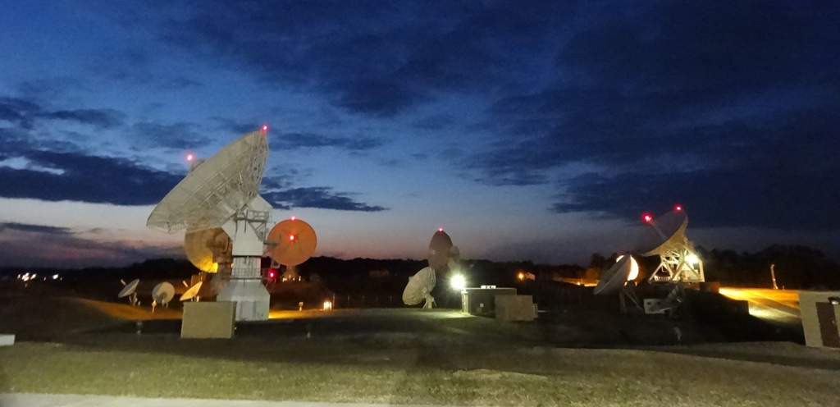
Microcom Direct Readout Ground Stations

Slide 5

Major US DRGS Sites
NOAA/NESDIS DRGS Sites
  Wallops Command and Data Acquisition Station (WCDAS); Wallops Island, Virginia.
  NOAA’s Satellite Operations Facility (NSOF); Suitland, Maryland.
  Both sites have complete East and West channel coverage with a total of 400 DCS demodulators (200 East & 200 West) at each site.
U.S. Geological Survey (USGS)
  Emergency Data Distribution Network (EDDN); Located at the Earth Resources Observation and Science (EROS) Center in Sioux Falls, South Dakota
  Complete East and West channel coverage with a total of 320
  DCS demodulators (160 East & 160 West).
Others
  National Interagency Fire Center (NIFC) – 80 Channels on West
  USACE Rock Island – 40 Channels on East and West each.
  Bureau of Reclamation – 80 Channels on West.

Slide 6
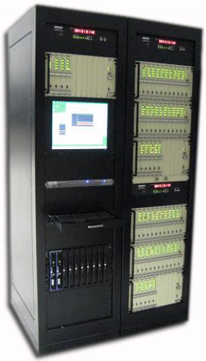
DAMS-NT DigiTrak Demodulator
Each DAMS-NT Cage can support up to 40 DCS channels and be independently configured for data rate and modulation format.
Digital Signal Processing (DSP) software based system provides flexibility and adaptability to new and/or changing formats.
Independent DSP engines ensures adequate computational capability.

Slide 7
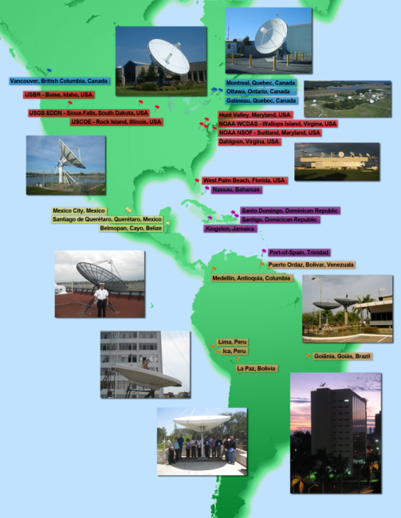
Geographic Breakdown of Microcom DRGS Sites
North American Sites
NOAA WCDAS – Wallops Island, VA
NOAA NSOF – Suitland, MD
USGS EDDN – Sioux Falls, SD
USACE – Rock Island, IL
NIFC – Boise, ID
USBR – Boise, ID
SFWMD – West Palm Beach, FL
FDOT – Lake City, FL
FDOT – Tallahassee, FL
  Alion – Annapolis Junction, MD
Dahlgren, VA
Microcom Design – Hunt Valley, MD
Montreal, Quebec
Ottawa, Ontario
Gatineau, Quebec
Victoria, British Columbia
South American Sites
Mexico City, Mexico
Cayo, Belize
Medellin, Columbia
Lima, Peru
Ica, Peru
Goiânia, Brazil
La Paz, Bolivia
Santiago, Chile
Santiago de Querétaro
Puerto Ordaz, Venezuela
Caribbean Systems
Nassau , Bahamas
Kingston, Jamaica
Port of Spain, Trinidad
Santiago, Dominican Republic
Santo Domingo, Dominican Republic

Slide 8
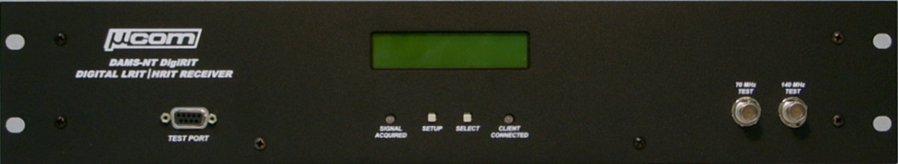
DAMS-NT DigiRIT LRIT/HRIT Receiver
By the end of 2018, will have 50 DigiRIT systems in operation.
Many agencies have multiple systems at multiple sites:
  NOAA-4; NIFC-2; USGS-2; USACOE-30+
Microcom working with NOAA to improve DCS data dissemination on HRIT – new enhanced file format.

Slide 9


Slide 10


Slide 11
Microcom’s New Direction
Continue to sustain and expand receive product line.
Emphasize transmit products, sensors, and full-circle environmental monitoring solutions.
  Supported by recently hired personnel, in-house manufacturing efforts, strong rebranding, and a new website.
  www.microcomenviro.com
  Further develop rapid deployment and temporary monitoring within the industry.
  Expand DCS capabilities of DCS platforms and take DCS platforms into new and unique applications.

Slide 12
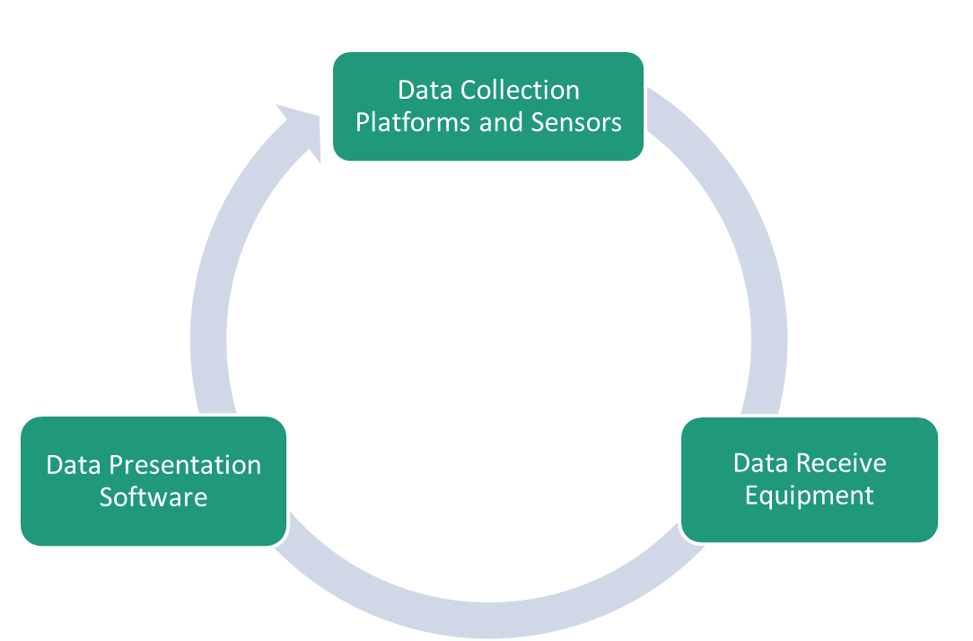
Full-Circle Product Line

Slide 13

Data Collection Platforms

Slide 14


The XPress and the GTX-2.0
Fully integrated GOES DCS Data Collection Platform
  GTX-2.0 Transmitter and Data Logger
  6 dBi Gain Antenna
  GPS Receiver and Antenna
  4.5 Amp-Hour Battery Pack and Solar Charger
Quick installation - attach sensors and plug and play
  Ideal for Rapid Deployment
Extremely cost-effective
Mounting & Power options available
GTX-2.0 Certified and Operational On:
  NOAA GOES (HDR 300/1200)
  Eumetsat (100 SRDCP/1200 HRDCP)
  JMA, INSAT, ARGOS, SCD, FY2

Slide 15
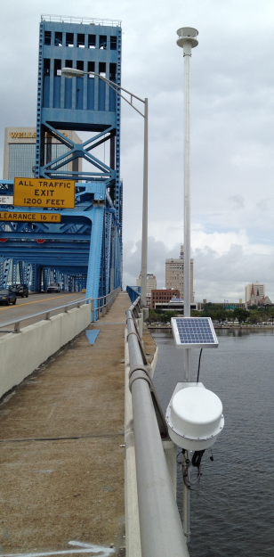
FDOT RWIS
Florida Department of Transportation (FDOT) has deployed numerous Road Weather Information Systems (RWIS) in the Florida Keys, Jacksonville area, and the Florida Panhandle region.
Primary objective is for emergency weather operations.
Focused on and near bridges.
Monitoring of wind speed and direction, water-level, road temperature, and scour velocity.

Slide 16
USGS RDG-4
The US Geological Survey (USGS) is using the Microcom XPress in its 4TH generation of the Rapid Deployment Gauge (RDG).
Designed for quick installation in advance of a flood or other emergency situations.
And quick, temporary replacements for monitoring systems lost or damaged during extreme weather.
Data communication via GOES DCS.
Sensors are customizable for the application.

Slide 17
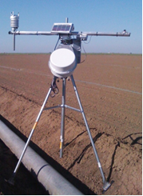
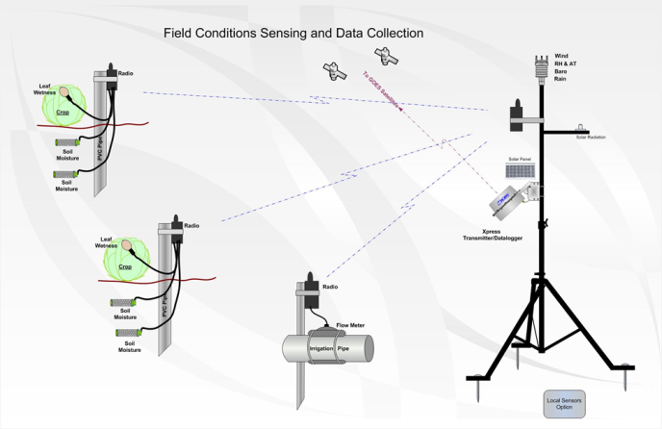
Evapotranspiration System
Working with a large commercial lettuce grower in California, Microcom developed an integrated and portable Evapotranspiration (ET) system using line-of-sight radio communication with a central GOES Data Collection Platforms to calculate and transmit ET and other data to make better decisions on when and how much to irrigate fields.

Slide 18

Two-Way DCP Communication
Under a NOAA contract, Microcom is working to bring reliable Two-Way communication to GOES Data Collection Platforms.
Two-Way Downlink to DCPs is at 468 MHz and is in a shared-use band along with Land Mobile Radio (LMR) users.
Must coexist in same band and provide robust communication link in the presence of LMR signals without impacting other licensees.
  Bench prototype system developed using Frequency Hopping Spread Spectrum approach to allow signal to hop between LMR channels while maintaining demodulation and data recovery.
  Next step is an Over-the-Air prototype.

Slide 19
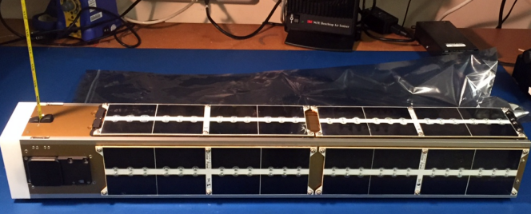
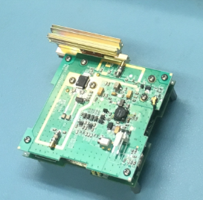
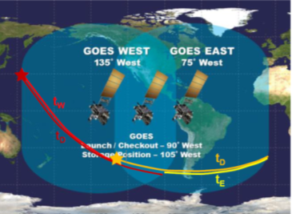
CubeSat Utilization Project
Microcom working along side of NOAA and NASA is investigating the feasibility and practicality of using DCS for CubeSats.
Later this year, the first prototype CubeSat DCP will be delivered to the International Space Station (ISS).
Deployment launch from ISS expected sometime in 2019.
On board algorithms will correct for Doppler shift and drift.
Will only attempt transmission when GOES-West or GOES-East is in view. potential for interference.

Slide 20
Points of Contact
  Brett Betsill Perry West
  President & RF Engineer Director of Sales & Marketing
  BBetsill@MicrocomDesign.com PWest@MicrocomDesign.com
  410.771.1070 x21 410.771.1070 x30
  Craig Pulford Duane Preble
  Vice President & Software Engineer Director of Product Development
  CPulford@MicrocomDesign.com DPreble@MicrocomDesign.com
  410.771.1070 x26 410.245.0098
www.MicrocomEnviro.com

