Slide 1
The WMO Stewardship Maturity Matrix for Climate Data (SMM-CD)
Christina Lief
Physical Scientist
International Expert Group on Climate Data Modernisation (IEG-CDM) Lead
CCl Expert Team on Data Development and Stewardship (ET-DDS) Co-Chair
WMO CBS TT-IM Meeting
Geneva, Switzerland
October 3-4, 2018
Notes:
Hello everyone. My name is Ge Peng; I go with Peng.
I am a Research Scholar at a cooperate institute bwt NOAA and North Carolina State University on climate and satellites.
I am also affiliated with NOAA’s National Centers for Environmental Information.
I appreciate the opportunity to introduce to you the WMO-wide Stewardship Maturity Matrix for Climate Data.

Slide 2

SMM-CD was developed by the SMM-CD Working Group
Ge Peng (CICS-NC/NCEI, USA), lead;
William Wright (BOM, Australia), co-lead;
Christina Lief (WMO);
Omar Baddour (WMO);
Valentin Aich (GCOS)
under the High-Quality Global Data Management Framework for Climate (HQ-GDMFC), in collaboration with the members of an ad hoc International Expert Group on Climate Data Modernisation (IEG-CDM)

Slide 3
HQ-GDMFC
CCl/CBS lead inter-programme initiative
WCRP
JCOMM
CHY
Goals
Utilizing high-quality climate data for policy and decision-making support;
Standardizing the definitions and processes;
Providing guidance on standards and best practices (data management and stewardship);
Improving climate data metadata and services.

Slide 4
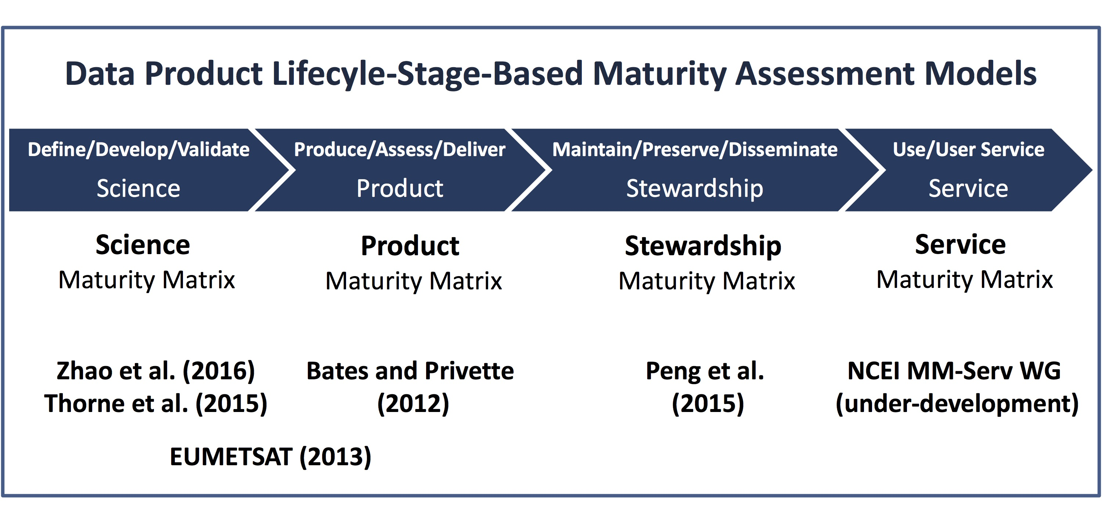
Assessing Dataset Maturity
Scientifically sound and utilized
Fully documented and transparent
Well preserved and integrated
Readily obtainable and usable
(Peng 2018, Data Science Journal)

Slide 5
Assessing Dataset Maturity
DSMM
SMM-CD
CORE-CLIMAX PSMM

Slide 6
SMM-CD: Categories and Aspects
SMM-CD Category
Data Access | Usability & Usage | Quality Management | Data Management
Discoverability | Data Portability | Quality Assurance & Control | Preservation
Accessibility | Documentation | Quality Assessment | Metadata
 | Usage | Uncertainty Analysis | Governance
 |  | Data Integrity
Aspect

Slide 7
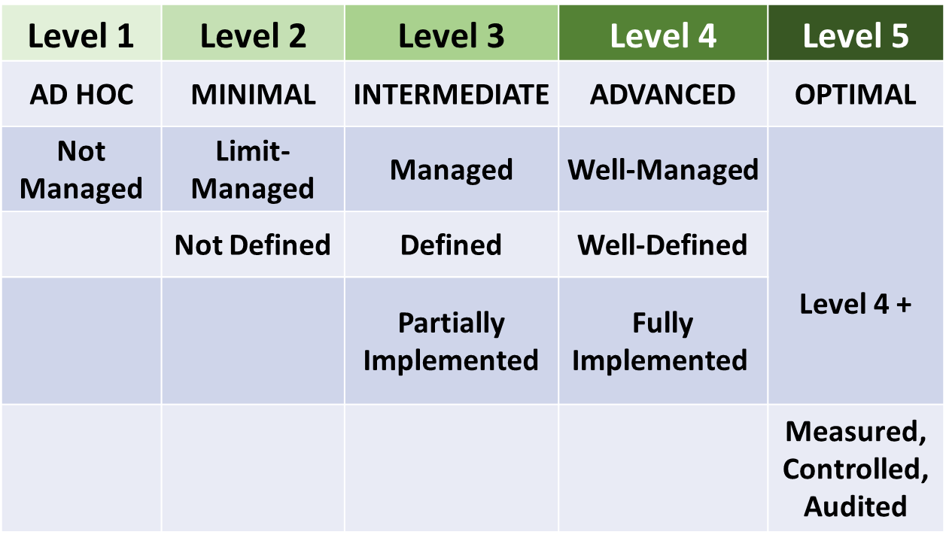
SMM-CD: Maturity Levels

Slide 8

SMM-CD: Development History
WMO CCl/CBS Workshop on Information Management (WMO, October 2017);
Meeting of the ad hoc International Expert Group on Climate Data Modernisation (IEG-CDM) (KNMI, April 2018);
IEG-CDM Group B SMM-CD Working Group developed the SMM-CD baselining documentation after internal and external reviews (The Earth Science Information Partners (ESIP) 2018 Conference).

Slide 9
SMM-CD: Ongoing Work
  IEG-CDM Group A SMEs are presently assessing initial 16 datasets;
  IEG-CDM Group C team is presently developing the Catalog on High Quality Climate Data that will include these 16 datasets.

Slide 10
SMM-CD: Documents
The short URLs to the current SMM-CD documents
Matrix: bit.ly/SMM-CD
Guidance Booklet: bit.ly/SMM-CD-Manual
Template: bit.ly/SMM-CD-Template

Slide 11
Acknowledgement
The members of IEG-CDM (in alphabetical order)
AICH, Valentin (GCOS)
BADDOUR, Omar (WMO)
BERGERON, Cedric (ECMWF)
BEROD, Dominique (WMO)
BUSSELBERG, Thorsten (DWD)
CAZENAVE, Anny (LEGOS)
DUNN, Robert (Met Office/Hadley Center)
GALLAHER, David (NSIDC)
GATES, Lydia (DWD)
LIEF, Christina (WMO, lead)
MILAN, Anna (NOAA/NCEI)
PENG, Ge (NCSU/CICS-NC, NOAA/NCEI)
ROBERTS, Kate (BOM)
SIEGMUND, Peter (KNMI)
VERVER, Ge (KNMI)
WRIGHT, William (BOM)
ZIESE, Markus (DWD)
Discussions with and feedback from the following are beneficial
Iolanda Maggio, Peter Thorne, Simon Eggleston, Darren Ghent, Jörg Schulz, Nancy Ritchey, Kenneth Kehoe, Imke Durre, Carolin Richter, Ruth Duerr

Slide 12
Thank you
Christina.lief@gmail.com

