Slide 1
Information Management Framework
Secretariat
Agenda item 3

Slide 2
TT-IM Terms of Reference
Collaborate with technical commissions to review available information management practices and develop and document appropriate standards and practices in information management
Recommend procedures for the long term maintenance and development of standards and best practices related to information management
Replace the Guide on World Weather Watch Data Management (WMO No. 788) with a new guide on best practices for information management across all WMO Programmes
Propose updates to incorporate standards and practices for information management under WIS Part C in the Manual on WIS (WMO No. 1060) and Guide to the WIS (WMO No. 1061)
(e) Recommend updates to the WIS competencies related to information management and associated training and learning guides.

Slide 3
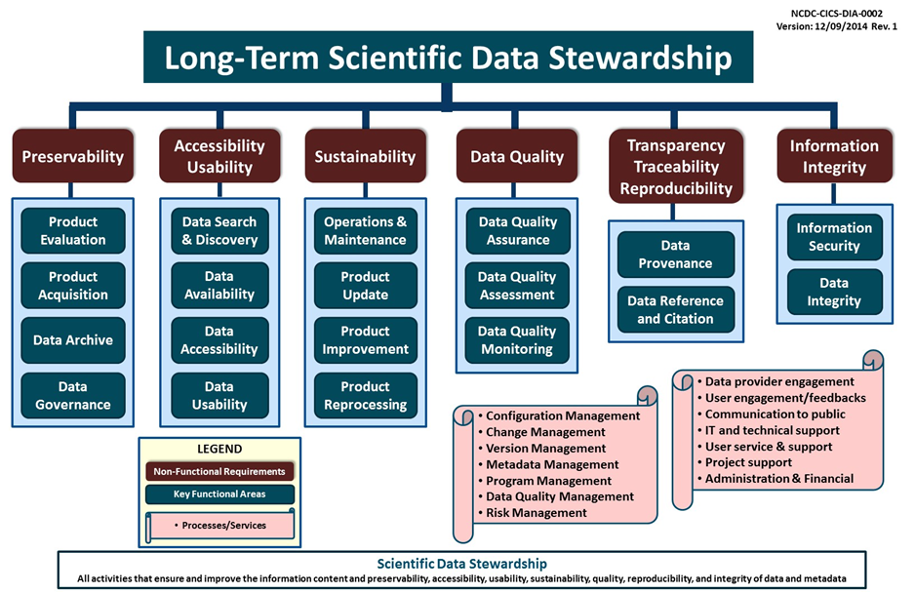
IM framework from non-functional requirements

Slide 4
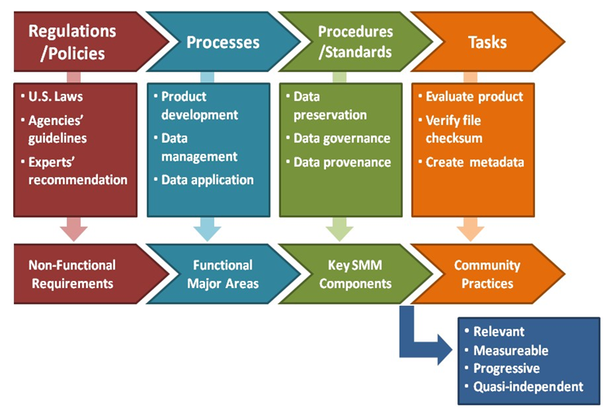
IM framework from non-functional requirements

Slide 7
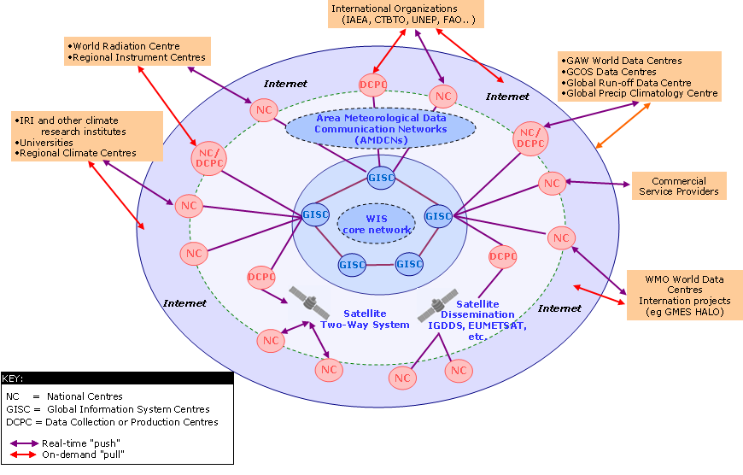
Information activities
Create
Documenting
Store
Cataloging
Quality control
Share
Acquisition, dissemination, access services
Use
Processing services
Usage tracking
Archive
Preservation
Destroy
Information activities
Create
Documenting
Store
Cataloging
Quality control
Share
Acquisition, dissemination, access services
Use
Processing services
Usage tracking
Archive
Preservation
Destroy
WIS 2.0 platform will be complemented by a set of principles to encourage best-practice in data life cycle management) by the WMO community

Slide 8
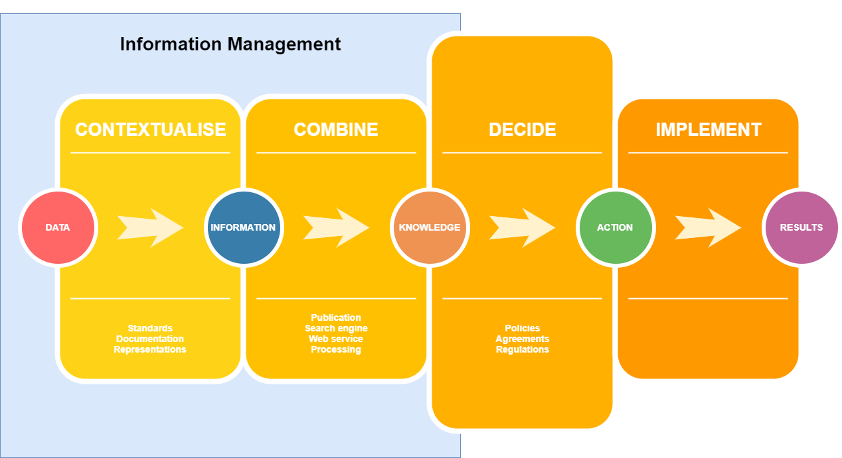

Strategic importance of IM

Slide 9
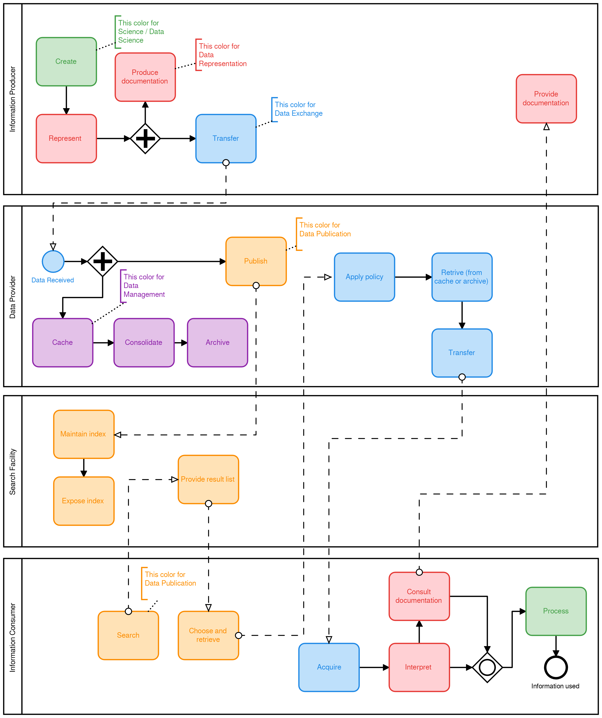
Process based framework for
Information Management

Slide 10
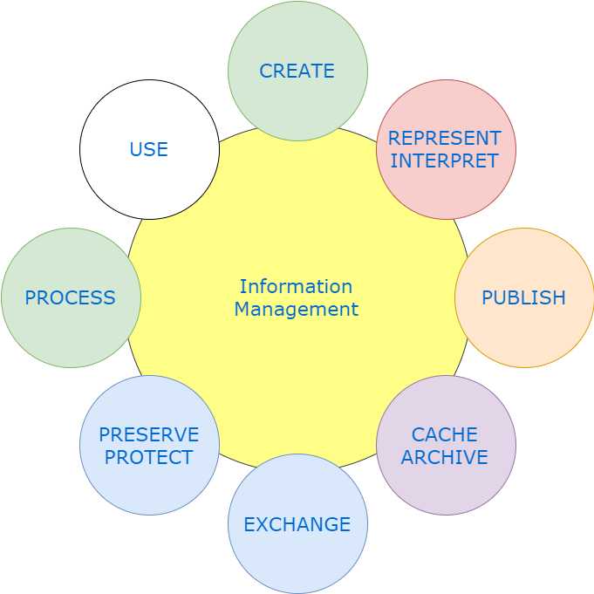
Process based framework for Information Management

Slide 11
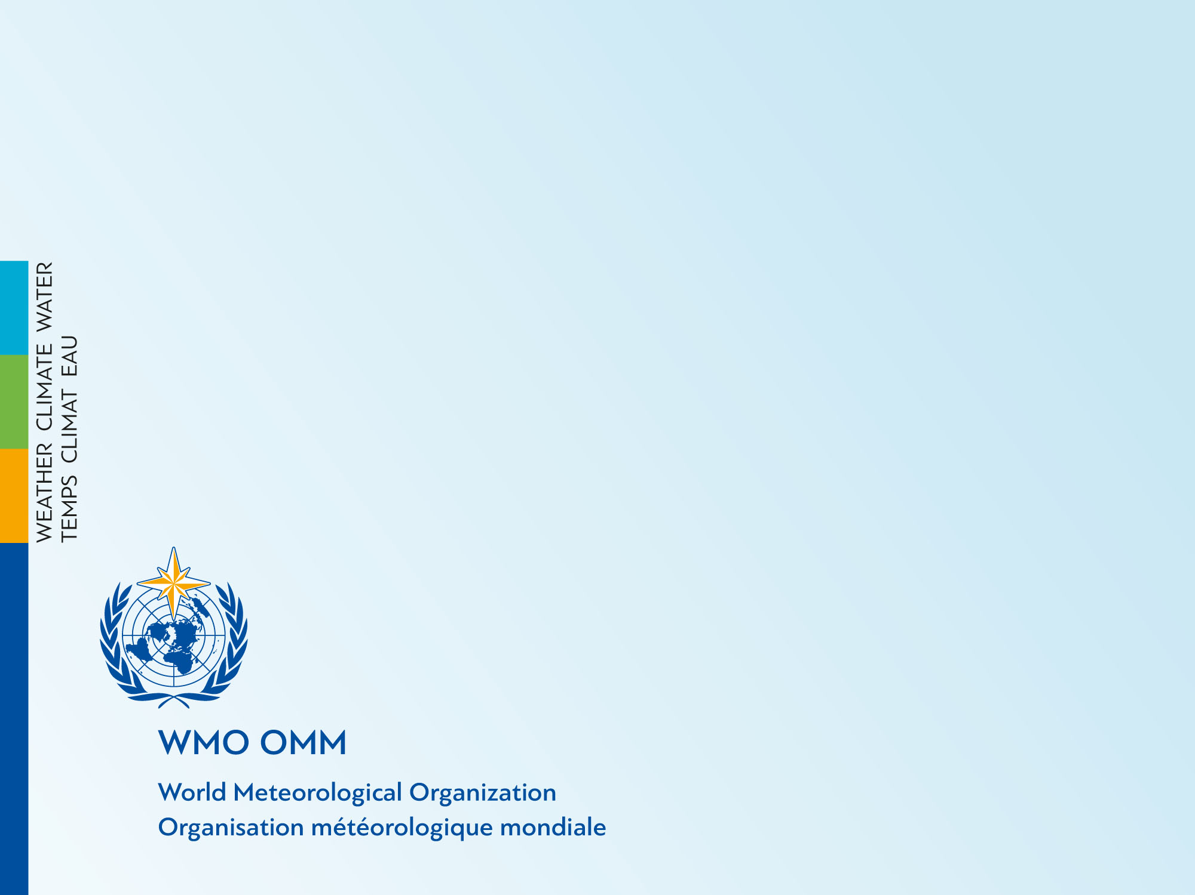
Thank you
Merci

