Slide 1










GISC MOSCOW STATUS REPORT 2018
TT-GISC Casablanca
18-20.09.2018
Vladimir Tsukanov

Slide 2
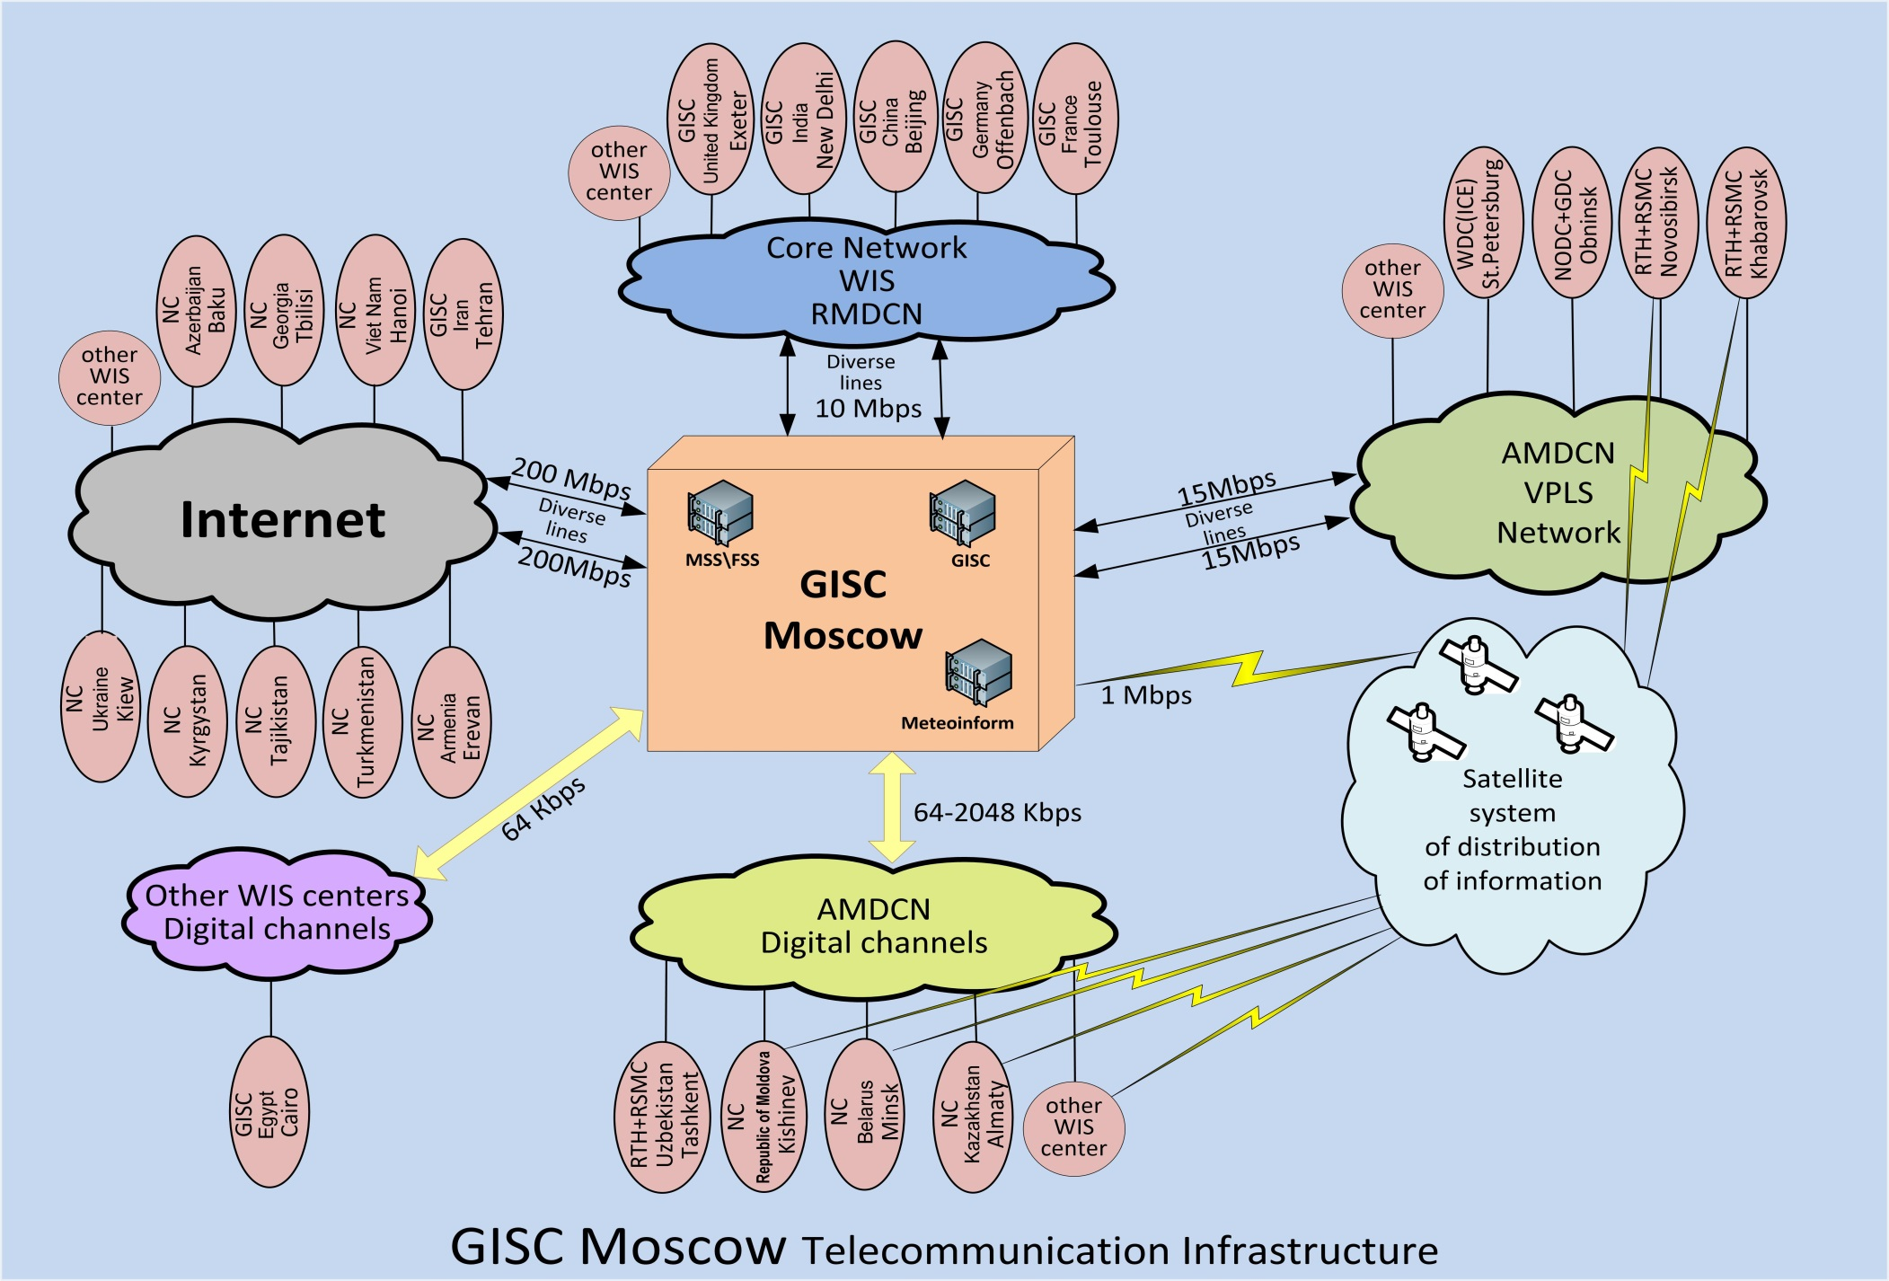

GISC Moscow Connectivity

Slide 3
GISC Moscow AoR
GISC Moscow operates as a principal GISC for 11 NMHSs:
- Armenia
Azerbaijan
Belarus
Georgia
Kazakhstan
Kyrgyzstan
Moldova
Tajikistan
Turkmenistan
Uzbekistan
Ukraine

Slide 4
AMDCN connectivity
  NC Yerevan Armenia – Internet, FTP
  NC Baku Azerbaijan – Internet, Socket-special+http
  NC Minsk Belarus – Dedicated connection CIR:128kbps (both directions) + Internet /Backup via Internet, Socket-special (512kbps)+FTP
  NC Tbilisi Georgia – Internet, FTP + http
  NC Astana Kazakhstan – Internet, FTP (Kazakhstan made efforts for GTS connectivity through the RMDCN in 2018). Kazakhstan nominated a new NC Astana, which became the main NC, and the NC Almaty is a back-up NC.
  NC Bishkek Kyrgystan – Internet, Socket-special (512kbps)
  NC Kishinev Republic of Moldova - Dedicated connection CIR:256 kbps (both directions), Socket-special+FTP_http/Backup via Internet, email
  NC Dushanbe Tajikistan - Internet, Socket-special (512kbps)
  NC Ashgabat Turkmenistan - Internet, FTP
  NC Tashkent Uzbekistan - Dedicated connection CIR:64 kbps (both directions), Socket-special+FTP/Backup via Internet, email
  NC Ukraine – Internet, FTP

Slide 5
Training
  The webinar (Q2/2018) examined some theoretical issues, including metadata management in the Moscow Central Control Center, Virtual National Centers in GISC Moscow).
  2. The next webinar to be conducted near end-2018 will focus on the issues of data uploading and metadata generation based on GTS data of the NC area of responsibility, etc.
  3. The webinar, scheduled for 2019, will examine the issues of organization and interaction of GISC Moscow and NC/DCPCs in its area of responsibility for implementing the WIS monitoring.
  Training materials have been published on GISC Moscow:
  http://portal.gisc-msk.wis.mecom.ru:8080/portal/portal/gisc-user/wmo

Slide 6
Operational issues considered
GISC Moscow is harvesting 12 metadata sets:
WIS-GISC-BEIJING
WIS-GISC-BRASILIA
WIS-GISC-EXETER
WIS-GISC-JEDDAH
WIS-GISC-MELBOURNE
WIS-GISC-OFFENBACH
WIS-GISC-SEOUL
WIS-GISC-TEHRAN
WIS-GISC-TOKYO
WIS-GISC-TOULOUSE
WIS-UNASSOCIATED
WIS-GISC-NEWDELHI

Slide 7
GISC back-up and activities
To date, GISC Moscow has concluded backup agreements with GISC Offenbach and GISC Toulouse.
The following centers in the AoR of GISC Moscow are connected to the back-up GISCs:
- NC Minsk Belarus, NC Bishkek Kyrgystan, NC Astana Kazakhstan, DCPC/RTH of Russian Federation (Khabarovsk, Novosibirsk) are backuped at GISC Offenbach.
- NC Kiev Ukraine, NCs Tbilisi Georgia and Erevan Armenia are backuped at GISC Toulouse.
- There are 5 countries in the AoR of GISC Moscow not backuped so far: Azerbaijan, Moldova, Tajikistan, Turkmenistan, Uzbekistan.
2. In 2018, measures were taken to connect the main NC of Kazakhstan (Astana) to GISC Moscow, including the modification of the abbreviated headings of the Astana meteorological bulletins (CCCC=UAST), the generation and provision of metadata of Kazakhstan to the WIS.
3. NC Tashkent is connected to GISC Moscow, the provision of Uzbekistan's metadata in WIS is transferred from GISC Tokyo to GISC Moscow.

Slide 8
Monitoring activity & volume
GISC Moscow monitors:
the functioning of GISC hardware/software portal;
communications status (RMDCN IPVPN health);
status of metadata catalogue synchronization with other GISCs;
24h data cache volume.
The monitoring results are provided in the form of JSON files
to WMO WIS Monitoring Site:
http://www.wis-jma.go.jp/wcd/v1/top.html

Slide 9
Traffic size and volumes
Metadata Catalogue status:
• Number of Metadata in WIS-CATALOGUE: ~ 99380 records
• Number of Metadata in WIS-GISC-MOSCOW: 3432 records
24h Cache status:
• Number of product instances: 564 434
• Size of cache: 12,6 Gb
• Number of product instances missing metadata: 394 309
• Size of product instances missing metadata: 10,4 Gb
• Number of unique products missing metadata: 1 535
• Number of unique products missing metadata AoR: 0

Slide 10
Outlook (planned changes/improvements)
1. GISC Moscow is planning to establish direct connection with GISC Tokyo, GISC Melbourne via RMDCN connection and with GISC Washington via Internet.
2. GISC Moscow continues work with NCs Azerbaijan, Republic of Moldova, Tajikistan, Turkmenistan and Uzbekistan to provide connection to backup GISC Offenbach.
3. The certification of NCs in the area of responsibility of GISC Moscow is scheduled to be completed in Q1/2019.
4. GISC Moscow makes every effort to hold the re-audit in Q1/2019.

