Slide 1
Status report of GISC Beijing
GISC Beijing/CMA
TT-GISC, 18th Sept. 2018, Casablanca

Slide 2
WIS implementation of GISC Beijing
GISC Beijing’s responsible area:
NCs (7):
China
Mongolia
Nepal
Pakistan
Hong Kong, China
Macao, China
Democratic People’s Republic of Korea. (new in Nov. 2015)
DCPCs (6):
WWIS ( Hong Kong, China )
5 CMA’s internal DCPCs
International roles of CMA in WIS:
NC China
GISC Beijing
RTH Beijing (DCPC)
RCC Beijing (DCPC)
RSMC Beijing – Geographical (DCPC)
RSMC Beijing – Activity – ATM (DCPC)
National Satellite Meteorological Center (DCPC)
Notes:
CMA fulfills the following international roles, each designated as GlSC or DCPC duties within the framework of WIS:

Slide 3
Data Communication Network
EUMETSAT
Offenbach
Tokyo
Osaka
Moscow
New Delhi
Toulouse
Seoul
0
RMDCN
MPLS VPN
16Mbps
16Mbps
Beijing (main site)
Beijing (DR site)
750Mbps
4Mbps
64Kbps
64Kbps
64Kbps
64Kbps
Internet
Thailand
Vietnam
DRPK
Mongolia
4Mbps
2Mbps
Hong Kong
Macao
Australia
Pakistan
Nepal
USA

Slide 4
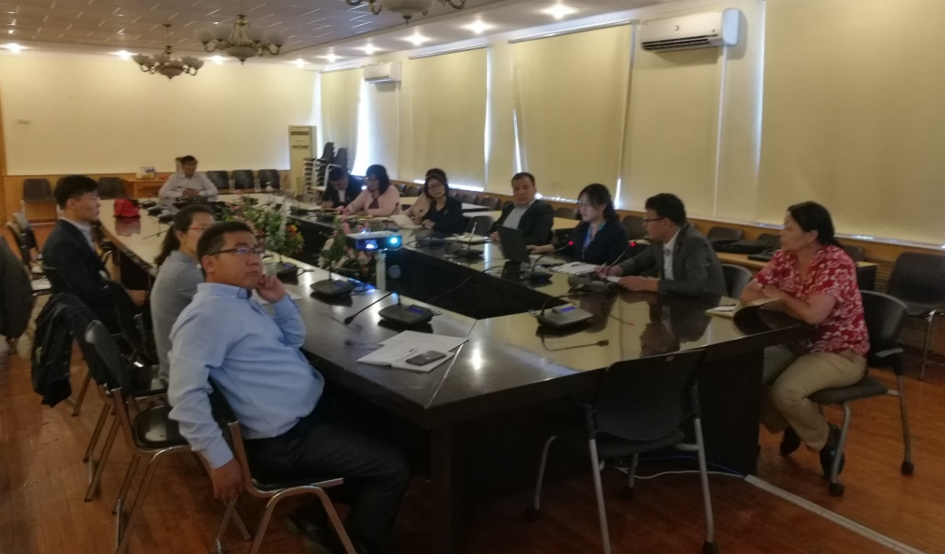
Training - Capacity building
On-site training on CMACast & WIS to WIS AoR users.
20th – 21st August 2018, to Mongolia
September 2018, to Vietnam
(Scheduled) October 2018, to Pakistan and Uzbekistan

Slide 5
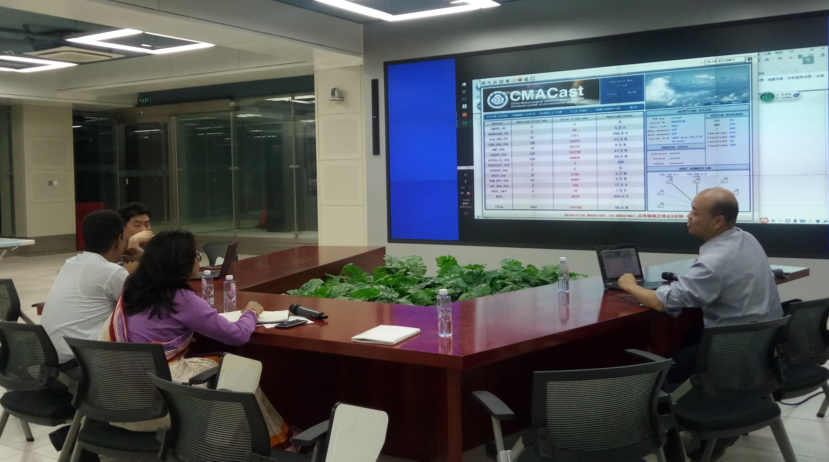
Training - Capacity building
Invited training on CMACast & WIS to WIS AoR users.
21st – 25th May 2018, to Bangladesh (in CMA, Beijing)

Slide 6
Operational Issues in last period
GISC Beijing encounters database server malfunction during 21st ~ 25th June, 2018
The cause is due to the incompatibility of “hardware – Oracle Linux – Oracle 12 database”
The issue SOLVED by changing OS to RHEL – Oracle 12 database

Slide 7
Monitoring activity
Participating in GISC Watch
Taking 2nd shift (16th ~ 31st May)

Slide 8
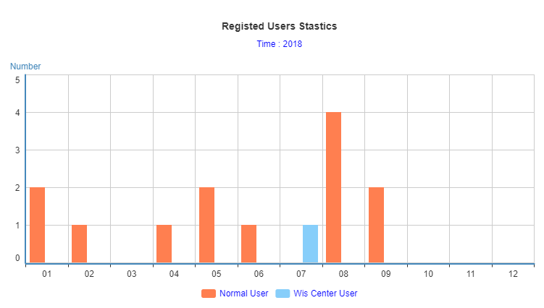
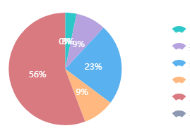
Traffic Status of GISC Beijing
As of 18th Sept. 2018, there are 143 users from 36 WMO Members registered in GISC Beijing. The daily data volume of distribution via CMACast and Internet is over 600GB.
Daily volume
Synoptic & AWS
Upper air
NWP
Weather Radar
Satellites
Others

Slide 9
Start to harvest Uzbekistan metadata from GISC Moscow
Mid August, 2018, after published by GISC Moscow
(7 records)
CSUZ10 UTTW
FCUZ31 UTTW
FTUZ31 UTTW
ISID20 UTTW
SAUZ31 UTTW
SIUZ20 UTTW
SMUZ10 UTTW

Slide 10
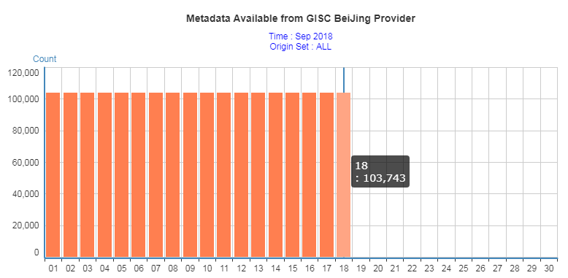
DAR Metadata of GISC Beijing
As of 18th Sept. 2018, there are 103743 DAR metadata records provided in GISC Beijing, including 97784 records of global exchange data.

Slide 11
Changes – Publish new data
YOPP SOP project "IAS - Intensive Atmospheric Soundings during the Chinese Arctic Cruise in 2018“
Upper air sounding observation in Arctic (from surface/ship)
IUSN59 BABJ
http://gisc.wis.cma.cn/wis/provider?verb=GetRecord&identifier=urn:x-wmo:md:int.wmo.wis::IUSN59BABJ&metadataPrefix=iso19139

Slide 12
Summary
The meeting noted the report from GISC Beijing. It reported that during 2018 GISC Beijing provided onsite training in neigbouring NMHS, including guidance for WIS implementation. GISC Beijing planned to continue capacity building activities for their AoR in 2019. It reported that GISC Beijing published upper air sounding data for YOPP, also on both GTS and WIS in 2018.

Slide 13
Thanks for your attention!

