Slide 1
GISC Offenbach
Kai Wirt
Task Team GISC
TT-GISC2018
18-20 Septembre 2018, Casablanca

Slide 2
Connectivity
AoR of 29 countries
GISC Offenbach directly connected to all other GISCs
Internet Access 7.5 GB/s via two ISPs
Backup Internet Access in Berlin
RMDCN Connection 50MB/s

Slide 3
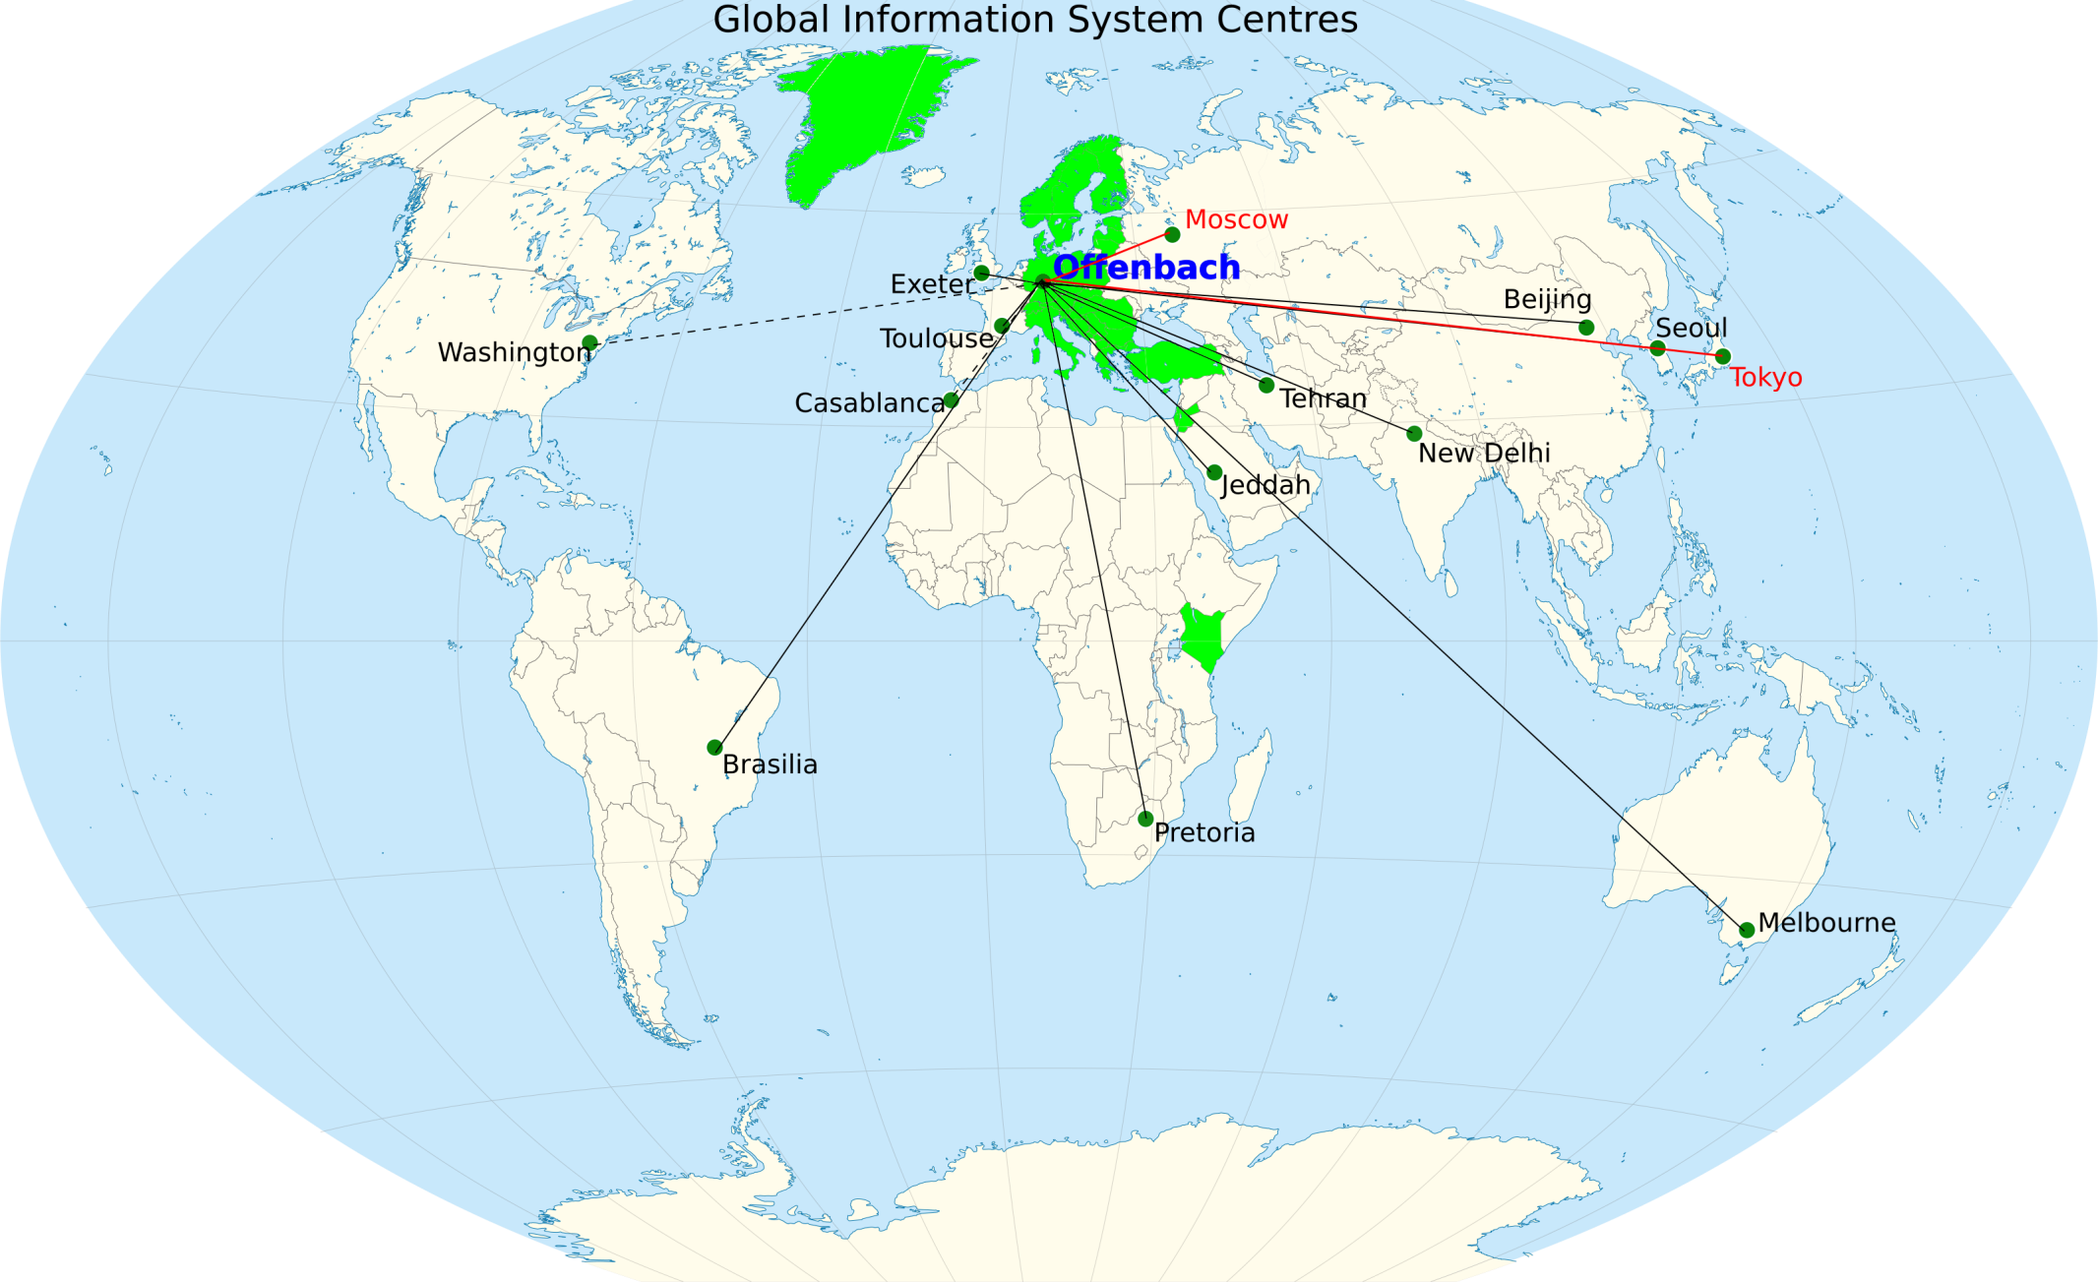
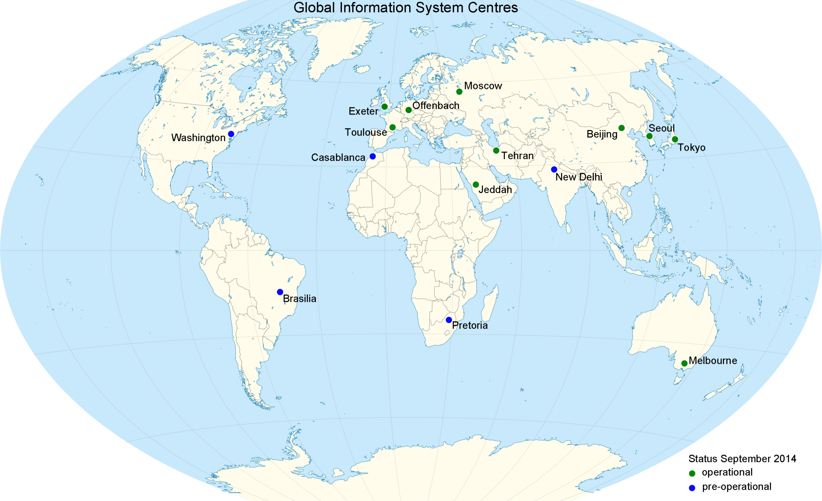

Slide 4
Training
2018: Training for RTH Sweden
Planned for 2019:
  Usage of GISC Offenbach Portal
  DWD‘s Metadata Generator

Slide 5
Operational Issues
Established connections to GISC Casablanca and GISC Washington
Outage of WIS Monitoring Files. Also noted by GISC watch.
End of 2018: ftp-outgoing.dwd.de discontinued.
Major outage of data transfer in 09/2018

Slide 6
Backup
GISC Tokyo and GISC Moscow
Jordan established second Backup at GISC Tokyo
Quarterly Backup Tests
  Very valuable
Users of the ftp-outgoing.dwd.de are required to create subscriptions at GISC Offenbach’s WIS Portal

Slide 7
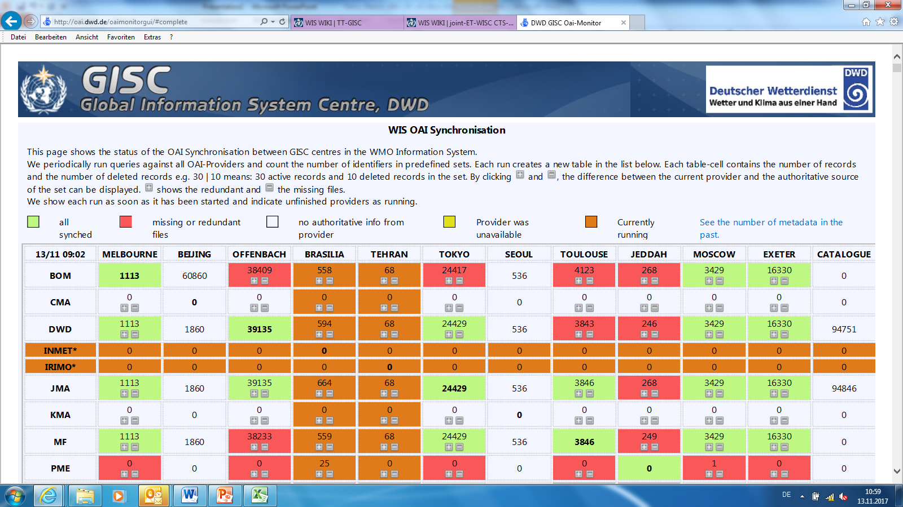
Monitoring

Slide 8
GISC Watch
01. – 15.09.
No major incidence
  But some questions
  See Gisc Watch Report

Slide 9
Changes / Outlook
Done: New Design of Search Results Page
Work in Progress:
  Implementation of OPEN Search Interface.
  Exposure of DAR Metadata to commercial search engines.
  Improvements of OAI Monitor

Slide 10
Recommended Text
The awareness of WIS in GISC Offenbach’s Area of Responsibility is good. Workshops to improve the usage of GISC Subscriptions over GTS message switching are planned. GISC Offenbach established direct connections with GISC Washington and GISC Casablanca.

Slide 11

Thank you
Merci

