Slide 1

Ad hoc Expert Working Group, Terms of Reference (TOR) and Thematic Focus
Christina de Groot-Lief (CCl-IPET-CDMP, FR)
Expert Meeting on Climate Data
Modernization
KNMI, De Bilt
April 16-20, 2018

Slide 2
Ad hoc Expert Working Group - Introduction
The user community of climate data is changing. Increasingly, public and private sector Decision-Makers, such as Policy Makers, Mayors, Urban Planners, and more, have to make decisions affecting the safety of their constituency and clients due to needs of climate change adaption and mitigation. These are at the global, national, regional and local level.
Many of these Decision-Makers are not scientists and are new to climate data and products and there is a need for them to have information about the climate data and products they are basing their decisions on.
While scientists are developing datasets based on research, observations, analysis, apertures data and more, and publishing most datasets based the peer review process, Decision-Makers are more and more requiring a means to get a feel for the trustworthiness of climate data and products.

Slide 3
Ad hoc Expert Working Group – Introduction (cont.)
The major national data centers and agencies have been responding to this need and there have been several efforts to develop ways to determine the maturity of a dataset and provide this information to users.
This gives a Decision-Maker an idea of how well a dataset has been managed and if its availability is dependable for example. It provides the maturity level of a dataset. A rating of trustworthiness.

Slide 4
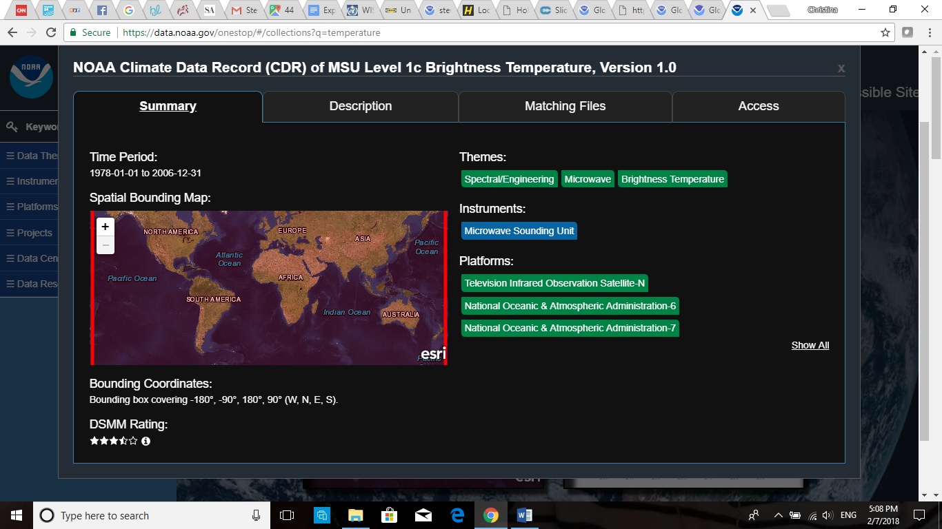
NOAA OneStop Data Access Portal

Slide 5
Ad hoc Expert Working Group – Terms of Reference (TOR)
The Ad hoc Expert Working Group was formed as a follow up of the WMO International Workshop on Information Management, held at WMO in October 2017, and is focusing on the group A recommendations.
The Working group is composed of some of the members that attended the workshop and some invited experts from the major data center, WMO Commissions, Programmes and Initiatives.
The main expected outcome of the Working Group and this meeting is the development of a catalog of trusted, high quality, major climate indictor datasets. This Catalog will be referenced in the WMO Information System (WIS) and made easily accessible through the main search engines for timely use. Users, including Decision-Makers, don’t necessarily go to science-based data servers or data centers when they start a search for data or a product. We need to reach out to them to provide them with the best quality data.

Slide 6
Ad hoc Expert Working Group – TOR (Cont.)
Terms of Reference (TOR):
Development of a WMO Data Catalog of High Quality data (ECV: Temperature; Precipitation; Sea Ice; Sea Level; Ice sheets; Glaciers) Climate Indices, Crowdsourced, and Hydrology datasets; (Breakout Group A lead by Peter)
Joint development of the CBS TT-IM of a WMO Maturity Matrix Convergence Model; (Breakout Group B lead by Peng)
Promotion mechanism of the Data Catalog in the WMO Information System (WIS) and the main search engines. (Breakout Group C lead by Anna)

Slide 7
Ad hoc Expert Working Group
Developing a WMO Maturity Matrix Convergence Model
The Workshop Participants also recommended jointly developing with the WMO Commission for Basic Systems (CBS) Tasks-Team on Information Management (TT-IM), a WMO Maturity Matrix Convergence Model based on the NOAA/NCEI Data Stewardship Maturity Matrix (DSMM) and the ESA CORE-CLIMAX System Maturity Matrix (SMM).
The working group adopted the Maturity level rating scale (Level 1 to 5) from the NOAA/NCEI DSMM and recommends 5-6 categories of evaluation categories/topics based on the DSMM and CORE-CLIMAX SSM. The CBS TT-IM has proposed 8 categories so far.

Slide 8
Ad hoc Expert Working Group – Thematic Focus
The group is working in cooperation with the GCOS program to determine the datasets for the Catalog that are based on ECVs: temperature, precipitation, cryosphere and sea level data. GCOS is working with the international panels to determine the datasets that are peer reviewed and can be viewed as best data for the 50 ECVs.
The working group also worked with KNMI for input as to high quality Climate Indicator data.
Team members met with WMO Hydrological experts to get input on best Hydrological data.
The group is looking towards JCOMM for input on high quality Marine data.

Slide 9
Ad hoc Expert Working Group – Thematic Focus (Cont.)
Invited working group experts will provide the status on specific data themes/variables presenting the problems/challenges with data completeness, gaps, and other issues.
This will help the group identify the data that are available for each of the themes/variables and best determine what dataset meet the high quality label to be included in the WMO HQ Data Catalog.

Slide 10

Thank you
Christina de Groot-Lief
Christina.lief@gmail.com

