Slide 1
Term of Reference
Breakout Working Group (BOG) B on WMO Maturity Matrix Convergence Model (MMCM)
Review & discuss the maturity models (NOAA-NCEI, Europe, others) for assessing maturity of Earth Science data sets
Review and potentially finalize the categories of the WMO-MMCM
Discuss the way to represent the maturity ratings
Start to define aspects of each categories
Define an action plan for a final draft and for draft review

Slide 2
Maturity Matrix
Maturity Matrix – A maturity assessment model with desired evolution in discrete, progressive stages from a more ad hoc approach to a more managed process
(Based on: Becker et al. 2009)
A maturity model is a tool for monitoring and improving aspects of organizational performance, and is often presented as a two dimensional matrix. The rows identify the various requirements and aspects for, say, data management, while the columns describe typical behaviours representing increasing capability against each aspect. Typically a maturity model uses five capability levels.
Behaviours at increasing level of maturity
Level 1 Ad Hoc Not Managed | Level 2 Minimal Managed Limited | Level 3 Intermediate Managed Defined, Partially Implemented | Level 4 Advanced Managed Well-Defined, Fully Implemented | Level 5 Optimal Level 4 + Measured , Controlled , Audit
Aspect
(From Wright 2018 )

Slide 3
CCl/CBS Eight Identified Requirements
in High Quality Data and Information Management
(CCl/CBS joint workshop in Information Management, Oct 2017)
Good documentation
Good governance
Effective storage and preservation
Effective quality assurance processes
Accessibility and sharing mechanism
Discoverability
Accountable asset management
Adequate competencies and training
(Based on Büßelberg 2018 )
Notes:
Documentation – product descriptive information: science: processing steps, QA/QC procedures, format; stewardship: archival procedures, file naming convention, fixation procedures, metadata; service: are they available? Interoperable? Easy to get and understand?
Governance – data or project?
Storage – a part of preservation
SA – should we include QC -> Effective QA/QC process (should also apply to metadata and documentation)
Combining Accessibility and Discoverability for metadata aspect?
Governance, asset management, training are programme management.

Slide 4
CEOS WGISS DSIG DMSMM Components
(Related to GEOSS 10 Data Management Principles)
DMP-1. Metadata for Discovery
DMP-2. Online Access
DMP-3. Data Encoding
DMP-4. Data Documentations
DMP-5. Data Traceability
DMP-6. Data Quality Control
DMP-7. Data Preservation
DMP-8. Data and Metadata Verification
DMP-9. Data Review and Reprocessing
DMP-10. Persistent and Resolvable Identifiers
(Based on GEOSS DMP Implementation Guideline 2015)

Slide 5
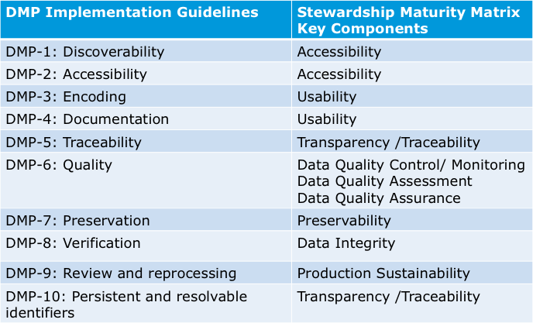
GEOSS DMP to DSMM Mapping
(Based on CEOS WGISS DSIG 2017)

Slide 6
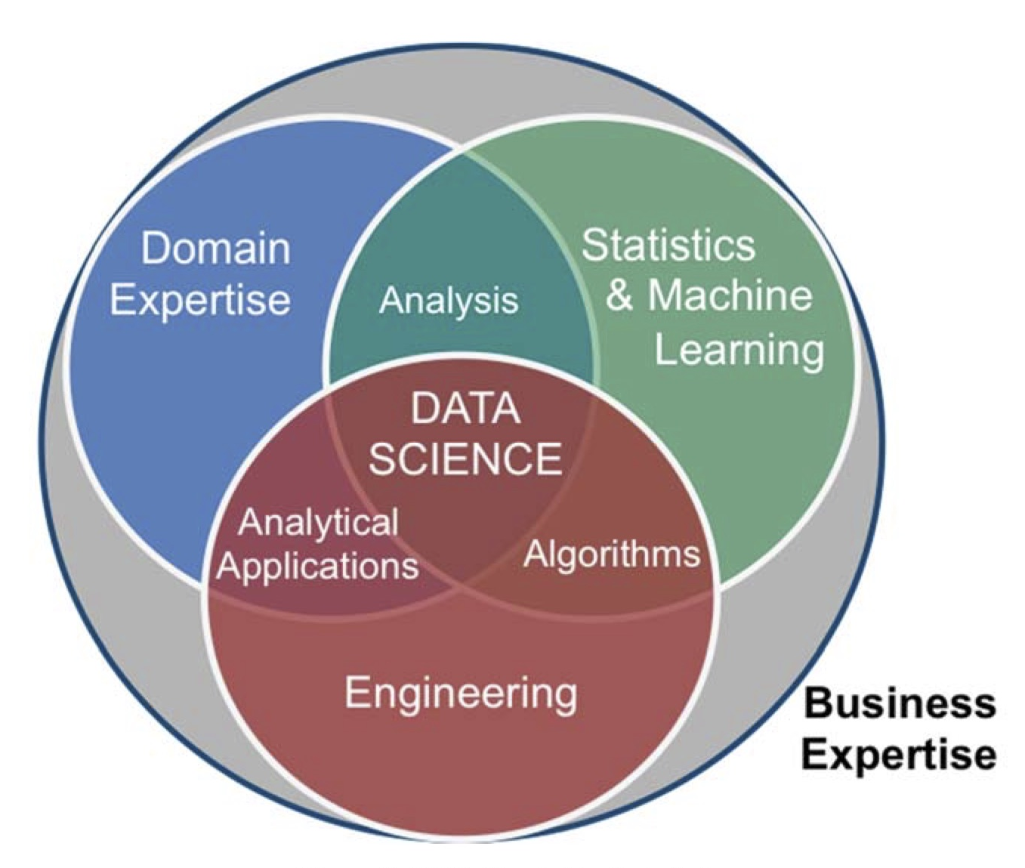
NIST Big Data Interoperability Framework
System
  Business Ownership; Governance; Data Science; System Architecture
Data Provider
  Data Sources; Data Persistence; Data Scrubbing (removing sensitive information); Data Annotation and Metadata Creation; Access Rights Management; Access Policy; Data Distribution; Capability Hosting; Data Availability Publication
Data Consumer
  Search and Retrieve; Download;
  Analyze Locally; Reporting; Visualization
Big Data Application Provider
Big Data Framework Provider
Security and Privacy
Management
(Based on NIST.SP.1500-1.pdf and NIST.SP.1500-2.pdf)
Notes:
Preservation is not included.

Slide 7
Definitions are different
for measuring the maturity of
Practices applied to individual datasets,
Processes of data management and stewardship,
Capability or performance of organizations or systems.

Slide 8
Why do we need to
consider multi-dimensions of quality?
There are different perspectives for the same requirement, for example, sustainability:
Observation System: availability and stability of the system for observing and collecting measurements
Product Production System: availability and stability of the system for generating and updating data product
Stewardship: availability and stability of data management and stewardship capability for long-term data access and use
Services: availability and stability of the tools and systems for servicing data to users.
They are all important to the quality of data to end users and independent in the sense that higher or lower quality in one aspect does not necessarily mean a higher or lower in another perspective.

Slide 9
Differences in Criteria for Data Access
CORE-CLIMAX SMM – Product Quality
Restricted availability from PI
Data available from PI
Data and documentation publically available from PI
Data record and documentation available from data provider and under data provider’s version control
Score 4 + source code archived by data provider; international data quality assessment are considered in periodic data record updates by data provider
Score 5 + source code available to the public
NCEI/CICS-NC DSMM – Stewardship Quality
Not publicly available Person-to-person
Publicly available; Direct file download; Collection/dataset level searchable
Level 2 + Non-standard data service; Limited data server performance; Granule/file level searchable; Limited search metrics
Level 3 + Community-standard data services; Enhanced data server performance; Conforming to community search metrics; Dissemination report metrics defined and implemented internally
Level 4 + Dissemination reports available online; Future technology and standard changes planned
Notes:
Preserving data, source code, and other documentation is addressed in Preservability in DSMM;
Availability of documentation including source code is addressed in Usability in DSMM.

Slide 10
Differences in Criteria for Data Access
FAIR Guiding Principles
A1. (meta)data are retrievable by their identifier using a standardized communications protocol
A2. metadata are accessible, even when the data are no longer available
CEOS WGISS Data Management & Stewardship MM
No online services available for data download. Data are not accessible online.
Basic online services available for data access (e.g. FTP/HTTP direct download).
1) Simple Access Architecture through metadata - e.g. Data Access through a catalogue service. 2) Data access system oriented towards an international standard (e.g. OpenSearch, ISO).
1) Data access system fully compliant with an international standard (e.g. OpenSearch, ISO). 2) Data policy regarding use conditions and restrictions of the data, available in the metadata. 3) Visualisation services allowing a user to view images of data (e.g. Web Map Services for geospatial data, browse image services). 4) Reporting system available (e.g. user statistics, data access reports, system availability reports, etc.). 5) Hosted processing (e.g. on the fly processing). 6) Quick adoption to new technologies and standards evolution.
Notes:
CEOS – Committee on Earth Observation Satellites;
WGISS – Working Group on Information Systems and Service;
Catalogue search in Discoverability

Slide 11
Backup Slides

Slide 12
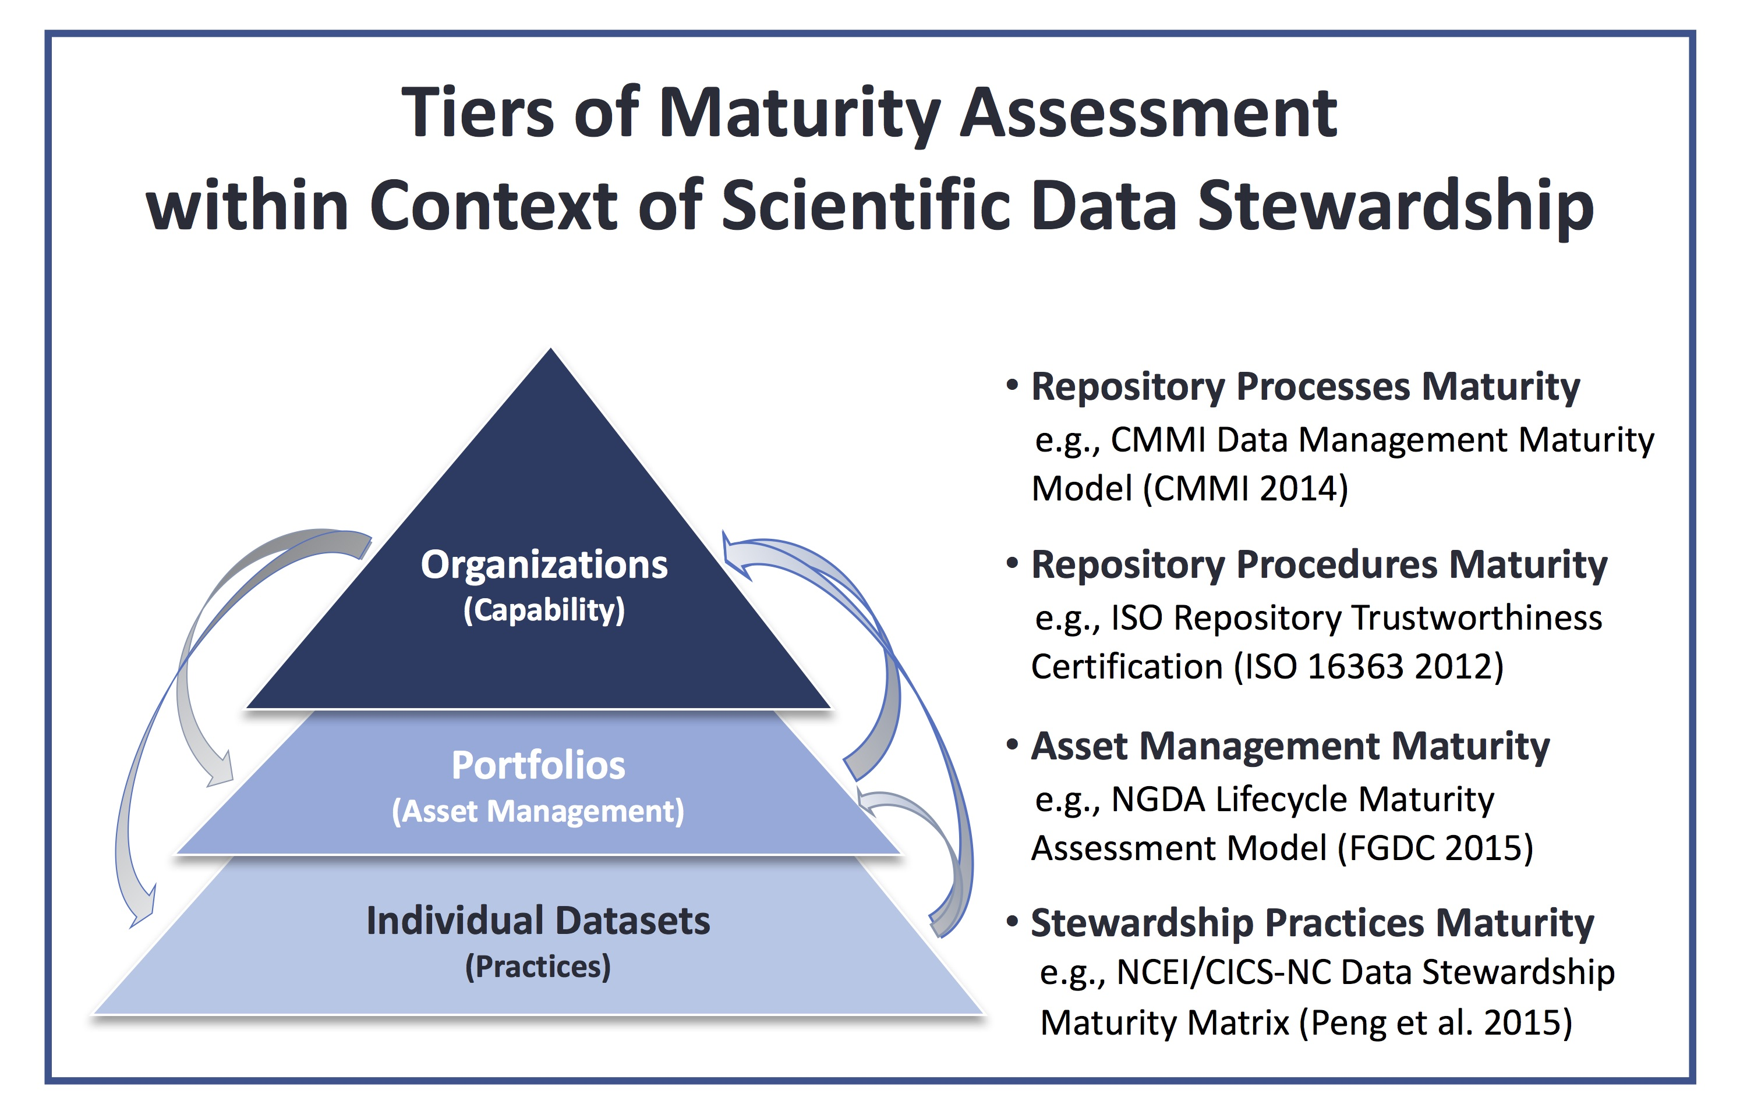
(Peng 2018, Data Science Journal)

Slide 13
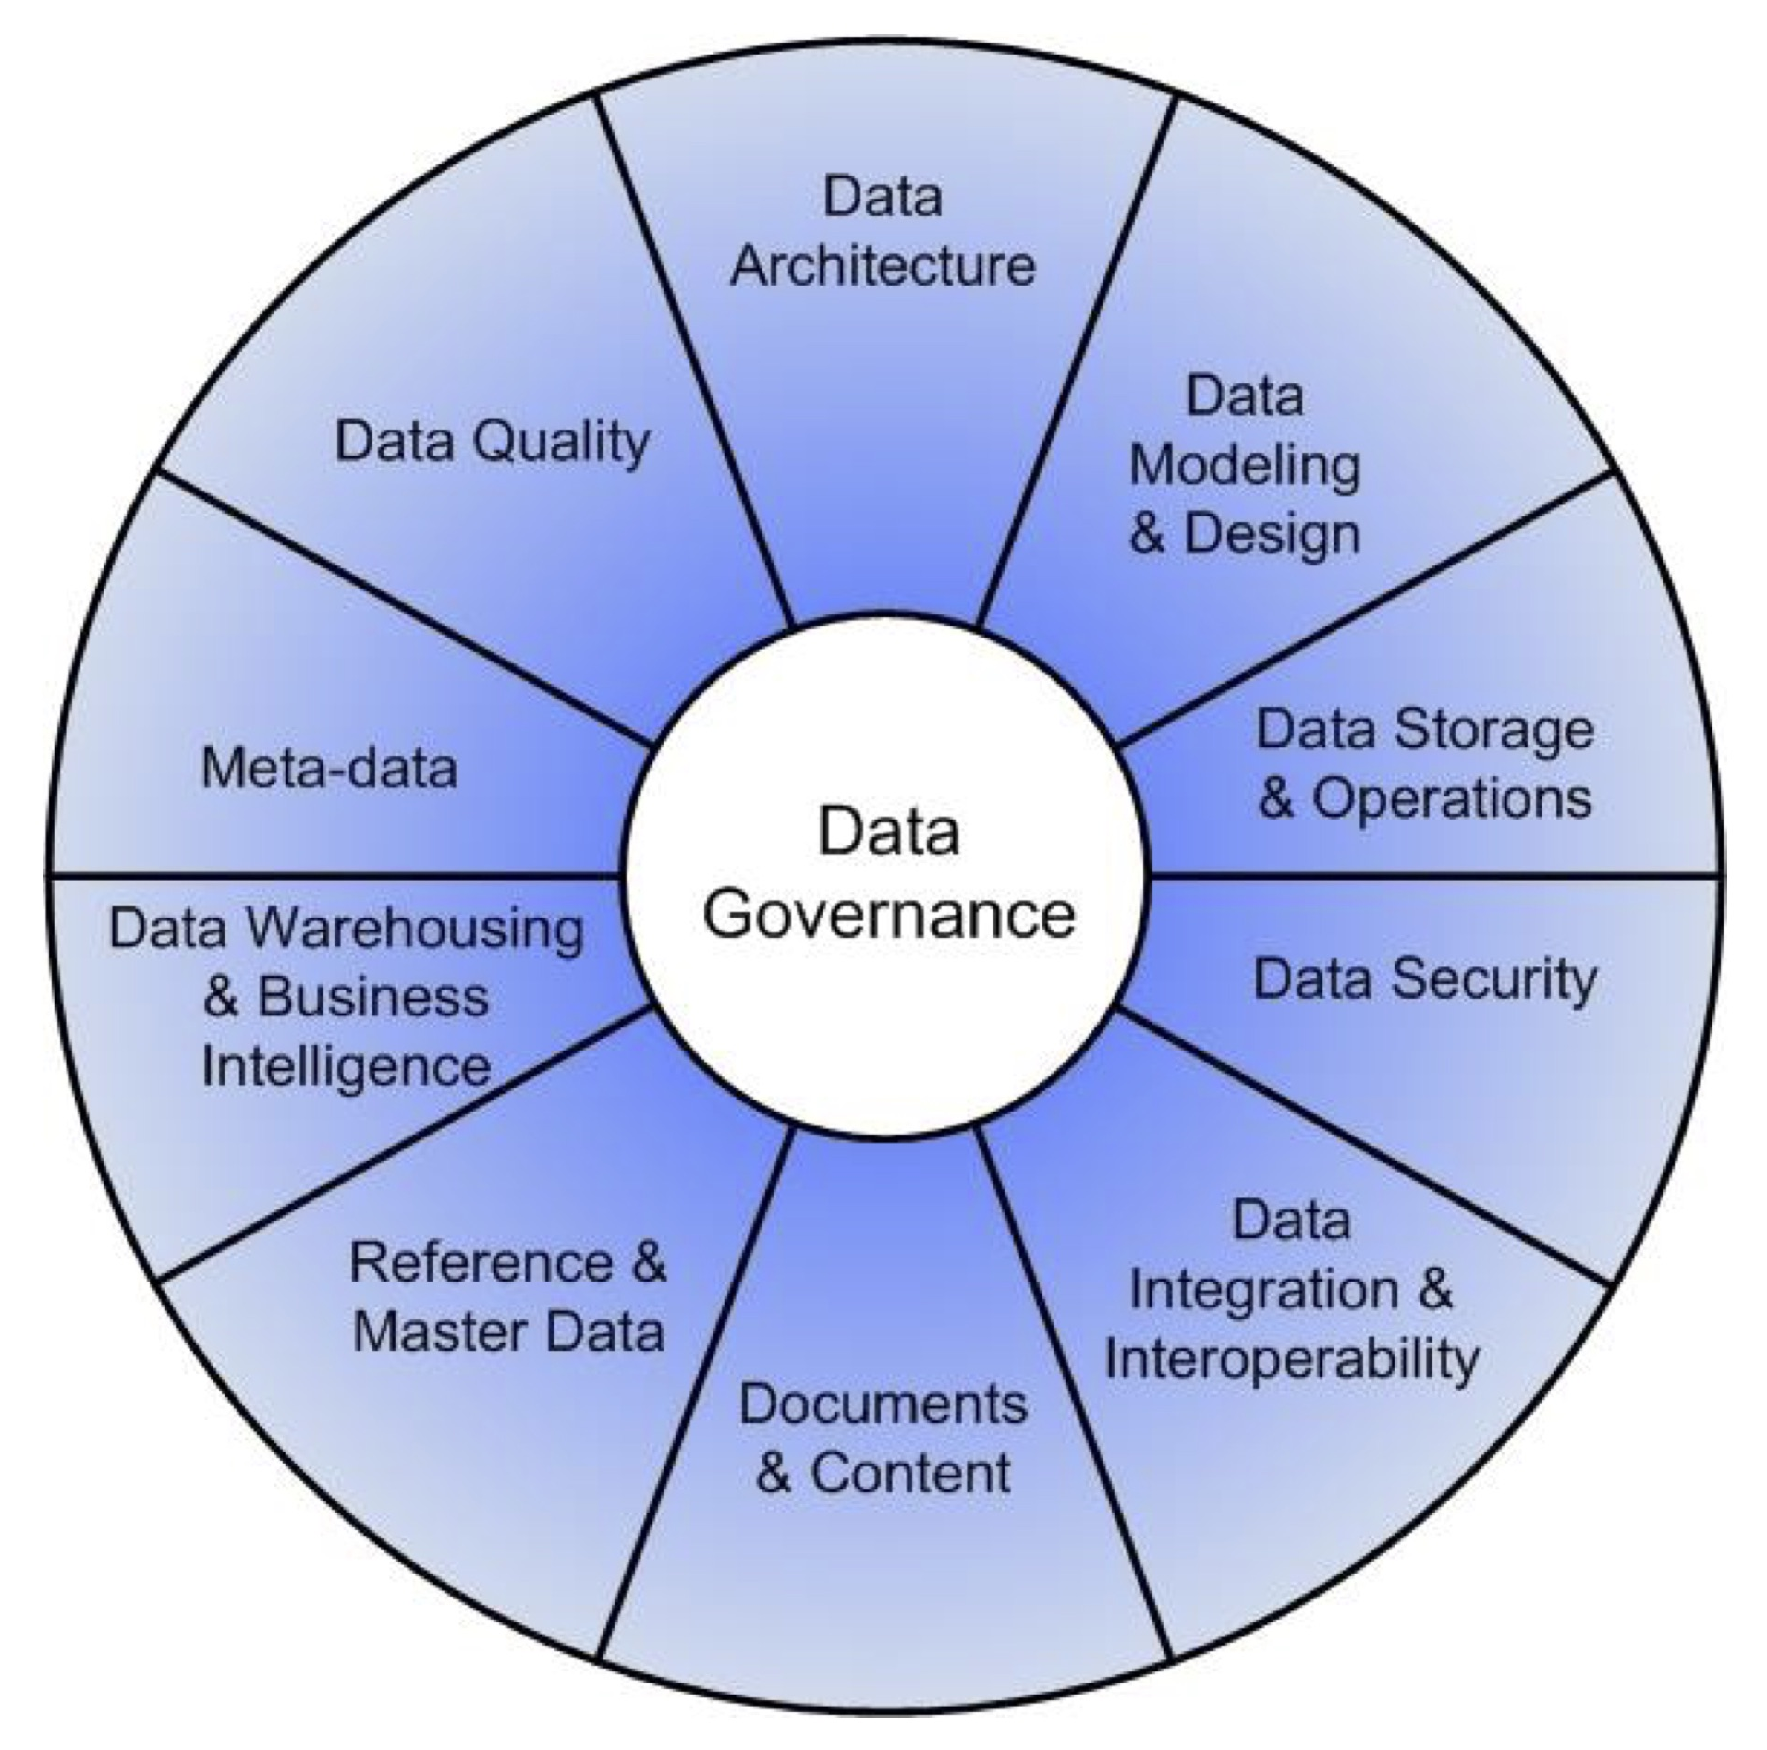
11 Knowledge Areas of Data Management
(DAMA International DMBOK 2014)

Slide 14
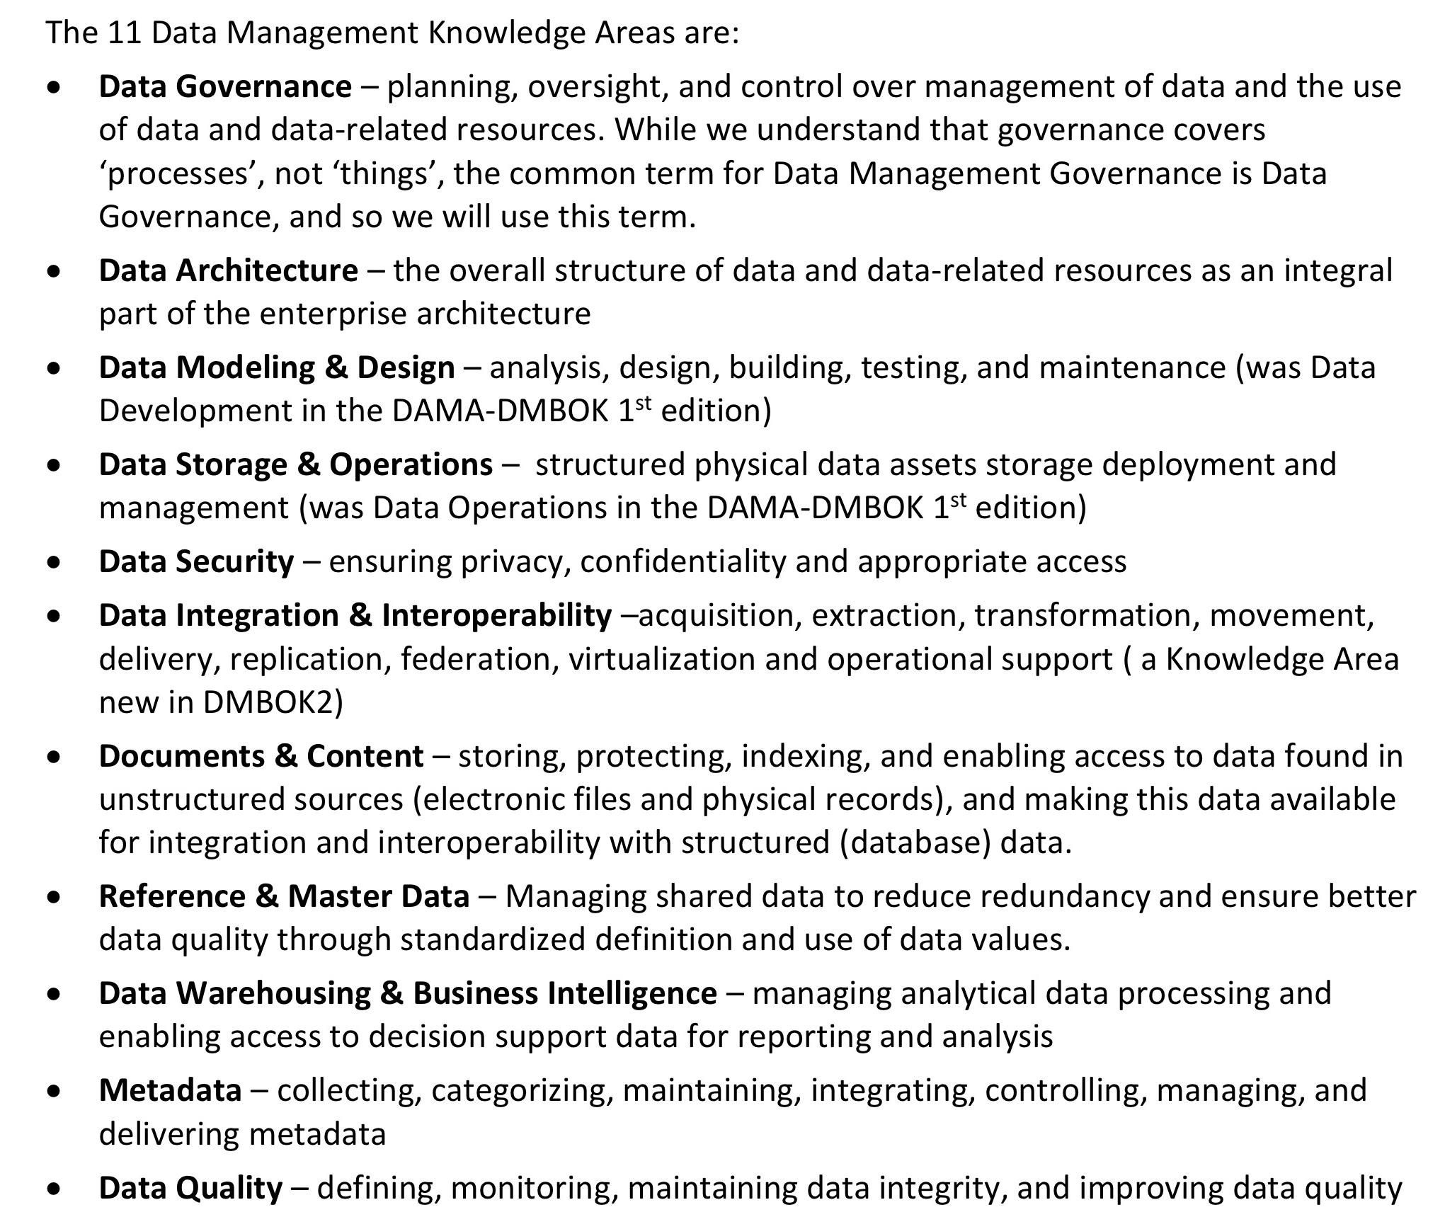
11 Knowledge Areas of Data Management
(DAMA International BOK 2014)

Slide 15
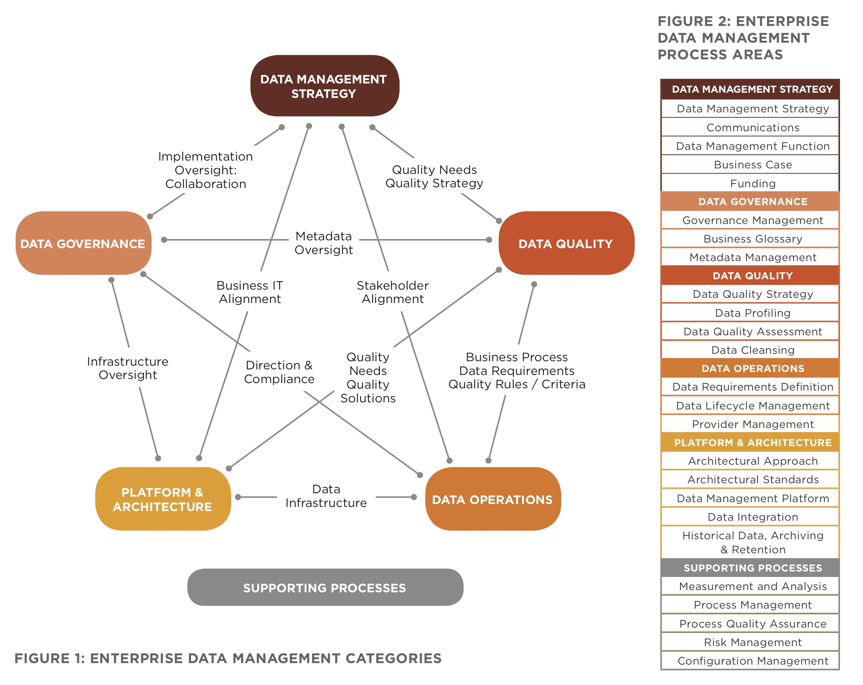
Categories of CMMI Data Management Maturity Model
(CMMI 2015)

Slide 16
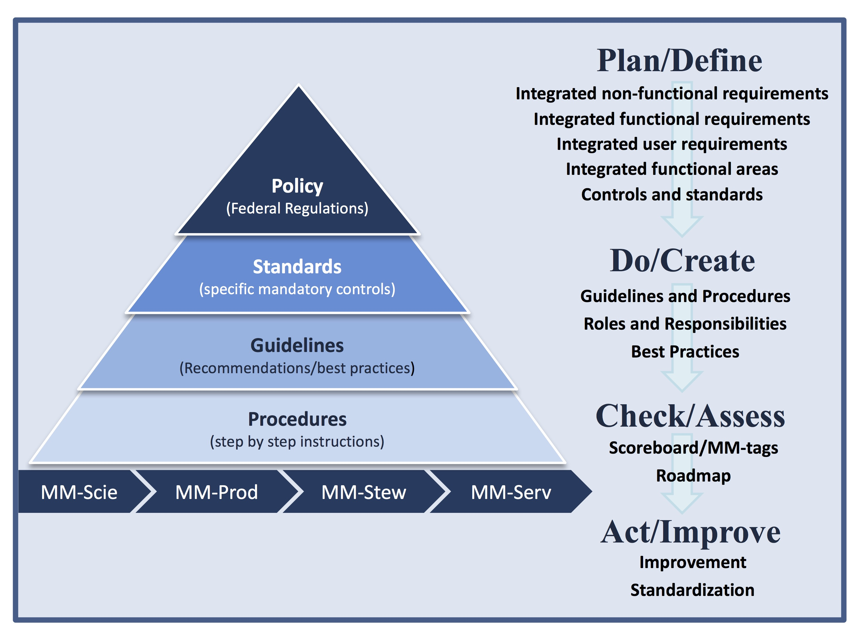
Enterprise Scientific Data Stewardship Framework
(Peng et al. 2018, Data Science Journal, submitted)

Slide 17
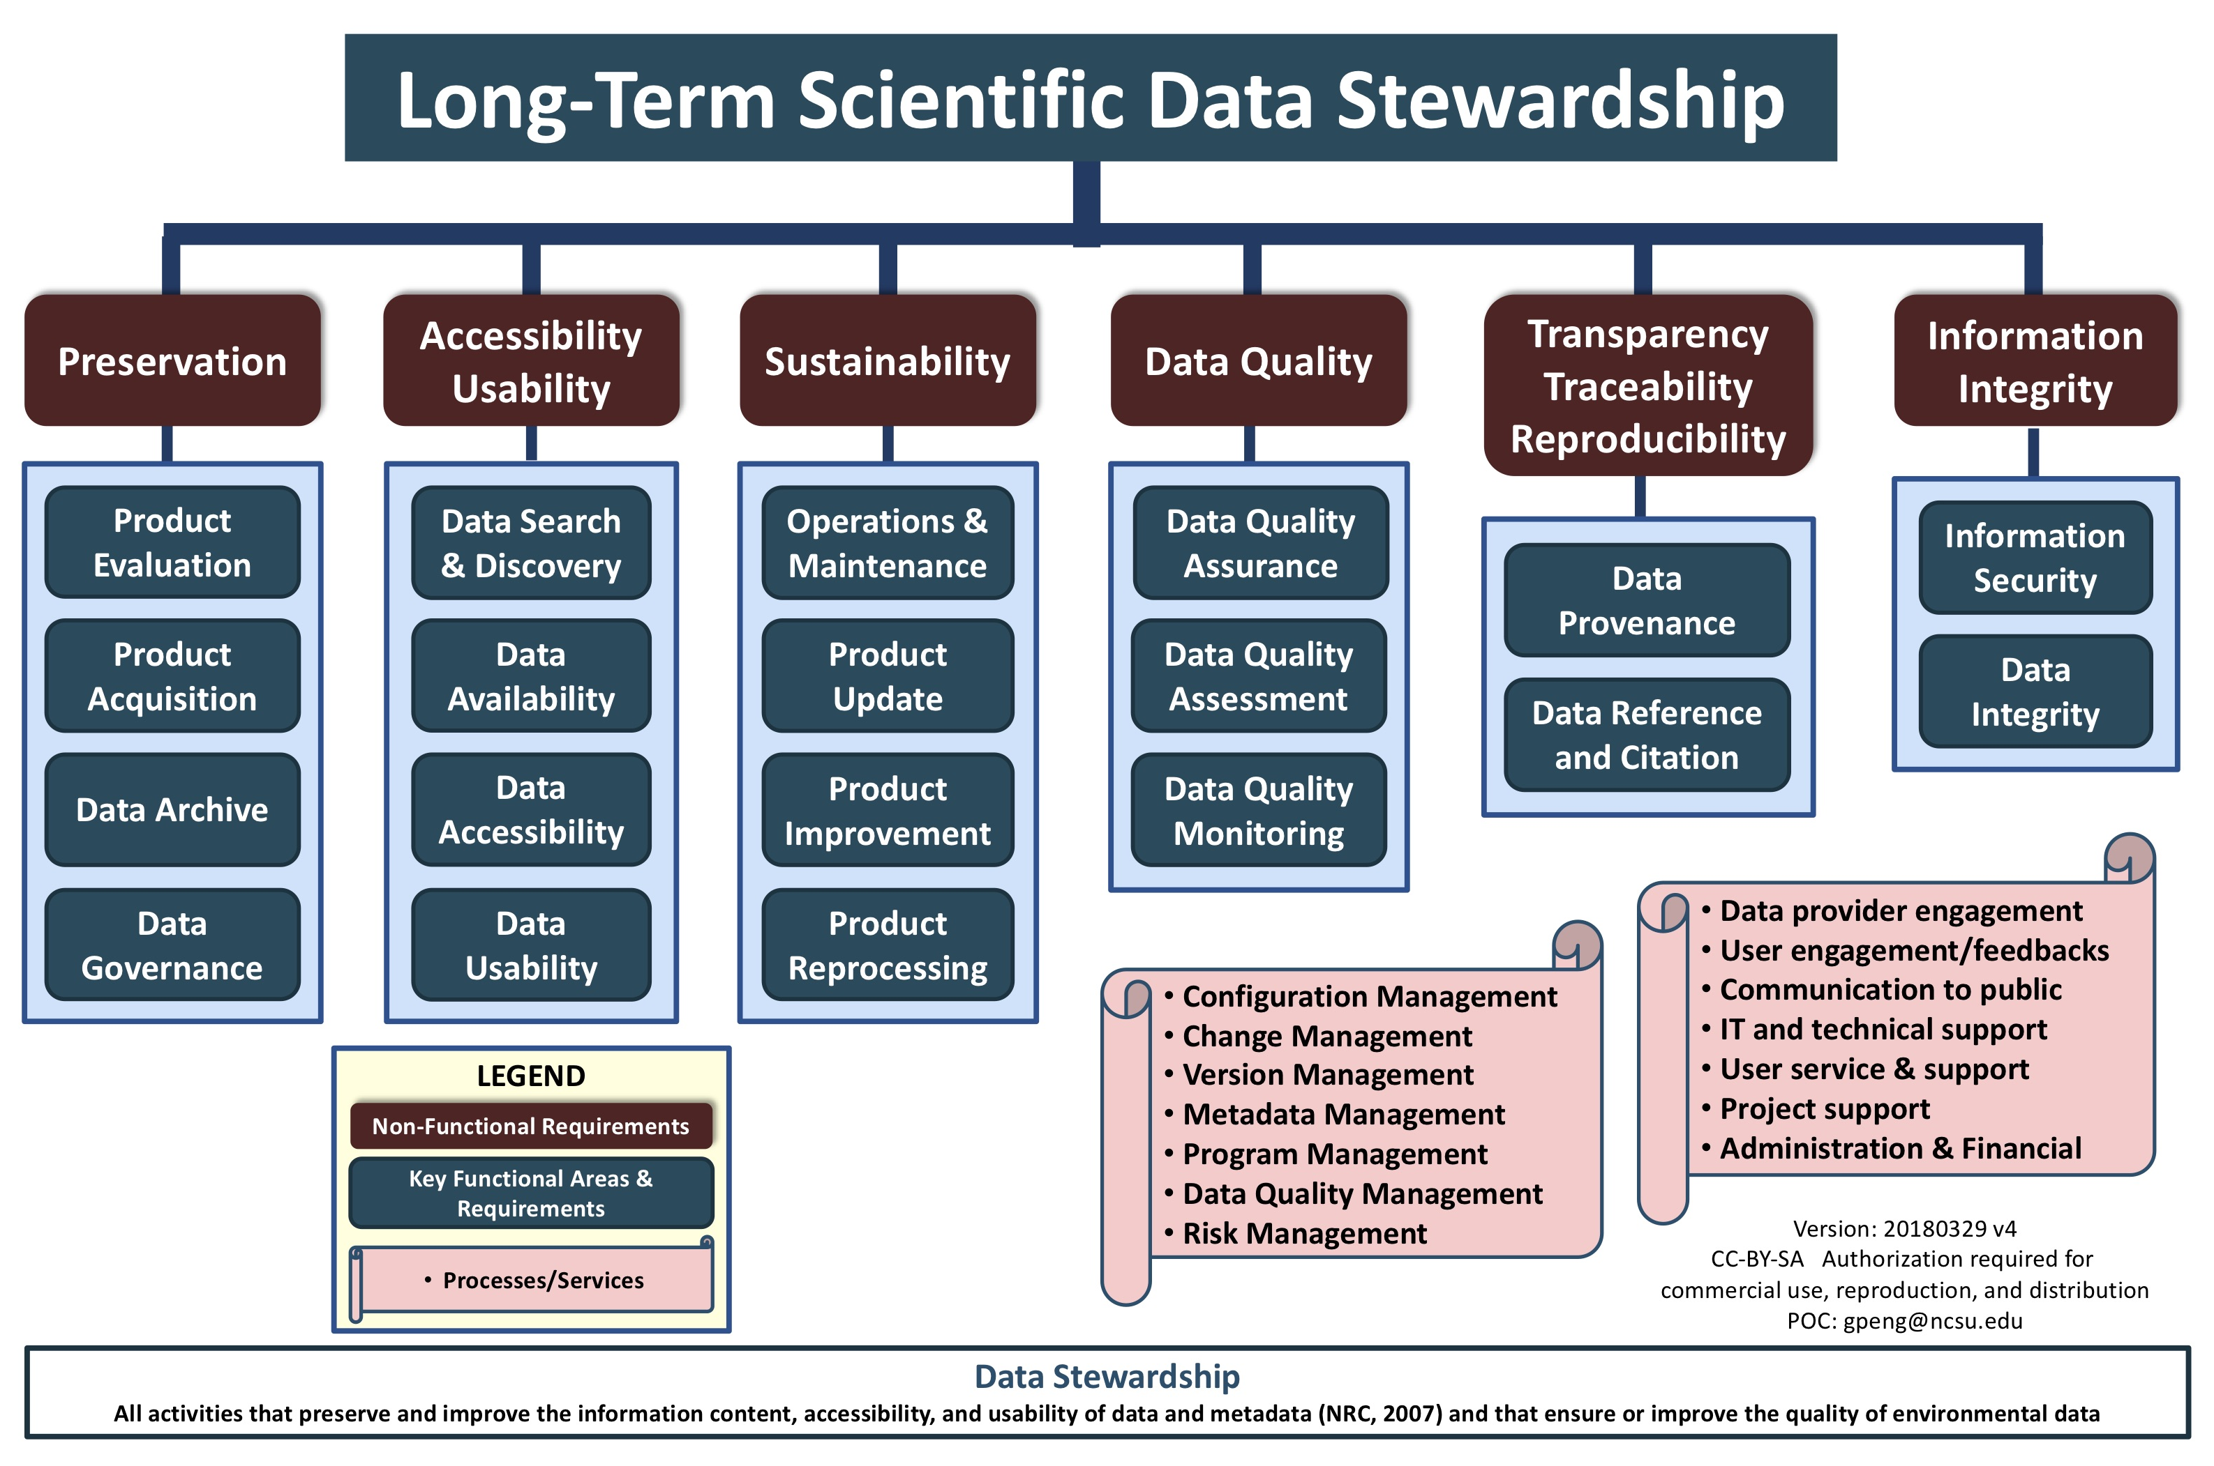
(https://www.slideshare.net/gepeng86/long-term-scientificdatastewardship20140226)

Slide 18
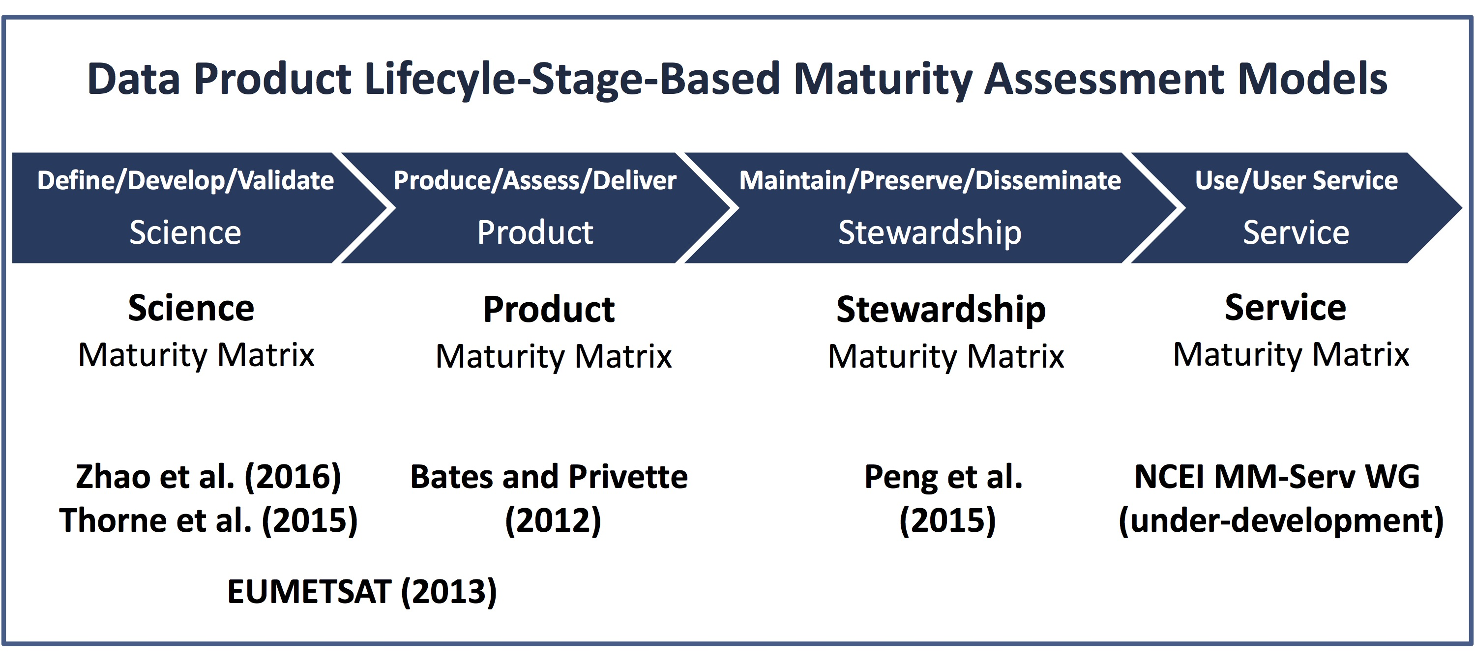
Overall quality of a data product tends to be dictated by the lowest quality from any stage of its entire life cycle!
(Peng 2018, Data Science Journal)
Notes:
See Peng (2018) for the references listed here.
It is important to take a holistic approach for managing information quality.

Slide 19
(Peng 2018, Data Science Journal)
An End-2-End, Consistent, Integrated Maturity Matrix Suite
A Consistent Measure of Product, Stewardship, and Service Quality
Notes:
See Peng (2018) for the references listed here. Product in the last includes science.

Slide 20
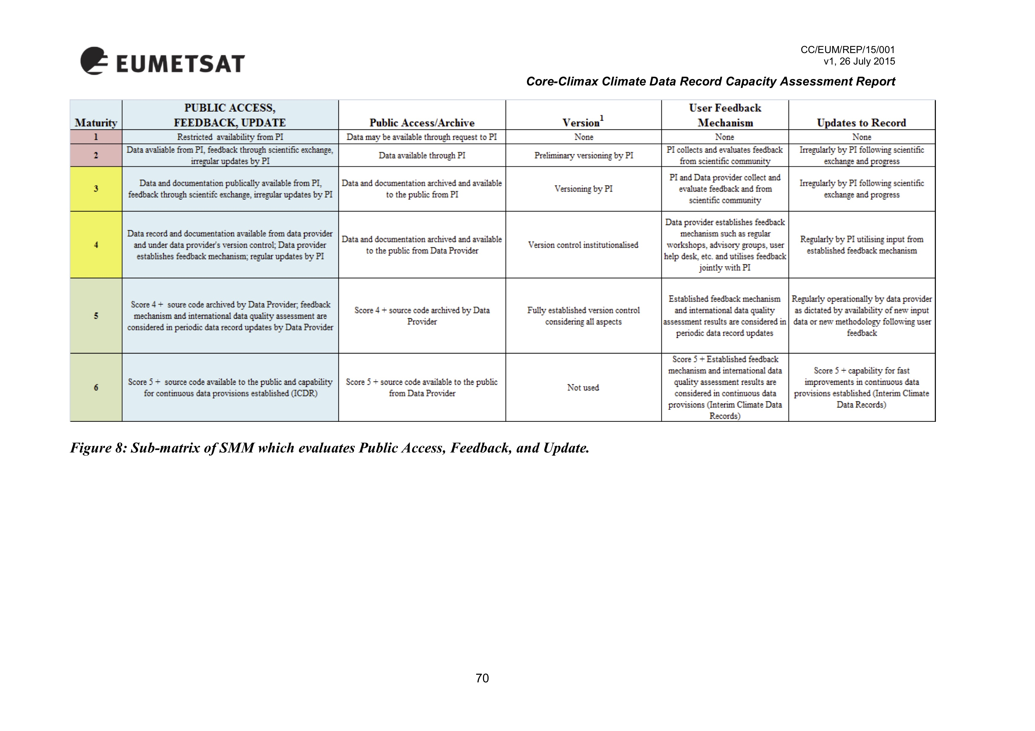
CORE-CLIMAX Production SMM
NCEI/CICS-NC DSMM
Maturity Scale | Accessibility
Level 1 – Ad Hoc Not Managed | Not publicly available Person-to-person
Level 2 - Minimal Managed Limited | Publicly available Direct file download (e.g., via anonymous FTP server) Collection/dataset level searchable
Level 3 - Intermediate Managed Defined, Partially Implemented | Level 2 + Non-standard data service Limited data server performance Granule/file level searchable Limited search metrics
Level 4 - Advanced Managed Well-Defined, Fully Implemented | Level 3 + Community-standard data services Enhanced data server performance Conforming to community search metrics Dissemination report metrics defined and implemented internally
Level 5 - Optimal Level 4 + Measured , Controlled , Audit | Level 4 + Dissemination reports available online Future technology and standard changes planned

Slide 21


