Slide 1
Marine Data Sets
Lydia Gates, DWD on behalf of the community

Slide 2
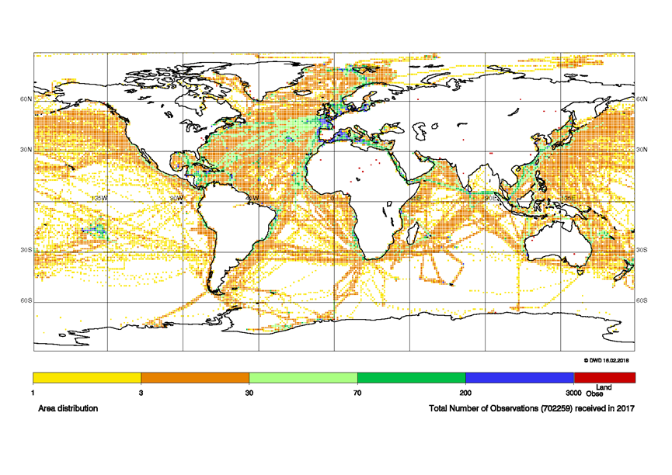
Voluntary Observing Ships in 2017 – Global Coverage
Both GCCs act as WMO Information System (WIS) Data Collection & Production Centres (DCPCs) and are able to provide 25.6 million MQCS-checked and flagged observations received by the GCCs. All data, original and MQC-checked, are available on the German WIS Global Information System Centre (GISC) http://gisc.dwd.de/GISC_DWD/toSimpleSearch.do.

Slide 3
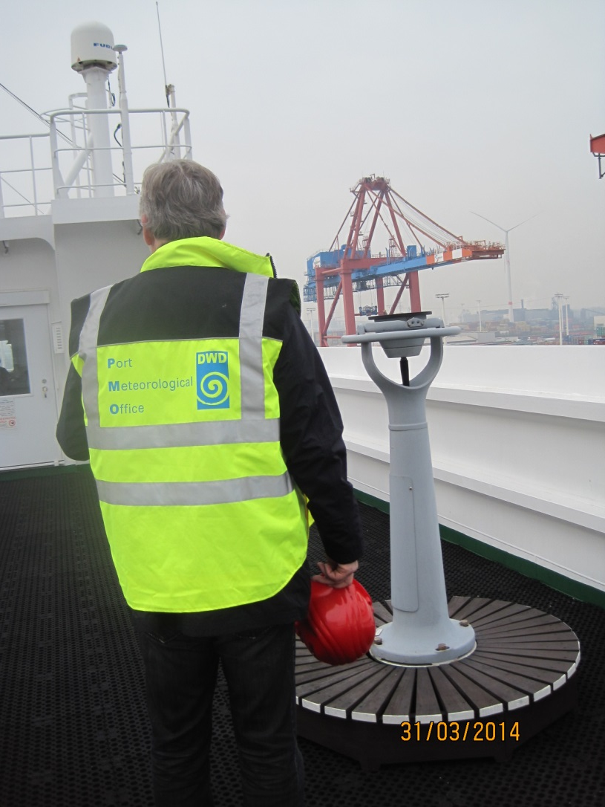
Interdisciplinary nature of observations

Slide 4
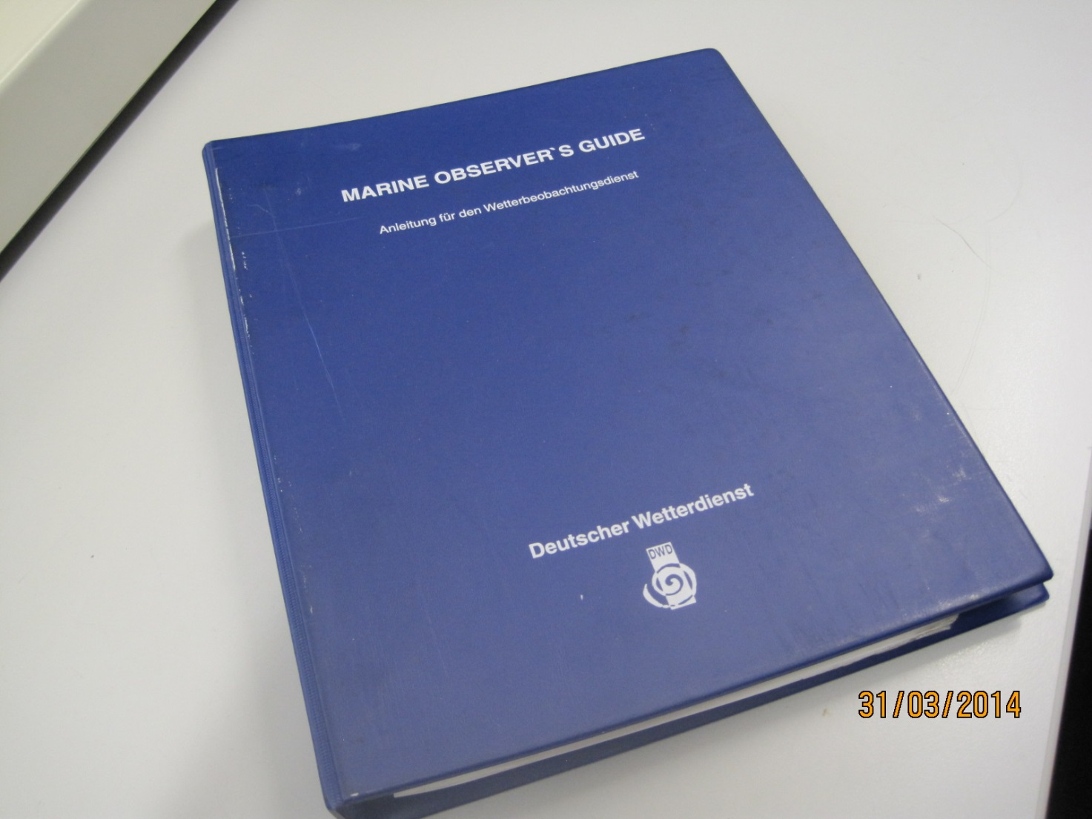
National and international standards and meta-data

Slide 5
Joint WMO-IOC Technical Commission for Oceanography and Marine Meteorology
JCOMM
Safety of life and property at sea and coastal areas
Resilience and preparedness
Disaster risk reduction
Climate research and services
Operational services
Growth of a sustainable ocean economy
Integrated met-ocean data of known accuracy
Dissemination platforms
Operational forecasting system
Data Management, inter-operability

Slide 6
JCOMM-5, 2017
10-Year Vision
(To be approved during inter-sessional period)
The JCOMM solution lies in meeting the user requirements through international cooperation.
Strategic Goals
Observations
Data Management
Services, Forecasting System
Standards and Best Practices
Coordination, Collaboration and Strategy

Slide 7
Marine Climate Data System
SETTING UP AND POPULATING THE MCDS
A well formed MCDS enables JCOMM to establish a much needed operational international path for acquisition and for sharing of relevant public access delayed-mode global marine meteorological and oceanographic data leveraging existing tested resources.
NODC = IODE National Oceanographic Data Centre
SODC = IODE Specialized Ocean Data Centre
ODIN = Ocean Data and Information Networks
GRA = GOOS Regional Alliances
MM = Marine Meteorological
DM = Delayed-mode data
RT = Real-time data
DAC = Data Acquisition Centre
GDAC = Global Data Assembly Centre
CMOC = Centre for Marine Meteorological and Oceanographic Climate Data
QC = Quality Control
Notes:
Points:
Three partitions for DAC, GDAC representing IODE, WMO, and other present pathways
Simplified version discussed in following slides

Slide 8
New CMOCs
  Limited number of CMOC data management areas proposed (6 to 10 total):
    CMOC-China (drifting buoy data/metadata); Already in operation
    CMOC-World Ocean Database (CMOC-WOD); profile oceanographic observations; Evaluation completed, approval from JCOMM-5
    CMOC-International Comprehensive Ocean Atmosphere Data Set (ICOADS); Surface marine observations; Candidate
    Other Candidates:
      Sea Ice
      Plankton
      Ocean Currents
      ?

Slide 9
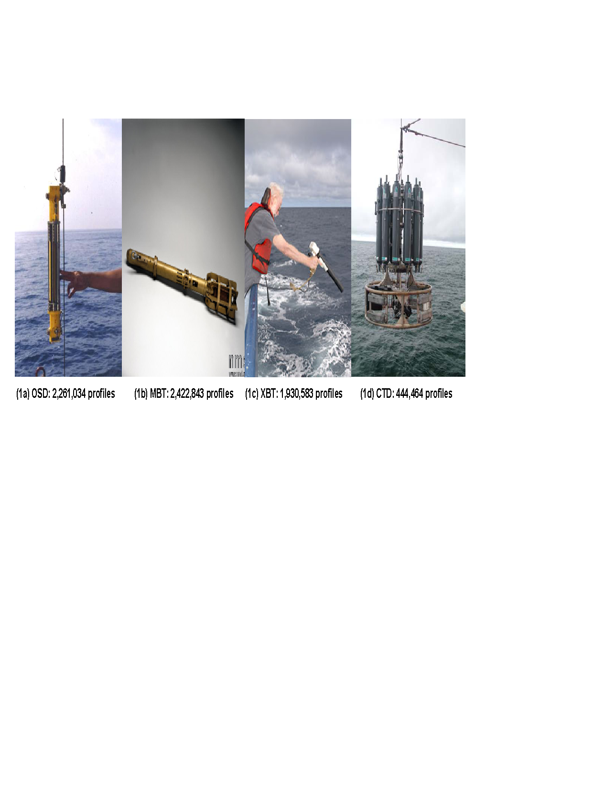
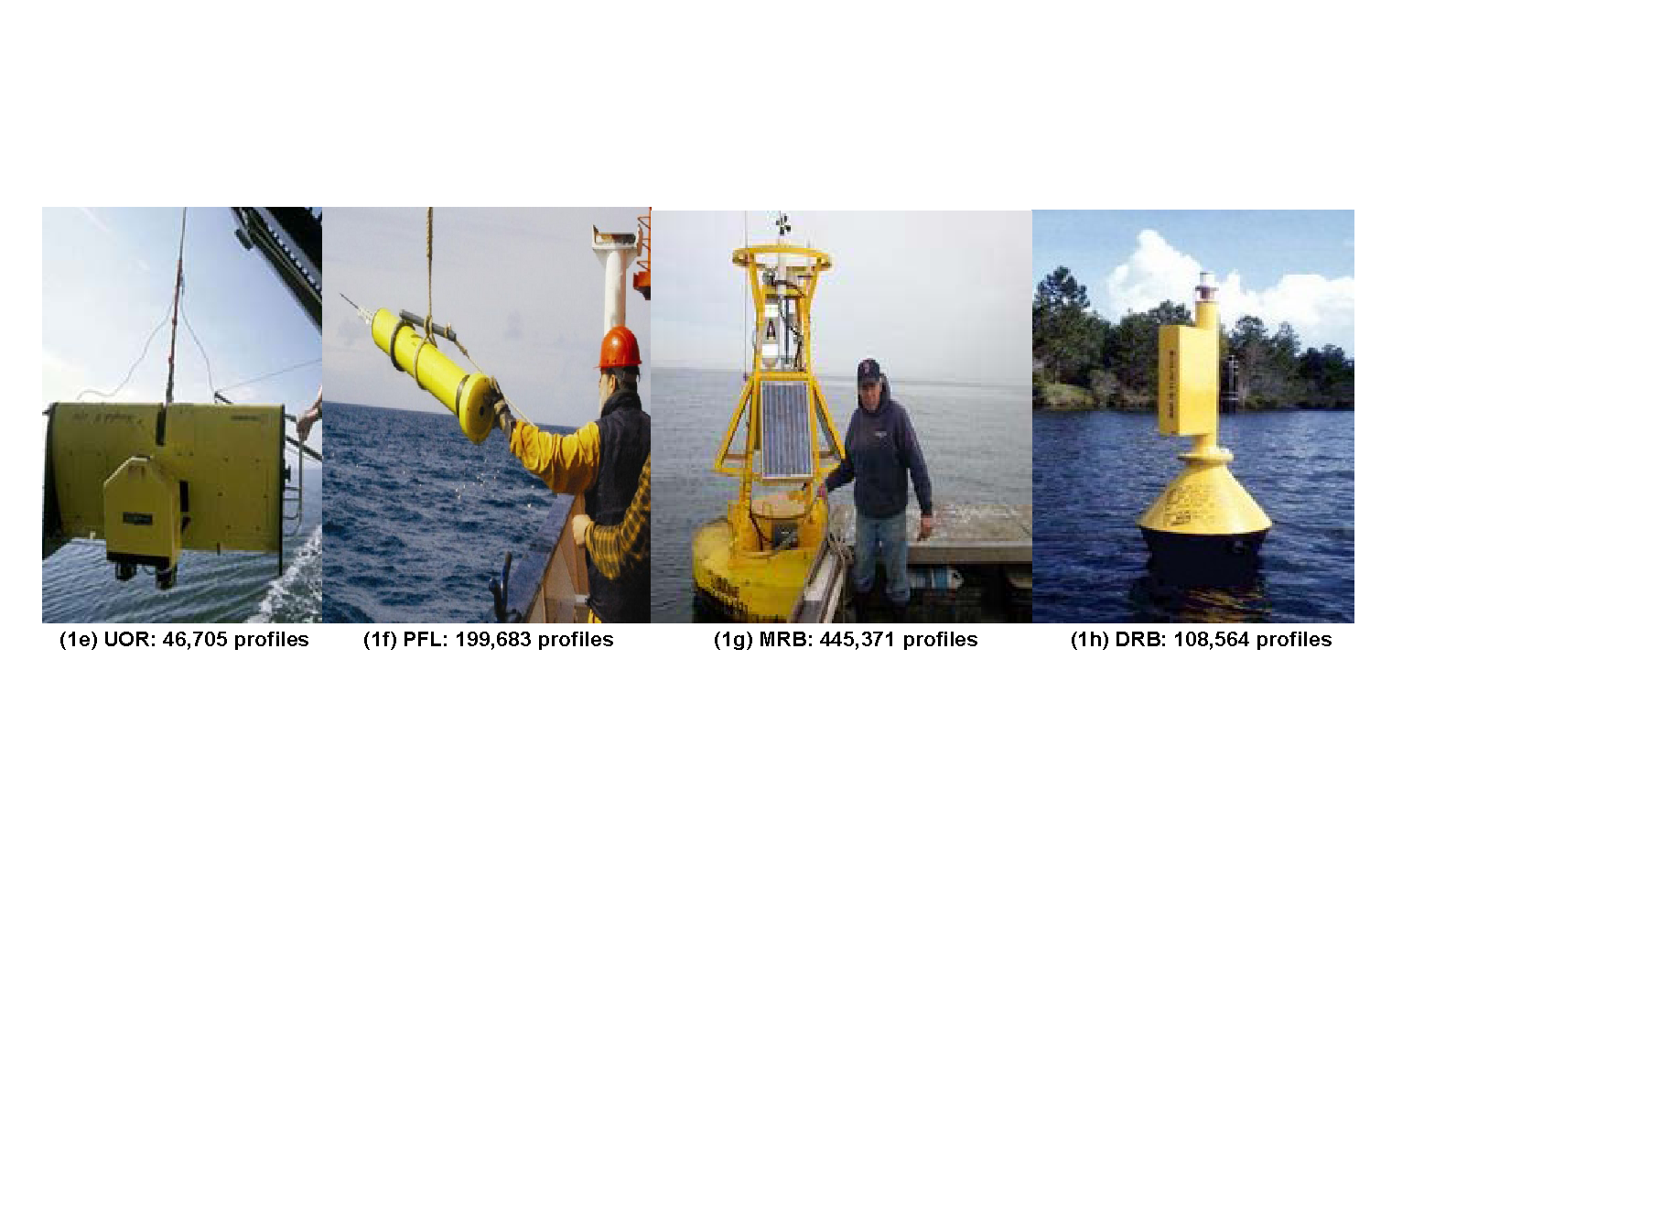
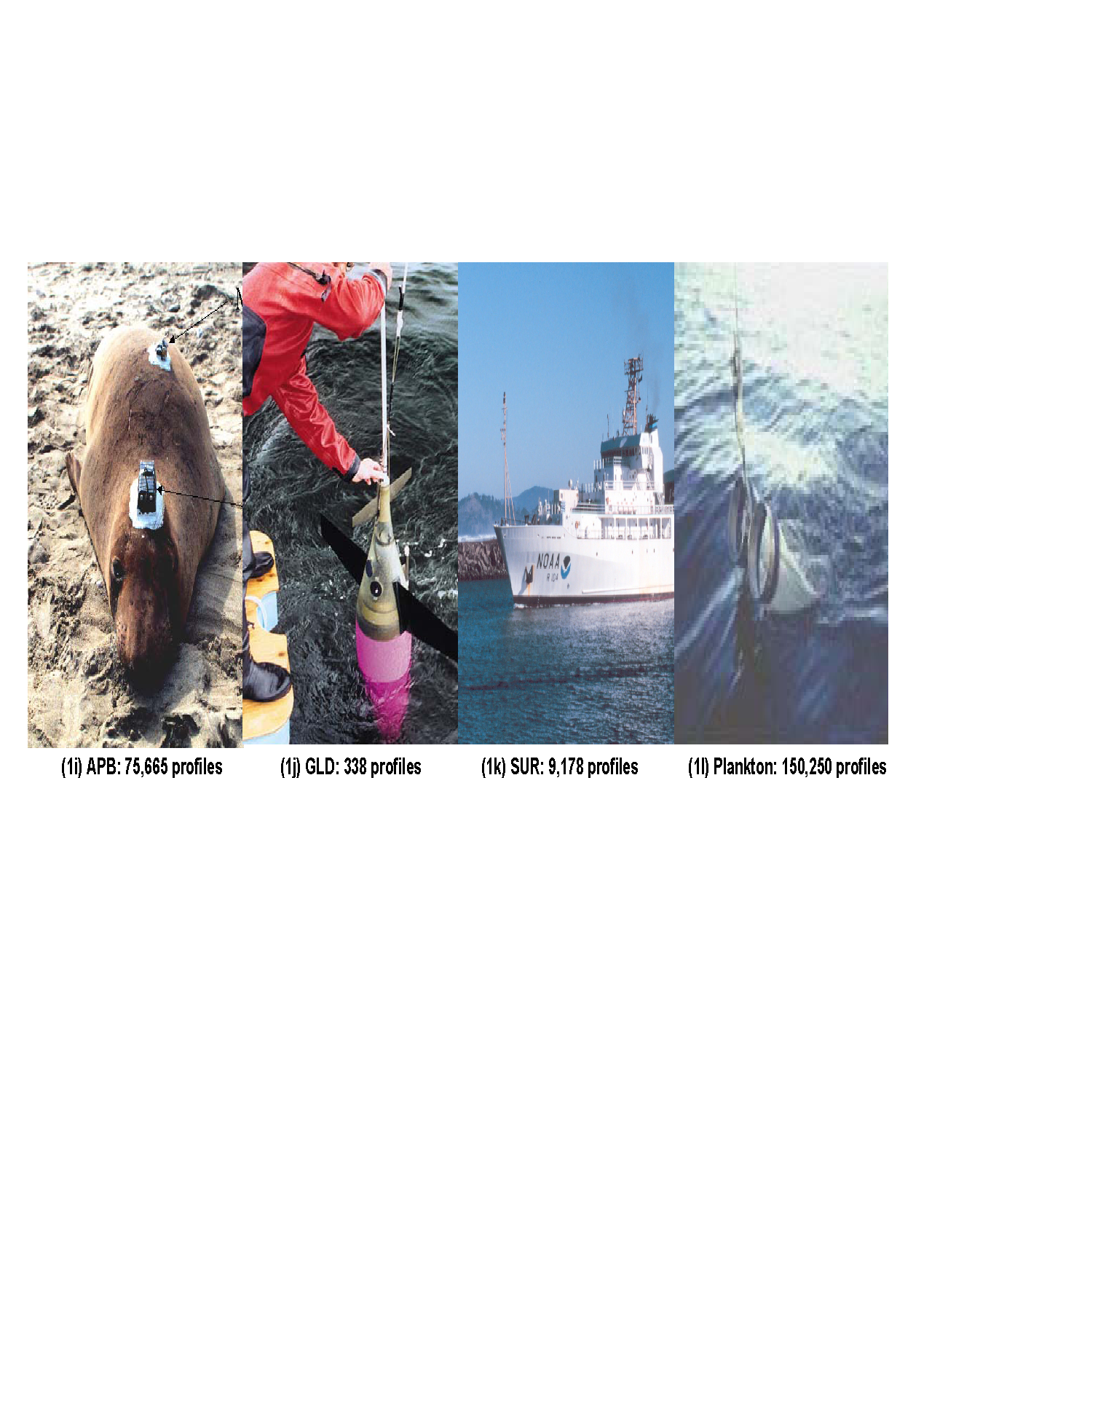
CMOC World Ocean Database: World’s largest publicly
available oceanographic profile database
Notes:
Points: (1) Many instruments, many reasons for measuring.
(2) Profiling floats (Argo) main purpose measuring changes in ocean physical state globally. Main subsurface ocean observing system now.
(3) Expendable Bathythermograph (XBT) – main observing system 1970s to early 2000s.

Slide 10
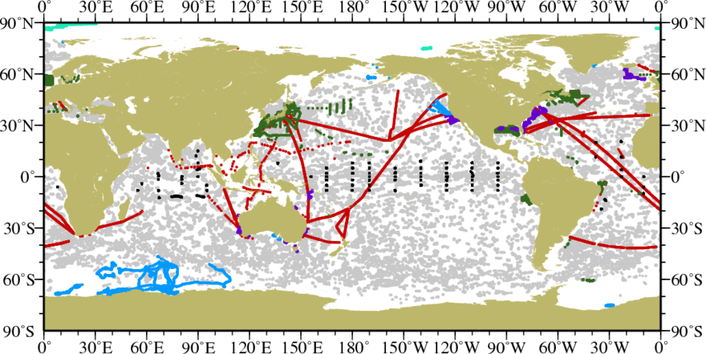
Grey - Argo cycles
Dark Green - CTD casts
Purple - Glider dives
Black - moored buoy series
Red - XBT drops
Blue - pinniped dives
Light Green - Ice Tethered profilers
Apr. – Jun. 2017 subsurface data input to WOD
CMOC pulls all relevant data streams together:
WOD as ocean profile CMOC

Slide 11
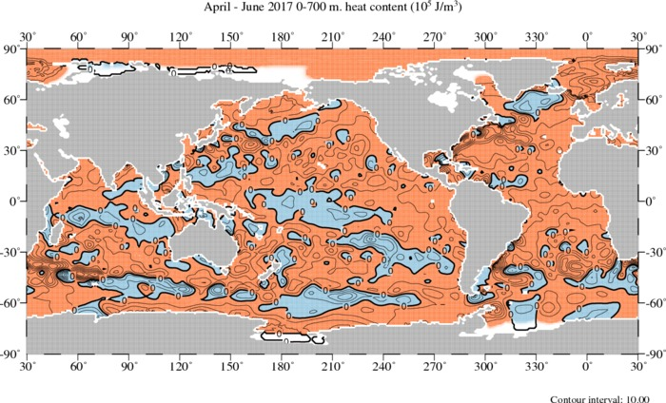
CMOC ALSO PROVIDES CLIMATE PRODUCTS:
WOD OCEAN HEAT CONTENT
Quarterly Heat Content (+ temperature/salinity anomalies/steric sea level) out to users. Above Apr. – Jun. 2017 Heat Content anomaly
Blue=below long term average (1955-2006)
Red = above long term average (1955-2006), Units= 10⁵ joules/m³

Slide 12
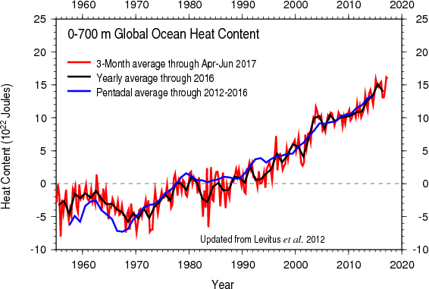
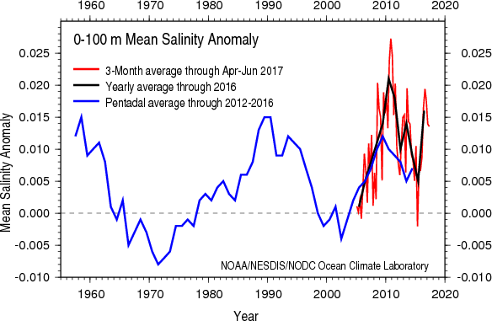
CMOC CONTRIBUTES TO ASSESSMENT AND OCEAN KNOWLEDGE

Slide 13
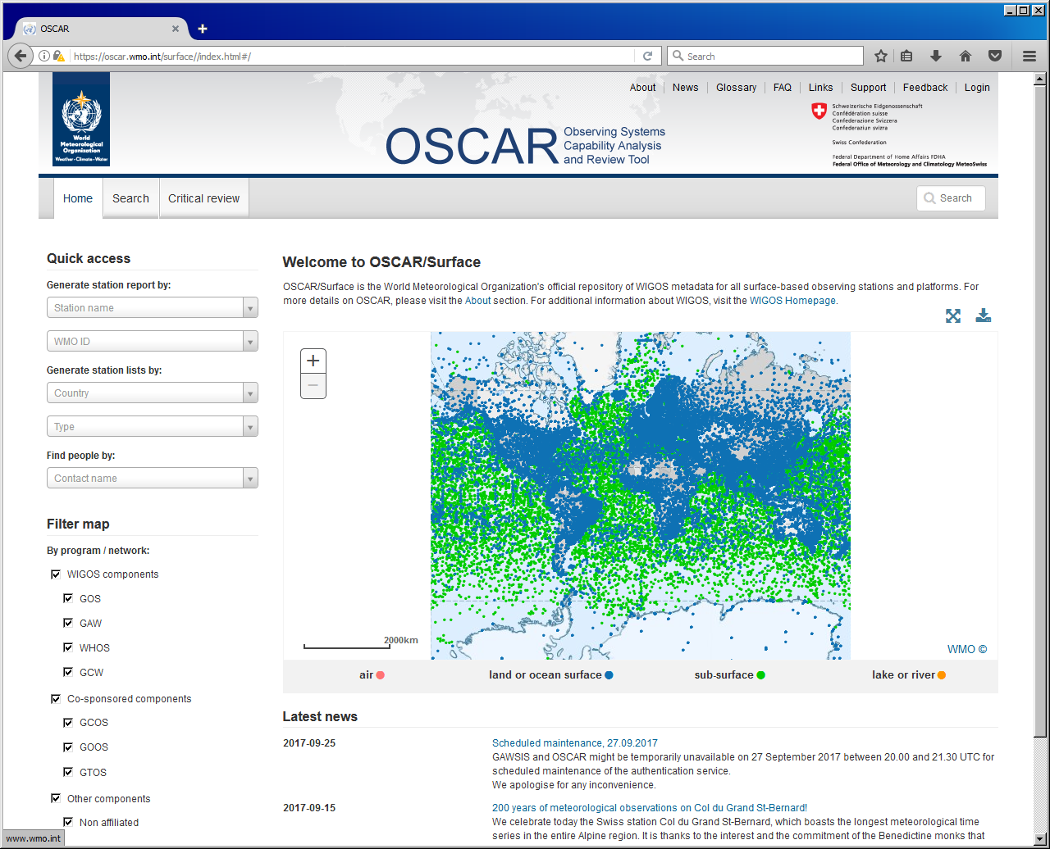
OBSERVING SYSTEM INPUT: WMO INTEGRATED GLOBAL OBSERVING SYSTEM (WIGOS)
Overarching system for identifying observations vital to MCDS
Sets of standards for form, metadata, quality control.
Not comprehensive for climate data. Many other data sources
A mechanism for data identification, not data flow.
Should work closely with MCDS for the enhancement of both
http://oscar.wmo.int/surface

Slide 14
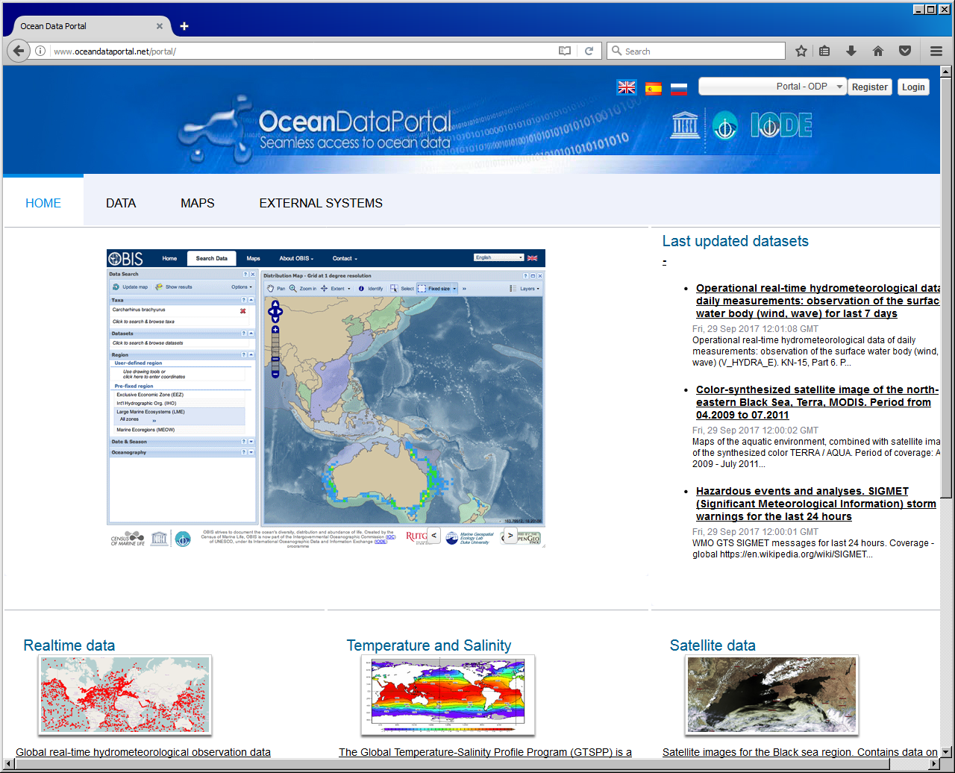
DATA DISCOVERY: JCOMM INTERFACE
WMO INFORMATION SYSTEM (WIS) – STANDARD METADATA NEEDED FROM MCDS FOR DISCOVERABILITY
IOC OCEAN DATA PORTAL (ODP) – STANDARD METADATA NEEDED FROM MCDS FOR DISCOVERABILITY
INFORMATION CAN COME FROM GDAC BUT NOT REQUIRED
INFORMATION MUST BE MADE AVAILABLE FROM CMOC - REQUIRED
http://www.oceandataportal.net/portal/
Notes:
Points: (1) WIS and ODP are data discovery mechanisms. The data will still be acquired through the MCDS

Slide 15
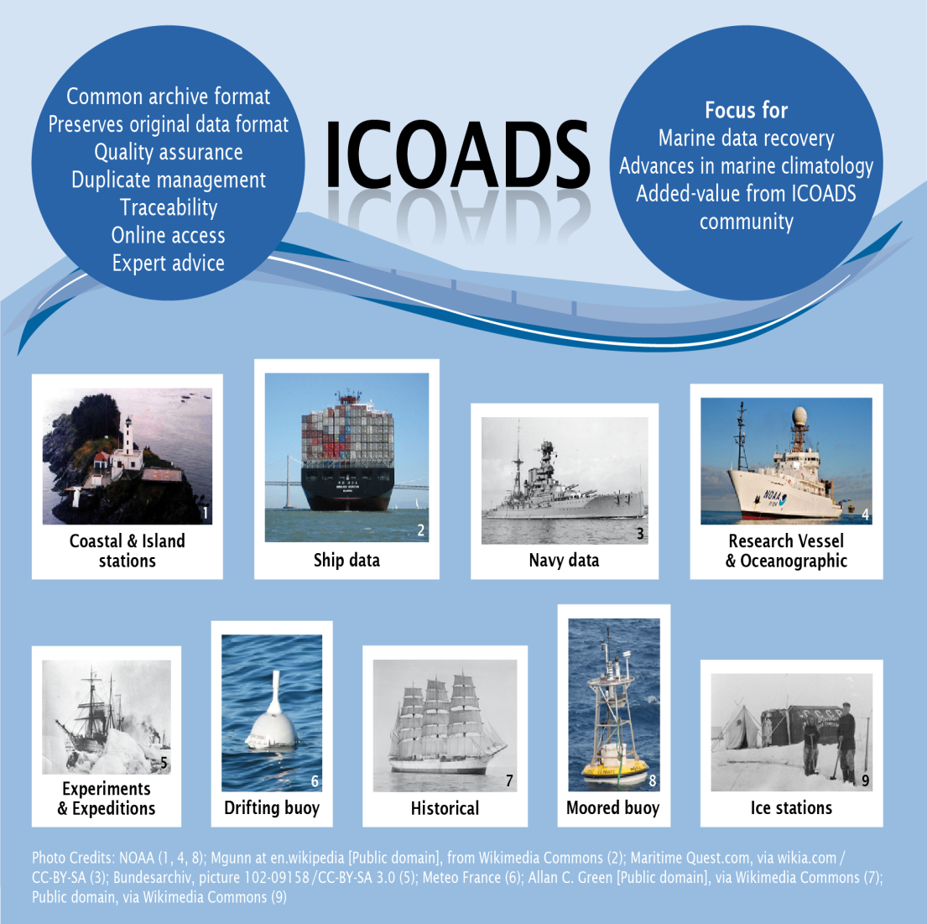
International Comprehensive Ocean-Atmosphere Data Set
Graphics: DWD partner contribution

Slide 16
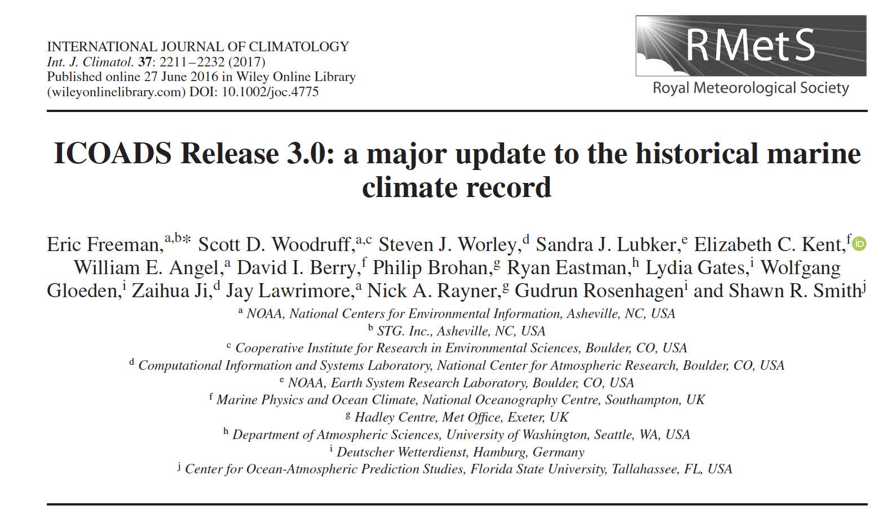
What is ICOADS?
ICOADS is the most extensive freely available archive of global surface marine data
  over 455 million individual marine reports
  observations and metadata reported from a given ship, buoy, coastal platform, or oceanographic instrument.
  common open access point
  version control

Slide 17
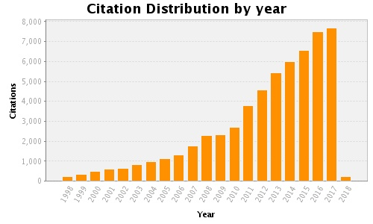
Who uses ICOADS?
ICOADS-based data services
Google BigQuery Cloud Platform
NASA Distributed Oceanographic Matchup Service
IVAD
Future: Copernicus Climate Data Store
Dataset developers – gridded analyses include:
  ERSST, currently v5
  HadNMAT2, used to bias-adjust ERSST
  NOAA OISST
  COBE-SST2
  HadISST1/2, HadSST3/4
Quality monitoring: iQUAM
Reanalysis producers including:
  ERA-Interim, ERA5, CERA-20C
  NOAA-CIRES 20th Century Reanalysis
  NCEP/NCAR Reanalysis I; NCEP/DOE Reanalysis II; NCEP NARR
  NCEP CFSR
  JRA-55
  NASA MERRA/2
Satellite product developers (use IVAD)
  NOAA-ESRL
  NASA
International, national and regional climate assessments
  IPCC, BAMS State of the Climate, etc.
> 7500 citations in 2017

Slide 18
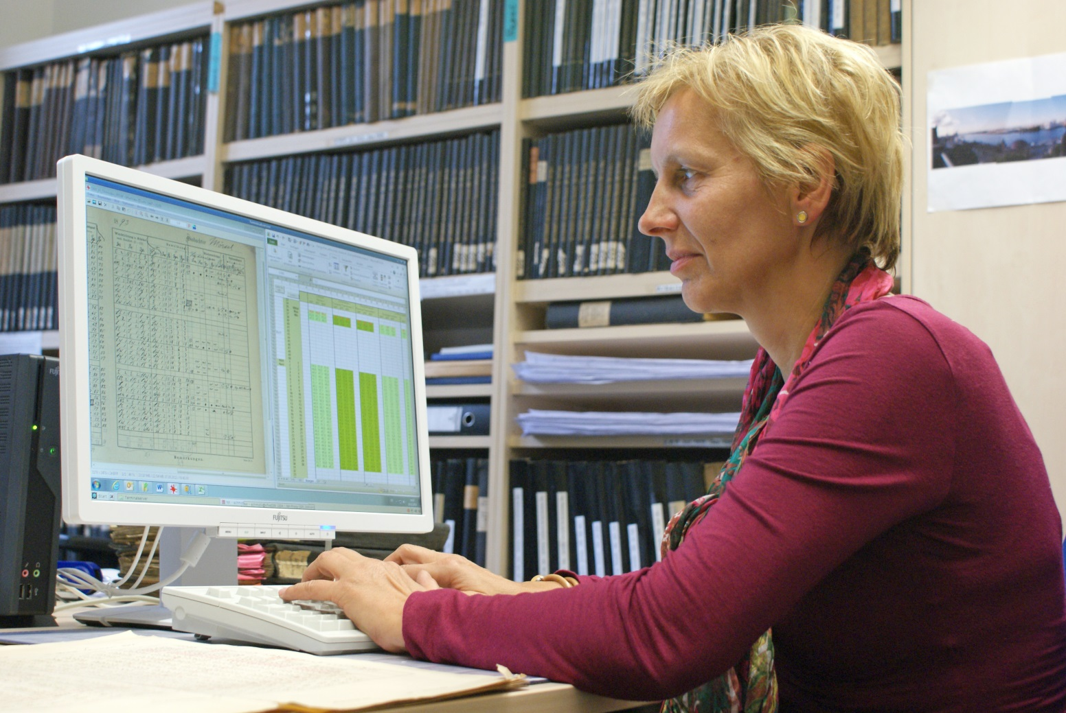
Legacy issues - from paper to server and retention rules

Slide 19
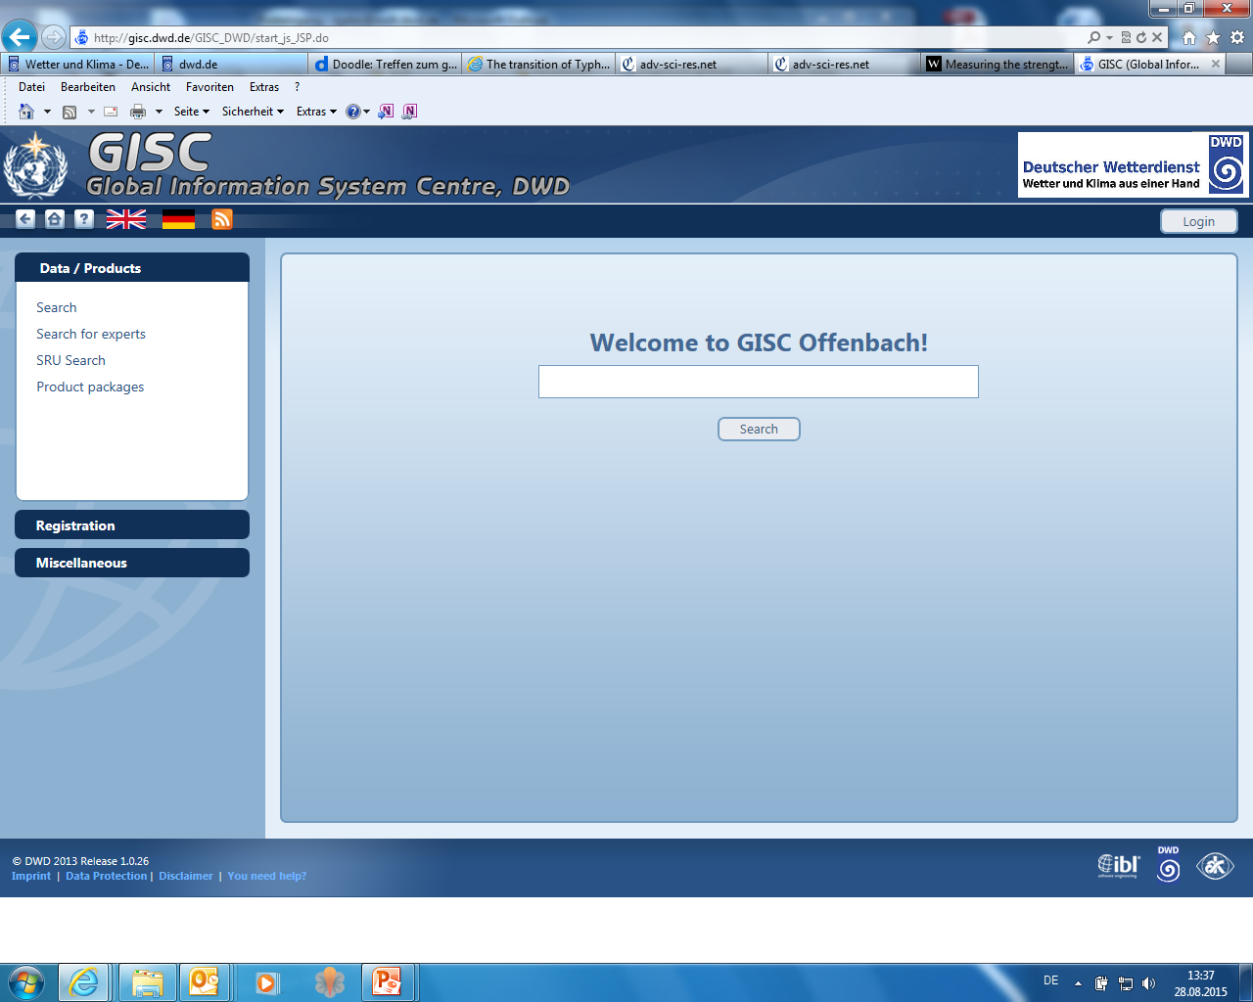
User access

Slide 20
GISC Global Information System Centre, DWD
  All data collected by the GCCs (Global Collecting Centres) are available at the WIS (WMO Information System) DCPC (Data Collection or Production Centre)
  German GISC (Global Information System Centre):
  http://gisc.dwd.de/GISC_DWD/

Slide 21
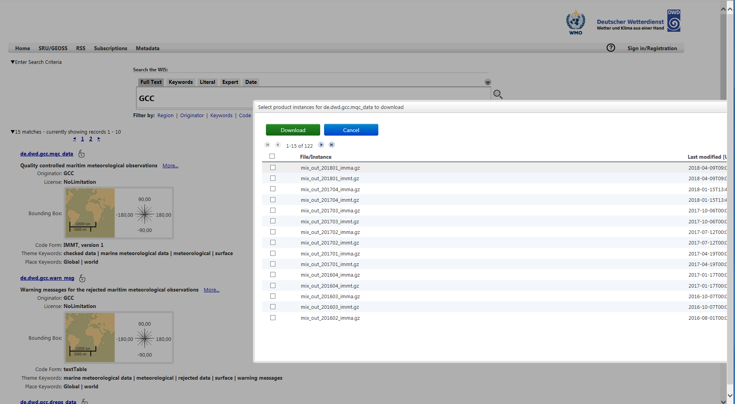

Slide 22
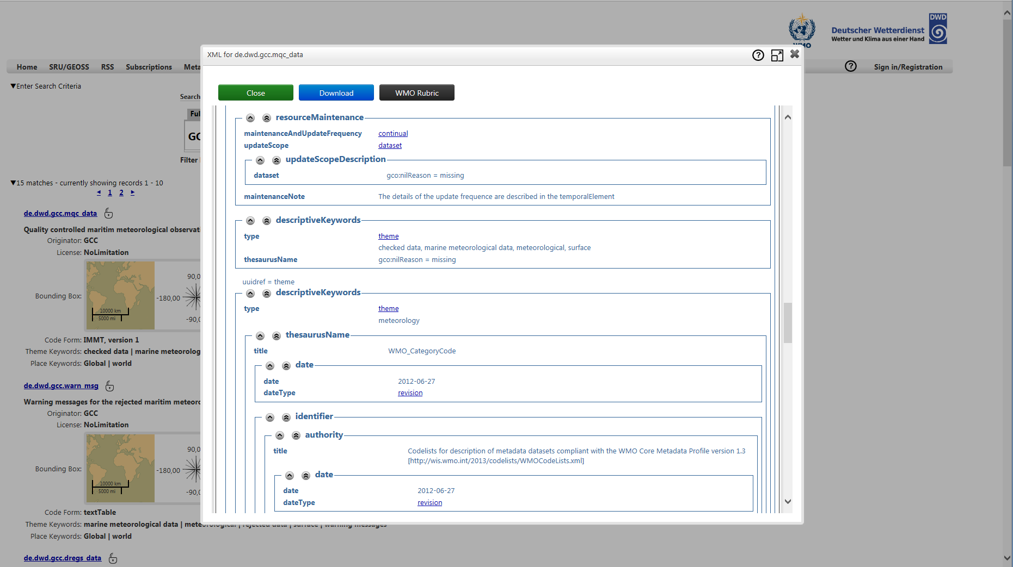

Slide 23
Feedback from the Community:
CLIMAR/MARCDAT Workshops
  Series of alternating and closely related workshops:
    JCOMM Workshop on Advances in Marine Climatology (CLIMAR): 1999, 2003, 2008, 2014
    Advances in the Use of Historical Marine Climate Data (MARCDAT): 2002, 2005, 2011, 2016
  Workshop Goals:
    review on-going developments in marine (oceanographic and meteorological) climatology, ranging from data management and governance practices to the exploitation of climate datasets and generation of products
  JCOMM-5 approved: CLIMAR-5 in to be held in Hamburg, 2019
    Data management is a major topic
    MCDS will be discussed

