Slide 1
Towards a process for identifying "trusted" datasets for climate purposes
Dr William J Wright
Australian Bureau of Meteorology
and
Co-chair Focus Area 1 of the Commission for Climatology
william.wright@bom.gov.au

Slide 2
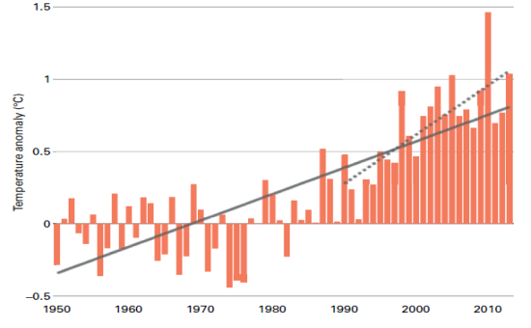
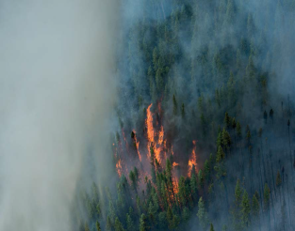
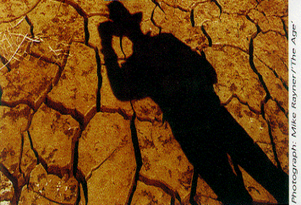
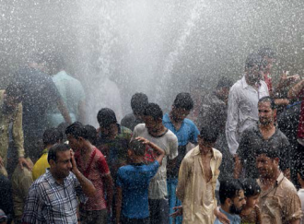
Introduction
Climate data supports many climate services that:
- help us track climate variability & change;
- help mitigate adverse effects of climate variability & change;
- help inform decision-making in climate-sensitive industries (agriculture, disaster relief, water resource planning etc)

Slide 3
What makes a high quality dataset?
To achieve these aims, the products and services must be underpinned by high quality, reliable data. Requirements:
Datasets must be
As long as possible (> 30 yrs), and accessible in digital forms;
As far as possible complete;
Properly quality controlled, with confidence assessments;
As far as possible free of spurious discontinuities and trends (requiring attention to observing practices);
Accompanied by adequate metadata and complete documentation of lineage.
The above are necessary but not sufficient. Stringent attention must be paid to management of data and metadata

Slide 4
...Cont'd
The dataset must be well-managed, sustainably
Question: what does this mean, and how do we measure it?
Quantitative measure to assess data management capability via maturity matrix approach. To be described later.
The work we will undertake is a multi-disciplinary endeavour, with a focus on climate-relevant outcomes (Note: "climate" refers to time-series of any meteorological/marine/hydrological/etc variable)
Notes:
DP 3: As will be explained later, we can quantitatively assign a measure of adequacy, or "maturity" against a number of criteria of good data management. This is the so-called Maturity Matrix approach.

Slide 5
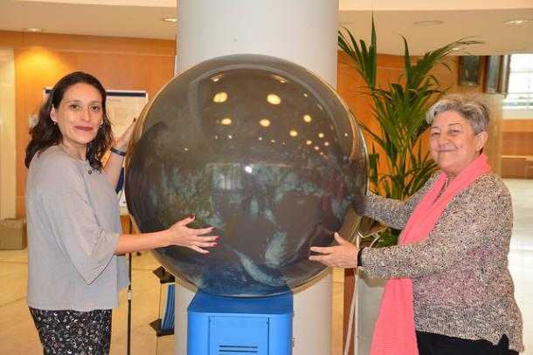
Where does this fit in with WMO Climate activities?
CCl meeting 10-13 Apr 2018 set workplans and structure for 2018-22.
Data-related focus is in FA 1: Climate Monitoring, Data and Assessment
FA 1 teams will cover:
- Reference Climate Networks & non- NMHS data;
Data Development & Stewardship;
Data Rescue & Management;
Data Exchange (new message formats; overcoming obstacles to Open Data)

Slide 6
Terms of Reference for Data Development and Stewardship Team
(a) Review and provide guidance on best practices, tools and training on QC, homogenization, uncertainty, traceability and maturity of climate data (including in-situ and remote sensed);
(b) Develop, maintain and update a catalogue of trusted mature climate data sets;
(c) Provide guidance on climate time-series maturity, including their homogenization requirements as a contribution to ongoing efforts for establishing global land surface climate fiducial reference network;
(d) Provide guidance for and monitor the provision of global datasets that are required for international exchange (i.e. Climate Normals, WWRs, CLIMAT, Daily CLIMAT);
(e) Collaborate with other programs on unified approach for managing data in support of climate activities and services building on IPET-CDMP legacy and the emerging new WIS concepts (WIS2.0).
Notes:
DP 2: The crossing out of "trusted" is in response to an intervention by the UK delegation at CCl, who wanted to be more explicit about what "Trusted" actually means, which was OK by me. However we will continue to utilise the concept of "Trusted" in our work.

Slide 7
HQ-GDMFC is A Multi-Disciplinary Climate Data Modernisation Initiative
Outcome: Making HQ Datasets available to users
–WMO HQ-GDMFC will identify high quality datasets and provide guidelines and best practices to improve climate data, such as harmonizing the Climatological Day definition, and management through WMO Technical Regulations.
–An internationally agreed Catalog providing a living list of high quality datasets will be developed and maintained under the auspices of WMO.
–This Data Catalog will be made available to users using the WIS and datasets will be easily discoverable and accessible though optimized search in main search engines.
“Not everything that can be counted counts, and not everything
that counts can be counted.” Albert Einstein
Notes:
The work of this group represents a nexus between the work of the IPET-CDMP, the TT-IM, and the CCl ET on Data Development And Stewardship

Slide 8
Aims of dataset project
The initial emphasis will be on international datasets, and will start with a relatively small number, as a "proof of concept"
The datasets will cover all the GCOS Essential Variables, and will emphasise at least daily time-scales (for tracking of extremes)
The Task Team – Information Management (TT-IM) has been tasked with developing a WMO-wide Maturity Matrix; at this meeting we have the opportunity to refine what has been developed so far, and apply it to selected climate datasets

Slide 9
A word on GCOS…..
GCOS identifies high quality datasets using methods that include peer-review processes.
These sets must provide, inter alia, evidence of conforming with the GCOS Monitoring Principles on the observing side.
The purpose of our Climate Datasets project is to ensure that the datasets are also well and sustainably managed.
Notes:
Noting that GCOS already defines a series of datasets that it considers high quality for especially climate monitoring applications, how does this initiative relate to the GCOS actions?

Slide 10
The story so far……
WW-IM (2017) defined characteristics of High Quality Datasets (which will form the "rows" of a Maturity Matrix), and TT-IM expanded on various aspects of these.
The Maturity Matrix model is not yet set in stone, although a proof of concept example from TT-IM was presented at the recent CBS TECO (including first cut at behaviours corresponding to capability levels)
Ms Christina Lief from IPET-CDMP developed an initial list of global data sets hosted by international data centres in USA, Europe and Asia, which are already used in climate activities, but still need to be assessed for their degree of maturity.
William Wright is leading the work on a reference Manual on High Quality Global Data Management Framework for Climate ( HQ-GDMFC), which aims at establishing a single source of standards and recommended practices for managing data in support of climate activities.

Slide 11
Intended outcomes of this CDM meeting
A Global Data set catalogue ( finalized)
WMO Convergence Maturity Model refined and applied to Climate Data Sets
WIS discovery Metadata requirements defined
Search requirements to ensure defined and tested datasets are prominently displayed

Slide 12

Thank you
Merci

Slide 14
Towards new technical regulations
(*May or may not use this slide)
Tech Regs can be phrased as shall (i.e. mandatory) or should.
Possible examples:
Members should ensure that their NMHSs develop and implement a migration strategy for their climate archive, and review it at regular intervals, to ensure currency and sustainability
Members shall allocate their NMHSs the necessary resources for the maintenance and sustainability of their climate record in a secure environment, including the acquisition of modern Climate Data Management Systems based on WMO specifications.

