Slide 1
Need for prominent discoverability of HQ Climate datasets, and use of WIS Infrastructure
Kate Roberts & Thorsten Busselberg
(BOM & WIS,Germany)
Thanks to all those who develop, produce and maintain datasets, metadata and data catalogues!

Slide 2
Overview
Discovery vehicles
Effective discovery
  User knowledge needed
  Metadata management needed
  Metadata dissemination needed
Use of WIS infrastructure
Indexing by Search Engines
Prominent discovery
  Within Data Catalogues (WIS ++)
  Within Search Engines
  Citation/References

Slide 3
Data Catalogue ecosystem
Data Catalogue ecosystem
Local Data Catalogue
    Metadata standards offered (DIF, FGDC, 19115)
    Formats / encodings (html, xml, json, etc)
Aggregator Data Catalogues
  WIS, GEOSS ++ (Thematic, Domain specific ),
  INSPIRE, Data.gov.uk, ANDS/RDA
  (National /Geographically-defined ++)
  WorldWideScience, DataCite (Research-focussed)
Directories of Data /Repository Catalogues
(RE3data, etc)

Slide 4
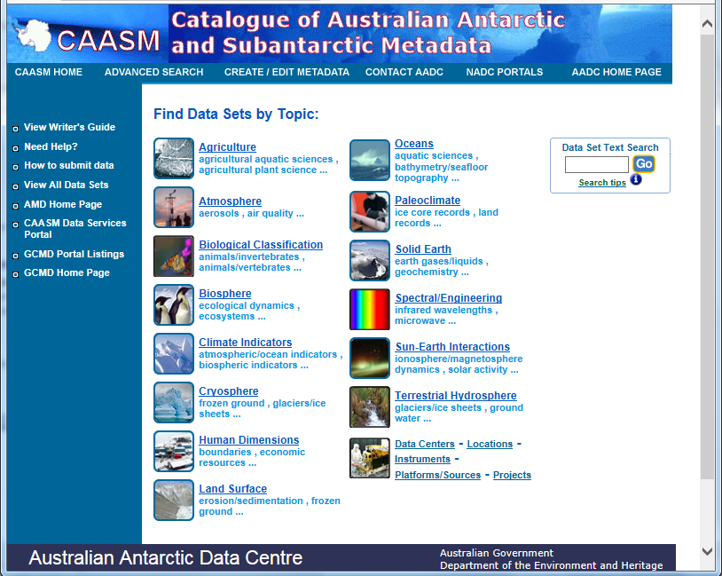
Data Catalogue ecosystem

Slide 5
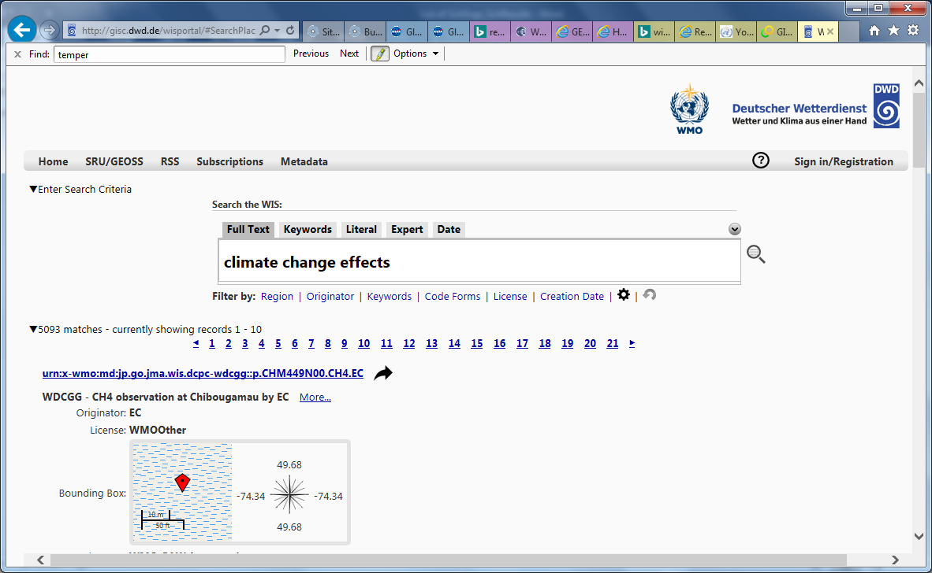
Data Catalogue ecosystem

Slide 6
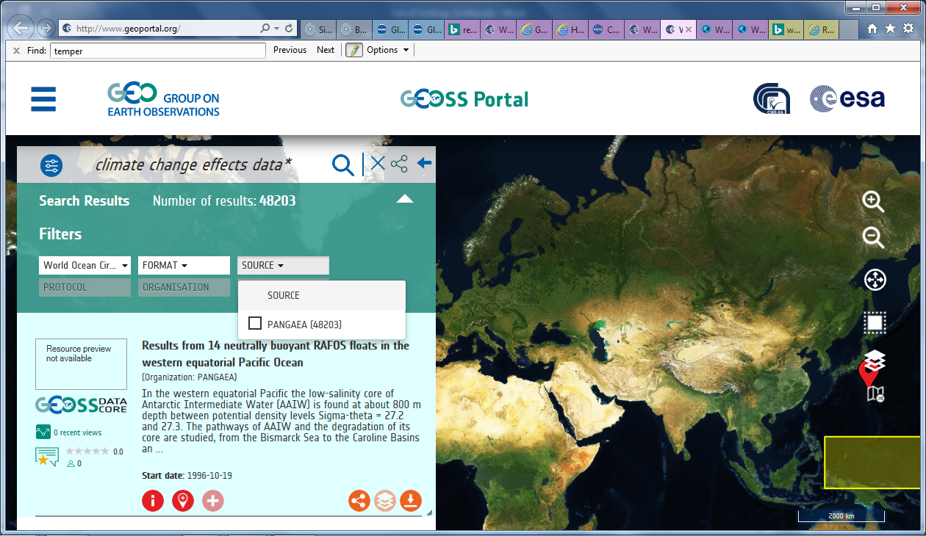
Data Catalogue ecosystem

Slide 7
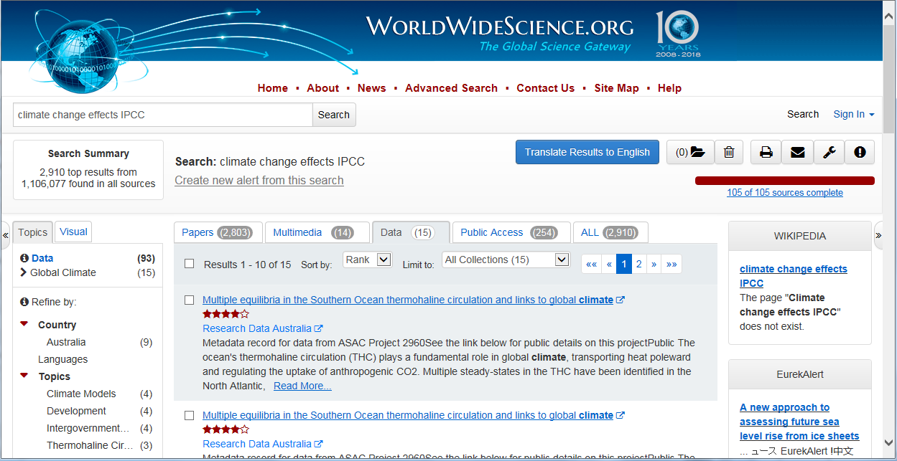
Data Catalogue ecosystem

Slide 8
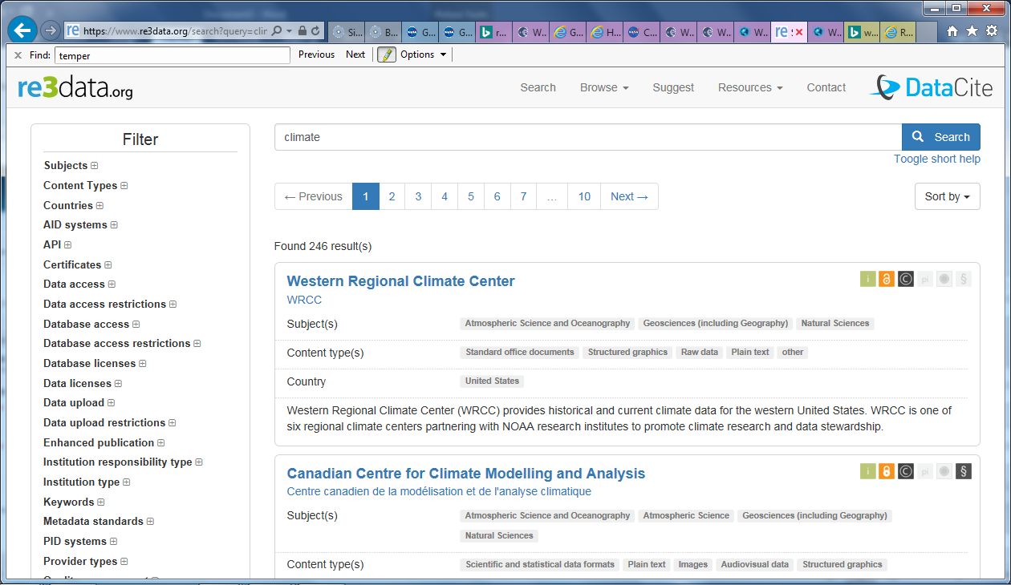
Data Catalogue ecosystem

Slide 9
Data Catalogue ecosystem
Data Catalogue ecosystem
Mature standards for catalogue interoperability (CSW, OAI, SRU +)
Mature "discovery" metadata standards
Crosswalks between mature metadata standards (FGDC, DIF, ISO19115, 19115-2)
Mature thesauri usage
Reasonably mature community practice
e.g. Harvesting catalogues typically state source catalogue that metadata is harvested from
Although a mature data catalogue (discovery) infrastructure exists
…to support metadata dissemination (and versioning)
Room for improvement
Data Catalogues need to improve their discoverability (including within Search Engines)
Improved metadata content (always – regardless of standard used)
Crosswalks between thesauri

Slide 10
Data Catalogue ecosystem
Data Catalogue ecosystem – Issues
Metadata life-cycle
  Format/encoding changes
  e.g. Local Catalogue for Australian Antarctic Division (AAD) dataset metadata is GCMD Catalog (DIF std) :
  - DIF
  -> ISO19115
    → MCP (for AODN)
    → WMO Core Profile ( WMCP) for WIS → GEOSS Catalog
    → DCAT (for Data.Gov.Au)
    → RIF-CS (for ANDS/RDA) -
  -> FGDC
  - DataCite (for DataCite Catalog) …..
  Synchronisation (currency) of a metadata record, across 'manifestations' (standards/ encodings)
  ➔ Catalogues should (& sometimes do) provide, for humans, clear detail of conversion done, and date last harvested
New "discovery" metadata standards (often immature /in flux, but used in earnest)
DCAT, DCAT-AP, DataCite, etc
New catalogue players (Data.gov suite, for instance) – can result in more chaotic user-experience

Slide 11
Data Catalogue ecosystem - Issues
Harvesting of metadata often results in subsetting of metadata (lossiness)
  Original (authoritative) and harvested metadata records need to declare their "Point-of-truth Metadata Url" with an indicator of Metadata Standard
  We need to ensure that that url isn't removed, when harvested (consider licencing of metadata)
  e.g the authoritative version of a metadata record should ideally be available
  as a webpage, with a well-managed (software brand independent) (p)url.
  Needed both for
  version control (related to catalogue harvesting), as well
  Search Engine indexing

Slide 12
Overview
Discovery vehicles
Effective discovery
  User knowledge needed
  Metadata management needed
  Metadata dissemination needed
Use of WIS infrastructure
Indexing by Search Engines
Prominent discovery
  Within Data Catalogues (WIS ++)
  Within Search Engines
  Citation/References

Slide 13
Integration with WIS Infrastructure
Original metadata for HQ Datasets will often be in local catalogue, and in different metadata standard.
We need to consider the ideal workflow, and rules, to address previous issues (versioning, etc), while also achieving:
Integration into WIS catalogue(s) - now and WIS2
Metadata as a webpage
- reliably accessible,
- with url independent of catalogue vendor software, and
- embedded in a Data Catalogue context)

Slide 14
Integration with WIS Infrastructure
Option 1
Original Record in local catalogue
Software converts MD to html/webpage
with relevant POTmdURL,
& indexable ++ content,
delivered in Catalogue context
Software converts MD to WMCP, & adds WMCP content
Record as html/webpage, within context of Data Catalogue
Questions:
Should the webpage metadata be WMCP or original standard?
Which catalog should it "exist" within?
  a separate HQ Climate Collection catalog?
  WIS2?
Record as WMCP in WIS catalogue

Slide 15
Integration with WIS Infrastructure
Option 2
Original Record in local catalogue
Software converts WMCP MD to html/webpage
with relevant POTmdURL,
& indexable ++ content,
delivered in Catalogue context
Questions:
Should the webpage metadata be WMCP or original standard?
Which catalog should it "exist" within?
  a separate HQ Climate Collection catalog?
  WIS2?
  Same metadata "fileIdentifier" as the original metadata record?
  (Either way:
  should, and how will, aggregator catalogs de-duplicate?)
Software converts MD to WMCP, & adds WMCP content
Record as html/webpage, within context of Data Catalogue
Record as WMCP in WIS catalogue

Slide 16
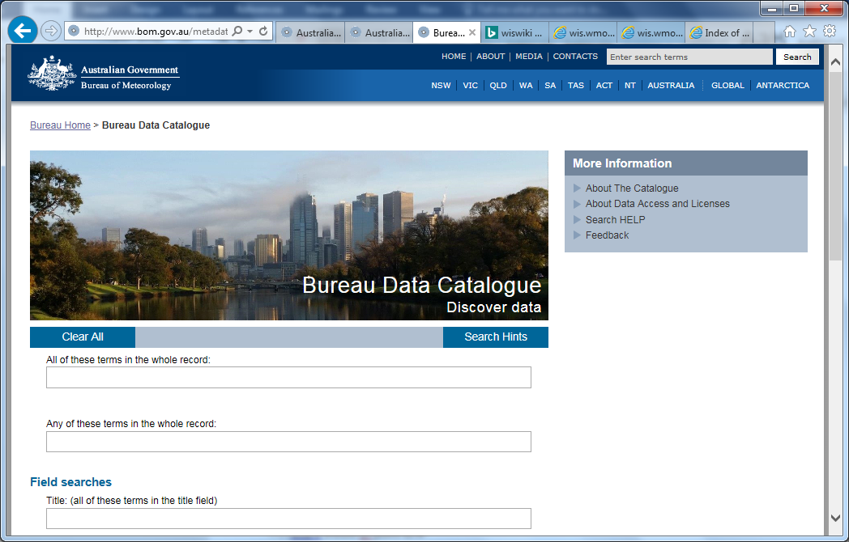
Example of backend integration with larger catalog, but with separate catalogue GUI/website
(➔ subsetting from larger WIS catalog will require a unique queryable string in HQ data records)

Slide 17
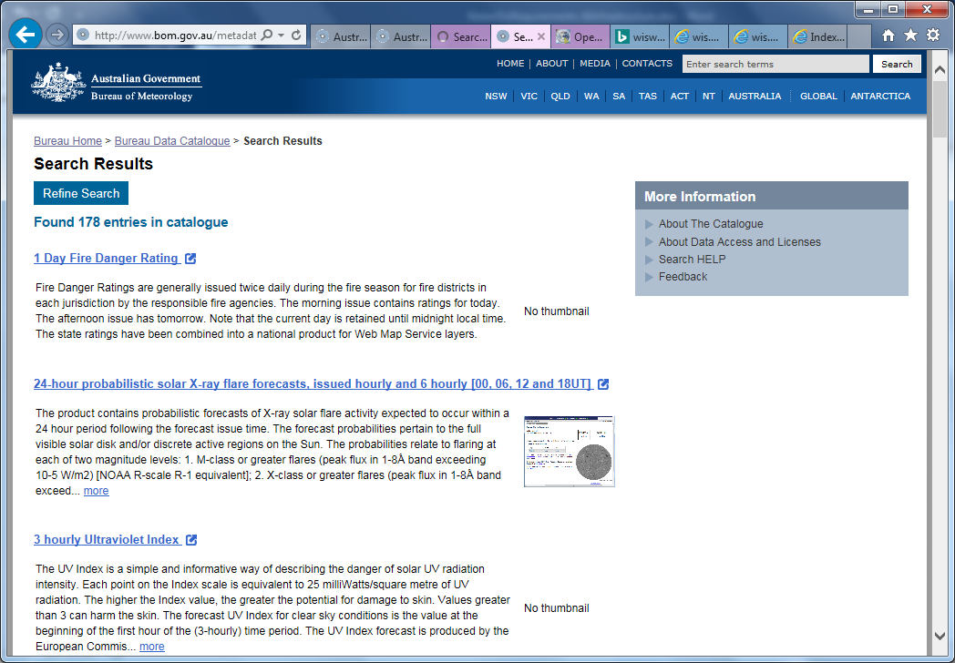
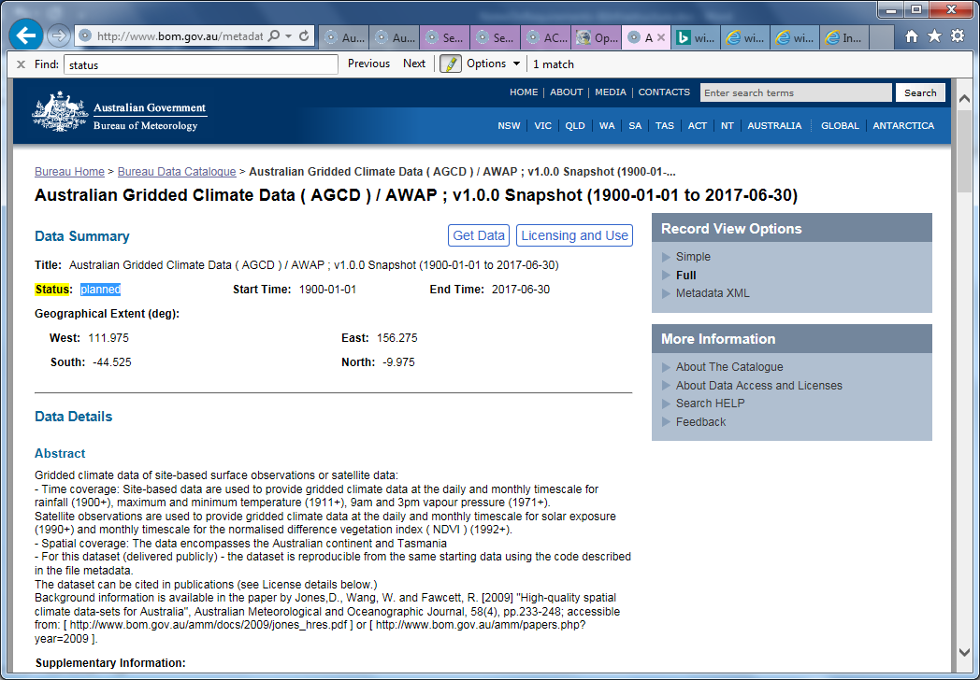
Example of backend integration with larger catalog, but with separate catalogue GUI/website (subsetting from larger catalog requires a unique queryable string in HQ data records)

Slide 18
Overview
Discovery vehicles
Effective discovery
  User knowledge needed
  Metadata management needed
  Metadata dissemination needed
Use of WIS infrastructure
Indexing by Search Engines
Prominent discovery
  Within Data Catalogues (WIS ++)
  Within Search Engines
  Citation/References

Slide 19
Search Engine Indexing
Mechanisms
Data catalogue (website) indexing
  Include in Sitemap
  Refer to catalog, from other websites
  Include useful words / terms, in Data Catalog's frontpage, "About",etc
Metadata records
  Arrange for each webpage (per metadata record) to be referenced by other webpages that will be SE-indexed
  Regularly auto-Generate an indexable webpage, containing a list of all HQ Climate datasets, with urls of those metadata records;
  Webpage can also contain urls per filtered search for each ECV.
  Html tagging (micro-format content, etc).
    Some solutions are old, and hardly implemented;
    Some solutions are new/in flux;
    … assess the maturity, and design agile conversion system for handling likely requirements changes
  References by others
    Encourage referencing by others (publications, webpages, etc)
    Advise how the metadata should be referenced.
    Encourage "participation/ownership" by offering alerts when data changes, and encouraging feedback.

Slide 20
Prominent discovery within a Search Engine
Issues and challenges
"Effective searching" isn't reliable
Search Engine search-results are rarely the same (unlike Data catalogues)
  Algorithms for search-results vary
    Per person, on day X compared with day Y
      Per computer used by a person
        and sometimes per person with same computer in different country
  Weighting for "prominence" changes, depending on both
    algorithm changes (driven by business needs), and
    "popularity"
Privacy
Search engines, as a business, collect (and on-sell) user information
Will SE Indexing increase discoverability (by users)?
Huge push from Search Engines encouraging data providers to make their metadata SE-indexed. Of obvious benefit to search engines.
But as more metadata is indexed (noting the eventual scale: trillions of metadata records), the same "discovery" challenges already experienced within data catalogues (caused by scant or inconsistent metadata), will persist, and could be magnified, because of the SE context (intermixed with non-data search results).

Slide 21
Search Engine indexing ROI
For Search Engine Indexing proposed methods:
Assess any Search Engine Indexing efforts required against actual longterm benefit likely to be gained (especially if that effort compromises other "discovery" improvement efforts)
Ensure that Search Engine discovery also raises users awareness of relevant Data Catalogues
And work to also increase / improve discovery of, and within Data Catalogs
Improve metadata quality ++
Support the Data Catalogue community in improving its effectiveness

Slide 22

Thank you
Merci

Slide 23
Introduction – Data Discovery vehicles
Discovery vehicles:
  Data Catalogue ecosystem (WIS, GEOSS +++)
  Search Engines
  Websites
  References by others (publications, webpages, etc)

Slide 24
Data Catalogue ecosystem
Data Catalogue ecosystem
Local Data Catalogue
    Metadata standards offered (DIF, FGDC, 19115)
    Formats / encodings (html, xml, json, etc)
Aggregator Data Catalogues
  WIS, GEOSS ++ (Thematic, Domain specific ),
  INSPIRE, Data.gov.uk, ANDS/RDA
  (National /Geographically-defined ++)
  WorldWideScience, DataCite (Research-focussed)
Directories of Data /Repository Catalogues
(RE3data, etc)

Slide 25
Data Catalogue ecosystem
Data Catalogue ecosystem
Local Data Catalogue
    Metadata standards offered (DIF, FGDC, 19115)
    Formats / encodings (html, xml, json, etc)
Aggregator Data Catalogues
  WIS, GEOSS ++ (Thematic, Domain specific ),
  INSPIRE, Data.gov.uk, ANDS/RDA
  (National /Geographically-defined ++)
  WorldWideScience, DataCite (Research-focussed)
Directories of Data /Repository Catalogues
(RE3data, etc)

Slide 26
Data Catalogue ecosystem
Data Catalogue ecosystem
Local Data Catalogue
    Metadata standards offered (DIF, FGDC, 19115)
    Formats / encodings (html, xml, json, etc)
Aggregator Data Catalogues
  WIS, GEOSS ++ (Thematic, Domain specific ),
  INSPIRE, Data.gov.uk, ANDS/RDA
  (National /Geographically-defined ++)
  WorldWideScience, DataCite (Research-focussed)
Directories of Data /Repository Catalogues
(RE3data, etc)

Slide 27
Data Catalogue ecosystem
Data Catalogue ecosystem
Local Data Catalogue
    Metadata standards offered (DIF, FGDC, 19115)
    Formats / encodings (html, xml, json, etc)
Aggregator Data Catalogues
  WIS, GEOSS ++ (Thematic, Domain specific ),
  INSPIRE, Data.gov.uk, ANDS/RDA
  (National /Geographically-defined ++)
  WorldWideScience, DataCite (Research-focussed)
Directories of Data /Repository Catalogues
(RE3data, etc)

Slide 28
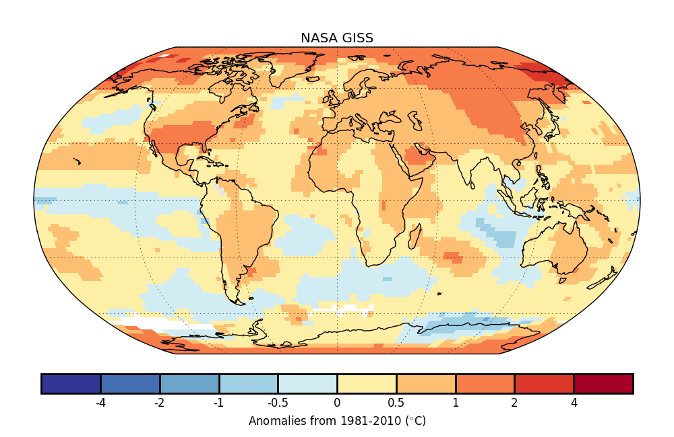
Introduction - Discovery
Discovery vehicles:
  Data Catalog ecosystem (WIS, GEOSS +++)
  Search Engines
  Websites
  References by others (publications, webpages, etc)
Effective discovery
  Knowledge of
  Where to search
  How to search
  What to search for
  Well-managed metadata
  Consistent, well-applied metadata content
  Sufficient information
  Currency
  Formats availability
  Versioning management
  Effective dissemination
  Replication /'mirroring' into relevant catalogues
  Version tracebacks to 'original'
  Indexing by Ses
  Citation /Refernces to datasets (to md in cat content)
  Website promoting this HQ Datasets Collection (and PR for it)
  PR to actual/potential stakeholders
Prominent discovery – SE challenges
  Algorithms for results vary per person (and sometimes per country);
  Weighting for "prominence changes, depending on both algorithm changes, and "popularity"
  Where to search
  How to search
  What to search for

Slide 29
Integration with WIS Infrastructure
Original metadata for HQ Datasets will often be in local catalogue, and in different metadata standard.
Workflow, and rules, to address previous issues (versioning, etc), while achieving:
Integration into WIS catalogue(s) - now and WIS2
Metadata as a webpage
Option 1
Original Record in local catalogue
Software converts MD to html/webpage
with relevant POTmdURL,
& indexable ++ content,
delivered in Catalogue context
Software converts MD to WMCP, & adds WMCP content
Record as html/webpage, within context of Data Catalogue
Questions:
Should the webpage metadata be WMCP or original standard?
Which catalog should it "exist" within?
  a separate HQ Climate Collection catalog?
  WIS2?
Record as WMCP in WIS catalogue

Slide 30
Integration with WIS Infrastructure
Original metadata for HQ Datasets will often be in local catalogue, and in different metadata standard.
Workflow, and rules, to address previous issues (versioning, etc), while achieving:
Integration into WIS catalogue(s) - now and WIS2
Metadata as a webpage
Option 1
Original Record in local catalogue
Software converts MD to html/webpage
with relevant POTmdURL,
& indexable ++ content,
delivered in Catalogue context
Software converts MD to WMCP, & adds WMCP content
Record as html/webpage, within context of Data Catalogue
Questions:
Should the webpage metadata be WMCP or original standard?
Which catalog should it "exist" within?
  a separate HQ Climate Collection catalog?
  WIS2?
Record as WMCP in WIS catalogue

Slide 31
Data Catalogue ecosystem
Data Catalogue ecosystem
Local Data Catalogue
    Metadata standards offered (DIF, FGDC, 19115)
    Formats / encodings (html, xml, json, etc)
Aggregator Data Catalogues
  WIS, GEOSS ++ (Thematic, Domain specific ),
  INSPIRE, Data.gov.uk, ANDS/RDA
  (National /Geographically-defined ++)
  WorldWideScience, DataCite (Research-focussed)
Directories of Data /Repository Catalogues
(RE3data, etc)
➔ A Mature data catalogue (discovery) infrastructure does exist
…to support metadata dissemination and re-use

Slide 32
Integration with WIS Infrastructure
Original Record in local catalogue
Software converts MD to html/webpage
with relevant POTmdURL,
& indexable ++ content,
delivered in Catalogue context
Software converts MD to WMCP, & adds WMCP content
Record as html/webpage, within context of Data Catalogue
Questions:
Should the webpage metadata be WMCP or original standard?
Which catalog should it "exist" within?
  a separate HQ Climate Collection catalog?
  WIS2?
Record as WMCP in WIS catalogue

Slide 33
Integration with WIS Infrastructure
Original metadata for HQ Datasets will often be in local catalogue, and in different metadata standard.
Workflow, and rules, to address previous issues (versioning, etc), while achieving:
Integration into WIS catalogue(s) - now and WIS2
Metadata as a webpage
Option 1
Original Record in local catalogue
Software converts MD to html/webpage
with relevant POTmdURL,
& indexable ++ content,
delivered in Catalogue context
Software converts MD to WMCP, & adds WMCP content
Record as html/webpage, within context of Data Catalogue
Questions:
Should the webpage metadata be WMCP or original standard?
Which catalog should it "exist" within?
  a separate HQ Climate Collection catalog?
  WIS2?
Record as WMCP in WIS catalogue

