Slide 1

OUTCOMES OF THE WMO WORKSHOP ON INFORMATION MANAGEMENT
Omar Baddour
World Meteorological Organisation
Geneva, Switzerland

Slide 2
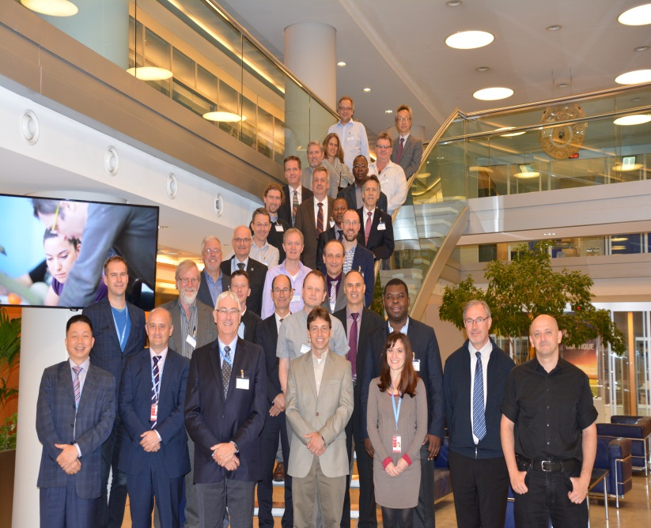
WMO WORKSHOP ON INFORMATION MANAGEMENT, Geneva, 2-4 October 2017
35 PARTICIPANTS:
Data Centers
IPCC
WCRP
GCOS
UN-BIG Data
Hydrology
Marine
Agriculture
Climatology
Weather
Michel Jean, President of the Commission for Basic Systems (CBS):
“The value chain of data was to generate information that leads to knowledge and ultimately to a WISDOM that creates advice and insight”
Notes:
Data is useful only if it is used. The value chain was to create information that leads to knowledge and ultimately a WISDOM that create advice insight and environmental intelligence

Slide 3
Objectives
Identify key climate data sources that should be promoted as reference sources , and outline a project to enhance their visibility in the WMO Information System (WIS)
Simplify user access to them
Provide guidance on the development of a WMO reference on information management

Slide 4
Structure
32 talks,
3 break out groups:
Project plan for climate data access
Project plan for improving access to climate datasets
Information management guidance topics

Slide 5
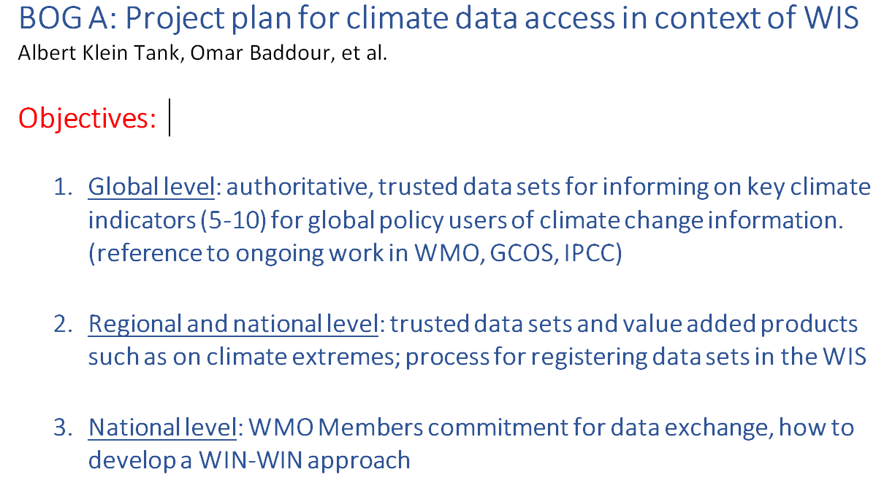

Slide 6
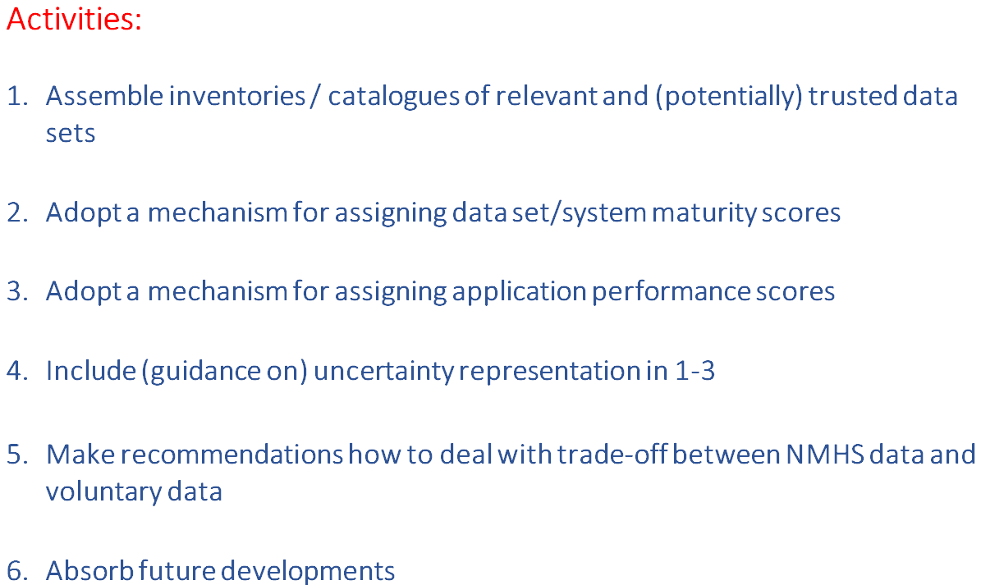

Slide 7
Project Plan for improving access to climate datsets
Aim: Providing data access to non-technical users. Scope includes finding the “trusted” datasets,
Establish a Process for endorsing datasets, using documented maturity model for datasets endorsement, pool of candidate datasets. → Endorsed datasets with maturity score within a certain range
Architecture consideration: governance, common standards, logical model, one stop shop but distributed datasets,
Partnership, with datasets providers, Regional Climate Centres and need for individual Met Services to maintain high standards for observations
Access: One point of entry , ‘WMO Dataset finder’, search engine to enhance search ability
Notes:
Datasets must meet standards:defined by a maturity index approach

Slide 8
Guidance on life cycle Management
Information activities
Create
Store
Share
Use
Archive
Destroy
Notes:
Information Life Cycle
Up to now, WIS has been concerned with making it easier to share information. This is only a small (but important) part of the life cycle of information.
Create - even before information is gathered, the need for it must be understood. Knowing what that need is will set the requirement for how that information is collected and handled. Some transformations of the original information (such as initial quality control, calibration) may be done before the information moves on to the next stage of its life.
Store - information has to be stored before it can be shared (even if only for a short time).
Share – the information may be shared before it is used – this is normal practice for real time weather information.
Use – the information is used (and may have new information created from it – which then goes through an information life-cycle of its own).
Archive – archiving is an active process – although the information content should not be changed, it is usually necessary to move the information between media so that it continues to be accessible as technology changes or to avoid the impact of deterioration of the medium on which the information is stored.
Destroy – retaining information costs money, and some information has no value after time has passed. The requirement for the information that was identified before the information was created should be used to make a decision on when the information is no longer needed. Some information (such as climate-quality observations) may need to be retained permanently; if this is the case then appropriate measures should be put in place to prevent its accidental destruction.

Slide 9
Next Steps
Development of a Catalogue of “trusted” datasets based on best practices in maturity models, to be used for monitoring key climate indicators ( to be included as part of a WMO reference manual )
Guidance on improved discoverability and access to data that are maturity assessed ,
Find a technical solution to improve accessibility through WIS and internet search engines

Slide 10
Mailstones
End of June 2018: WMO Executive Council, present high level structure of Manual and Guides on information management
July 2018 - March 2019 : Consolidated version of Manual and Guides with key items of each chapter of the guide, Prepare final high level version of Manual and Guides and circulate for comments
June 2019: Submission to WMO Congress adoption

Slide 11

Thank you

