Slide 1
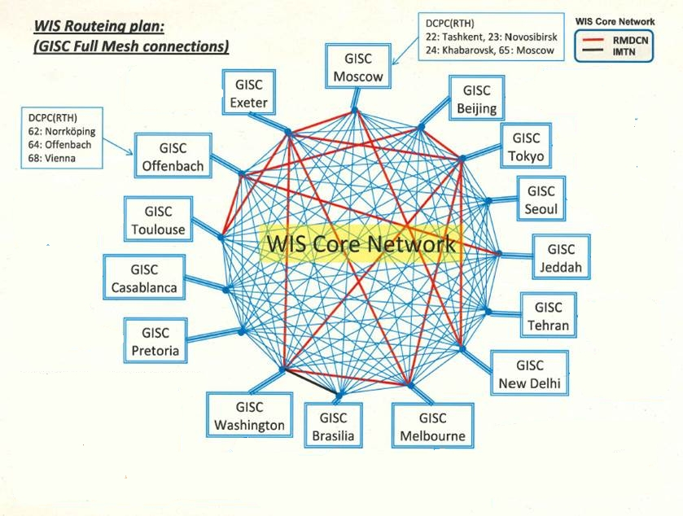
WMO Information System
Kate Roberts and Thorsten Büßelberg

Slide 2

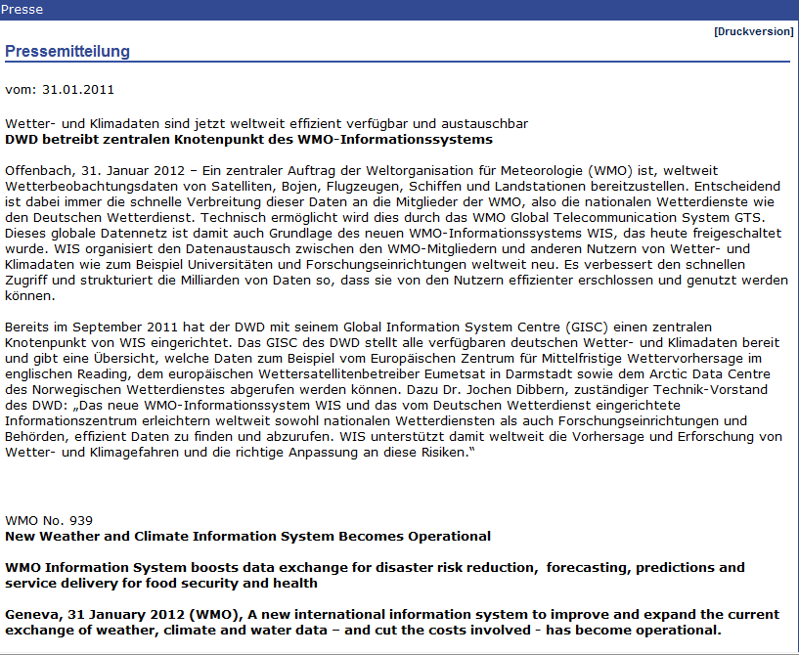
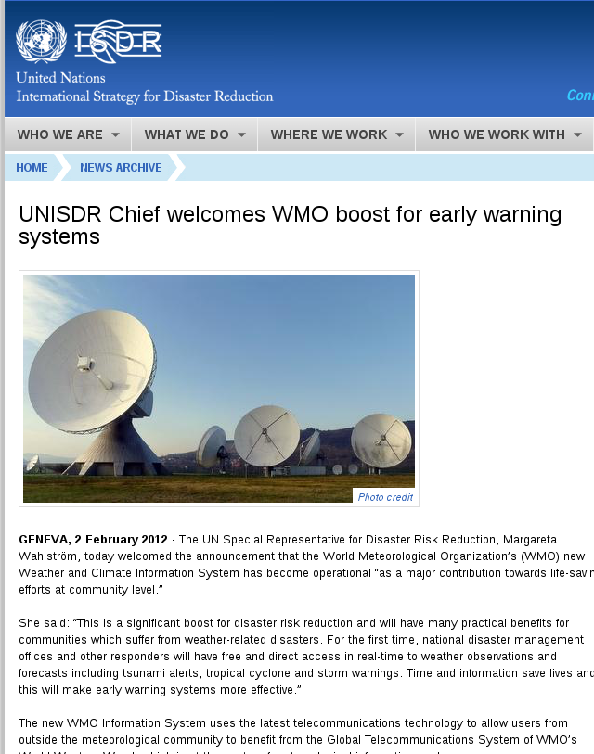
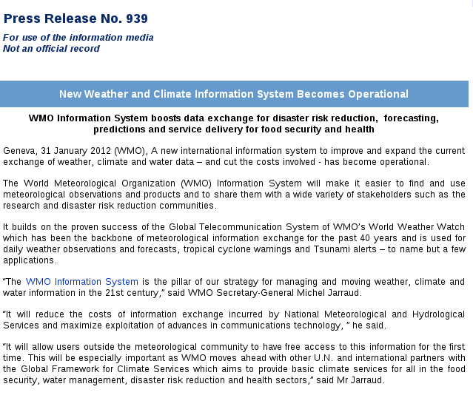
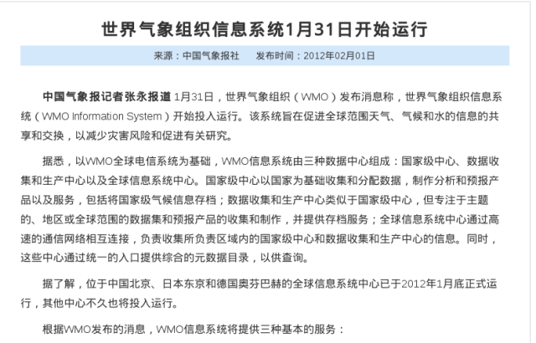
WMO Information System
WIS is operational since January 2012
https://www.wmo.int/pages/prog/www/WIS/index_en.html

Slide 3
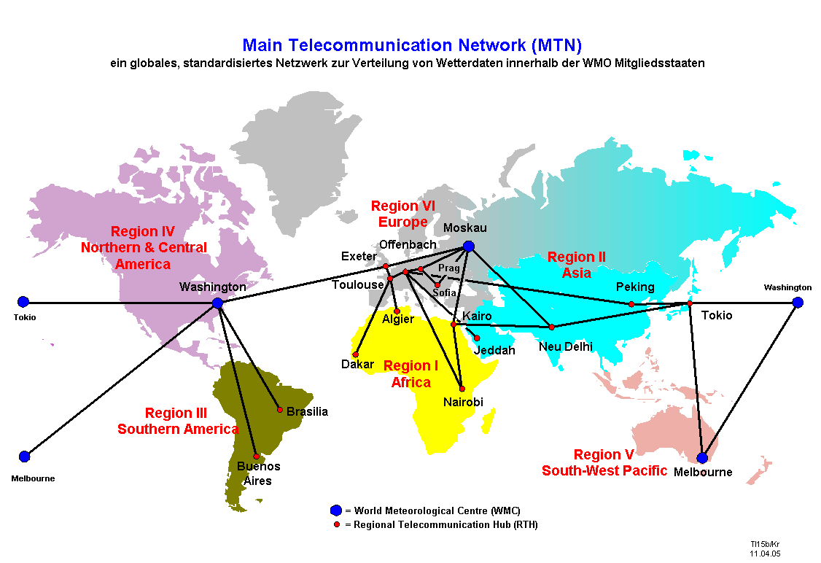
Data Exchange since ~1950: GTS
GTS
Global Telecommunications System
WMC
World Meteorological Center
RTH
Regional Telecommunications Hub
NMHS
National Met. / Hydrol. Service

Slide 4
Data exchange today: WMO Information System
WIS
WMO Information System
GISC
Global Information System Center
DCPC
Data Collection / Production Center
NC
National Center

Slide 5

Supermarket without metadata
Source: WMO Core Metadata Profile v1-2 Guidance Documentation v0.1
Notes:
5
5

Slide 6
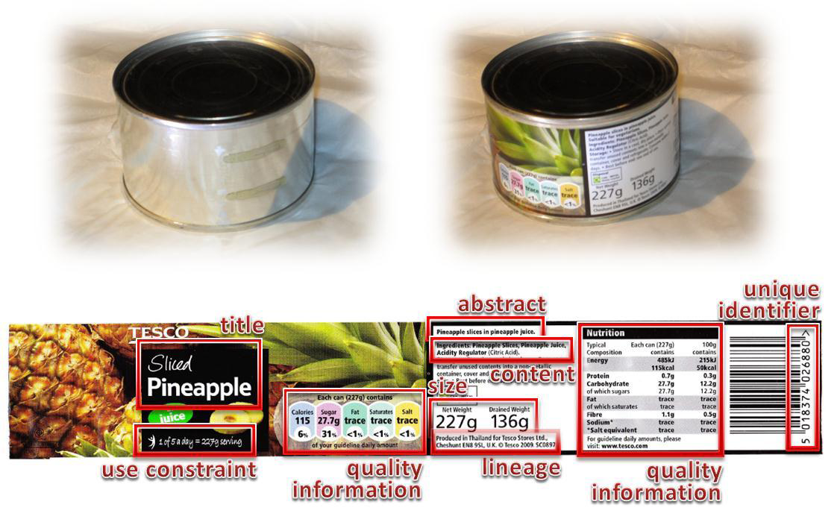
Supermarket with metadata
Source: WMO Core Metadata Profile v1-2 Guidance Documentation v0.1
Notes:
6
6

Slide 7
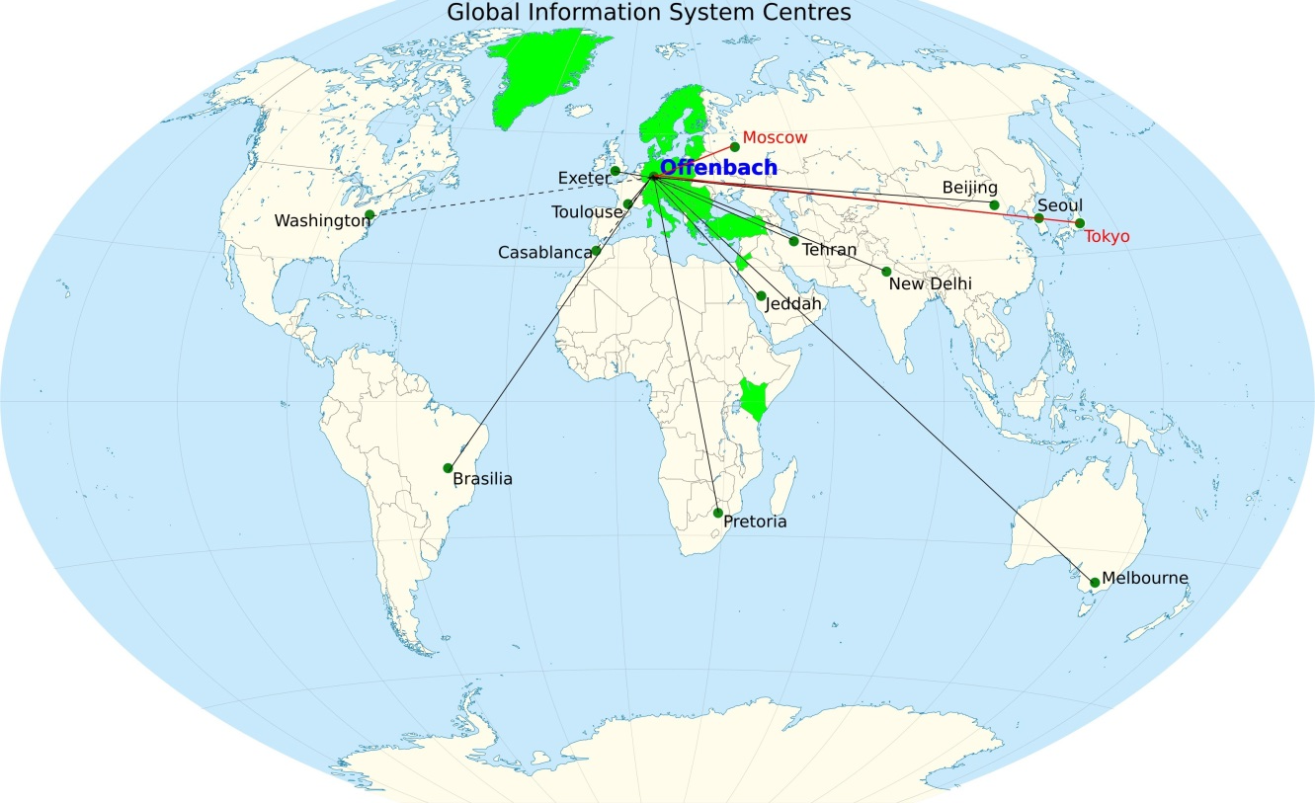
WIS Centres - Global Information System Center
Hold global metadata catalogue
Upload metadata for area of responsibility
Distribute (global exchange) data to other GISCs
Provide (global exchange) data to area of responsibility
Ad hoc and subscription data supply
Ensure area of responsibility
has effective telecommunications

Slide 8

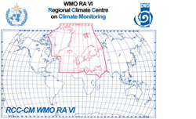



WIS Centres - Data Collection / Production Center
Programme function
  WWW regional telecommunications hub
  RSMC
  World Data Centre
Provide metadata
Provide data

Slide 9
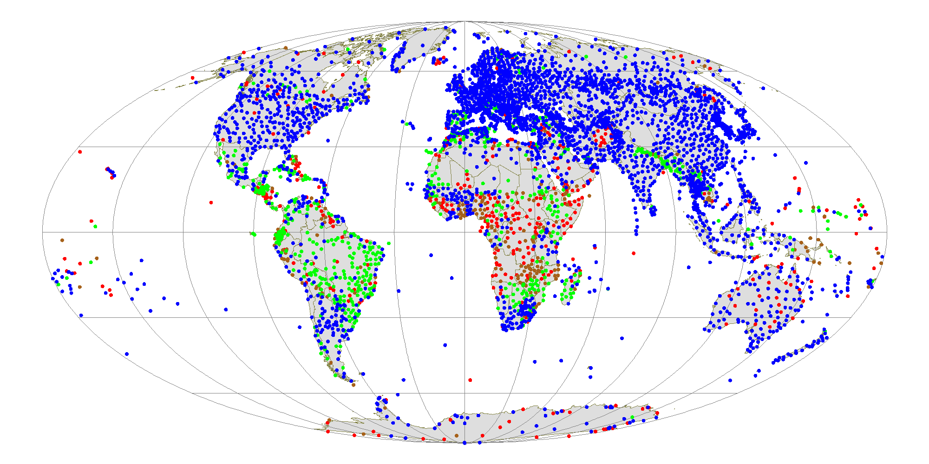
WIS Centres - National Center
Collect and pass national data to WIS
Receive data from WIS for national users
Provide metadata to WIS
Main source of information for national purposes
SYNOP reports from RBSN stations

Slide 10




Metadata synchronization
OAI and FTP
WIS core network
DKRZ
AWI (PANGAEA)
DLR
EUMETSAT
National Meteorological
Centres,
e.g. Austria,
Croatia, …
  connected to GISC Offenbach as external DCPC
    DKRZ
    DLR
    AWI Bremerhaven (Pangaea)
    EUMETSAT
connected to GISC Offenbach as internal DWD centre:
  GCC, Global Collection Centre
  GPCC, Global Precipitation Climate Centre
  GRUAN, GCOS Reference Upper-Air Network
  RCC-CM, Regional Climate Centre on Climate Monitoring for Europe

Slide 11
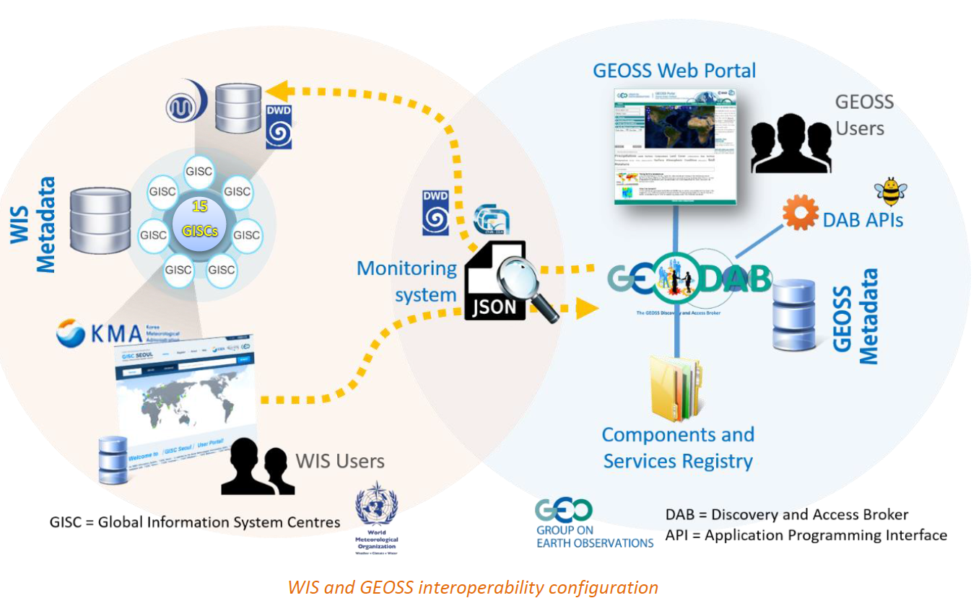
Interoperability WMO Information System – GEOSS

Slide 12

WIS Discovery Metadata
WIS Discovery Metadata
What datasets contain
Who is responsible
How to get datasets
Image by Tim Parkinson from http://www.flickr.com/photos/timparkinson/320165882/ under the creative commons licence http://creativecommons.org/licenses/by/2.0/

Slide 13
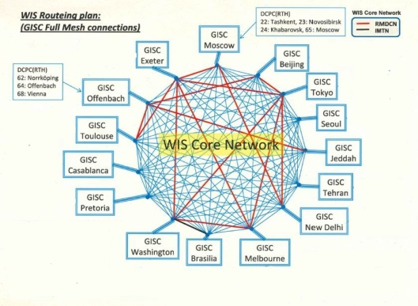

Summary
WMO Information System
  GISC
  Global Information System Center
  DCPC
  Data Collection / Production Center
  NC
  National Center
GISCs hold searchable metadata catalogue
DCPC and NC provide data and metadata

Slide 14
Thank you !

