Slide 1

A Way Forward for Prominent Discovery
for the Data Catalog of High-Quality Climate Data
Anna Milan
Metadata Standards Lead
NOAA’s National Centers for Environmental Information
WMO Expert Meeting on Climate Data Modernisation Workshop
2018-04-16
National Oceanic and Atmospheric Administration | NOAA Satellite and Information Service

Slide 2
OR: A Look at How NOAA is Developing the
OneStop Discovery and Access Project
Anna Milan
Metadata Standards Lead
NOAA’s National Centers for Environmental Information
WMO Expert Meeting on Climate Data Modernisation Workshop
2018-04-16
National Oceanic and Atmospheric Administration | NOAA Satellite and Information Service

Slide 3
About OneStop

Slide 4
OneStop Decisions Align with WWIM Plans
Identifying key datasets
Easy intuitive interface
Improving discovery
Increasing ease of access, utilizing the cloud
Applying maturity scales
Providing tangible guidance and training materials

Slide 5
OneStop Project Background
Pathfinder effort through the NOAA National Centers for Environmental Information (NCEI) to improve discovery, access, and usability of NOAA's data. Leverages agency, national and international initiatives for open and accessible data.

Slide 6
OneStop Activities
Recently (~last two years)
Identified 20 target NCEI data groups
Developed OneStop Readiness Requirements
Improved 15 data groups
Assessed Maturity of 350+ collections
Produced hundreds of thousands of granule metadata
Worked closely with the User Interface agile team

Slide 7
OneStop Activities
Next
Streamline data and metadata pipelines
Simplify DSM Assessment
Harden User Interface
Provide stable OneStop Readiness Guidance
Eventually
Integrate all of NOAA data
More sophisticated data discovery and access options

Slide 8
OneStop Search Results are Driven by Standardized Metadata Content

Slide 9
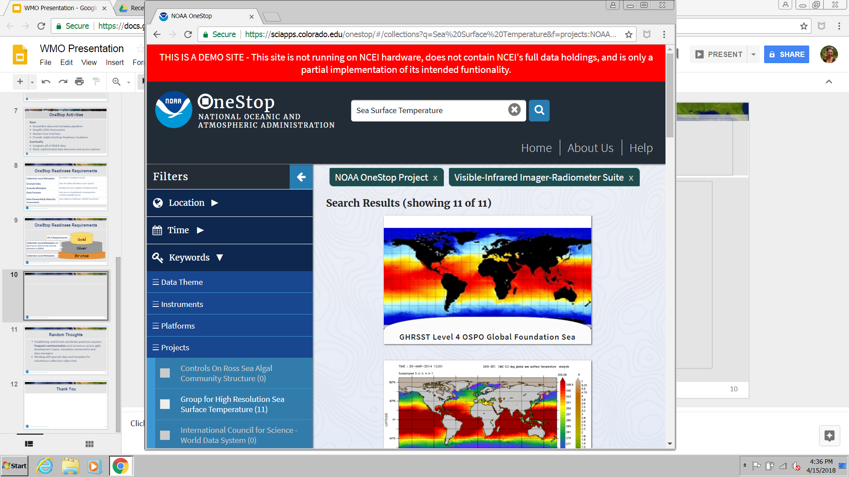
Collection Metadata Results in OneStop
GCMD keywords in metadata produce filter options
Browse Graphic thumbnail in metadata displays in search results

Slide 10
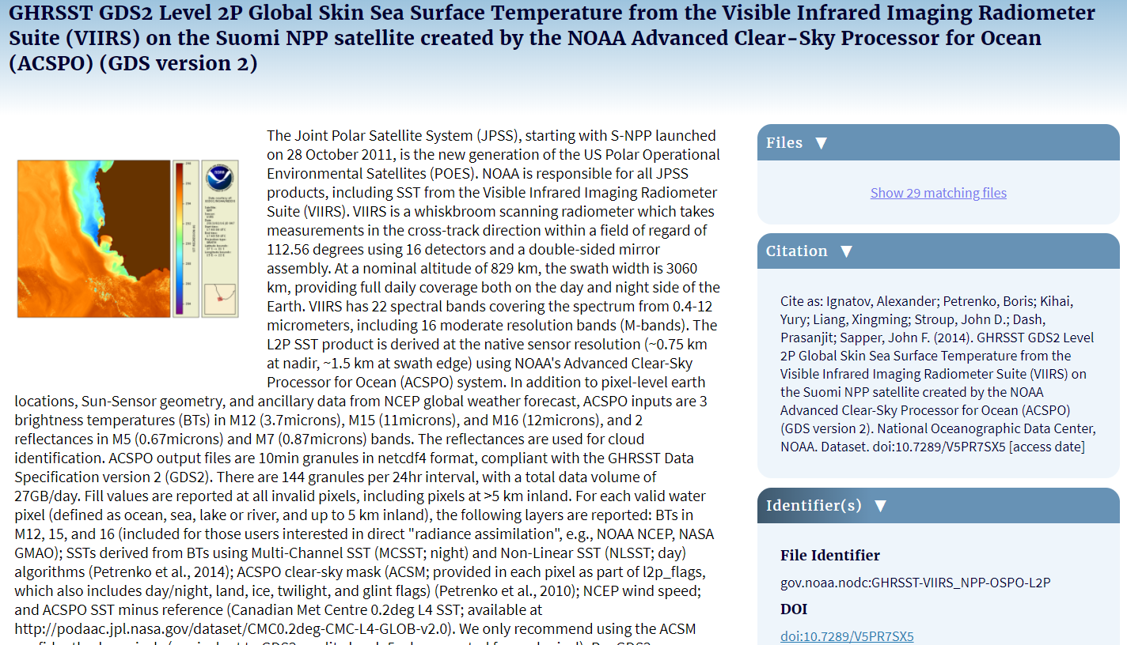
Collection Metadata Results in OneStop
Granule
Files
Citation and DOI
Metadata content feeds landing page display

Slide 11
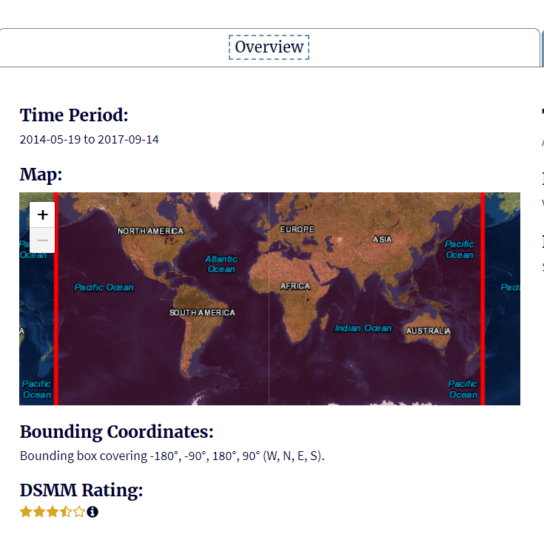
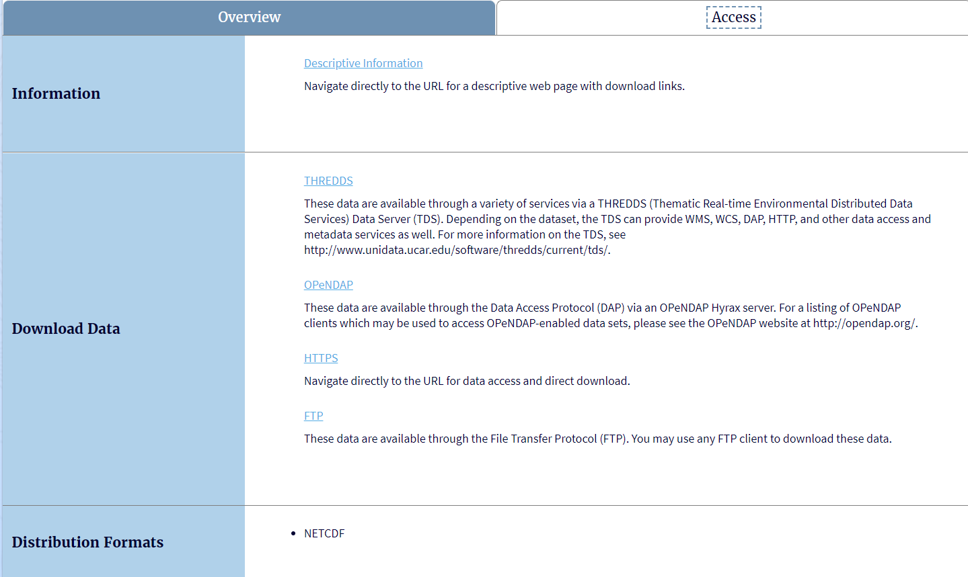
Collection Metadata Results in OneStop
Maturity Assessment Result
Collection Access Links
NetCDF Data Format

Slide 12
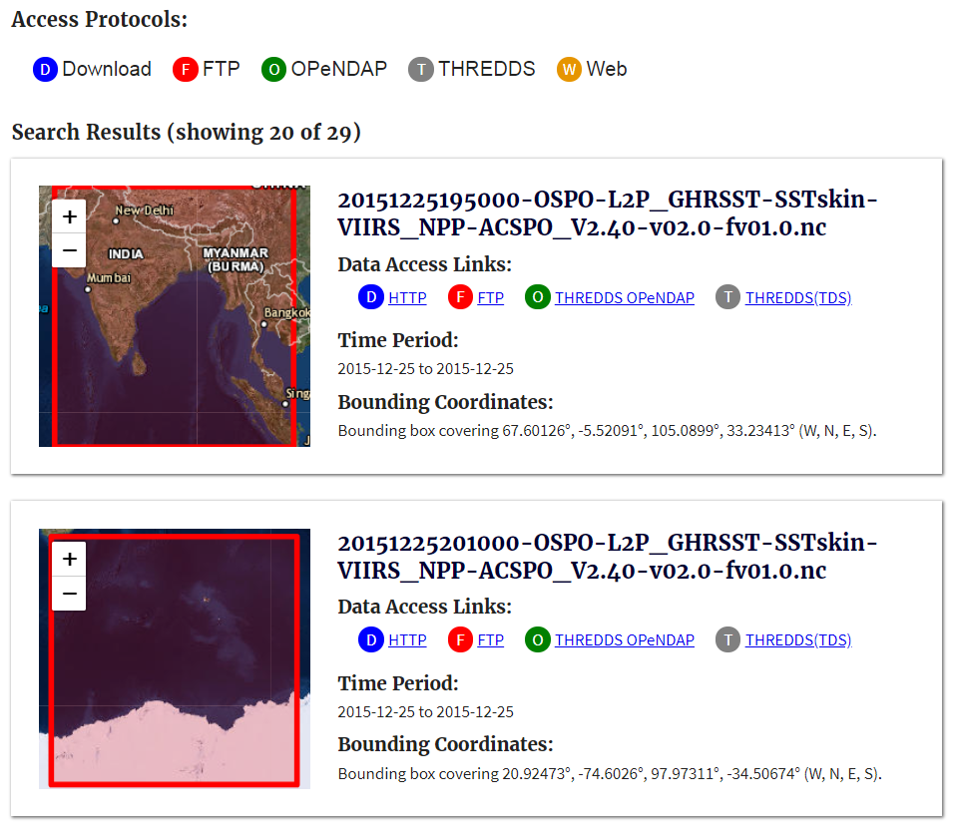
Granule Metadata Results
Access Protocols
File Access Links
Granule Extent

Slide 13
OneStop Readiness Requirements

Slide 14
OneStop Readiness Requirements
Collection Level Metadata | ISO 19115-2 compliant records
Granule Data | Data are online with direct access options
Granule Metadata | OneStop ISO-Lite compliant metadata records
Data Formats | Data are in a standardized, non-proprietary machine-readable format
Data Stewardship Maturity Assessment | Each collection shall have a DSMM Assessment

Slide 15
OneStop Readiness Requirements
Gold
All 5 Requirements
Collection Level Metadata +2:
Data Access, Data Format, Granule Metadata or DSMM
Silver
Bronze
Collection Level Metadata

Slide 16
Collection Metadata Readiness
Every collection level record in the data group shall have a completeness score of at least 90% following the V2 Completeness Rubric
GCMD Science, Place and DataCentre Keywords
GCMD Platform, Instrument, Project Keywords (if applicable)
GCMD Keyword thesaurus titles following NOAA’s Keyword Implementation Guidance
URL to a browse graphic thumbnail

Slide 17
Granule Data Readiness
Granule metadata must be online with direct access options available
  e.g., Cloud Service, HTTP/FTP, THREDDs, ERDDAP, OPeNDAP, etc.

Slide 18
Granule Metadata Readiness
Each granule shall have a OneStop ISO-Lite* compliant metadata record
Every access URL shall have a protocol field associated
A parent identifier to the collection level metadata
The term ‘Granule’ in the hierarchyLevelName field
Only unique content that identifies the granule distinctly from the collection and yet enough information to easily distinguish differences across a set of similar granules
Notes:
* See ISO-Lite granule template

Slide 19
Data Formats
Data are in a standardized, non-proprietary machine-readable format
  Examples include but are not limited to: CSV, HDF, NetCDF, GeoTIFF, etc.
  Highly recommend use of NetCDF/HDF following the NCEI NetCDF Template v2.0

Slide 20
Data Stewardship Assessment
Each collection shall have a Data Stewardship Maturity Assessment
The final assessment report shall be published to NOAA's library repository
The results shall be encoded into the collection level metadata

Slide 21
DSM Questionnaire Example
5.1 | How best describes the Data Quality Assurance (DQA) procedures (including screening)? | DQA procedure of the dataset unknown or none DQA procedure is Ad Hoc and not regular and procedure not defined. DQA procedure is partially defined with basic metrics. DQA procedure is fully defined or has standard-based DQA metrics (e.g. CORE-CLIMAX)
5.2 | Is DQA documentation describing the procedures and practices available online? | No DQA documentation available DQA documentation is available online DQA documentation is available online with master reference data

Slide 22
Web Page Discovery

Slide 23
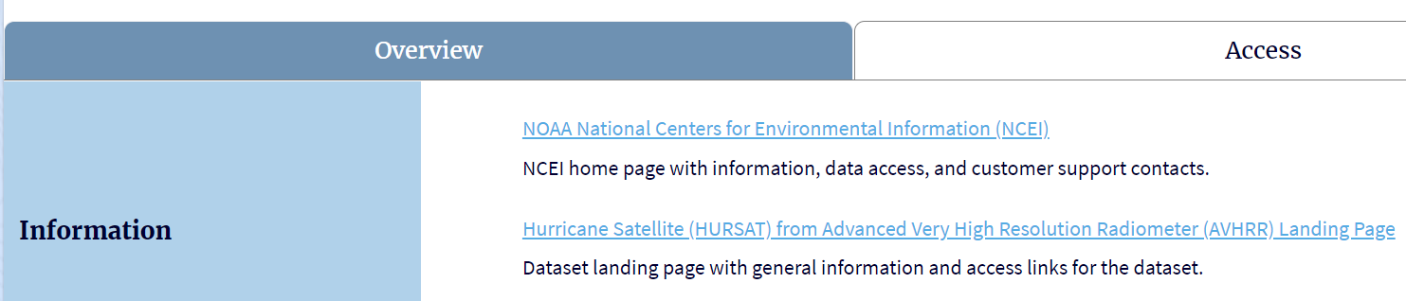
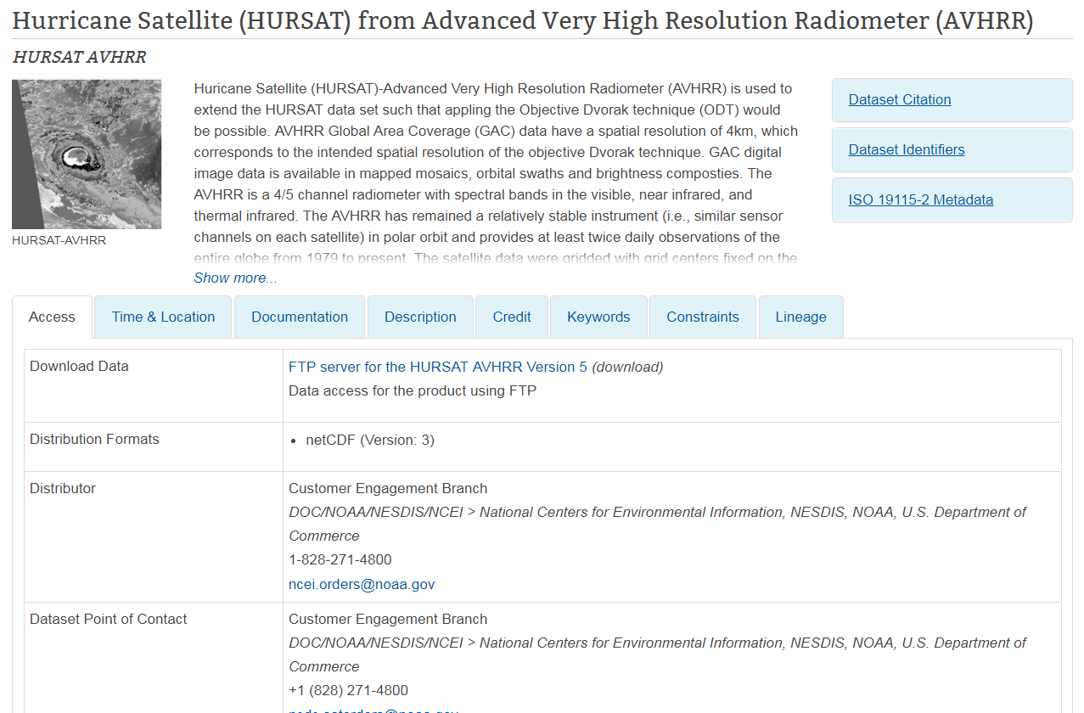
Discovery for Google
https://doi.org/10.7289/V5RF5S0T

Slide 24
Behind the Web Page
<ISO XML/>
<HTML/>
+
Schema.org JSON
HTML Landing Page

Slide 25
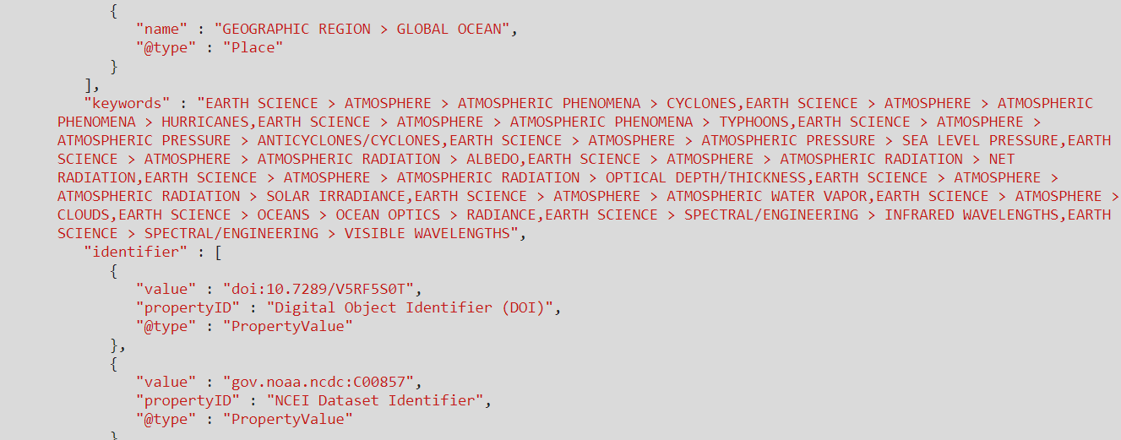
JSON embedded into HTML

Slide 26
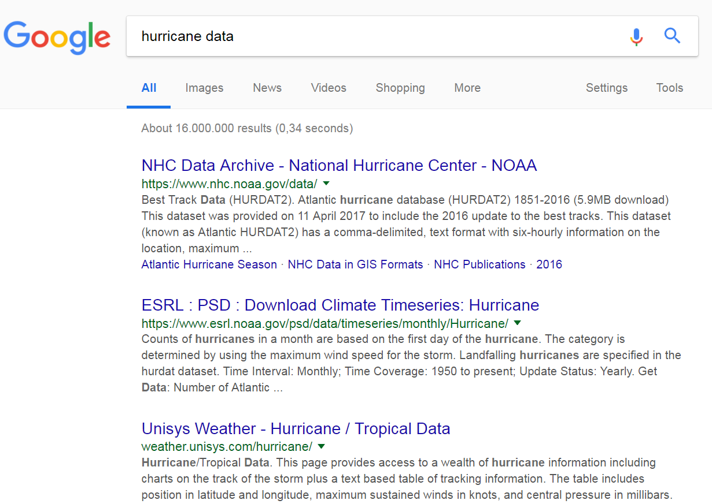
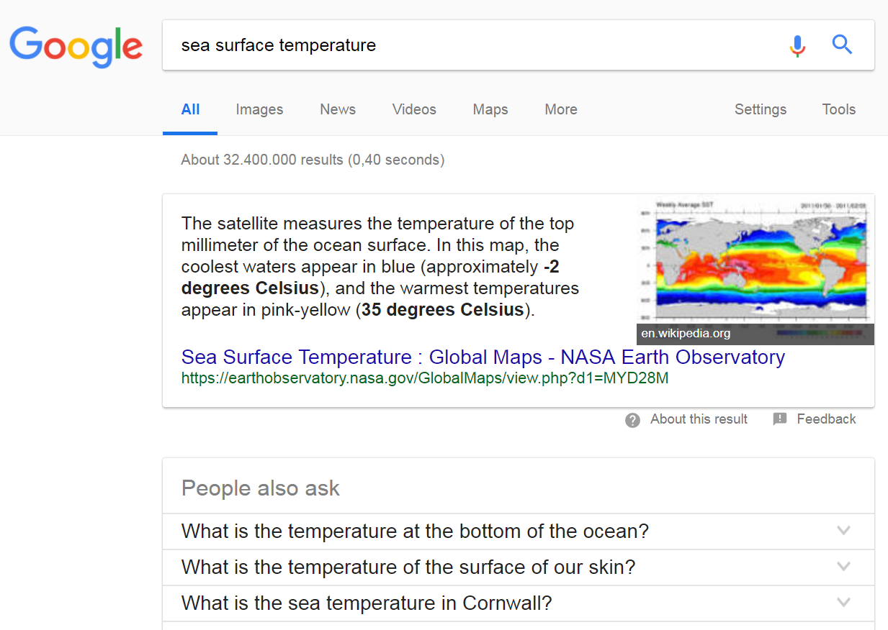
Should enable discovery in Google

Slide 27
Wrap Up

Slide 28
Random Thoughts
Critical: Keywords, keywords, keywords (especially: GCMD, WMO, CF standard names, domain specific)
Establishing useful discovery requires frequent communication and agile consensus across development teams, standard experts and science/data experts
Heavy Lifts
  DSMM Assessments (especially for data quality categories)
  Granule data accessibility and metadata production

Slide 29
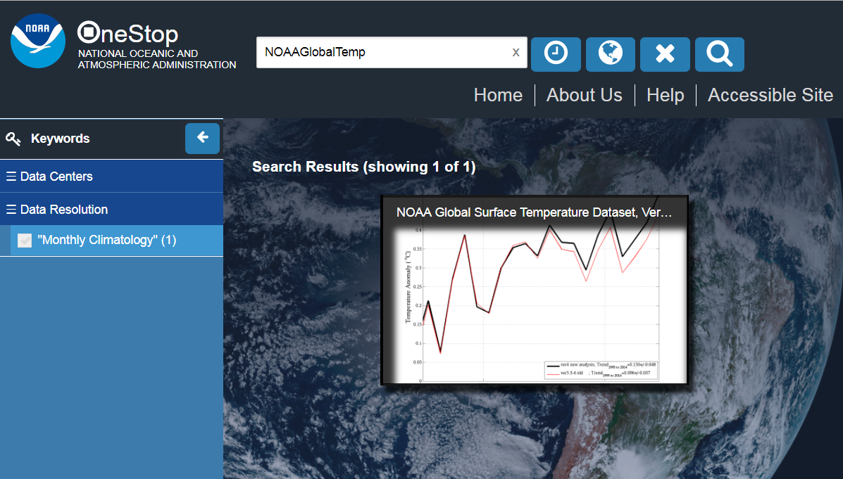
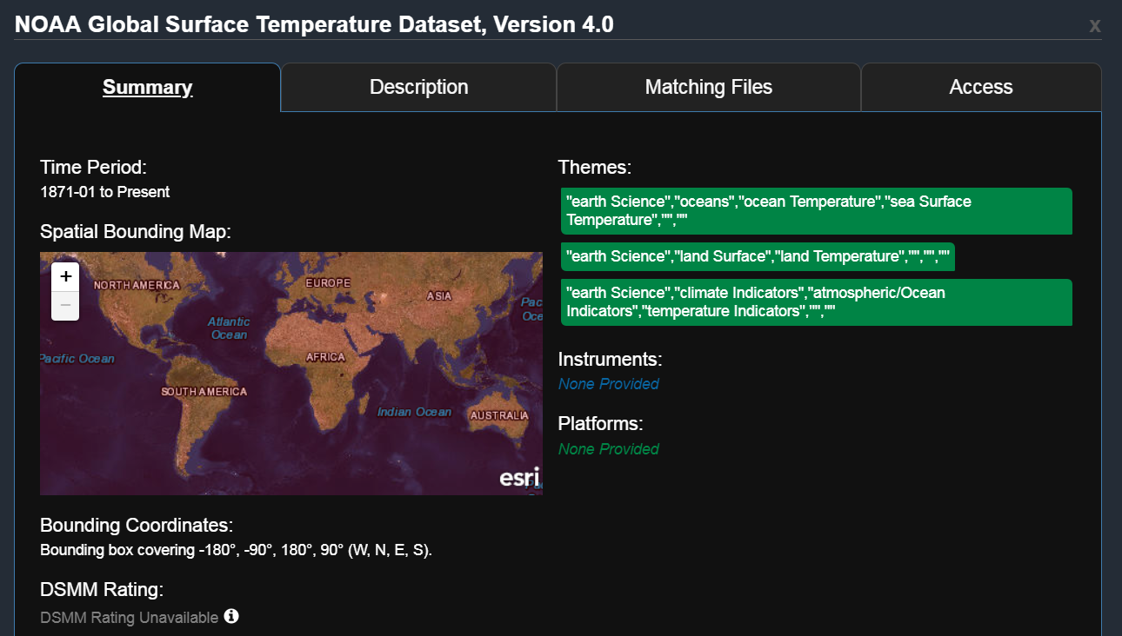
Prototype Improvement of Key NOAA Data for OneStop and WMO Catalog?
Dataset: NOAAGlobalTemp

Slide 30
Thank You
Anna.Milan@noaa.gov

