Slide 1

Maturity Models for Measuring Maturity of
Individual Earth Science Datasets
Ge Peng, PhD
NOAA’s National Centers for Environmental information (NCEI)
Cooperative Institute for Climate and Satellites – NC/NC State University
Expert Meeting on
Climate Data Modernisation
KNMI, De Bilt, Netherlands
April 16–18, 2018
Notes:
Hello everyone. My name is Ge Peng; I go with Peng.
I am a Research Scholar at a cooperate institute bwt NOAA and North Carolina State University on climate and satellites.
I am also affiliated with NOAA’s National Centers for Environmental Information.
I appreciate the opportunity to present an overview of current approaches for assessing dataset maturity.

Slide 2

Quality – i) A distinctive attribute or characteristic possessed by something or someone; ii) How good or bad a thing is; iii) The degree of excellence of something.
Terminology
Maturity – The quality or state of being mature.
Maturity Matrix – A maturity assessment model with desired evolution in discrete, progressive stages from a more ad hoc approach to a more managed process
(Based on: Becker et al. 2009)
maturity of organization capability, a process, a project, or an individual product
Notes:
I’d like to start by defining some terms.
What does it mean how good or bad a data product is? What does it mean being mature? So, it is underlining a benchmark for measuring quality or evaluating maturity.
As indicated in the previous talk, …
A maturity matrix can be developed to measure the maturity of organizational capability, a process, a project, or an individual product. In this talk, I’ll be focusing on those for datasets.

Slide 3
Data Maturity Assessment Models
Why do we need them?
WMO Resolution 40 (Cg-XII)
WMO commits itself to broadening and enhancing the free and unrestricted international exchange of meteorological and related data and products
WMO Quality Management Framework
WMO, through its Programmes and activities, is dedicated to ensuring the highest possible quality of all meteorological, climatological, hydrological, marine and related environmental data, products and services
(https://public.wmo.int/en//our-mandate/how-we-do-it/Quality-Management-Framework)
WIS Objective for Global Climate Data Access
Authoritative, trusted data sets for informing on key climate indicators for global policy users of climate change information
Notes:
Why do we need data maturity assessment models? Why are they beneficial?
WMO is committed to free exchange of data and products;
WMO has dedicated to ensuring the high quality of data, products, and services.
The WMO Information System (WIS) objective for global climate data access is to provide authoritative, trusted datasets
WMO data and products support high influential scientific findings. These findings support policy decisions with significant societal impact. These data and products are required to be, not only scientific sound, but also traceable and transparent to ensure their trustworthiness. Therefore, we need to demonstrate to our users that our data, products and services are in fact high quality. But how? If not, how to improve?

Slide 4
Data Maturity Assessment Models
Why do we need them?
WMO Requirements and Commitments
Open Data & Data Sharing
High-Quality and Trusted Data
WMO management: Do WMO data, products and services meet these commitments?
Data producers/providers: What do they mean? How do I know? What to do to be compliant?
Notes:
So WMO has made the commitments. How does WMO management know?
Data producers or providers: what do these mean? How do I know if I am compliant not? If not, what do I need to do?
WMO data and products support high influential scientific findings. These findings support policy decisions with significant societal impact. These data and products are required to be, not only scientific sound, but also traceable and transparent to ensure their trustworthiness. Therefore, we need to demonstrate to our users that our data, products and services are in fact high quality. But how? If not, how to improve?

Slide 5
Support Compliance Verification and Reporting – Consistent and quantitative measures.
Data Maturity Assessment Models
Why are they beneficial?
Provide Guidance – Progressive, incremental improvement utilizing cross-disciplinary best practices.
Provide Structure – Necessary for systematic implementation and integration.
Allow for Tiered Quality Requirements – ECVs vs non-ECVs; GCOS vs non-GCOS variables and stations; Core vs non-core production systems.
Manage Data Stewardship Activity – Knowing where you are, where you need to go, and how to get there.
Notes:
Here are some of the benefits of maturity models
So you will say, that’s great and let’s have a MM for measuring dataset maturity and be done with it!
Unfortunately, there are big challenges for developing and implementing a MM.
ECVs – Essential Climate Variables (air temperature, precipitation, atmospheric motion (i.e. winds), air pressure, humidity and solar radiation)
GCOS – Global Climate Observing Systems.

Slide 6
Data and Information Quality Are Multi-Dimensional
(Vast number of ways to define data quality attributes)
Perspective
Quality Attributes
Based on importance of data quality attributes ranked by data consumers (15 out of 179 possible attributes)
(Wang and Strong 1996, J. Management Info. Sys.)
Intrinsic (accuracy, objectivity, believability, reputation),
Contextual (relevance, timeliness, completeness, value-added, appropriate amount of data),
Representational (ease of understanding, concise representation and representational consistency, interpretability), and
Accessibility (accessibility, access security).
Notes:
One of the biggest challenges is the fact that there are so many if not infinite number of ways to define data quality attributes. Here are some of the examples.
This perspective considers the scientific quality of data, addresses the fitness for purpose, usability and accessibility but does not explicitly consider quality attributes for preservation..

Slide 7
Data and Information Quality Are Multi-Dimensional
(Vast number of ways to define data quality attributes)
Perspective
Quality Attributes
Based on the open data and data sharing principles
(Wilkinson et al. 2016, Scientific Data)
Findable,
Accessible,
Interoperable,
Reusable.
FAIR Data Guiding Principles
Scientific data publishers
Requirements, such as those for preserving and ensuring science quality of data products, not explicitly addressed.
Notes:
This perspective primarily considers requirements for data users to find, get, integrate, and use the data – scientific data publishers.
However, as repositories or service centers, we may also need to satisfy other requirements such as those for preserving data and ensuring data quality and integrity.

Slide 8
Data and Information Quality Are Multi-Dimensional
(Vast number of ways to define data quality attributes)
Perspective
Quality Attributes
Based on different data product lifecycle phases
(Ramapriyan et al. 2017, D.-Lib Magazine)
Science (accuracy, precision, uncertainty)
(define, develop, and validate),
Product (how well the product has been produced and assessed; product metadata and document completeness)
(produce, assess, and deliver),
Stewardship (how well the data are being managed, preserved, and stewarded; metadata and documentation for access)
(maintain, preserve and disseminate),
Service (how well the data are being serviced; user support and engagement)
(use, services, and support)
Notes:
There are many other perspectives one could consider.
I like this one, not just because I am one of the co-authors, but also because it takes an entire data product lifecycle into consideration. It helps facilitating roles and knowledge required for evaluating the maturity of datasets for these quality attributes.
In the following of this presentation, I will touch on the existing maturity assessment models for each of these four dimensions

Slide 9
Data Product Lifecycle-Stage-Based MMs
Quality Perspective
Maturity Matrix
Science (define/develop/validate)
Gap Analysis for Integrated Atmospheric ECV CLimate Monitoring (GAIA-CLIM) measurement system maturity matrix (Thorne et al 2015),
NOAA’s Center for Satellite Applications and Research (STAR) data product algorithm maturity matrix (Reed 2013; Zhou et al. 2016 ),
COordinating Earth observation data validation for RE-analysis for CLIMAte ServiceS (CORE-CLIMAX) production system maturity matrix (EUMETSAT 2013)
(Peng 2018, Data Science Journal)
Notes:
Several MMs can be mapped to science quality perspective. Such as the one for measurement system.

Slide 10
Data Product Lifecycle-Stage-Based MMs
Quality Perspective
Maturity Matrix
Product (Produce/Assess/Deliver)
NOAA satellite-based climate data records (CDR) product maturity matrix (Bates and Privette 2012),
CORE-CLIMAX production system maturity matrix (EUMETSAT 2013)
(Peng 2018, Data Science Journal)

Slide 11
Data Product Lifecycle-Stage-Based MMs
Quality Perspective
Maturity Matrix
Stewardship (maintain/Preserve/Disseminate)
NCEI/CICS-NC scientific data stewardship maturity matrix (Peng et al. 2015),
CEOS Working Group on Information Systems and Services (WGISS) data management and stewardship maturity matrix (WGISS DSIG 2017).
(Peng 2018, Data Science Journal)
Notes:
WGISS MM is based on GEOS Data Management Principles.

Slide 12
Data Product Lifecycle-Stage-Based MMs
Quality Perspective
Maturity Matrix
Service (use/Service/Support)
National Snow and Ice Data Center (NSIDC) level of services (Duerr et al. 2009),
NCEI tiered scientific data stewardship services (Peng et al. 2016a),
Global Climate Observing System (GCOS) ECV Data and Information Access Matrix,
Global Ocean Observing System (GOOS) framework,
NCEI data monitoring and user engagement maturity matrix (Arndt and Brewer 2016).
(Peng 2018, Data Science Journal)
Notes:
NCEI Data Use/Service MM Working Group has been trying to develop a Use/Service MM, in collaboration with Earth Science Information Partners (ESIP) Data Stewardship Committee.

Slide 13
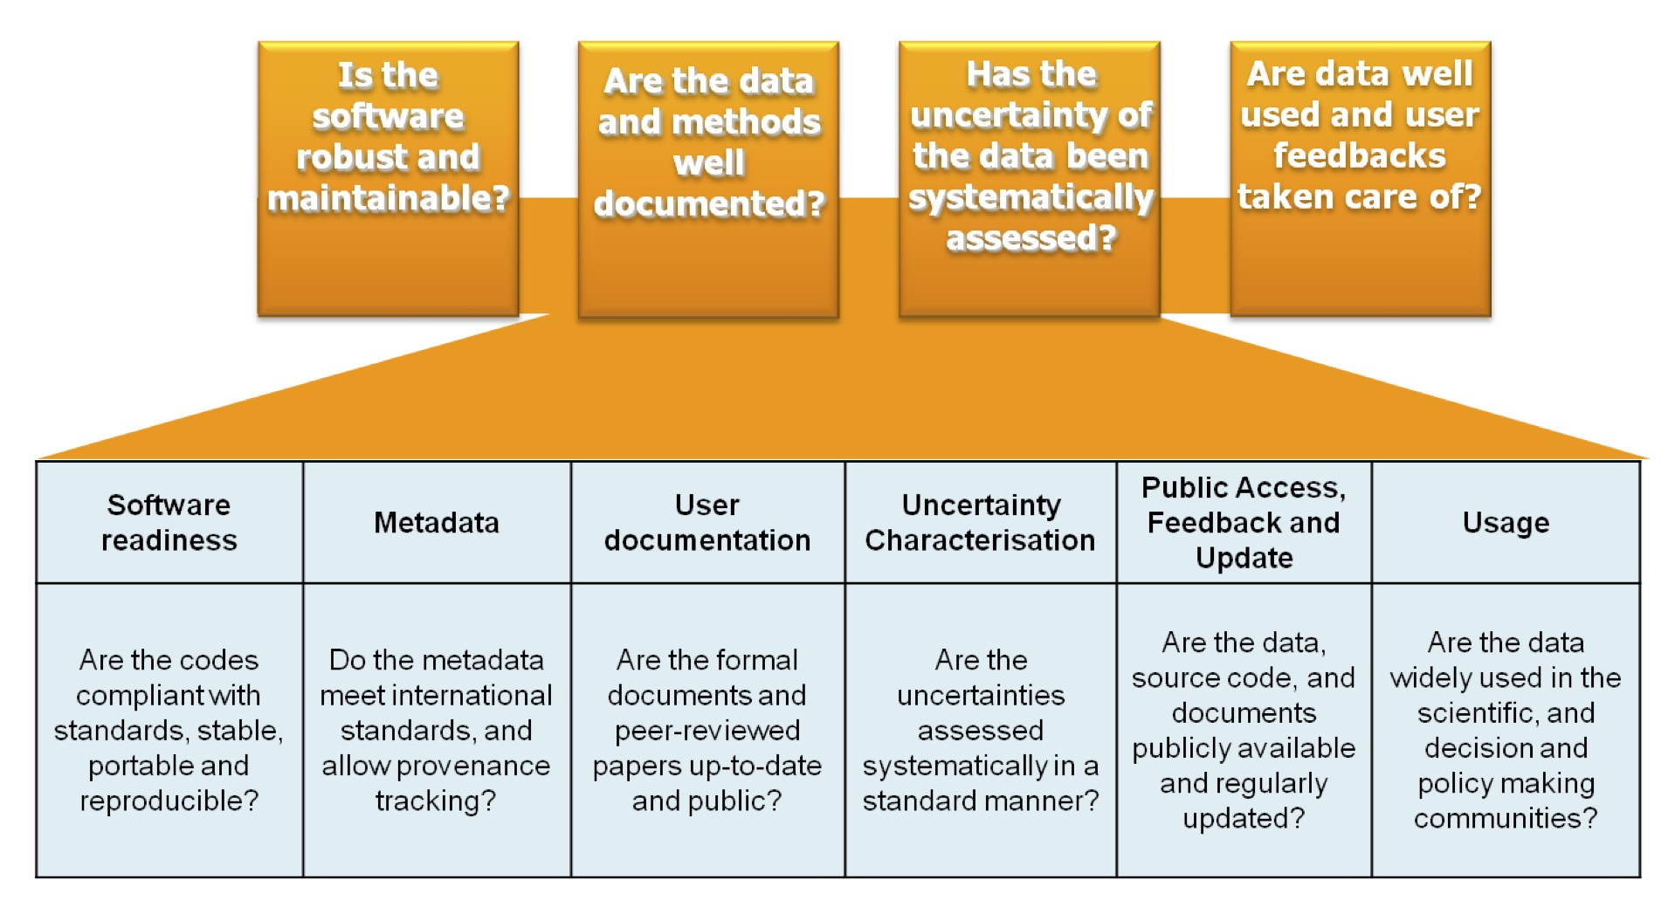
CORE-CLIMAX Production System MM
( six key areas)
(EUMETSAT 2015, Core-Climax Deliverable D2.25)

Slide 14
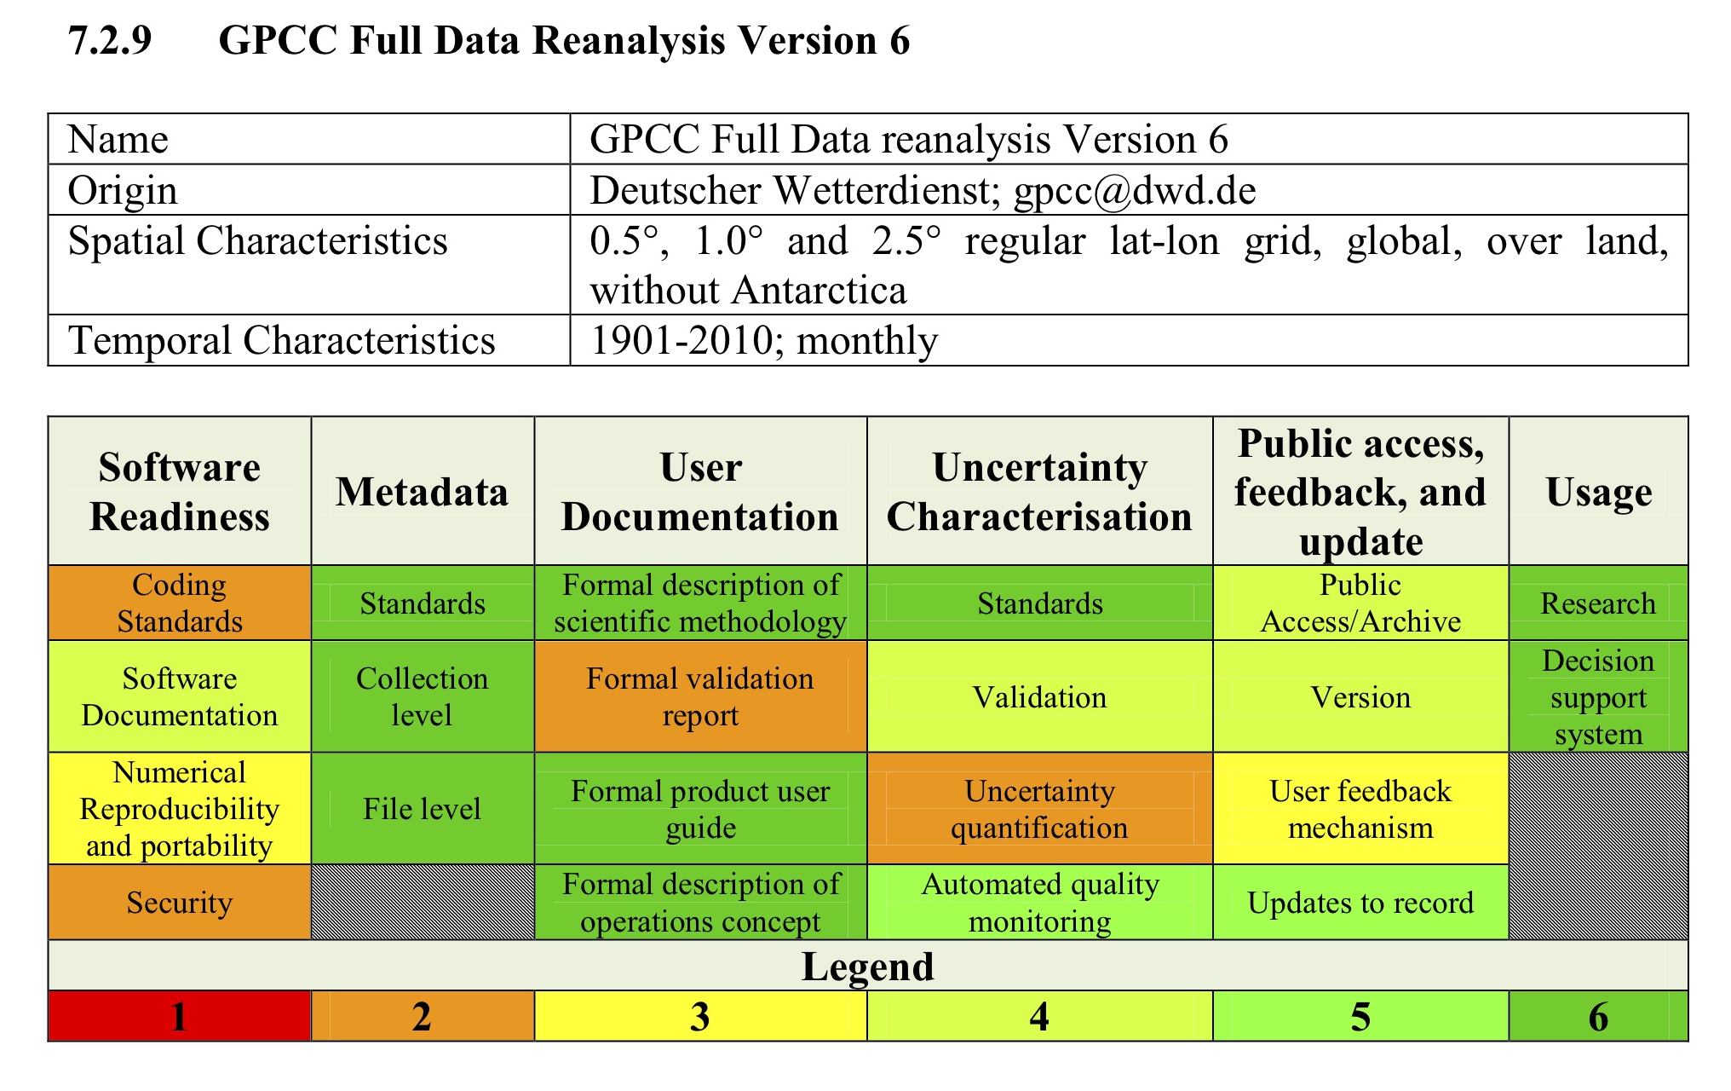
CORE-CLIMAX Production System MM
(EUMETSAT 2015, Core-Climax Deliverable D2.25)

Slide 15
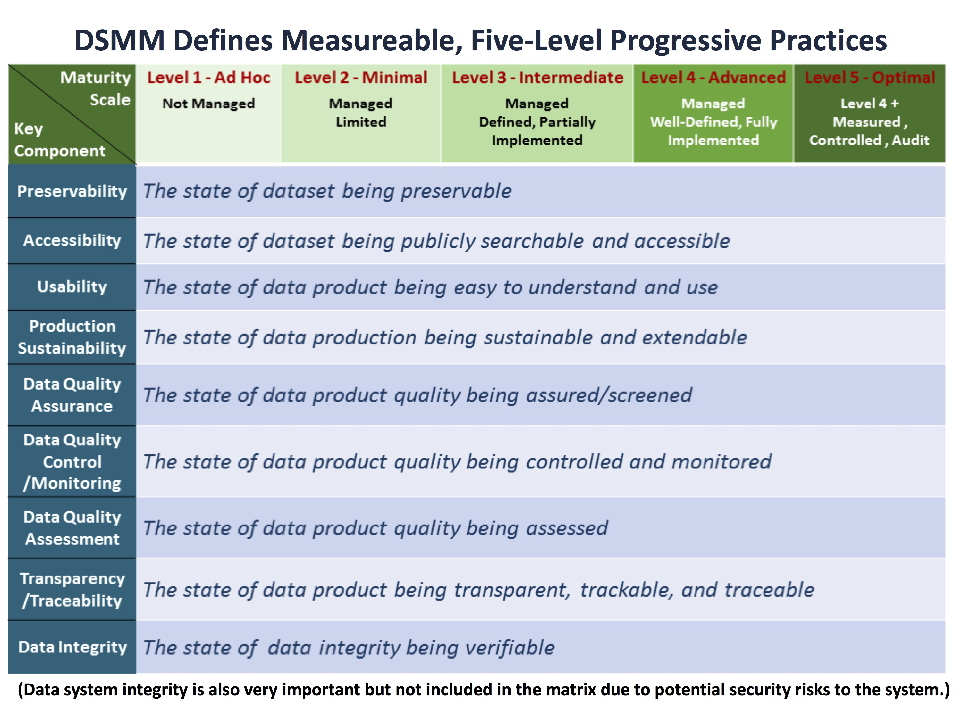
NCEI/CICS-NC Data Stewardship MM
(Nine Key Components within Functional Entities of
the Open Archival Information System (OAIS) RM)
(Getting to know DSMM: tinyurl.com/DSMM-FlowChart)

Slide 16
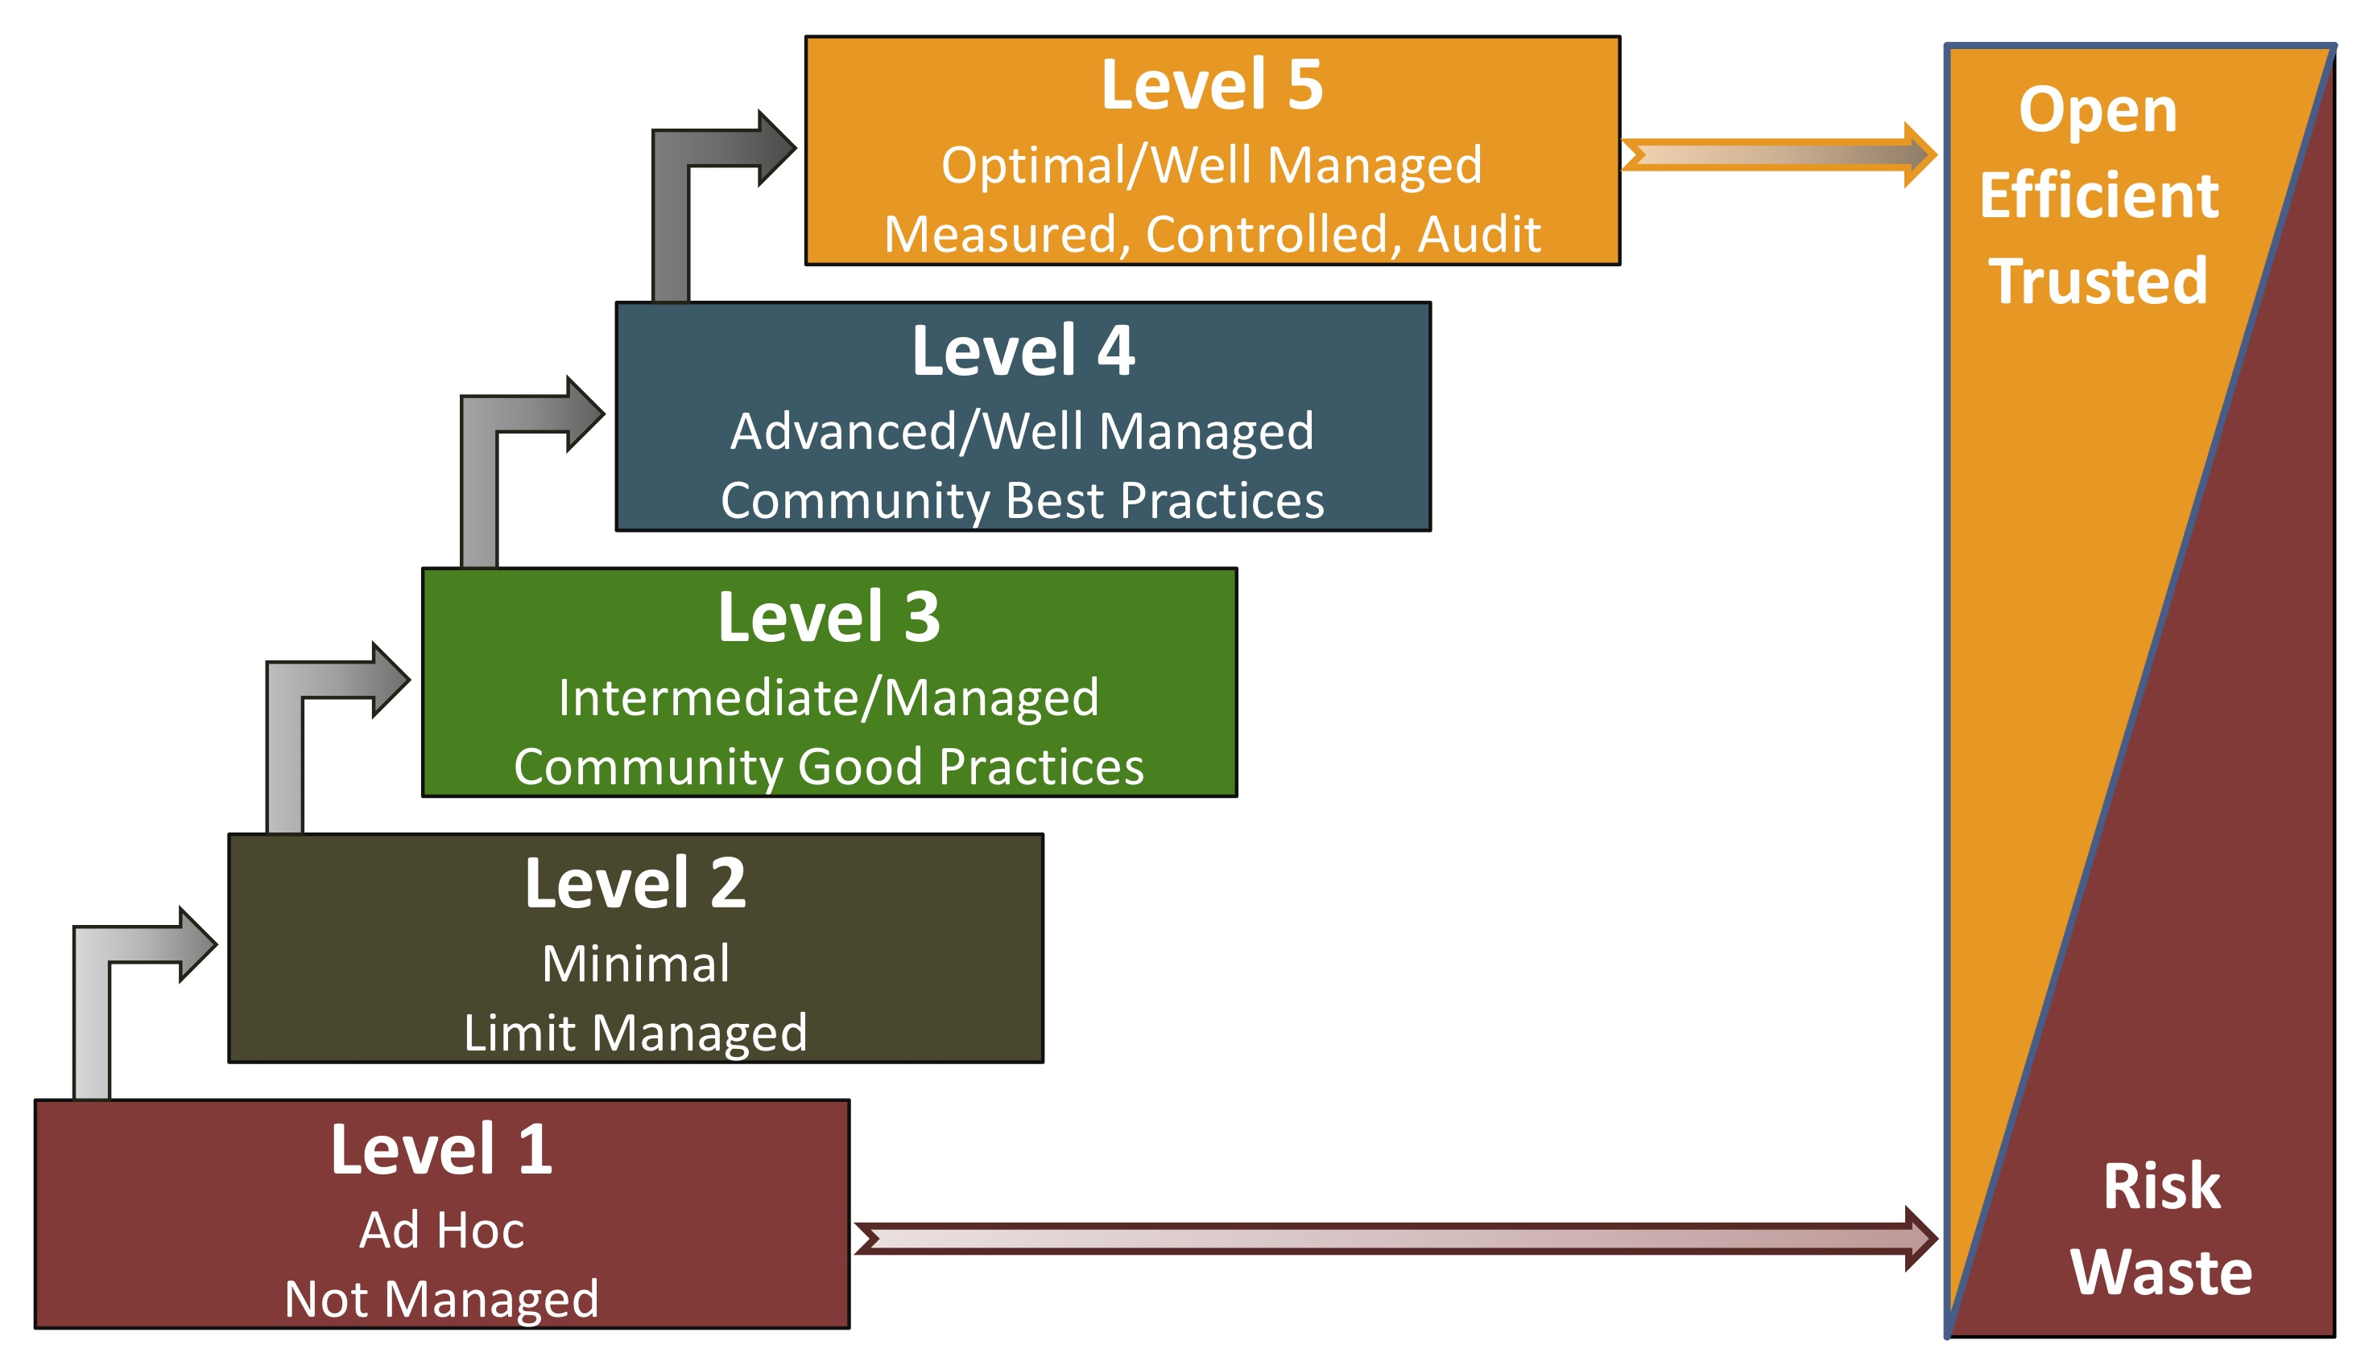
DSMM Follows CMMI Level Structure
Reference Maturity Level Structure
Capability Maturity Model Integration (CMMI)
Levels of Maturity of Digital repository

Slide 17
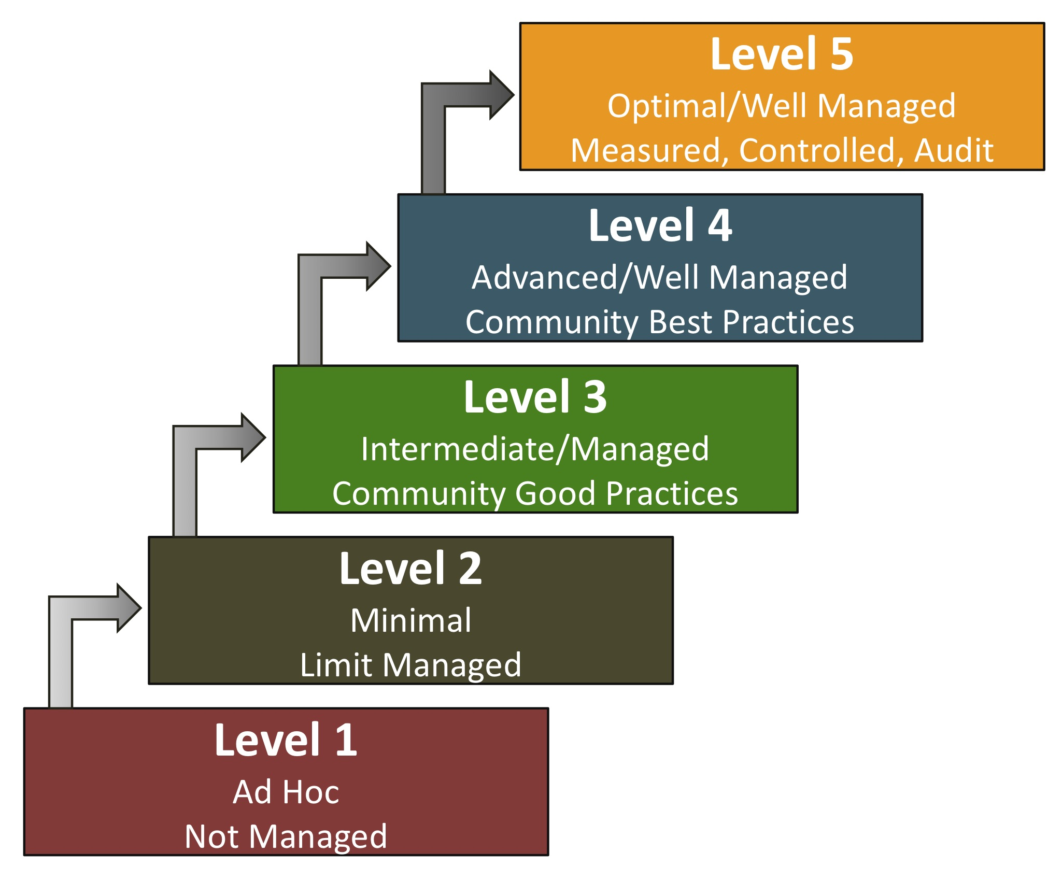
DSMM Follows CMMI Level Structure
Recommended level for
operational digital products
stewarded by National
Data Centers/Programs
WMO High-Quality Climate Datasets
Reference Maturity Level Structure
Capability Maturity Model Integration (CMMI)
Levels of Maturity of Digital repository

Slide 18
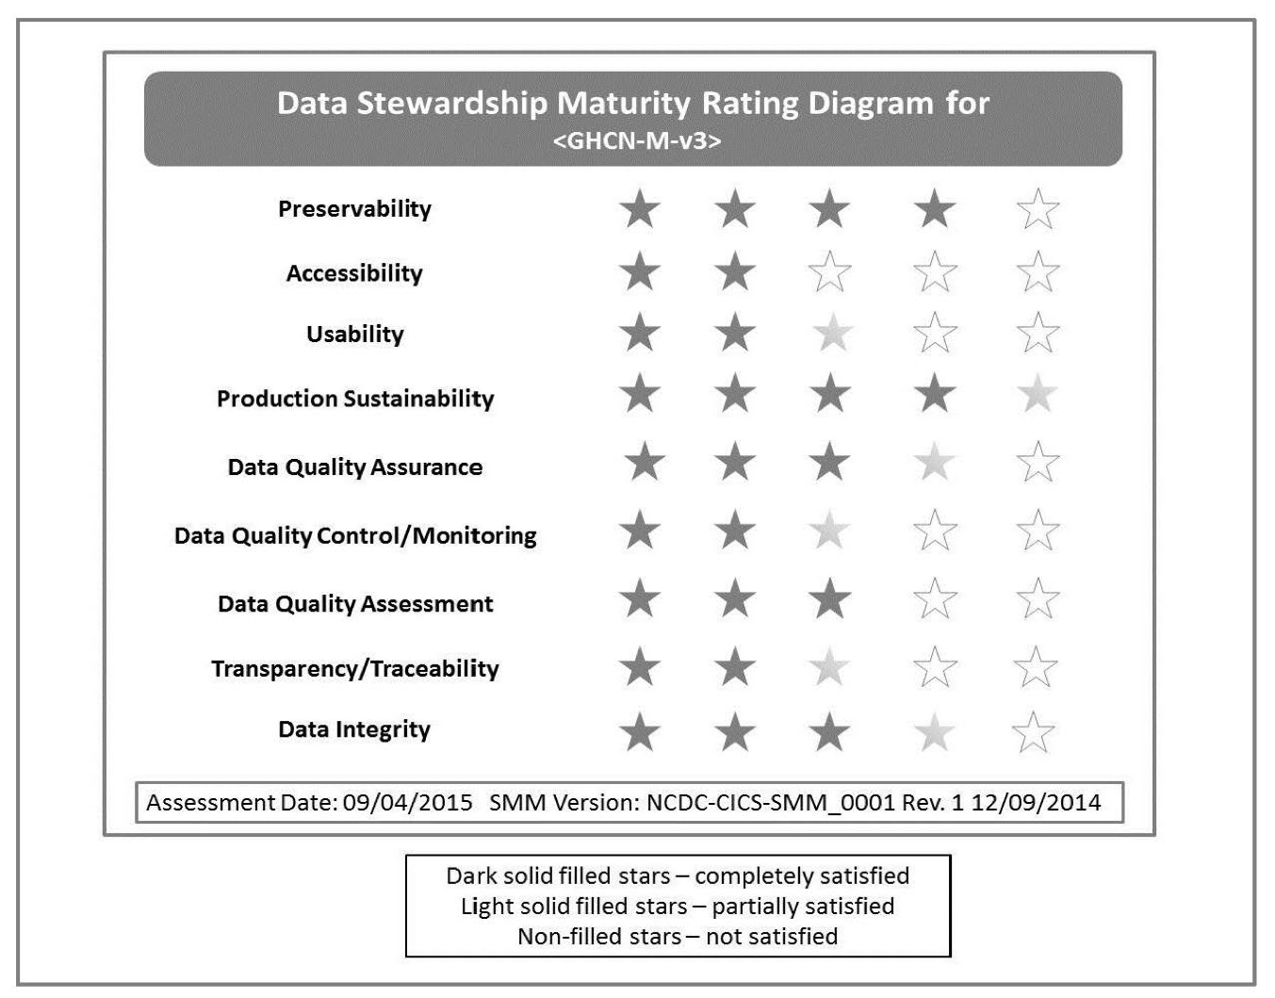
MM-Stew Rating Diagram of GHCN-Monthly v3
Notes:
GHCN - Global Historical Climatology Network

Slide 19
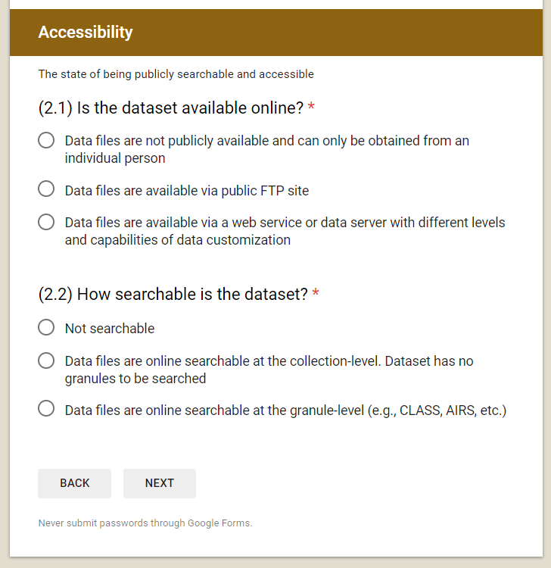
Streamline the Assessment Process
Maturity Scale | Accessibility
Level 1 – Ad Hoc Not Managed | Not publicly available Person-to-person
Level 2 - Minimal Managed Limited | Publicly available Direct file download (e.g., via anonymous FTP server) Collection/dataset level searchable
Level 3 - Intermediate Managed Defined, Partially Implemented | Level 2 + Non-standard data service Limited data server performance Granule/file level searchable Limited search metrics
Level 4 - Advanced Managed Well-Defined, Fully Implemented | Level 3 + Community-standard data services Enhanced data server performance Conforming to community search metrics Dissemination report metrics defined and implemented internally
Level 5 - Optimal Level 4 + Measured , Controlled , Audit | Level 4 + Dissemination reports available online Future technology and standard changes planned
Data Stewardship Maturity Questionnaire
(Courtesy of OneStop Metadata Content Editor Team)
Notes:
Having a MM is an important but still just a first step. One needs guidance to implement the MM, to actually make assessment utilizing the MM, capture the assessment results in metadata and document, preferably in a consistent and persistent fashion, integrate ratings across systems, and convey the information to data users.
NOAA OneStop Program has developed workflows, tools, and best practices of applying DSMM that I would like to touch on in the next a few slides. They may be useful once a WMO-wide MM is developed.
Making assessment is so far the most manual and labor-intensive part – there are a number of reasons for that and I would not go into details in this talk. Please feel free to talk to me if you would like to know more. To streamline this process, OneStop has developed the Data Stewardship Maturity Questionnaire – pre-defined questions with pre-populated answers

Slide 20
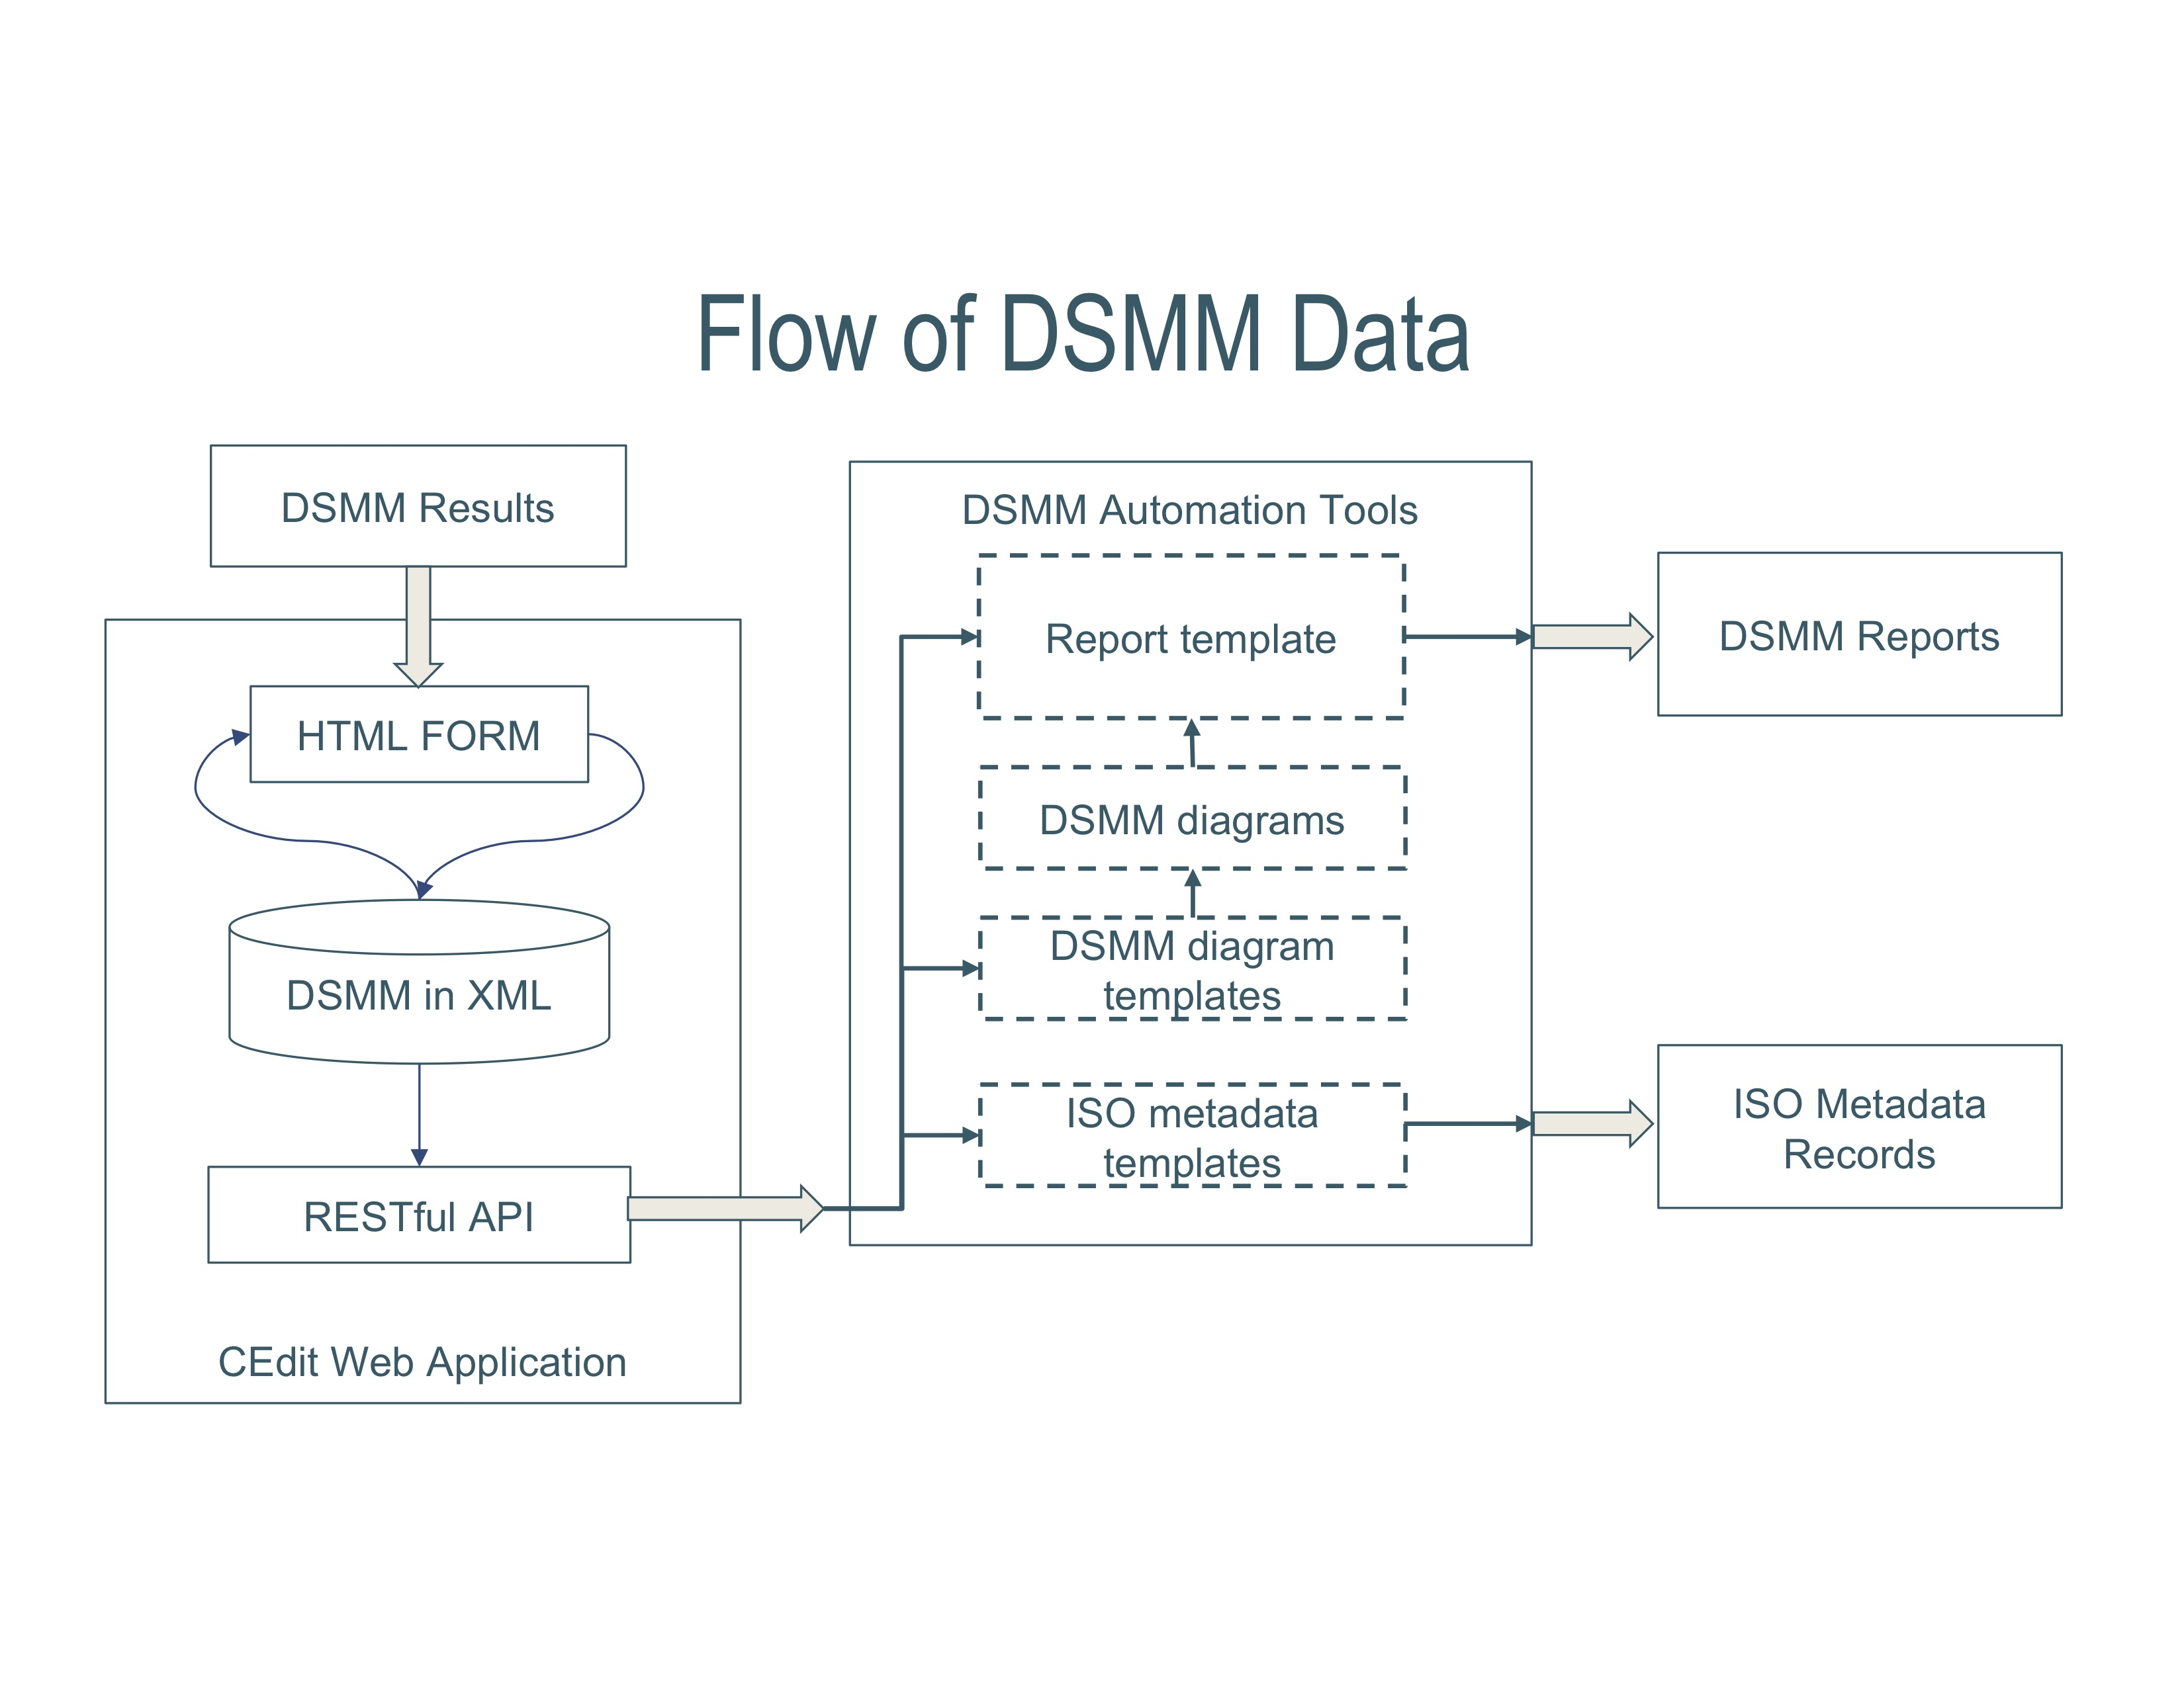
Automate the Integration Process
Citable & Discoverable Quality Descriptive Information
Web Accessible Folder
OneStop Search & Discovery Portal
(Courtesy of S. Zinn, OneStop Tools and Services Team)
Notes:
Assessments are captured via web application using RESTful API. Tools are developed to automate generating consistent DSMM rating diagrams and reports; to capture ratings into ISO collection-level metadata records via an ISO data quality metadata template. These ISO collection metadata records are utilized by OneStop Search and Discovery Portal and harvested by online catalogs and search engines.
We are at the last step to archive and publish DSMM reports by NOAA Central Library as technical Information Series (TIS)

Slide 21
ISO Data Quality Metadata Implementation
Data Quality
Is expressed by
DQ Element
is described by
DQ Measure Reference
DQ Evaluation Method
DQ Result
DQ Metadata
Measure Name
Measure ID
Measure Description
Evaluation Method Description
Evaluation Procedure Reference
Evaluation Quantitative Results
Conformance Result Explanation
Evaluation Date
Evaluation Version
Evaluation POC
Evaluation Citation
(Best practices developed by OneStop Metadata Team)
Notes:
In collaboration with NOAA Enterprise Metadata Working Group, OneStop Metadata Team has developed the best practices to represent DSMM ratings using ISO data quality metadata standards.

Slide 22
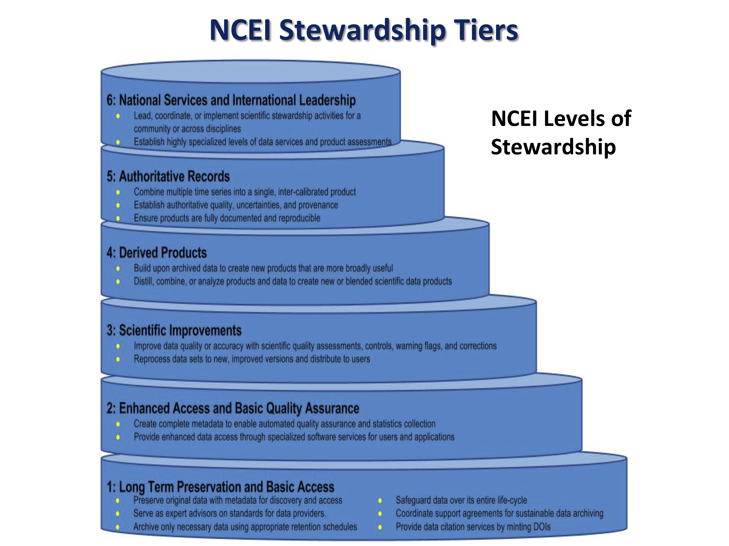
NOAA’s NCEI Tiered Scientific Data Stewardship Services

Slide 23
What Does “Trusted” Mean?
Trusted data: Data that is
drawn from carefully selected sources,
transformed in accordance with data’s intended use, and
delivered in formats and time frames that are appropriate to specific consumers of reports and other manifestations of data.
(Source: https://tdwi.org/articles/2011/05/18/the-six-cs-of-trusted-data.aspx)
A trusted digital repository is one whose mission is to provide reliable, long-term access to managed digital resources to its designated community, now and in the future
(source: https://www.oclc.org/content/dam/research/activities/trustedrep/repositories.pdf)
Notes:
Hope that has given you some idea about current maturity assessment models that have been used for Earth Science datasets.
A sense of complicity of assessing quality, namely, maturity of data, products, and services.
Now I’d like to conclude my presentation with this question: What does “Trusted” mean?
Here are a couple of examples. What do we mean by Trusted Data or a trusted digital repository?

Slide 24

Thank you
Ge.Peng@noaa.gov

Slide 25
Backup Slides

Slide 26
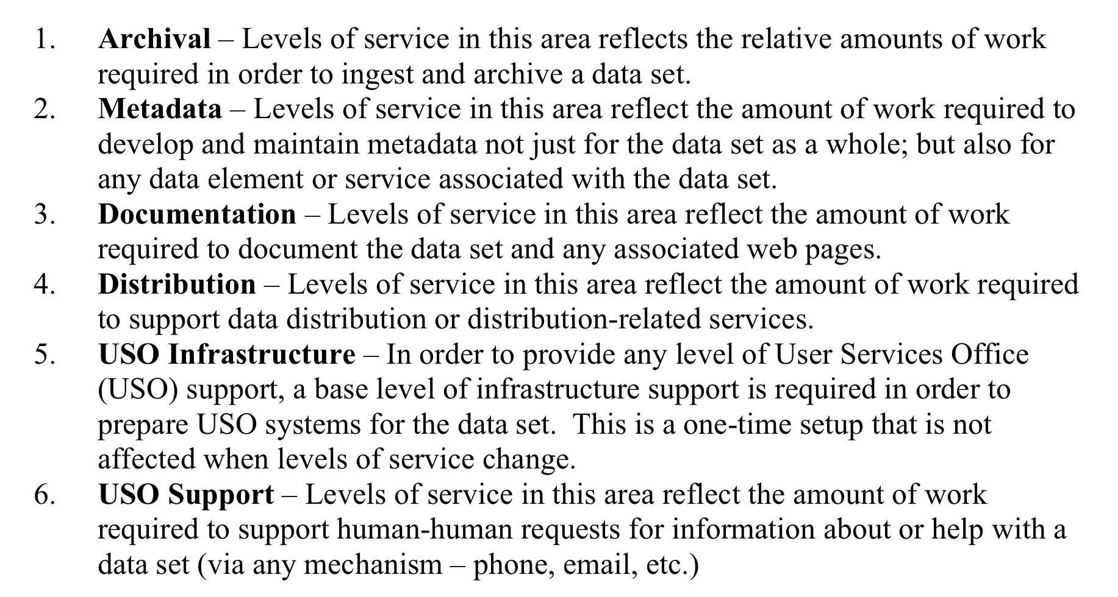
Categories of NSIDC Levels of Services
(Duerr et al. 2009, National Snow and Ice Data Center)

Slide 27
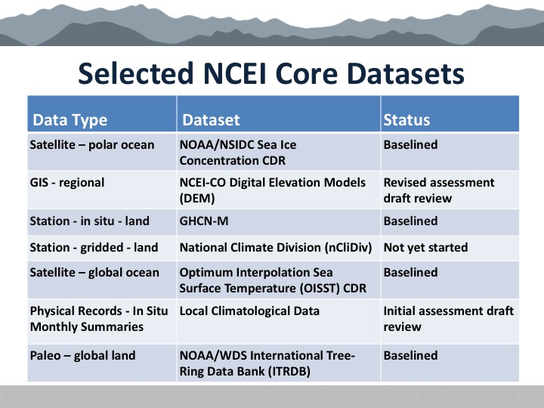
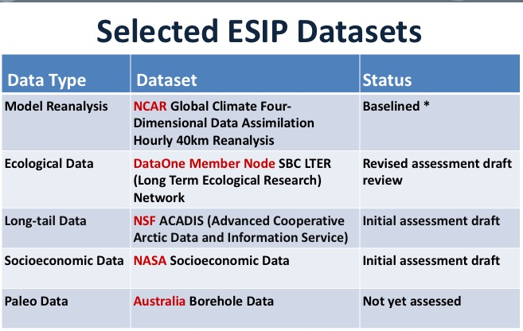
DSMM Vetting Process
Community Engagement: Feedback and Collaboration
  Internal (Domain SMEs from NOAA Data Centers: NCDC, NGDC, and NODC –> NCEI)
  External (SMEs from ESIP Data Stewardship Committee; ESIP, AMS and AGU meetings)
Use Case Studies
  NCEI Core Datasets – Different data types managed by same organization
  ESIP DSC Datasets – Different disciplines managed by different organizations

Slide 28
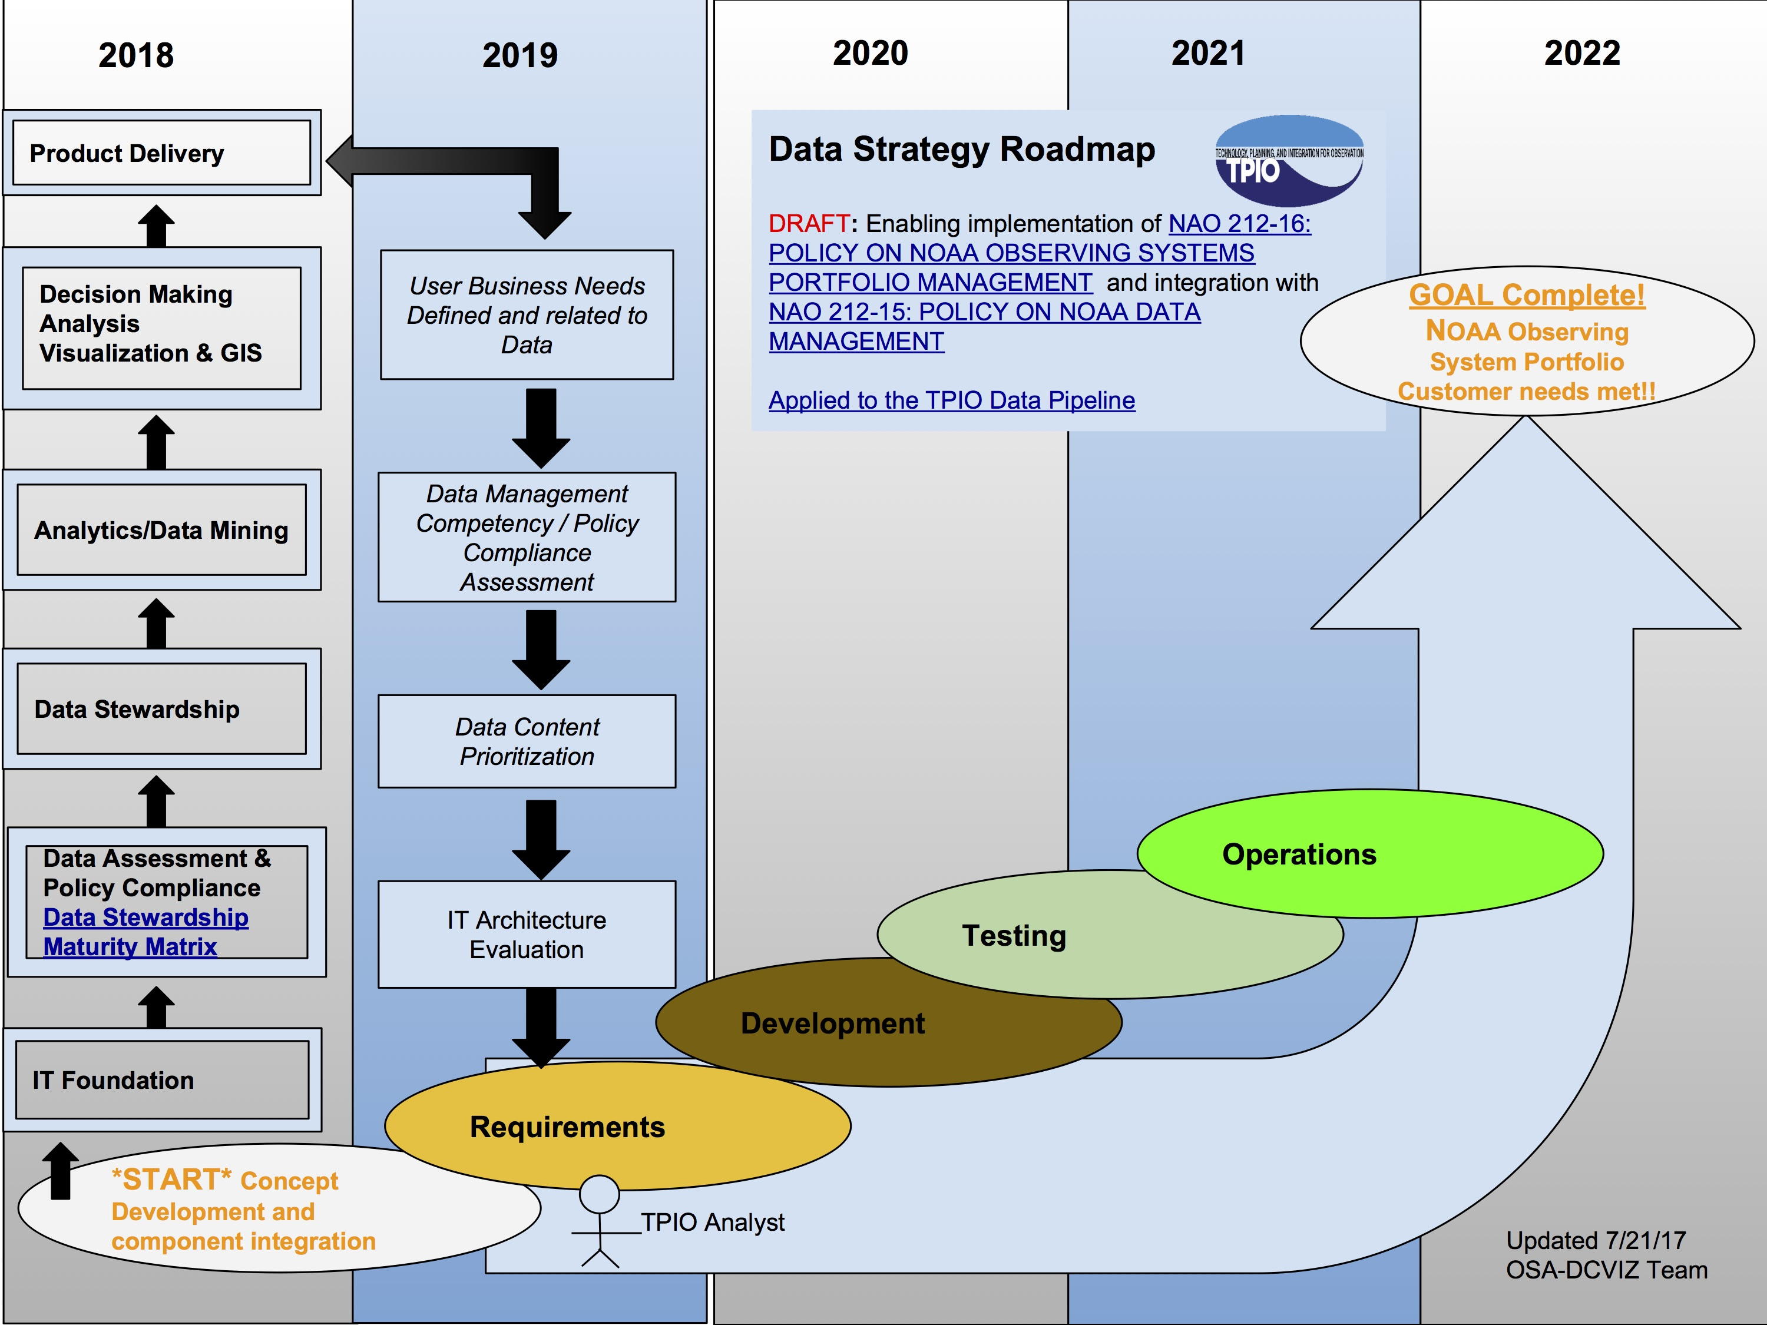
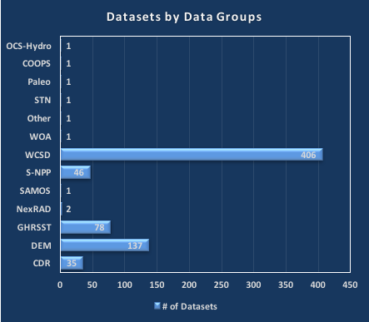
DSMM Applications & Implementation
Data Quality Descriptive Information
DSMM
Evaluating data product stewardship maturity (as of 1/31/2017), mostly done by OneStop Metadata Team
NOAA TPIO Data Strategy Roadmap
(Courtesy of Matthew Austin, Team Lead)

Slide 29
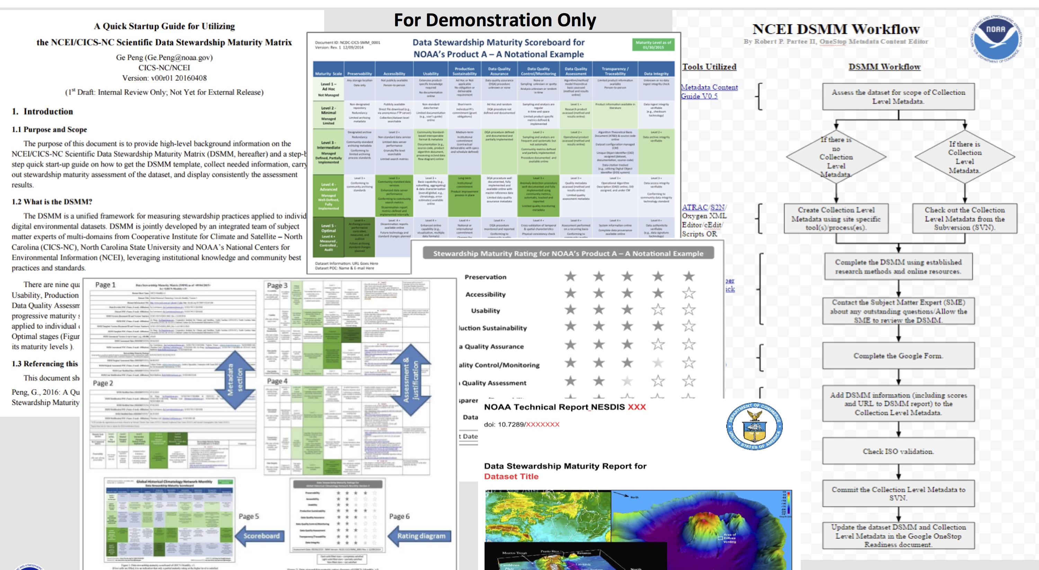
NOAA OneStop Application of DSMM
Promoting consistent and systematic assessment, representation, documentation, and integration of dataset quality (tinyurl.com/DSMM-OneStop-Poster)

Slide 30
Implementing DSMM ratings into ISO Data Quality Metadata
Measure Name | Data Stewardship Maturity Assessment
Measure ID | MM-Stew
Measure Description | The Data Stewardship Maturity Matrix (DSMM) is a unified framework that defines criteria for each of nine components based on measurable practices, which can be used to apply a progressive, 6-level rating to an individual dataset, representing stewardship maturity stages rated as not assessed or not available (Level 0), d Hoc (Level 1), minimum (Level 2), intermediate (Level 3), advanced (Level 4), and optimal (Level 5).
Evaluation Description | Data Stewardship Maturity Assessment was evaluated by the metadata content editor for the NOAA OneStop project using the Scientific Data Stewardship Maturity Assessment Model Template v4.0.
Procedure Reference | Peng, Ge. The Scientific Data Stewardship Maturity Assessment Model Template. 2015-06-23. doi:10.6084/m9.figshare.1211954

Slide 31
Implementing DSMM ratings into ISO Data Quality Metadata
Date of Measurement | 2016-12-08
Version of Measurement
Quantitative Results
Preservability | advanced
Accessibility | minimum
Usability | advanced
Production Sustainability | advanced
Data Quality Assurance | advanced
Data Quality Control/Monitoring | minimal
Data Quality Assessment | intermediate
Transparency/Traceability | intermediate
Data Integrity | advanced
Conformance Results Explanation | Data stewardship maturity assessment was carried out by NOAA OneStop metadata content editor, in collaboration with subject matter experts of the product and the maturity matrix.
Reference | Lemieux, P., G. Peng, and D.J. Scott, 2017: Data Stewardship Maturity Report for NOAA Climate Data Record (CDR) of Passive Microwave Sea Ice Concentration, Version 2. Figshare. doi:https://doi.org/10.6084/m9.figshare.5279932

Slide 32
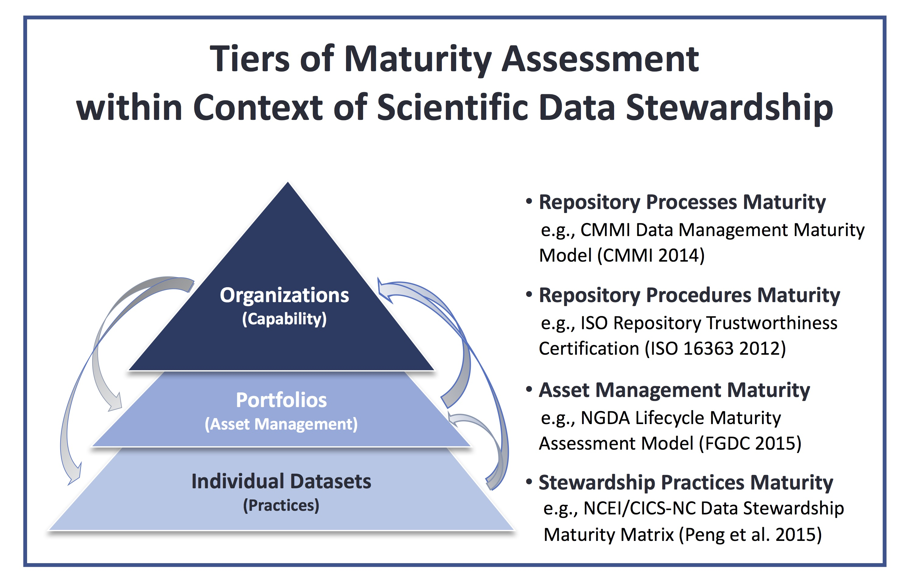
(Peng 2018, Data Science Journal)

Slide 33
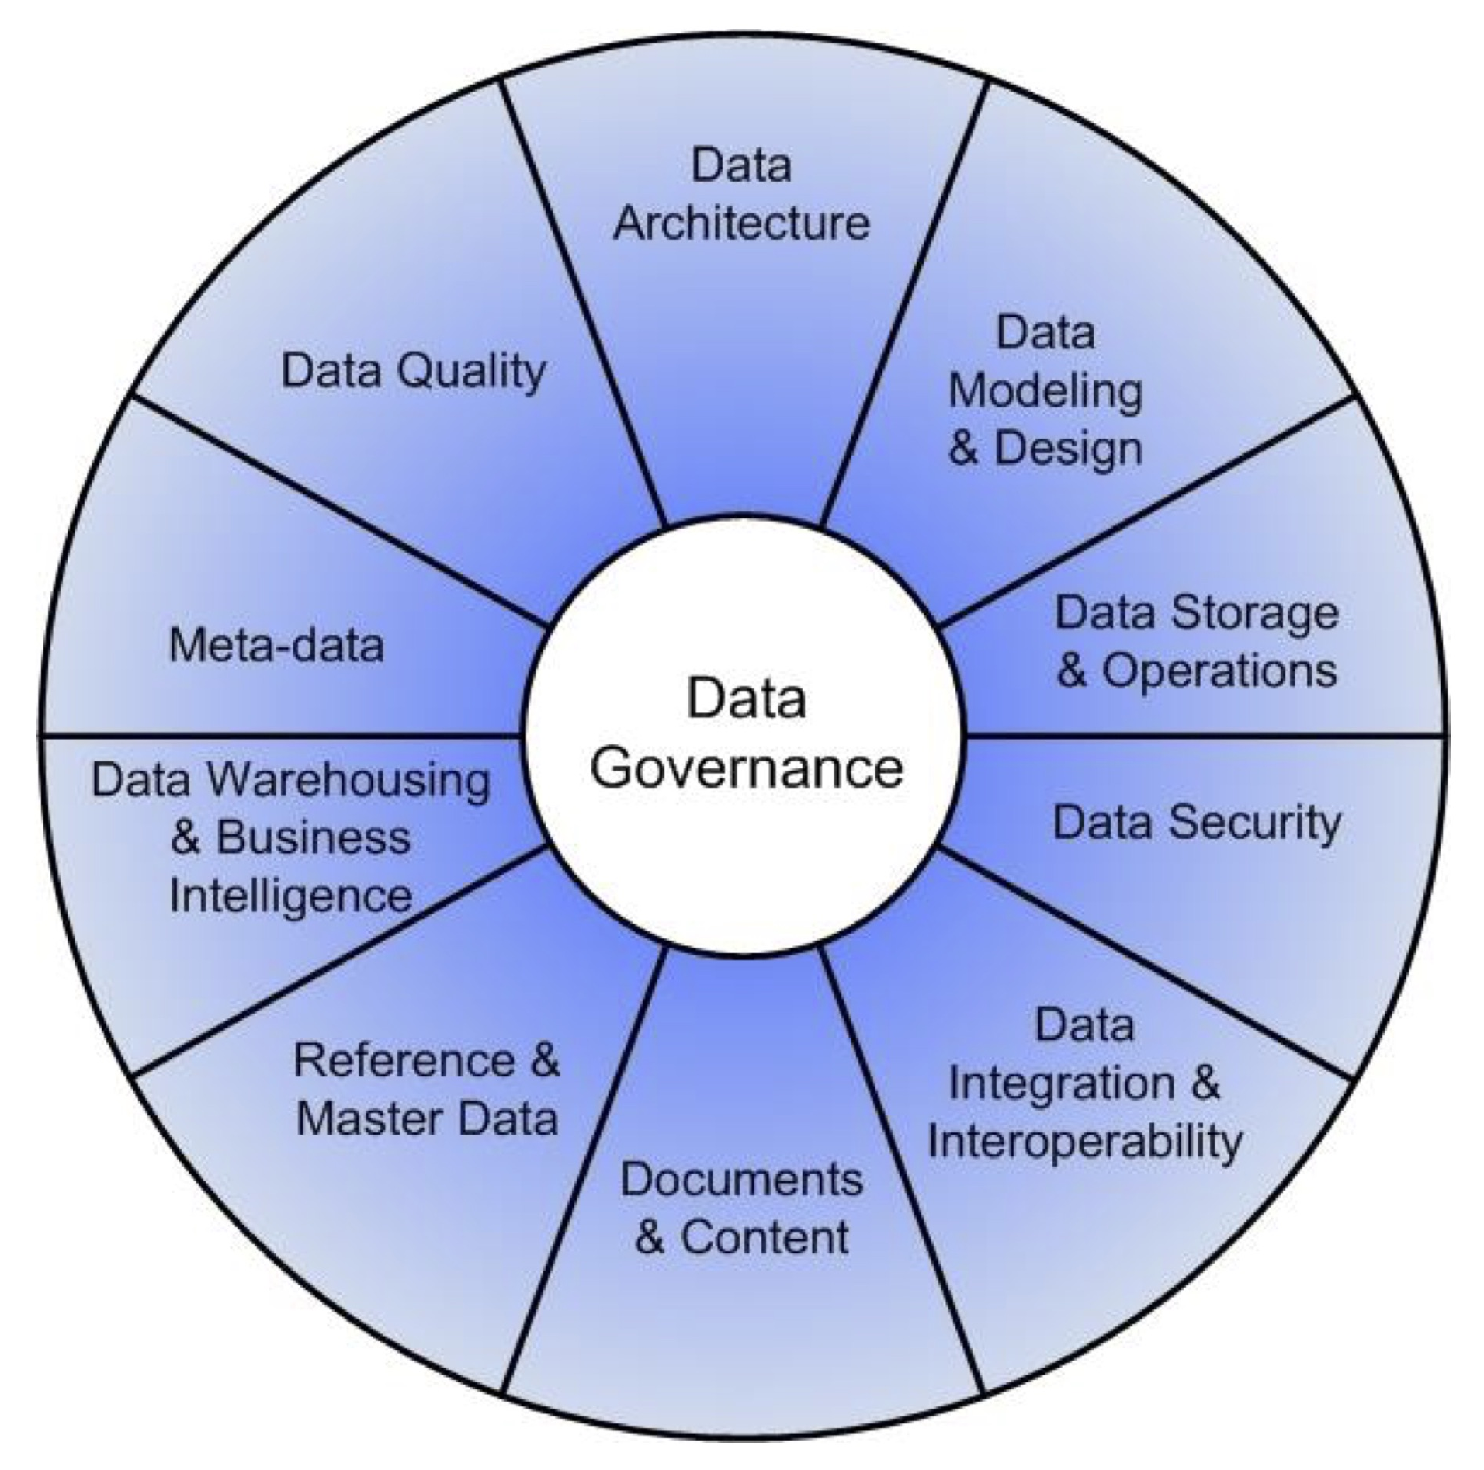
11 Knowledge Areas of Data Management
(DAMA International DMBOK 2014)

Slide 34
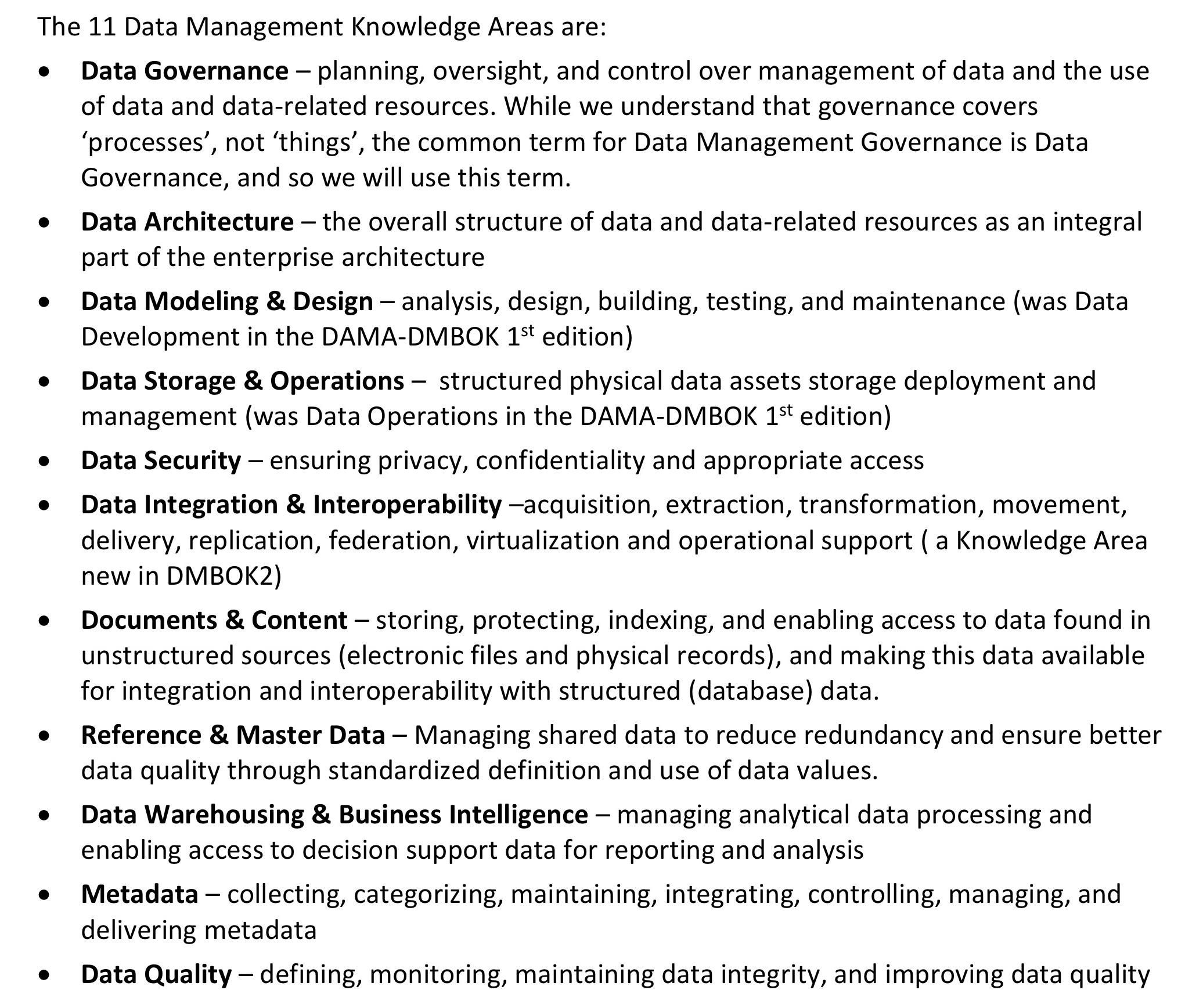
11 Knowledge Areas of Data Management
(DAMA International BOK 2014)

Slide 35
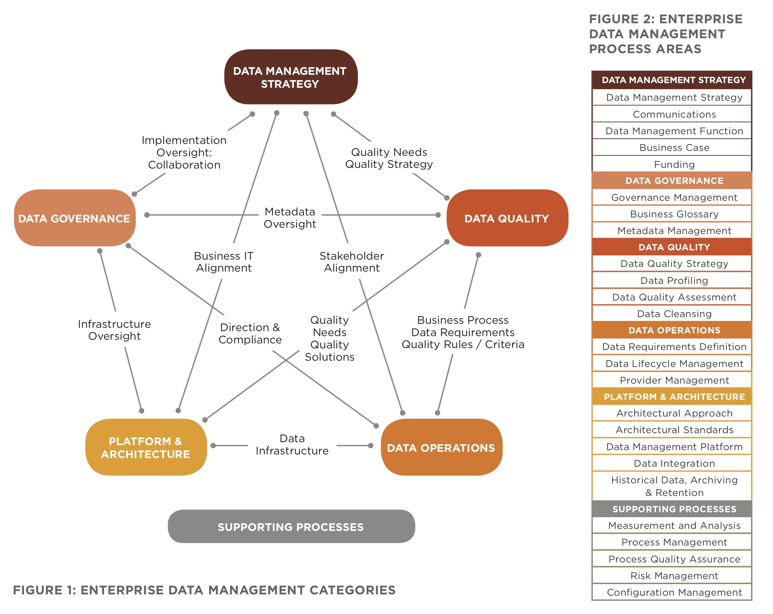
Categories of CMMI Data Management Maturity Model
(CMMI 2015)

Slide 36
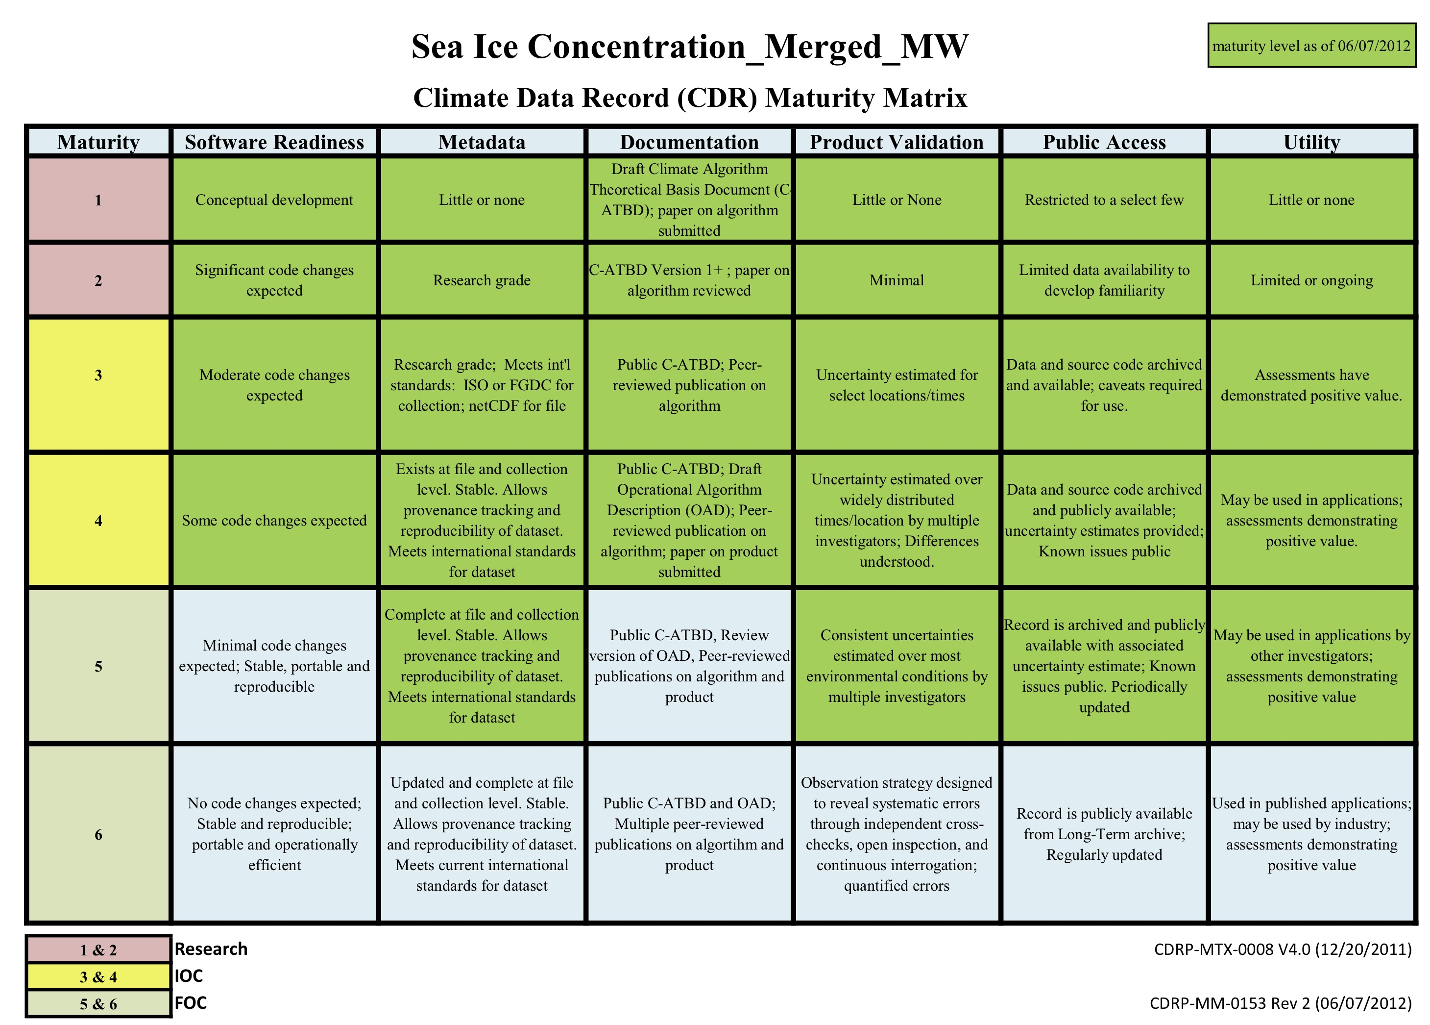
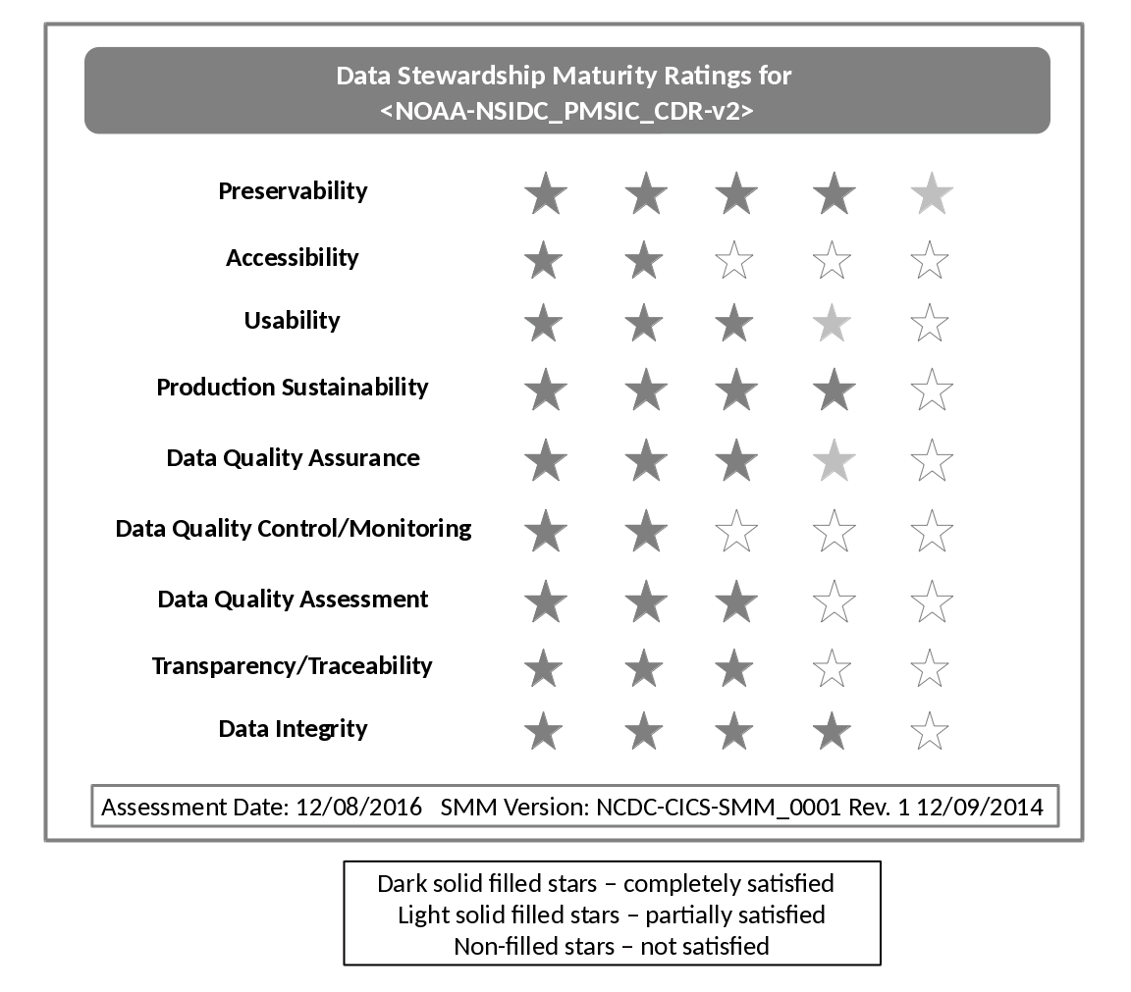
Maturity Ratings of Sea Ice Concentration CDR v2
MM-Stew
CDR MM-Prod

Slide 37
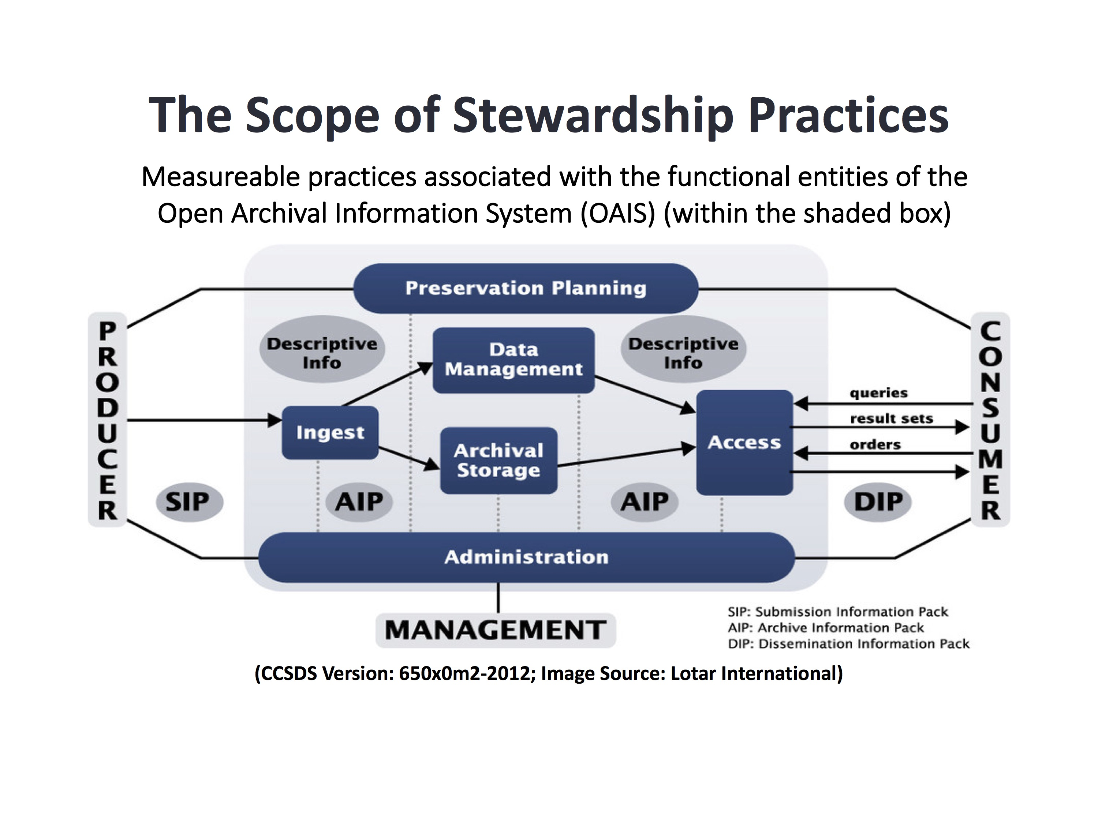
Scope of DSMM
Within Functional Entities of
the Open Archival Information System (OAIS) RM

Slide 38
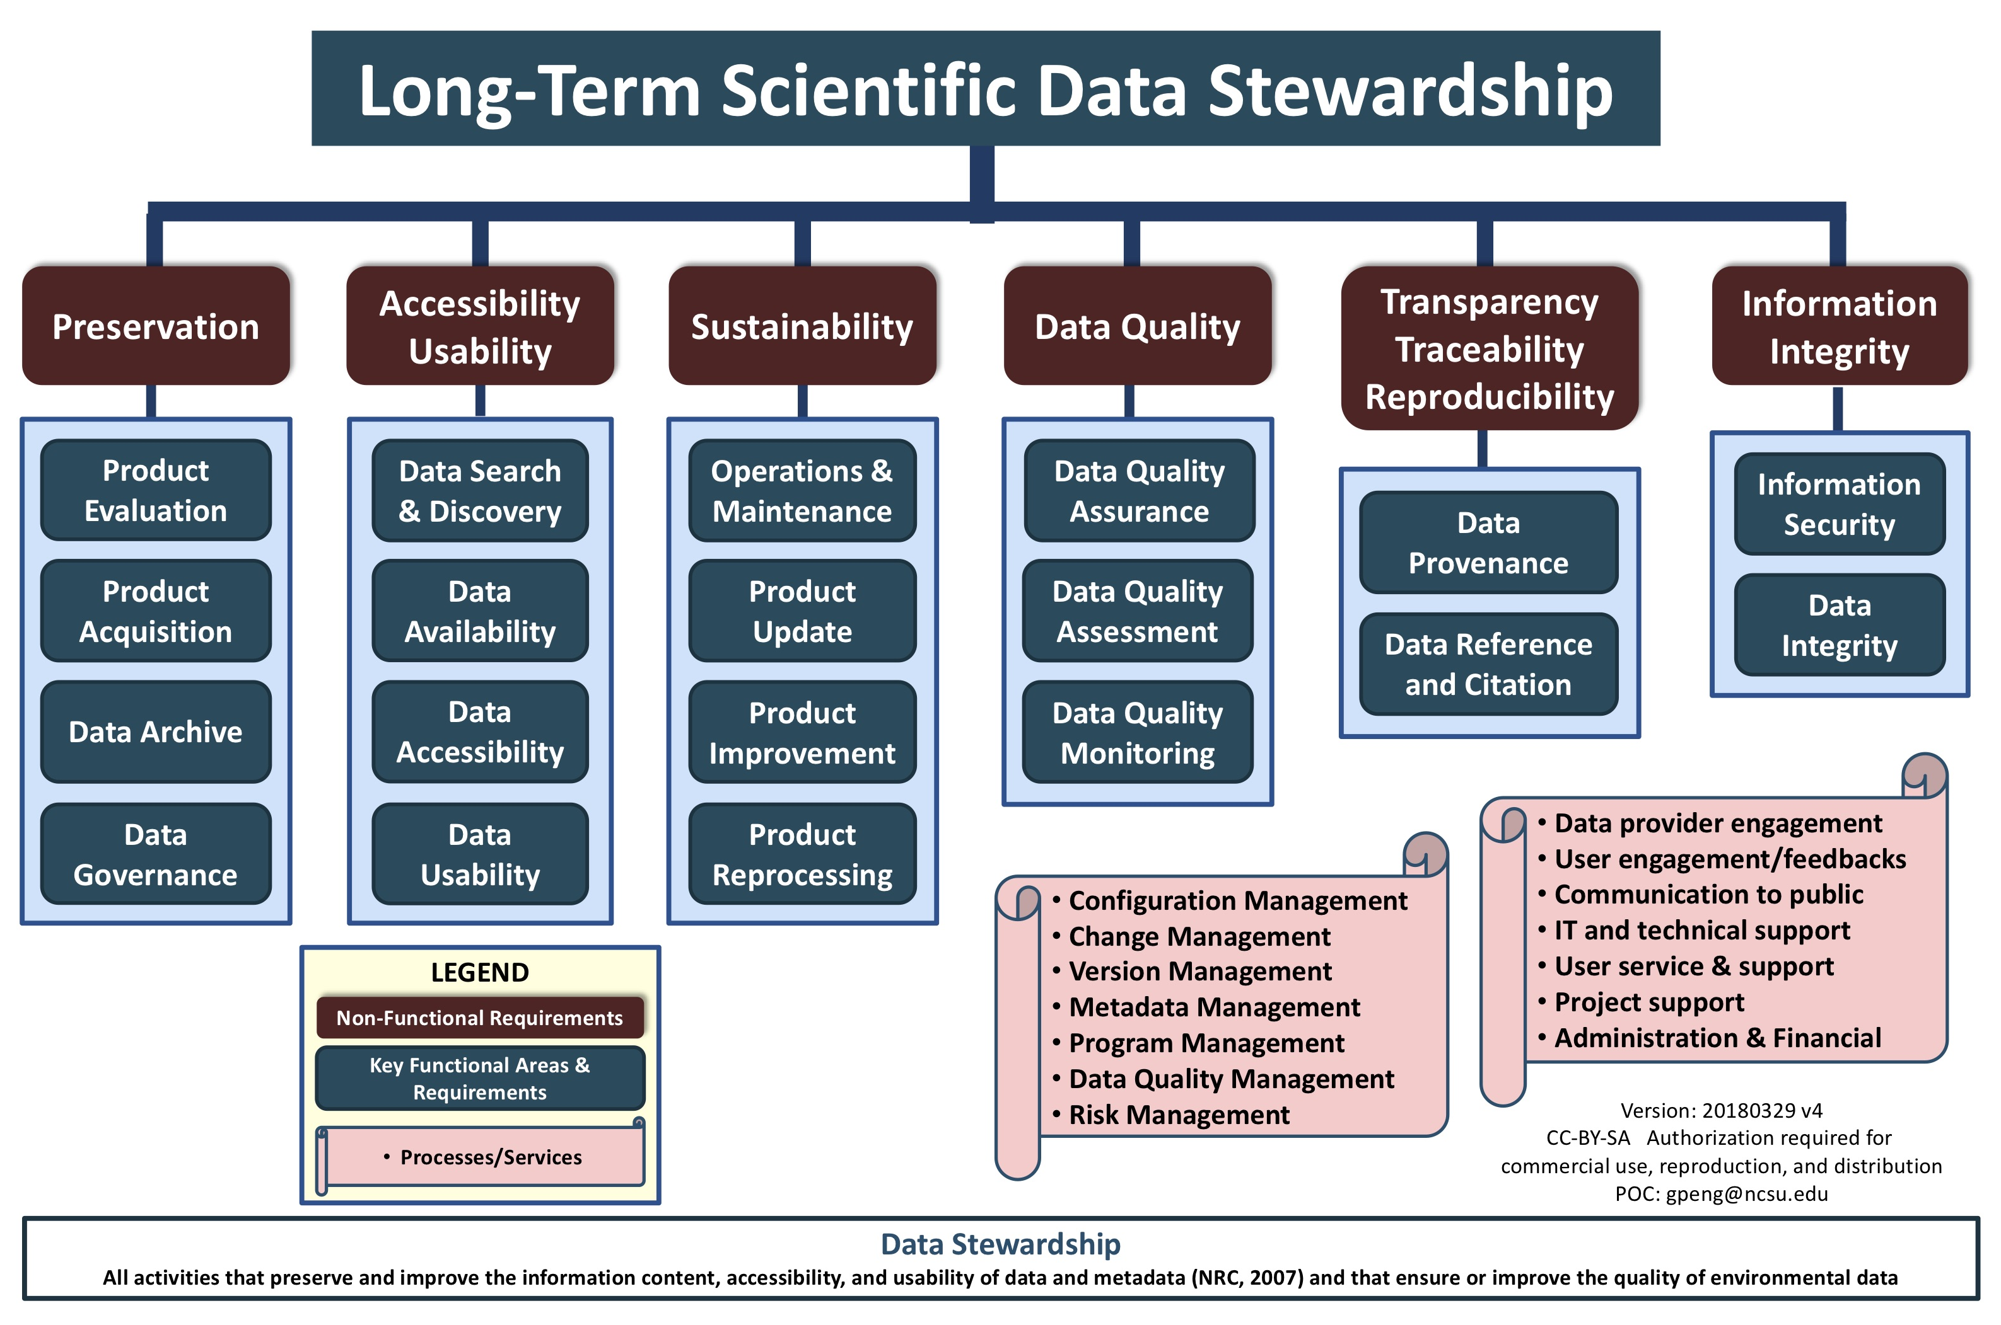
(https://www.slideshare.net/gepeng86/long-term-scientificdatastewardship20140226)

Slide 39
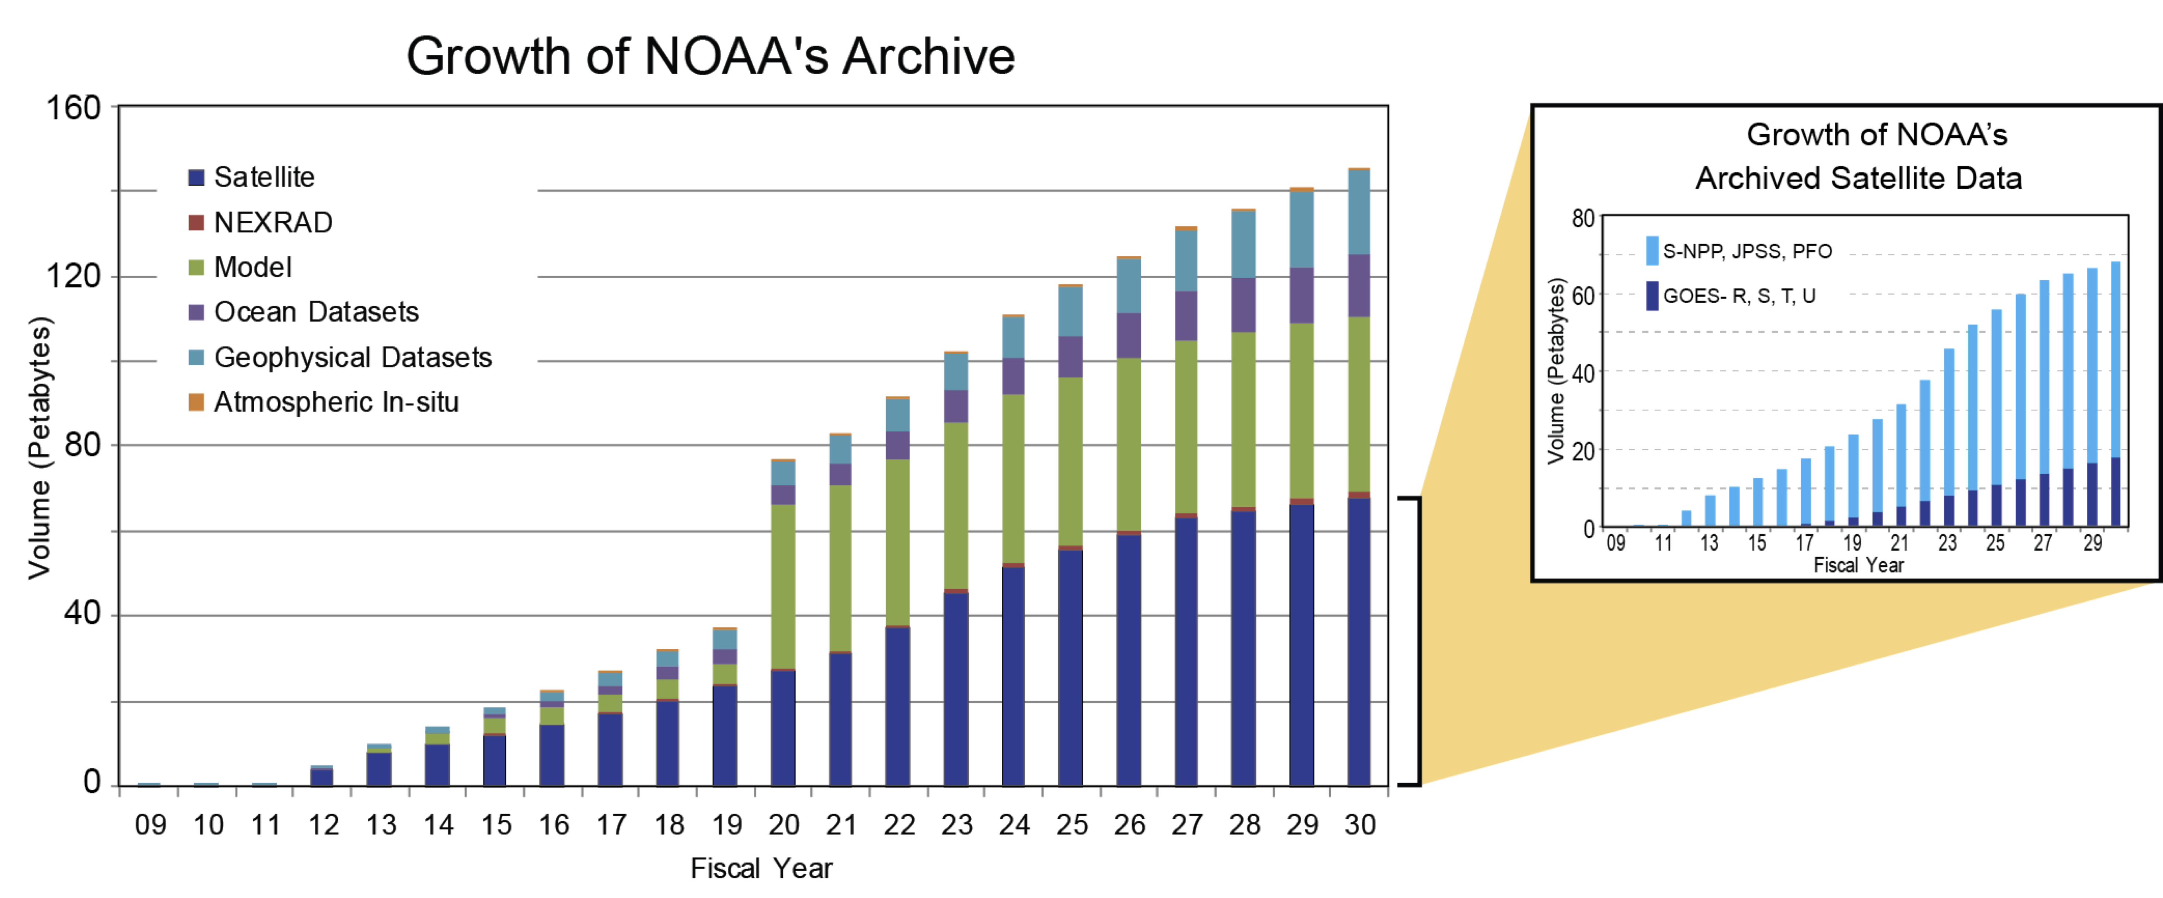
Why Do We Need a DSMM?
NOAA: 2000+ parameters
NCEI: 800+ collections
~145PB
~25PB
Ensure the federally funded data are
  preserved and secure
  available, discoverable, and accessible
  credible and understandable
  usable and useful
  sustainable and extendable
  citable, traceable, reproducible
Data Stewardship
Scalable
Transparent
Content-rich
Interoperable
Timely

