Slide 1

Expert Meeting on Climate Data Modernisation
Utrecht, April 16-18 2018
Hydrological observations and
Data management: WMO activities
Dominique Berod

Slide 2
Hydrology at WMO

Slide 3







Activities in Basic systems in Hydrology
DATA PRODUCTION & COLLECTION | DATA PROCESSING & STORAGE | DATA VISIBILITY & AVAILABILITY | DATA RESCUE & SERVICES
World Hydrological Cycle Observing System (WHYCOS) Standardisation and quality management QMF | Meteorological, Climatological and Hydrological (MCH) Database Management System | WMO Hydrological Observing System (WHOS) Global Data Centers WaterML 2.0 | Global Data Centers: Global Runoff Data Centre (GRDC), International Data Centre On Hydrology Of Lakes And Reservoirs (HYDROLARE) & International Groundwater Resources Assessment Centre (IGRAC)
HYDROHUB, the WMO GLOBAL HYDROMETRY SUPPORT FACILITY
HydroSOS, Global Status and Outlook System

Slide 4
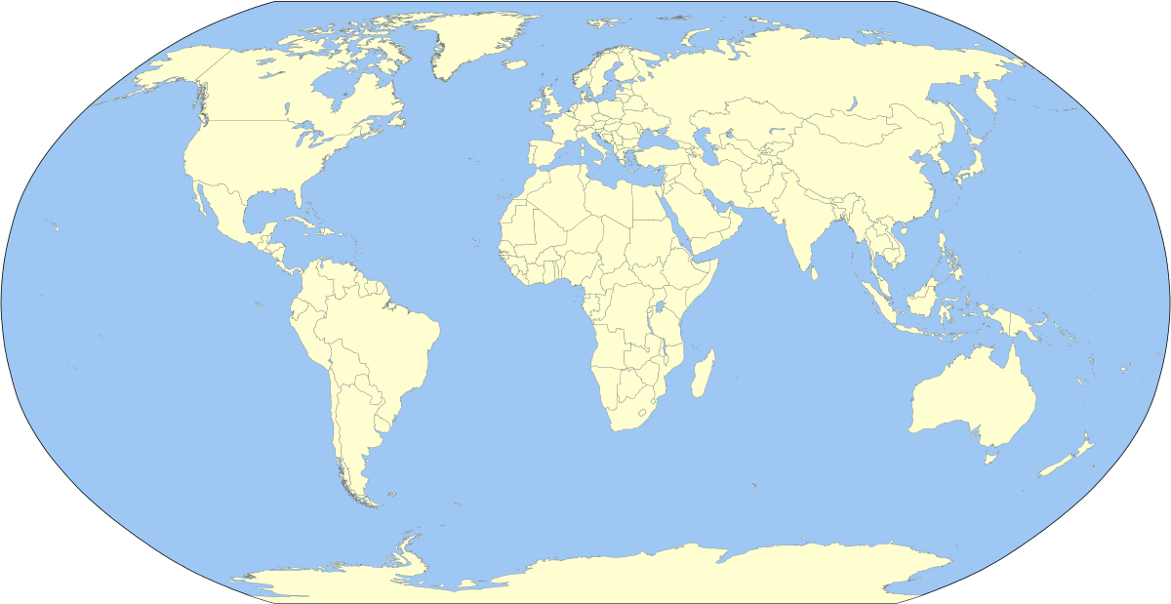
The World Hydrological Cycle Observing System (WHYCOS)
Artic-Hycos
2014- ongoing
Aral – Hycos
2006– on going
Med-Hycos
1997-2001
HKH-Hycos 2009-on going
Carib-HYCOS
2007 – on going
Niger-Hycos 2005 – on going
Senegal-Hycos 2007-on going
Mekong-Hycos 2006-2012
AOC-HYCOS 2000-2002
IGAD – Hycos
2011 – on going
Volta-Hycos 2006 – on going
Pacific-HYCOS 2006 – on going
Congo-Hycos 2010-on going
SADC-HYCOS Phase II 2005-2009
SADC-HYCOS Phase I 1998-2001
Notes:
Med- Hycos: 1997 – 2001 Eighteen countries from the Mediterranean rim participated in the project implementation (1997-2001) (Albania, Algeria, Bosnia and Herzegovina, Bulgaria, Croatia, Cyprus, France, Greece, Italy, Malta, Macedonia (FYR), Morocco, Romania, Serbia and Montenegro, Slovenia, Spain, Tunisia, Turkey)
SADC-HYCOS Phase I June 1998 to August 2001. Eleven countries from the Southern African Development Community (Angola, Botswana, Lesotho, Malawi, Mozambique, Namibia, South Africa, Swaziland, Tanzania, Zambia, and Zimbabwe) participated in the project.
AOC-HYCOS 2000 – 2002 covering twenty-two countries of Western and Central Africa, Between 2000 and 2002 WMO implemented a Pilot Phase in cooperation with eleven countries from the region (Burkina Faso, Cape Verde, Chad, Gambia, Ghana, Guinea, Mali, Mauritania, Niger, Nigeria, and Senegal)
Niger-Hycos (2005-on going)The active watershed of the Niger River is shared between nine West and Central African countries, namely Benin, Burkina Faso, Cameroon, Chad, Côte d’Ivoire, Guinea, Mali, Niger and Nigeria. The inactive basin essentially concerns Algeria, Mali and Niger.
Volta-Hycos (2006 – on going) Benin, Burkina Faso, Côte d'Ivoire, Ghana, Mali, Togo
Mekong-Hycos 2006-2012, he objective of Mekong-HYCOS is to establish and operate a real-time flood information system in the Mekong basin with Cambodia, Lao, Thailand and Vietnam as participating countries.
Pacific-HYCOS 2006 participating countries were Cook Islands, Federated States of Micronesia, Fiji Islands, Kiribati, Marshall Islands, Nauru, Niue, Palau, Papua New Guinea, Samoa, Solomon Islands, Tonga, Tuvalu and Vanuatu
Aral – Hycos 2006 -now :Kazakhstan, Kyrgyz Republic, Tajikistan, Turkmenistan, Uzbekistan
SADC-HYCOS Phase II 2005-2009
Carib-HYCOS 2007- eight countries concerned (Barbados, Cuba, Dominican Republic, Guadeloupe, Hait, Jamaica, Martinique, Trinidad and Tobago)
Senegal-HYCOS 2007 – on going: la Guinée, le Mali, la Mauritanie et le Sénégal
Hindu Kush Himalaya-HYCOS (HKH) 2009 – on going Bangladesh, Bhutan, Nepal and Pakistan
Congo-Hycos 2010 – on going: Cameroon, Central African Republic, Congo and the Democratic Republic of Congo,
IGAD-Hycos : 2011 – on going : Burundi, Djibouti, Ethiopia, Kenya, Rwanda, Somalia, South Sudan, Sudan and Uganda
Artic-Hycos: 2014 – on going Canada, Denmark, Finland, Iceland, Norway, Russian Federation, Sweden and United States of America

Slide 5
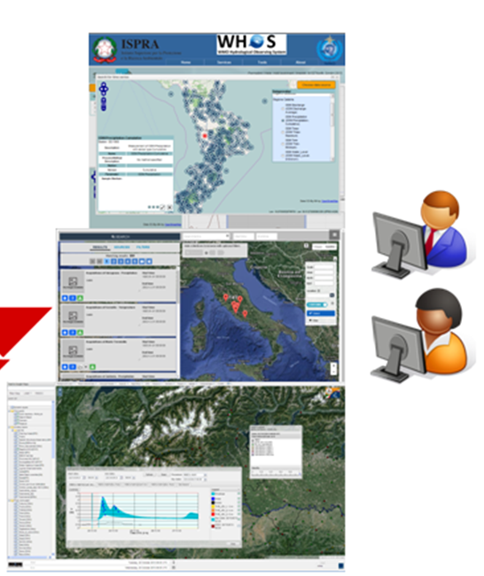
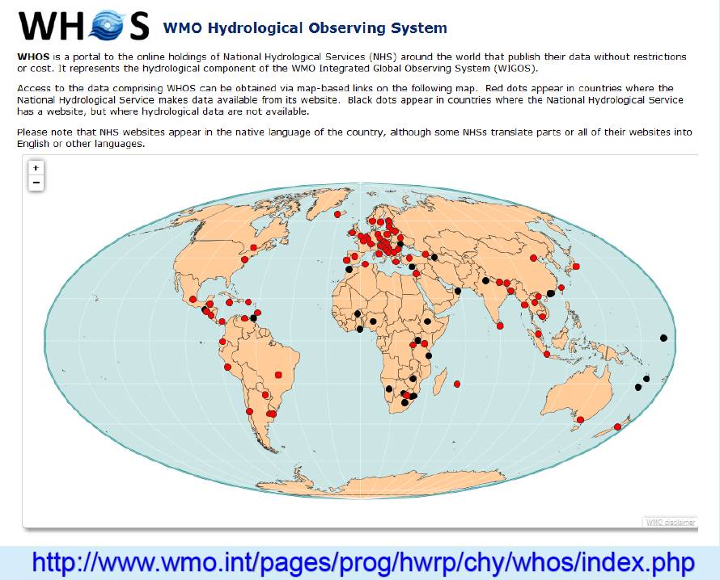

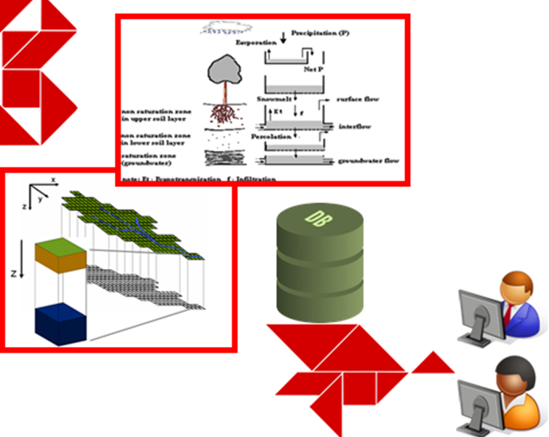
WMO Hydrological Observing System

Slide 6

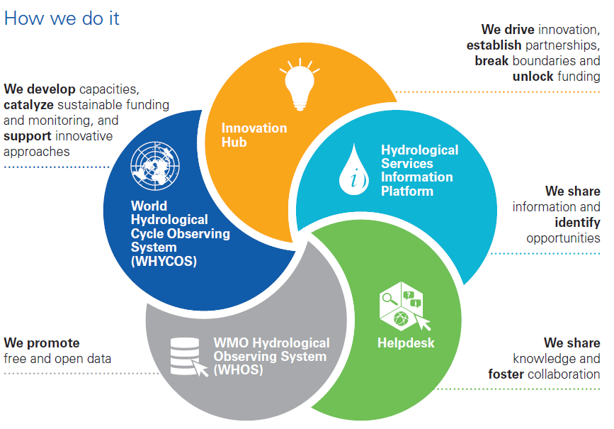
A new paradigm for Hydrometry

Slide 7


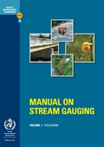
WMO regulatory framework
Technical Regulation
Manual
Guides

Slide 8
Standards
Quality Management Framework – Hydrology
WaterML 2.0
Strengthen users’s confidence in data, products and services quality
Make users aware of inherent uncertainty
No need for formal certification
National implementation
Notes:
WaterML 2.0, Part 1 – Timeseries
WaterML 2.0, Part 2 – Ratings, Gaugings, and Sections
Given the complexity intrinsic to hydrological processes and the impracticality of completely eliminating uncertainty in observed data and derived products, it is useful to make users aware of the various uncertainties. Further, many research activities require the sharing and use of data among numerous countries. To support such analyses, it is essential that the data be compatible, comparable and of known quality.
Implementation of quality management systems will assist NHSs in the provision of good management practices and ultimately will enhance confidence in the quality of their data, products and services.
It is worth noting that quality management is useful to an NHS even if there is no intention by the Service to enter into a formal certification process, as the adoption of quality management principles, approaches and practices facilitates the efficient and effective management and operation of a Service.
Commonly in hydrology multiple organizations perform similar activities with different objectives or at different scales within a country. Overall responsibility for maintaining and improving the quality of hydrological observations, products and services may rest with a central authority, e.g. the NHS. Such a central authority should strive to establish and support the quality-related structures and processes of the various other hydrological organizations operating within the country, including the private sector when possible.
Importance dans le contexte transfrontalier

Slide 9
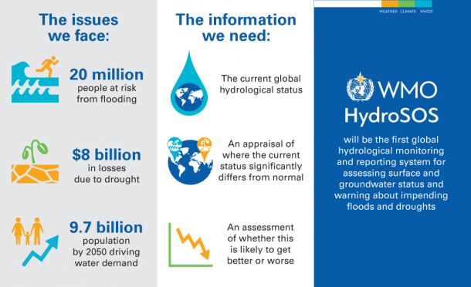
A flagship under construction: HydroSOS
NEEDS
NEEDS

Slide 10
Conclusions
Hydrological observations and data management: challenge accepted
Used for all societal, economical and environmental water challenges
Links to climate data obvious:
  WHYCOS and HydroHub: monitoring requirement
  WHOS and WMO Global Data Centers: data access
  HydroSOS: ICT infrastructure, products
WIS WIN
E
E

Slide 11

Thank you
Merci

