Slide 1
Dataset issues
(Or, what we learnt last time)
Robert Dunn
(Met Office Hadley Centre)

Slide 2
What do we want to know?
What are datasets for?
  As a user, datasets are a tool for analysing the behaviour of a given ECV
  In space, over time, specific statistics
Users are likely to want to know “the truth”
  Can the truth be defined?
  Can we/they even define the question?
Making a transparent assessment of dataset qualities is very important
  Includes documentation, intercomparison activities
  Maturity matrices have their part to play in summarising these qualities
Give suitable information in allowing users to make an informed and appropriate choice.
  Cannot make the decision for them
  We aren’t the experts for their use-case
  Can we force them to think about the data they want to use, and what aspects should be important?

Slide 3
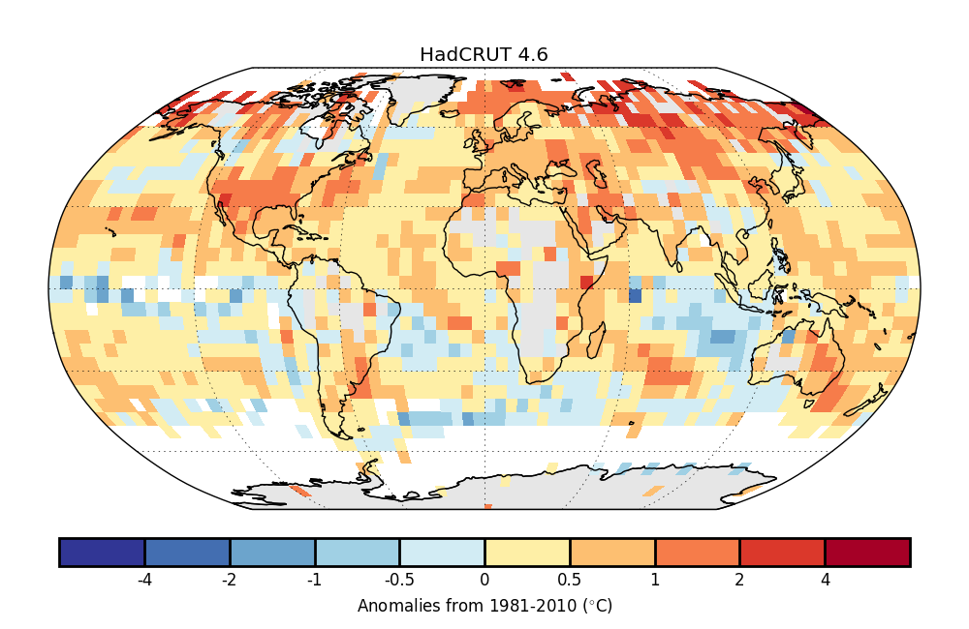
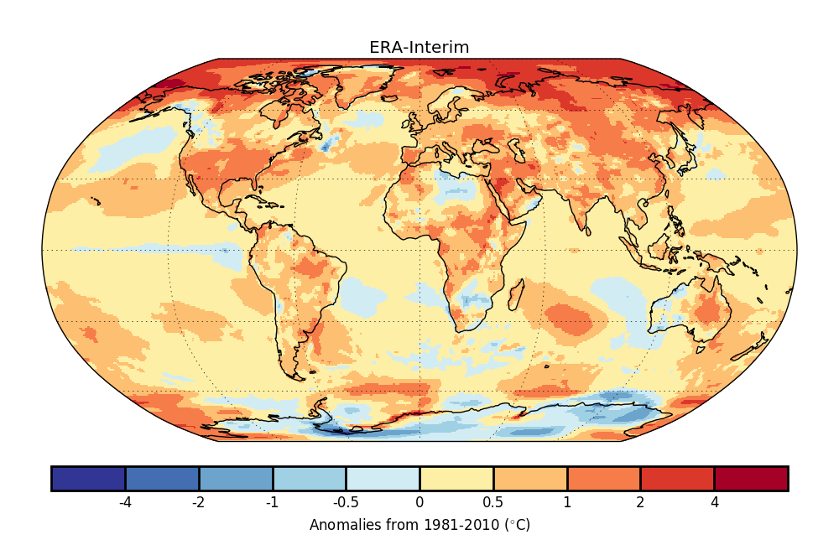
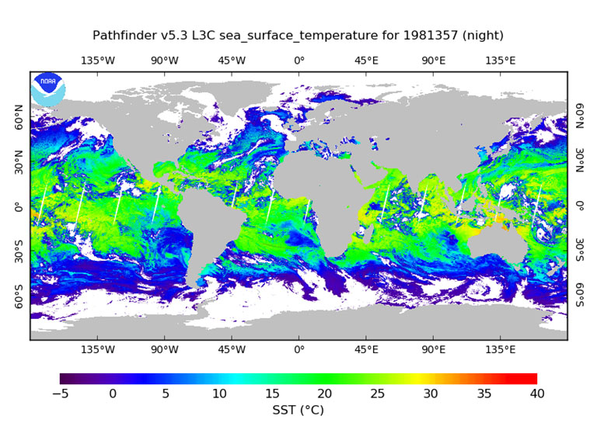
Dataset types
In situ observations
  From stations/buoys/drifters/ships etc
  Often processed to get from points to grids
Reanalyses
  Observations assimilated into a physical model
  Model has further settings
Remote Sensing
  Radiances/brightness temperatures converted to physical parameter
(Models)
  Not really covering these here
  Important differences to real world data (30d months, 360d years etc)

Slide 4
Processing differences
Spatial
  Measured at stations (in-situ)
  Measured as areal average (satellite)
Gridding
  How to go from point to space filling?
  What about infilling gaps
  Blending at coastlines
Timescale
  Instantaneous (hourly in-situ, satellite)
  Derived time average (daily, monthly)
  Accumulation
Exact type
  2m air temperature vs skin temperature
  09-09 vs 12-12 accumulations
  Time of observation for Tmax/Tmin
T
Days or Years?

Slide 5
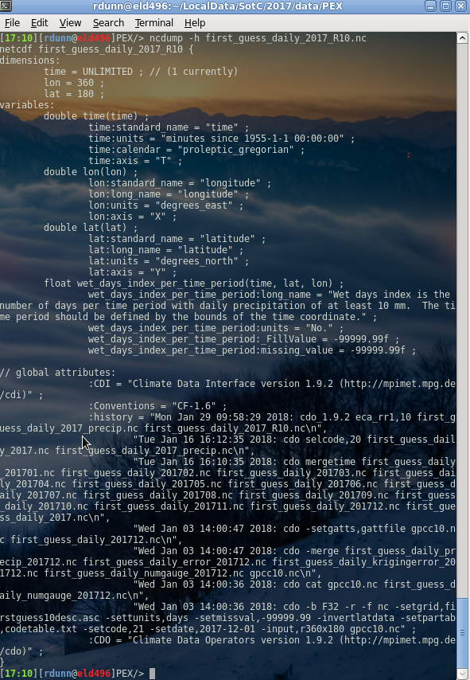
Metadata
For the data files
  Depends on data format
  The more the better
  Follow standards where possible
For the data sets
  See above
Ongoing expansion and development to fill in the gaps
There is a minimum useful set for climate use
Continuity and stability can be imperative
  Currently no operational WMO Pub 47 (metadata for ship observations)
  Makes bias adjustments hard!

Slide 6
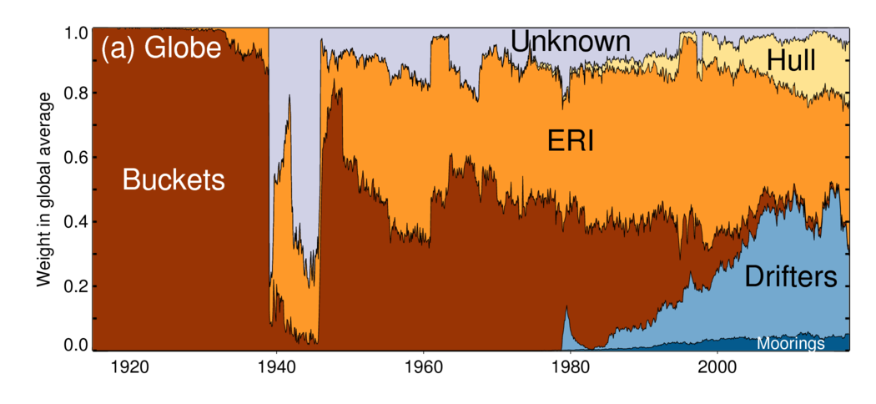
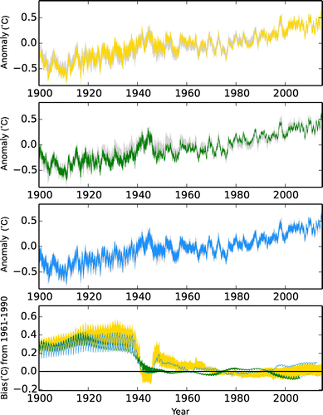
Uncertainties
Measurement
  Instrument, transcription, calibration …
Processing – parametric
  Choices of values in processing algorithms
  Especially for more derived data (e.g. satellite)
Processing – structural
  Choices of methods in processing systems
  E.g. various types of gridding
Ensembles of opportunity
  Multiple datasets allow exploration of uncertainty & coverage issues
Implementation
  +/- values
  Ensembles of plausible realisations
Kent et al, 2017

Slide 7







Procedural Aspects
Version control
  Of data, metadata and processing code
Quality assurance, open code, automation
  Of the data, of the code
  Robustness and resilience
Timely access/updates
  For reports, articles, comments
(Maintained) documentation
  Of data, of code, of use cases
Communications via peer review, user engagement
  Scientific papers aren’t the only way
Collaboration, knowledge sharing
  Spread the load, sow ideas, reap rewards
  Dataset.x.y.z.YYYY.i
Iris

Slide 8

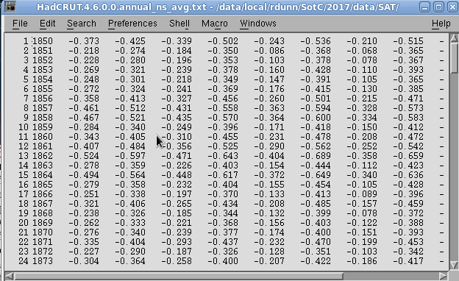

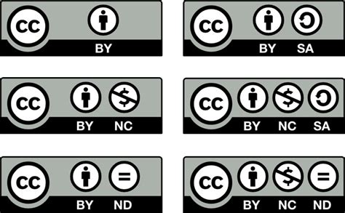
Accessibility
Formats
  CF netCDF open to interpretation
  ASCII – human readable but no standard
  GRIB? FITS?
Mirrors
  Many hosts, but need identical versions
Documentation (again)
Standards, and flexibility therein
  E.g. observed or modelled quantity
Licences
  Open would be best
Controlled vocabulary
  What do you mean with “temperature”? (see next talk)

Slide 9
Summary
Dataset types
Processing differences
Metadata
Uncertainties
Procedural Aspects
Accessibility
All have their part to play
Ongoing effort will be required to ensure the work of this group remains useful.

Slide 10

Thank you
Merci

