Slide 1
Temperature Data
Robert Dunn
(Met Office Hadley Centre)
Thanks to all those who develop, produce and maintain datasets!

Slide 2
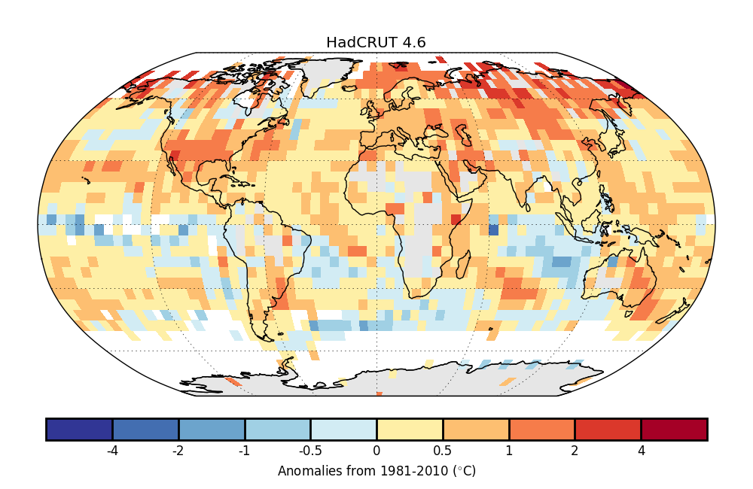
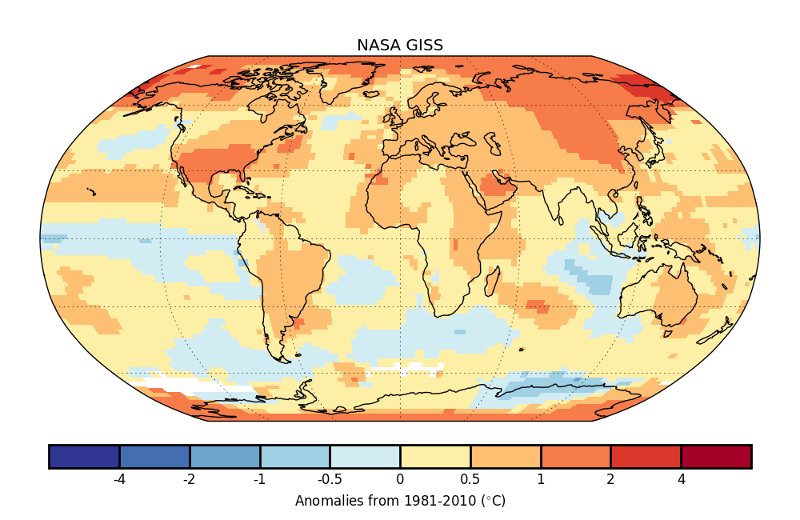
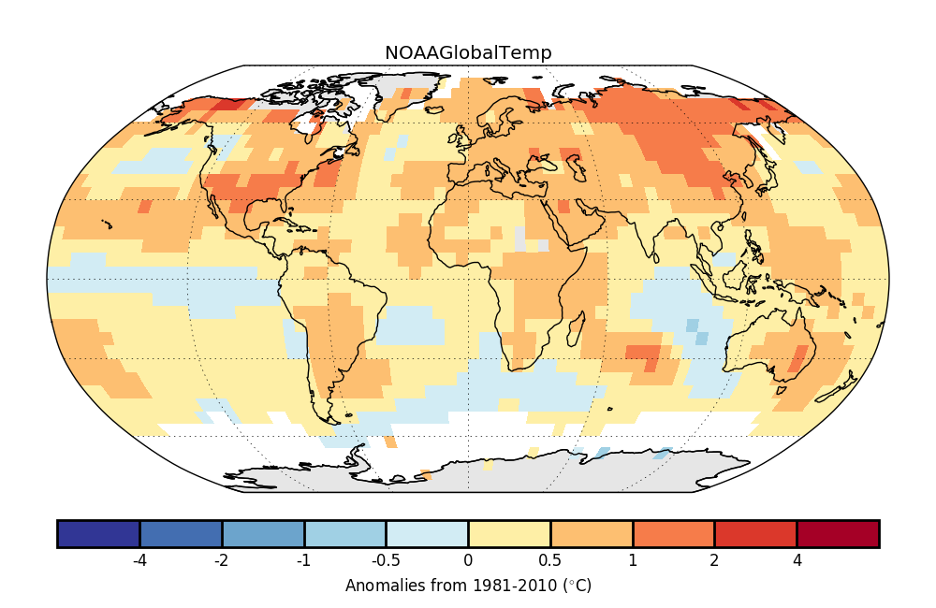
Introduction
What do we mean by “Temperature data”?
  Probably this
  Or this
  Or this
All show similar patterns for the 2017 annual anomalies
But they are not identical

Slide 3
Surface T/in situ observations
Based on monthly station data
Have different gridding methods
Have different levels of infilling
Other versions of global monthly temperature data exist too
  Cowtan+Way (infilled HadCRUT4)
  Berkeley Earth
  JMA
  Others under development

Slide 4
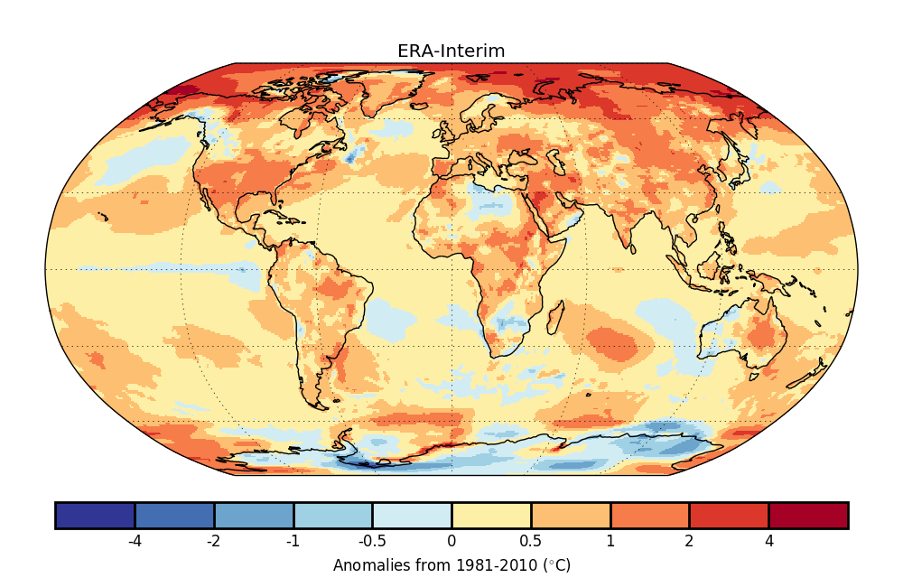
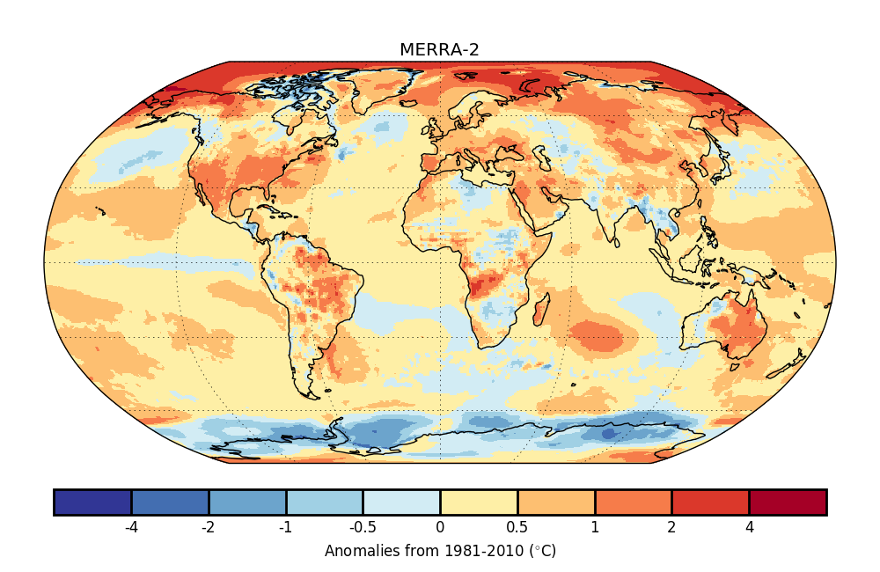
Surface T/reanalyses
Take the observations & place through a set of physical models
Also show similar patterns to the in-situ set
Other examples:
  JRA-55
  20th Century Reanalysis
  NCAR NCEP
  ERA5/CERA-20C/ERA-20C ….
A physically motivated way of filling in the gaps
  Extra complications from using a computer model
  Have limited time coverage
  Have limited time resolution
  Also have known issues, e.g.: https://software.ecmwf.int/wiki/display/CKB/ERA-Interim+known+issues

Slide 5
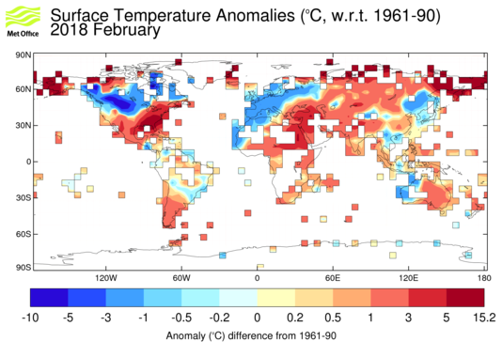
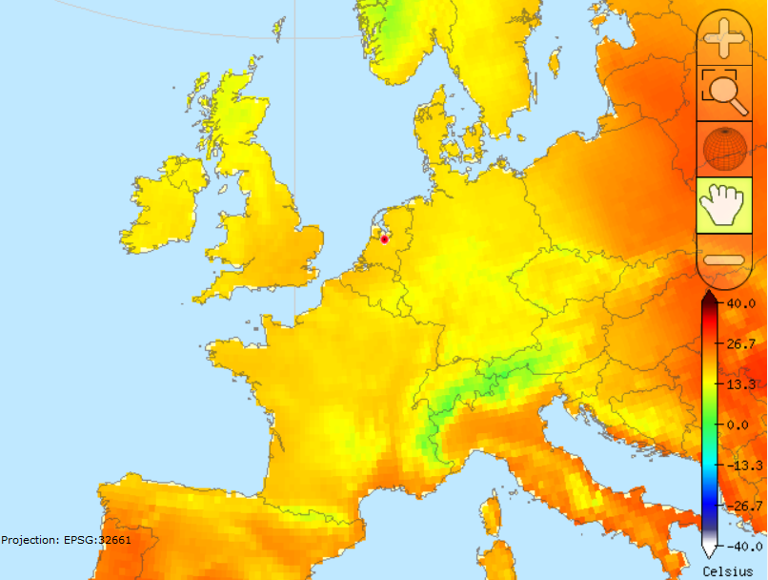
Surface T/in situ observations/land
Previous in-situ observations were monthly
  Blended land and surface marine
  Un-blended land – e.g. CRUTEM4
  Station-based files – e.g. GHCN-M
Daily datasets also exist (especially at national level)
  GHCN-daily – Tmax/Tmin + others
  HadGHCND – gridded daily Tmax/Tmin
  E-Obs, ECA&D,
Sub-daily datasets too
  E.g. ISD – though not gridded.
How have daily/monthly averages been calculated from the raw observations?
What about daily extremes:
  ETCCDI extremes indices (14T + 13P indices)
  HadEX2/GHCNDEX (see Peter’s talk)

Slide 6
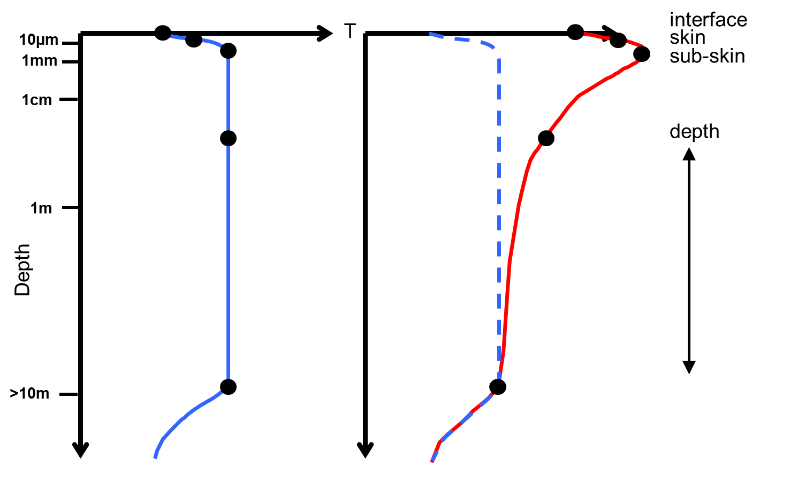
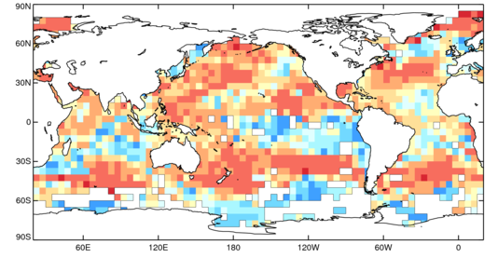
Surface T/in situ observations/marine
Sea-surface temperature
  How deep does this go?
  Bucket/buoy/engine intake
  E.g. ERSST, HadSST, HadISST
Marine air temperature
  How high was it taken?
  Buoy/platform/superstructure
  E.g. HadNMAT
Ice shelf
  Class as land or marine
  Few met. stations present
  E.g.HadISST
Lakes?

Slide 7
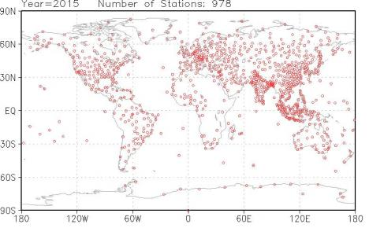
non-Surface T/in situ observations
“Surface T” approximates 2m-air temperature
  To mimic what humans experience
It’s not the surface, really
  tas vs t2m vs…
Radiosonde data for upper air
  Comparatively few launching sites
  Instrumentation standardisation
  E.g. RAOBCORE, RICH, RATPAC A2, UNSW
  Reanalyses – but see earlier (CFSR)
Sub-surface land
  Permafrost from boreholes (e.g. GTN-P, national datasets)

Slide 8
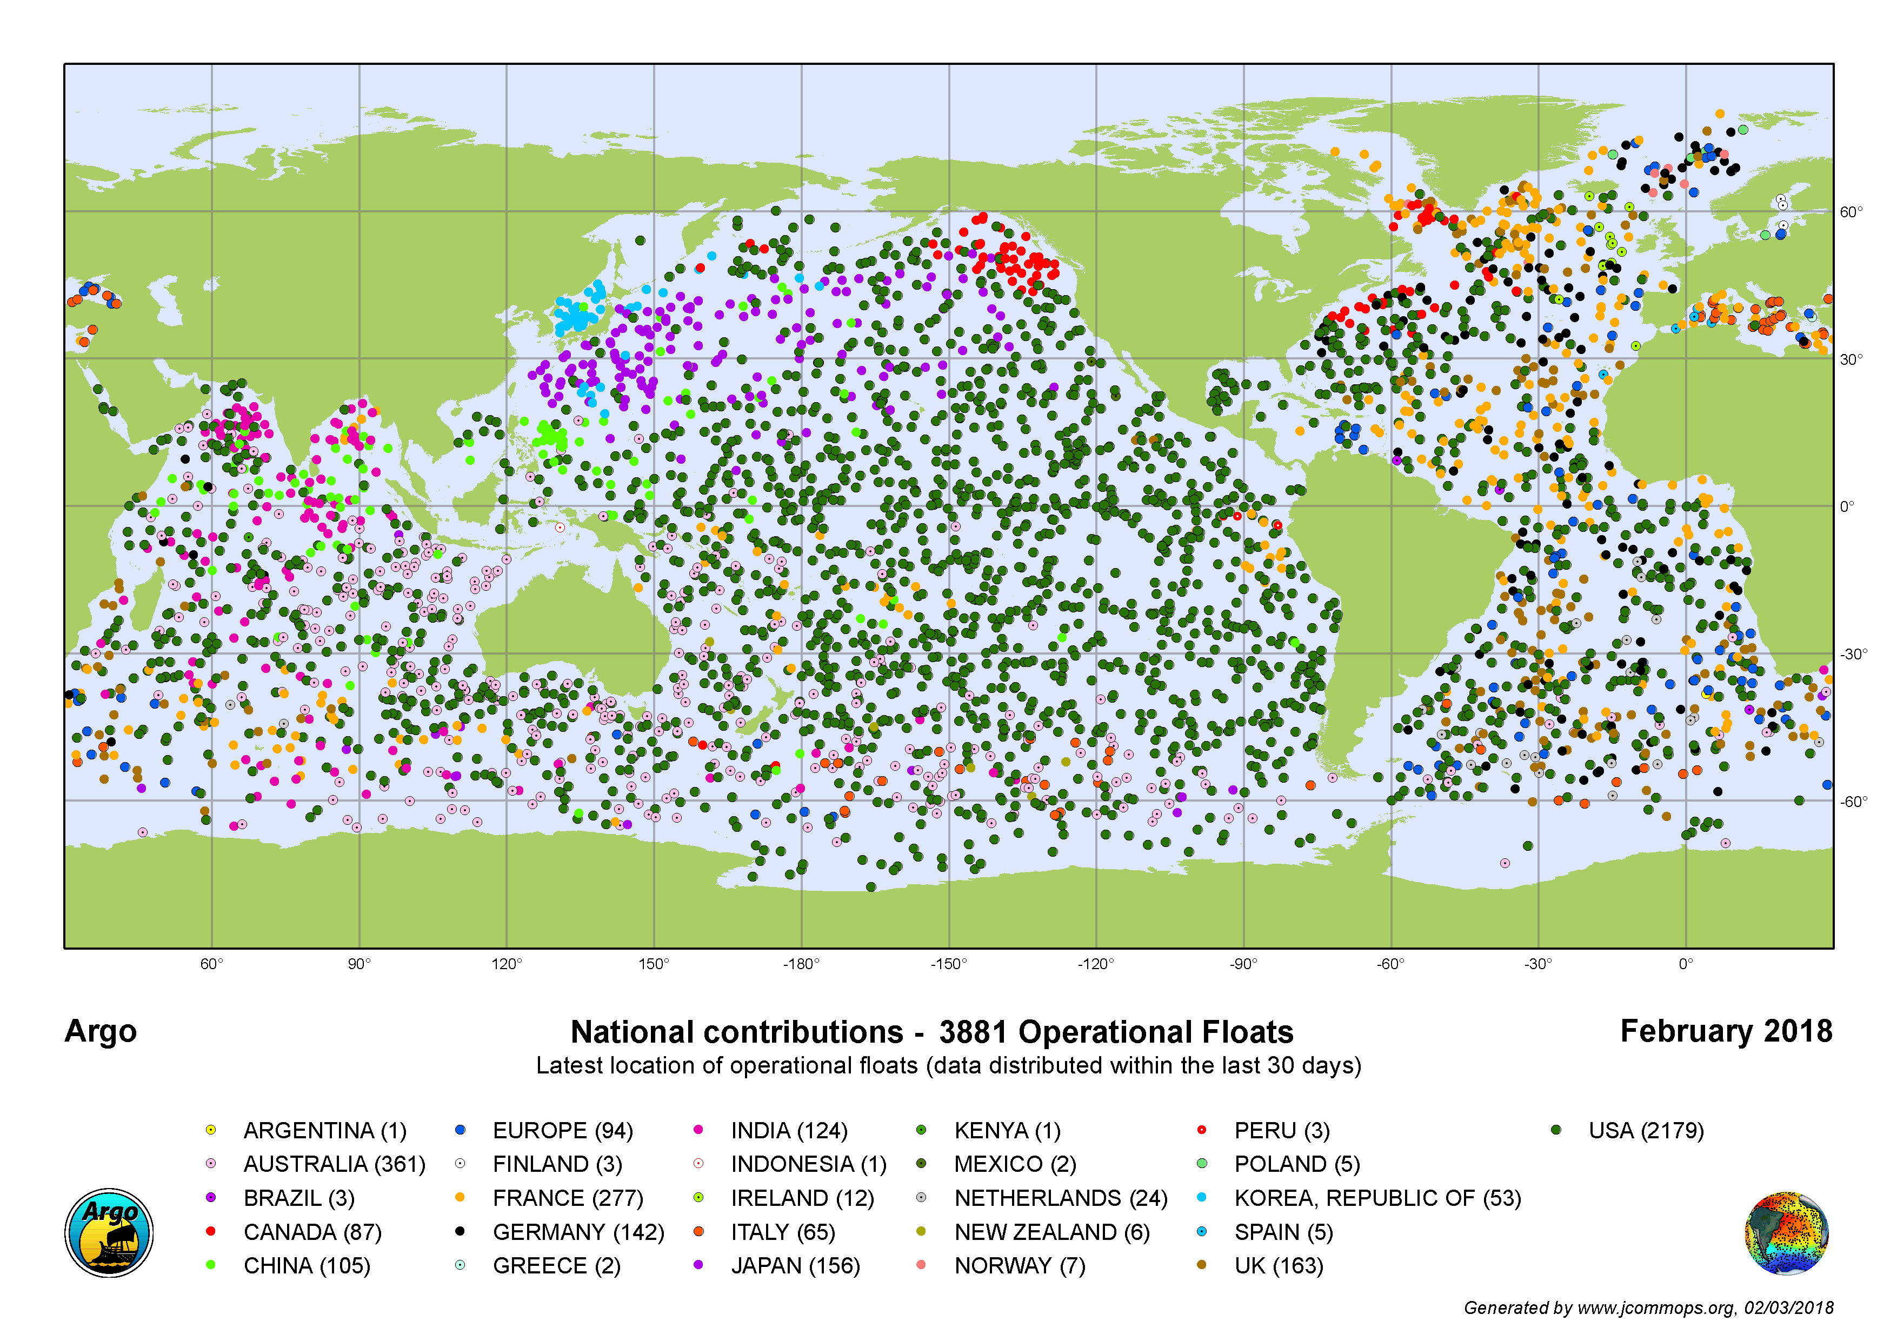
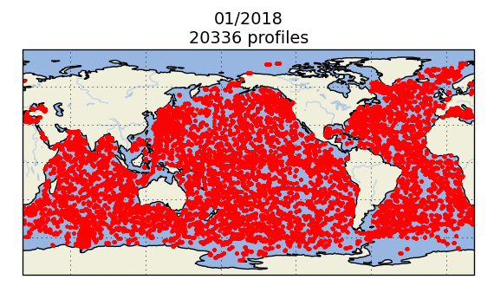
non-Surface T/in situ observations
Sub-surface marine
  E.g. Argo & Moored buoys
  E.g. EN4, NODC
  Needs to be consistent with SSTs at the surface

Slide 9
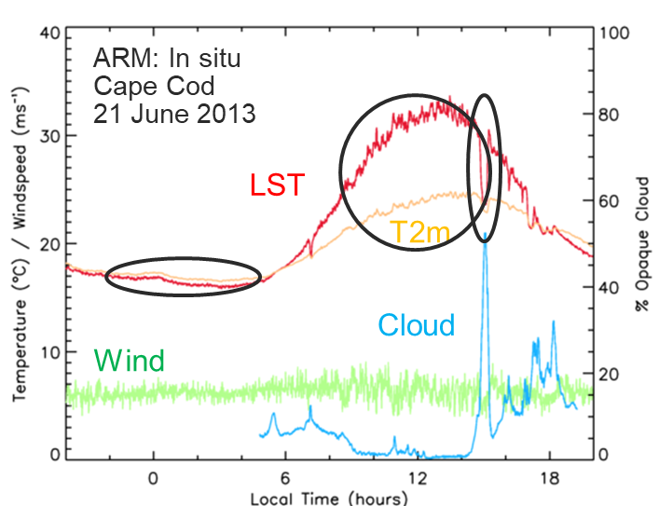
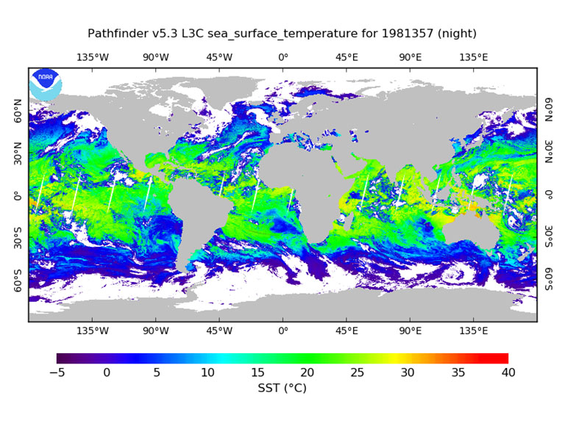
Surface T/remote sensing
Satellites measure radiances/brightness temperatures
  Do not measure temperature directly
Radiances are converted using algorithms
  Physically motivated, regularly calibrated
Also, do not measure “surface T”
  Measure the skin temperature
  Initial work in converting skinT to surface
Coverage
  Clouds
  Geostationary (high refresh, low spatial resolution)
  Polar (low refresh, high spatial resolution)
  Biases from drifting orbits
A wide variety of platforms
  E.g. Seviri, MODIS

Slide 10
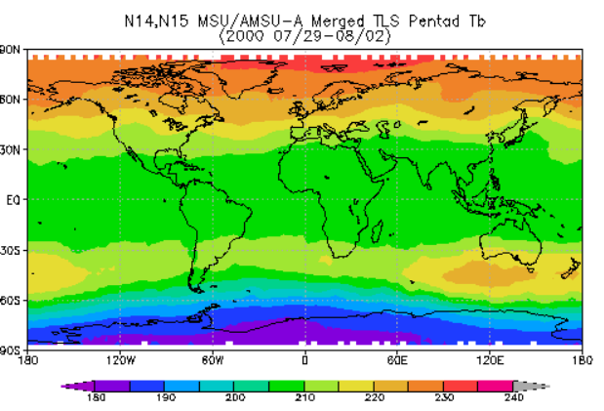
non-Surface T/remote sensing
Upper atmosphere
  E.g. UAH, RSS, NOAA-STAR
Tune radiances to different levels in the atmosphere.
Not “clean”
  Levels to which the bands are sensitive vary over the year

Slide 11
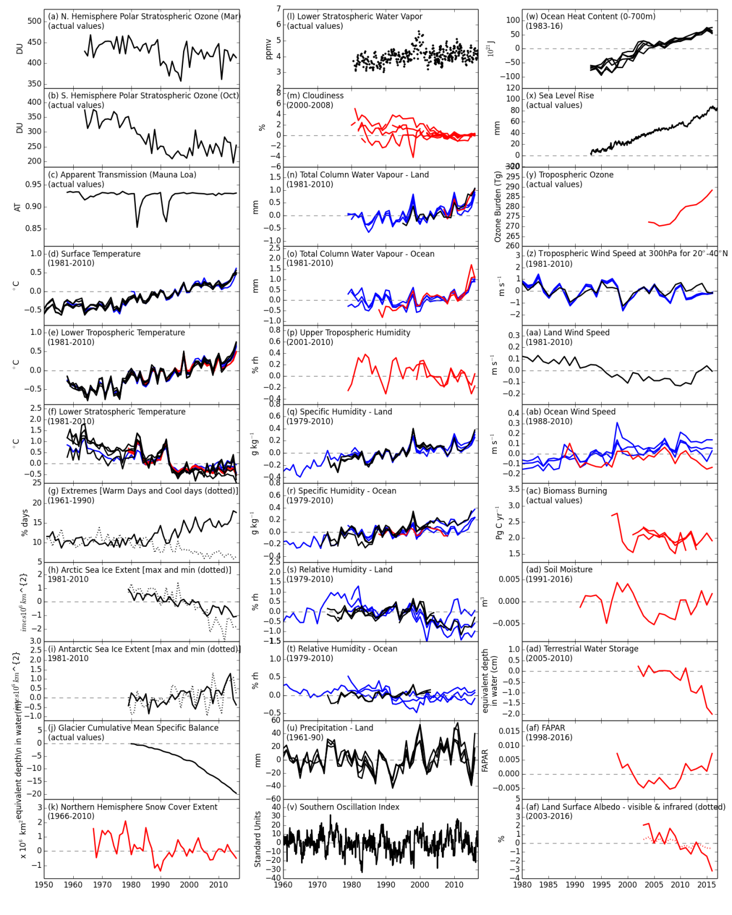
Summary
What do we mean by “temperature”?
What do users want from “temperature”?
We and they need to be precise and specific
Depending on the use-case, each dataset has features to be aware of.
Intercomparison is useful
Uncertainties are helpful
Education and informed decision making is vital

Slide 12

Thank you
Merci

