Slide 1




Status ofCryospheric Data:
Gaps and Challanges
David Gallaher
NASA Snow & Ice DAAC
National Snow and Ice Data Center (NSIDC)
University of Colorado Boulder

Slide 2
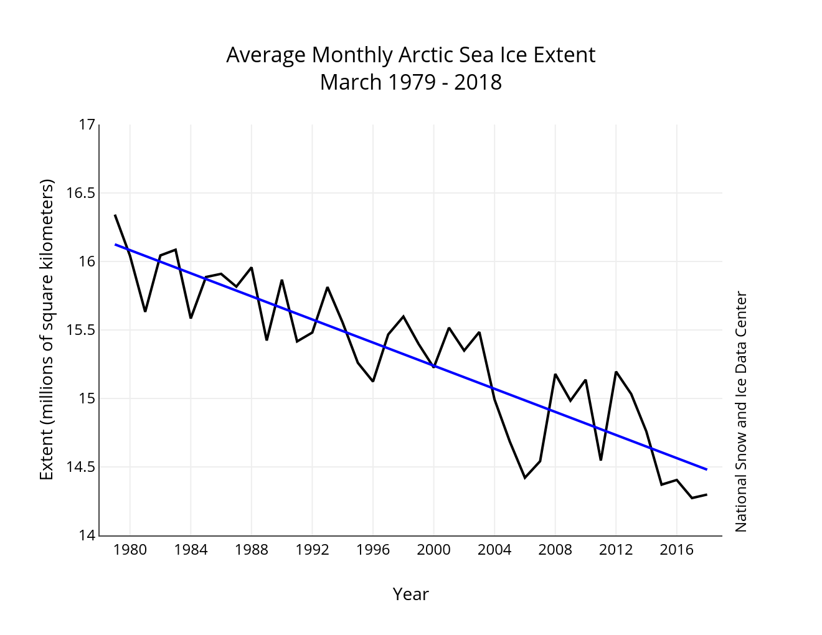
Arctic Sea Ice Extent

Slide 3
North Pole surges above freezing in dead of winter

Slide 4
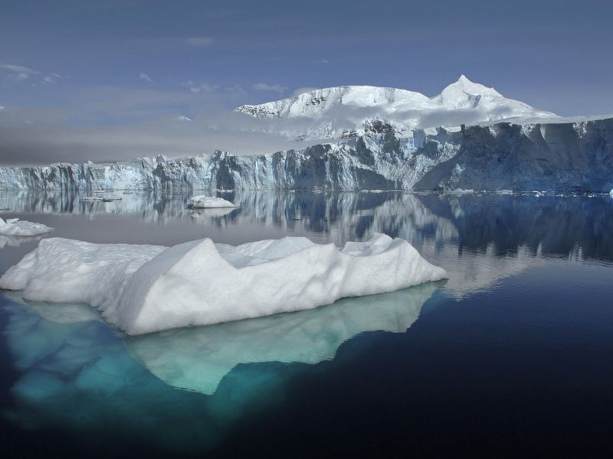
Status of Cryosphere Data
Status of cryospheric data
(Ice sheets, sea ice, permafrost snow and glacier data)
Data challenges
Data Gaps
Quality of data sets
Recommendations
Summary
Greenland glacier calving

Slide 5
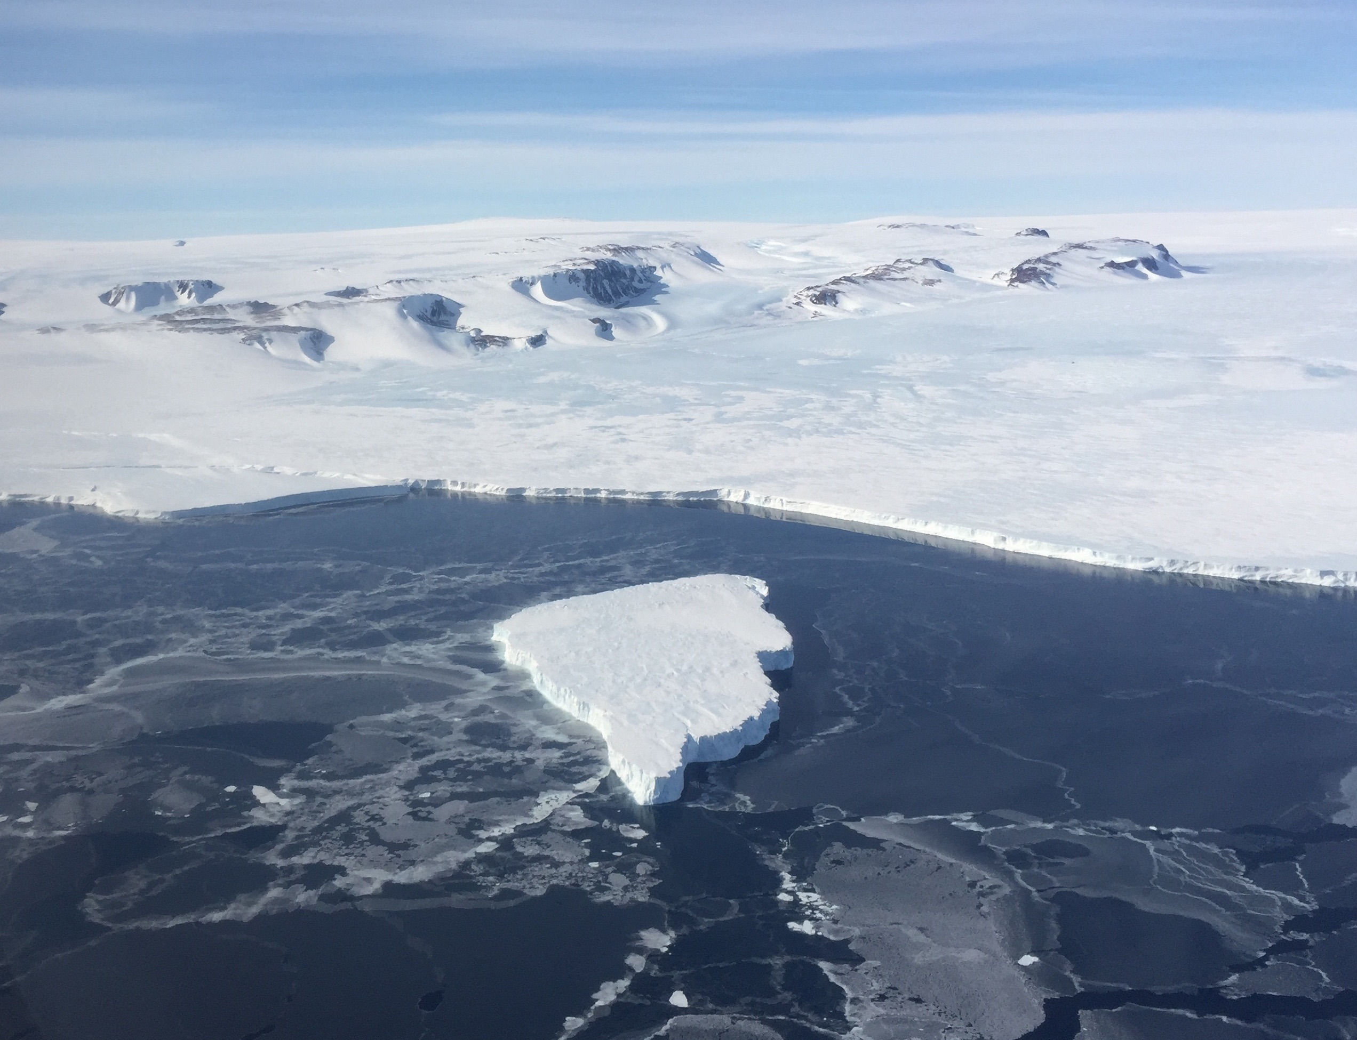
Examples of Key Cryospheric climate-related data sets
Sea Ice Extent
Sea Ice Concentration
Sea Ice Volume
Ice Velocity
Snow Cover
Permafrost
Ice Sheet Elevation
Ice Sheet Mass
Ice Sheet Albedo, SWE
Ice Shelf Change
Antarctic unexpected open water

Slide 6
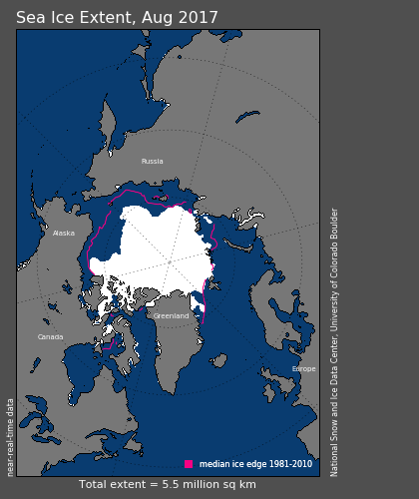
Sea Ice extent 1979 to present
The monthly Sea Ice Index provides a quick look at Arctic-wide changes in sea ice. It is a source for consistently processed ice extent and concentration images and data values from passive microwave since 1979. Monthly images show sea ice extent with an outline of the 30-year (1981-2010) median extent for that month (magenta line). Other monthly images show sea ice concentration and anomalies and trends in concentration.

Slide 7
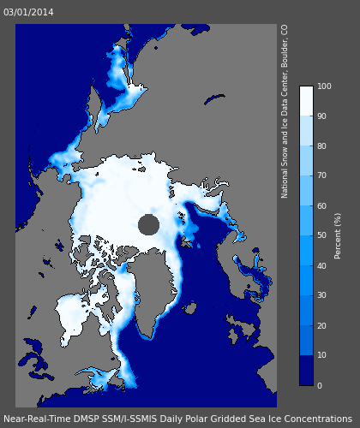
Sea Ice Concentrations
This data set from Nimbus-7 SMMR and DMSP SSM/I-SSMIS Passive Microwave Data is generated from brightness temperature data and is designed to provide a consistent time series of sea ice concentrations spanning the coverage of several passive microwave instruments. The data are provided in the polar stereographic projection at a grid cell size of 25 x 25 km.

Slide 9
Sea Ice Volume to 2011-present
The seasonal Sea Ice volume using data from Cryosat’s CPOM’s sea ice processor, has a 7 year time series also shows large year-on-year variations in the volume of sea ice which persists in the Arctic year round: between 2010 and 2012, volume declined by 31%, followed by an 89% increase in 2013 and then a 27% decrease from 2013–2016. This is a radar altimetry based sensor.

Slide 10
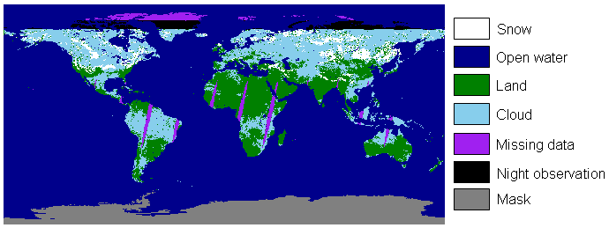
Snow Cover
This data set contains daily, gridded snow cover and albedo derived from radiance data acquired by the MODIS and AVHRR satellites. Snow cover is identified using the Normalized Difference Snow Index (NDSI) and a series of screens designed to alleviate errors and flag uncertain snow cover detections. Unbiasing the data indicates seasonal SCE exhibited negative slopes in all seasons but was only statistically significant in the summer (JJA) and fall (SON).
The Rutgers Northern Hemisphere Snow and Ice Climate Data Records or the new (2017) long-term Northern Hemisphere (NH) daily 5-km snow cover extent (SCE) product (JASMES) may be better datasets.

Slide 11
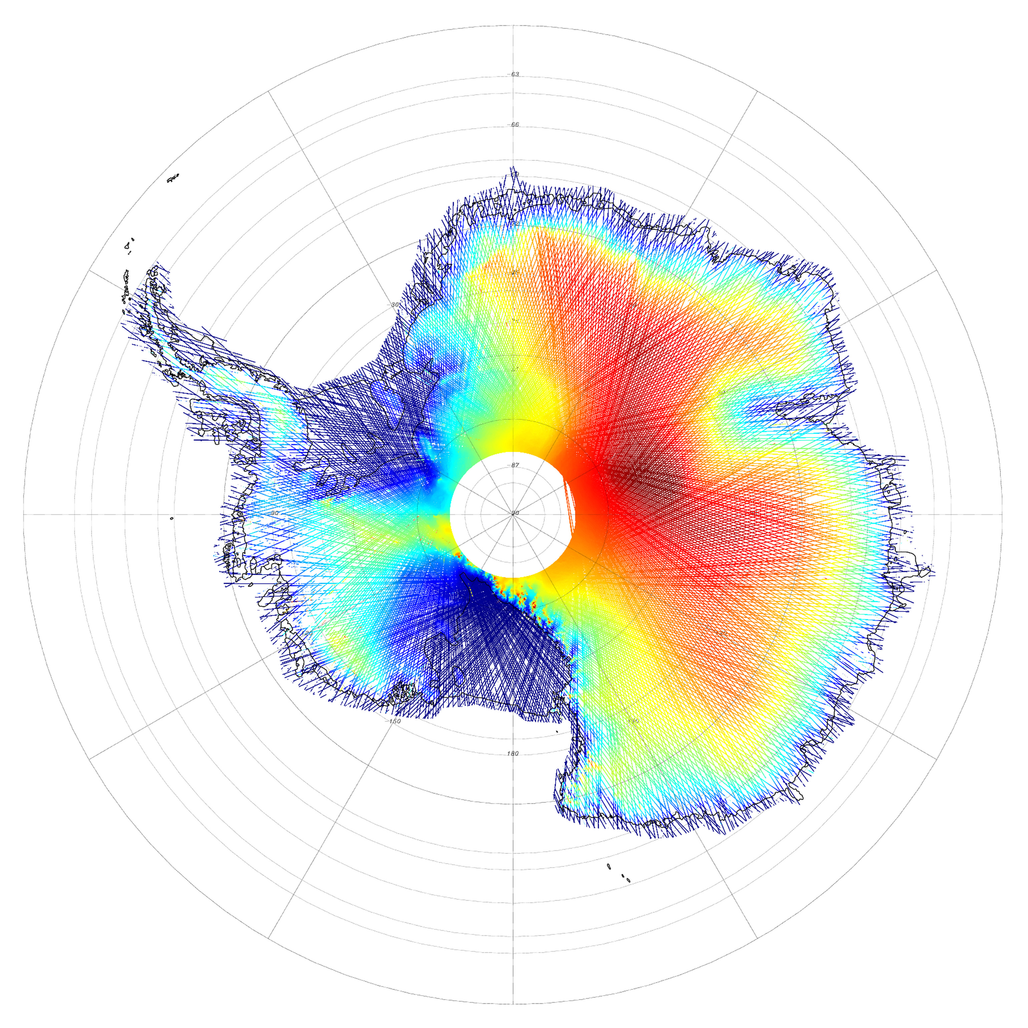
Ice Sheet Elevation
Cryosat is currently providing the best ice sheet elevation. The ICESat-2 mission will deploy LIDAR sensors to collect altimetry data of the Earth's surface in 2018. ICESat-2 will continue the important observations of ice-sheet elevation change, sea-ice freeboard, and vegetation canopy height begun by ICESat in 2003 and continued by Icebridge to the present.
IceSat Antarctic surface elevation

Slide 12
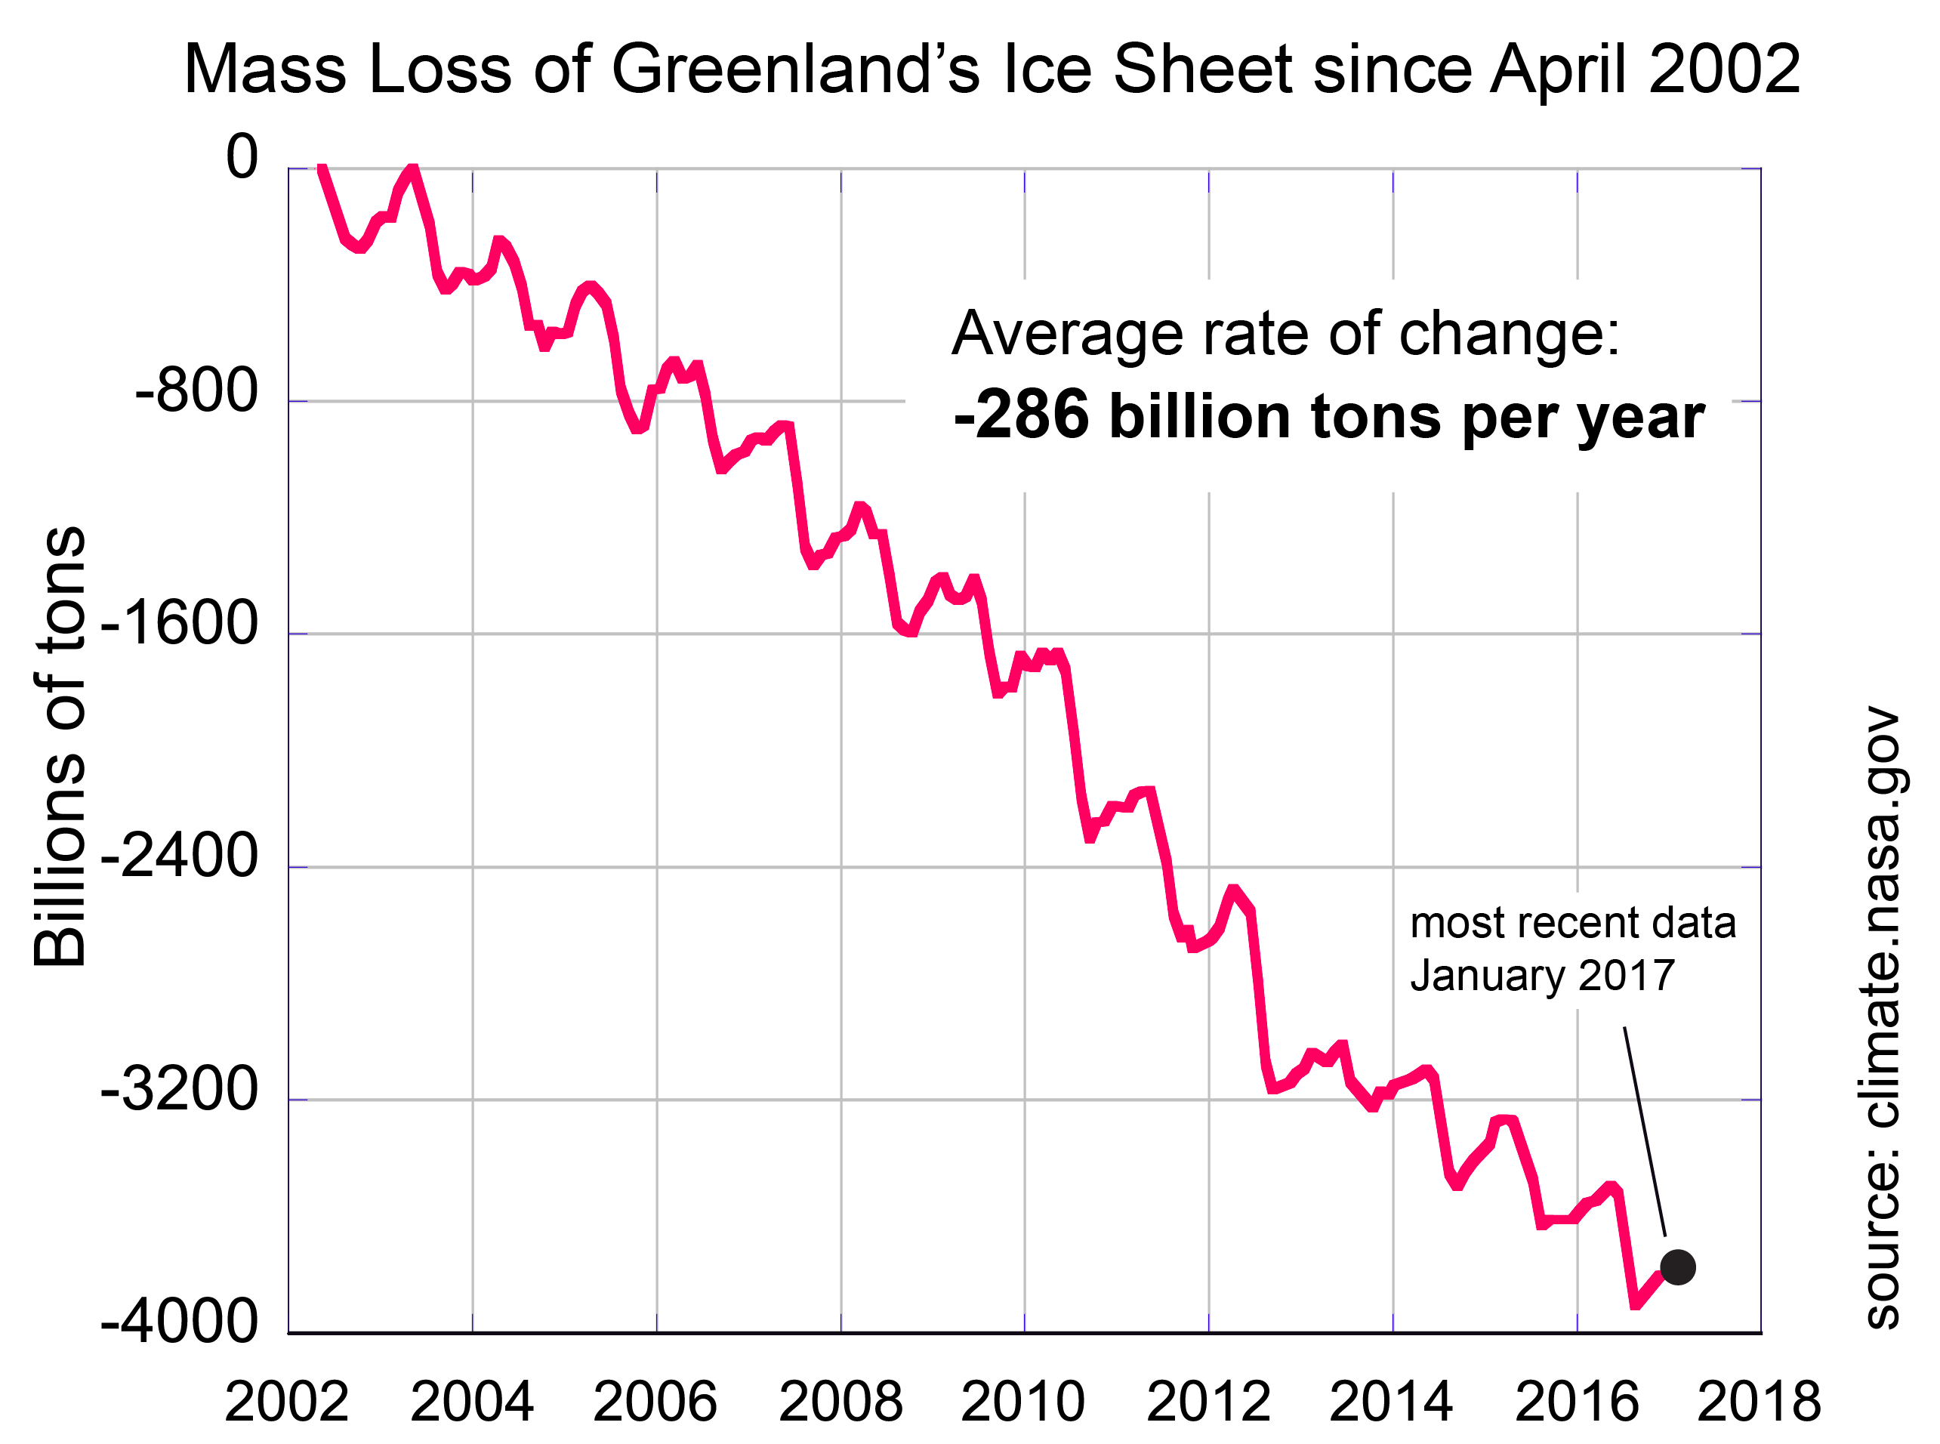
Ice Sheet Mass
Since 2002, the twin satellites of GRACE have made a complete map of Earth’s gravitational field every 30 days. Gravity is determined by mass. By tracking these changes, GRACE and GRACE-FO can identify how much ice sheets and glaciers are shrinking. Both Greenland and Antarctica are losing mass. Grace failed in 2017

Slide 13
Climate Variable | Primary Sources | Gap Potential | Quality
Sea Ice Extent | SSM/I, AMSR-2, Radar, FY-3C, others | High due to loss of F-20, AMSR-2 age | Low resolution or narrow swath, long record 1979
Sea Ice Concentration | SSM/I, AMSR-2, FY-3C | High due to loss of F-20, AMSR-2 age | Low resolution, water on Ice
Sea Ice Volume | Cryosat-2 | CryoSat 2 age | Large error bars
Ice Velocity | InSAR, LandSat | Very low | Improving
Snow Cover | MODIS,AVHRR, GOES, SSMI, Sentinel, etc. | Low but MODIS age | High, continuous to 1978
Permafrost | Ground sources, SMAP? | No known replacement | Low, need models
Ice Sheet Elevation | InSAR (CryoSAT), IceSat-2 | IceSat-1 failed 2009 | Excellent in combination
Ice Sheet Mass | Grace 1, Grace 2 | Grace 1 failed 2017 | Risks due to lack of cross correlation
Ice Sheet Albedo, SWE | MODIS, Sentinel-2, VIIRS | Aqua and Terra age | Cloud issues
Ice Shelf Change | MODIS, Sentinel-2, Radar | Aqua and Terra age | Usually detected in a day

Slide 14
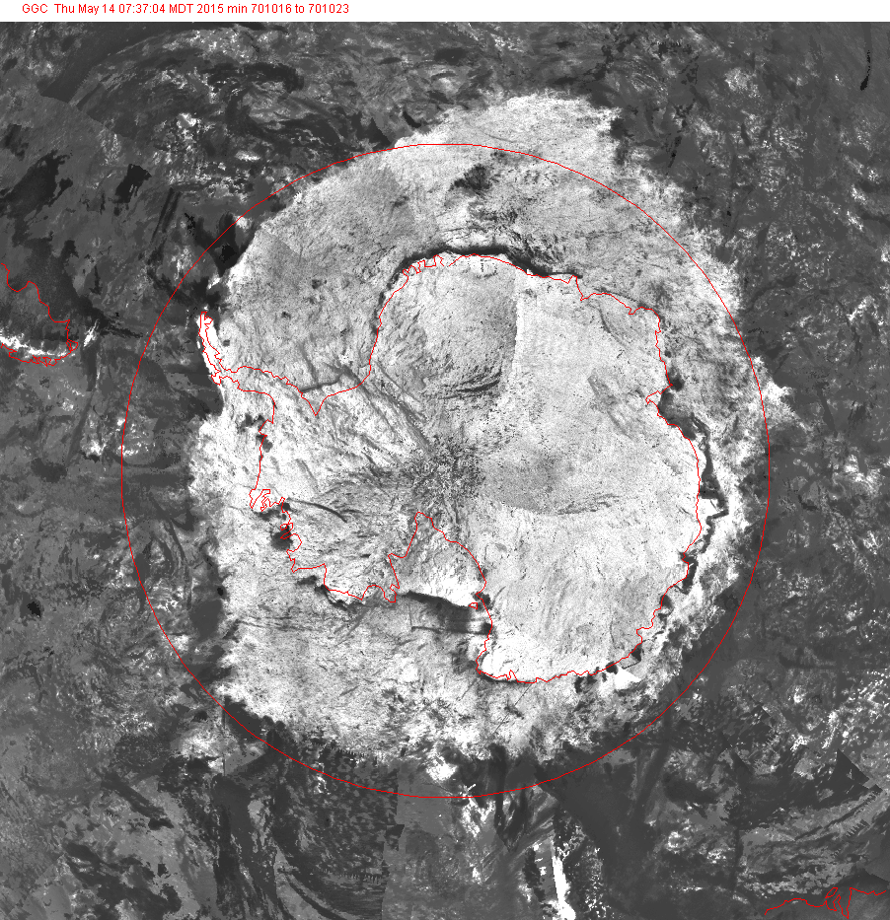
Other Global Cryospheric Data Sources
Military – Space Based Infrared
Commercial satellite constellations (Planet, Iceye, Hera, Astro Digital, OMS etc)
Data rescue datasets
Canadian ice charts
AVHRR
MODIS
RadarSAT
LandSat
Other FY series
Russian Satellites
Glacial Photos
And many others….
Antarctic ice extent October 1970 Nimbus IV

Slide 15
Summary
Data Gaps: Several gaps and potential gaps in the satellite record threaten the overall quality of the record when satellite failures prevent cross correlation of satellite sensors.
Data sets impacted by Gaps: IceSat (even with Operation Ice Bridge), Grace (a one year gap).
Data sets with high risk of Gaps: DMSP/SSM/I passive microwave and Cryosat-2
Overall risks: Decreased funding for Earth observation in the U.S. Real fear the Trump administration will cancel new satellites an deactivate operational satellites.
Commercial Remote Sensing Satellites: May be able to fill some of the gap but how does science get access to these commercial sources.

Slide 16

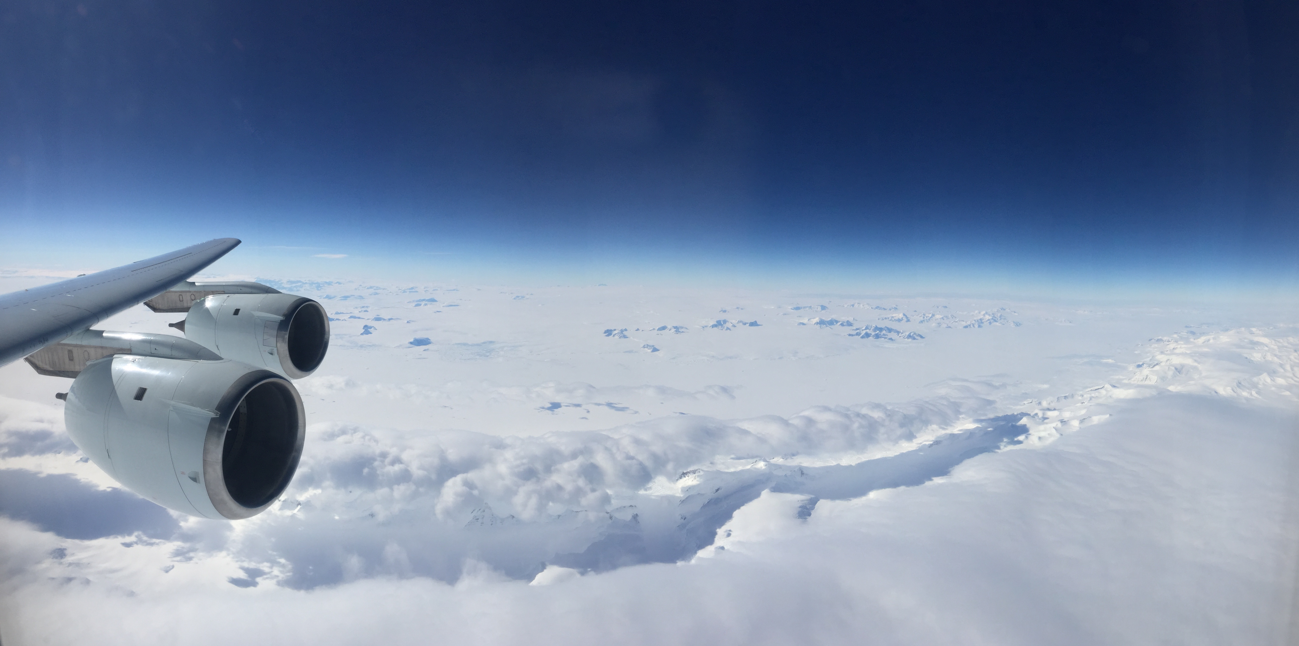
Thank you
Merci
Antarctic Peninsula NASA Operation IceBridge 2016

