Slide 1
Maturity Models and need for
WMO Maturity Matrix Convergence Model
Peter Siegmund
Royal Netherlands Meteorological Institute (KNMI)
16 April 2018, 10:00-10:30
WMO Expert Meeting on
Climate Data Modernisation
De Bilt, Netherlands
16-18 April 2018

Slide 2
WMO WORKSHOP ON INFORMATION MANAGEMENT, 2-4 OCTOBER 2017
Break Out Group A: Project plan for climate data access in context of WIS
Albert Klein Tank, Omar Baddour, et al. (1)
Objectives:
Global level: authoritative, trusted data sets for informing on key climate indicators (5-10) for global policy users of climate change information. (reference to ongoing work in WMO, GCOS, IPCC)
Regional and national level: trusted data sets and value added products such as on climate extremes; process for registering data sets in the WIS
National level: WMO Members commitment for data exchange, how to develop a WIN-WIN approach
Activity 2 (of 6):
Adopt a mechanism for assigning data set/system maturity scores
(1) Workshop Group A Project Plan For Climate Data Access

Slide 3


Slide 4

WMO Workshop on Information Management,
2-4 October 2017 ⁽¹⁾
Executive summary, bullet 4:
CCl investigates an objective approach for getting several “best trusted” climate datasets as an interim measure to provide guidance while a maturity-based approach will be made.
4.2 Project plan for improving access to climate datasets, bullet 23:
The group emphasized the potential usefulness of using a documented maturity model to select datasets for WMO endorsement.
Motivation:
Instead of choosing datasets, which would put the onus on the WMO and could be perceived as "picking winners", a call for datasets could be made. This would create a pool of candidates for endorsement. Those that met the maturity model within a certain range of ranking would be received into a community of endorsed datasets.
Maturity approach = important
⁽¹⁾ https://wis.wmo.int/file=3799

Slide 5
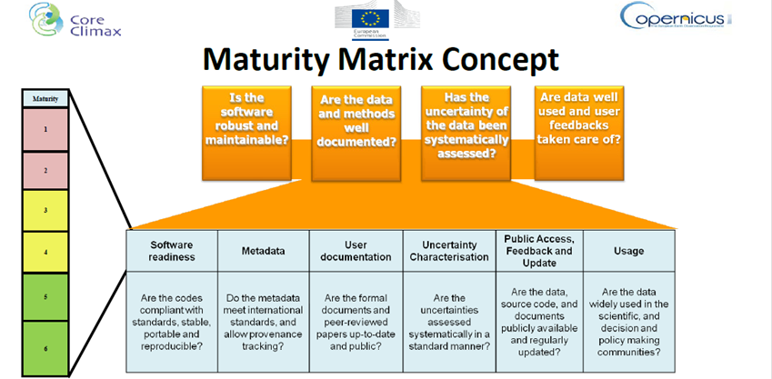
SYSTEM MATURITY ASSESSMENT, EU-CORE-CLIMAX, Jörg Schulz ⁽¹⁾
Example 1 of Maturity Matrix
Categories →
Levels →
https://wiswiki.wmo.int/tiki-index.php?page=WWIM
Schulz_EUM_Maturity_Matrix_150701.pdf

Slide 6
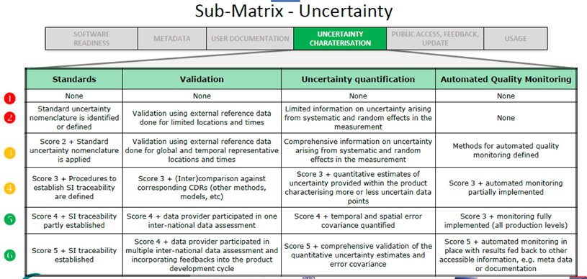
Example 1, continued
Aspects (for each category) →
Levels →
Behavior (for each aspect-level combination)

Slide 7
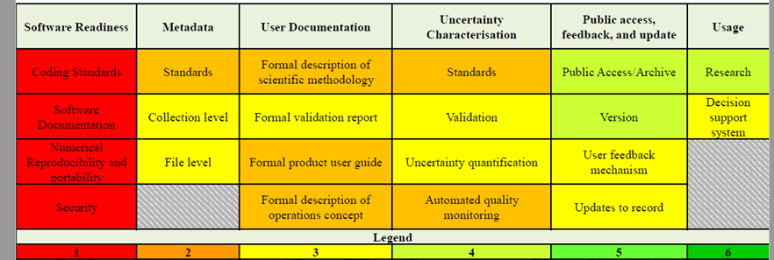
Example 1, continued
Level (color) per category and aspect (example)
→ category
→ aspect

Slide 8
Presentation Data Stewardship Maturity Matrix (DSMM) by Christina Lief ⁽¹⁾
What is it?
DSMM is a unified framework for measuring stewardship practices applied to individual digital environmental data products that are publicly available online
Why do we need it?
Increased need for a more formal approach to stewardship that supports rigorous compliance verification.
Developing a Maturity Matrix for an NCEI data set
Who could use it? Data providers, -users, -managers/stewards, scientists
How to use it?
To know: the current state of your data set (Maturity Assessment), where you want or need to be (Stewardship Requirements),how to get there (Roadmap Forward)
⁽¹⁾ https://wiswiki.wmo.int/tiki-download_file.php?fileId=3682

Slide 9
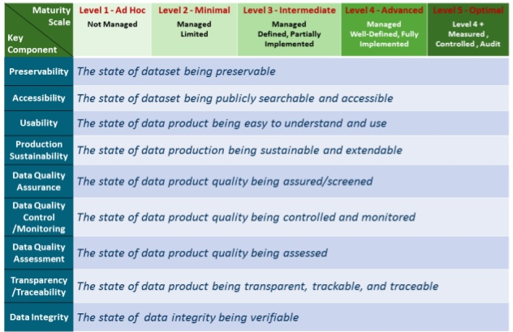
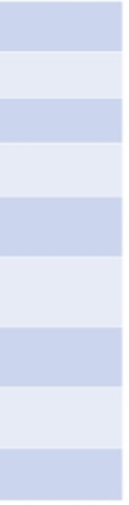
Example 2 of Maturity Matrix
Developing a Maturity Matrix for an NCEI data set
Measurable, five-level progressive practices
→ level
→ category

Slide 10
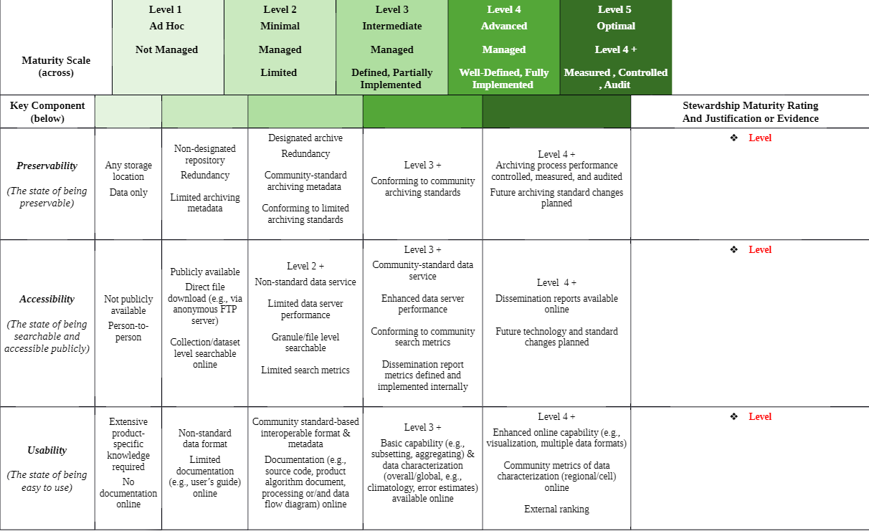
Example 2, continued
Behaviour/competences per category and level

Slide 11
FINAL REPORT OF THE FIRST MEETING OF THE
TASK TEAM ON INFORMATION MANAGEMENT
5-6 OCTOBER 2017 ⁽¹⁾
Decision 2: Participants agreed that a maturity model approach would be appropriate for developing, managing and monitoring information management practices within WMO.
Decision 6: Eight categories to be used to develop the maturity matrix:
see next slide
Each categories should be sub-divided into aspects of that category for which standards or guidance would be needed. The maturity model would be developed by considering behaviours for each of the aspects that would be expected in practice at each of five maturity levels.
Although the maturity model from NCEI that had been discussed at the WWIM covered many of the areas for which guidance was needed, it did not cover guidance on managing ICT infrastructures in support of information management.
⁽¹⁾ https://wis.wmo.int/file=3811

Slide 12
Decision 6:
Eight top level categories to be used to describe WIS Information Management
and to develop the maturity matrix:
documentation
governance
storage and preservation
quality management
access and sharing
discovery
change management
Competences
Five maturity levels (those of NCEI/Christine):
1 = ad hoc, 2 = minimal, 3 = intermediate, 4= advanced, 5 = optimal

Slide 13
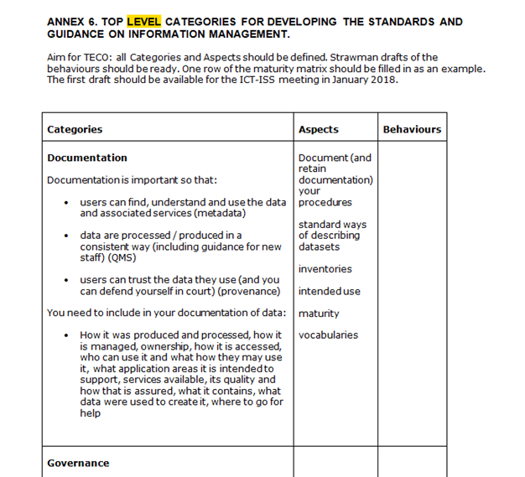
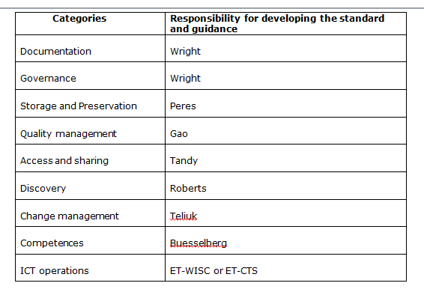
TT-IM final report, Annex 6 ⁽¹⁾:
8 Top level categories > Aspects> Behaviors for each of 5 maturity levels
https://wis.wmo.int/file=3811

Slide 14
Questions
  How to base the total score on the scores of the categories and aspects?
  E.g.: total score = lowest of 8 category scores, and
  category score = lowest of aspects scores? average of aspect scores? …?
  Which aspects and behaviors are already available?
To do (?):
  Per category: define aspects
  Per aspect: define behavior per maturity level
  Define total maturity score formula
  Establish threshold score defining a dataset as trusted.
  Only if trusted it will be included in the Data Catalog.

Slide 15

Thank you
Merci
Peter.Siegmund@knmi.nl

