Slide 1
Sea Level Data
« Expert Meeting on
Climate Data Modernization »
Anny Cazenave (LEGOS, France)
Presented by Christina Lief (WMO, Geneva)
KNMI, April 2018

Slide 2
Sea Level
An important indicator of global climate changes →integrated response of ocean heat content, land ice, land water storage to external forcing factors (including anthropogenic forcing) and internal climate variability
One of the 50 GCOS Essential Climate Variables (ECVs)
One of the first set of 13 ECVs recently reprocessed within the ESA Climate Change Initiative (CCI) project

Slide 3
Sea Level observed from space at global and regional scales since 25 years
The constellation of high-precision altimeter satellites

Slide 4
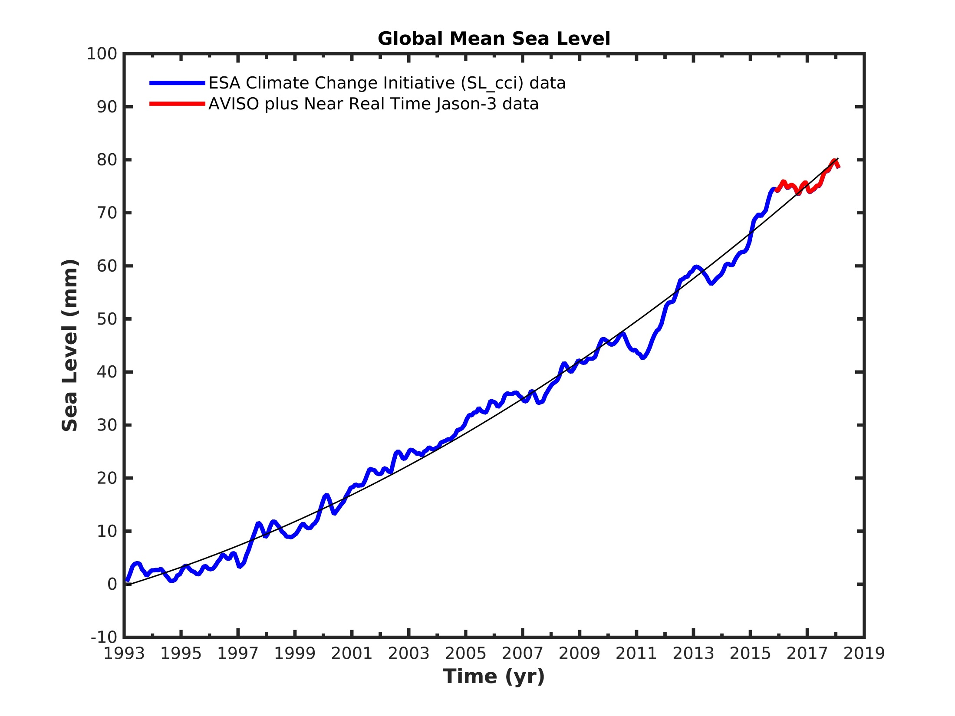
Global Mean Sea Level (Altimetry Era)
January 1993 → March 2018
Mean rate of rise: 3.0 +/- 0.3 mm/yr
Acceleration : 0.09 mm/yr²
Global mean sea level rise
mostly results from anthropogenic global warming

Slide 5
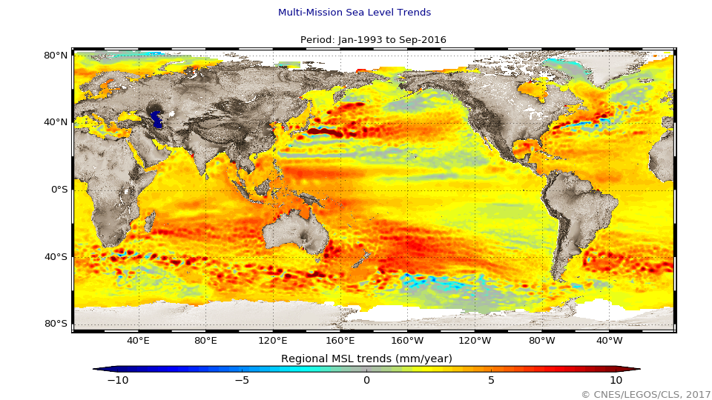
Regional rates of sea level change (1993-2016) (mm/yr)
Regional sea level changes
still dominated by the
internal climate variability

Slide 6
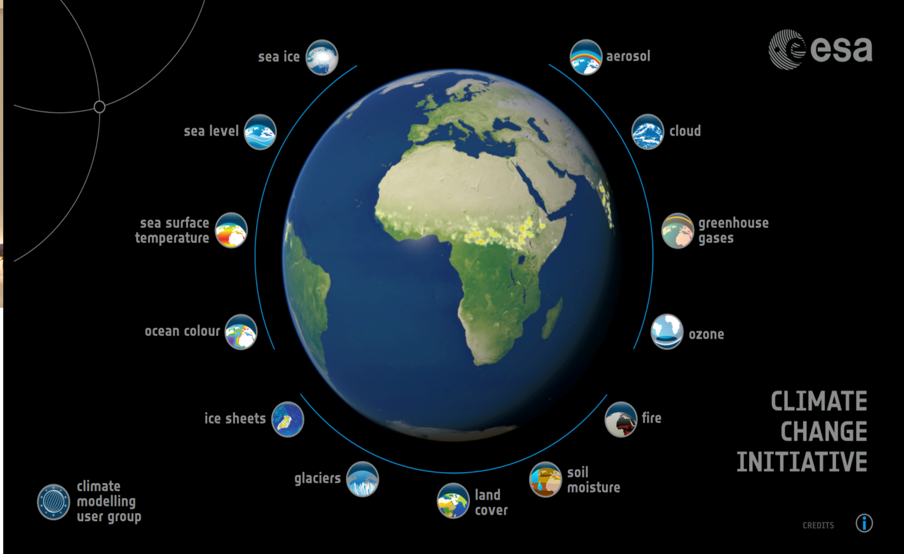
“Climate Change Initiative” Project from ESA
→ Reprocessing of 13 Essential Climate Variables among the 26 ECVs observable from space as identified by GCOS to monitor climate change
Complete reprocessing of 9 altimetry missions:
T/P, Jason1/2, ERS-1/2, ENVISAT, GFO; CryoSat-2, SARAL/AltiKa
Improvement of orbit computation, and of instrumental & geophysical corrections,
reduction of intermission bias, combination of missions, etc.
Period: 1993-2015 (+70 years of cumulated reprocessed altimetry data)

Slide 7
Sea Level: current uncertainty of
«ESA Climate Change Initiative/CCI» products
Spatial Scales | Temporal Scales | GCOS Requirements | Errors of CCI products
Global Mean Sea Level | Long-term trend | <0.3 mm/yr | 0.3-0.4 mm/yr
 | Interannual signals | 0.5 mm over 1 year | < 2 mm over 1 year
Regional Sea Level | Long-term trend | <1 mm/yr | <3 mm/yr
Since 2017, operational generation of sea level products
by the Copernicus Climate Change Service/C3S (Europe)
BUT continuing upstream research strongly needed to provide
improved altimetry-based sea level data sets!!!!
GCOS: Global Climate Observing System

Slide 8
Global Mean Sea Level Budget
Sea
Level
Budget
Observed Global Mean Sea Level
=
Ocean Thermal Expansion + Ocean Mass
ΔM_{ocean} = - ΔM_{LI} - ΔM_{LW} - ΔM_{WV} - ΔM -…….
Snow
Ocean mass
Land ice
Land waters
Atmospheric
water vapor
Snow
Δ = Time variation
M = Mass components
LI = Land Ice (glaciers + ice sheets)
LW = Land Waters
WV = Water Vapour
Mass Budget

Slide 9
Motivations for regularly assessing the sea level budget
Better understand processes at work and follow temporal changes (acceleration?) of individual components
Place bounds on missing or poorly known contributions (e.g., deep >2000m ocean warming not sampled by Argo, …)
Constrain current Earth’s Energy Imbalance
Validate climate models used for projections

Slide 10
World Climate Reserach Programme
Grand Challenge « Regional Sea Level and Coastal Impacts »
WP 6: Global Sea Level Budget Assessment (Sea Level as ‘Global Climate Indicator’; Focus on altimetry era & observations)
Leads: Anny Cazenave and Benoit Meyssignac (LEGOS)
Supporting team: > 80 scientists from 60 institutions worldwide
Scientific objective: ASSESS products used in the sea level budget (sea level and components) provided by different groups worldwide and on-going international projects (e.g. the ESA Climate Change Initiative/Sea Level Budget Closure Project , NOAA annual sea level budget, IMBIE2, ….).
- Describe data sets used for the sea level budget
- Characterize uncertainties
- Examine closure of the sea level and mass budgets
1st assessment completed; Article submitted to Earth System Science Data (April 2018)

Slide 11
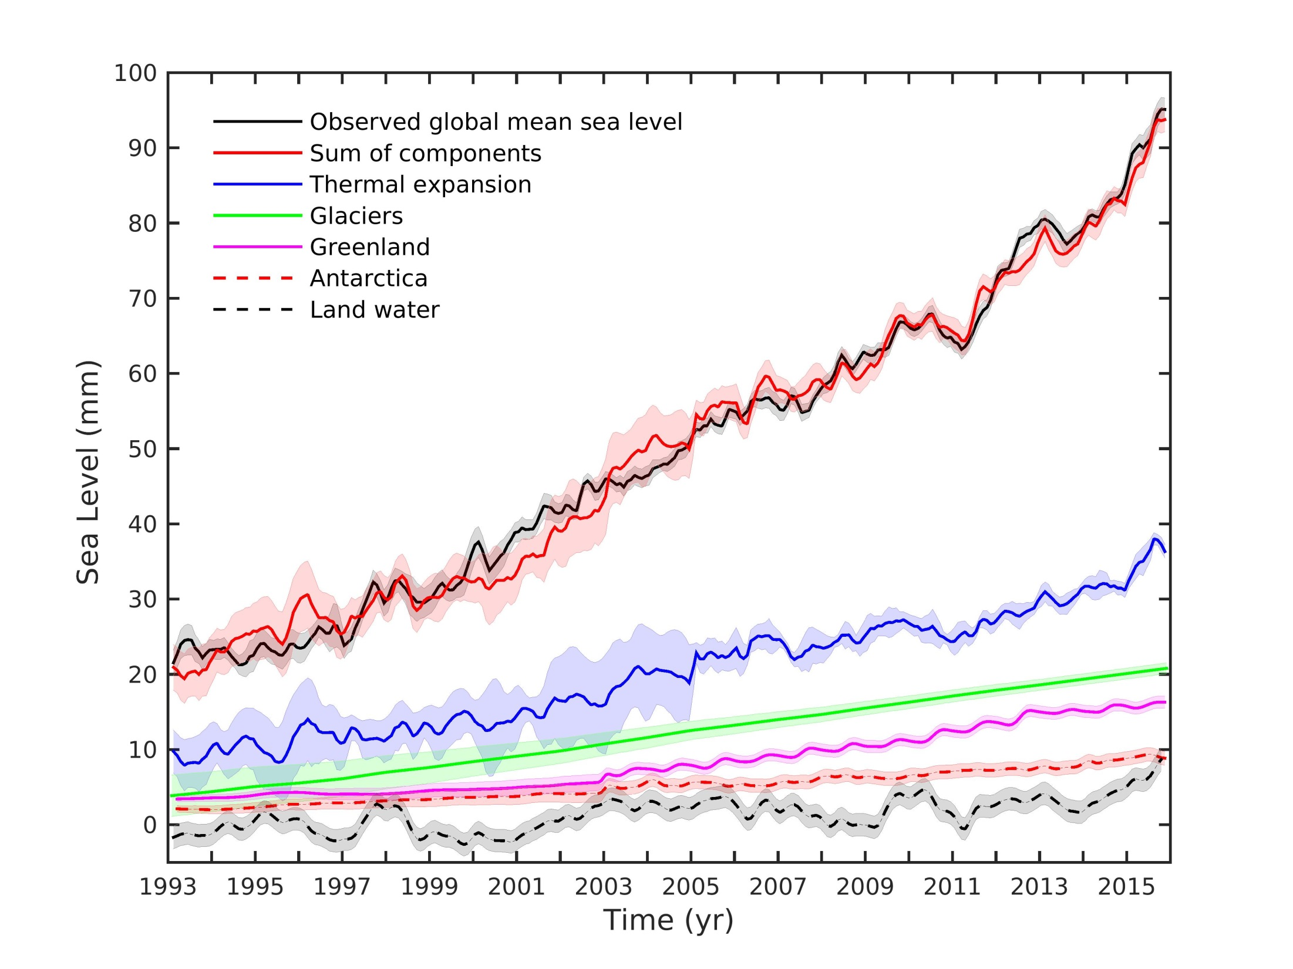
The Global Mean Sea Level Budget
The WCRP Global Sea Level Budget Group, ESSD, 2018

Slide 12
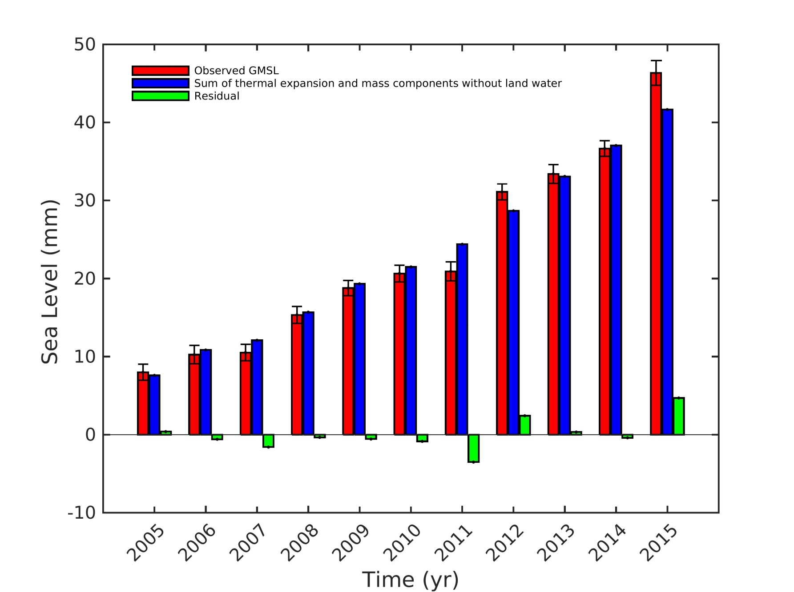
Annual Sea Level Budget
Observed sea level
Sum of contributions
The WCRP Global Sea Level Budget Group, ESSD, 2018

Slide 13
The Sea Level Record:
What has been done? What remains to be done?
**More research needed to fully reach the GCOS requirements
***Ensure continuity of the high-quality sea level record for climate research and include new satellites in orbit (e.g., CryoSat, Sentinel-3, Jason-3, …)
***Need for continuing R&D ACTIVITIES to feed operational production of sea level by C3S
***Develop multi-mission COASTAL SEA LEVEL products GLOBALLY!!!

Slide 14
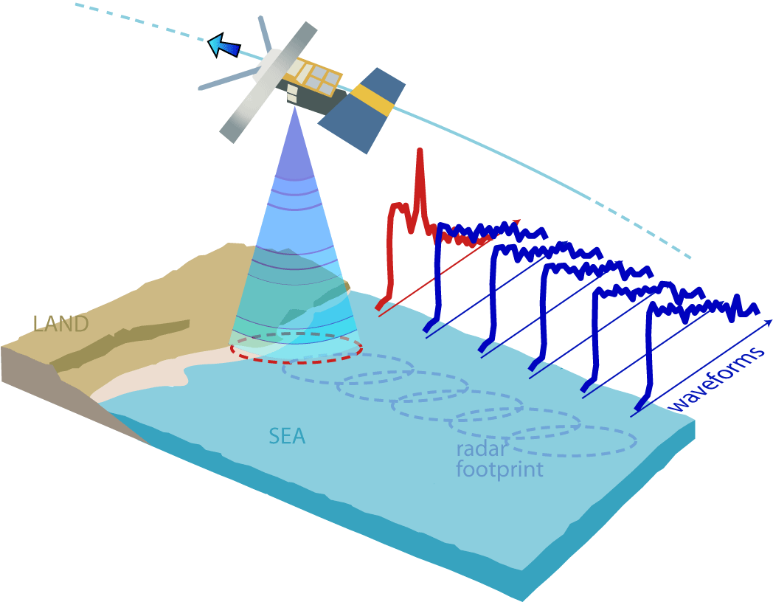
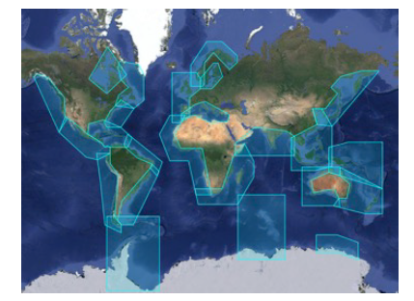
The answer to the question: “is sea level at the coast rising at the same rate as in the open ocean?” is UNKNOWN (→ Yet, there are reasons to suspect that coastal sea level differs from the open ocean because of many additional processes: shelf currents, waves, river runoff in deltas and estuaries, etc.)
Need for a global, altimetry-based, coastal sea level data set (with reprocessing of radar echoes, improved corrections, gridded multi mission products,
link with open ocean sea level, …)
→ important for assessing coastal impacts of climate change
and develop adaptation strategies
Conventional satellite altimetry
does not work well within 20 km
to the coast (perturbations from land)

Slide 15
What do we need for science?
A long and accurate global and regional sea level record → sustained altimetry missions
Regular estimates of closure of the sea level budget at global
and regional scales → process understanding, constraints on missing contributions and Earth’s Energy Imbalance, detection & attribution studies, validation of climate models…
A global, multi-mission Coastal Altimetry data set → important for studying coastal impacts of global change
To conclude….

Slide 16
Thanks for your attention

