Slide 1
Updates on Preparations for
CPM19-2, RA-19 and WRC-19
3rd Meeting of the
APT Conference Preparatory Group
for WRC-19 (APG19-3)
12-16 March 2018, Perth, Australia
Philippe Aubineau
Counsellor, ITU-R Study Groups,
Radiocommunication Bureau, ITU

Slide 2
Main Steps towards WRC-19
WRC-15: WRC-19 Agenda - Resolution 809 (WRC-15)
1st Session of Conference Preparatory Meeting: CPM19-1
30 Nov – 1 Dec. 2015; Results @CA/226 of 23/12/2015
C-16: WRC-19 agenda & dates in Res. 1380 with MOD venue @ C-17
Text of Res. 1380 (C-17) at www.itu.int/md/S17-CL-C-0141, see also the WRC-19 booklet
CL No. 17/52 of 18 Dec. 2017 confirmed RA-19 & WRC-19 venue in Sharm el-Sheikh (Egypt)
2nd Session of Conference Preparatory Meeting: CPM19-2
Planned dates at CICG in Geneva from 18 to 28 February 2019
Final meetings of regional groups
Member States’ proposals to WRC-19
RA-19: 21 to 25 Oct. 2019 ; WRC-19: 28 Oct. to 22 Nov. 2019

Slide 3
Summary of CPM Report Preparation
Responsible
ITU-R Groups
WRC-19 agenda items (AI),
incl. issues under AI 9.1
1.15
Dates/Deadlines
WP 1A
Chapter 1
(draft texts)
To CPM-19
Chapter
Rapporteurs
prior to
31 August
2018
9.1.6
9.1.7
Chapter 2
(draft texts)
WP 1B
Chapter 3
(draft texts)
1.4
1.5
1.6
7
Chapter 4
(draft texts)
WP 4A
9.1.2*
9.1.3
9.1.9
Chapter 5
(draft texts)
Chapter 6
(draft texts)
WP 4C
9.1.1*
* Relevant part
WP 5A
1.1
1.11
1.12
1.16
9.1.5
{6-7
Sep. 2018}
CPM Management
Team Meeting
WP 5B
1.8**
1.9.1
1.9.2
1.10
9.1.4
** WP 4C for studies & CPM text
on resolves to invite ITU-R 2 of Res. 359 (Rev.WRC-15)
to be sent to WP 5B
> 3 months
prior to
CPM19-2
1.14
Draft
CPM Report
WP 5C
WP 5D
9.1.8
{18-28
Feb. 2019
in CICG}
1.2
1.3
1.7
CPM19-2
WP 7B
TG 5/1
1.13
CPM Report
to WRC-19
{Prior to
Apr. 2019}
CPM19-2
2
4
10
{planned}

Slide 4
Next Meetings of Resp. Groups
Responsible ITU-R Groups
WRC-19 agenda items (AI), incl. issues under AI 9.1
TG 5/1
1.13
{2 – 11 May 18}
WP 7B
1.2
1.3
1.7
14 – 18 May 18
WP 7C, responsible for WRC-23 preliminary agenda items 2.2 and 2.3, meets usually in parallel with WP 7B
WP 5A
1.1
1.11
1.12
1.16
9.1.5
21 – 31 May 18
WP 5B
1.8**
1.9.1
1.9.2
1.10
9.1.4
21 May – 1 June 18
** WP 4C is in charge of developing studies and draft CPM text on resolves to invite ITU-R 2 of Res. 359 (Rev.WRC-15) (AI 1.8) and sending that to WP 5B
WP 5C
1.14
21 May – 5 June 18
^{Last meetings to finalize}
^{the relevant draft CPM texts}
WP 1A
1.15
4 – 12 June 18
WP 1B
9.1.6
9.1.7
WP 5D
9.1.8
{13 – 20 June 18}
WP 4C**
9.1.1*
{26 June – 3 July 18}
* Relevant part
1.4
1.5
1.6
7
WP 4A
{4 – 13 July 18}
9.1.2*
9.1.3
9.1.9
TG 5/1
1.13
{20 – 29 Aug. 18}
Up-to-date information online at: http://www.itu.int/en/events/Pages/Calendar-Events.aspx?sector=ITU-R
{planned meetings}

Slide 5
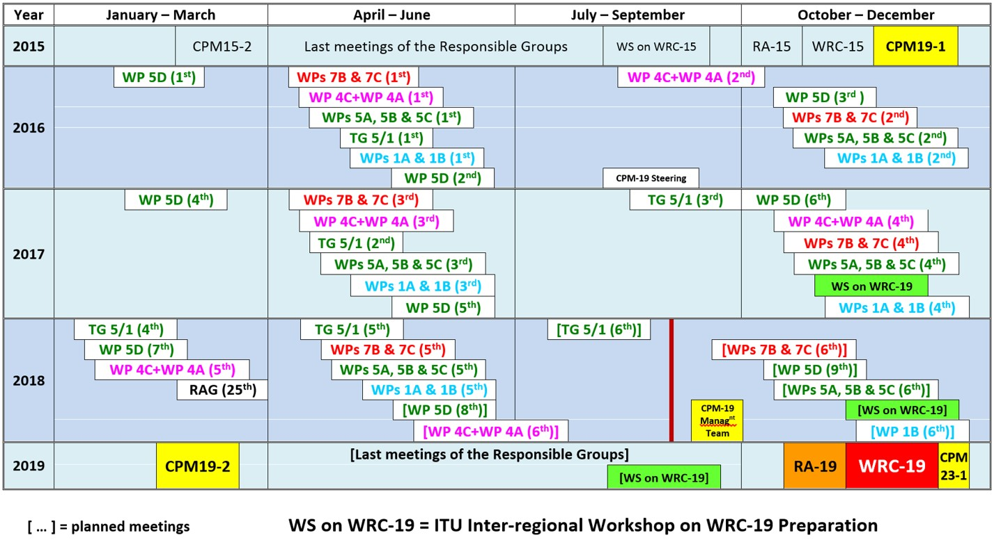
Overview of the ITU-R Calendar
towards WRC-19
Up-to-date information online at: www.itu.int/en/events/Pages/Calendar-Events.aspx?sector=ITU-R

Slide 6
AI with Overlapping frequency bands **
Organization of the studies
to address mutual compatibility & sharing feasibility among the services/applications under AI-Resolutions with overlapping freq. bands
1.6 – NGSO FSS Res. 159 (WRC-15) (studies by WP 4A) | 1.13 – IMT Res. 238 (WRC-15) (studies by TG 5/1) | 1.14 – HAPS Res. 160 (WRC-15) (studies by WP 5C) | 9.1 (9.1.9) – FSS Res. 162 (WRC-15) (studies by WP 4A)
 | 24.25-27.5 | 24.25-27.5 (Reg. 2)
37.5-39.5 (s-E*) | 37-40.5 | 38‑39.5 (globally)
39.5-42.5 (s-E*) | 40.5-42.5
47.2-50.2 (E-s*) | 47.2-50.2
50.4-51.4 (E-s*) | 50.4-52.6 |  | 51.4-52.4 (E-s*)
* E-s: Earth-to-space; s-E: space-to-Earth.
Studies*** by
WP 5C
Studies*** by
TG 5/1
Studies*** by
WP 4A
** Frequency bands in GHz
*** Other studies to address mutual compatibility & sharing feasibility among the services/applications for which allocation/identification is envisaged under the corresponding Res. relating to the AI in the overlapping bands

Slide 7
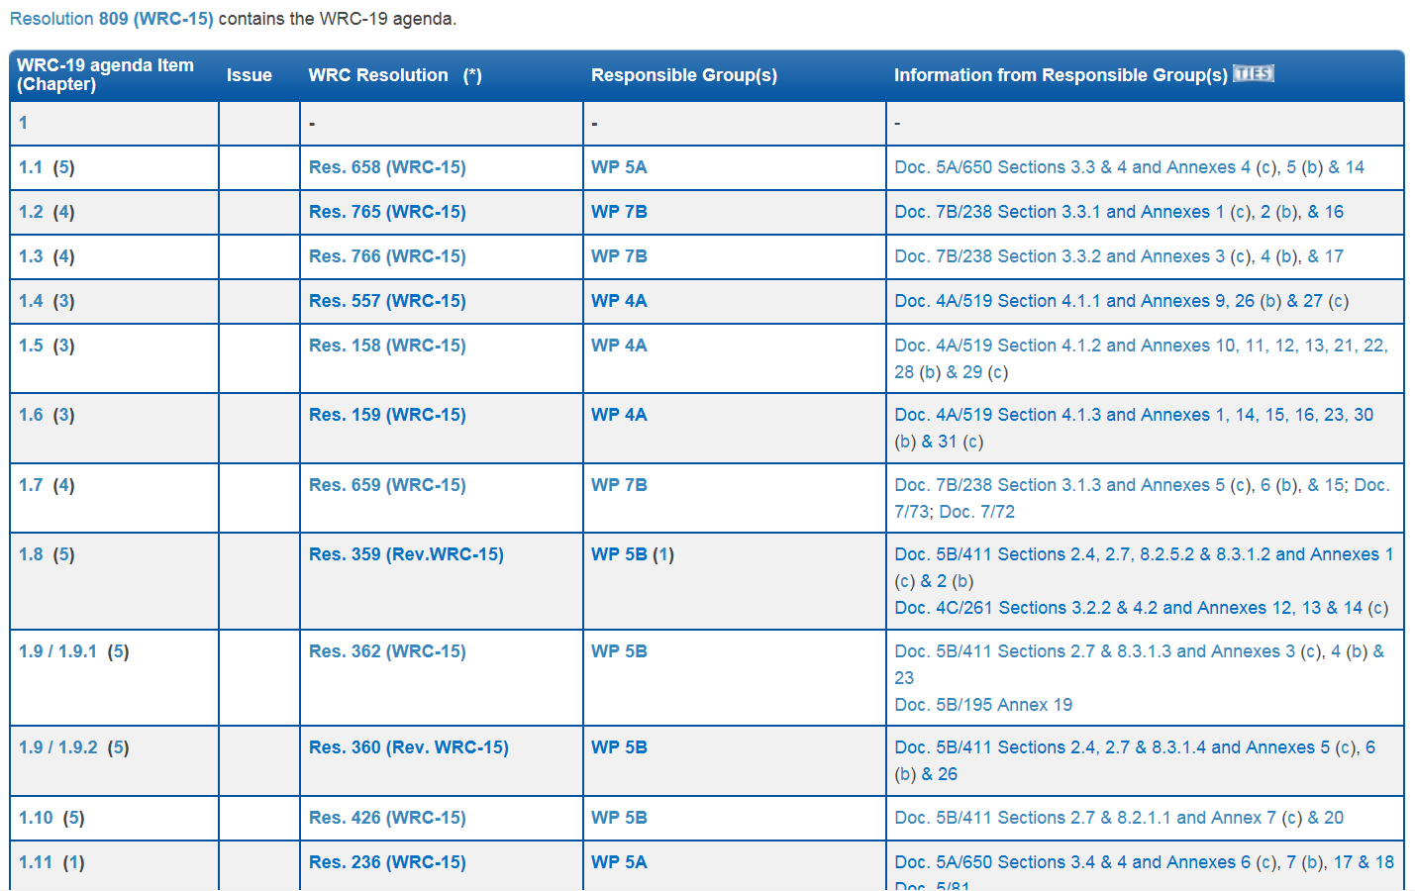
ITU-R Preparatory Studies for WRC-19
www.itu.int/go/rcpm-wrc-19-studies
Updated after the Sep. to Nov. 2017 meetings

Slide 8
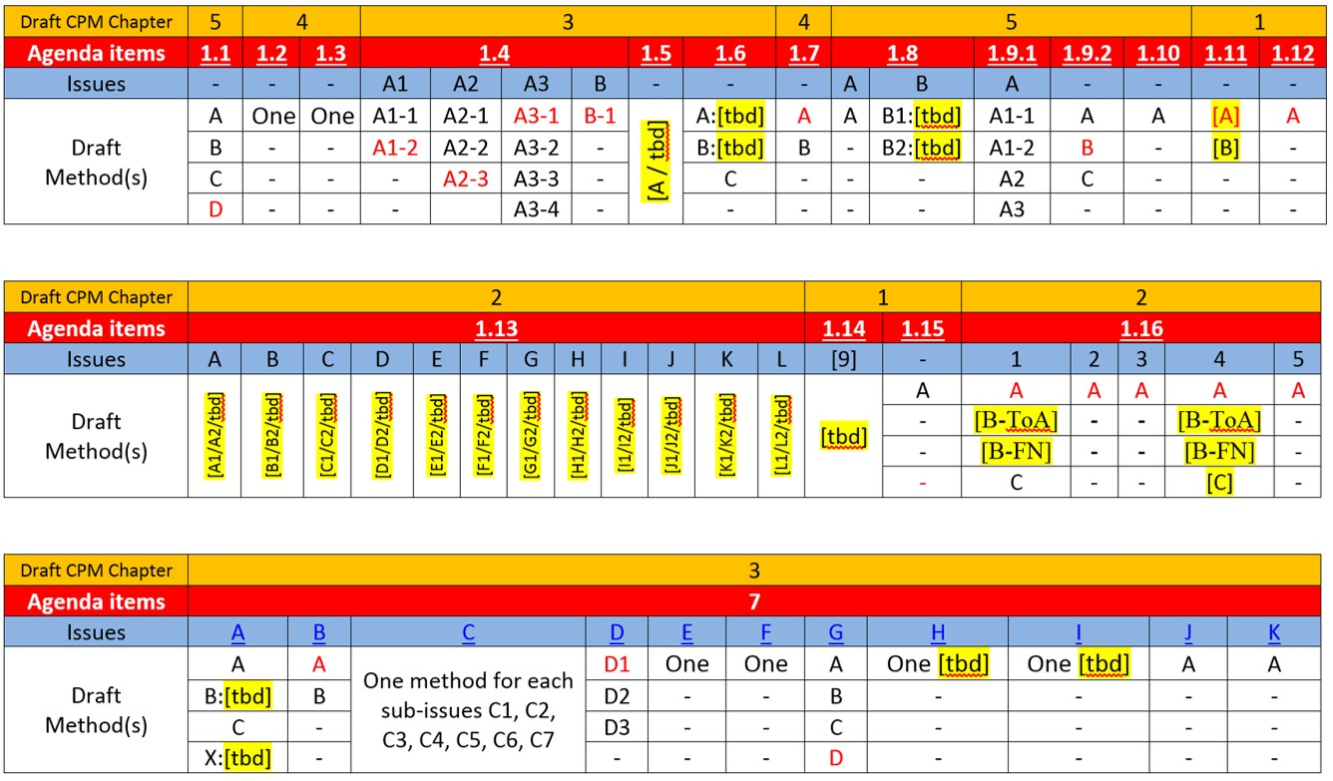
Draft Methods* to satisfy the WRC-19 AIs
* Provisional situation after the Sep. to Nov. 2017 meetings of the Responsible Groups (the draft methods with NOC to the RR are indicated in red font)

Slide 9
Previous & next RAG Meetings
Summary of Conclusions of the 24th RAG meeting (26-13 April 2017)
see BR Administrative Circular CA/233 at: www.itu.int/md/R00-CA-CIR-0233, including:
“RAG also considered Doc. RAG17/16 from France on a proposed review of Resolution ITU-R 2, supporting the current CPM process while proposing changes in various aspects to provide more time for the ITU-R Working Parties to conclude their work on the draft CPM texts as well as to reduce the duration of the duration of CPM-2 to 8 working days, from a Tuesday to a Thursday. RAG noted the document and indicated that Members States are free to submit their proposals for a possible revision of Resolution ITU-R 2 directly to RA-19”
“RAG considered Doc. RAG17/2 from Italy and the Vatican City, proposing to merge into a single resolution the three resolutions that relate to the work of the CCV (Resolutions ITU-R 34, 35 and 36). RAG noted that the proposal had been also submitted to the CCV, which is preparing a proposed revision of Resolution ITU-R 36 along those lines for submission to RA-19. It was noted that a Member State, if it so wishes, may also submit such a proposal directly to the RA-19.”
Invitation to the 25th RAG meeting (26-29 March 2018)
in Administrative Circular CA/236 at: www.itu.int/md/R00-CA-CIR-0236
(RAG webpage: www.itu.int/ITU-R/go/rag; SGs webpage: www.itu.int/ITU-R/go/rsg)

Slide 10
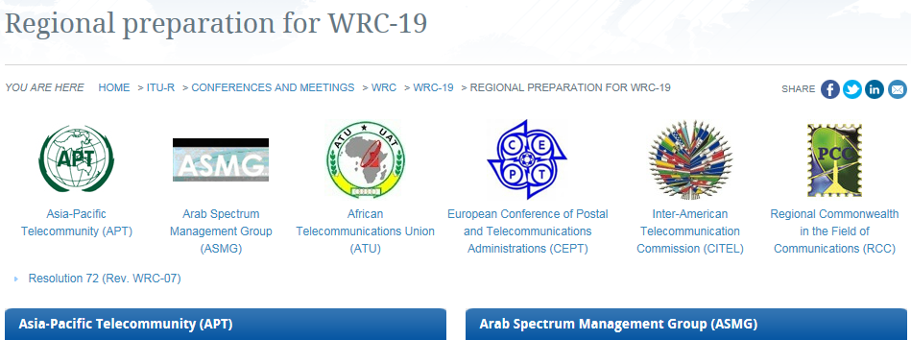
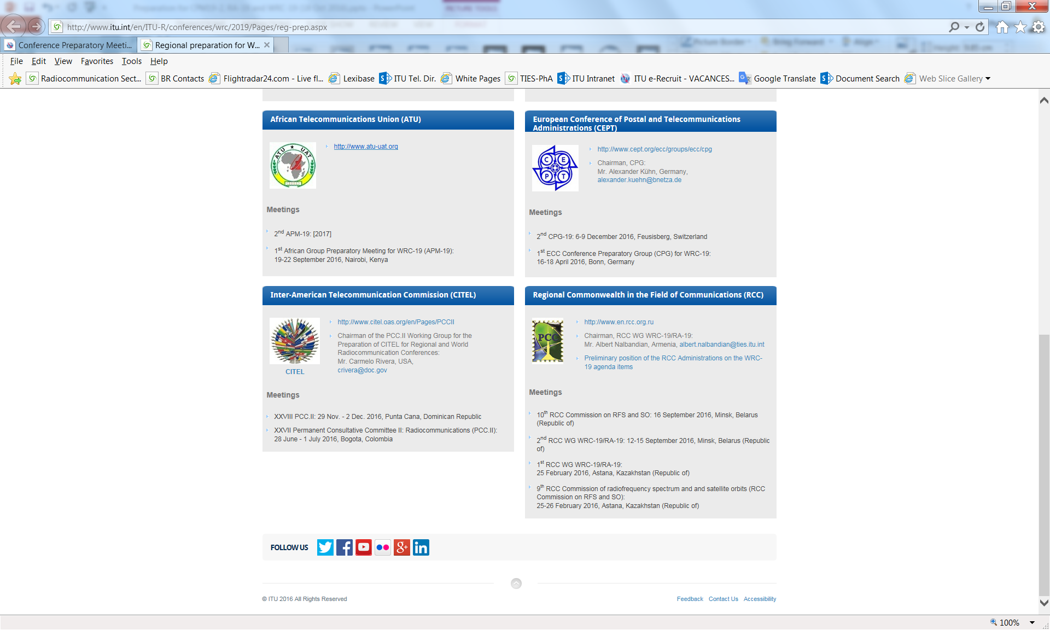
WRC Regional Preparation
Pursuant to Resolution 72 (Rev. WRC-07)
See details @ www.itu.int/go/wrc-19-regional
3rd APG-19: 12-16 March 2018, Perth, Australia
23rd ASMG: [7-11 April 2018, Marrakech, MRC]
3rd APM-19: [17-21 Sep. 2018, Cairo, Egypt]
6th CPG-19: [26-29 June 2018, Turku, Finland]
31st PCC.II: [16-20 July 2018, Mexico]
5th RCC WG: [2018]
Informal Group (Chairman: Mr. T. Al Awadhi, tariq.alawadhi@tra.gov.ae)

Slide 11
ITU Inter-Regional Workshops
on WRC-19 Preparation
Webpage
1st Workshop on 21-22 Nov. 2017
To be scheduled halfway through the preparatory cycle
Presentation and review of the on-going preparatory
studies of the ITU-R responsible groups for CPM-19
Presentation of the organization, preliminary views,
draft priorities and positions of the regional groups
Webpage
2nd Workshop [21-23
November 2018]*
To be scheduled few months prior to CPM19-2
Presentation of the Draft CPM Report to WRC-19
(explanation of the draft Methods to satisfy the
WRC-19 agenda items)
Presentation and review of the regional groups’ draft
views, positions and common proposals
3rd Workshop [Q3 2019]*
To be scheduled few months prior to WRC-19
Presentation of the CPM & Dir. Reports to WRC-19
Presentation and review of the regional groups’ draft
views, positions and common proposals
* Updated information on meeting dates to be provided later on at: www.itu.int/en/events/Pages/Calendar-Events.aspx?sector=ITU-R

Slide 12
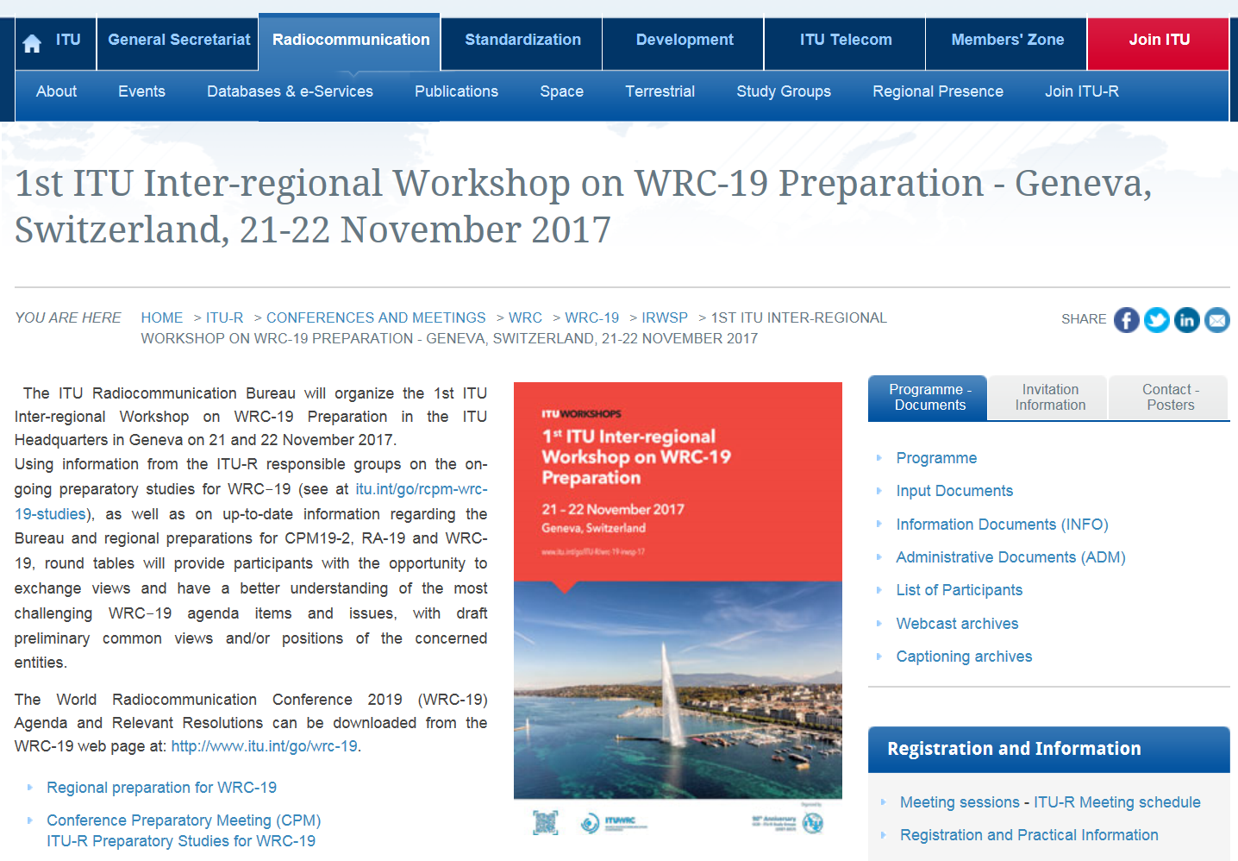
1st ITU Inter-regional Workshop on WRC-19 Preparation
Access to the information exchanged during the Workshop

Slide 13
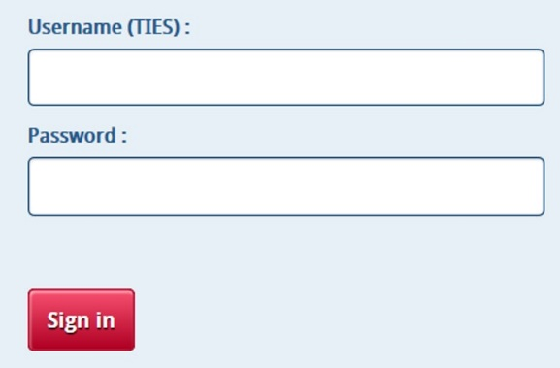
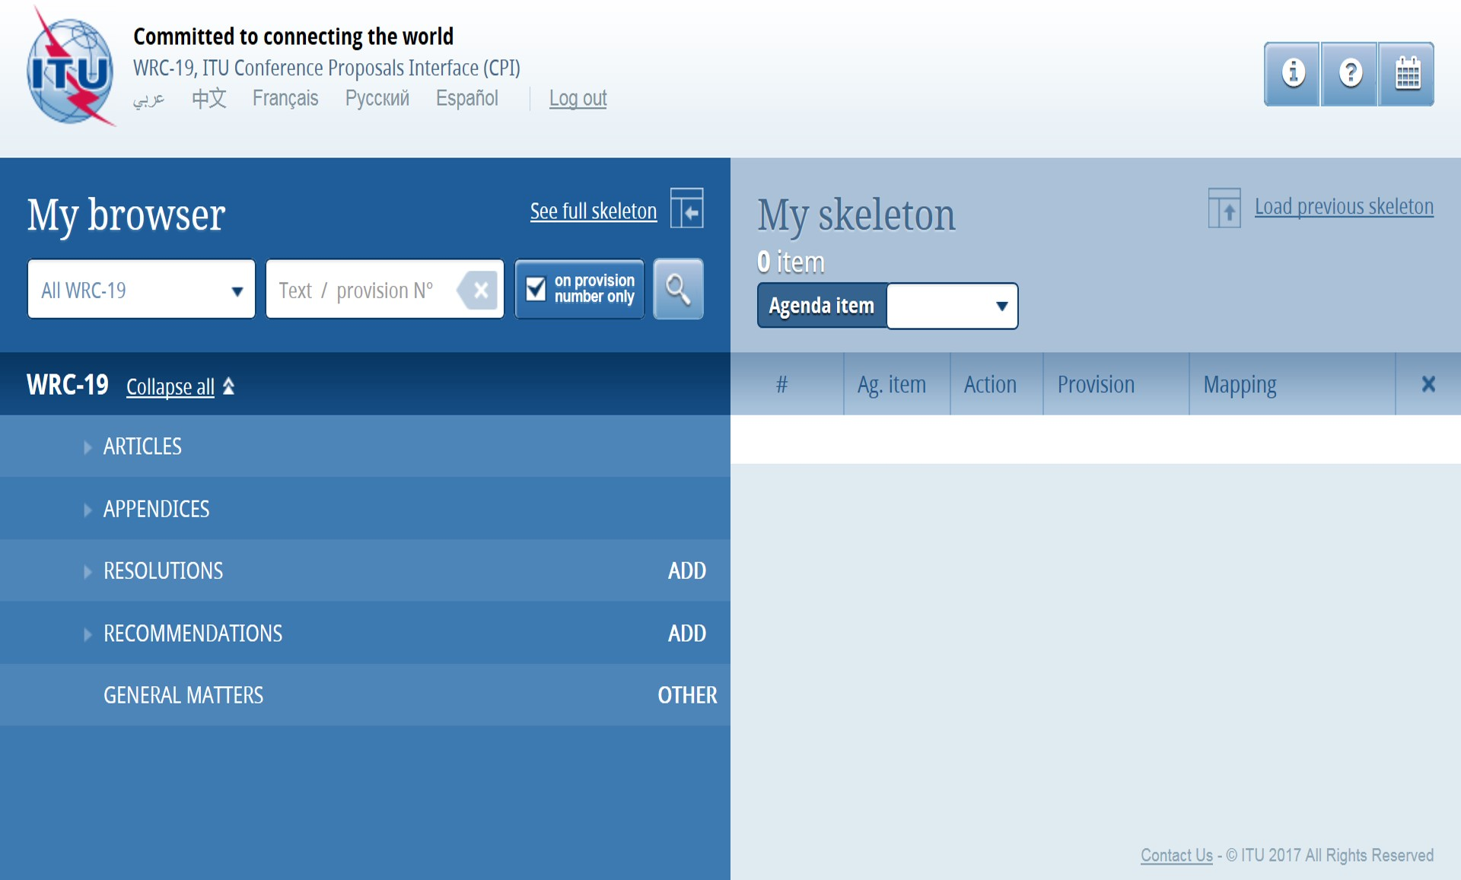
New Conference Proposals Interface for WRC-19
www.itu.int/net4/Proposals/CPI/WRC19/Main
Preliminary version to be used for preparation
of draft documents with proposed actions
(MOD, ADD, etc.) to RR-2016 texts
(to access the screen below)
List of the WRC-19 agenda items (issues)
2016 Edition of the Radio Regulations

Slide 14
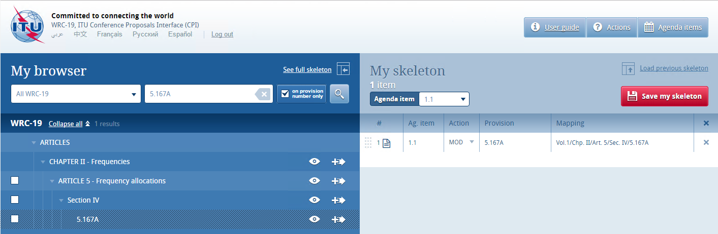
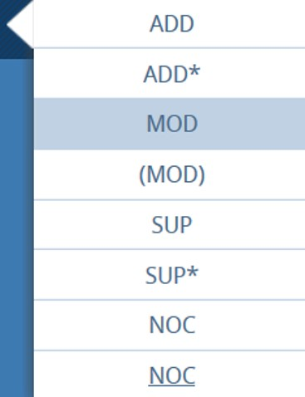
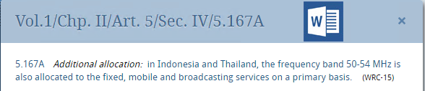
Include RR text(s) in a draft document
(main steps)
Additional information can be found in relevant parts of the CPI User Guide for WRC-15
agenda item/(issue) selection
2
5
RR text search
6
1
3
Action selection (e.g. MOD) for “My skeleton”
4
RR text view
Repeat steps 1 to 4 to add other RR text(s) (provisions, etc.)

Slide 15
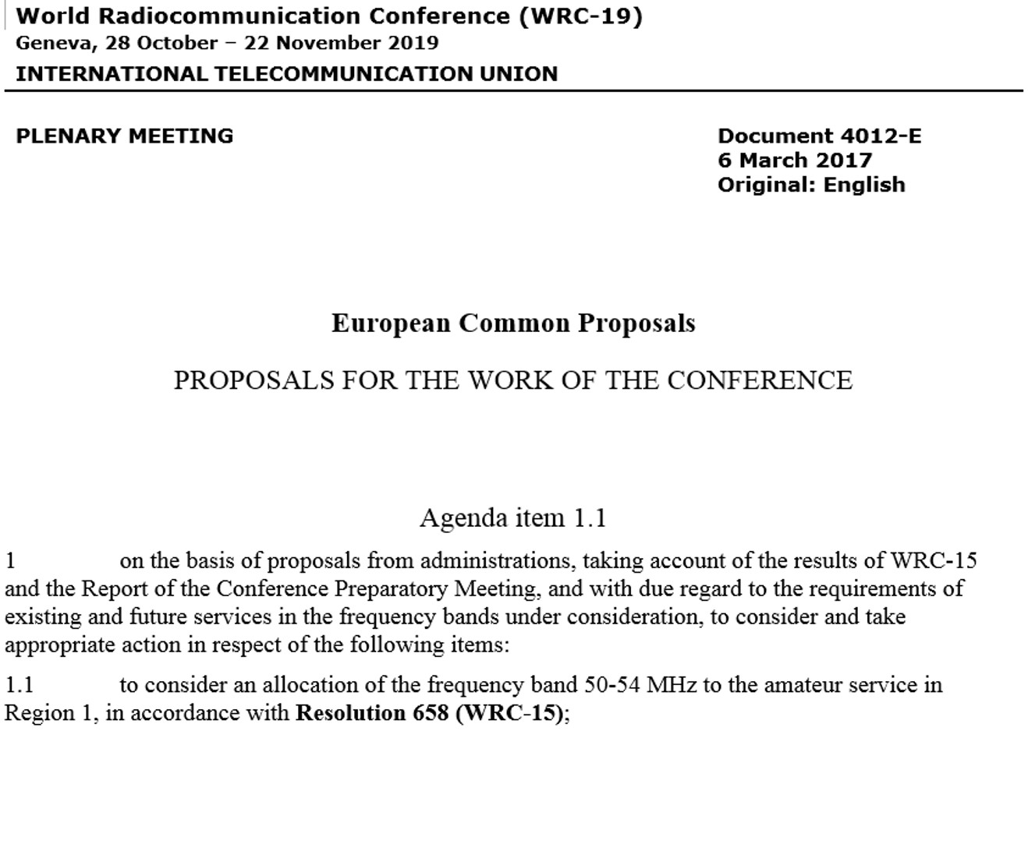

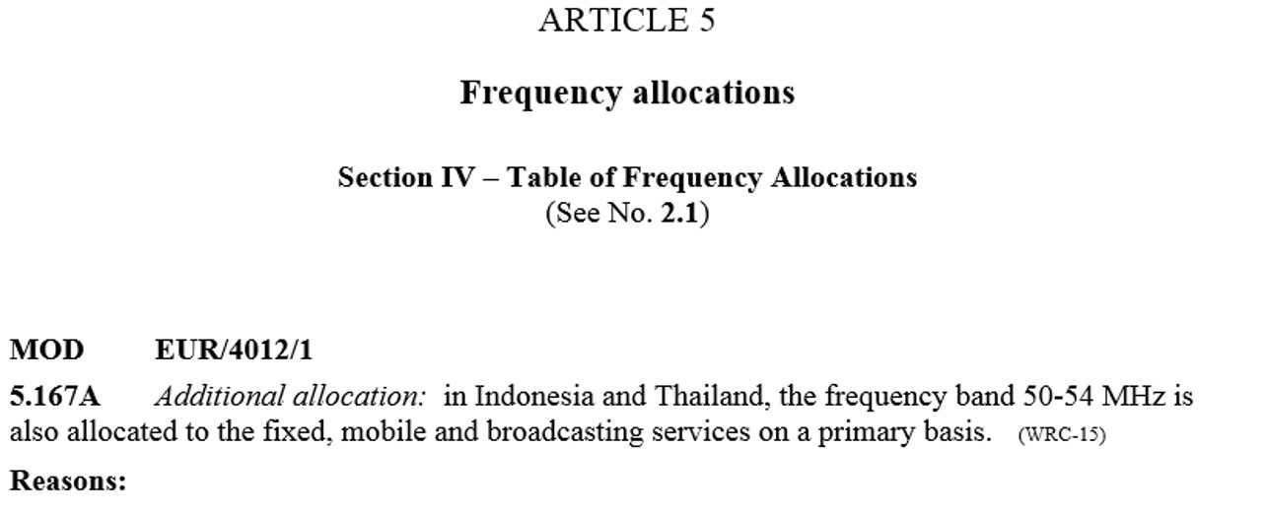

Draft Doc. created with CPI for WRC-19
Sample Doc. generated
by CPI when clicking on
*. The Doc. is
also attached to an email
sent by CPI to the User
Using WRC-19 and
ITU-R Study Group
Document Templates
No button yet in CPI to
submit WRC-19 proposals
(will be in a future version)
Sample Doc. part not relevant at this stage
Sample RR texts correctly formatted
* An intermediate screen appears to enter the name of the country/regional group and the Doc. suffix number.
This information is not necessary at this stage and can be ignored by clicking on “Save my skeleton”.

Slide 16
Information for the
preparation of the draft CPM texts
Resolution ITU-R 2-7 with Annexes 1 and 2 (Rev. RA-15)
www.itu.int/pub/R-RES-R.2-7-2015
BR Administrative Circular CA/226, its Add. 1 & Corr. 2
www.itu.int/md/R00-CA-CIR-0226
Proposed detailed Structure for the Draft CPM Report to WRC-19
www.itu.int/oth/R0A0A000007/en
CPM Chairman’s Document to ITU-R Responsible Groups
www.itu.int/md/R15-WP1A-C-0077/en of 19 Sep. 2016
Additional information and examples of RR modificiations in Sections 2.5, 3.4, 3.6 to 3.9 and Annex 2 of the former
Guidelines for the Preparation of Proposals for WRC15

Slide 17
Thank you for your attention
philippe.aubineau@itu.int
Counsellor for ITU-R SG1 & CPM
ITU-R Study Groups: www.itu.int/ITU-R/go/rsg
Email: brsgd@itu.int
Conference Preparatory Meeting (CPM) for WRC-19:
www.itu.int/ITU-R/go/rcpm, Email: rcpm@itu.int
Additional slides on
CPM-19 webpage, leadership, draft Report structure
Topics and items on the Agenda for WRC-19
Preparation for RA-19
Radio services and other abbreviations

Slide 18
CPM-19
www.itu.int/ITU-R/go/rcpm
Chairman
Mr K. AL-AWADHI (UAE), E-mail: khalid.alawadi@tra.gov.ae
Vice-Chairmen, CPM
Mr M. AL BADI (OMA), E-mail: albadi@tra.gov.om
Ms C. BEAUMIER (CAN), E-mail: chantal.beaumier@canada.ca
Mr X. GAO (CHN), E-mail: gaoxiaoyang@chinasatcom.com
Mr V. GOEL (IND), E-mail: viresh.goel@gmail.com
Mr A. KÜHN (D), E-mail: alexander.kuehn@bnetza.de
Dr H. SEONG (KOR), E-mail: seong@msip.go.kr
Mr T. SHAFIEE (IRN), E-mail: shafiee@cra.ir
Mr. A. V. VASSILIEV (RUS), E-mail: alexandre.vassiliev@ties.itu.int
(see details at www.itu.int/go/ITU-R/cvc/CPM)

Slide 19
CPM-19 Management Team
Organised in accordance with Res. ITU-R 2-7 and composed of:
- CPM-19 Chairman, Vice-Chairmen and Chapter Rapporteurs
- Chairmen of Study Groups and Responsible Groups
⇒ Consolidate the draft CPM texts/chapters into the
draft CPM Report to WRC-19 (input to CPM19-2)
See also CA/226 Add.1 on Preparation of the Draft CPM Report to WRC-19
Second Session of CPM-19
Based on the draft CPM Report (available in six official ITU languages a minimum of 3 months before CPM19-2)
Consider contributions from ITU Member States
& ITU-R Sector Members
Consider also a preliminary draft version of the
BR Director’s Report to WRC-19
To finalize the CPM Report to WRC-19 (incl.
draft solutions (methods) to satisfy the agenda items)

Slide 20
Draft CPM Report – ToC
(see Annex 6 to CA/226)
Chapters of the draft CPM Report
WRC-19 Agenda items
1. Land mobile and fixed services
2. Broadband applications
in the mobile service
3. Satellite services
4. Science services
5. Maritime, aeronautical
and amateur services
6. General issues
1.11, 1.12, 1.14, 1.15
1.13, 1.16,
9.1 (9.1.1, 9.1.5, 9.1.8)
1.4, 1.5, 1.6, 7,
9.1 (9.1.2, 9.1.3, 9.1.9)
1.2, 1.3, 1.7
1.1, 1.8, 1.9.1, 1.9.2, 1.10, 9.1 (9.1.4)
2, 4, 9.1 (9.1.6, 9.1.7), 10

Slide 21
CPM Chapter Rapporteurs
Chapters | Rapporteurs
1. Land mobile and fixed services | Ms K. ZHU (CHN), Email: Zhukeer@miit.gov.cn
2. Broadband applications in the mobile service | Mr J. ARIAS FRANCO (MEX), Email: jose.arias@ift.org.mx
3. Satellite services | Mr N. VARLAMOV (RUS), Email: vnv73@mail.ru
4. Science services | Mr V. MEENS (F), Email: vincent.meens@cnes.fr
5. Maritime, aeronautical and amateur services | Mr W. EL SAYED (EGY), Email: wsayed@ntra.gov.eg
6. General issues | Mr P.N. NGIGE (KEN), Email: ngige@cck.go.ke
(see details at www.itu.int/en/ITU-R/study-groups/rcpm/Pages/cpm-19-chp-rapporteurs.aspx)

Slide 22
Structure of the draft CPM texts for
an agenda item in a given chapter
(see Annexes 6 and 11 to CA/226)
Chapter N
Agenda Item 1.XY
[Relevant WRC Resolutions if any]
N/1.XY/1 Executive Summary*
N/1.XY/2 Background*
N/1.XY/3 Summary and Analysis of the results of ITU-R studies, including a list of relevant ITU-R Recommendations
N/1.XY/4 Method(s) to satisfy the Agenda Item**
N/1.XY/5 Regulatory and procedural considerations**
(see the Proposed detailed Structure for the Draft CPM Report to WRC-19 at:
http://www.itu.int/oth/R0A0A00000A/en)
* Not more than half a page of text ** Not applicable to issues under agenda item 9.1, instead:
N/9.1.X/4 Conclusions

Slide 23
Topics and items on the Agenda for the 2019 World Radiocommunication Conference
WRC2019

Slide 24

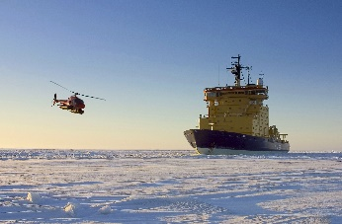
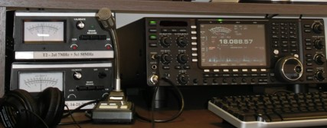

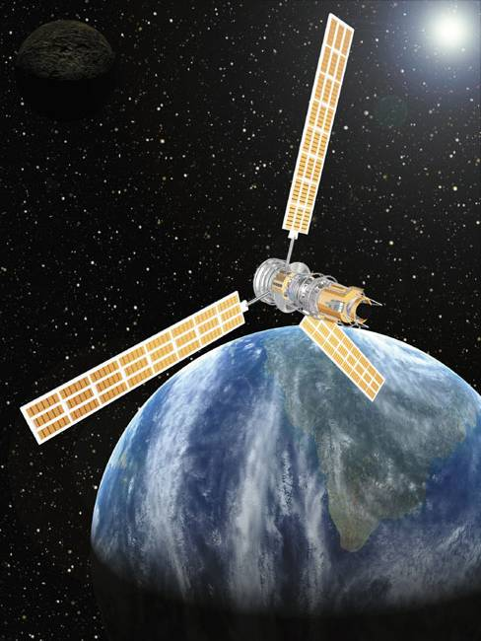



Topics on the WRC-19 Agenda
17 specific & 11 standing items ► Res.809 (WRC-15)
1.13
1.14
1.15
1.16
Fix. & Mob. BB Apps
(24.25 < IMT < 86 GHz, HAPS, Apps.Id>275 GHz,
WAS/RLAN @ 5 GHz)
Maritime (GMDSS
modernization (+Sat.),
use of radio devices,
VDES Sat component)
1.8
1.9.1
1.9.2
1.1
Amateur in R1
@ 50-54 MHz
(4WW allocation)
WRC2019
Aeronautical
(GADSS needs)
1.10
Satellite issues
(BSS/FSS @12 GHz, ESIM, regul. for N-GSO FSS @ 37.5 to 51.4 GHz)
New Transport
systems
(harmonized bands
for railways, ITS)
1.11
1.12
1.4, 1.5, 1.6
Regulatory issues
(Sat. regulations,
harmonization of
spectrum use, etc.)
1.2
1.3
1.7
Earth resources & Climate monitoring
Weather forecast,
DCS improvement, TT&C for
N-GSO Sat. of short duration
7
8
Note: WRC-19 agenda item numbers indicated in italic

Slide 25
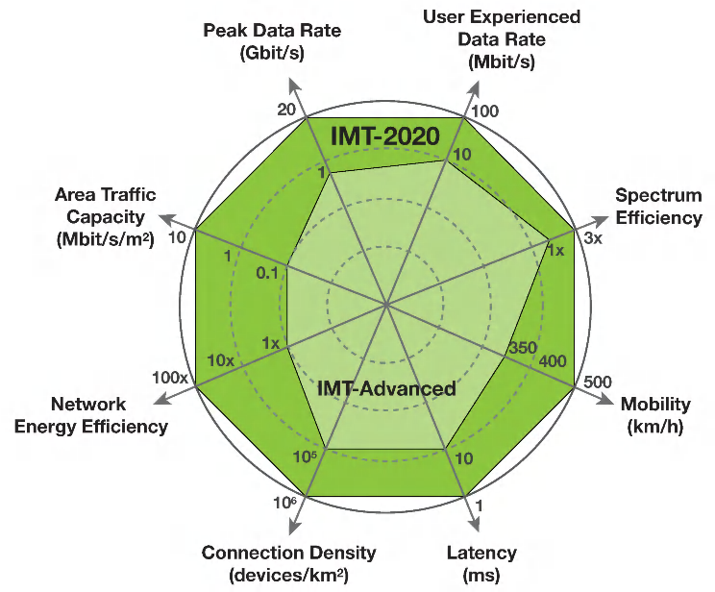
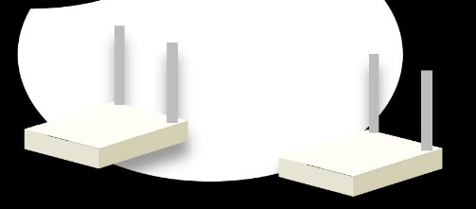
Broadband applications in the MS
(WRC-19 agenda items 1.13 and 1.16)
The following bands, which are already allocated to mobile, will be studied with a view to an IMT-2020 identification:
• 24.25 – 27.5 GHz • 37 – 40.5 GHz
• 42.5 – 43.5 GHz • 45.5 – 47 GHz
• 47.2 – 50.2 GHz • 50.4 – 52.6 GHz
• 66 – 76 GHz • 81 – 86 GHz
The following bands will also be studied,
although they do not currently have
global mobile allocations:
• 31.8 – 33.4 GHz
• 40.5 – 42.5 GHz
• 47 - 47.2 GHz
► Res. 238 (WRC-15)
Appropriate regulatory actions, incl. additional
MS allocations, for WAS/RLAN will be studied in the bands between 5 150-5 925 MHz
► Res. 239 (WRC-15)

Slide 26

Other LMS & FS Systems & Apps.
(WRC-19 agenda items 1.14 and 1.15)
Studies for considering appropriate regulatory actions for HAPS*, within existing FS alloc. at 47.2-47.5, 47.9-48.2 & 31.0-31.3**/27.9-28.2** GHz (**outside Reg. 2, +5 ADMs @6.5/6.5 MHz) or
study new bands: 38-39.5 GHz & 21.4-22*** & 24.25-27.5*** GHz
(*high-altitude platform stations (HAPS); *** in Region 2)
► Res. 160 (WRC-15)
Studies towards an identification for use by administrations for
LMS and FS applications operating in the frequency range 275-450 GHz
► Res. 767 (WRC-15)

Slide 27
New transport systems in the MS
(WRC-19 agenda items 1.11 & 1.12)
Studies to take necessary actions, as appropriate, to facilitate
global or regional harmonized bands to support
railway radiocommunication systems between
train & trackside within existing MS allocations
► Res. 236 (WRC-15)
Studies to consider possible global or regional
harmonized bands, to the maximum extent possible,
for implementation of evolving ITS*
within existing MS allocations
► Res. 237 (WRC-15)
* Intelligent Transport systems (ITS)

Slide 28
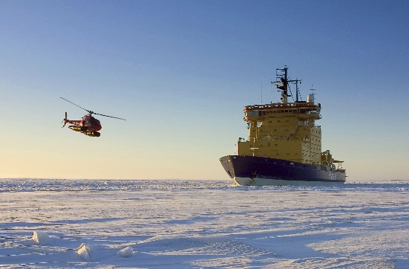
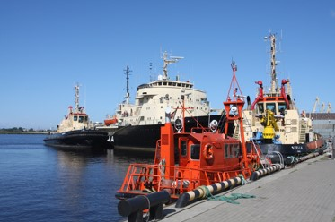
Maritime issues
(WRC-19 agenda items 1.8, 1.9.1 & 1.9.2)
Studies to consider possible regulatory actions to support GMDSS (Global Maritime Distress and Safety Systems) modernization and the introduction of additional satellite systems into the GMDSS
► Res. 359 (Rev.WRC-15)
Studies to consider regulatory actions within the
band 156-162.05 MHz for autonomous maritime
radio devices to protect the GMDSS and AIS
(Automatic Identification System)
► Res. 362 (WRC-15)
Studies to consider RR MODs, including new MMSS (E-s & s-E) allocations, preferably within 156.0125-157.4375 MHz &
160.6125-162.0375 MHz of RR App. 18, to enable a new VDES (VHF data exchange system) satellite component
► Res. 360 (Rev.WRC-15)

Slide 29








Aeronautical and Amateur issues
(WRC-19 agenda items 1.10 & 1.1)
Studies to consider spectrum needs & regulatory provisions for introduction and use of the GADSS (Global Aeronautical Distress and Safety System)
► Res. 426 (WRC-15)
Studies for consideration of an
allocation of the band 50-54 MHz to
the amateur service in Region 1 (towards a worldwide allocation for harmonized weak signal communications)
► Res. 658 (WRC-15)

Slide 30
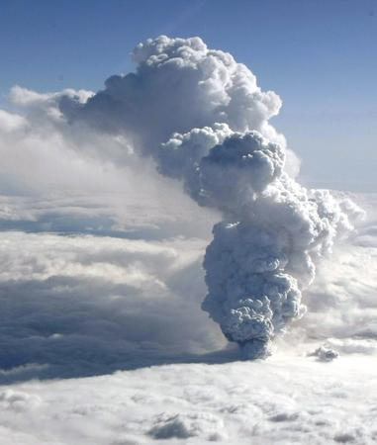
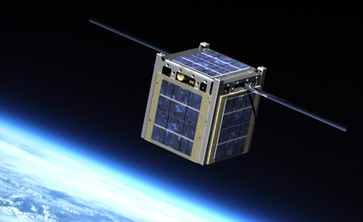
Science issues
(WRC-19 agenda items 1.2, 1.3 and 1.7)
Studies to consider in-band power limits for earth stations in MetSat & EESS @ 401-403 MHz and in the MSS @ 399.9-400.05 MHz for DCS*
► Res. 765 (WRC-15)
Studies to consider possible upgrading of the 2^{ndary} MetSat (s-E) allocation to 1^{mary} status & a possible 1^{mary} EESS (s-E) allocation @ 460-470 MHz for DCS
► Res. 766 (WRC-15)
Study spectrum needs for TT&C in the SOS for non-GSO satellites with short duration missions & consider, if necessary, new SOS allocations
► Res. 659 (WRC-15)
* Data Collection Systems (DCS) are used to monitor and predict climate change, monitor oceans, weather and water resources, weather forecasting and assisting in protecting biodiversity, improving maritime security

Slide 31
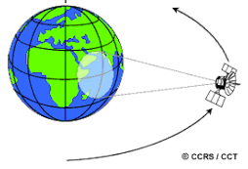
Satellite issues
(WRC-19 agenda items 1.4, 1.5, 1.6 & 7)
Consider results of studies on review, and possible revision if necessary, of RR App. 30 Annex 7 limitations, incl. orbital position limitations
► Res. 557 (WRC-15)
Studies to consider the use of the bands 17.7-19.7 GHz (s-E)
and 27.5 29.5 GHz (E-s) by earth stations in motion communicating with GSO space stations in the FSS and
take appropriate action
► Res. 158 (WRC-15)
Studies on development of a regulatory framework for non-GSO FSS systems that may operate in the bands 37.5-39.5 GHz (s-E), 39.5-42.5 GHz (s-E), 47.2-50.2 GHz (E-s) and 50.4-51.4 GHz (E-s)
► Res. 159 (WRC-15)
Satellite Regulatory issues
► Res. 86 (Rev.WRC-07)

Slide 32
Preparation of WRC-19 agenda item 8
Consider/take appropriate action on requests from ADMs to
delete their country footnotes or to
have their country name deleted from footnotes, if no longer required, taking into account Resolution 26 (Rev.WRC-07)
At least last two WRCs adopted a similar approach:
see WRC-15 Doc. 142 (Rev.1) at: www.itu.int/md/R15-WRC15-C-0142
ADD of FN or MOD of FN addressed by Res. 26 (Rev. WRC-07) were considered under the relevant WRC agenda item, as appropriate, and had to be re-submitted under that relevant AI.
(would be better to submit them directly under the relevant AI)
Other ADD of FN were not considered!
Other MOD of FN to add ADM’s name were accepted, until the end of the 1st week and treated under AI 8, under certain circumstances on a purely exceptional basis & if justified, subject to the express condition of no objections from affected countries
SUP of FN or MOD of FN to sup. ADM’s name were accepted, until end of the 2nd week, and considered under AI 8

Slide 33
RA-15 > some key study topics > RA-19
In response to updated ITU-R Resolutions (www.itu.int/pub/R-RES) related to, e.g.:
– Harmonization of Short-range devices (SRDs) – Res. ITU-R 54-2
– Disaster prediction, detection, mitigation & relief – Res. ITU-R 55-2 (now incl. 53-1)
– Implementation and use of Cognitive radio systems (CRS) – Res. ITU-R 58-2
– Terrestrial Electronic News Gathering (ENG) systems – Res. ITU-R 59-2
Res. ITU-R 64 – Guidelines for the management of unauthorized operation of earth station terminals (referred to in WRC-15 Res. 958 (i.e. AI 9.1, issue 9.1.7))
Res. ITU-R 65 – Principles for the process of future development of IMT for 2020 and beyond (see also Circular Letter 5/LCCE/59 of 22 March 2016)
Res. ITU-R 56-2 – Naming for IMT (incl. IMT-2000, IMT-Advanced & IMT-2020)
Res. ITU-R 66 – Studies related to wireless systems and applications for the development of the Internet of Things (IoT)
Res. ITU-R 67 – Telecommunication/ICT accessibility for persons with disabilities and persons with specific needs
Res. ITU-R 68 – Improving the dissemination of knowledge concerning the applicable regulatory procedures for small satellites, incl. nano- & pico-satellites
Res. ITU-R 69 – Development and deployment of international public telecommunications via satellite in developing countries

Slide 34
RA-15 > ITU-R Study Groups > RA-19
Rev. Working Methods - streamline & clarify procedures (Res. ITU-R 1-7)
Unchanged basic Structure of Study Groups (see Res. ITU-R 4-7)
Updated Work Programme & Questions (see Res. ITU-R 5-7)
ITU-R collaboration with:
- ITU-T (new possibility of Intersector Rap. Groups (IRG), Res. ITU-R 6-2)
- ITU-D (substantial areas of mutual interest identified, Res. ITU-R 7-3,
e.g.: SM, BB & IMT, CRS, LSA, DSA)
- Other relevant organizations, incl. ISO, IEC & CISPR (Res. ITU-R 9-5)
Study Groups (SG) and sub-groups (e.g. Working Parties):
- List of SG Chairmen and Vice-Chairmen online
- List of sub-groups Chairmen and Vice-Chairmen online
- Assignment of texts to the Sub-Groups on:
Spectrum Management (SG 1, Doc. 1/1) Radiowave Propagation (SG 3, Doc. 3/1)
Satellite Services (SG 4, Doc. 4/1) Terrestrial Services (SG 5, Doc. 5/1)
Broadcasting Service (SG 6, Doc. 6/1) Science Services (SG 7, Doc. 7/1)

Slide 35
Radio service abbreviations (1/2)
Abbreviations | Radio services | RR definition
AMS | aeronautical mobile service | No. 1.32
AM(R)S | aeronautical mobile (route) service | No. 1.33
AMSS | aeronautical mobile-satellite service | No. 1.35
AMS(R)S | aeronautical mobile-satellite (route) service | No. 1.36
ARNS | aeronautical radionavigation service | No. 1.46
ARNSS | aeronautical radionavigation-satellite service | No. 1.47
ARS | amateur service | No. 1.56
ARSS | amateur-satellite service | No. 1.57
BS | broadcasting service | No. 1.38
BSS | broadcasting-satellite service | No. 1.39
EESS | Earth exploration-satellite service | No. 1.51
FS | fixed service | No. 1.20
FSS | fixed-satellite service | No. 1.21
ISS | inter-satellite service | No. 1.22
LMS | land mobile service | No. 1.26
LMSS | land mobile-satellite service | No. 1.27
MetAids | meteorological aids service | No. 1.50
MetSat | meteorological-satellite service | No. 1.52

Slide 36
Radio service abbreviations (2/2)
Abbreviations | Radio services | RR definition
MMS | maritime mobile service | No. 1.28
MMSS | maritime mobile-satellite service | No. 1.29
MRNS | maritime radionavigation service | No. 1.44
MRNSS | maritime radionavigation-satellite service | No. 1.45
MS | mobile service | No. 1.24
MSS | mobile-satellite service | No. 1.25
RAS | radio astronomy service | No. 1.58
RDS | radiodetermination service | No. 1.40
RDSS | radiodetermination-satellite service | No. 1.41
RLS | radiolocation service | No. 1.48
RLSS | radiolocation-satellite service | No. 1.49
RNS | radionavigation service | No. 1.42
RNSS | radionavigation-satellite service | No. 1.43
SOS | space operation service | No. 1.23
SFTSS | standard frequency and time signal service | No. 1.53
SFTSSS | standard frequency and time signal-satellite service | No. 1.53
SRS | space research service | No. 1.55

Slide 37
Other abbreviations (1/2)
Abbreviations | Description | RR Nos.
AIS | Automatic Identification System | -
Apps | Applications | -
Art. or AP/App | An Article or an Appendix of the RR | -
BB | Broadband | -
BR | ITU Radiocommunication Bureau | -
DCS | Data Collection System | -
E-s, s-E | Earth-to-space, space-to-Earth | -
ES | Earth station | No. 1.63
ESIM | ES In Motion | -
GMDSS | Global Maritime Distress and Safety System | -
GSO | Geostationary-Satellite Orbit | No. 1.190
HAPS | High Altitude Platform Station | No. 1.66A
HF VHF UHF | High Frequency: 3 to 30 MHz Very High Frequency: 30 to 300 MHz Ultra High Frequency: 300 to 3000 MHz | No. 2.1

Slide 38
Other abbreviations (2/2)
Abbreviations | Description | RR Nos.
IMT | International Mobile Telecommunications | -
ITS | Intelligent Transport Systems | -
ITU | International Telecommunication Union | -
ITU-R | ITU Radiocommunication Sector | -
R1, R2, R3 | RR Regions 1, 2 or 3 | Nos. 5.2 to 5.9
Rec. / Rap. | Recommendation / Report | -
Res. | Resolution | -
RLAN | Radio Local Area Network(s) | -
RR | ITU Radio Regulations | -
RRB | ITU Radio Regulations Board | -
TT&C | Telemetry, Tracking and Command | (See Nos. 1.131-1.136)
VDES | VHF Data Exchange System | -
WAS | Wireless Access System(s) | -
WRC | World Radiocommunication Conference | -

