Slide 1
Take -aways for IPET-CDMP
William J Wright , Chair of IPET-CDMP

Slide 2
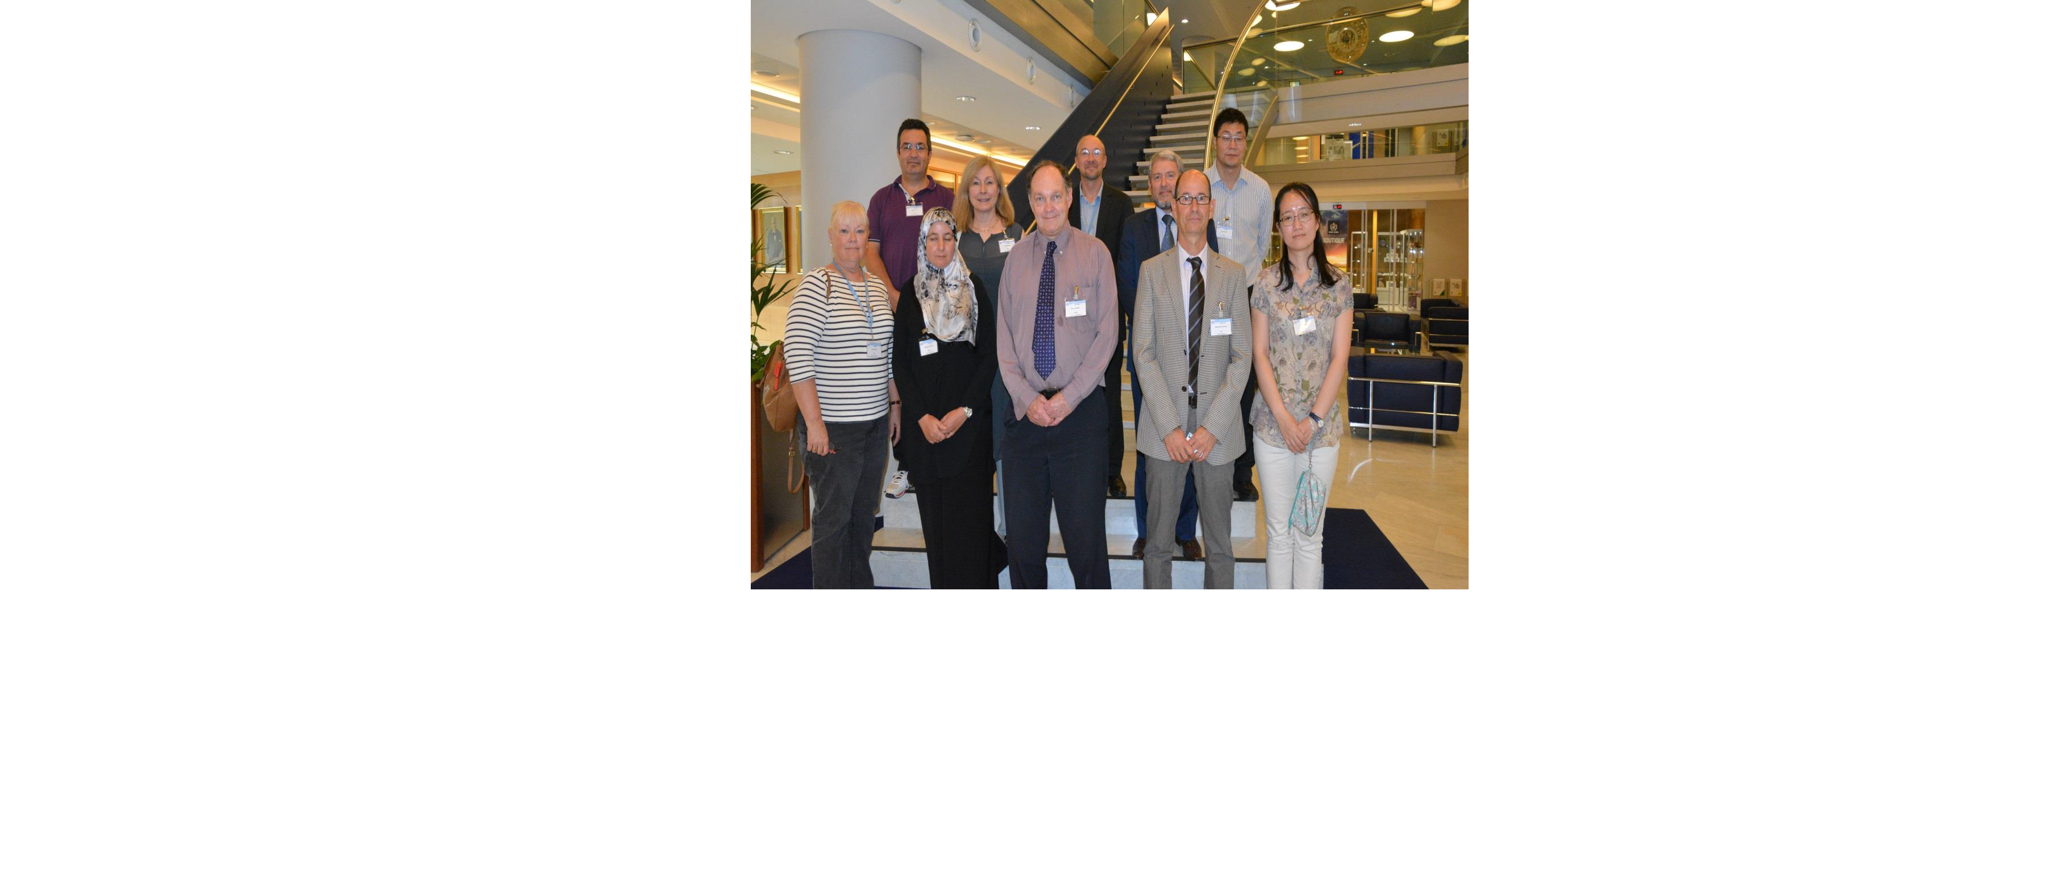
The IPET-CDMP team
Notes:
Here is the IPET-CDMP team, and I'd like to acknowledge their efforts in advancing the HQ-GDMFC. Pictured are: Christina Lief, Mithat Ekici, Meriem Alaouri, Lydia Gates, Will Wright, Michel Rixon, Omar Baddour, Matteo Dell'Acqua, Guofu Wang, Ren Yuyu

Slide 3
The IPET-CDMP
(Inter-Program Expert Team- Climate Data Modernisation Program)
Set up by WMO in 2015 to facilitate sound data management guidance and processes in support of the GFCS
Climate data-focussed, but integrated with cross-domain initiatives within WMO
Co-chairs: W. Wright (Aus); Matteo dell'Acqua (Meteofrance)
Chief outcome: a High Quality Global Data Management Framework for Climate (HQ-GDMFC), including a Manual on Climate data Management
Notes:
DP 2: The Team is cross-program because while noting the special needs of climate, it was recognised that standards, regulations and recommended practices for more general data management need to be developed need to be developed in a consistent way.

Slide 4
MANUAL OUTLINE
The Manual aims to provide guidance, as well as technical regulations, to optimise and harmonise the way data are managed.
Scope of Manual
Guiding principles & general requirements
Definitions and concepts for climate data
Sources of data
Guidance on data management for climate
Collaborative infrastructure for information management
Information management governance
Capacity-building
Quality management

Slide 5
Domain-specific practices
QC/QA
Interoperability and data sharing
Maturity indices and their value; recommended best practice
Meeting user community needs – appropriate datasets
Utilising the Cloud
Spatial data
Partnerships with GFCS priority areas

Slide 6
Cross-domain practices
Communication with users
Metadata standards
Standard data management practices(expand)
Data and information policy
DOI's etc
Strategy for communicating requirements and recommended best-practice to NMHS & IDC Information Management
Update schedule for guidance
Broader approach to communicating and implementing standards
Catalogues and discoverability

Slide 7
Cross-domain practices (2)
Inventory and Catalogue of trusted data: IPET-CDMP (or future equivalent team) should further work with TT-IM on promoting a standard best-practice guidance on what constitutes "trusted" datasets and mechanisms for updateupdate
Selection of Data sets: Work with other groups, such as GCOS, IPCC, GFCS on Maturity, citation, versioning and performance scores for climate Data sets. These might be trivial for global data centers but still not popular at RCCs, NMHSs level
Register of datasets: IPET-CDMP to work with TT-IM, next-iteration of ET-CDMS=DARE to help encourage NMHSs to register and preferably inventorise their data records, and help Members develop discoverability metadata, and communicate benefit for registration.

Slide 8
Recommended intermediate step
(by end 2018)
Achieve 1 and 2 focusing on authoritative global and regional data sets from different sources in particular to serve top level priorities in informing on global climate change and Regional Climate Services. Work on an objective approach to be applied on existing data sets to make a selection of limited number of these data sets to be recognized as best trusted data sets (Maturity model provides a good way forward, we need to think of an optimal way for its application). The approach will be tested in demo mode, then on operational mode afterwards

Slide 10
Infrastructure
Scope exists for collaborative arrangements for data management between different scales and different domains:
  - International Data Centres, non-WMO initiatives etc;
  - Regional Climate Centres (underutilised so far);
  - NMHSs;
Notes:
DP 1: In fact, this is one of the reasons we're all here, to start working out the details.

Slide 11
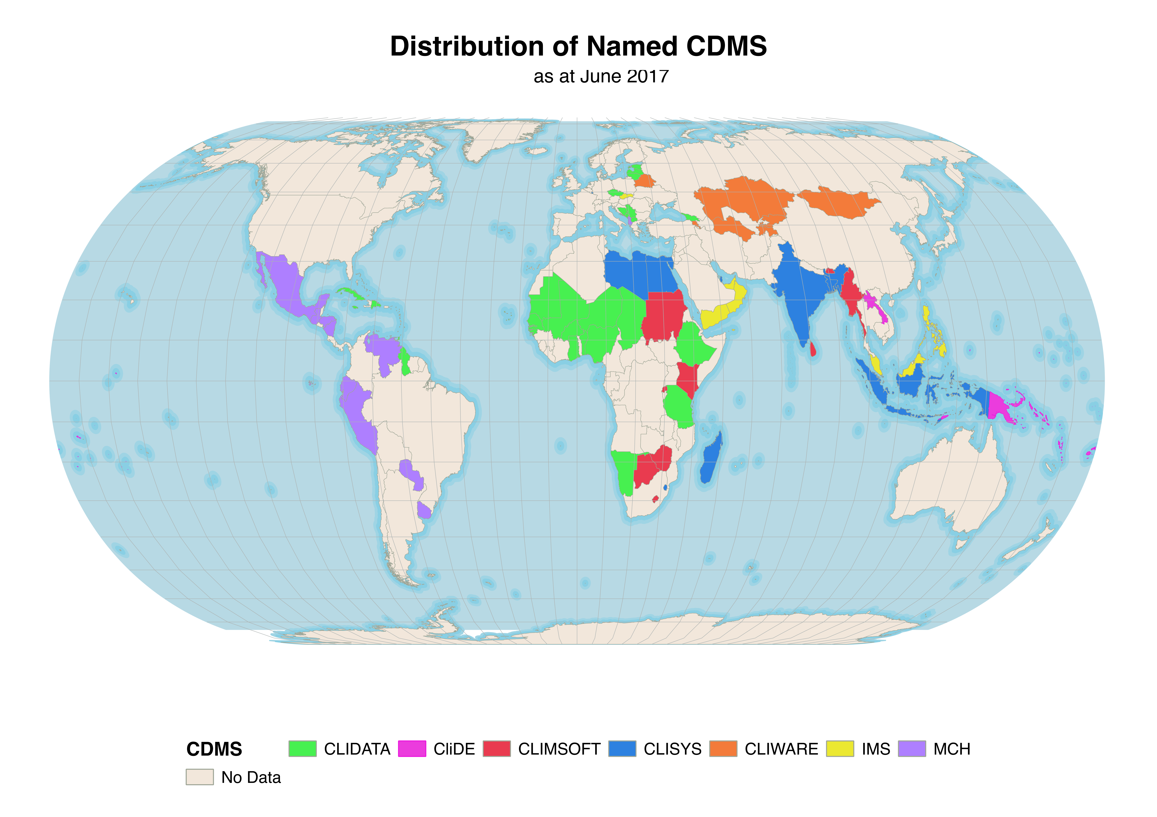
Capacity building in climate DM
Expressed need for training in climate data management
Manual covers:
  Responsibilities and core competencies
  Sources of guidance, advice and training for Members
  Guidelines on implementing climate data management projects in D & LD countries.

Slide 12

Thank you
Merci

