Slide 1
Information Management Guidance Topics
WMO Workshop on Information Management (breakout group C)

Slide 2
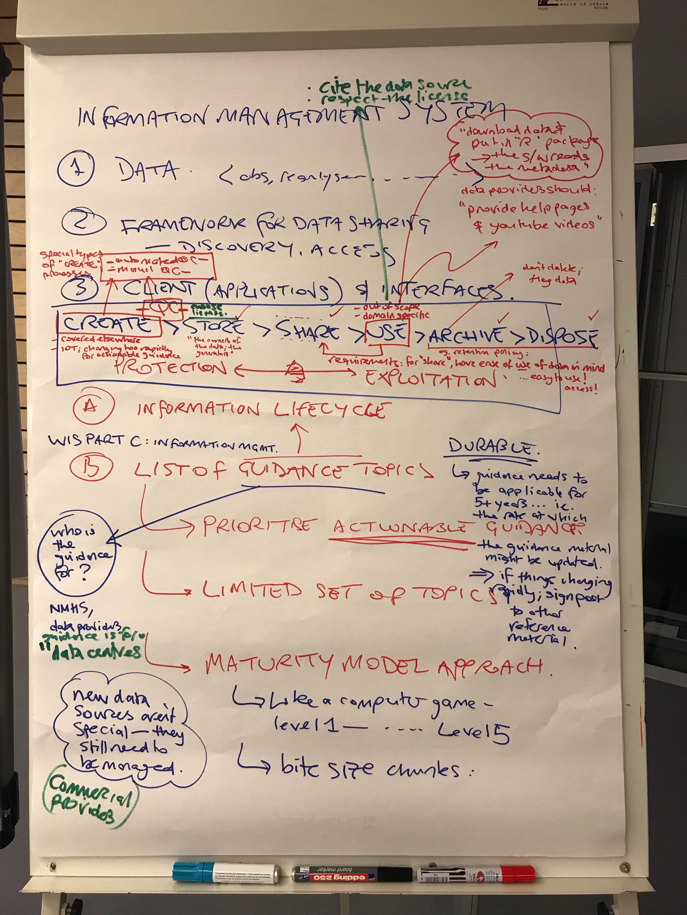
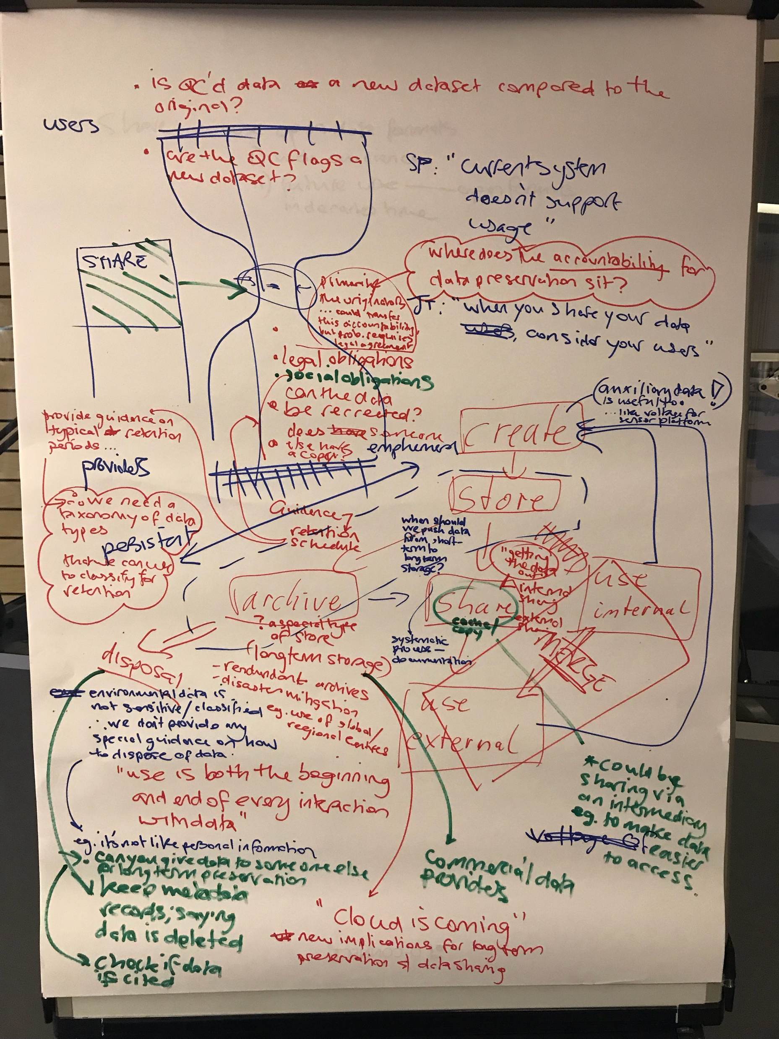

Slide 3
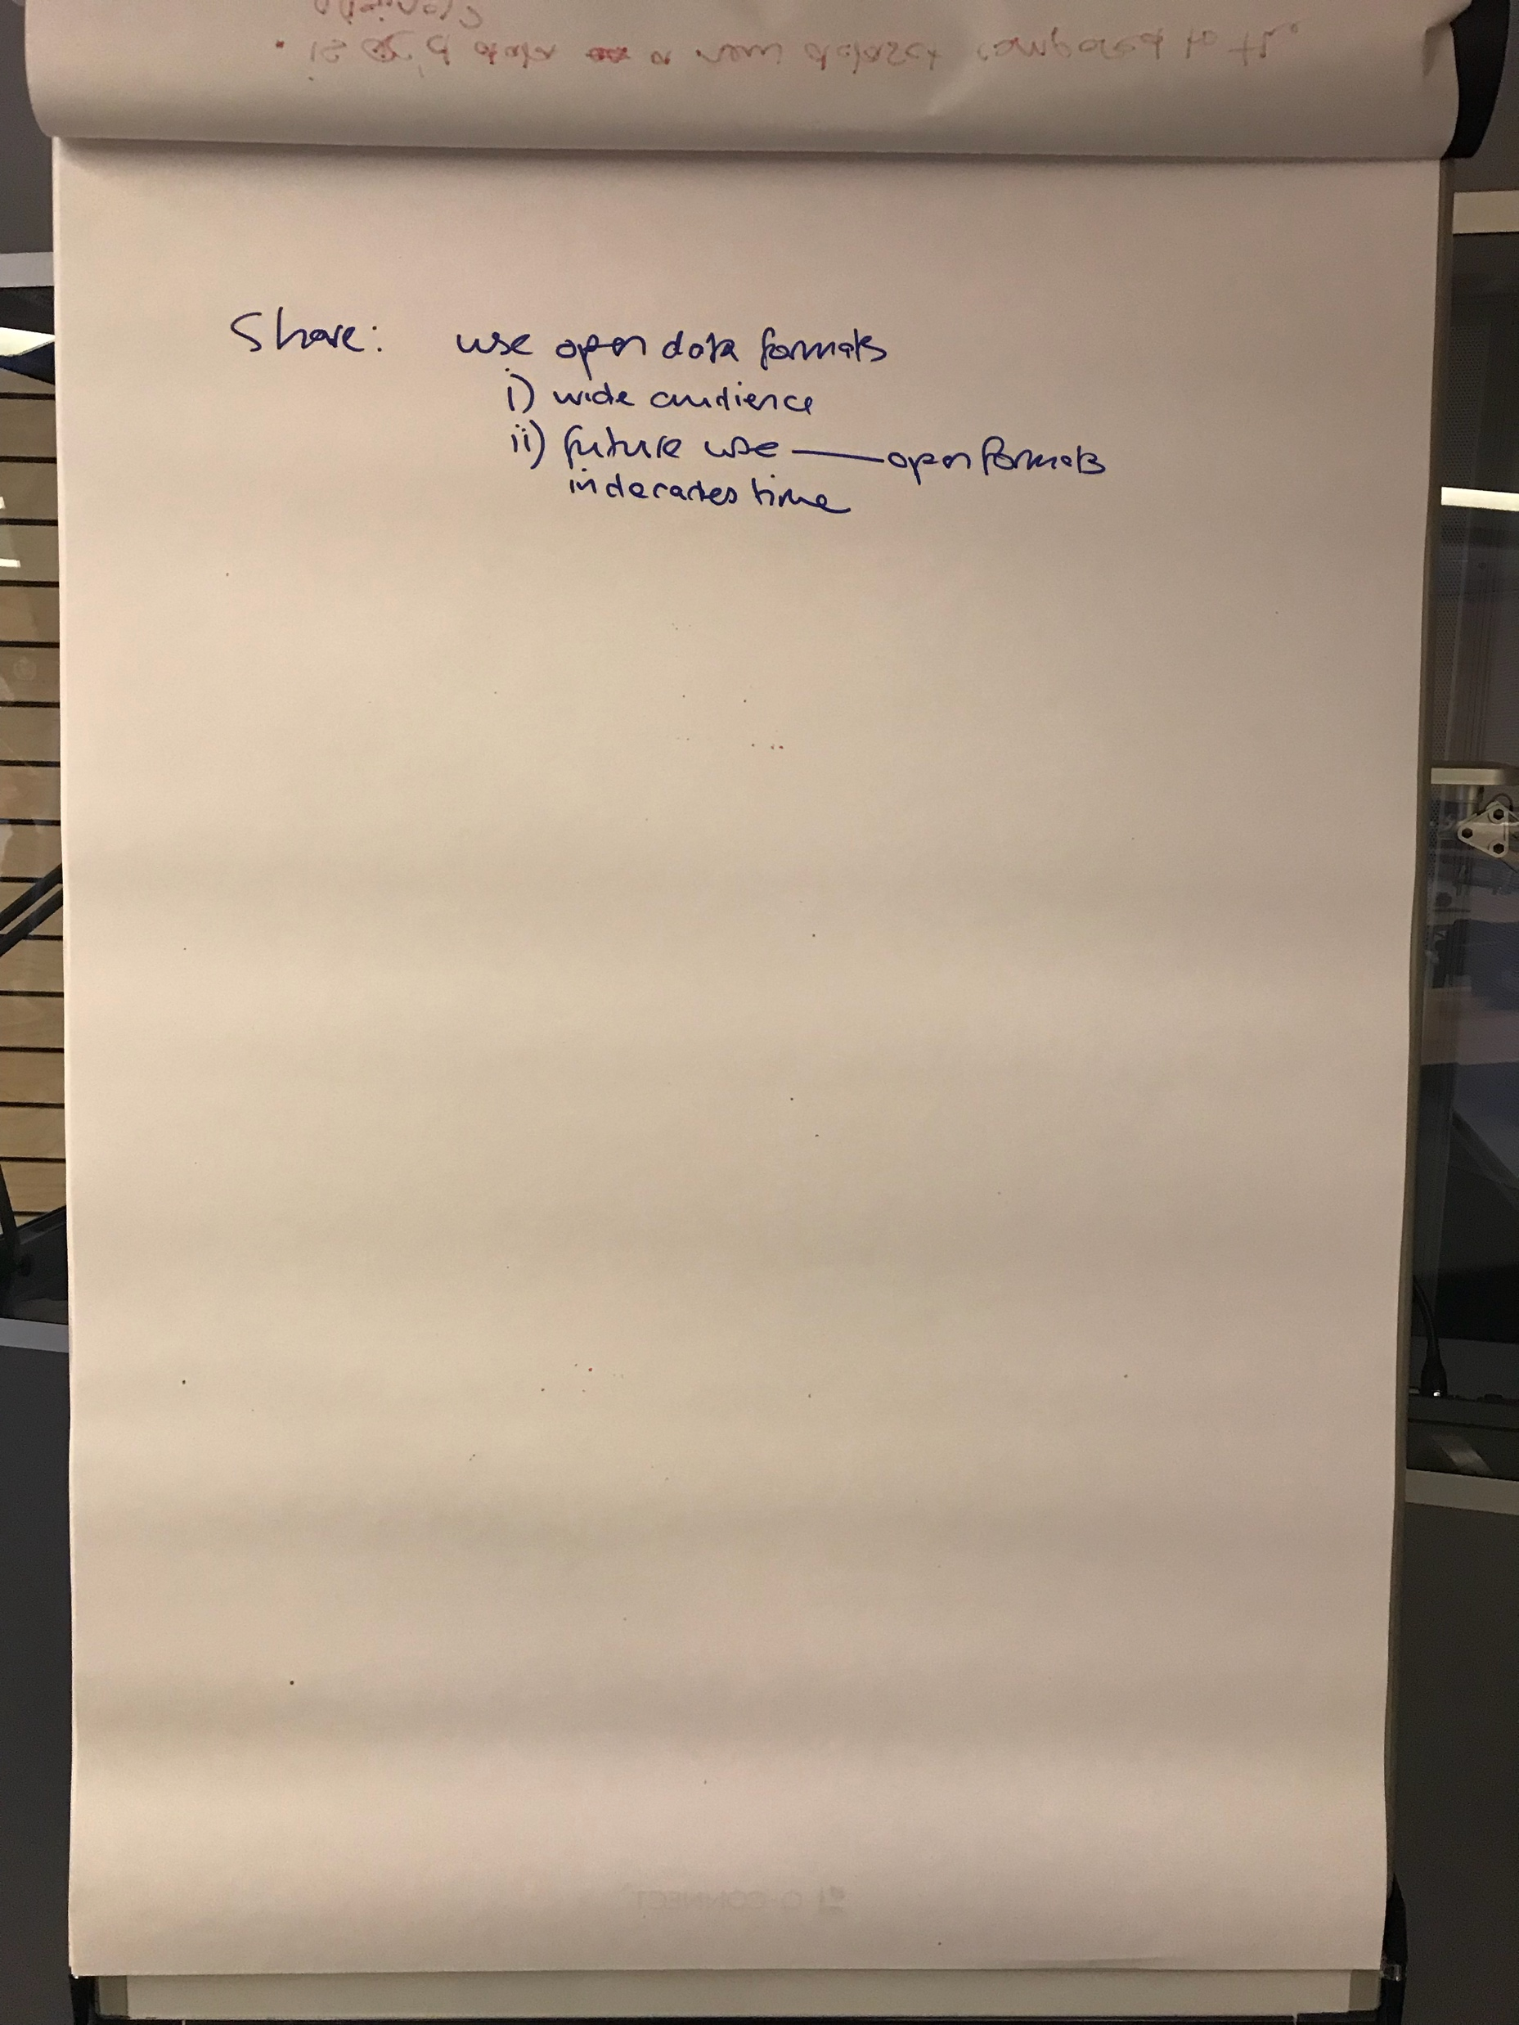
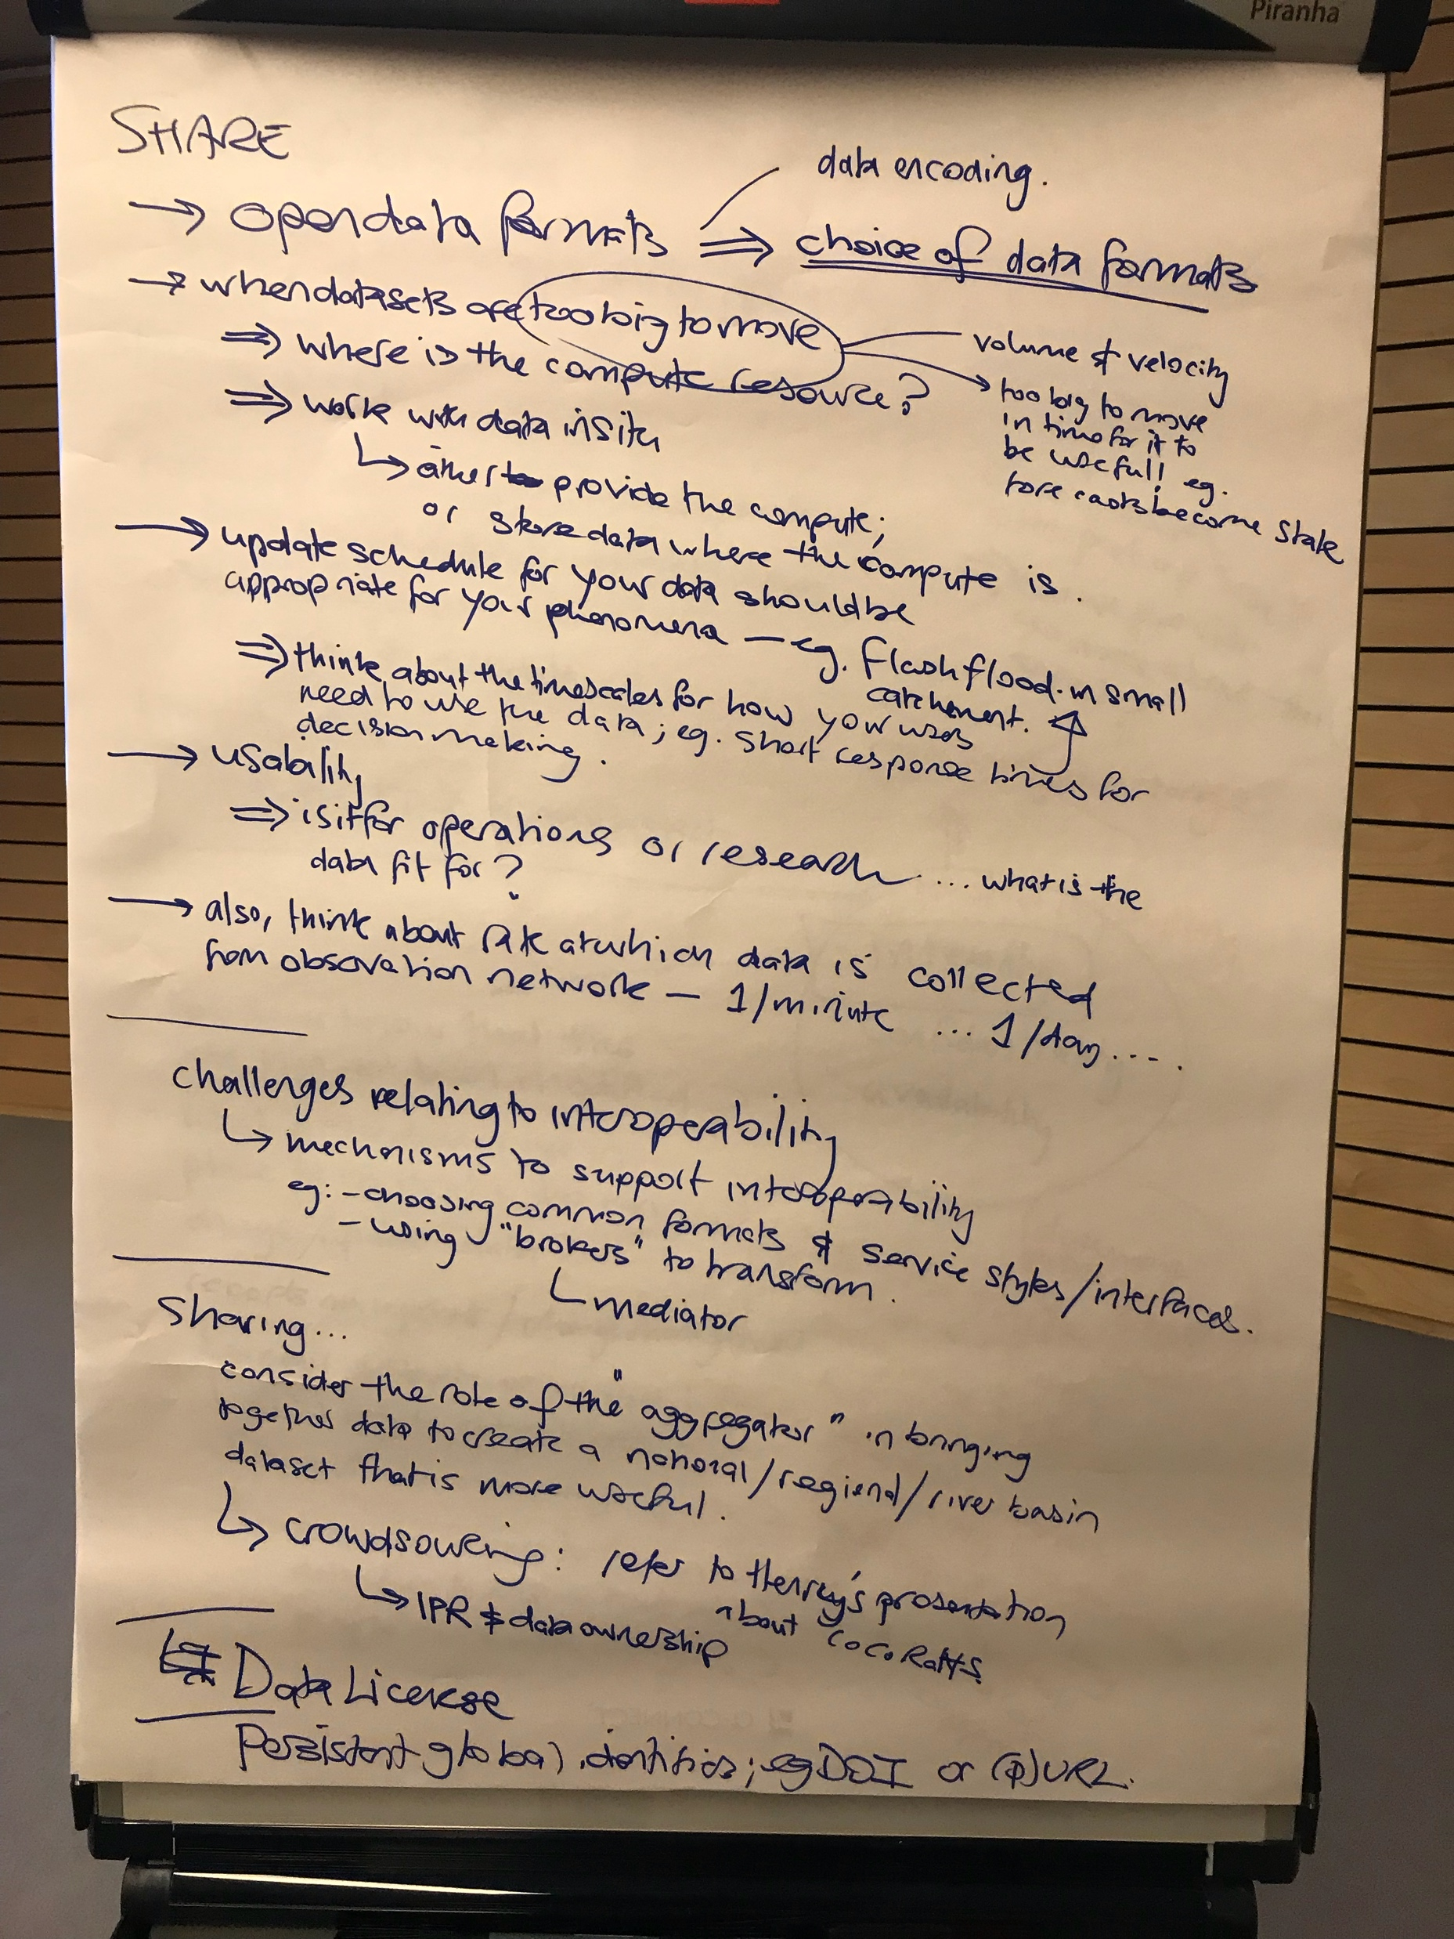

Slide 4
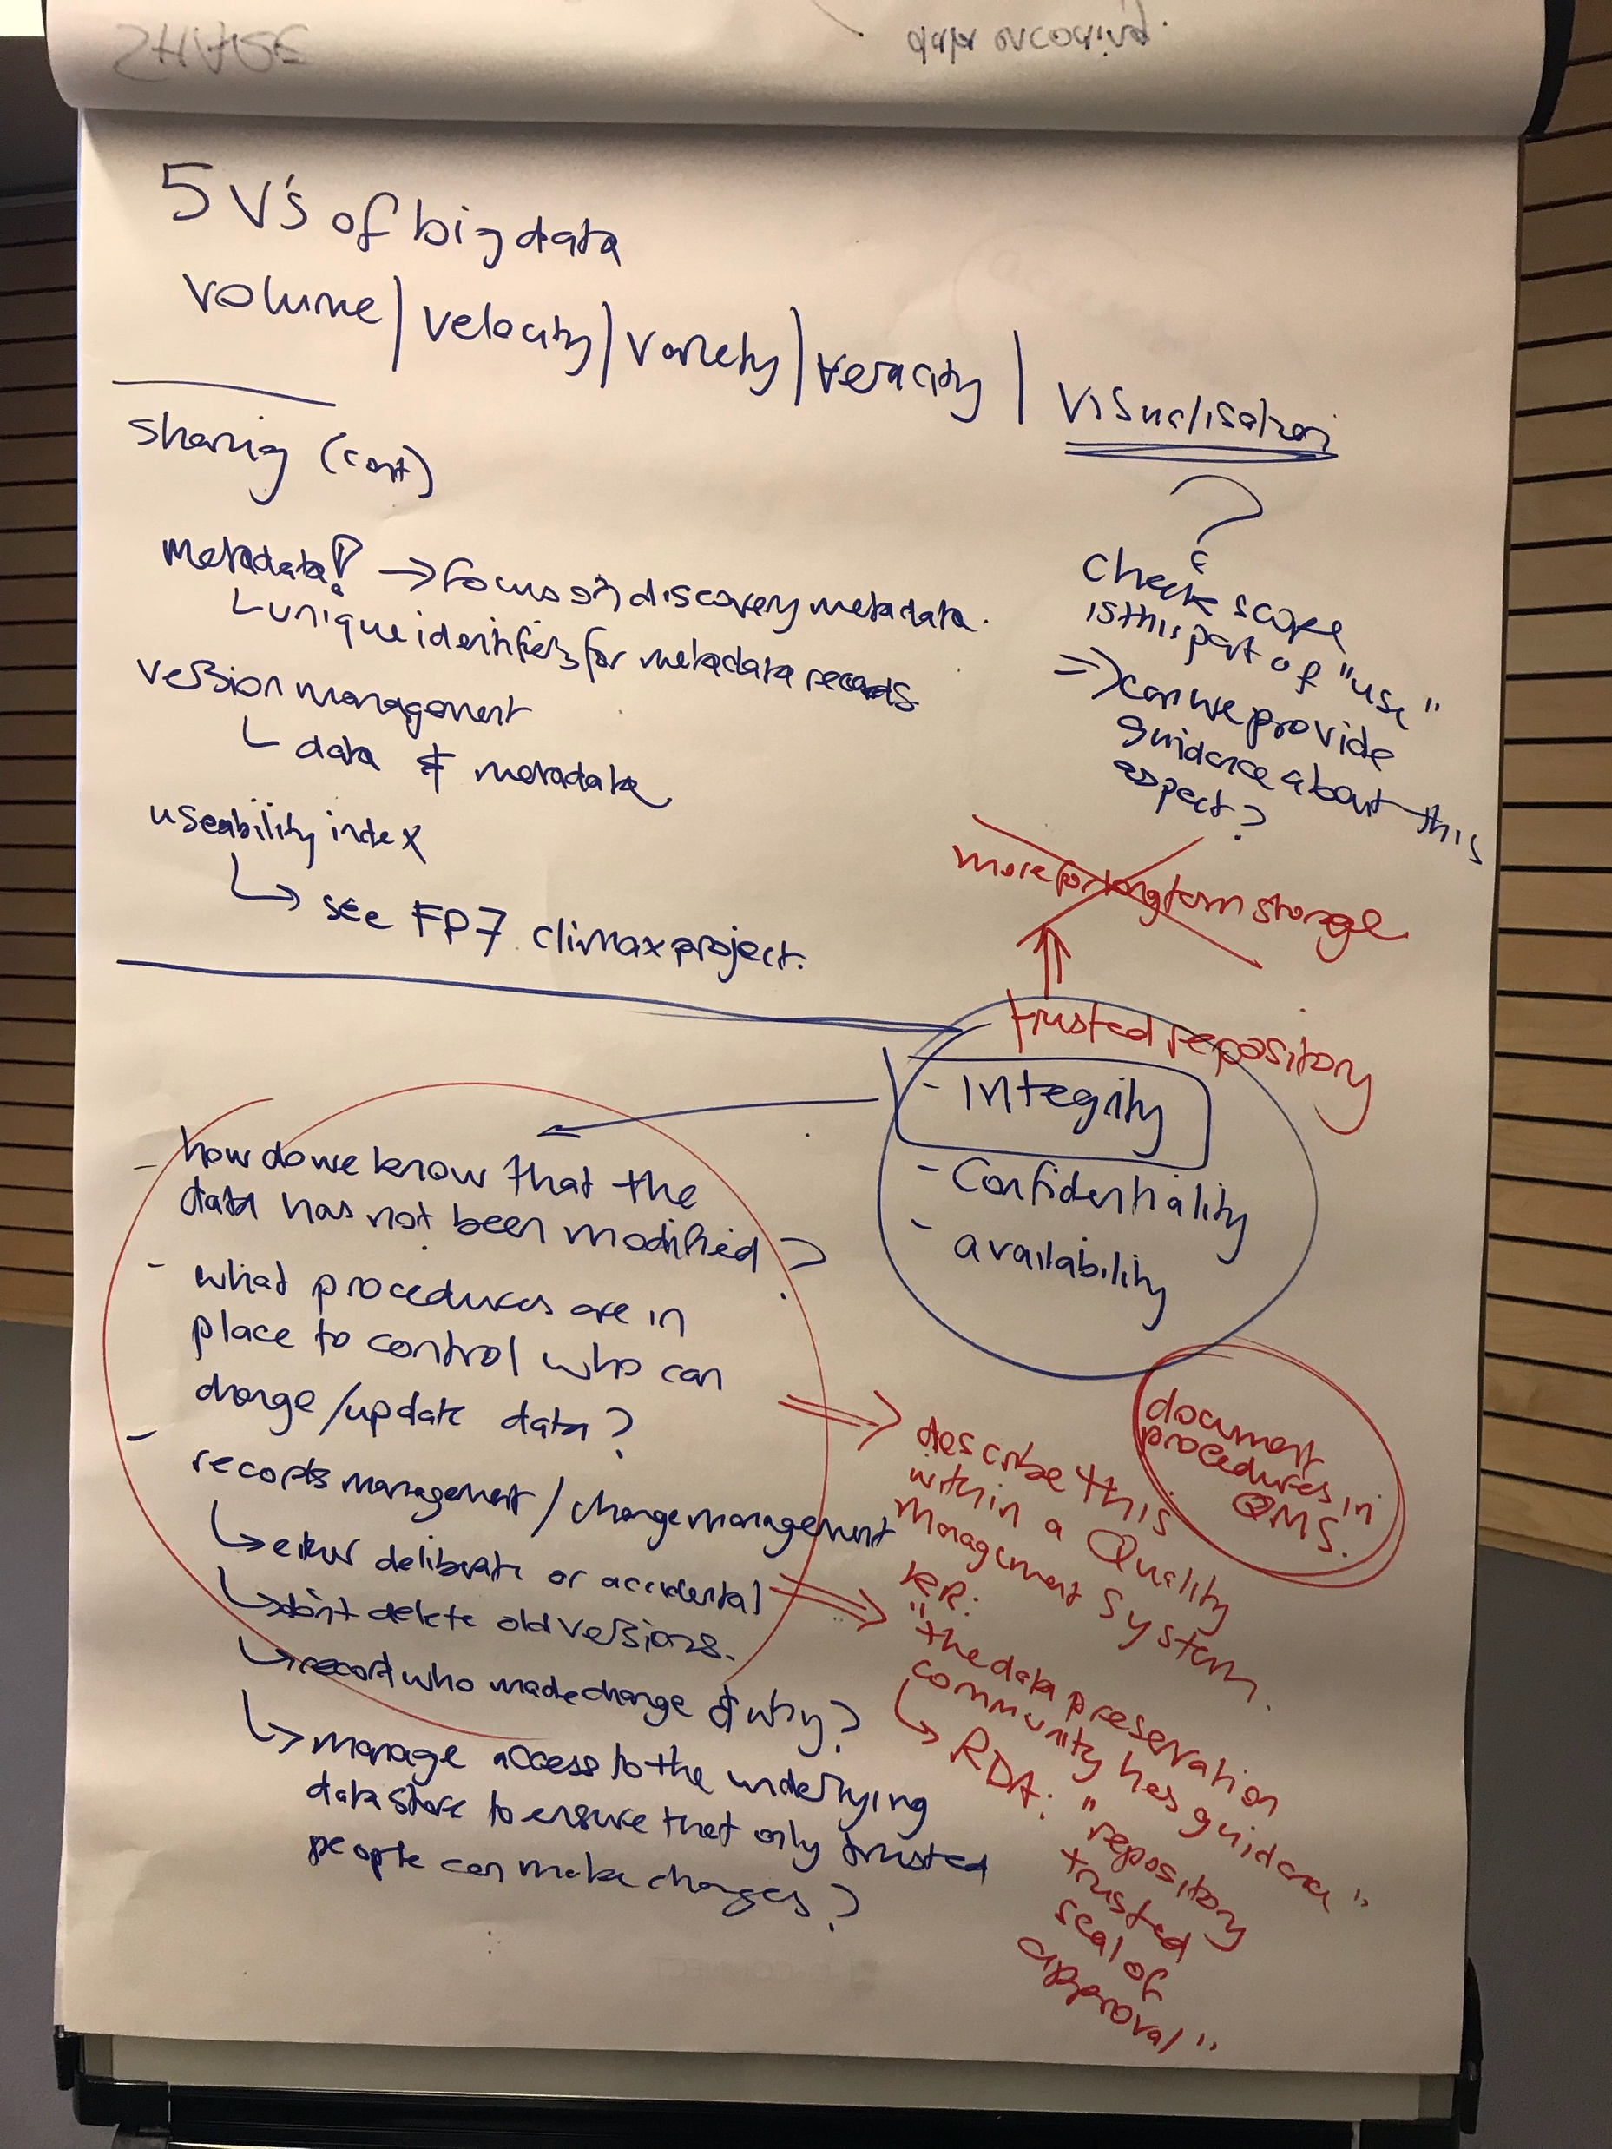
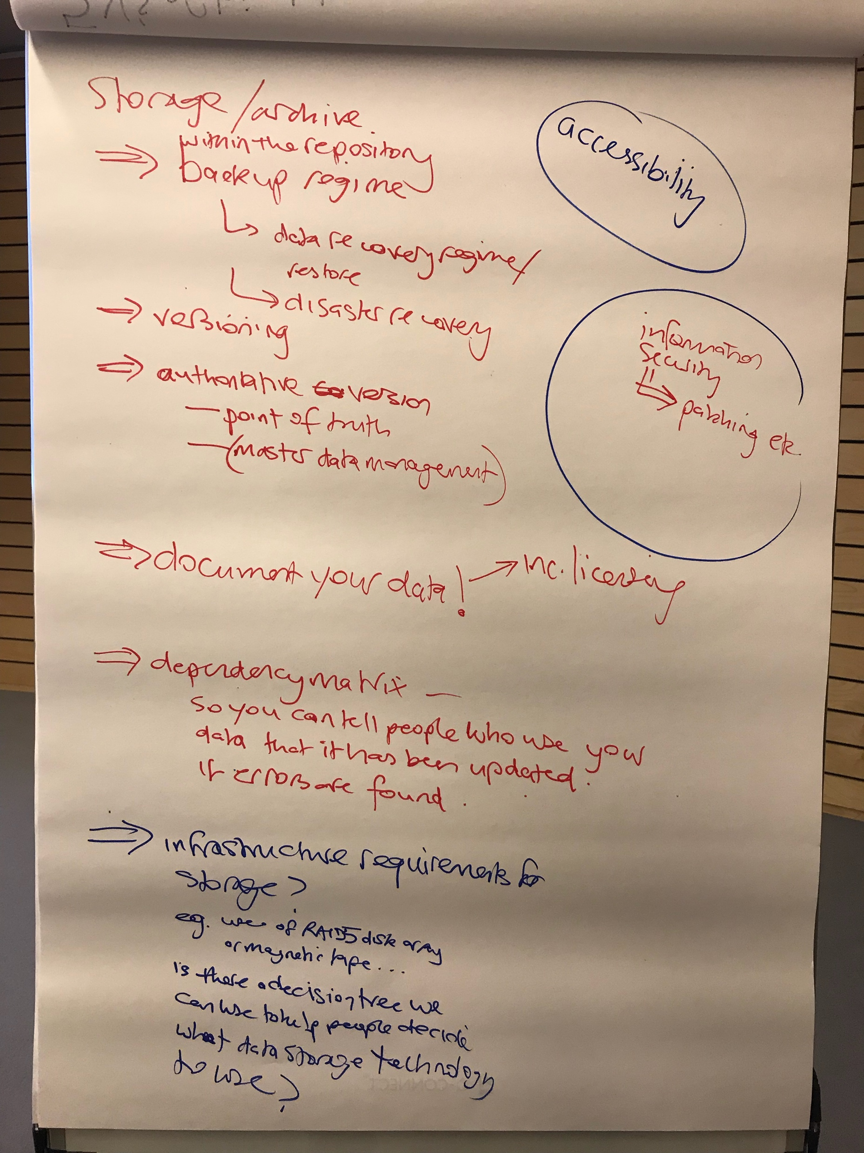

Slide 5
Who is the guidance for?
Information Management guidance for us
NMHS …
Data publishers
Data aggregators
Data stewards
Data curators
“Data centres”

Slide 6
Actionable guidance
We need to focus on providing guidance that the audience can use
… there are 192 WMO Members – not all at the same level of skill

Slide 7
Durable guidance
WMO can’t afford to update this guidance faster than every few years
Guidance needs to be relevant today, in 4-years time, in 8-years time
DURABLE guidance
Probably can’t be specific about technologies
If things change rapidly, then signpost external guidance/reference material

Slide 8
Maturity model approach
We want to change behaviour
Avoid deluge of guidance
Use ‘maturity model’ approach to provide focused guidance
“Level-up” like in a computer game as you improve capability for information management
Allow people to focus on a small set of principles/practices that they can actually achieve based on their current capabilities
“Bite size” advice that people can actually use!

Slide 9
Guidance structure and scope
Information Lifecycle:
CREATE > STORE > SHAPE > USE > ARCHIVE > DISPOSE / DESTROY
Create: covered elsewhere, new technology (e.g. IoT) interesting- but changing too rapidly for us to provide useful/actionable guidance
Use: “there are as many ways to use data as there are grains of sand on a beach” – difficult to provide actionable guidance here, and users unlikely to read a WMO manual!

Slide 10
Balance
Data protection vs. data exploitation / usage

Slide 11
Data life-cycle is non-linear
CREATE > STORE > SHAPE > USE > ARCHIVE > DISPOSE / DESTROY
Data USE often leads to a new data CREATION activity – new data resources that have their own data lifecycle (e.g. merging 4 datasets to create a new homogenised / complete dataset)
ARCHIVE and STORE are on a ’data-retention’ spectrum – different guidance applies … (need to capture these aspects)

