Slide 1
Data Stewardship Maturity Matrix (DSMM) -
Use of a Maturity Matrix to Guide Management
of Multi-Disciplinary Information
Christina de Groot-Lief
NOAA’s National Centers for Environmental information (NCEI)
Agenda Item 5.7
WMO Workshop on
Information Management
Geneva, Switzerland
October 2-4, 2017

Slide 2

Data Stewardship Maturity Matrix (DSMM)
What is it?
Definition:
Leveraging:
DSMM is a unified framework for measuring stewardship practices applied to individual digital environmental data products that are publicly available online
Institutional knowledge in multiple domains (e.g., Science, Data Management, Technology)
Community best practices and standards

Slide 3
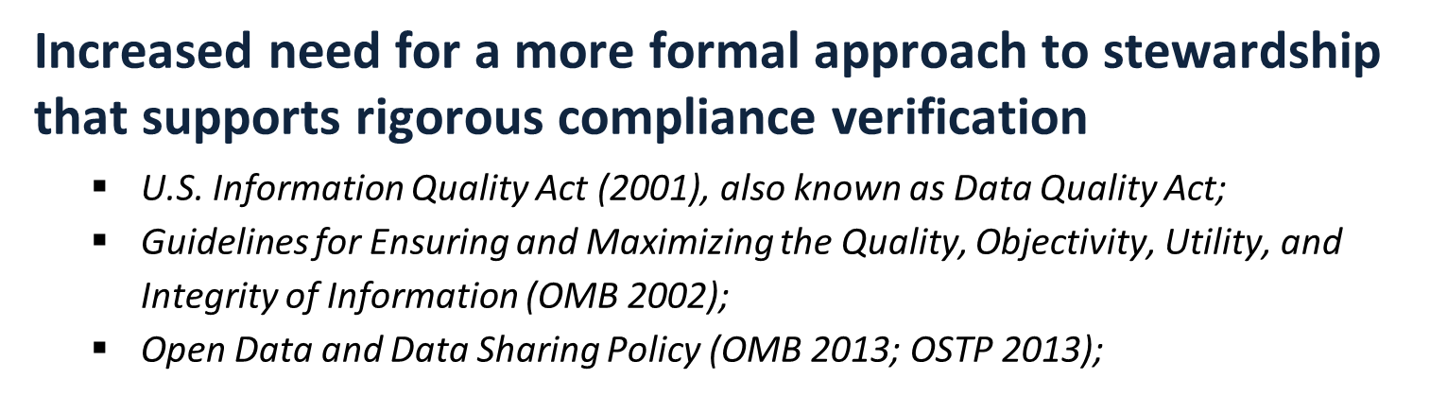

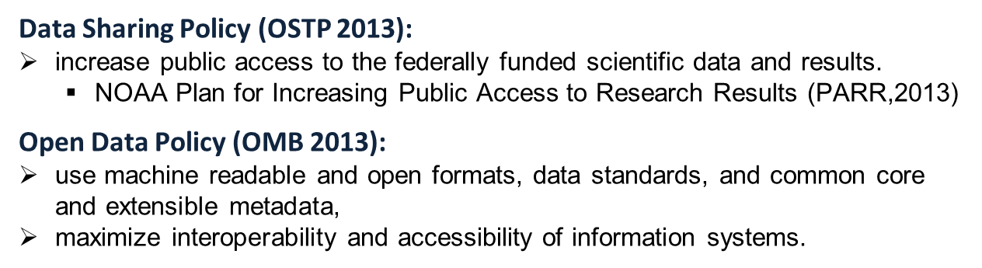
Why Do We Need a DSMM?

Slide 4
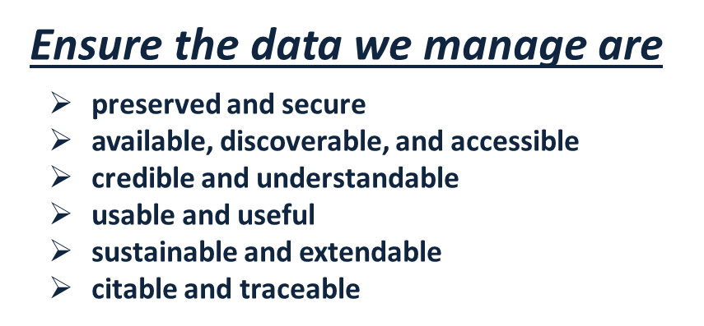
Why Do We Need a DSMM? (cont'd)

Slide 5
Data Stewardship Maturity Matrix (DSMM)
Development
Lead: Ge Peng, Research Scholar,
Cooperative Institute for Climate and Satellites-NC (CICS-NC))
We formed a team comprised of Scientists and Subject Matter Experts (SME) from NCEI and CICS-NC
We started with developing a Maturity Matrix for an NCEI data set: the GHCN-M
We published results in a paper: ‘Assessing Stewardship Maturity of the Global Historical Climatology Network-Monthly (GHCN-M) Dataset: Use Case Study and Lessons Learned’

Slide 6
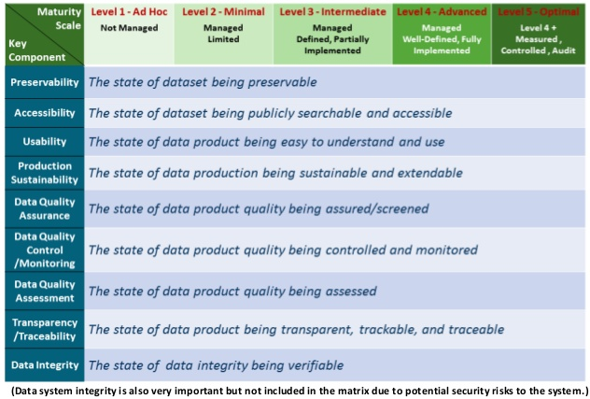
DSMM Defines Measurable, Five-Level Progressive Practices

Slide 7
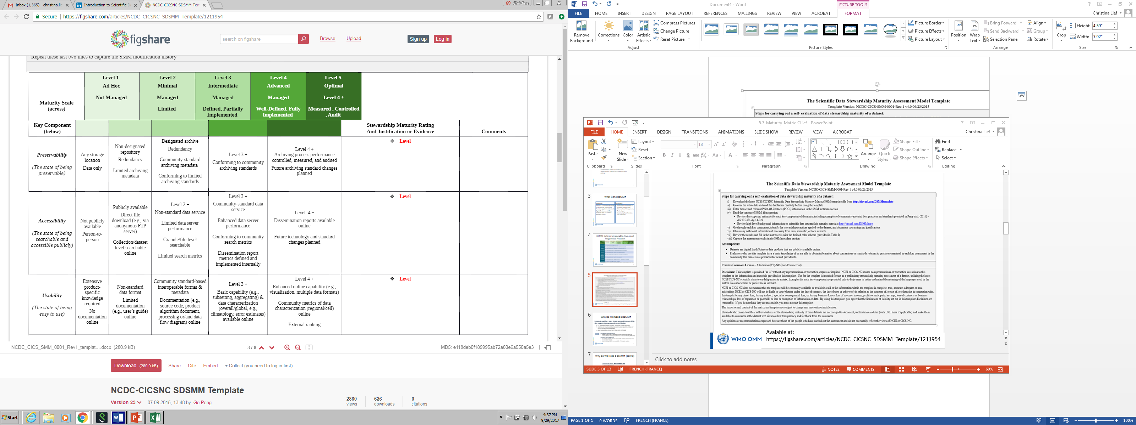
Assigning a maturity scale for the data set for each of the key
components: Preservability Accessibility, Usability, etc.

Slide 8
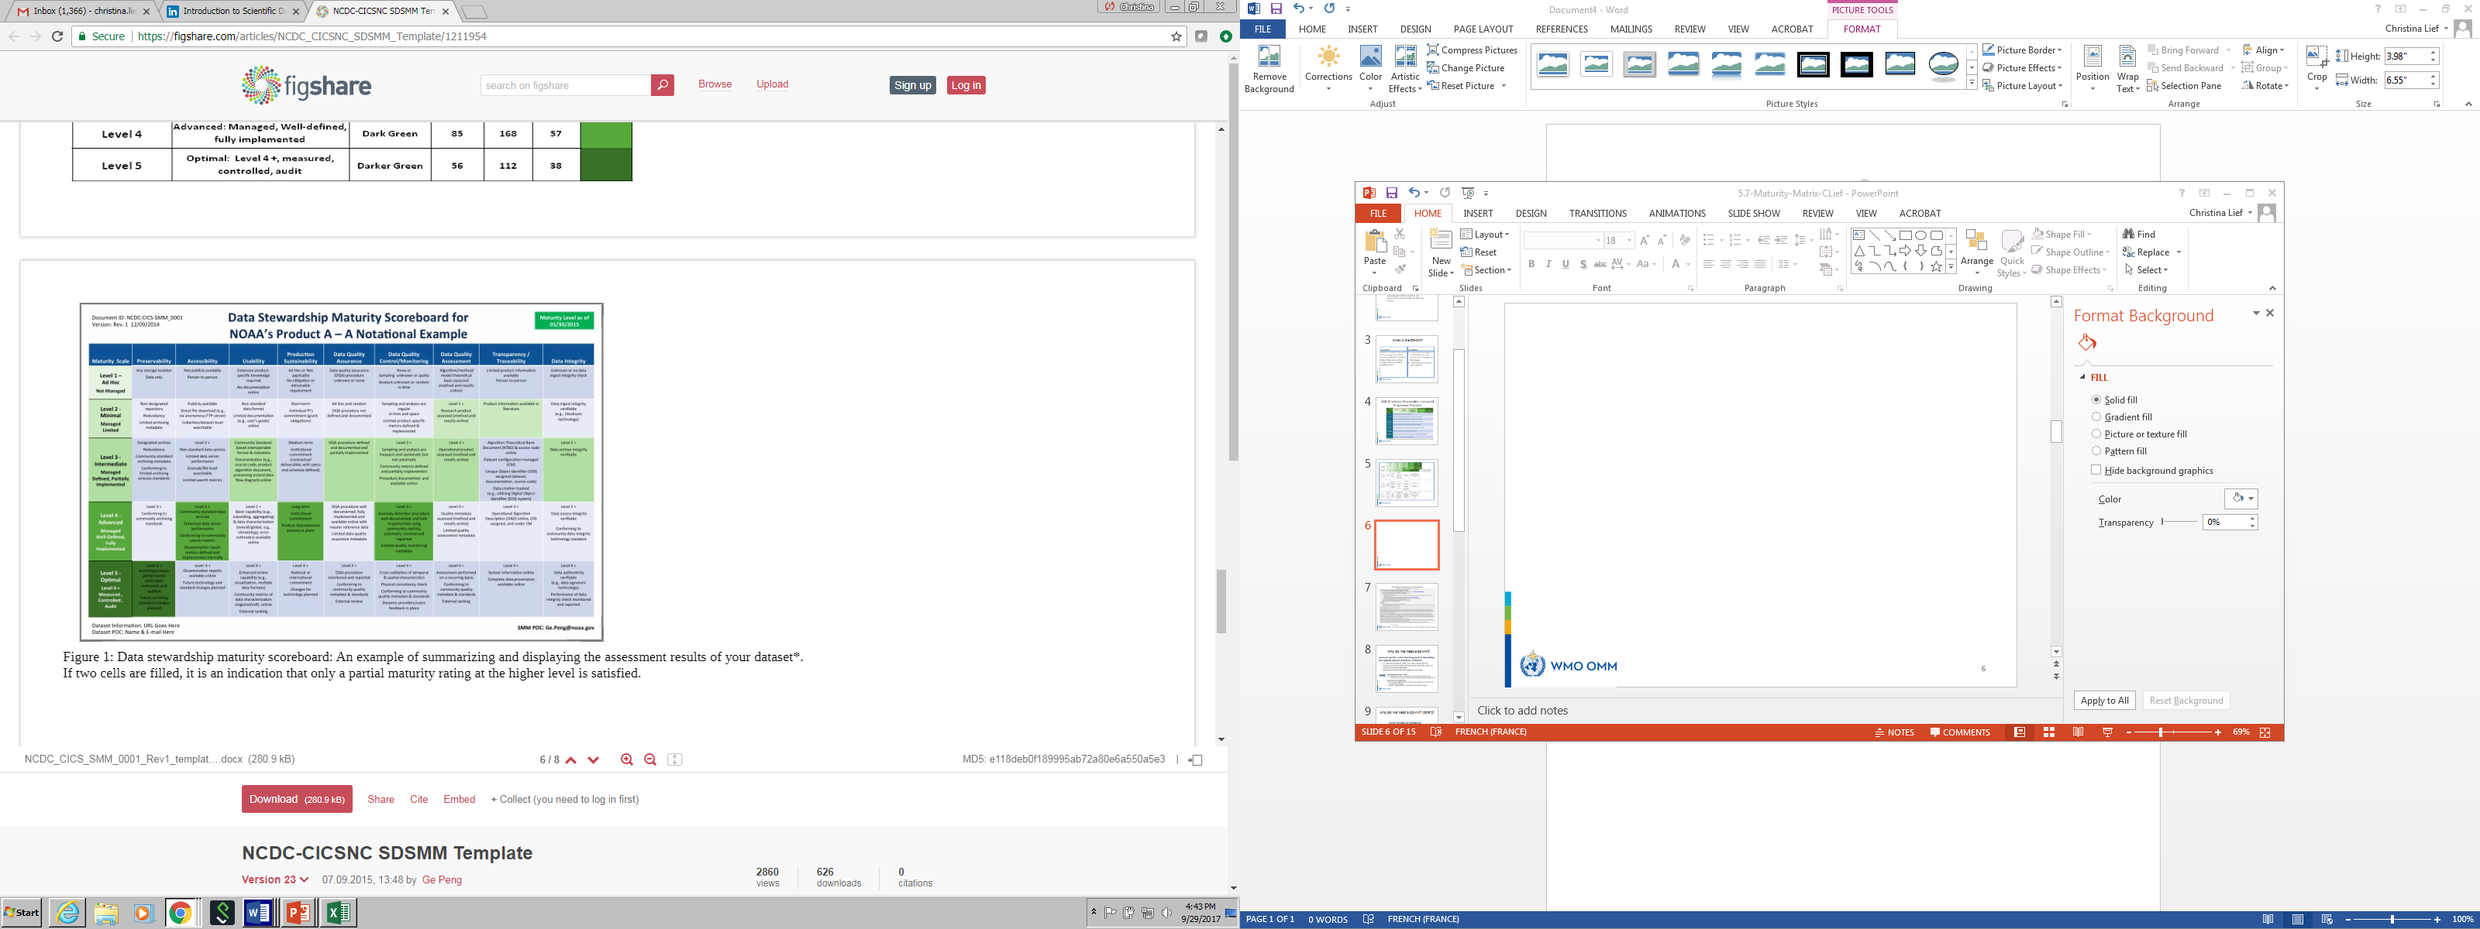

Slide 9
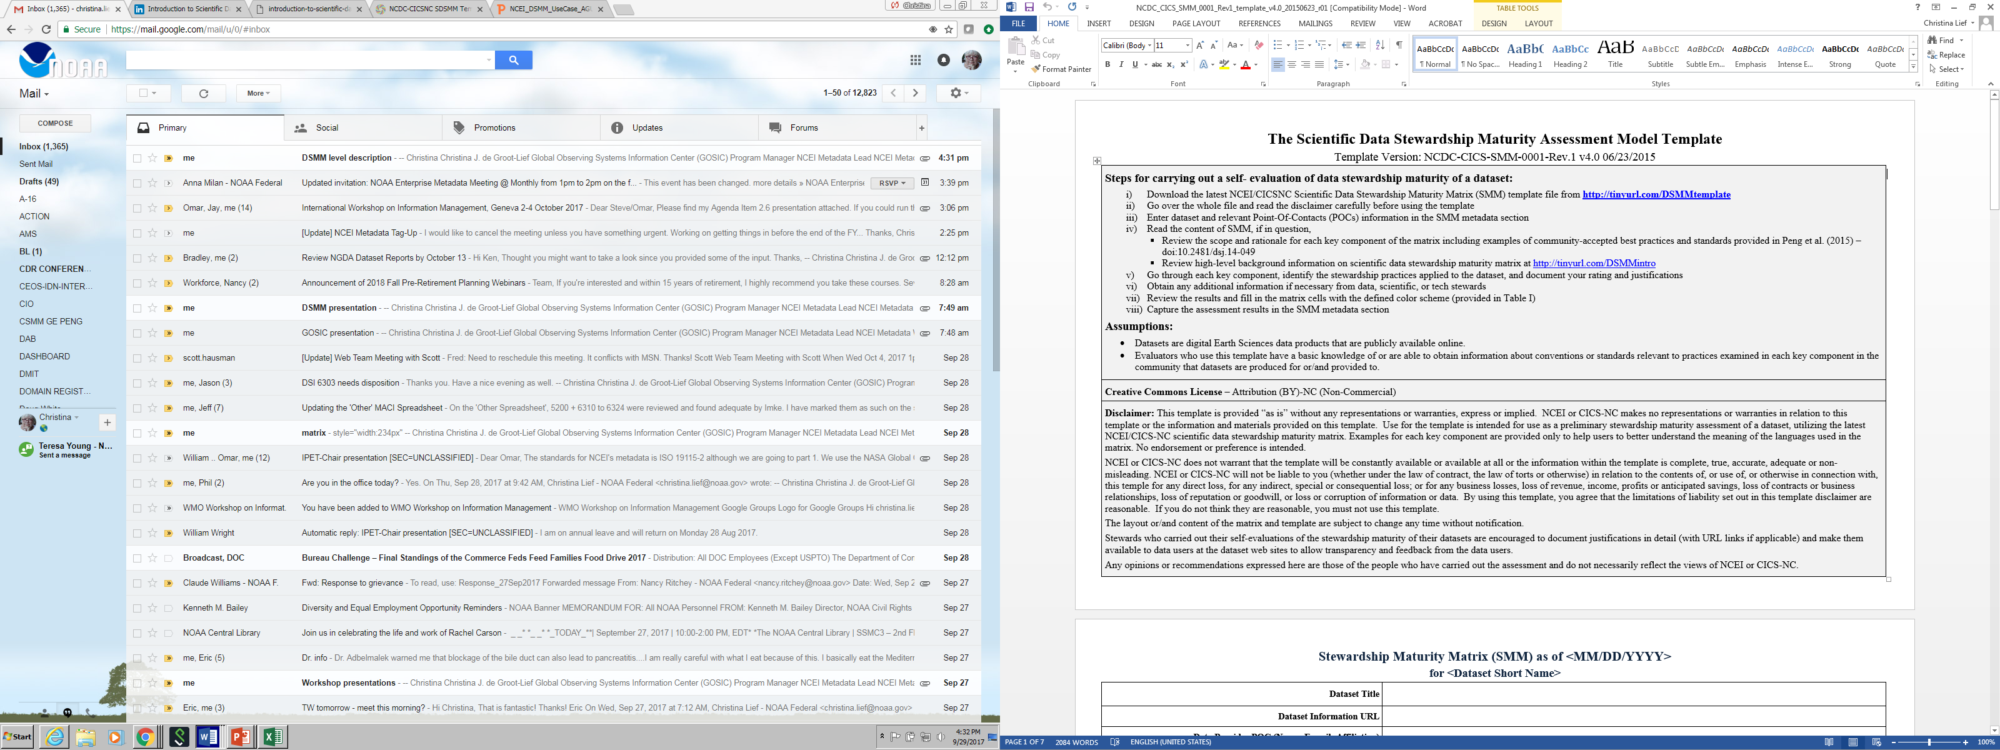

Slide 10
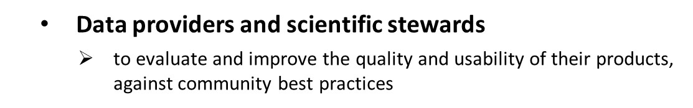
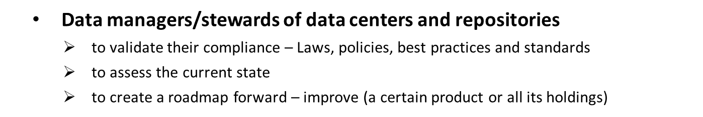

Who Could Use the DSMM & Results?

Slide 11
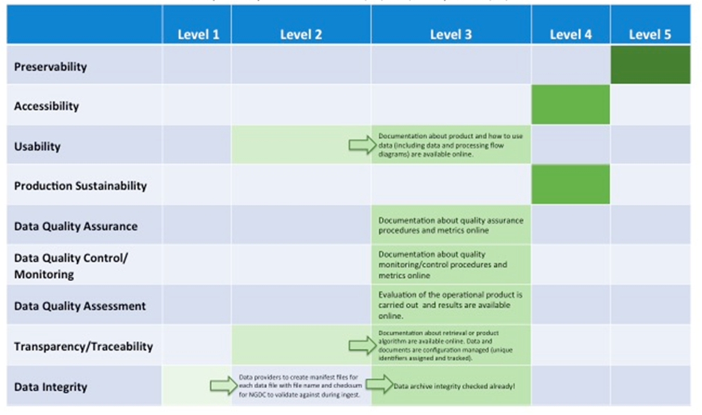



Ways to Use the DSMM
To know the current state of your data set – Maturity Assessment (scoreboard)
To know where you want or need to be – Stewardship Requirements
To Know how to get there – Roadmap Forward (informed, actionable steps)

Slide 12
Ways to Use the DSMM (cont’d)
A reference model for stewardship planning and resource allocation – informed decision-making support
A consolidated source and consistent information about stewardship practices – Data stewardship maturity reports (transparency/trustworthiness)
A tool to enhance discoverability and usability – Content-rich quality metadata

Slide 13
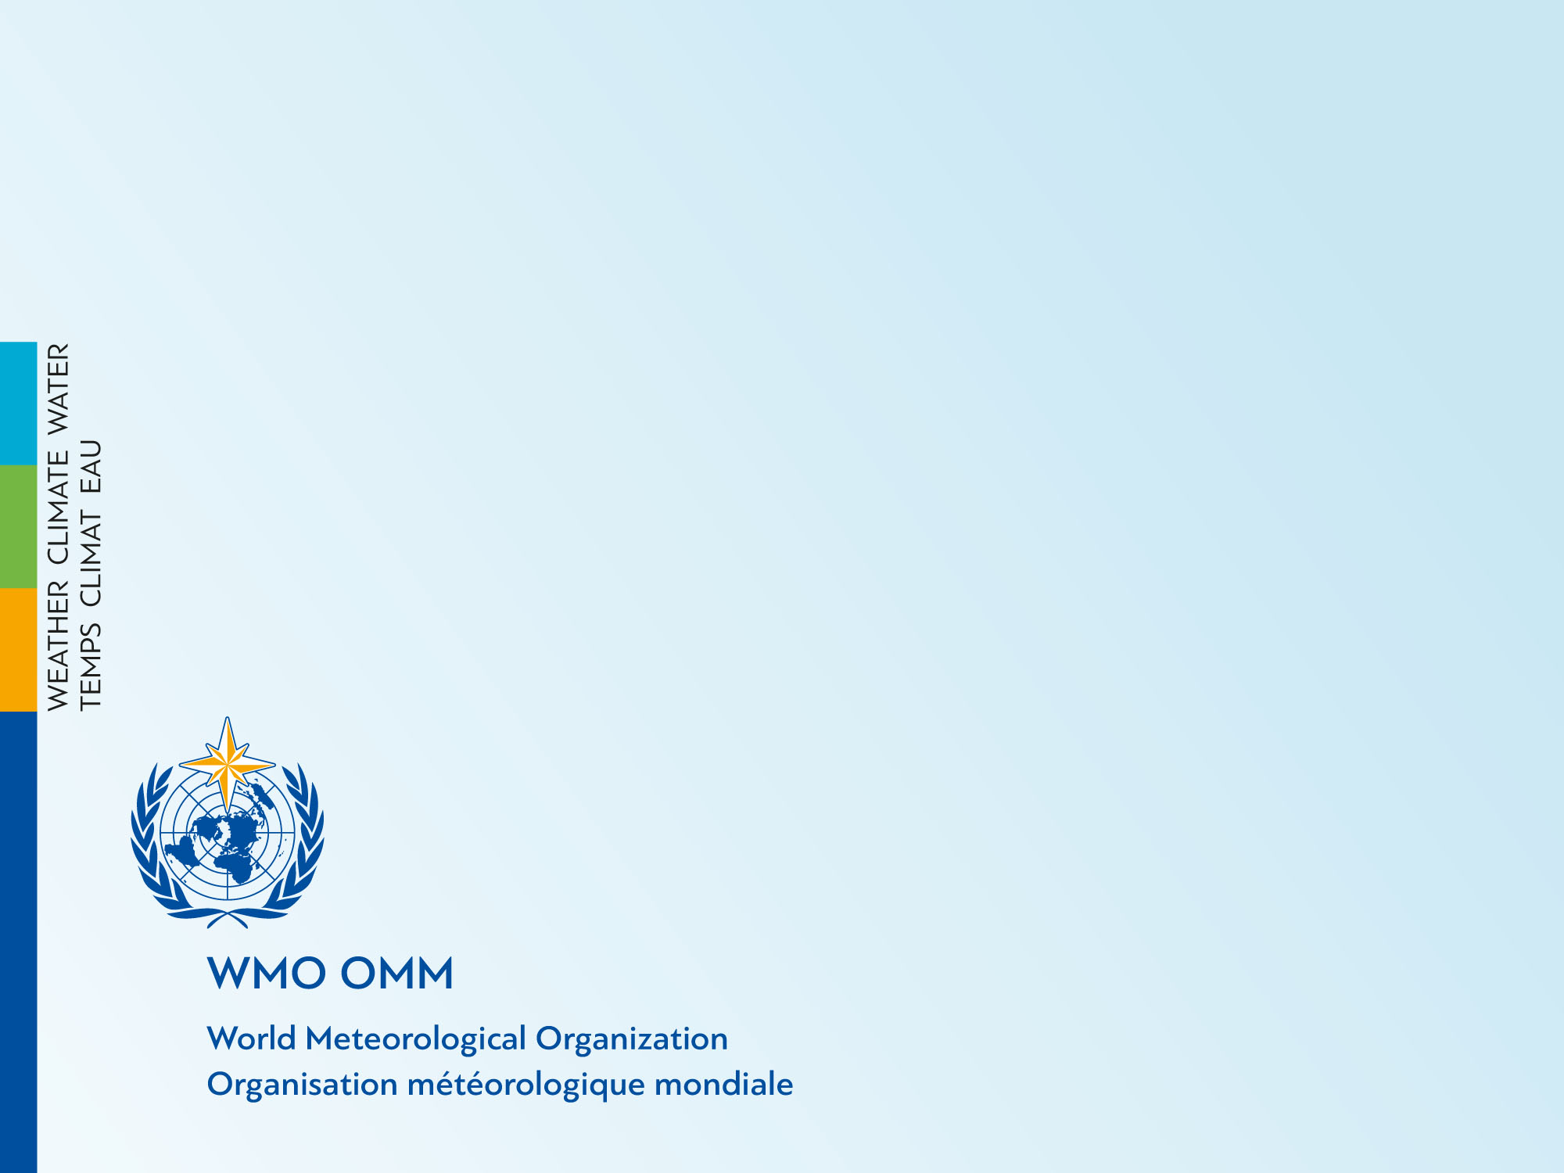
Thank you
Merci
Christina.lief@noaa.gov

