Slide 1
Information Management
OPAG - Data Processing and Forecasting Systems (DPFS)
A. Harou
2.11

Slide 2
The Global Data Processing and Forecasting System
Is organized as a three-level system to carry out functions at global, regional and national levels
  World Meteorological Centre (WMC)
    Global deterministic forecasts
    Global Ensemble Prediction System
    Global Long Range Forecast
  Regional Specialized Meteorological Centre (RSMC) (incl. Regional Climate Centre (RCC))
  National Meteorological Centre (NMC)
Cg-17 Side Event
2

Slide 3
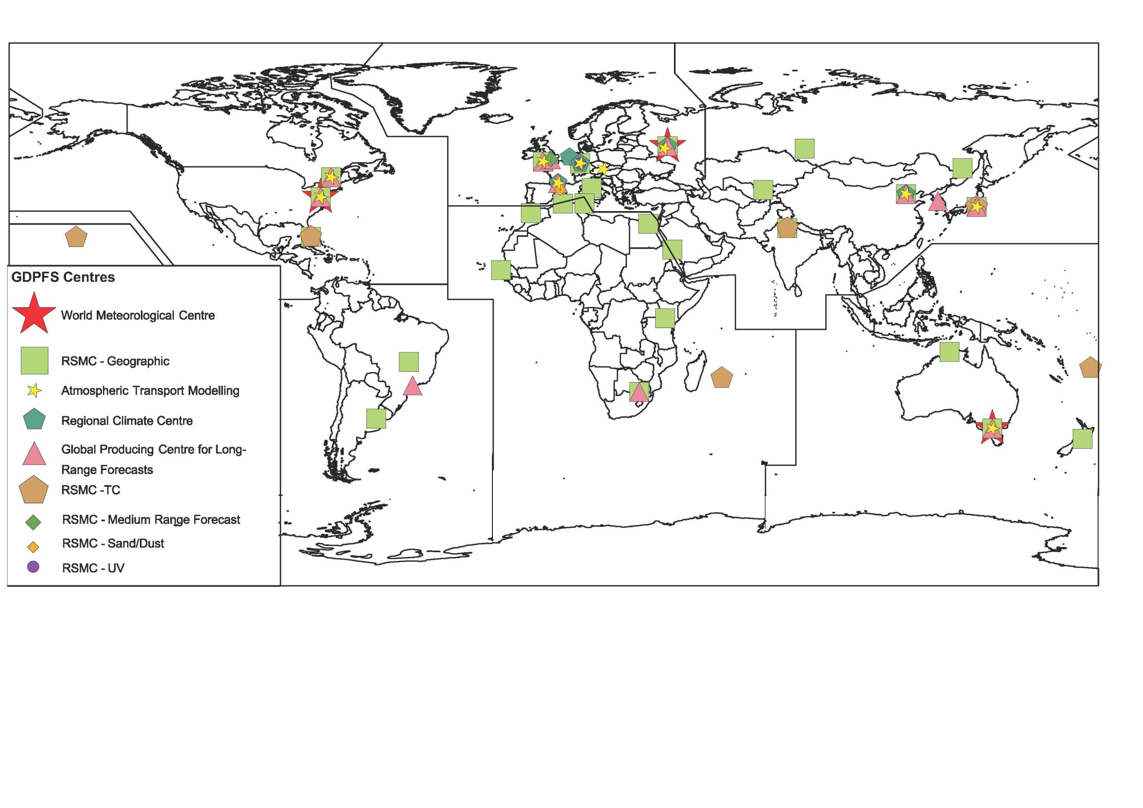
The WMO Centers Today…
8 World Meteorological Centres (WMCs)
35 Regional Specialiazed Meteorological Centres (RSMCs) with Geographical Specialization and 16 with Activity Specialization
13 Global Prediction Centres (GPCs) for Long Range Forecasts (LRF)
9 Regional Climate Centres (RCCs) and 2 RCC-Networks
test footer
3
Notes:
3

Slide 4
GDPFS activities coordinated through the Open Program Area Group- Data Processing and Forecasting System (OPAG-DPFS )
OPAG & ICT DPFS
SG SWFDP
Expert Team on Operational Weather Forecast Processes and Systems (ET-OWFPS)
Inter-Programme Expert Team on Operational prediction from subseasonal to longer time scale (IPET-OPSLS)
(joint CBS/CCL)
Expert Team on Emergency Response Activities (ET-ERA)
OPAG DPFS/PWS
CBS TT – Humanitarian
IPT SWeISS
Assist with access to hi Res Reg NWP
Standards procedure for SFC verif
Guidelines on interpretation of VSRF products
…..
Provision of LRF products form GPcs and LCs
Dev of services to RCCs
LCs support to Global Seasonal Climate Update
Scoping/implementation of sub-seasonal forecasts and Longer than seasonal
…..
Maintain operational response readiness
Maintain MoU with IAEA
Explore new products
Dev operational procedures for non nuclear ERA
…..

Slide 5
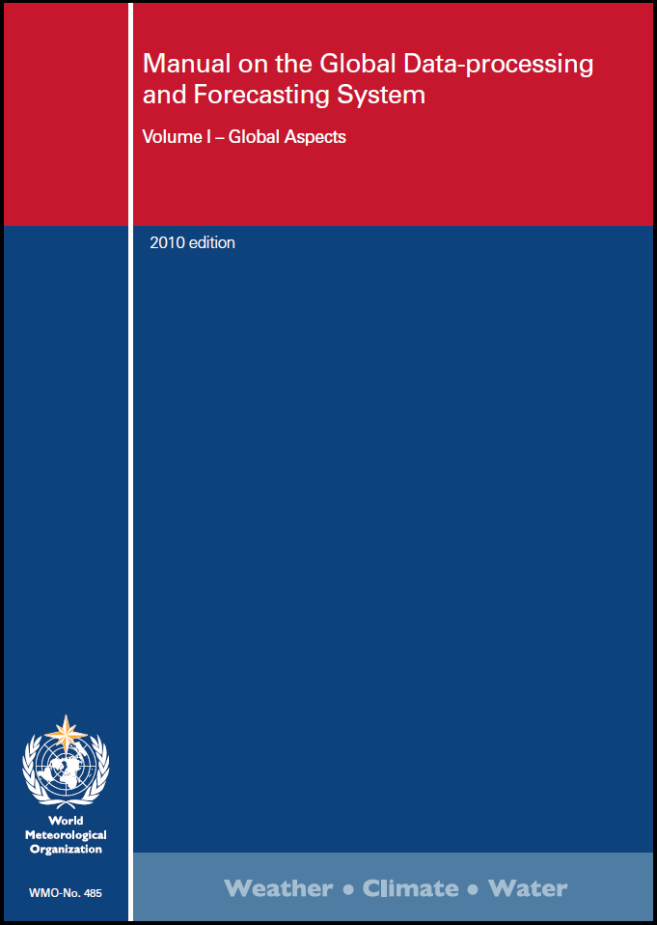
The Manual on the GDPFS
A single source of technical regulations for all operational data-processing and forecasting systems operated by WMO Members
It includes the criteria for designation of operational centres, including those coordinated by CBS, jointly with other technical commission(s) and/or WMO Programme(s), as well as with other international organizations
5
Notes:
The GDPFS regulates the operational production arrangements and practices, through its Manual (WMO-No. 485). It describes the criteria for designation of centres (including functions and operational procedures, list of mandatory and recommended products and information to be exchanged, data policy, etc.). It is a single source of technical regulations for all operational data-processing and forecasting systems operated by WMO Members.
The revision of the Manual on the GDPFS (WMO‑No. 485) has been recently considered at the sixteenth session of the Commission for Basic Systems (CBS-16, November 2016), who recommended to the Executive Council its adoption. This revised version includes the criteria for designation of operational centres, including those coordinated by CBS, jointly with other technical commission(s) and/or WMO Programme(s), as well as with other international organizations. I take this opportunity to highlight the significant collaboration among experts from the various technical commissions.
5

Slide 6
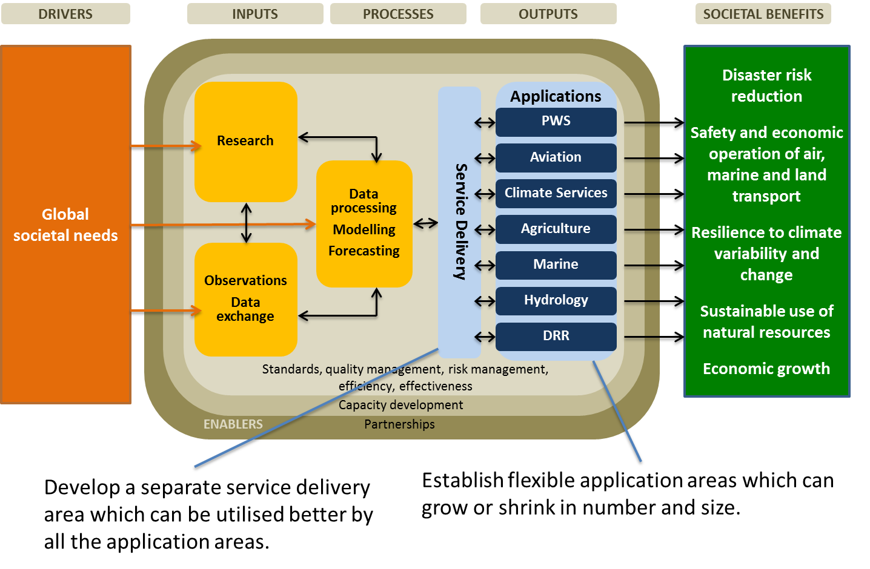
WMO Operational System –link to Common Interface for Service Delivery
Application and services are hub for the linkages between the core business/function based business and the global societal benefits and relevant goals of UN Agendas
Notes:
I believe a small correction needed to be made to the operational graphic shown in the Strategic Plan:
We need to consider services delivery as the link between operations of WMO function-based business and various application areas.
Application and services are hub for the linkages between the core business/function based business and the global societal benefits and relevant goals of UN Agendas
We can consider this approach as providing the menus with variety of basic products and processing capabilities for variety of services to support various applications areas which are growing in number according to users requirements and needs (Public weather services, Agriculture, Marine, Aviation , Transportation, Health, Tourism etc.)
Therefore, It might be right time to consider the further developement of a seperate service delivery area as a common capacity for service related product generation which can be utilised better by all the application areas.

Slide 7
The future GDPFS -Seamless GDPFS- will…
Be an effective and adaptable monitoring and prediction system enabling Members and partners to make better-informed decisions
Facilitate the provision of impact-based forecasts and risk-based warnings through partnership and collaboration
Do so through the sharing of weather, water, climate and related environmental data, products and services in a cost effective, timely and agile way, with the effect of benefitting all WMO Members, while also reducing the gaps between developed and developing Members
Notes:
These developments are aligned with the future GDPFS, which by definition, enables seamless operations. The GDPFS will (vision statement as approved by EC-68):
- Be an effective and adaptable monitoring and prediction system enabling Members and partners to make better-informed decisions
- Facilitate the provision of impact-based forecasts and risk-based warnings through partnership and collaboration
- Do so through the sharing of weather, water, climate and related environmental data, products and services in a cost effective, timely and agile way, with the effect of benefitting all WMO Members, while also reducing the gaps between developed and developing Members

Slide 8
In summary, the seamless GDPFS is…
WMO foundational activity addressing the data-processing and forecasting needs of the weather, climate, water and environmental services of its Members
A framework for integrating all WMO data-processing and forecasting systems under a common regulatory and management framework
Notes:
In summary, the seamless GDPFS is:
- WMO foundational activity addressing the data-processing and forecasting needs of the weather, climate, water and environmental services of its Members;
- A framework for integrating all WMO data-processing and forecasting systems under a common regulatory and management framework.
The seamless GDPFS is not:
- Replacing or taking over existing data-processing and forecasting systems, which will continue to be owned and operated by the various technical commissions and programmes. Example presented relates to the Global Producing Centres for Long-range Forecasts, wherein the development of the designation criteria (including functions and operational procedures, list of mandatory products and recommended products to be exchanged, data policy, etc.), as well as the monitoring process, are under the responsibility of the joint CBS-CCl Expert Team on Operational Predictions from Sub-seasonal to Longer-time Scales (ET-OPSLS).

Slide 9

OPAG DPFS & Information Management
ET- OWFPS (Operational Weather Forecast Processes and Systems)
  Auditing activities will be implemented to ensure designated centre continue to perform at the level required by the GDPFS Manual (MWO-No.485). This may need an adoption of an information management system.
ET-ERA (Emergency Response Activities)
  Nuclear Emergency. Recently added non-nuclear emergency
  Procedures for ERA involve the exchange of some basic information with the IAEA (i.e. they send RSMC a request) and the RSMCs then respond by sending dispersion model information (charts).
IPET-OPSLS (Operational Prediction from Sub-seasonal to Longer time Scale)
  For GPC LRF designation and LC-LRFMME activity, there is a requirement for the exchange of model forecast data and information: the exchange follows standard WMO protocols – GRIB, WIS. These protocols have been adequate for the exchange of information within operational centers.
  There has been a discussion, and a Task Team within the IPET-OPSLS about making available model data bases on formats other than GRIB to meet requirements of non-operational center users - work is at the initial stage.
The paradigm shift of Impact-based forecast and risk-based warnings imposes new challenges to GDPFS. How to integrate/supperpose non-conventional data such as exposure and vulnerability to weather, water and climate information. Information management in that sense is must. OPAG DPFS will discuss the issue of information management and come up with the requirement of seamless GDPFS to be addressed by WIS 2.0

Slide 10
In Summary
GDPFS is already using Standard WMO protocols for data (GRIB, WIS)
It is felt that these WMO protocols are adequate for the GDPFS
Auditing function to be implemented may require the use of a different information management – Clarity will come later
Impact-based forecasting and risk-based warnings will require information management – may be one of the requirements for WIS 2.0 from the seamless GDPFS
OPAG DPFS will develop a set of requirements for WIS 2.0

Slide 11
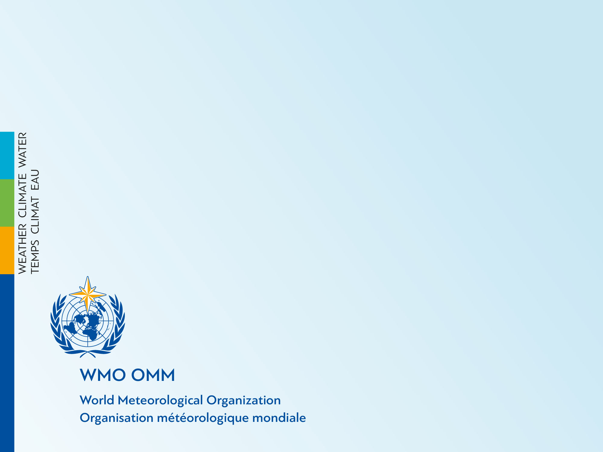
Thank you
Merci

Slide 12
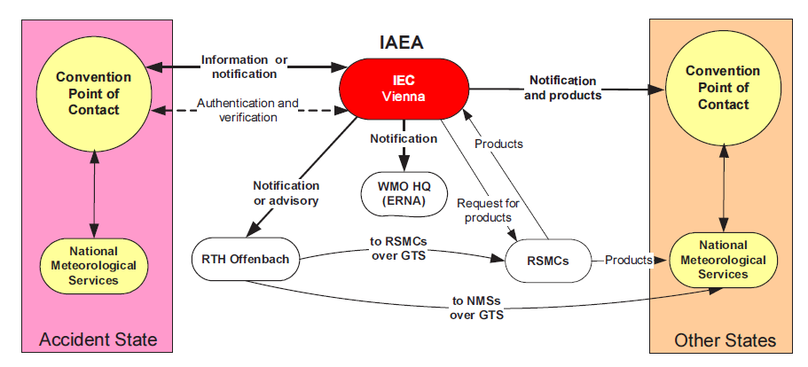
Concept of Operations: IAEA - WMO Notification and WMO provision of services – Nuclear Emergency
IAEA: International Atomic Energy Agency
IEC: Incident Emergency <Centre
RTH: Regional Telecom Hub
RSMC: Regional Specialized Meteorological Centre
GTS: (WIS): Global Telecomunication Hub
NMS: National Meteorological Service

