Slide 1
WMO International workshop on Information Management
2-4 October 2017
Requirements for managing information for international civil aviation
Dimitar Ivanov, C/AEM
Item 2.10

Slide 2

Aeronautical Meteorological Information
Definition
Meteorological information supplied to the following users:
operators (airlines)
flight crew members
air traffic services units
search and rescue services units
airport managements; and
others concerned with the conduct or development of international air navigation
necessary for the performance of their respective functions

Slide 3
Aeronautical Meteorological Information
Characteristics
Highly regulated (context, format, exchange procedures, quality) at international and national level
Fit-for-purpose – based on concrete user requirements
Well defined and recognized purpose – safety, regularity, efficiency of the air transport operations
Decision-supporting information
Restricted use
Cost-recoverable information service provision

Slide 4
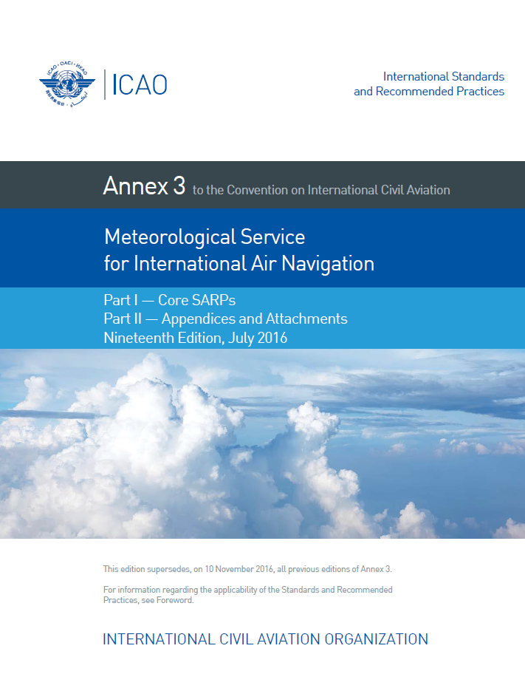
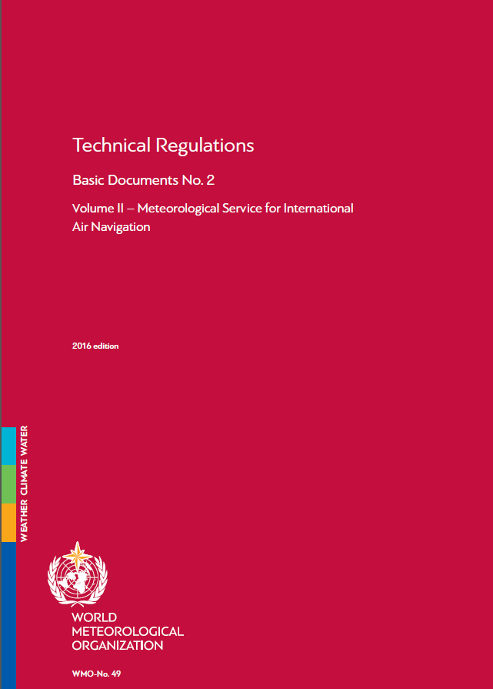
Regulatory Framework
International framework – ICAO and WMO

Slide 5
Regulatory Framework
International framework – ICAO and WMO
  Annex 3 (to the ICAO (Chicago) Convention), Meteorological Service for International Air Navigation
  WMO Technical Regulations (WMO-No-49), Volume II, Meteorological Service for International Air Navigation
  Other ICAO and WMO regulatory and guidance material
National (or regional, e.g., EASA) regulatory framework
National law (e.g., Meteorology Act, Civil Aviation Act)
Other regulatory instruments; SOPs
Transposition of the international regulations, with account of different national/local requirements and conditions

Slide 6
Regulatory Framework
Structure of regulations related to aeronautical MET information and service
Governance, roles, responsibilities
Establishment of international information services and facilities – WAFS (WAFCs), IAVW (VAACs), TCACs …
Standardization of
  observations, reports
  forecasting and warning procedures
  aeronautical climatological information
  services to stakeholders – use cases
  flight documentation
  Communications and information exchange

Slide 7
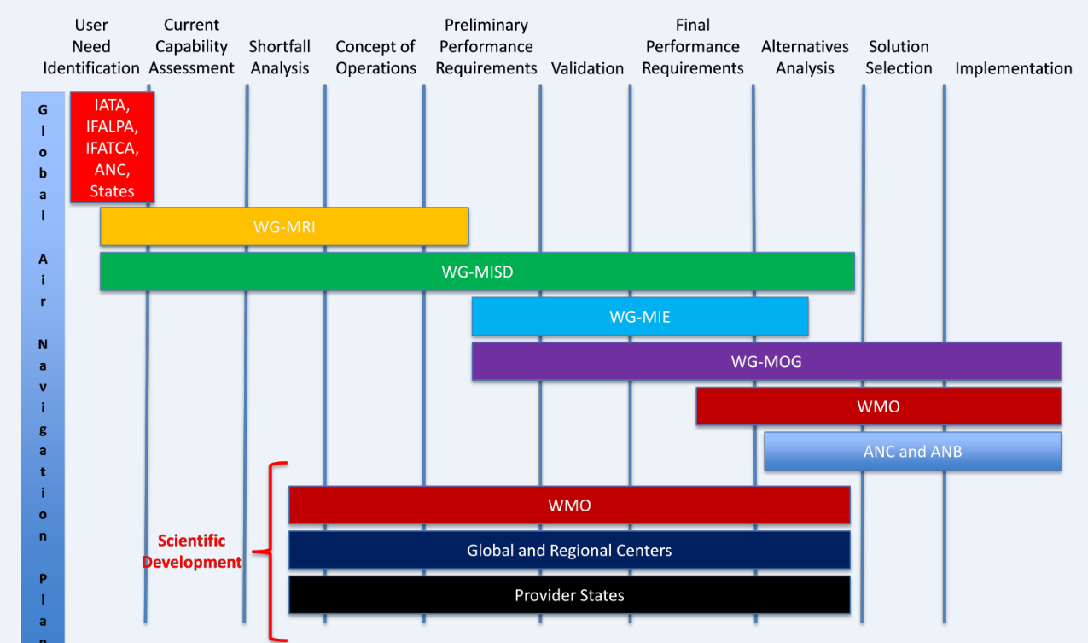
Regulatory Framework
User Requirements - process

Slide 8
Regulatory Framework
2.1.4 Each Contracting State shall designate the authority, hereinafter referred to as the meteorological authority, to provide or to arrange for the provision of meteorological service for international air navigation on its behalf.
Currently, the following functions are considered in an information service provision arrangement:
Regulator – authority (MA)
Aviation MET Service Provider(s) (AMSP)
Oversight body (could be combined with MA)
Regional layer – each ICAO Region has a Regional Air Navigation Plan (ANP); all requirements for OPMET information required from the States in the Region are specified in the ANP
Regular monitoring exercises on availability and compliance are conducted by relevant regional groups
For non-regular information – regular exercises based on simulations

Slide 9
Regulatory Framework
2.2.2 Each Contracting State shall ensure that the designated meteorological authority … establishes and implements a properly organized quality system comprising procedures, processes and resources necessary to provide for the quality management of the meteorological information to be supplied to the users listed in 2.1.2.
2.2.4 Recommendation.— The quality system should provide the users with assurance that the meteorological information supplied complies with the stated requirements in terms of the:
geographical and spatial coverage,
format and content,
time and frequency of issuance and period of validity,
as well as the accuracy of measurements, observations and forecasts.

Slide 10
Regulatory Framework
2.2.9 The meteorological information supplied to the users listed in 2.1.2 shall be consistent with Human Factors principles and shall be in forms which require a minimum of interpretation by these users …
Note.— Guidance material on the application of Human Factors principles can be found in the Human Factors Training Manual (Doc 9683)

Slide 11
OPMET Information
OPMET = OPerational METeorological information
OPMET data types:
  Alphanumeric (currently in TAC form):
    Observations – METAR, SPECI, local reports; aircraft reports
    Forecasts – TAF
    Advisories and warnings - SIGMET, AIRMET, VA and TC advisory, aerodrome warnings, SWX advisory (coming in Nov 2018)
  Binary: GRIB, BUFR
    WAFS forecasts for wind, temperature, icing, turbulence, CB
    WAFS SIG weather forecasts in BUFR
  Graphical:
    SIG Wx charts, graphical advisories, graphical SIGMET

Slide 12
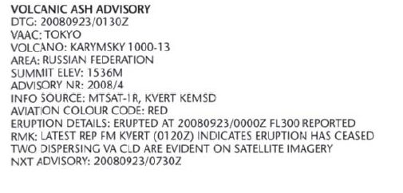
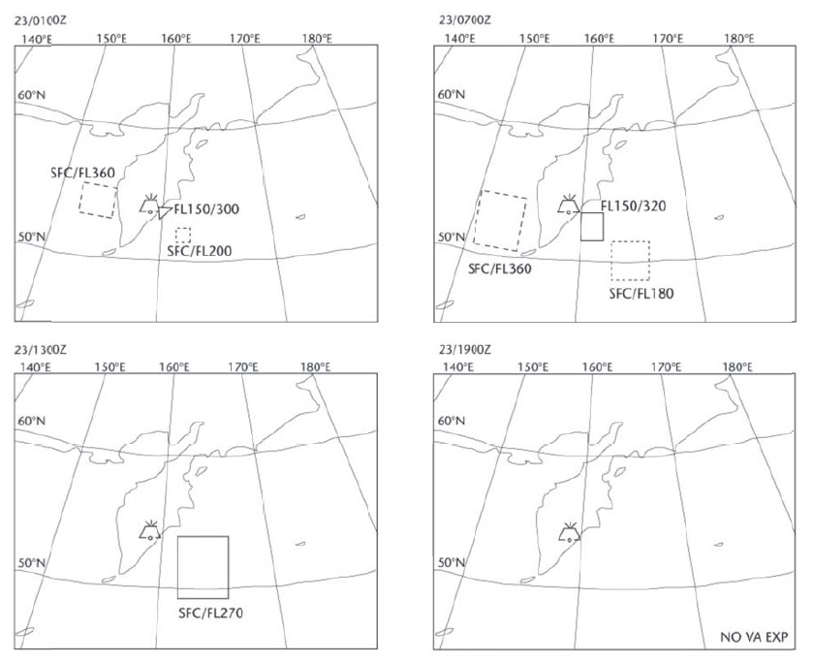

Slide 13
OPMET Information
OPMET information is not part of the practices under the WMO Resolution 40!
  Annex 4, note 3:
  Aeronautical information generated specifically to serve the needs of aviation and controlled under the Convention on International Civil Aviation (Chicago, 1944) is not included in the application of the practice.

Slide 14
Other Information
Aircraft observations and reports (ICAO regulated)
  Routine air-reports by air-ground data link – ADS-C or SSR Mode S
  Special air-reports by air-ground data link
  Special air-reports by voice communications
Climatological Information
Non-ICAO regulated information and services
  AMDAR
  Additional information and services on contract
  Private sector services

Slide 15
Information Delivery and Exchange
11.1.9 Recommendation.— The telecommunications facilities used for the exchange of operational meteorological information should be the aeronautical fixed service or, for the exchange of non-time critical operational meteorological information, the public Internet, subject to availability, satisfactory operation and bilateral/multilateral and/or regional air navigation agreements.
Note 1.— Aeronautical fixed service Internet-based services, operated by the world area forecast centres, providing for global coverage are used to support the global exchanges of operational meteorological information.
Note 2.— Guidance material on non-time-critical operational meteorological information and relevant aspects of the public Internet is provided in the Guidelines on the Use of the Public Internet for Aeronautical Applications (Doc 9855).
Aeronautical fixed service (AFS). A telecommunication service between specified fixed points provided primarily for the safety of air navigation and for the regular, efficient and economical operation of air services.
The AFS is provided by voice and data networks, including: AFTN, AMHS and CIDIN.

Slide 16
Information Delivery and Exchange
Time-critical – flight safety information/messages
SIGMET information
special air-reports (AIREP)
AIRMET messages
volcanic ash advisories
tropical cyclone advisories
amended aerodrome forecasts (TAF AMD)

Slide 17
Information Delivery and Exchange
Non-time-critical – meteorological information
forecasts, e.g. TAF, area and route forecasts
observations METAR and SPECI)
meteorological information provided by the WAFCs
volcanic ash advisories in graphical format (VAG)
GAMET area forecasts
route forecasts (ROFOR)

Slide 18
Information Delivery and Exchange
Performance requirements - timeliness, availability, accessibility
Filing times for messages and bulletins
Transit times
Transmission interruption times
Back-up arrangements between international centres
3.5.3 In case of interruption of the operation of a VAAC, its functions shall be carried out by another VAAC or another meteorological centre, as designated by the VAAC Provider State concerned.
Note.― Back-up procedures to be used in case of interruption of the operation of a VAAC are included in Doc 9766.

Slide 19
Information Delivery and Exchange
IWXXM – ICAO Weather Exchange Model
Additional requirements for the exchange of OPMET messages (METAR, SPECI, TAF, SIGMET …) in “digital form”
“ … in accordance with a globally interoperable information exchange model and shall use extensible markup language (XML)/geography markup language (GML)”
IWXXM development – a joint ICAO-WMO venture
Amendment 78 to Annex 3, applicable Nov 2018 – mandatory requirements for the exchange of the current TAC messages in “IWXXM GML form” as of 5 November 2020

Slide 20
Use Cases
Annex 3 specifies different use cases of meteorological information
Service for operators and flight crew members
  pre-flight planning by operators;
  in-flight replanning by operators using centralized operational control of flight operations;
  use by flight crew members before departure
  aircraft in flight
Information for Air Traffic Services (ATS), Search and Rescue Services (SAR) and Aeronautical Information Services (AIS)

Slide 21
Use Cases
Special requirements for investigations
9.3.4 The meteorological authority shall retain information supplied to flight crew members, either as printed copies or in computer files, for a period of at least 30 days from the date of issue. This information shall be made available, on request, for inquiries or investigations and, for these purposes, shall be retained until the inquiry or investigation is completed.

Slide 22
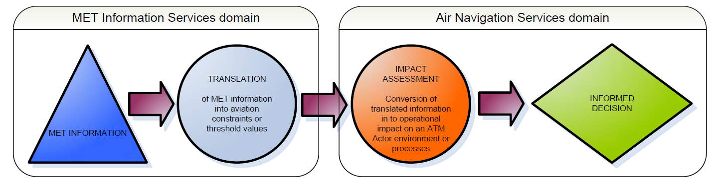
Integration of MET information in ATM

Slide 23
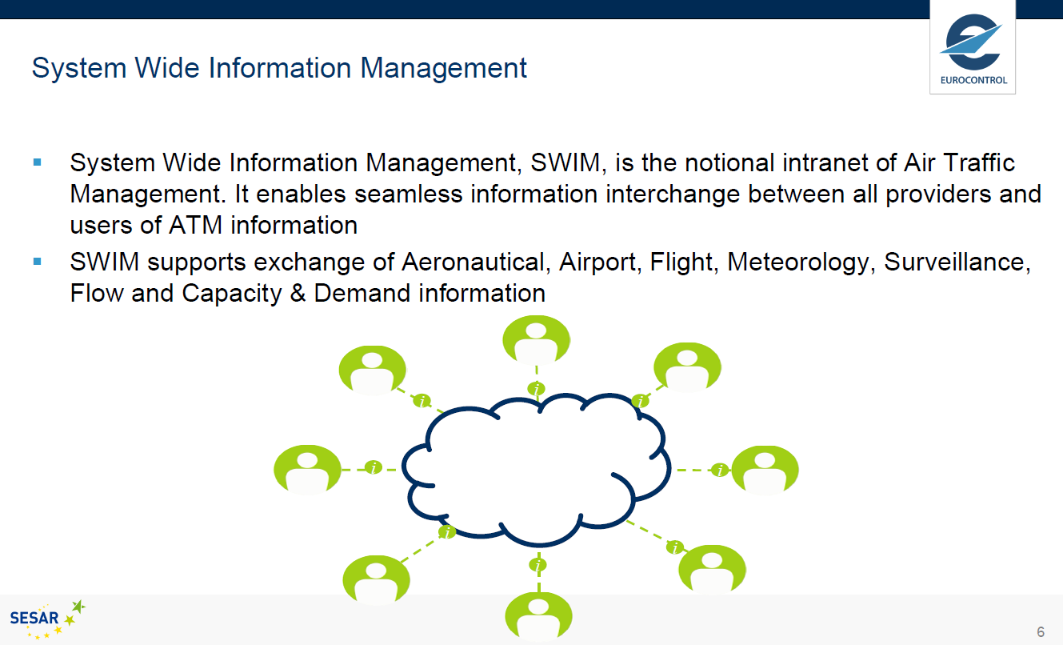
System-Wide Information Management

Slide 24
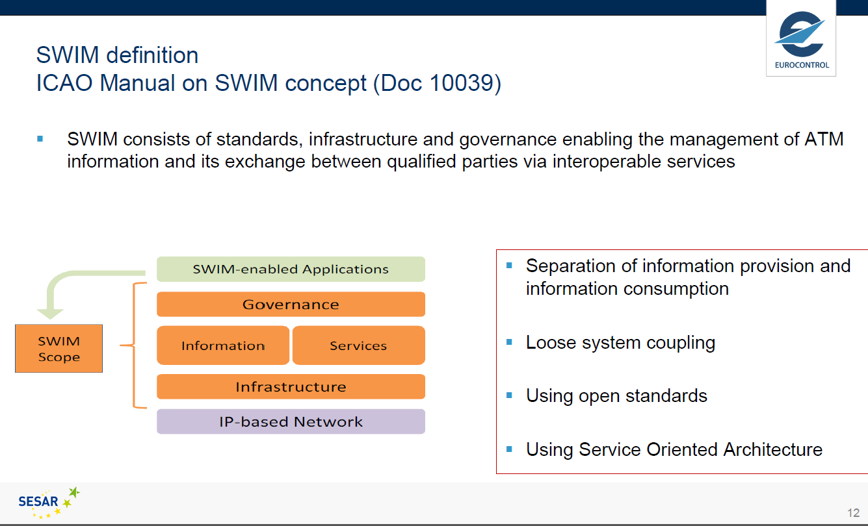
System-Wide Information Management

Slide 25
Recommendations
Recognize the high level of regulation and standardization at international level (ICAO and WMO) of the aeronautical meteorological information.
Consider the requirements for quality management of the aeronautical meteorological information raised at the level of a standard as a good practice.
Note the ICAO process for establishing user requirements and consider its applicability within the WMO information management.
New requirements for the MET information stem from the need for further integration in the stakeholders’ decision-making (mostly automated) systems and processes.
Strong user requirement for more near-real-time information uplinked directly to the cockpit to support near-term decisions (e.g., 0 to 20 min decision horizon).

Slide 26
Recommendations
6. Note the current trends and developments in the aeronautical meteorology with regard to the information management, as stipulated in the ICAO Global Air Navigation Plan (GANP) and its Aviation System Block Upgrades (ASBU) methodology including:
  a. Transition from TAC forms to IWXXM;
  b. Integration of MET information in the Air Traffic Management (ATM) decision-making systems;
  c. The migration from a “product-centric” to a “data-centric” information service;
  d. Implementation of the ICAO System-Wide Information Management (SWIM) concept;
  e. Further regionalization and globalization of service provision.
7. Need to maintain close coordination and cooperation between ICAO and WMO in the information management domain; interoperability between WIS and SWIM is a concern for some information providers.
8. Aviation users are getting more interested in potential climate change impact on aviation – need to develop appropriate ways to present such information to various stakeholders.

Slide 27
Impact of climate change on aviation – recent NYT article
https://www.nytimes.com/2017/09/30/business/airports-climate-change-global-warming.html?emc=edit_tnt_20170930&nlid=39145487&tntemail0=y

Slide 28

Thank you
Merci

