Slide 1
Information Management Challenges Associated with Big Data
Tomaz Logar
2.14

Slide 2

Introduction
Big Data Engineer at UN Global Pulse, working on:
  Software development
  Development Operations
  Data Security
  Privacy
Notes:
Giving some thoughts on big data solutions and challenges

Slide 3

Introduction
Big data = 3V
(high Volume, high Velocity, high Variety)
Notes:
Big data is often described with three Vs
It’s a messy definition
“big data” can cover any data that is of size not manageable by classic tools
Or is coming in at high speed
Or is a result of fusion of multiple sources

Slide 4
Introduction
Caveat Emptor
Hardly any meteorological
solutions and challenges
Notes:
Buyer beware!

Slide 5
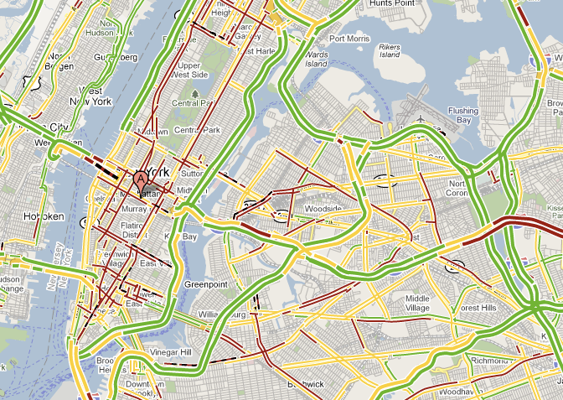
Solutions
Private sector solution example:
Real-time Traffic
Recommendation
Challenge:
Privacy
Notes:
Using mobile phone movement information
it’s possible come up with congestion maps
A case of big volume in the 3V paradigm
Global Pulse version: equipping public transport minivans with GPS trackers

Slide 6
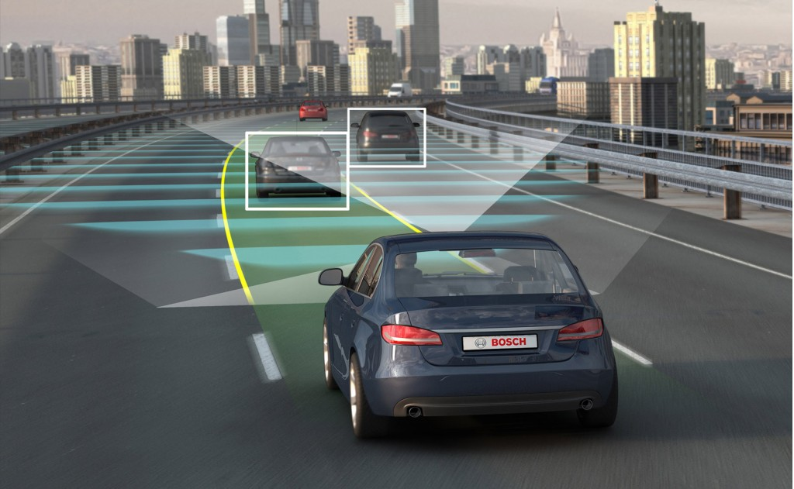
Solutions
Private sector solution example:
Autonomous
cars / trucks
Challenge:
Ethics
Privacy
Notes:
Ethic question: when the car is getting into an accident it’s AI may need to decide who to (not to) kill.

Slide 7
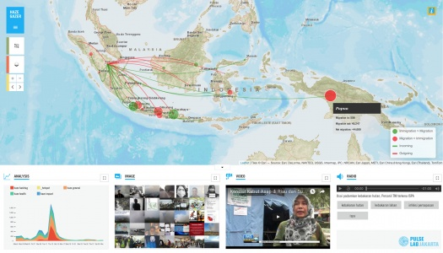
Solutions
UN Global Pulse solution example:
Haze Gazer
Potential outcome:
Increased health and
policy response
Challenge:
Privacy
Notes:
Haze in Indonesia is particularly severe problem because farmers tend to burn large forests instead of cutting them down
Using social media and citizen reporting to track haze in Indonesia

Slide 8
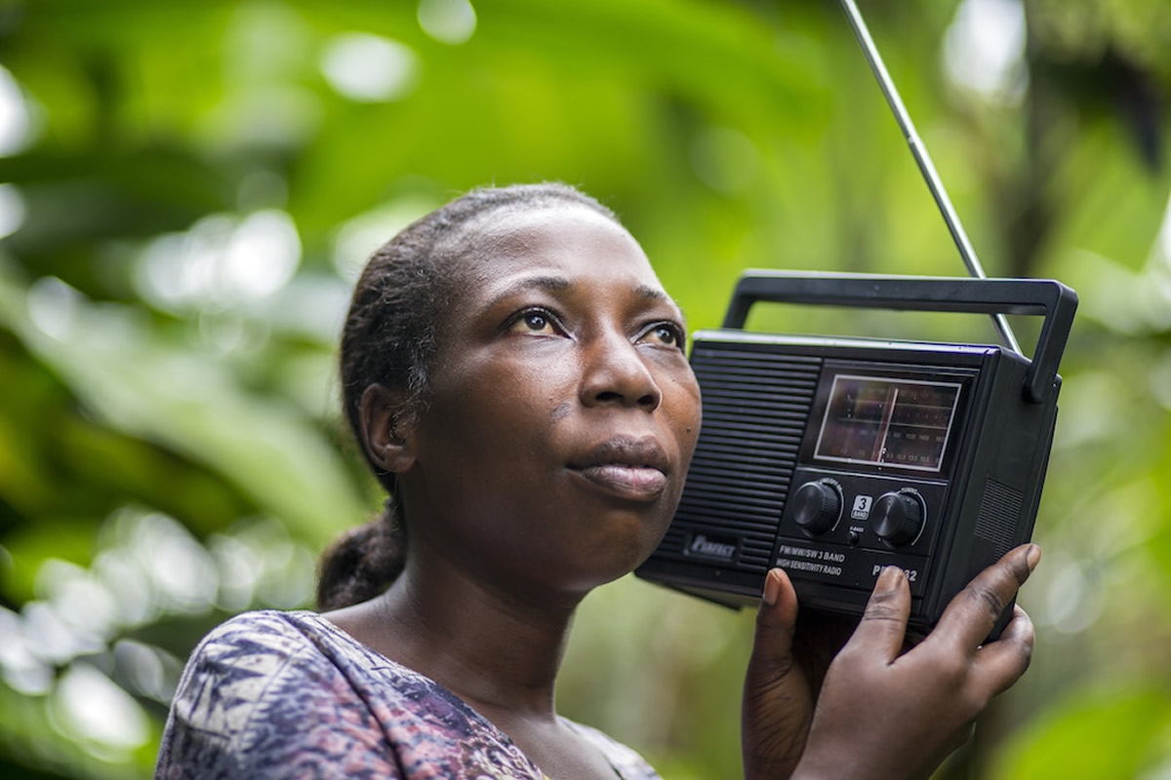
Solutions
UN Global Pulse solution example:
Radio Mining
Potential outcome:
Increased economic or
humanitarian response
Challenge:
Privacy
Notes:
In remote areas social media is still AM/FM radio
Raspberry Pis with AM/FM receivers,
sending MP3 files to central location in Kampala,
then stored in AWS S3

Slide 9
Challenges
Security
Privacy
Ethics
Confirmation bias
Technical
Is high automation really welcome in every scenario?
Notes:
Once again – general big data challenges – not weather-related
Security – classic data problem
Privacy is a challenge that doesn’t live just in NOW, but also in the future
Gaining unintended insights by combining future datasets
(somewhat futuristic) example – combining basic housing data with waste management data
Ethics - talked about at autonomous cars
Confirmation bias – If bald people are statically more violent, am I violent and will AI say to the judge to just lock me up?

Slide 10

Thank you
Merci

