Slide 1
The GCOS Essential Climate Variable (ECV)
Data Access and Information Matrix -
Easy Access to High Quality Global Datasets
Christina de Groot-Lief
NOAA’s National Centers for Environmental information (NCEI)
Agenda Item 2.6
WMO Workshop on Information Management
Geneva, Switzerland
October 2-4, 2017

Slide 2
ECV Data Access and Information Matrix - Background
The Global Observing System for Climate (GCOS) Essential Climate Variable (ECV) Data Access and Information Matrix is hosted on the Global Observing Systems Information Center (GOSIC) Portal.
The GOSIC Portal:
  was developed starting in 1997 at the University of Delaware under a NOAA Grant and moved to NOAA’s National Centers for Environmental Information (NCEI) (priorly known as NCDC) in 2005 and became operational in 2007.
  is hosted by NCEI on behalf of the international community under the NCEI web farm.
  is supported by one part-time Program Manager and the NCEI Website Drupal Developer Support Team.
  can be accessed at https://GOSIC.org

Slide 3
ECV Data Access and Information Matrix – Background (cont’d)
Originally the GOSIC provided a wide array of information on the GCOS programme but content has been simplified and will soon exclusively provide access to GCOS ECV data through the data access matrix. The timeline for completion of this effort is by the end of 2017.
This data access matrix mostly provides access to in situ data.
There is an effort by the joint Committee on Earth Observation Satellites (CEOS)/Coordination Group for Meteorological Satellites (CGMS) Working Group on Climate (WGClimate) that provides data of ECVs measured from space. Spreadsheet can be downloaded at: http://climatemonitoring.info/temporary-ecv-inventory

Slide 4
ECV Data Access and Information Matrix – How was it developed
The matrix was developed:
  in cooperation with WMO GCOS
  with user input. Users wanted:
    one location for easy access
    a design that provides a quick overview of content
    least amount of clicks to access data and information on individual ECVs
    provide authoritative information and key datasets data sets that have been submitted to critical appraisal, curated for quality and are properly documented by metadata.

Slide 5
ECV Data Access and Information Matrix –
What does this tool provide?
The matrix facilitates the discovery of and access to key data, products, metadata and information for the following GCOS ECVs:
Atmosphere ECVs:
Surface: Precipitation, Pressure, Surface Radiation Budget, Surface Wind Speed and Direction, Temperature, Water Vapour
Upper Atmosphere: Earth Radiation Budget, Lightning, Temperature, Water Vapour, Wind speed and Direction
Atmospheric Composition: Aerosols properties, Carbon Dioxide, Methane and other Greenhouse gases, Cloud Properties, Ozone, Precursors (supporting the Aerosol and Ozone ECVs)
Ocean ECVs:
Physical: Ocean Surface Heat Flux, Sea Ice, Sea Level, Sea State, Sea Surface Salinity, Sea Surface Temperature, Subsurface Currents, Subsurface Salinity, Subsurface Temperature, Surface Currents, Surface Stress
Biogeochemical: Inorganic Carbon, Nitrous Oxide, Nutrients, Ocean Colour, Oxygen, Transient Tracers
Biological/Ecosystems : Marine Habitat Properties, Plankton
Land ECVs: Above-ground biomass, Albedo, Anthropogenic Greenhouse Gas Fluxes, Anthropogenic Water Use, Fire, Fraction of Absorbed Photosynthetically Active Radiation (FAPAR), Glaciers, Groundwater, Ice Sheets and Ice Shelves, Lakes, Land Cover, Land Surface Temperature, Latent and Sensible Heat fluxes, Leaf Area Index (LAI), Permafrost, River Discharge, Snow, Soil Carbon, Soil Moisture

Slide 6
ECV Data Access and Information Matrix –
What does this tool provide? (Cont’d)
Latest update information was provided by WMO/GCOS for the Atmosphere, Ocean and Land ECVs. This information was used to update the content of the matrix.
  Atmosphere-ECV-matrix 2017-03-22.xls
  Ocean-ECV-matrix 2017-01-11.xls
  Land-ECV-Matrix 2017-01-06.xls

Slide 7
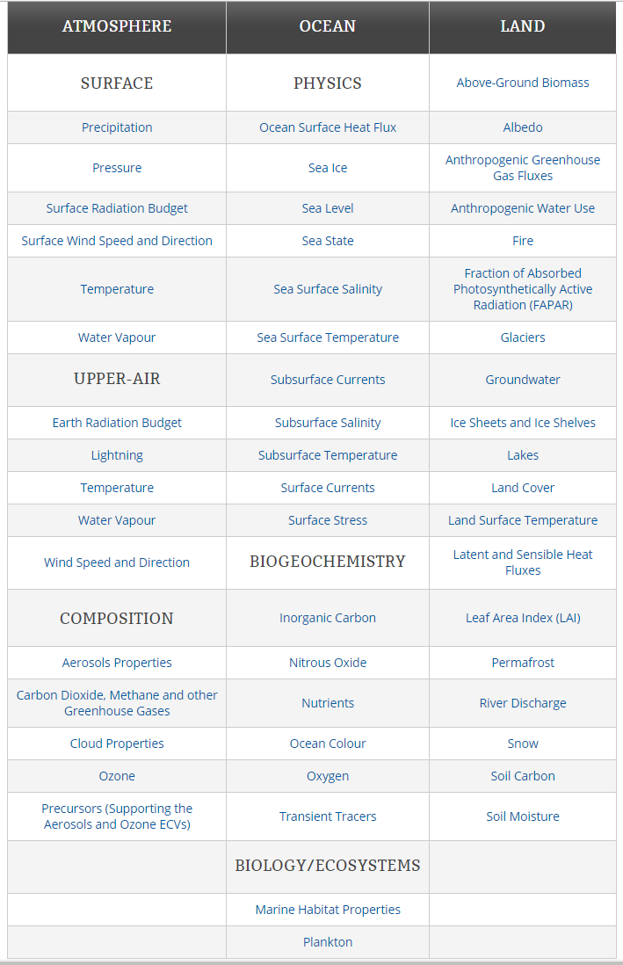
ECV Data Access and Information Matrix –
Main Page

Slide 8
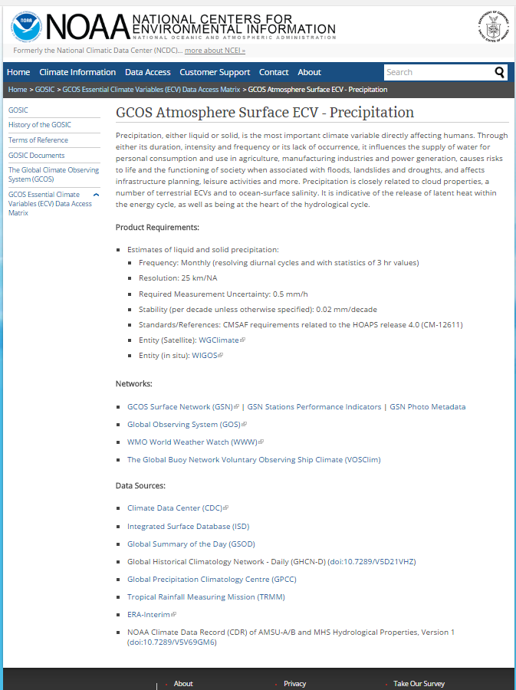
ECV Data Access and Information Matrix –
Individual Page for
GCOS Atmosphere
Surface ECV –
Precipitation

Slide 9
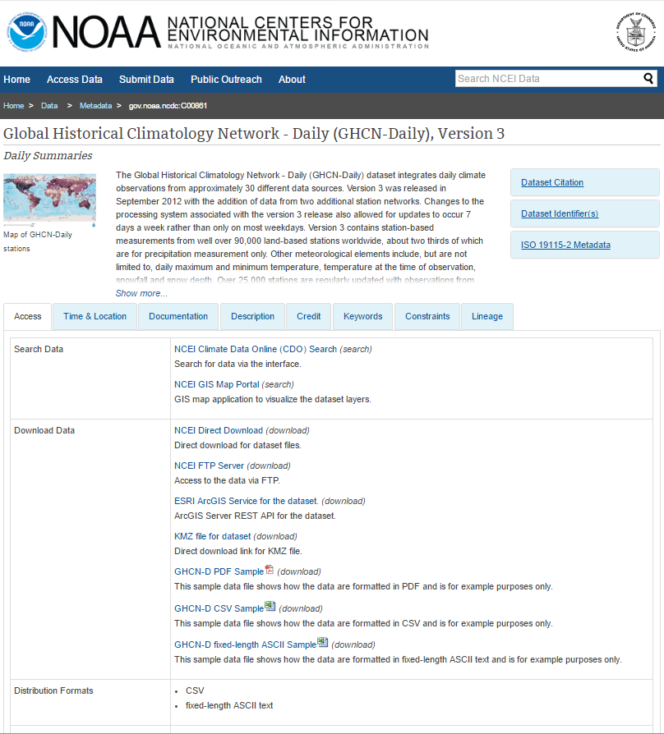
ECV Data Access and Information Matrix –
Individual Dataset Page

Slide 10
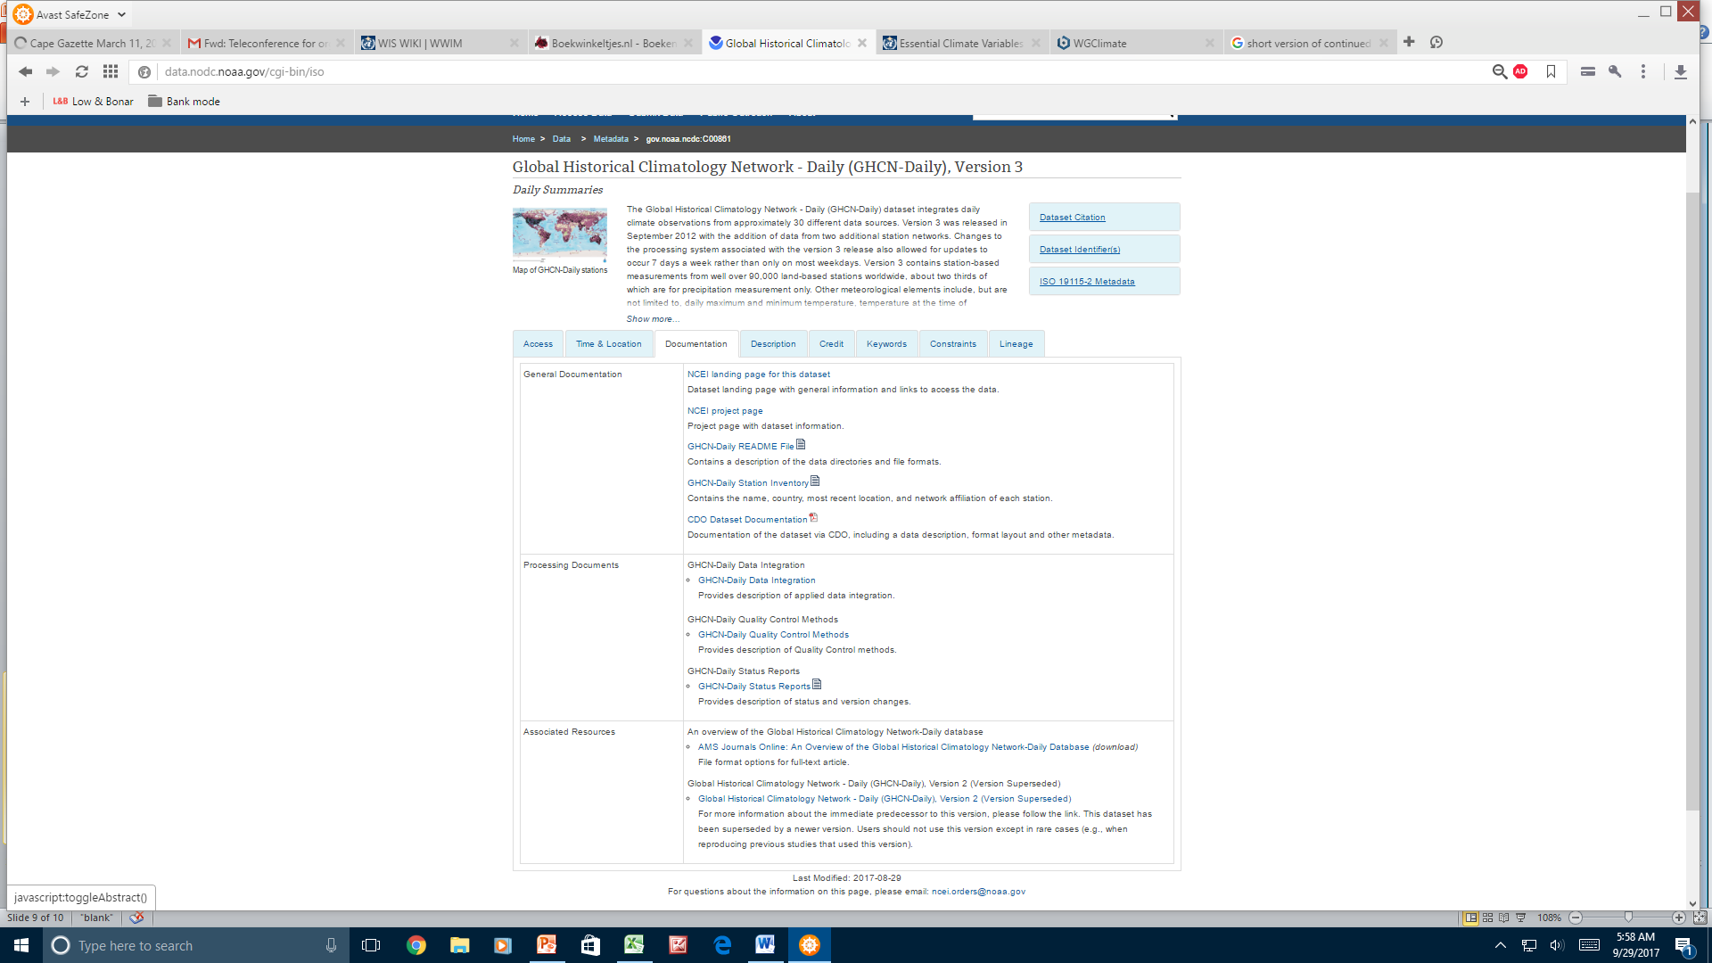
ECV Data Access and Information Matrix –
Individual Dataset Page (Cont’d)

Slide 11
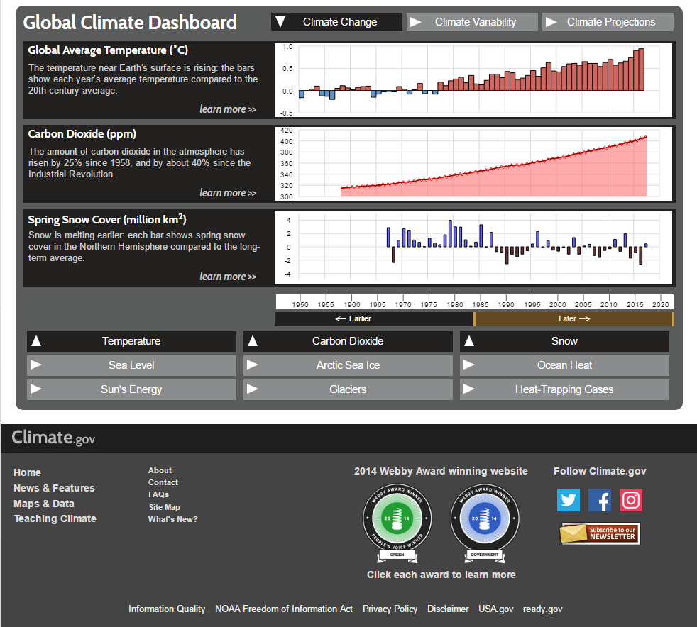
Products based on ECV data accessible on the NOAA Climate Portal Dashboard https://Climate.gov

Slide 12
List of Requirement for Information Management
Users want to efficiently discover and access trusted data sets. How can this be accomplished? What we have done so far at NCEI while consolidating 4 Data Centers:
Archival of data using Submission Agreements (users follow an end-to-end process SOP)
Standardized data documentation (metadata). NCEI uses the ISO 19115-2 standard and standardized key words from the NASA Global Change Master Directory (GCMD) as well as standard data access formats. Display of metadata on standardized landing page template.
Assigned Subject Matter Experts (SME) to be in charge of their data sets and documentation generation and maintenance. NCEI had a paradigm shift in 2014 and trained SMEs to be in charge of their own data documentation. This was accomplished by providing easy to use text based tools to generate standardized metadata records (one such tool NCEI uses is ATRAC: https://www.ncdc.noaa.gov/atrac/index.html)
Mint DOIs when appropriate
Make data available through general data search and specialized data access tools such as matrices or clearinghouses. Users want to be able to go to one location as well as find a data collection such as the ECVs. We might need to clarify that there are separate data access utilities for in situ and remote sensed ECVs.
Data Centers are dealing with finding ways to facilitate data access for their users. As we are consolidating centers within the US Federal Government and moving towards a single entry point such as https://data.gov . Challenges remain with helping users better discover the data and/or product they are interested in.

Slide 13

Thank you
Merci
Christina.lief@noaa.gov

