Slide 1

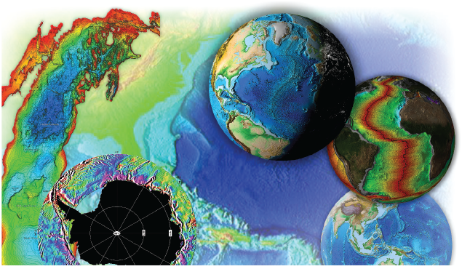
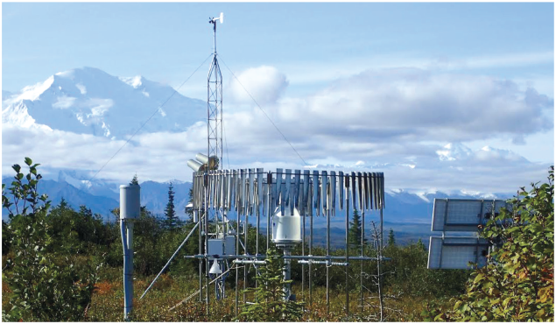

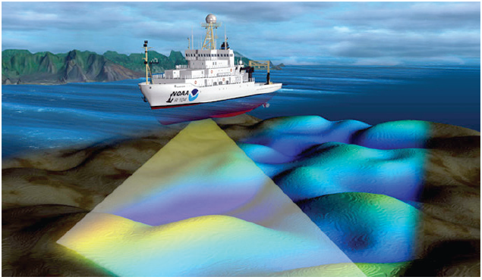

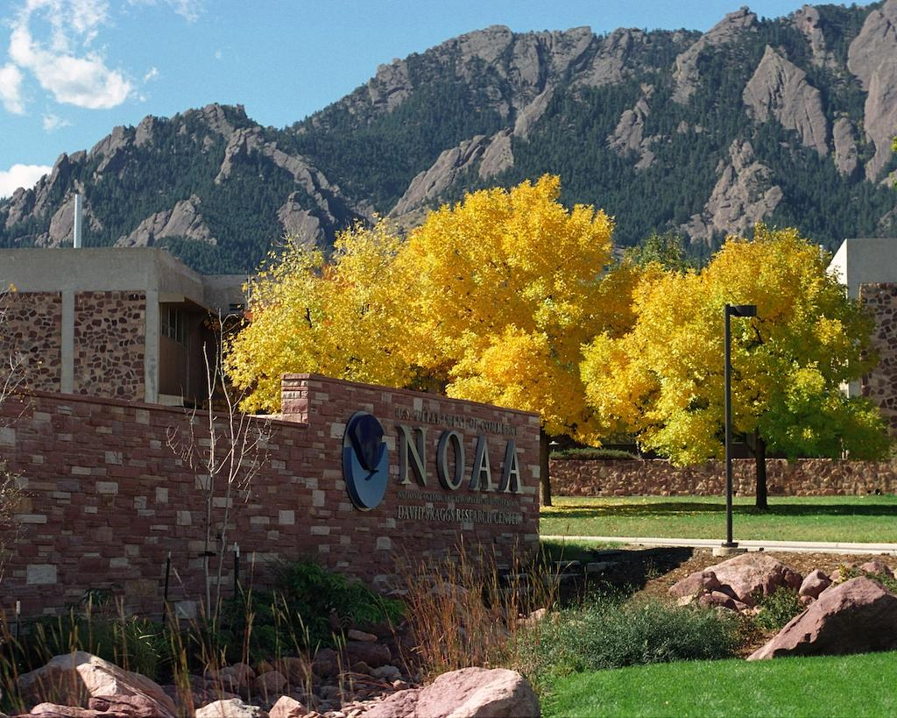


DATA MANAGEMENT AT NOAA’s NATIONAL CENTERS FOR ENVIRONMENTAL INFORMATION (NCEI)
Jay Lawrimore
Chief, Dataset Section
NCEI Center for Weather and Climate
NOAA Satellite and Information Service | National Centers for Environmental Information

Slide 2

National Centers for Environmental Information
Responsible for hosting and providing access to one of the most significant archives on Earth, with comprehensive oceanic, atmospheric, and geophysical data
A consolidation of NOAA’s National Climatic Data Center, National Oceanographic Data Center, National Geophysical Data Center in 2015
From the depths of the ocean to the surface of the sun and from million-year-old sediment records to near real-time satellite images

Slide 3
Presentation Outline
Overview of Tiers of Data Stewardship
  Six Tiers from Long-term Preservation and Basic Access to development of Authoritative Records that support National Services and International Leadership
Data Management issues affecting higher Tier data sets
  Building and Maintaining Historical Data Holdings
  Maintaining Datasets through Operational Ingest
  Maintaining Datasets through Other Means
  Building a Dataset from Multiple Sources
  Quality Control
  Metadata
  Data and Product Access

Slide 4
Data Management at NCEI
Data Management at NCEI can be understood through Six Tiers (Levels) of Stewardship
At the most basic tier, NCEI provides fundamental archive and access to climatological observations collected from across the US and world
At higher tiers, scientific expertise is used to apply quality control, bias corrections, documentation, and expert analysis to provide authoritative Data Records and highly specialized types of data services and assessments

Slide 5
Tiers of Stewardship
National Services and International Leadership
6
5
Authoritative Records
4
Derived Products
3
Scientific Improvements
Enhanced Access and Basic Quality Assurance
2
Long Term preservation and Basic Access
1
Long-Term preservation and Basic Access

Slide 6
1. Long-Term Preservation and Basic Access
Preserve data with metadata adequate for basic discovery and DOI Minting
Provide basic access to the original data and ensure the safeguarding of the dataset over its entire life cycle
Serve as expert advisors on data formats, conventions, metadata creation, and standards for data providers
Examples
  Comprehensive Large Array-data Stewardship System (CLASS) Satellite Archive
  Meteorological Assimilation Data Ingest System (MADIS)

Slide 7
2. Enhanced Access and Basic Quality Assurance
Provide enhanced data access through specialized software services for users and applications
Support users ability to conduct quality assurance, subsetting, and statistics collection
Examples:
  National Operational Model Archive and Distribution System (NOMADS)
  THREDDS Data Servers
  Climate Data Online (CDO)

Slide 8
NOMADS
NOAA’s Operational Model Archive and Distribution System (NOMADS)
A repository of weather model output datasets, model input datasets (assimilation), and a subset of climate model datasets generated by NOAA
  Reanalysis, Numerical Weather Prediction, Ocean Models, and Climate Prediction, Derived/Other Model data
Several tools are available to download and visualize these data
  NOAA Weather and Climate Toolkit (https://www.ncdc.noaa.gov/wct/ )
  Other freely available software such as Ncview, GrADS, NCAR Command Language
  See https://www.ncdc.noaa.gov/nomads/tools-services

Slide 9
3. Scientific Improvements
Improve data quality or accuracy with scientific quality assessments, controls, warning flags, and corrections
Reprocess datasets to new, improved versions or formats and distribute to users
Examples
  Global Temperature and Salinity Profile Program (GTSPP)
  NEXRAD Multi-Radar/Multi-Sensor Reprocessing (2002-2011)
  Processed 1-minute DART and tide data for tsunami research

Slide 10
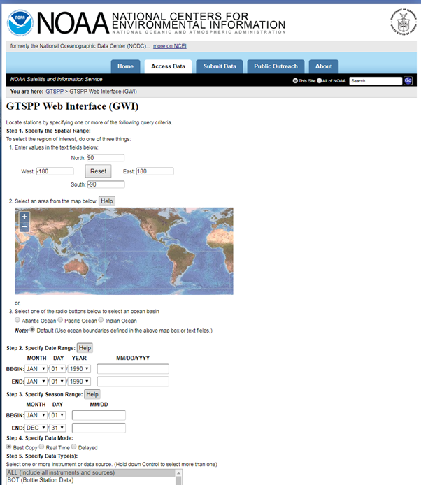
Global Temperature & Salinity Profile Program
GTSPP is recognized by GCOS as one of the international operational activities that provide sub-surface climate variables of temp & salinity profile data
Timely and complete data with documented quality flags using internationally agreed quality control & overall management of ocean data
The GTSPP Web Interface (GWI) provides access and retrieval of GTSPP data https://www.nodc.noaa.gov/GTSPP/gwi.html

Slide 11
4. Derived Products
Build upon archived data to create new products that are more broadly useful
Distill, combine, or analyze products and data sources to create new or blended scientific data sets and products
Examples
  International Best Track Archive for Climate Stewardship (IBTrACS)
  Integrated Surface Dataset (ISD)
  International Comprehensive Ocean-Atmosphere Data Set (ICOADS)
  VIIRS & DMSP Nighttime Light and Fire Products

Slide 12
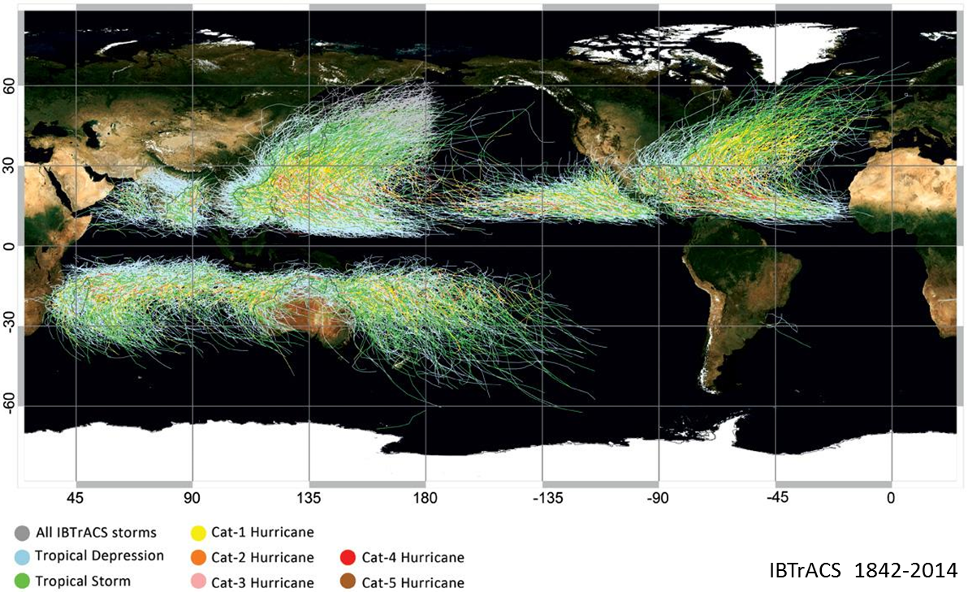
IBTrACS: International Best Track Archive for Climate Stewardship
Provides tropical cyclone best track data in a centralized location to aid the understanding of the distribution, frequency, and intensity of tropical cyclones worldwide
Overcomes data availability issues by working with all the Regional Specialized Meteorological Centers and other international centers
Merges storm information from multiple centers into one product, archives, and makes the data available for public use.

Slide 13
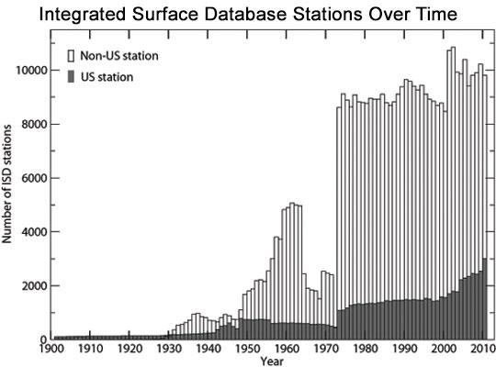
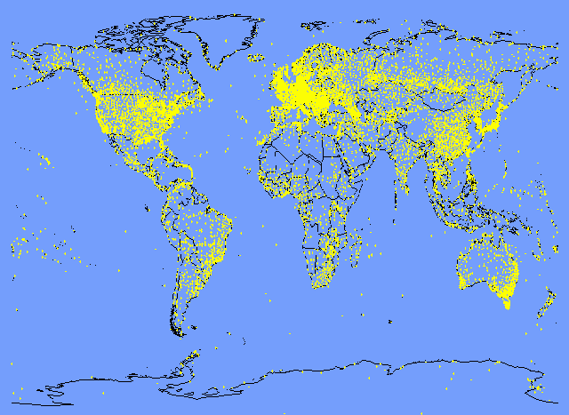
Integrated Surface Database (ISD)
Hourly and Synoptic observations consisting of an integration of more than 100 source datasets
  Includes Automated Surface Observing System (ASOS), Synoptic, Airways, METAR, Coastal Marine (CMAN), Buoy, and various others, from both military and civilian stations and including both automated and manual observations
More than 35,000 stations worldwide from 1901 to present
  <100 stations in early years, > 14,000 stations currently active
Updated each day
  Collaboration with U.S. Air Force for global data acquisition

Slide 14
5. Authoritative Records
Combine multiple sources into a single, inter-calibrated data product
Authoritatively establish the quality and provenance for a data product
Ensure the product is fully documented, reproducible, and its production methods are transparent by preserving the data, metadata, algorithms, and workflows used in creating the product
Examples
  Global Historical Climatology Network (GHCN)
  International Satellite Cloud Climatology Project (ISCCP)
  Other Climate Data Records (CDRs)

Slide 15
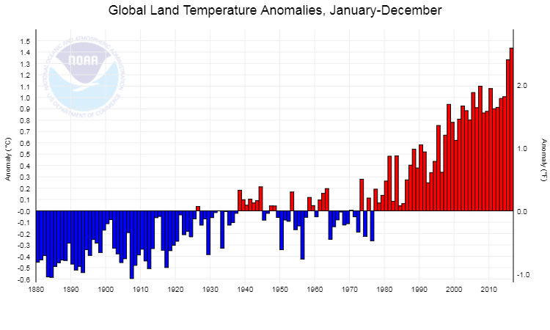
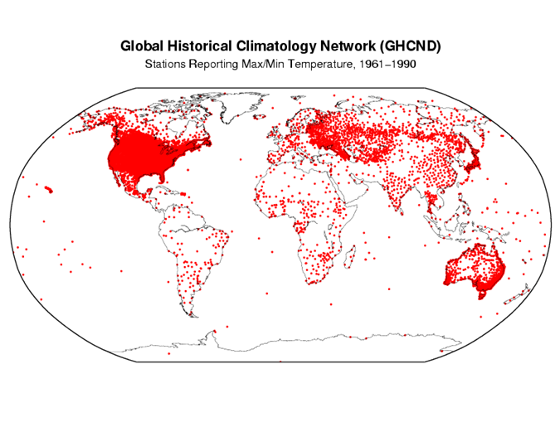
Global Historical Climatology Network (GHCN)
GHCN-Monthly
  Land surface air monthly mean temperatures and precipitation
  Mean temperature bias corrections to remove inhomogeneities associated with non-climatic factors
  Version 4 mean temperature in beta release
    Built from GHCN-Daily and International Surface Temperature Initiative (ISTI) sources
    >25,000 stations
GHCN-Daily
  Most used dataset at NCEI
  Global Summary of the Day observations
    >30,000 temperature stations
    >100,000 precipitation stations
    >40,000 stations with snow observations
  More than 2 billion observations
    Earliest value from January 1, 1763
    Latest value from yesterday

Slide 16
6. National Services and International Leadership
Lead, coordinate, or implement scientific stewardship activities for a community or across disciplines
Provide highly specialized levels of data services and product assessments based on information products and scientific knowledge
Examples
  Climate Monitoring/State of the Climate
  National Climate Assessment (NCA)
  Intergovernmental Panel on Climate Change (IPCC)
  National Integrated Drought Information System (NIDIS)

Slide 17
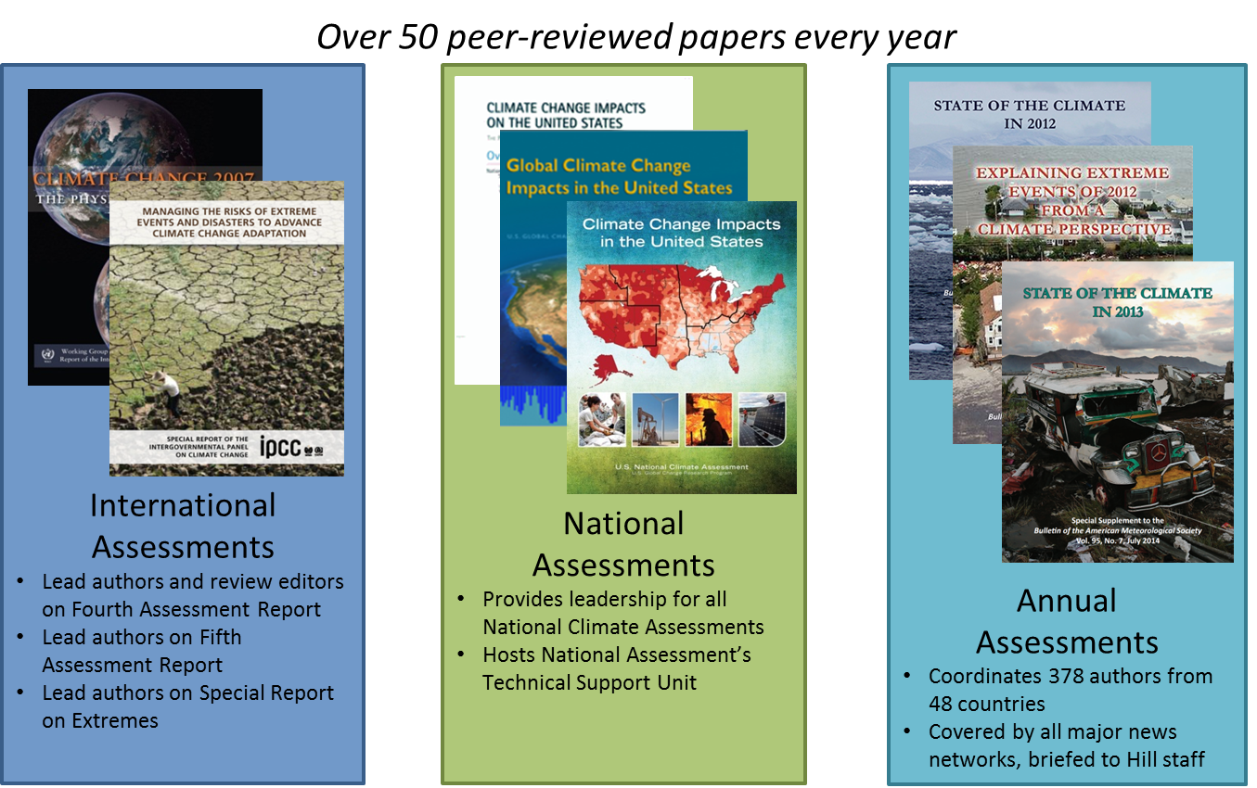
Assess the Earth’s Climate:
International, National, Annual Assessments

Slide 18
Data Management issues affecting
Higher Tier data sets
Building and Maintaining Historical Data Holdings
Maintaining Datasets through Operational Ingest
Maintaining Datasets through Other Means
Building a Dataset from Multiple Sources
Quality Control
Metadata
Data and Product Access

Slide 19
Building & Maintaining Historical Data Holdings
Datasets have been developed using a variety of sources acquired through various means
  Direct Agreements with other Meteorological and Data Centers that collect, archive, manage and distribute climate data
    e.g., Australian Bureau of Meteorology provided daily data for 17,000 stations
    Data Sharing Restrictions within some countries limit data access
  Related Projects (e.g., WMO normals, World Weather Records, Colonial Era Archives)
    World Weather Records (Decadal/Annual data collections)
      Excellent source of data during this decade AND data from the previous decades
      Greatest success in collecting data from countries is often in association with a WMO Request
      Time consuming processing of converting multiple and diverse formats.
  Personal Contacts
  International Workshops

Slide 20
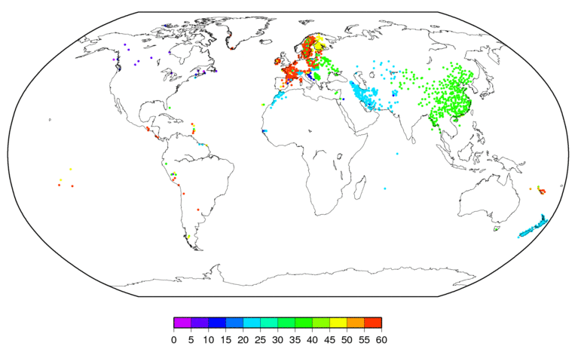
World Weather Records
Map shows number of months of data received from World Weather Record submissions for months since 2011 – for stations not provided via monthly CLIMAT reporting*
*1443 stations are shown. There are an additional 48 stations not shown.

Slide 21
Maintaining Datasets Through Operational Ingest
Ongoing updates to Datasets are accomplished largely through operational automated acquisition and ingest processes
GTS transmissions
  Monthly Means (via CLIMAT bulletins)
  Synoptic (observations every 3 or 6 hours, can include daily max and min temperature)
  METAR (hourly observations, typically from airports)
Web Services (Country-to-Country)
  Countries such as Canada have provided data daily via web services (now providing via ftp)
FTP
  Currently receiving updates to data from Australia on the 4th of each month
E-mail
  A small amount of data are still received via e-mail

Slide 22
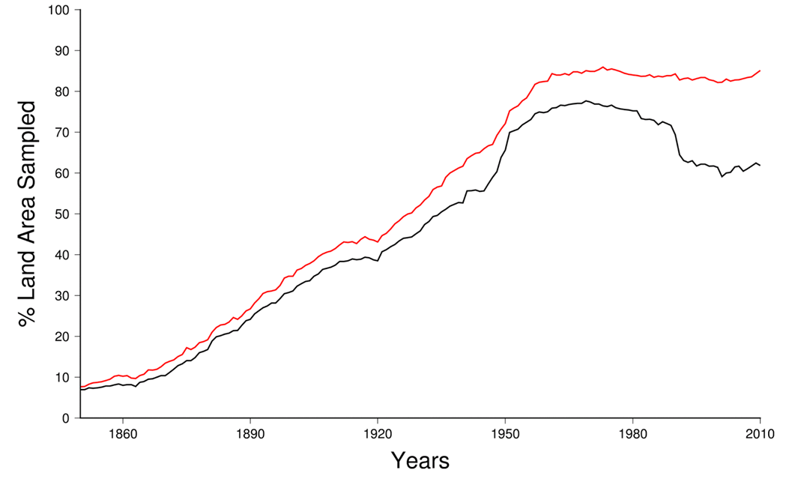
Maintaining Datasets Through Other Means
Operational Ingest and Acquisition alone provides only a portion of all data
Without continued attention to acquire and incorporate data from other sources, the number of stations in the datasets suffer decline
  Many stations do not report in near real-time
  Stations stop operating
  Addition of stations can require years of effort to locate, collect, process, and incorporate
GHCN-M v4: Additional source collected in part through ISTI provides greatly improved coverage
GHCN-M v3: Operational ingest alone resulted in drop-off in station coverage

Slide 23
Building a Dataset from Multiple Sources
Formatting
  Labor intensive efforts to convert from one of many formats
  Manual effort involved to decipher, align, remove extraneous lines, columns, and data
  Ensure inventory (metadata) contains stations in data file
Duplicates
  There are dozens of different ways to calculate monthly mean temperature
  Multiple sources are often similar but not exactly the same
  Often not possible to determine one definitive time series

Slide 24
Building a Dataset from Multiple Sources
Metadata inaccuracies complicate merging of station records
  Even if large percentages of data match, large distances between stations make station matching difficult
Other Complicating Factors
  ID changes that occur unrelated to station moves and stations that are members of multiple networks
Comparisons of overlapping observational data between sources often required to match stations
  Rarely exact data matches
  For example in ISD dataset; Temperature, Dew Point Temperature, and Wind Direction all used to verify station match if 70% of data are within pre-selected ranges

Slide 25
Quality Control
NCEI relies heavily on automated, objective and repeatable processes for quality control of monthly, daily, and sub-daily data
  As new algorithms are developed entire period of record can be re-quality controlled
Manual corrections are NOT made operationally but there is a mechanism for incorporating manual edits retrospectively
  NCEI uses a Web-based reporting mechanism (DATZILLA) so that external users can report possible data errors for investigation/correction
GCOS Monitoring Centers have proven very effective at identifying problems on the monthly timescale

Slide 26
Metadata
Accurate metadata is essential to proper data management
Metadata often consists of no more than station location and elevation
  Detailed station histories have yet to be fully exchanged internationally
  Much global metadata at NCEI is outdated
  Little to no information on observing instruments, practices, and surrounding areas
Additional metadata can be created from other sources
  Digital Elevation Models
  Night-Light data from Satellites to determine urban versus rural areas
  Google Maps

Slide 27
Data and Product Access
NCEI provides many ways to access data and products
Bulk download (ftp/https)
Web Service API (server to server downloads)
Web Search & Discovery Services (OneStop; https://www.ncdc.noaa.gov/onestop/#/ )
Web Order Fulfillment Services (Common Access)
  Custom subsetting
  Certified data orders
  Deep archive data orders (tape)
Enterprise Application Services
  THREDDS (Easy downloads of NetCDF data)
  ERDDAP (Download subsets in common formats and make graphs & maps)

Slide 28
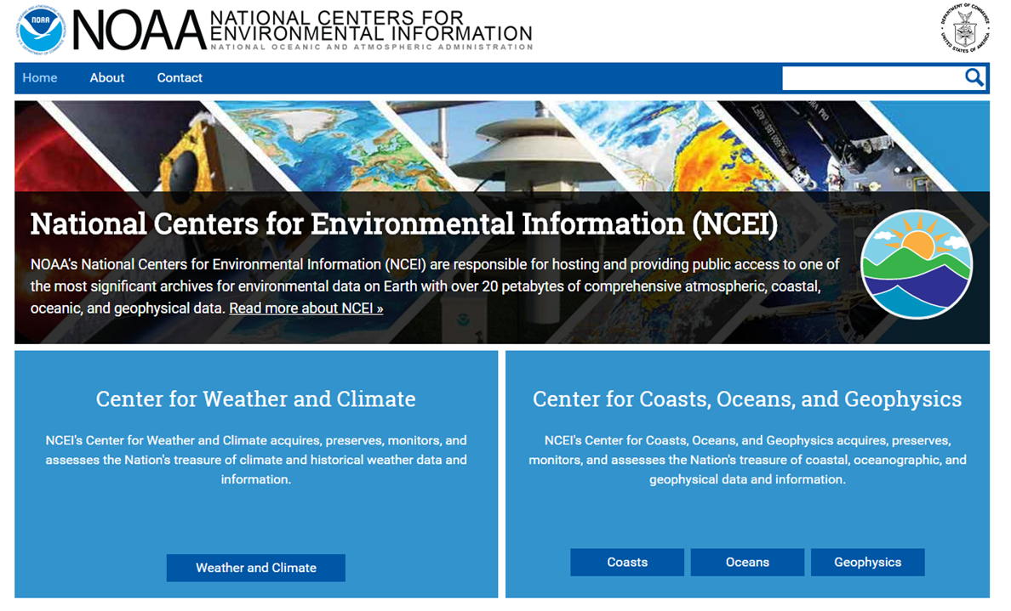
Thank You!
Jay Lawrimore
Jay.Lawrimore@noaa.gov
Chief, Dataset Section
Center for Weather and Climate
NOAA's National Centers for Environmental Information (NCEI)
151 Patton Ave
Asheville, NC 28801
828-271-4750
fax: 828-271-4022
http://www.ncei.noaa.gov
Follow NCEI on Facebook and Twitter
@NOAANCEI

