Slide 1
A coordinated approach to climate data management: the CCl approach
William J Wright , Bureau of Meteorology, Australia
Agenda item 2.3

Slide 2
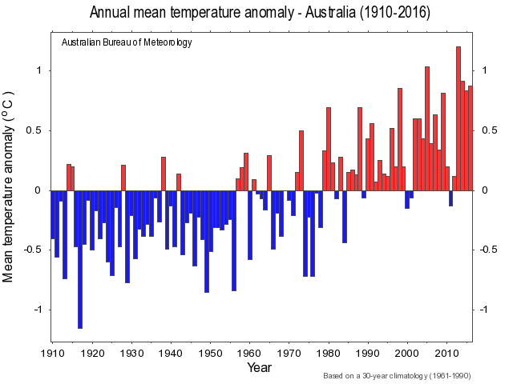
A need for high quality data
High quality climate datasets are required to:
- provide authoritative climate assessments;
- ensure the integrity of climate data;
- develop climate change knowledge and inform adaptation strategies, at global, regional and national levels;
- support climate modelling and climate change projections

Slide 3
Climate data special requirements
Climate datasets should be:
As long as possible, and accessible in digital forms;
As far as possible complete;
Properly quality controlled, with confidence assessments;
As far as possible free of spurious discontinuities and trends (requiring attention to observing practices);
Accompanied by adequate metadata and complete documentation of lineage.
Above needs make stringent attention to management of data and metadata important
Notes:
High quality climate datasets, suitable for the wide variety of climate services provided by NMHSs and the broader climate science community such as climate change monitoring and modelling, have a number of particular characteristics. These characteristics require greater rigour in the archival and management of the data compared with data sources used in other meteorological applications such as forecasting.
Climate datasets should be:
As long as possible, and accessible in digital forms (with requirements for data rescue, digitization, secure archival);
As far as possible complete (emphasizing the need for rigorous back-ups, processes for tracking missing data and escalating problems to the data providers, and data rescue);
Properly quality controlled, with confidence assessments (to flag and remove errors that affect the reliability of the data, to uncover systemic errors in observing practices and software, and to provide users with an indication of the confidence that may be placed in the data);
As far as possible free of spurious discontinuities and trends (requiring attention to observing practices
Accompanied by adequate metadata and documentation of lineage (to enable judgment of fitness for purpose, and to enable inhomogeneities to be identified and corrected for, via homogenization)

Slide 4
The IPET-CDMP
(Inter-Program Expert Team- Climate Data Modernisation Program)
Set up by WMO in 2015 to facilitate sound data management guidance and processes in support of the GFCS
Climate data-focussed, but integrated with cross-domain initiatives within WMO
Co-chairs: W. Wright (Aus); Matteo dell'Acqua (Meteofrance)
Chief outcome: a High Quality Global Data Management Framework for Climate (HQ-GDMFC), including a Manual on Climate data Management

Slide 5
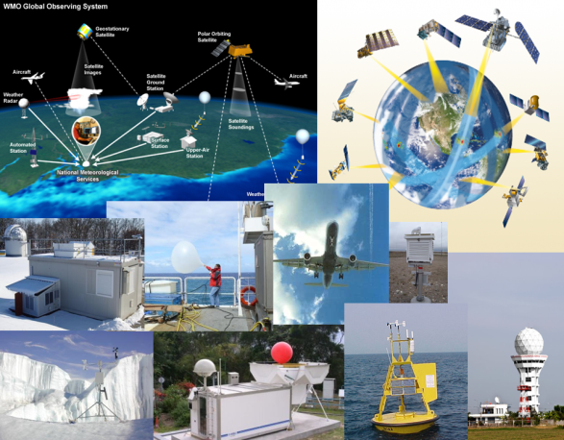
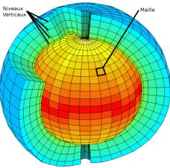
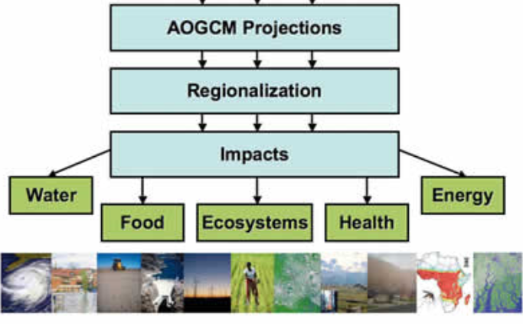
Why a HQ-GDMFC?
Much existing guidance on climate data management is out of date, due to rapid recent advances in technologies etc
Many countries' NMHSs report lack of capacity in (climate) data management
Lack of standardisation of terminology, processes, policies
Lack of a regulatory framework
Opportunity: make better use of proliferation of new data sources and advances in technology.
Notes:
The desired outcome is improved climate datasets. The HQ-GDMFC attempts to facilitate this by addressing a number of shortcomings in relation to the way climate data is managed.

Slide 6
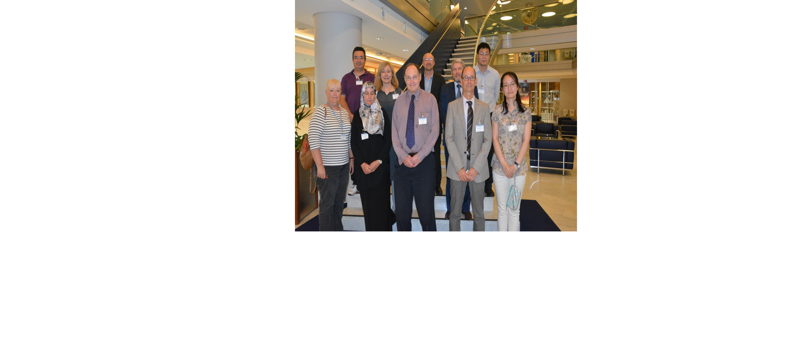
The IPET-CDMP team
Notes:
Here is the IPET-CDMP team, and I'd like to acknowledge their efforts in advancing the HQ-GDMFC

Slide 7
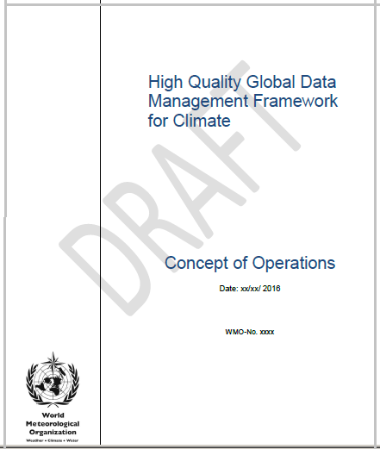
Approach
Cross-program IPET-CDMP formed- 1st meeting Aug 2015
Three meetings, teleconferences, assignments
CONOPS developed
Various guidance documents developed
Write-shop on Manual June 2017

Slide 8
MANUAL OUTLINE
The Manual aims to provide guidance, as well as technical regulations, to optimise and harmonise the way data are managed.
Scope of Manual
Guiding principles & general requirements
Definitions and concepts for climate data
Sources of data
Guidance on data management for climate
Collaborative infrastructure for information management
Information management governance
Capacity-building
Quality management

Slide 9
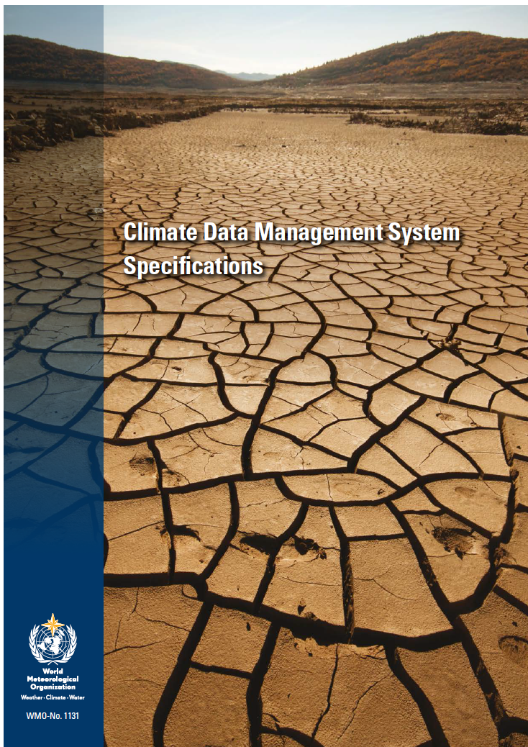
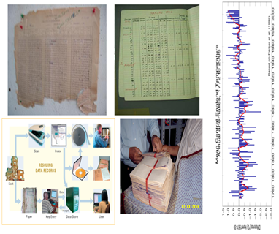
Guidance on data management
Recommended and proposed "required" practices (technical regulations)
Manual references existing and new guidance documents a.f.a.p.
Climate-specific topics:
- definitions and terms;
- data recue, preservation and digitisation;
- quality control;
- homogenisation;
- provenance metadata
Notes:
DP 3, 1st sub-point. This includes trying to establish a standardised defintion of, e.g, a climatological day

Slide 10
Infrastructure
Scope exists for collaborative arrangements for data management between different scales and different domains:
  - International Data Centres;
  - Regional Climate Centres (underutilised so far);
  - NMHSs;
  - WIS
Notes:
DP 1: In fact, this is one of the reasons we're all here, to start working out the details.

Slide 11
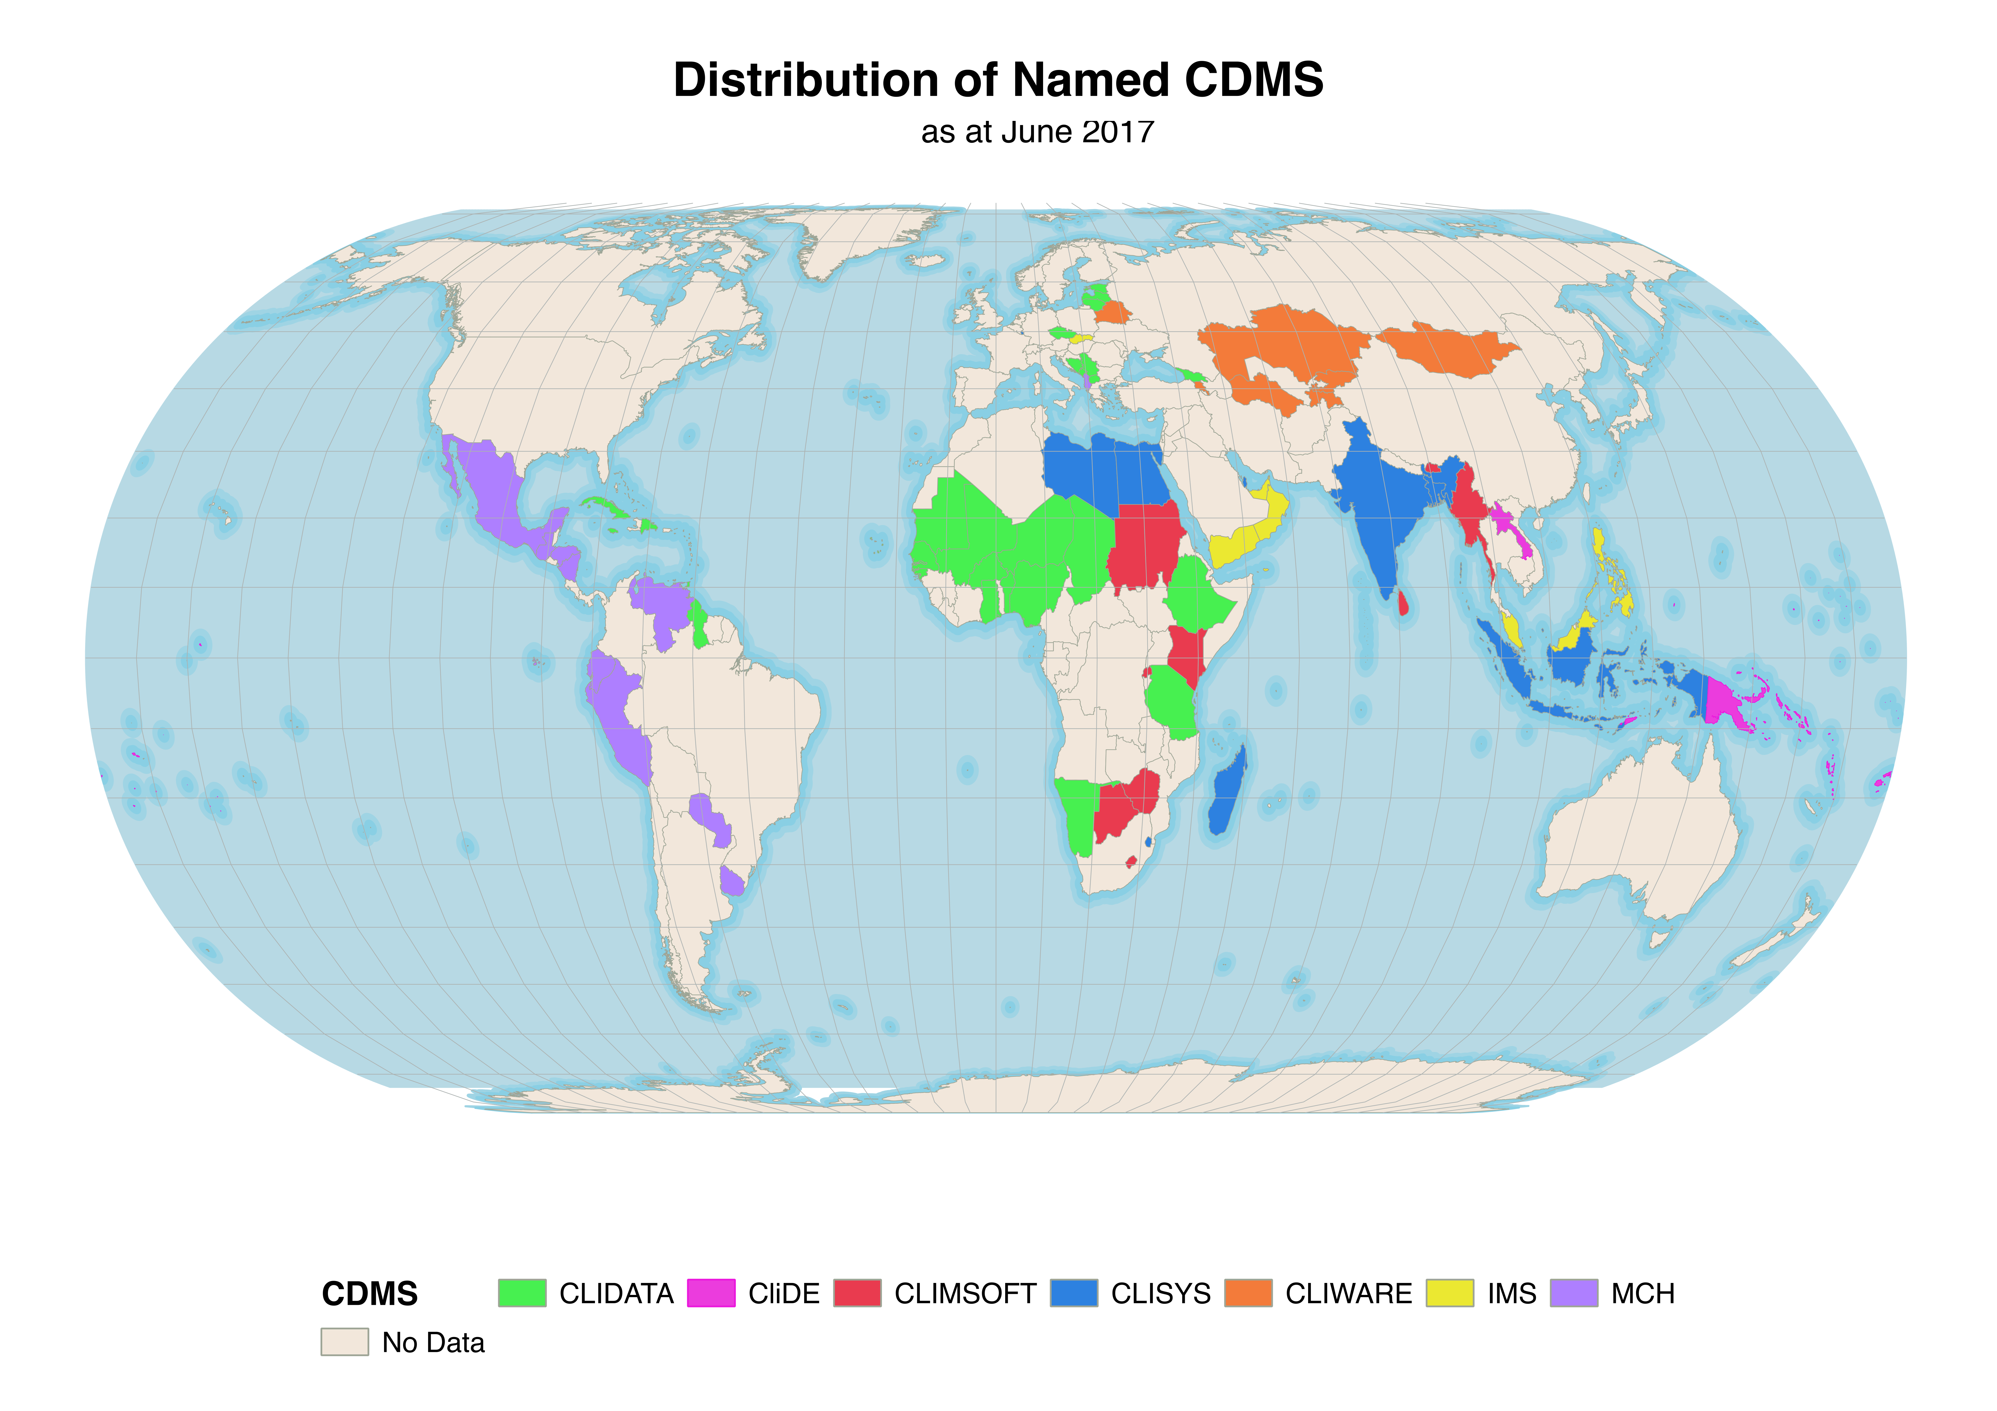
Capacity building in climate DM
Expressed need for training in climate data management
Manual covers:
  Responsibilities and core competencies
  Sources of guidance, advice and training for Members
  Guidelines on implementing climate data management projects in D & LD countries.

Slide 12
Quality management
An outline of practices to ensure climate data processes are "fit for purpose", including :
Managing changes to observing systems and processes
Proper process documentation
Authentication and publication of climate datasets
Proposed new standards
Notes:
DP 2 includes a description of required processes and accountabilities, and also documentation of algorithms, computer code etc so that there is full transparency in how the Climate Record was collected and processed.

Slide 13

Thank you
Merci

