Slide 1
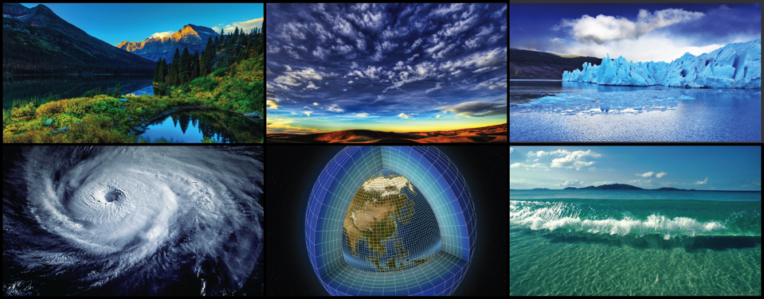

WORLD CLIMATE RESEARCH PROGRAMME
Requirements for managing information for climate research
Michel Rixen
WMO International Workshop on Information Management
CBS-CCl
2 October 2017
Geneva

Slide 2



WCRP’s mission….
... is to facilitate analysis and prediction of Earth system variability and change for use in an increasing range of practical applications of direct relevance, benefit and value to society.
The two overarching objectives of WCRP are:
to determine the predictability of climate
to determine the effect of human activities on climate

Slide 3
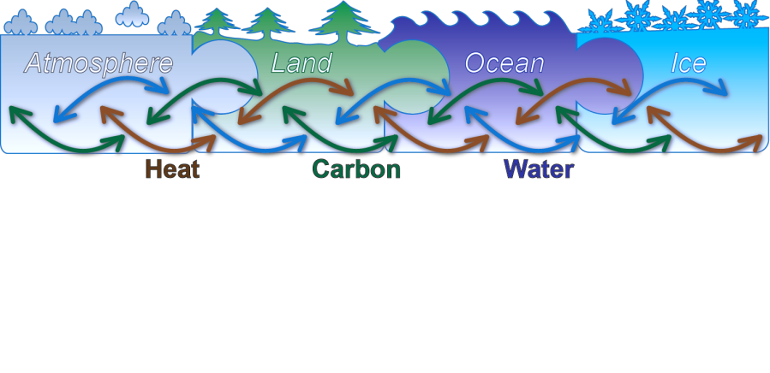
Scope of WCRP
Models
Observations
Reanalyses
Week
Season
Decade
Century

Slide 4





WCRP Structure
Joint Scientific Committee
Joint Planning Staff
Modeling Advisory Council
Data Advisory Council
Working Groups on: Numerical Experimentation (WGNE), Seasonal to Interannual Prediction (WGSIP), Coupled Modeling (WGCM), Regional Climate (WGRC)
CliC
CLIVAR
GEWEX
SPARC
CORDEX
Melting Ice & Global Consequences
Regional Seal Level & Coastal Impacts
Water for Food Baskets
Weather & Climate Extremes
Clouds, Circulation & Climate Sensitivity
Near-Term Prediction (Decadal)
Carbon & Climate

Slide 5

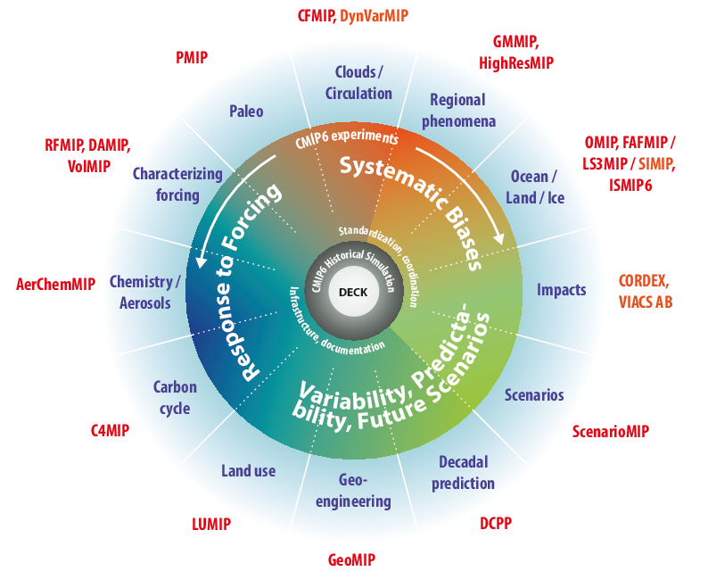
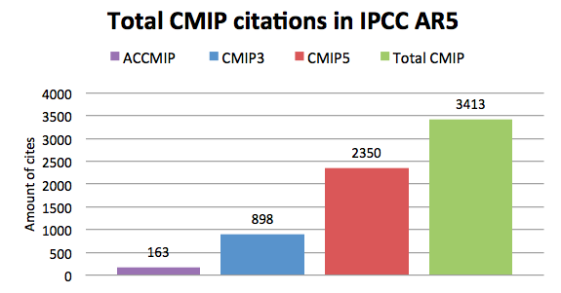
CMIP
Coupled Model Intercomparison Project
CMIP is a project of WCRP’s Working
Group on Coupled Modeling (WGCM)
CMIP has led to an improved understanding of past, present and future climate change and variability in a multi-model framework
CMIP defines common experiment protocols, forcings and output
21 CMIP6-Endorsed MIPs

Slide 6

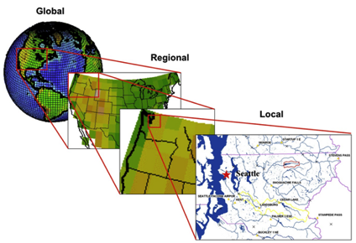
CORDEX
COordinated Regional climate Downscaling Experiment
Advancing the science and application of regional climate downscaling, for improved regional climate information
CORDEX scientific challenges:
Added value of downscaling, scales, bias and uncertainties, user-oriented metrics
Understanding and simulating human elements, e.g. land use, urban development, climate and coastal cities
Coordination of regional coupled modeling
Precipitation, e.g. convective systems, monsoon
Local wind systems

Slide 7
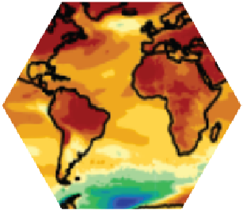
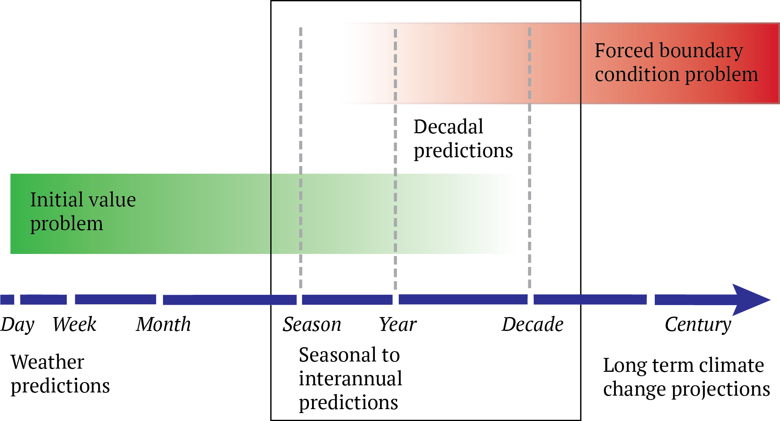
Seamless Climate Predictions
How can we enhance the understanding of sources of predictability?
How can we transition research outcomes into operations?
Pilot “Decadal Climate Outlook“
Contribution to GDPFS manuals
Contribution to IPCC SR 1.5 Deg
Explore contribution to Global Stocktake
“s2D Conference”, Sep ‘18, Boulder, with involvement of IPET-OPSLS

Slide 8
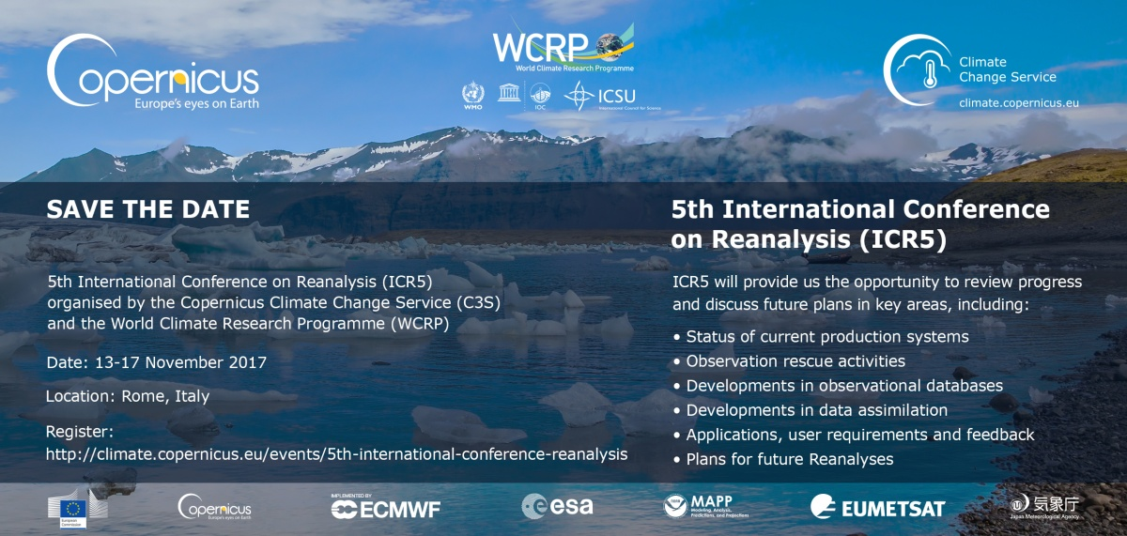
5th International Conference on Reanalysis

Slide 9
Evolving context
Research is pulled into a new and broader
“operational/service/policy” landscape
IPCC Assessment Reports
UNFCCC Global Stocktake
Global Framework for Climate Services
Sendai Framework for Disaster Risk Reduction
…

Slide 10
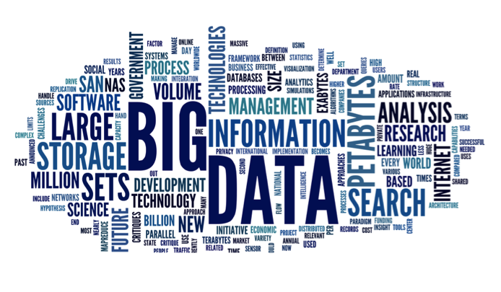
WCRP vision for a data infrastructure:
Earth System Grid Federation
Observations+ε
Simulations
+ε
Reanalyses
+ε

Slide 11
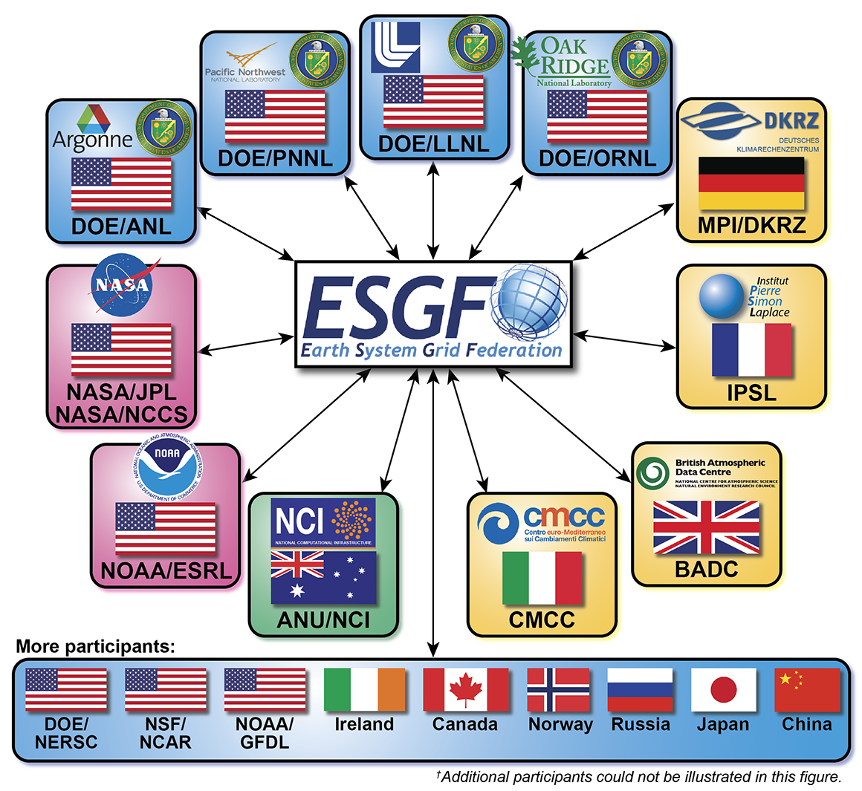
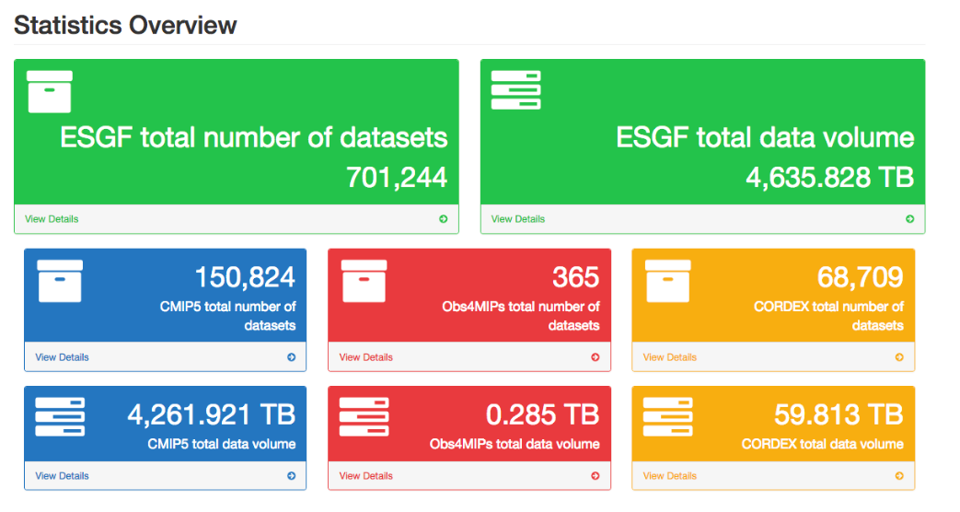
Data accessibility for WCRP projects
Earth System Grid Federation (ESGF) used for CMIP (and, increasingly, many observations/reanalysis/predictions and projections at global and regional scale)
obs4MIPs: Climate Data Records from major agencies (ESA, EUMETSAT, NASA, NOAA, etc)

Slide 12
Requirements
Big data
Distributed infrastructure
Open data policy
Metadata and documentation
Interoperability
Maturity index
Uncertainty / confidence level
Usage guidance
Accountability
Version tracking
Governance
Disclaimer
Research – operations co-design
User feedback
Funding
Innovation at all stages
Observations: sustained, calibrated against intl standards

Slide 13
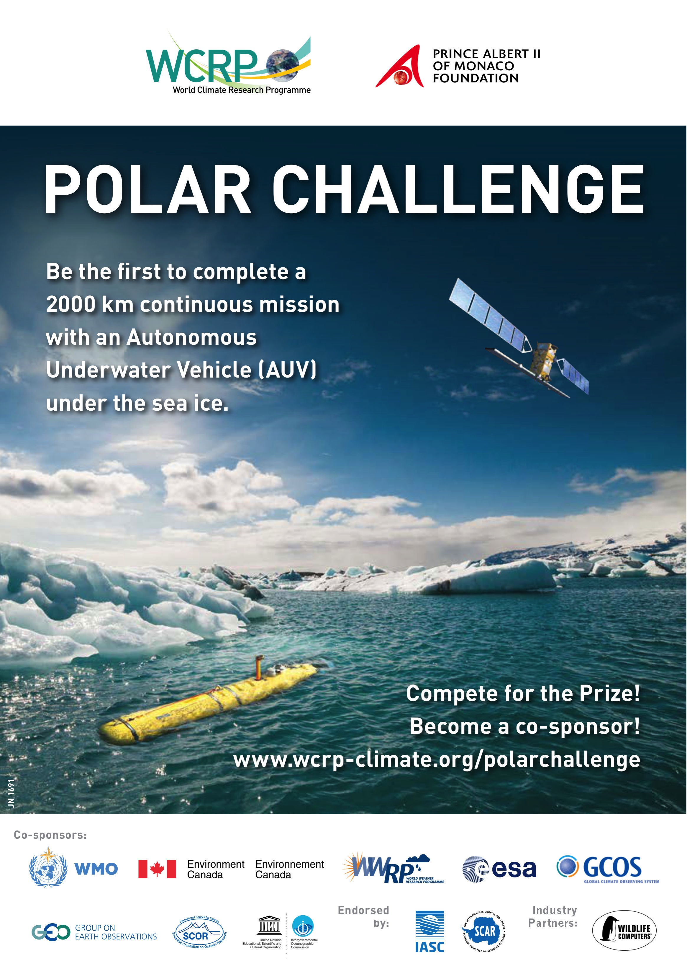
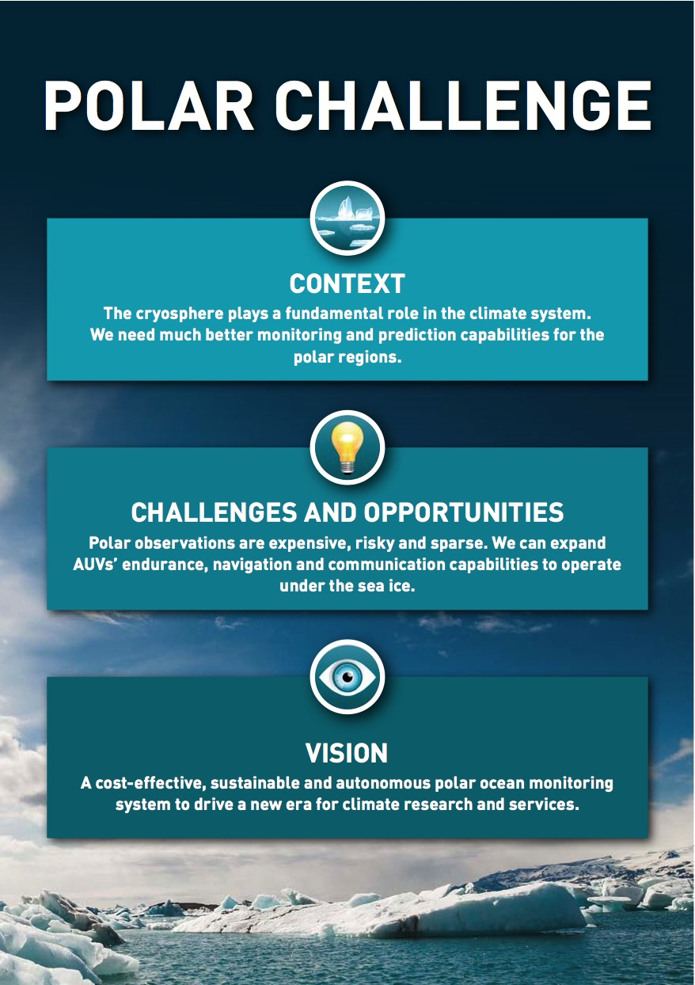
500K CHF

Slide 14

WORLD CLIMATE RESEARCH PROGRAMME
Thank you for your attention!

