Slide 1
Information Management
Michel Jean
CBS President

Slide 2
We live in a time of brilliant technologies and the rhythm of innovation is increasing at an unprecedented pace. We are flooded by earth observations, social media provides access to contextual information and unprecedented dissemination mechanisms and high performance computing platform allow us to tackle previously unsolvable problems. It is only a matter of time before the fusion of weather, big data technologies and business applications go mainstream and change the way people and businesses view weather and water data, and experience the force-multiplying effects it will have on improving life and weather sensitive business decisions. Not only is this forcing us to rethink our business models, our recruitment and training strategies and our partnership strategies at the national level, it will also have a fundamental impact on the global meteorological enterprise. If we do not have an information management strategy, we will fail…..

Slide 3
Why are we here?
What is information management?
Where do we go from here?

Slide 4

Why are we here?

Slide 5

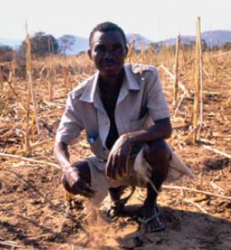
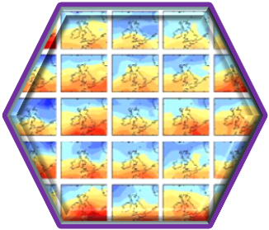

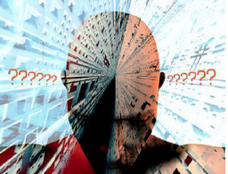
WMO depends on information
Notes:
WMO depends on information.
Whether it is weather forecasting, advising farmers on which crops to grow next season, or helping planners design flood defences that will last the next 50 years, all weather, water and climate services rely on information.
Advances in science, computing and our ability to observe the environment around us have made it possible to provide more reliable advice to decision makers than ever before. We can combine weather, water and climate information in new ways, and increasingly we need to draw on other types of information to improve our services.
With increasing volumes of information, and increasing dependencies on multiple sources of information, seventeenth World Meteorological Congress decided that Members of WMO would benefit from standards, guidance and tools to support them. Although there are examples of excellent practice, these are not universal. Congress therefore asked that the scope of the WMO Information System (WIS) be extended beyond mechanisms for exchanging information to include assistance for managing the information (“WIS Part C”) to help Members have access to information on which they can rely.
One of the key aims of this workshop is to identify standards, practices and tools that may form part of the WIS Information management component.
Although the WIS provides a catalogue of all the information that is being made available by Members, it does not contain recommendations of which dataset may be the most appropriate for what purpose. A second objective of the workshop is to make it easier for users to identify appropriate, or recommended, datasets for climate applications. This means that the workshop should identify which datasets should be suggested and should suggest methods of allowing them to be promoted to users.

Slide 6
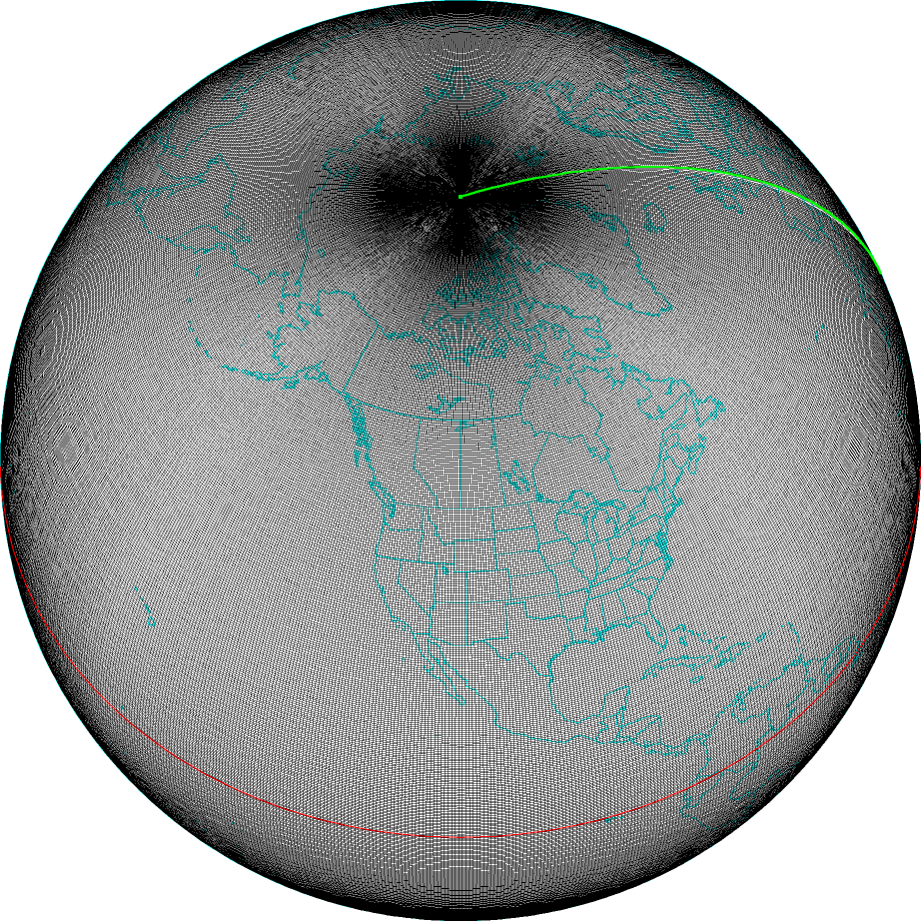
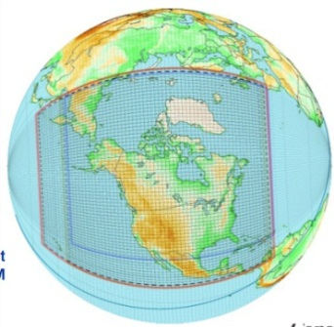
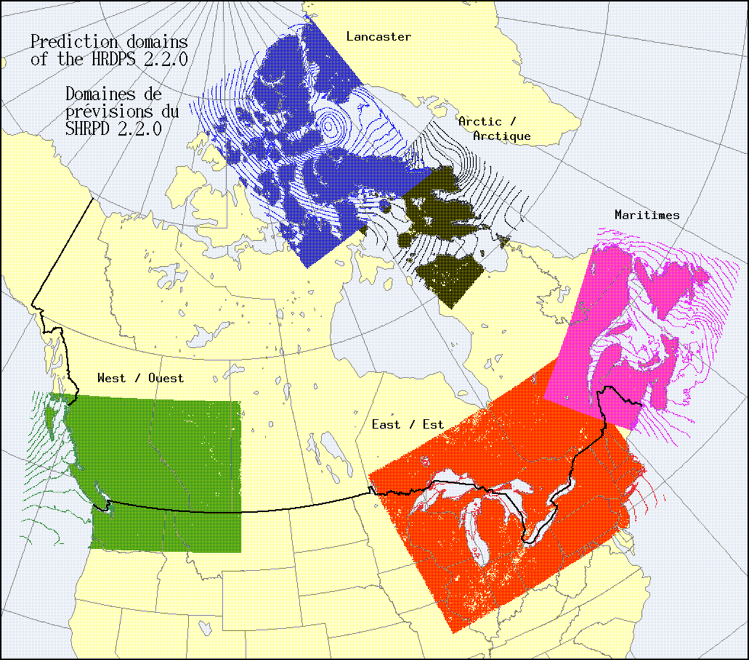
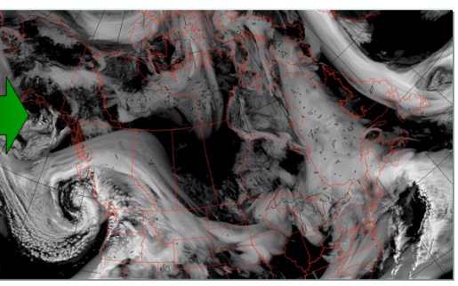
Our modelling strategy is evolving to seamless timescale
Monthly & Seasonnal
150 km
EnVar remplace 4DVar
Improved biais correction
Additional data
Global
Ensemble (EnKF)
66 km / 16 days
Global
deterministic
25 km / 10 days
50 km / 32 days
Improved data assimilation
Regional
Ensemble (EnKF)
15 km / 3 days
Grid spacing
Regional
deterministic
10 km / 48hr
Major step towards:
North American coverage
48 hrs / 4 times a day
High res.
2.5 km / 24hr
Forecast leadtime

Slide 7
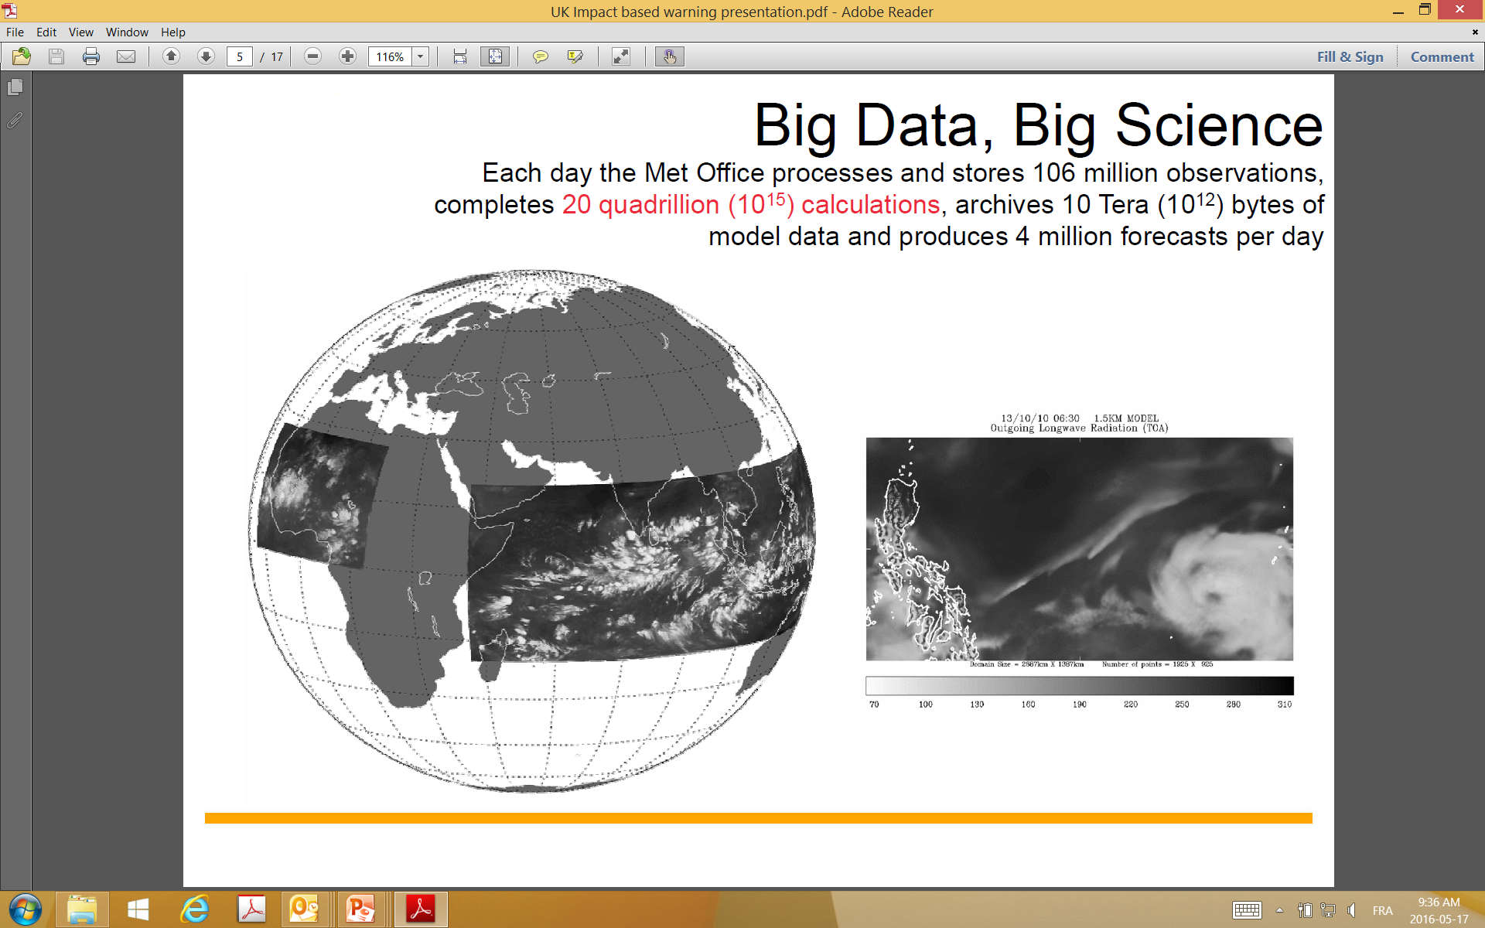
A quick example… UK Met Office

Slide 8
What is information management?

Slide 9

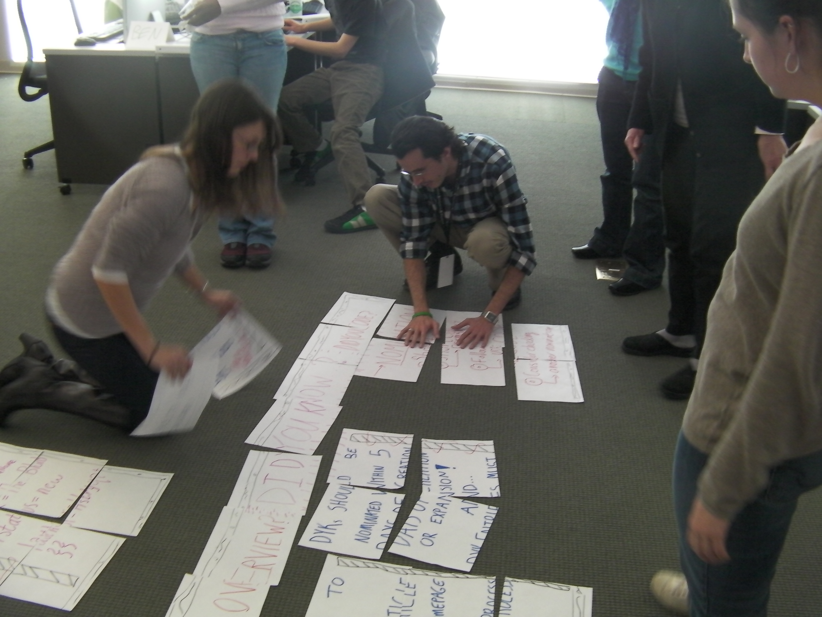

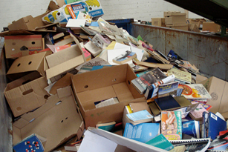
What is information?
Wisdom
Information
Data
Knowledge
By Maximilianklein (Own work) [GFDL (http://www.gnu.org/copyleft/fdl.html) or CC BY-SA 3.0 (https://creativecommons.org/licenses/by-sa/3.0)], via Wikimedia Commons
By allispossible.org.uk [CC BY 2.0 https://creativecommons.org/licenses/by/2.0/] via https://www.flickr.com/photos/wheatfields/3707196312/in/photostream
By ParentingPatch (Own work) [CC BY-SA 3.0 (https://creativecommons.org/licenses/by-sa/3.0)], via Wikimedia Commons
Notes:
The terms “information,” “product,” and “data” are often used interchangeably. When thinking about how to handle data or information, it can be useful to think of a hierarchy from “data” to “wisdom.”
During the first stage of its life, “data” is unstructured and difficult to use and handle like a pile of books. Adding structure and quality control (by labelling the books, discarding the ones with missing pages), allows more use to be made of “information”. Some form of processing can be applied to the information to create “knowledge” (such as analysing the contents of a shelf of history books to create a list of significant events). What we are really interested in is applying that knowledge to the real world to gain insights on which we can take action – attaining “wisdom”.
Of course, in the real world, one person’s “information” may be someone else’s “data”. Because of that, in this workshop we are likely to use the words “data” and “information” interchangeably. For the remainder of this presentation I will use the word “information.”

Slide 10
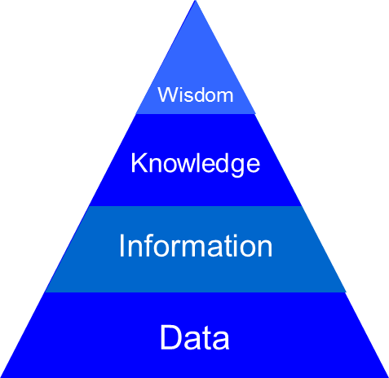
That sounds like our business!
Applied wisdom-advice → insight, environmental intelligence
Science, numerical models, reports, national accounts, assessments, policies
Analyses, forecasts, warnings, outlooks; climate record; discovery metadata
Environmental observations: land, oceans, water, atmosphere, space
Value
Ref. Robert Logan (2012)

Slide 11
Information life cycle
Information activities
Create
Store
Share
Use
Archive
Destroy
Notes:
Information Life Cycle
Up to now, WIS has been concerned with making it easier to share information. This is only a small (but important) part of the life cycle of information.
Create - even before information is gathered, the need for it must be understood. Knowing what that need is will set the requirement for how that information is collected and handled. Some transformations of the original information (such as initial quality control, calibration) may be done before the information moves on to the next stage of its life.
Store - information has to be stored before it can be shared (even if only for a short time).
Share – the information may be shared before it is used – this is normal practice for real time weather information.
Use – the information is used (and may have new information created from it – which then goes through an information life-cycle of its own).
Archive – archiving is an active process – although the information content should not be changed, it is usually necessary to move the information between media so that it continues to be accessible as technology changes or to avoid the impact of deterioration of the medium on which the information is stored.
Destroy – retaining information costs money, and some information has no value after time has passed. The requirement for the information that was identified before the information was created should be used to make a decision on when the information is no longer needed. Some information (such as climate-quality observations) may need to be retained permanently; if this is the case then appropriate measures should be put in place to prevent its accidental destruction.

Slide 12
What is information management?
Deciding what information is needed
Making sure the information is fit for purpose
Making sure people know about the information
Making sure the information is available to (only) those who need it
Making sure that the information content is preserved for as long as the information is needed

Slide 13
Where do we go from here?

Slide 14
This workshop will:
Identify the main needs of WMO Programmes for help in managing information
Identify existing standards, good practice and tools for information management
To inform the CBS Task Team on Information Management in their planning for “WIS Part C”
Identify key climate datasets to be recommended to users
Identify what needs to be in place to help users find the recommended datasets
To inform CCl of steps needed to help users choose the appropriate climate dataset

Slide 15
Summary
We will:
Start work on providing guidance on information management
Identify reference climate datasets and how to promote them

Slide 16

Thank you
Merci

