Slide 1
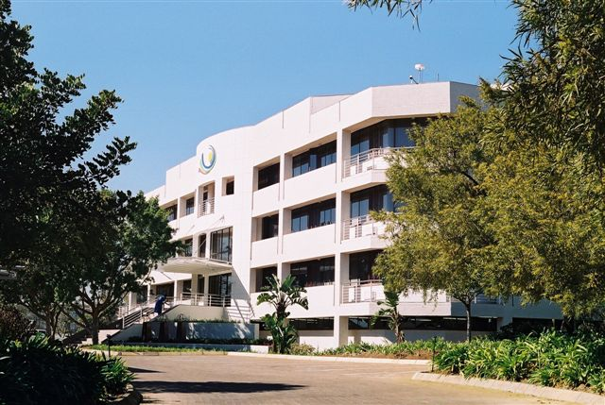
South African Weather Service
GISC Pretoria
Notes:
Bolepi House “Weather House”

Slide 2
Introduction
The first meteorological national service in South Africa (The Cape Meteorological Commission) was established on 26 October 1860 and was one of the first fully functioning national weather services in the world and has more than a 150 years of service excellence
The organization has developed over the years in terms of technological innovation; legislative developments; infrastructural advancement and international cooperation
In July 2001, the South African Weather Service (SAWS) became a public entity (SA Weather Service Act Number 8 of 2001) under the Ministry of Environmental Affairs

Slide 3
Introduction (continued)
The SAWS
is a 9001 certified Organization and recently upgraded to ISO 9001 v2008
is the authority for weather and climate forecasting in South Africa
complies with international meteorological standards, as a member of the World Meteorological Organisation (WMO)
is the Aviation Meteorological Authority in South Africa and is designated by the state to provide weather services to the aviation industry and to fulfil the international obligations of the government under the Convention of the International Civil Aviation Organisation (ICAO)
has a very strong relationship with the Aviation Association of South Africa and participates in regular industry meetings and serves on the Advisory Committee for Aeronautical Meteorological Services
provides Maritime Weather Forecasting services for the vast oceans around southern Africa up to Antarctica
strives to be a world-class meteorological organisation and, as such, provides the best possible service to the aviation industry in South Africa

Slide 4
Introduction (continued)
The SAWS in terms of carrying out its mandate include the development and implementation of various forecasting products aimed at enhancing decision-making and planning in key socioeconomic sectors, such as:
the South African Flash Flood Guidance System (SAFFG)
the South African Regional Flood Guidance System (SARFFG)
the Severe Weather Warning System (SWWS)
The SAWS has also continued to meet its international obligations in terms of aviation and marina services and the implementation of the SADC Regional Metrological Development Project

Slide 5
Core Services
Established as a Schedule 3A public entity on 15 June 2001 (Amended in 2013)
Two distinct Services: Public Good & Commercial
Public Good
Funded by Government Grant
Commercial Services
User-pays principle applies
Notes:
The South African Weather Service is an agency of the Department of Environmental Affairs and is governed by a board.
It provides two distinct services:
Public good services: (funded by government and delivered to the public free of charge) include general forecasts for the public, severe weather warnings and advisories, seasonal outlooks for farmers and the Department of Agriculture, and marine forecasts
Commercial services (where the user-pays principle applies) for tailor made products & services

Slide 6
Vision, Mission & Values
Vision
Values
Community conscious
Continuous learning
Collaboration
Safety Conscious
Simplicity
Scientific
A Weather-Smart
Nation
Mission
A weather and climate centre of excellence providing innovative solutions to ensure a weather-smart region, sustainable development and economic growth
Notes:
Vision -A Weather-Smart Nation: The vision has been reviewed to be simpler and to articulate clearly the desired end state
In this case, the organisation wants to achieve an end-state where citizens, communities and business sectors are weather resilient because they are able to use the information, products and services provided by the South African Weather Service optimally
Mission: A weather & climate….SAWS will realise this through:
Thought leadership in meteorological, climatological and other related sciences;
The development of relevant and innovative applications and products utilising cutting edge technology; and
Establishing and leveraging collaborative partnerships
Values
The South African Weather Service is guided by and committed to a set of internal values, set out in the values statement below:
COMMUNITY CONSCIOUS
A commitment to being mindful of the needs of SAWS stakeholders as well as, to be caring and compassionate towards the communities SAWS serves.
SAFETY CONSCIOUS
A consistent consciousness of the safety of SAWS employees as well as that of the communities SAWS serves.
SCIENTIFIC
A commitment to scientific excellence and innovation, always striving for knowledge leadership in our field of expertise.
SIMPLICITY
A commitment to providing weather and climate information and solutions that are simple to understand, relevant and easy to apply.
COLLABORATION
A willingness to work with, share with and gain knowledge from various stakeholders towards achieving a common goal, by making use of diverse strengths and abilities.
CONTINUOUS LEARNING
An openness to continually expanding our knowledge base and applying such in developing solutions to challenges.

Slide 7
Mandate
The SAWS is a section 3a entity governed by the South African Weather Service Act, (Act No. 8 of 2001 as amended), the public finance management act (PFMA) and associated treasury regulations.
  SAWS is mandated to:
Maintain, extend and improve the quality of meteorological and ambient air quality–related information services for the benefit of all South Africans
Provide public good services and commercial services to all South Africans
Ensure the ongoing collection of meteorological and ambient air quality data over South Africa and surrounding southern oceans for the use by current and future generations
Be the long-term custodian of a reliable national climatological and ambient air quality record
As the national meteorological service of the Republic of South Africa , to fulfil international obligations of the Government under the Convention of the World Meteorological Organization
As the Aviation Meteorological Authority , to fulfil the international obligations of the Government under the Convention of the International Civil Aviation Organization
Provide services that are sensitive to the demographic realities of the country
Fulfil such other weather-related or ambient air quality information international obligations as the Minister may direct ; and
Be the custodian of the SAAQIS (South African Air Quality Information System)

Slide 8

Organizational Structure
CHIEF EXECUTIVE OFFICER
OPERATIONS
HUMAN CAPITAL MANAGEMENT
CORPORATE AFFAIRS
SAWS BOARD
CHIEF FINANCIAL OFFICER
HUMAN CAPITAL SERVICES
I . C. T.
CORPORATE COMMUNICATIONS
STAKEHOLDER RELATIONS
FINANCE
REGIONAL OFFICES
RESEARCH
AVIATION
FORECASTING
CLIMATE SERVICE
HUMAN CAPITAL DEVELOPMENT
COMMERCIAL
TOTAL QUALITY MANAGEMENT
Internal Audit
Company Secretary
Projects Office
International Relations
Risk Management
MET Authority
OCCUPATIONAL HEALTH & SAFETY
SUPPLY CHAIN MANAGEMENT
LEGAL SERVICES
TECHNICAL SERVICES
REGIONAL TRAINING CENTRE
AIR QUALITY

Slide 9
SAWS stakeholders at a glance
Govt. departments
DEAT
Shareholder
BOARD
Utilities &
organisations
SAWS
Employees
Private companies /
businesses
Media
Strategic partners
& joint ventures
Customers & Users
Communities
Investors
Academic,
Training &
Research Inst.
WMO/ICAO &other
International bodies
Notes:
In support of its strategic goal of ensuring effective stakeholder, partner and key client relations, the SAWS has signed a number of MOUs with academic and science institutions, and with various other stakeholders. The organisation has also facilitated and participated in various round table meetings and workshops on climate change.

Slide 10
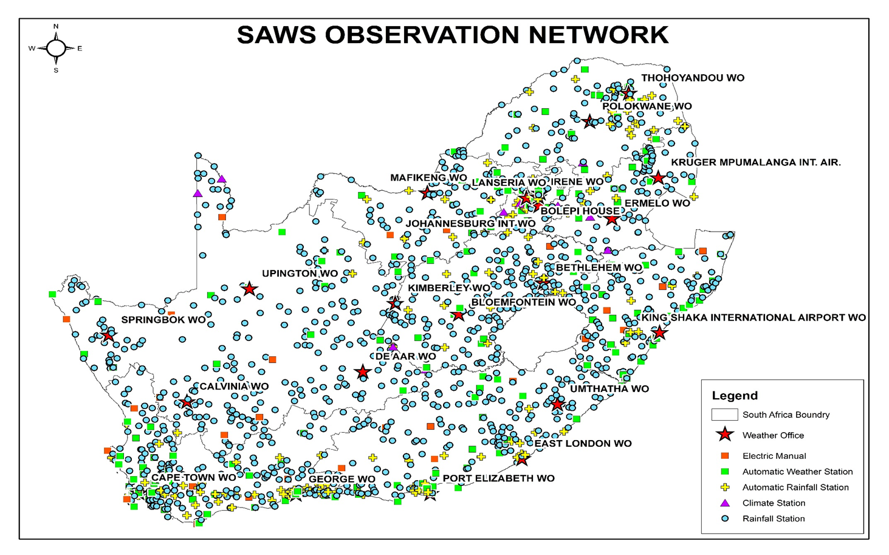
Observation Network
1 NFC
23 Weather Offices
3 Aircraft
1277 Rainfall Stations
2 Dobson Ozone Spectrophotometer Stations
(Irene & Springbok)
214 Automatic Weather Stations (AWS)
13 Air Quality Measuring and Monitoring Stations
141 Automatic Rainfall Stations (ARS)
10 Upper-Air Sounding Stations
50 Weather buoys
25 Climate Stations
24 Lightning Detection Network Sensors
14 Meteorological Radar Systems
(C-, S- and X-Band)
Notes:
SAWS is classified as an essential service and therefore requires the necessary access to national and global data 24 hours a day.
In order to support both these mandates SAWS deploys high-tech weather equipment throughout the country that provides real-time surface observations and remote sensing data. Of this equipment the radar systems and LDN are the most critical.
The data collected from this equipment is used to detect severe thunderstorms and to support national impacts such as disaster management (safety of life and property), aviation safety and our regional flash flood guidance systems.
This equipment is often located in remote areas and thus subject to poor power quality and frequent supply disruptions. The equipment concerned is sensitive to power fluctuations which results in costly damage to the hardware.

Slide 11
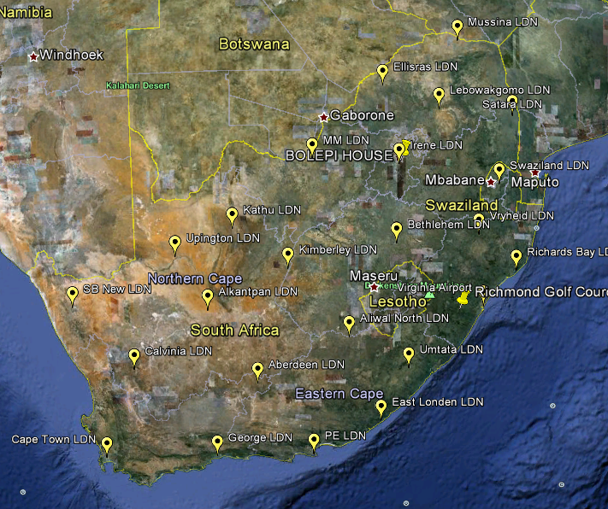
Lightning Detection Network
Notes:
24 LDN installed across the country

Slide 12
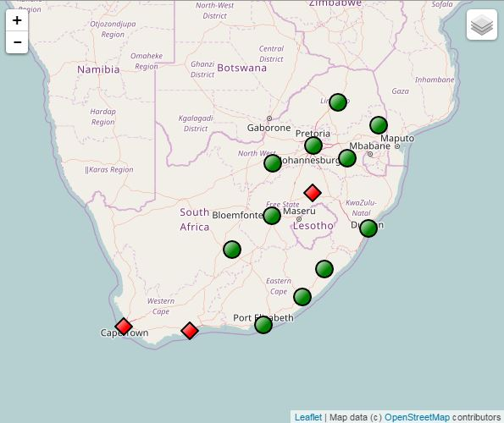
RADAR Network
Notes:
14 RADAR’s (C-, S- and X-band), one mobile radar

Slide 13
ICT related Infrastructure
Environment which consists of:
  Observational Systems and Networks
  Telecommunication Systems and Networks (connected to RMDCN)
  Internet, local and international connections
  Data Processing, Analysis and Forecasting Systems
  Data-base Management Systems and Archiving
  Product Generation and Information Dissemination Systems
  HPC – run various models
  Virtual environment – VMWARE & Hyper-V
  Backup & storage systems and devices
  Disaster recovery site & replication of servers
  Software solutions provided by vendors
  In-house developed software e.g. (METCAP, metGIS, etc.)

Slide 14
Products and Services
Products & Services
Public Good
Public General Forecasting
International Obligations
    WMO – RTH, RSMC, RTC, GISC
    Permanent representative
Safety Of Life At Sea (SOLAS)
Disaster Risk Reduction – Early Warning System
Research and Development – Reduce impact of weather related natural disasters
Custodian of Climate Data
Notes:
14

Slide 15
Products and Services (continued)
Products & Services (continued)
Commercial
Specific Products
    Lightning Detection Network – Utility Industries
    Specialized Climate Information
    Aviation Industry
    Specialist Service Consultancies – Legal
    – Insurance etc.
    Research and Development
    Manufacturing of Meteorological Equipment
Notes:
15

Slide 16
Forecasting Activities
In terms of the provisions of the Act, the SA Weather service has the mandate to be the sole authoritative voice regarding severe weather alerts (advisories, watches, warnings) in South Africa
        Broadly, Forecasting activities are stratified into:
        Aviation
        Marine
        General forecasting with special focus also on severe weather warnings

Slide 17
Weather Forecasts and Warnings
Observations
Numerical Weather Prediction
Global Climate Model
Coupled: GCM+ Ocean
Satellite
Radar
SAFFG
Synops
LDN
Upper Air
Regional (SADC)
Local (SA)
Mesoscale
Ensembles
MOS
Medium range (ECMWF)
Ensembles (NCEP)
MOS
Ensembles
MOS
Multi-model Ensembles
MOS
Ocean Models -GCM Ensembles
Tools
> 2 Years
30 Days– 2 Years
Forecast
11- 30 Days
4 -10 Days
Outlook:
Rainfall & temperature anomalies
Outlook:
Rainfall and temperature anomalies
Rainfall and Temperature Tendencies
Climate Change
24 -72 Hours
Advisories:
Potential hazardous weather events
Rain and temperature anomalies
6-24 Hours
Products
0 – 6 Hours
Watches & Warnings:
Severe weather
Daily weather elements
Reducing the vulnerability of society to climate-related hazards - air pollution, heat, floods, drought, lightning detection and diseases
Build necessary skills in the sector that enables better decisions - Operations & Scheduling, Routing Planning
and public users
Maximising the utilisation of existing weather and climate service infrastructure
Improving coordination, and strengthening and building infrastructure where needed – strategically positioning observation network
Benefits

Slide 18
Aviation Activities
Contribute towards aviation Safety, Efficiency and Regularity
Designated Meteorological office (MWO)
MWOs are designated by State to serve the FIRs
Functions of MWOs
  Maintain continuous watch over MET conditions which may affect the safety of flight operations within their area of responsibility
  Issue information on occurrence or expected occurrence of hazardous en-route weather conditions
  Prepare and disseminate SIGMET and AIRMET information to associated Air Traffic Service units, Flight Info Centres and Aviation Control Centres

Slide 19
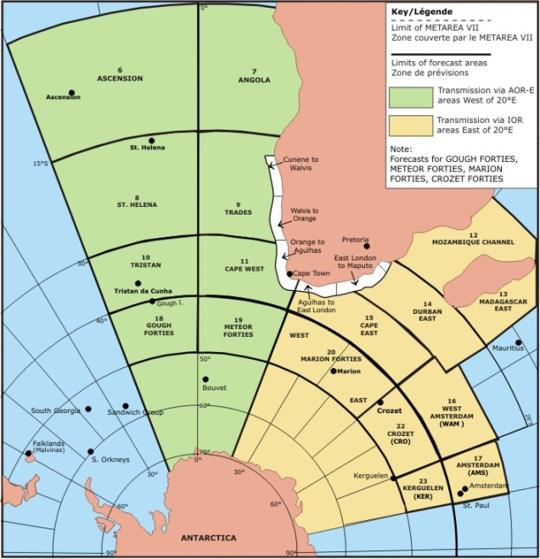
Marine Activities
SAWS is responsible for METAREAVII
Second largest areas to USA
Coastal and Deep Sea warnings, forecasts and services in accordance with WMO,IMO regulations

Slide 20

SOLAS Convention
Safety Of Life At Sea
South Africa is responsible for Metarea VII
We forecast and disseminate general weather conditions and alerts for this area
These alerts and forecasts area available to any vessel entering our region
Forecasts for the Antarctic region are done on special request
SAWS helps SAMSA or the NSRI when they require forecasts for search and rescue or salvation purposes

Slide 21
Climate Service Activities
Custodian of national climate data
Coordinate deployment of surface observation infrastructure
Provide an air quality information service
Research and analysis of historical climate data
Provide a Climate Information Service
Publish the near real-time products

Slide 22
Requirements for provision of data
Maintenance
Infrastructure (instrumentation and communication networks)
Data
Extraction of data according to requirements
Human resources
Specialist capability to interpret requirements
Specialist capability to advise on requirements
Climate database with on-going quality adjustments
Dissemination in various formats
Notes:
22
Original infrastructure funded by Government however SAWS has also expanded the observation network using its own resources/reserves. SAWS also has to maintain the infrastructure using its operational budget together with the operational costs quality controlling. Although SAWS is perceived to be selling raw data, more work required beyond instrument measurement to ensure quality. This is despite SAWS funding cut by R16 million in 2011/12. If SAWS were to deem climate data a free service then an additional grant would be required to covers: Additional staff costs with the extra work, operational costs for maintaining the observation network, funding for additional infrastructure required. The costs of ‘basic infrastructure’ which underpins the provision of meteorological services are short- to medium-term in nature, and have relatively high depreciation rates.
This means there is a continuing need to upgrade/improve this infrastructure to maintain it as state-of-the-art systems.

Slide 23
Research & Development Activities
Research priority areas
The SAWS is involved in research initiatives (several in collaboration with other academic and research institutes locally and internationally) to ensure that its services are improved and focuses on developing products for reducing risks and severe weather warnings on all time scales
Early warning service
Numerical weather prediction
Climate change
Air quality, atmospheric monitoring and research Science/social impact research
Technology development
Notes:
Early warning service: It conducts research and development (R&D) to enhance early warnings of weather hazards over all time scales.
Numerical weather prediction: In the light of the introduction of the new unified model for short-range forecasting, an ideal opportunity exists for the SAWS to ensure that cooperative research in the field of numerical weather prediction is focused on this particular model, its verification, improvement and the development of user-friendly products.
Climate change: The SAWS is interested in ways to downscale the possible effects of global climate change and to determine impacts on local scales. These impacts will be important to guide the SAWS on ways to evolve its services and the types of systems required to deliver these services.
Air quality, atmospheric monitoring and research: The sustained monitoring and research of atmospheric characteristics, trace gases, pollutants and aerosols that are critical to global climate change and air pollution monitoring are carried out by South Africa’s global atmosphere watch station at Cape Point.
Science/social impact research: The SAWS strives to align its products and services with user needs, ensuring that these needs are correctly interpreted when developing and packaging new services. It also aims to optimally include indigenous knowledge in its services.
Technology development: The SAWS aims to ensure that all technological developments with regard to instrumentation, new methods of observation, improved signal acquisitioning, data processing and interfacing to instrumentation are undertaken.

Slide 24
Human resources & Skills development
SAWS has a staff complement of 429
SAWS has long recognised the importance of investing in the development of human talent
The organisation’s aim is to broaden access to education for previously disadvantaged and academically competent learners, and to contribute to South Africa’s national goals by expanding the skills base
SAWS endows bursaries to learners in order to enable the organisation to meet its growing need for skilled personnel in various fields of speciality

Slide 25
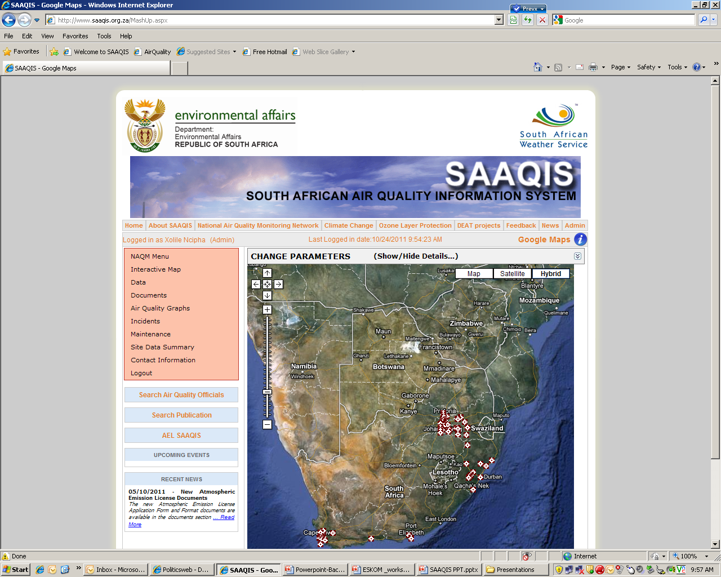
South African Air Quality Information System
(SAAQIS)
  Objectives
    Allow public access to air quality information
    Provide different stakeholders with different useful on-line applications
    Informed decision making
    Build capacity in air quality management
Notes:
SAAQIS, provides a common platform for managing air quality information in South Africa. It makes data available to stakeholders including the public and provides a mechanism to ensure uniformity in the way air quality data is managed i.e. captured, stored, validated, analysed and reported on in South Africa.

Slide 26
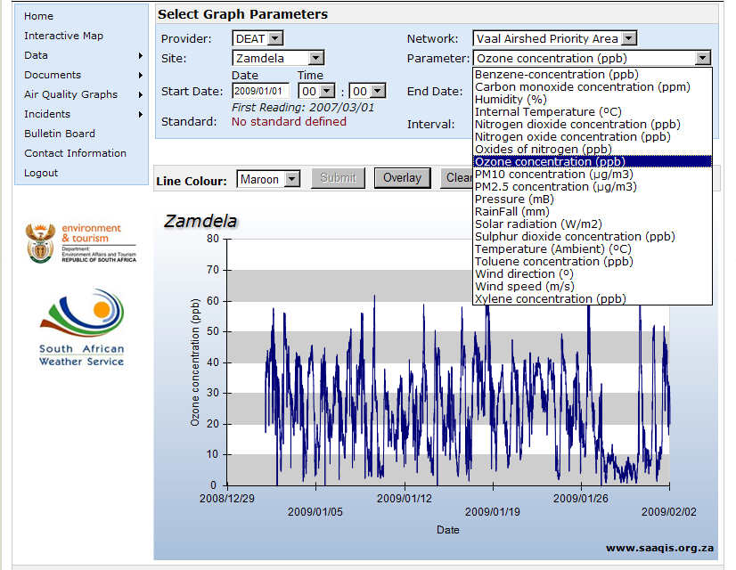
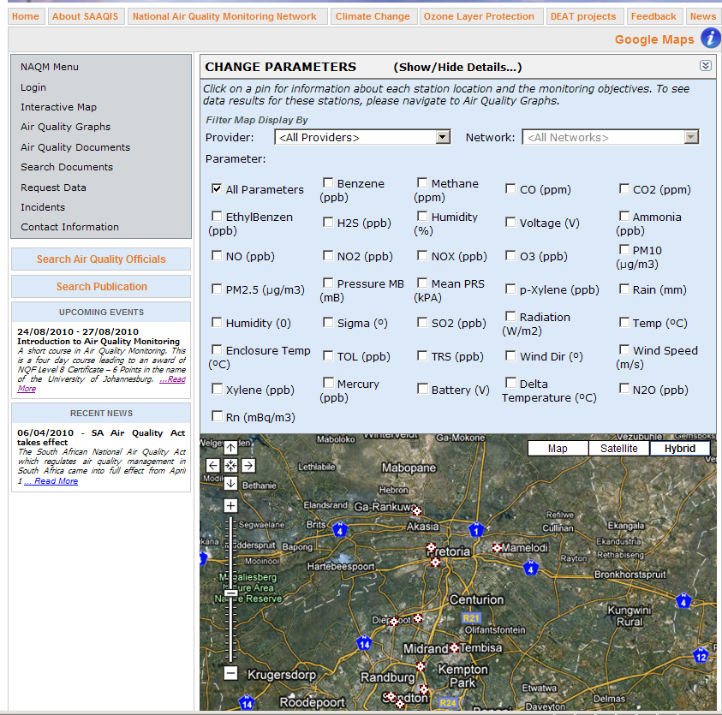
SAAQIS Website Applications
  Central Repository for Air Quality (AQ) Documents & Scientific Publications
  National AQ Data Storage
  Access to National AQ Officials Contact Details
  Mapping of AQ stations across SA
  Public Data Requests Utility (CSV files, 10 min, 1hr, 24hr, monthly and annual data resolution)
  Upcoming AQ Events and Recent News Reporting
http://www.saaqis.org.za
REFERENCE: SAWS-PPT-ESKOM-2011-006.1

Slide 27
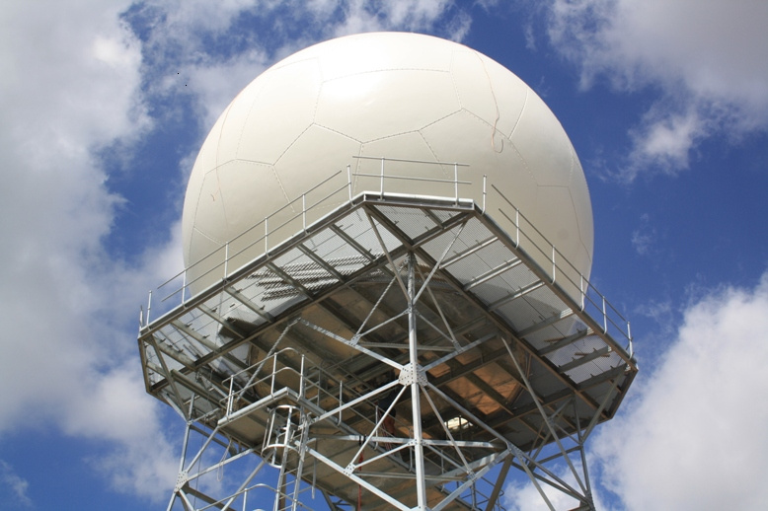
Technical Service Activities
Accountable for the support and maintenance of observation network….such as
RADAR
LDN
Responsible for manufacturing function of SAWS for
  AWS
  ARS

Slide 28
ICT Activities
accountable for the support and maintenance of all computer applications and systems, hardware and software
involved in the design and development of new products
the Regional Telecommunications Hub (RTH) focal point for World Meteorological Organisation (WMO)
provides and maintains the Message Switching System which is a part of the WMO Global Telecommunications System (GTS)
Department provides and maintains the Operational Meteorological (OPMET) Database and adheres to International Civil Aviation (ICAO) regulations.

Slide 29
Regional Training Centre (RTC)
RTC as a centre of excellence
The RTC is a region wide facility that has obtained CoE status in providing training and facilities for meteorologists from NMS’s within the SADC region and beyond
Activities also include:
Weather observer training & weather observation refresher training
Forecaster training, conducting an honours course in meteorology in collaboration with the University of Pretoria
A six-month bridging course in meteorology for general BSc learners who have not studied a BSc in Meteorology, as preparation for the honours degree in Meteorology
Training of weather observers based on Gough Island, Marion and Prince Edward Islands and at the South African National Antarctic Expedition base (SANAE IV) on Antarctica, and ad hoc training
Officials from the RTC are involved as task team members for the updating of the International Cloud Atlas and is leading one of the tasks

Slide 30
SAWS Recent Achievements
During 2015/16, SAWS advanced and expanded its service and product delivery to support adaptation to climate change – this was especially relevant seeing the impact of the recent El Niño episode
Significant enhancements were made to the SAWS long range forecasting models
A new group of researchers at SAWS was tasked with research in the areas of agro-and hydro-meteorology, energy and health
Continued development of a Lightning Threat Index in collaboration with the Department of Statistics at the University of Pretoria
Co-hosted the Lights on Lightning conference, which aimed to bring together researchers, students, government and various industries to engage on the multifaceted impact of lightning on socio-economic imperatives in various aspects of lightning research
Upgraded the SAWS observations network
Retained ISO certification in respect of our Total Quality Management System

Slide 31
SAWS Recent Achievements(continued)
SAWS produced new technological products during 2015 to support the practical management of climate and weather phenomena that have a direct impact on personal safety, public health and national food security. These include:
  The online rainfall management application HydroNet, which offers easy access to real-time monitoring and rainfall predictions as well as information about water availability
  The WeatherSmart app in collaboration with mobile technology provider AfriGIS. The app is a public good offering that gives users automatic access to weather related information for their current location, such as rain forecasting, temperatures and storm or other severe weather alerts
  We have also introduced a location-based USSD *120*7297# to access local weather information
  We developed the Keisan Discomfort Index which facilitates the monitoring of employee discomfort so that appropriate remedial measures can be implemented

Slide 32
WIS
GISC Pretoria

Slide 33
Overview
The core components of (WIS) WMO Information System comprises of the following:
  Global Information System Centres (GISCs)
  Data Collection or Production Centres (DCPCs)
  National Centres (NCs)
  Network connectivity

Slide 34
Overview continued
GISC function
Hold global metadata catalogue
Upload metadata for area of responsibility
Distribute (global exchange) data to other GISCs
Provide (global exchange) data to area of responsibility
Ad hoc and subscription data supply
Ensure area of responsibility has effective telecommunications

Slide 35
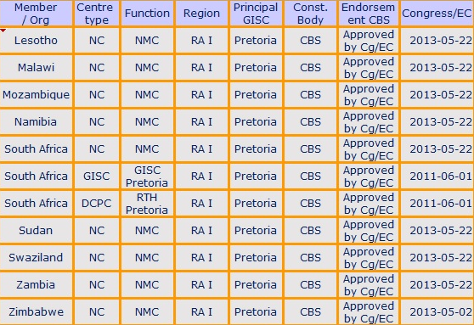
RA 1 WIS Centres connect through Pretoria
Notes:
Francis
We also serve Lesotho, Mozambique, Zimbabwe, Angola, Malawi. Madagascar made a request in April to be served by Pretoria.

Slide 36
Road map GISC Pretoria Implementation
Pretoria is a Regional Telecommunication Hub (RTH) for the Southern African region and surrounding ocean areas
Pretoria was under review as a GISC and DCPC by ET-GDDP since 2011-06-01
South Africa (Pretoria) was approved by CG/EC on the 22-05-2013 as the National Center (NC)
An Information Management System was acquired from IBL Software Engineering in second half of 2013
GISC Pretoria was audited in April 2014 and was found to be compliant with all requirements
GISC Pretoria was endorsed by EC in May 2014

Slide 37
Hardware Infrastructure
Discover Weather server
Virtual (Vmware), Intel(R) Xeon(R) CPU E5430 @ 2.66GHz (2 cores), 16GB RAM, 1TB HDD
Duplicated hardware at DR site (vmware) located at SAWS Johannesburg office
For redundancy, the GISC server is replicated daily to the DR site in Johannesburg

Slide 38
Software Installed
The operating system installed on the GISC server is Linux CentOS 6.2
The application software:
Discover Weather Administration Portal
Discover Weather Public Portal
Discover Weather helper applications
Moving Weather
Oracle Database Standard Edition

Slide 39
Network Infrastructure
SAWS is connected to MTN via ECMWF RMDCN line implemented in 2011 2Mbs and to be upgraded to 4Mbs in 2017
Linked to UKMET (GTS connection) on RMDCN since May 2012
National Internet bandwidth at Internet Solutions (ISP) of 6Mbs and SANREN 24Mbs for international use
National Internet connection of 1Gbs

Slide 40
Current Implementation
GISC Pretoria is currently connected to the Internet but not directly connected to the RMDCN
The automatic message switching system is directly connected to the RMDCN which exchanges data with Exeter (GTS) and also populates GISC Pretoria with data
Discovery metadata is automatically being synchronized via the Internet with Beijing and Offenbach.
Discovery metadata can be manually synchronized with the following GISCs:
Exeter
Melbourne
Tokyo
Toulouse

Slide 41
WIS portal functionality
Data discovery and retrieval
Registration of organizations and users
Product (metadata) management
Subscription for regular data dissemination
Metadata editing

Slide 42
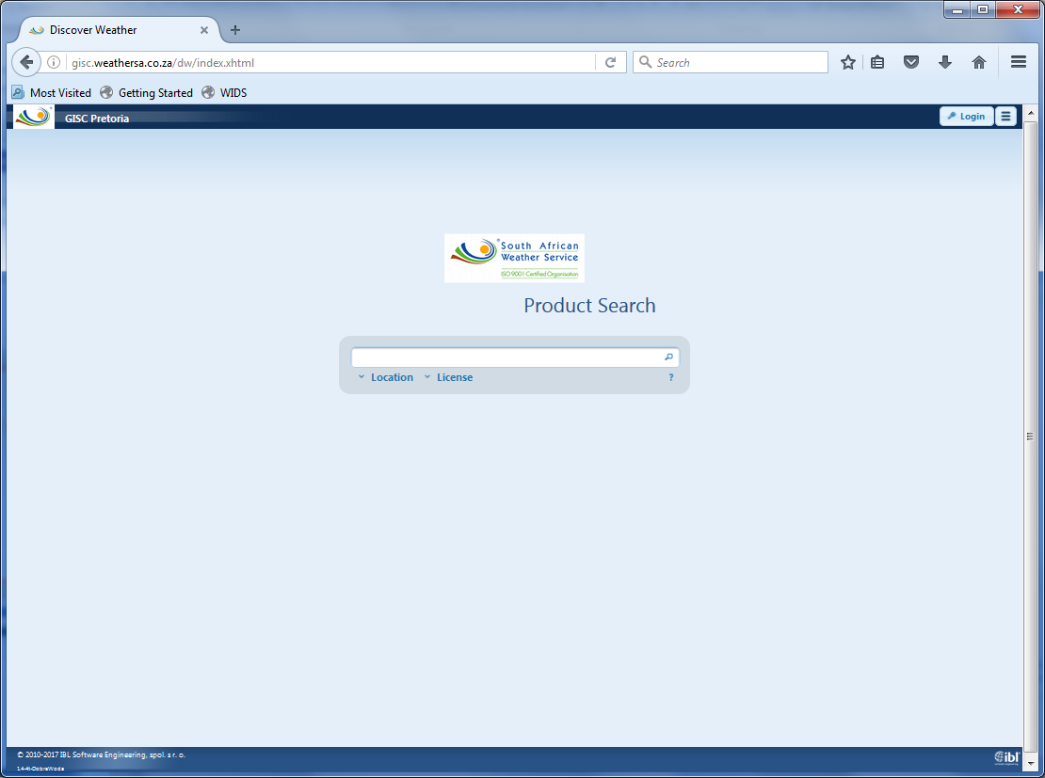
GISC Pretoria web portal

Slide 43
GISC Pretoria and RTH connectivity

Slide 44
Pretoria RTH connectivity
RTH Pretoria GTS connections
Country | City | Connection type | Protocol
Angola | Luanda | Internet | gtssoc
Botswana | Gaberone | Direct data line - 64Kbs | gtssoc
Kenya | Nairobi | Internet | gtssoc
La Reunion | St. Denis | Internet | FTP
Lesotho | Maseru | Direct data line - 64Kbs | gtssoc
Malawi | Lilongwe/Blantyre | Internet | gtssoc
Mozambique | Maputo | Direct data line - 64Kbs | gtssoc
Namibia | Windhoek | Direct data line - 64Kbs | gtssoc
Swaziland | Matsapa | Direct data line - 64Kbs | gtssoc
UKMET | Exeter | RMDCN - 2Mbps | gtssoc
Zambia | Lusaka | Internet | gtssoc
Zimbabwe | Harare | Internet | gtssoc

Slide 45
Toulouse
Algiers
Rome
Moscow
Madrid
Casablanca
New Delhi
Western
Sahara
Tunis
Cairo
Canary
Tripoli
Jeddah
Offenbach
Nouakchott
Toulouse
Khartoum
Dakar
Niamey
Asmara
Banjul
Bamako
Djibouti
Bissau
Ouagadougou
N'djamena
Conakry
Addis Ababa
Sal
Bangui
Freetown
Accra
Cotonou
Lagos
Entebbe
Mogadiscio
Monrovia
Nairobi
Abidjan
Lome
Douala
Kigali
Malabo
Bujumbura
Seychelles
Libreville
Brazzaville
Dar Es Salaam
Exeter
Sao Tome
Kinshasa
Lusaka
Lilongwe
Mauritius
Luanda
RTH
Harare
NMC
Ascension
Windhoek
Gaberone
Moroni
St Denis
Centre in other region
St. Helena
Maputo
Antananarivo
Pretoria
MTN circuit
Maseru
Manzini
New
Amsterdam
Regional circuit
Kerguelen
Interregional circuit
Regional Meteorological Telecommunication Network for Region I (Africa)

Slide 46
Benefits for the RA 1 WMO community GISC Pretoria
Pretoria has been the RTH for Southern RA 1 Sub-region for many years
WIS allows for a push-pull mechanism which overrides the current RTH push only system limitations
NC will be able to access data from sources that would have been hidden the past

Slide 47
Benefits for the RA 1 WMO community GISC Pretoria
NC will be able to access Web Portals such as (SWFDP) Severe Weather Forecasting Demonstration Program
Training linked to a GISC can be done at Pretoria

Slide 48
Planning
GISC Pretoria nominated Exeter as their backup GISC – backup arrangements need to be formalized
Need to engage with other organizations who may have an interest in publishing their metadata
GISC Pretoria needs to be connected directly to the RMDCN (currently connected to Internet, receiving data through RMDCN connection via AMSS system)
Discovery metadata to be fully updated by data originators
WIS monitoring to be implemented
Become fully operational

Slide 49
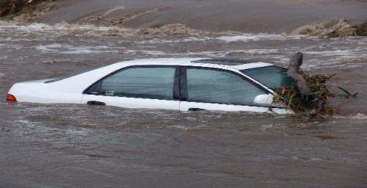

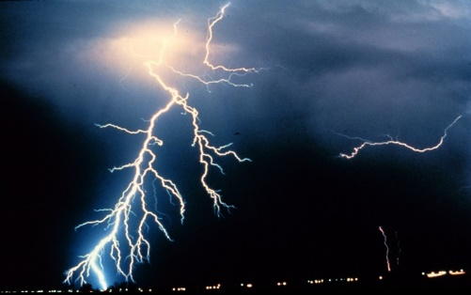
  Thank You

