Slide 1
WIS Telecommunications
WIS Project Office
WMO
Wis-help@wmo.int

Slide 2
WIS Telecommunications
WIS structure
WIS Networks
Securing operations
2

Slide 3
WIS structure
Logical structure
Component systems

Slide 4


WIS Structure
International Organizations
(IAEA, CTBTO, UNEP, FAO.. )
GAW World Data Centres
GCOS Data Centres
Global Run-off Data Centre
Global Precip Climatology Centre
World Radiation Centre
Regional Climate Centres
DCPC
Internet
AMDCN
NC
Internet
NC
Area Meteorological Data
Communication Networks (AMDCNs)
NC/
DCPC
NC/
DCPC
Commercial service providers
IRI and other climate research institutes
Universities
GISC
NC
NC
GISC
GISC
WIS Core
WIS
Core network
NC
NC
Internet
GISC
GISC
DCPC
DCPC
World Data
Centres
International projects (e.g. RA VI Copernicus)
Internet
Satellite
Two-Way System
Satellite Dissemination
IGDDS, EUMETSAT, etc.
KEY
NC
NC = National Centre
DCPC = Data Collection and
Production Centre
GISC = Global Information
System Centre
NC
NC
Internet
NC
IGDDS
Network connection
Internet

Slide 5
WIS Networks
WIS Core network
Regional networks

Slide 6
WIS Core Network
Connects GISCs
Carries data
  global exchange
  between regions
Internet VPN connections
Private network
  High service levels
  High availability
  Limited bandwidth

Slide 7
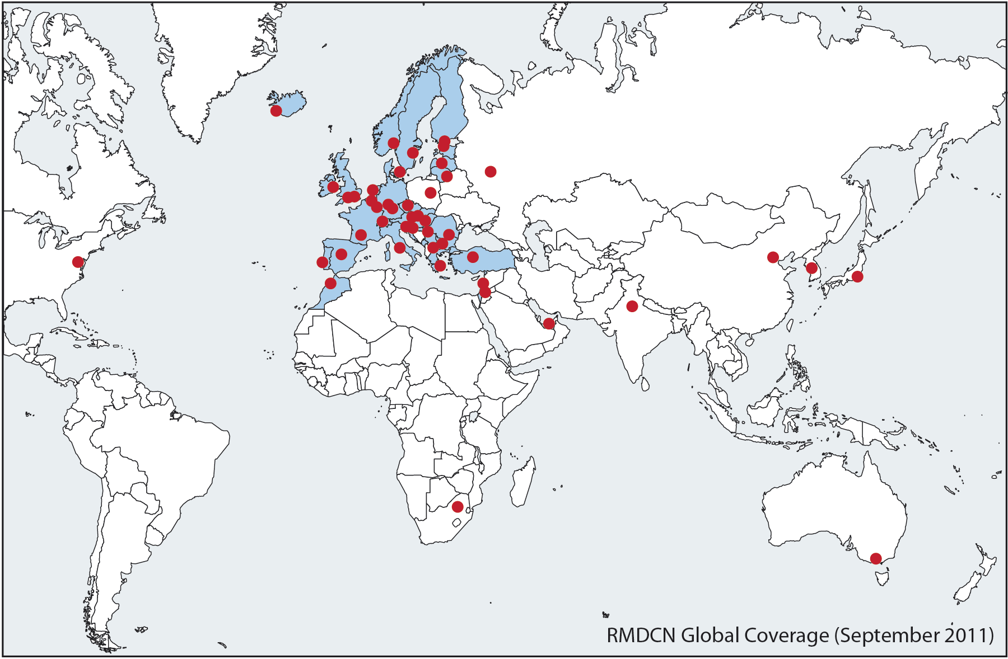
Private WIS Core Network - RMDCN
Single supplier
Competitive procurement
Managed by ECMWF

Slide 8
WIS Core Network – logical structure

Slide 9
WIS Core Network –structure
Single logical connection at each centre
  High availability sites have two physical
Any centre could talk to any other
  Supplier provides logical circuits
    Act like dedicated links
    Bandwidth guaranteed
      Can “burst” above this
At present uses MPLS
  Appears private, but actually over supplier’s shared network

Slide 10
AMDCN – Manual on WIS
Data, products and metadata shall flow to a GISC from the DCPCs and NCs that are within its area of responsibility.
An Area Meteorological Data Communication Network (AMDCN) shall connect each GISC to DCPCs and NCs in the GISC area of responsibility.
An AMDCN may span multiple Regional Meteorological Telecommunication Networks (RMTNs) and parts thereof.

Slide 11
AMDCN – what it means
GISCs must work with attached NCs and DCPCs
  Ensure that effective telecommunications
  RA III
    GISC Brasilia
    RTH Buenos Aires
    RA III RMTN – VPN over the Internet based
      Some private low speed GTS links
    Connection to GISC Washington via GTS
    Connection to other GISCs via Internet

Slide 12
Regional networks
May be independent of GISC
Can be
  Combination of independent links
  Mix of private lines and internet
  Single supplier
Needs to be reliable and available
  Internet makes no service level promises
GTS techniques
  RTHs, message and file switches, etc

Slide 13
Securing operations
IT Security Guide
Guide for Virtual Private Networks (VPN) via the Internet between GTS centres

Slide 14
IT Security Guide
Protecting your infrastructure
Risk assessment
  Threats, risks and countermeasures
Network security
Anti-virus and malware protection

Slide 15
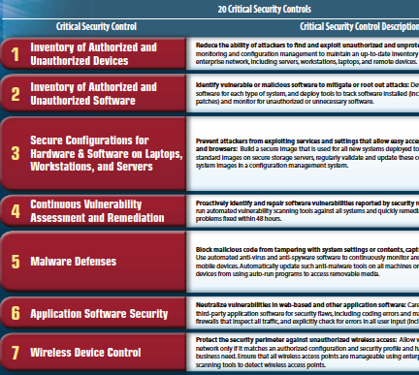
www.sans.org/critical-security-controls/winter-2012-poster.pdf

Slide 16
Exercise
Agree appropriate transport mechanisms to use to transfer data for:
Tsunami warnings
THORPEX ensemble global model results
Aviation TAFs
Climate observations from Antarctica
Satellite imagery of hurricane
19th century observations from central Africa

Slide 17
Summary
WIS Core network
Regional networks
IT Security
http://wis.wmo.int/page=TrainingAids

