Slide 1
WIS Data Exchange
WIS Project Office
WMO
wis-help@wmo.int
www.wmo.int

Slide 2
WIS Data Exchange
Discovery Metadata
Providing data
Receiving data
Standardizing data
2

Slide 3
Discovery Metadata
WIS and discovery metadata
What makes good metadata
Responsibilities for metadata

Slide 4

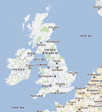

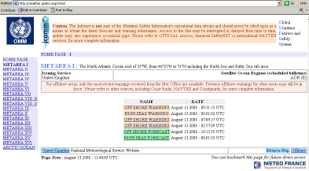

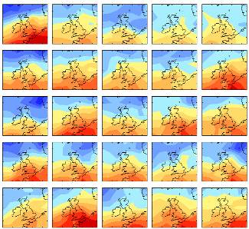
Search: Climate change for 48°N to 60°N and 10°W to 5°E
Search Results
User searches for metadata then retrieves information from data custodian
Information request to custodian
http://www.metoffice.gov.uk/precis/qump
Centre publishes metadata to GISC DAR catalogue
Retrieve information
Security/authentication/authorization and even charging is managed by each service provider
GISC – DAR service
NC/DCPC information access service

Slide 5
What makes good metadata?
Technically compliant
  Or WIS will not work
Useful to users
  Describes data in way users can find
Kept up to date with data it describes
Consistent with other information sources
The “start-up” metadata are technically compliant, but not “good”
  Search for “Frankfurt temperature” – no data
  Search for “Frankfurt SYNOP” – several records

Slide 6
Data restrictions – Resolutions 40, 25 and 60
Resolutions 40 (Cg-XII), 25 (Cg-XIII) & 60 (Cg-(7)
Essential data (“WMOEssential”)
  “… data and products which are essential to support WMO Programmes … exchange without charge and with no conditions on use….”
Additional data (“WMOAdditional”)
  Data on which the originator has placed restrictions (on commercial use)
Data not covered by these (“WMOOther”)
PR notifies WMO of “additional data”

Slide 7
Providing data
Register metadata
Agree delivery methods
Supply data

Slide 8
Register metadata
Decide how data to be grouped
  GTS bulletin? five day global forecast? 200 year climate simulation?
Describe data – in way user will understand
Create metadata record
Publish on your principal GISC (or WIMMS)

Slide 9








Agree delivery methods
WMO Pizza Programme
DCPC
?

Slide 10
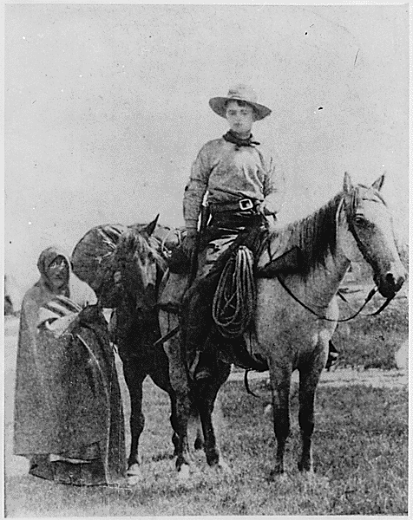
Supply your data to WIS
Implement the procedures you agreed with your GISC or DCPC

Slide 11
Receiving data
One-off requests
Subscriptions

Slide 12
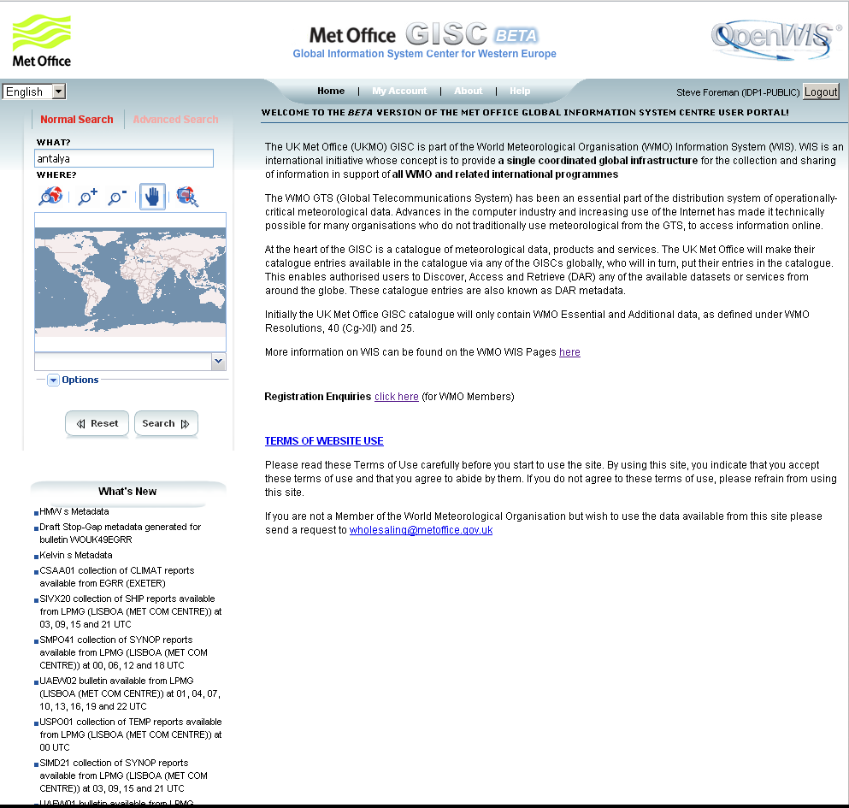
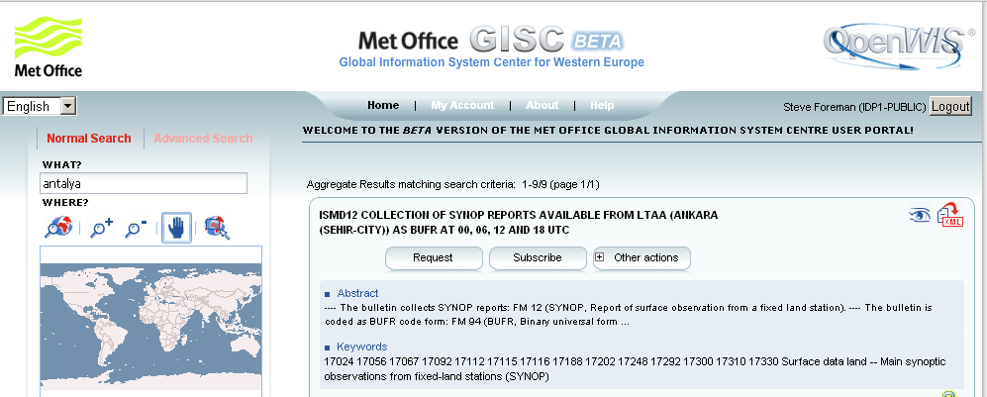
Find information
Look at metadata
… and request it
Search phrase
Links to web sites
Search metadata fields
One-off
Search
in area
Search
button
Regular delivery
Download
metadata

Slide 13
Delivery methods
Login
needed
Login needed for “additional” data
Method | Request | Subscribe
Download | ✓ | ✗
Email | ✓ | ✓
FTP | ✓ | ✓
GTS | Not Usually | By arrangement
Post | Perhaps | Perhaps

Slide 14
Standardizing data
Why standardize formats
WMO formats
Candidate “other” formats

Slide 15

Standardizing data
Know
Content
  what values to expect
Format
  how to read the values
File names / headers
  what you are handling

Slide 16
WMO Formats
Table Driven Code Forms
  Irregular data
    BUFR
    CREX
      Observations, satellite data, significant weather…
  Regular data
    GRIB
      Model fields …
Traditional Alphanumeric Codes
  Cannot describe modern data
  Strongly discouraged
New – model driven code forms

Slide 17
Other formats
XML
  Built into many systems
    OGC Observations and Measurements
      IWXXM (in Manual on Codes)
      Water ML2 (submitted to Manual on Codes)
NetCDF
  Widely used in research community

Slide 18
Exercise
Visit a GISC web site and find some data for your country that is in readable form. Download the data to a text file. Try finding the same data at a different GISC.

Slide 19
GISC addresses
Full list at
www.wmo.int/giscs
GISC Pretoria
http://gisc.weathersa.co.za/
GISC Casablanca
http://gisc.marocmeteo.ma/

Slide 20
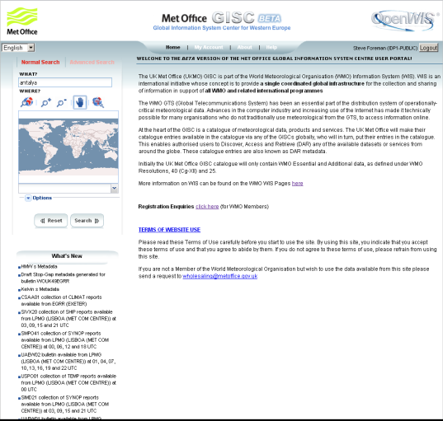
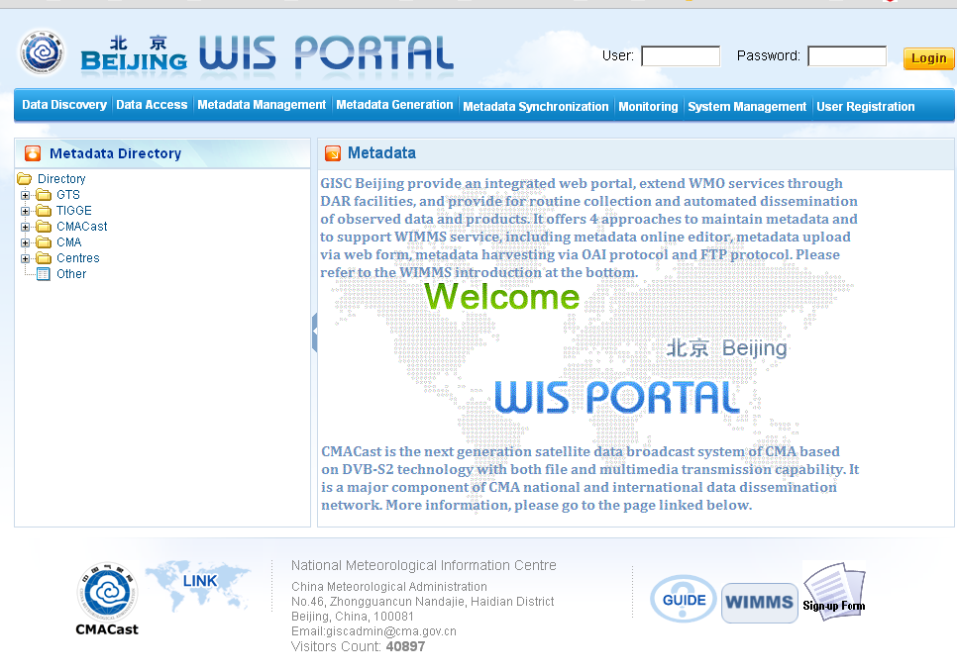
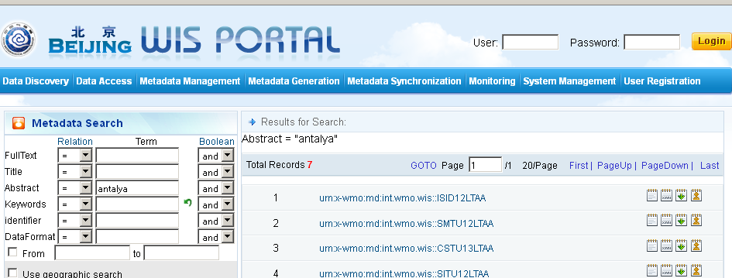
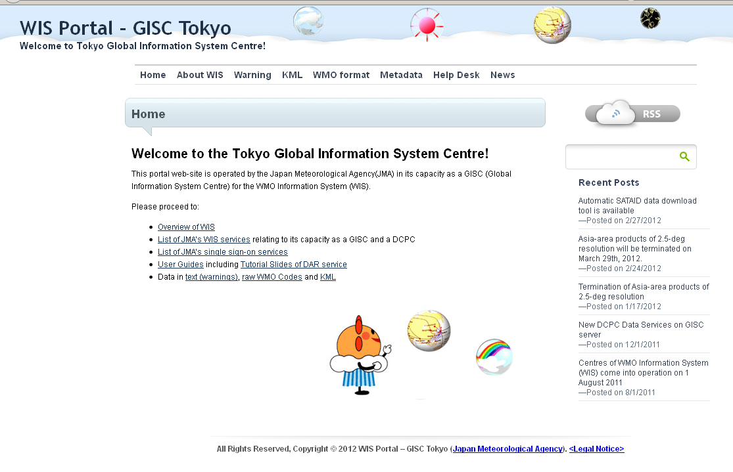
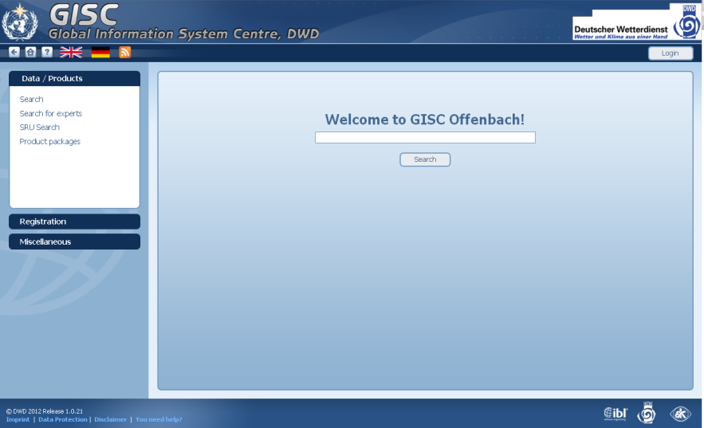
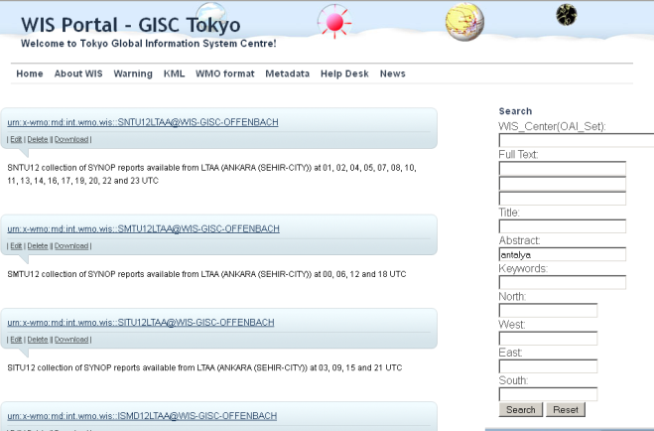
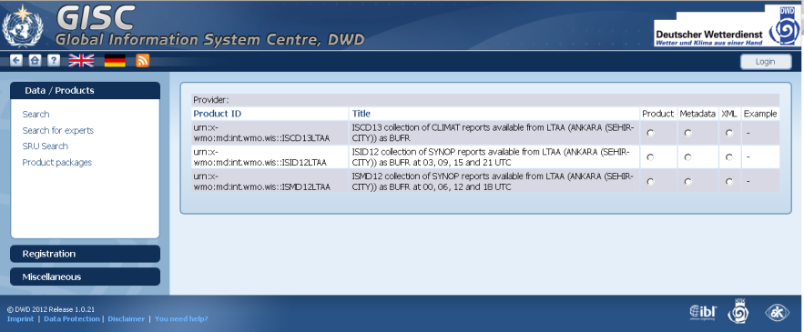
GISC interfaces

Slide 21
Summary
Role of discovery metadata
Providing data to WIS
Receiving data from WIS
Standards for data exchange

