Slide 1
WIS Discovery Metadata
WIS Project Office
WMO
wis-help@wmo.int
Notes:
This module describes the metadata standard that is used to support WIS functions, and how you can use it to describe information that you wish to publish through the WIS, and to find information that others have published.

Slide 2
Data Management in WIS architecture
Context
Manage Data Discovery
Manage Data Flow
Notes:
WIS Discovery Metadata – Key to data management in the WIS architecture
On completion of this module you will be able to:
Competency 3: Manage the data flow
1. Apply data policy
1.1. Set the WMO data policy to be applied to a set of information (WMO_DataLicenceCode) in the WIS metadata record.
2. Describe how to pass data to their Principal GISC or Regional Telecommunications Hub for inclusion in the routine global exchange of data.
Competency 4: Manage the data discovery
1. Gather the information needed to complete a WIS metadata record.
2. Decide on appropriate metadata records needed to describe information your centre publishes in the WIS catalogue.
3. Use the facilities provided by the Principal GISC for your centre to:
3.1. Create a WIS metadata record for set of information published by your centre. (Pre-training information gathering needed).
3.2. Edit a WIS metadata record for information published by your centre.
3.3. Describe the internal authorization procedure in your centre for publishing a WIS metadata record. (Pre-training information gathering needed on the internal approvals procedures for authorizing new data products).
3.4. Authorize the GISC to move a metadata record from the editing environment to the live WIS Metadata catalogue.
3.5. Authorize the GISC to remove a metadata record from the WIS Metadata catalogue.
4. Identify existing metadata records that are the responsibility of your centre.
Implementation of the a WIS Implementation Plan
1. Use the materials provided during the course to deliver training in the use of WIS Discovery Metadata training to others at yourcentre.
This module covers:
The context for WIS Discovery Metadata
The role of WIS Discovery Metadata are used in the Discovery, Access and Retrieval functions of the WIS, and also in the routine exchange of information through the WIS
How skills in the use of WIS Discovery Metadata contribute to demonstrating WIS Competences.
What WIS Discovery Metadata records have to contain in order to provide the minimum information needed for the WIS to operate correctly.
How WIS Discovery Metadata records contribute to managing data flows within WIS.

Slide 3
Context

Slide 4
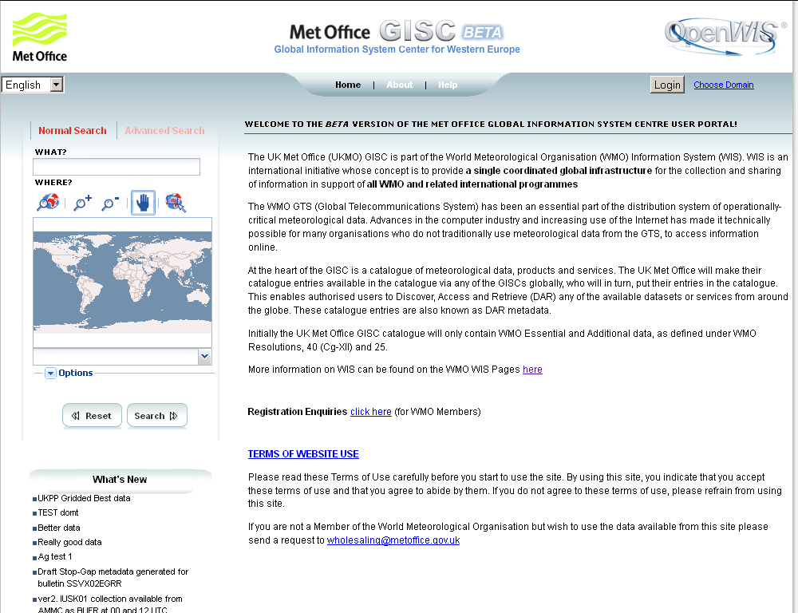
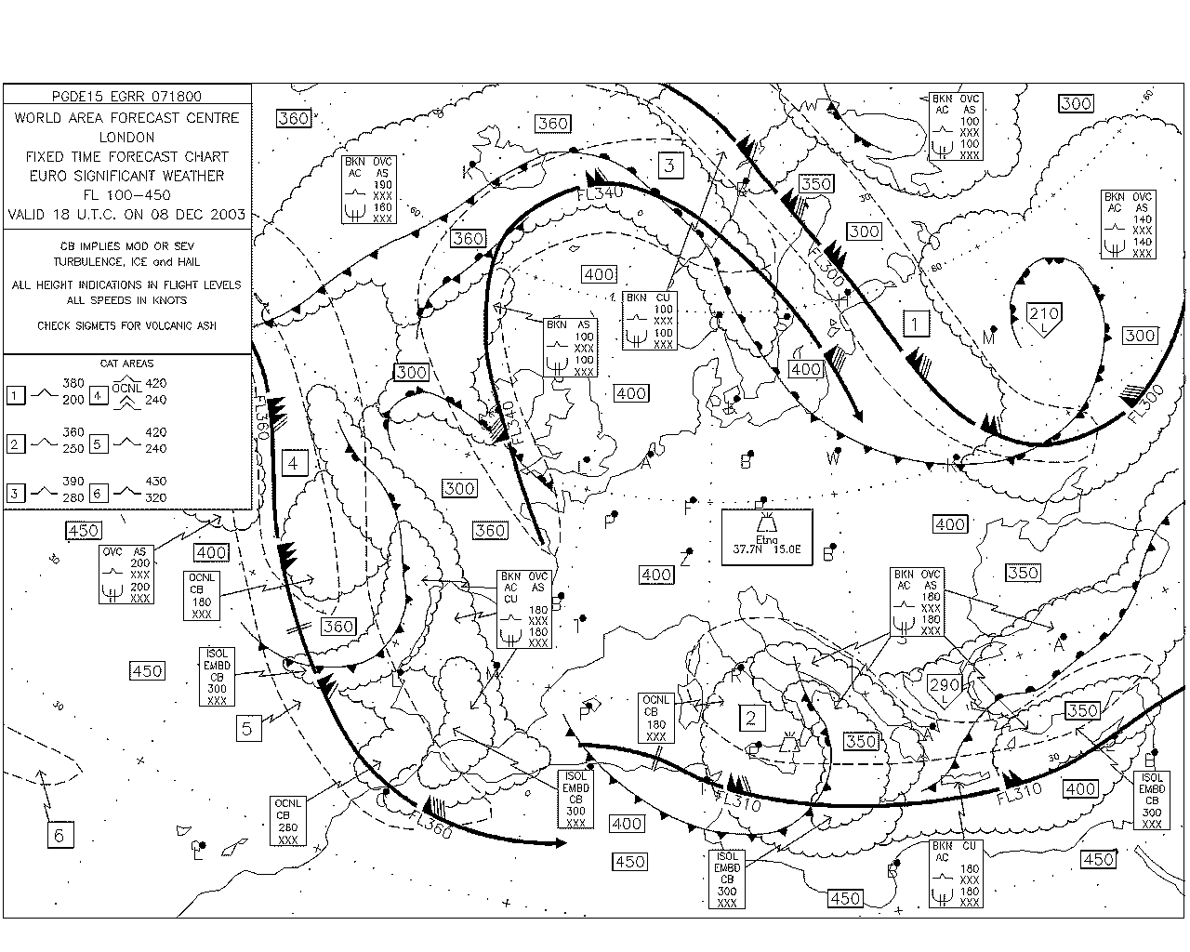
Discovery, Access, Retrieval
User
Searches catalogue at GISC
Asks GISC/DCPC for product
GISC
2
DCPC
1
DCPC
Passes WIS metadata to GISC
DCPC
Passes product to user
3
4
Notes:
Discovery, Access and Retrieval
Discovery, Access and Retrieval is the main new functionality introduced by the WMO Information System (WIS). It allows users to search for information in a way that is familiar to them, to find out how to obtain that information and, in many cases, to download or arrange for routine delivery of that information.
Telling the WIS that information is available for sharing. A centre that wishes to share information creates a WIS Discovery Metadata record describing that information and passes that metadata record to its GISC. In this example the information is a series of significant weather charts for aviation. The GISC places the metadata record in the WIS Discovery Metadata Catalogue; that catalogue is synchronized between all the GISCs so that each GISC holds a complete copy of the WIS Discovery Metadata Catalogue.
2. A user searches for information. A user who wants to find information that is available through the WIS uses the internet to view the web page of a GISC (a list of GISCs can be found at http://www.wmo.int/giscs). That web page provides a search function. A simple search searches the metadata records for the text that is entered in the search box, but GISCs also allow more detailed searches to be performed (such as for information within an area, or only searching some parts of the metadata record). The search returns a list of WIS Discovery Metadata records that match the search criteria. Each record in the list will have several options – selecting the “view metadata” option shows the full metadata record for that item.
3 The user obtains the information of interest. The metadata records tell the user how to obtain the information. In many cases there will be options to download the information directly, to subscribe to it (if the information is refreshed regularly and has been agreed to be for “global exchange”), or if these are not available the metadata record will state how to obtain the information.

Slide 5
WIS Competences
Infrastructure
  Manage the physical infrastructure
  Manage the operational applications
Data
  Manage the data flow
  Manage the data discovery
External interactions
  Manage WIS centre-centre interactions
  Manage user interactions
Operational Service
  Manage the operational service
Notes:
WIS competences that require proficiency in the use of WIS Discovery Metadata
The WIS competences are grouped into four categories:
Infrastructure
Data
External Interactions
Operational Service
Proficiency in the use of WIS Discovery Metadata is a key component of the “Data” category, that covers
Manage the data flow, and
Manage the data discovery.

Slide 6
3. Manage the data flow - Performance
Ensure collection and distribution of data and products as per data policy
Publish data and products
Subscribe to data and products
Encode, decode, validate and package data and products
Create, update and maintain data flow catalogues
Manage connectivity between centres
Control the data flow to meet service levels
Notes:
Performance criteria for the WIS competence “Manage the data flow”
Each of the WIS competences has associated performance criteria that are designed to allow managers to assess what their organization has to be capable of achieving, and allow individuals to assess whether they have all the skills they need to do their job. In addition to the WIS competences themselves, organizations and individuals are expected to have an appropriate level of competence in general IT skills.
Every organization is different, and each has to assess the level of detail and expertise that is needed to achieve their goals. For example, a GISC needs a higher level of competence in managing WIS Discovery Metadata records than does a centre that provides only a handful of metadata records – though the centre providing the records may need higher competence in writing the contents of a metadata record than would a GISC.
The particular performance aspects of “Manage the data flow” that are associated with metadata are:
Ensure collection and distribution of data and products as per data policy
Publish data and products
Subscribe to data and products

Slide 7
3. Manage the data flow – knowledge and skill
System and network monitoring and viewing tools
Data formats and protocols
Licensing and data policies
Message and file switching systems
Notes:
Knowledge and skills for the WIS competence “Manage the data flow”
Specific knowledge and skills are required to use the WIS Discovery Metadata correctly as a publisher or user of information.
Data formats and protocols – the metadata records describe the formats and methods of transferring the data, so a knowledge of these is important to make sure that the metadata records are correct. As a user, you will need to know which of the formats you can handle, and how to identify these in a metadata record.
Licensing and data policies – these are statements of what users can do with the information; as an information provider, it is up to you to be explicit about any constraints on the use of the information; as a data user you must be able to understand the constraints on the use of information that are described in the metadata records and to act on them. If the information provider does not describe the constraints accurately, the user (no matter how well intentioned) may not be able to comply with them.

Slide 8
4. Manage the data discovery - performance
Create and maintain discovery metadata records describing products and services
Add, replace or delete metadata records within the catalogue
Ensure that all information and service offerings from a WIS centre have complete, valid and meaningful discovery metadata records uploaded to the catalogue
Notes:
Performance criteria for “Manage the data discovery”
WIS Discovery Metadata are at the heart of data discovery, so all aspects of performance associated with that competence are relevant to metadata.
Create and maintain discovery metadata records describing products and services
Add, replace or delete metadata records within the catalogue
Ensure that all information and service offerings from a WIS centre have complete, valid and meaningful discovery metadata records uploaded to the catalogue

Slide 9
Manage the data discovery - knowledge and skill
Metadata entry and management tools
Policies and standards
Discovery metadata concepts and formats
Written English
Notes:
Knowledge and skill required for “Manage the data discovery”
The key knowledge and skill needed to work with WIS Discovery Metadata are:
Metadata entry and management tools – so that you can create, edit, update and delete metadata records that describe your information
Policies and standards – both those that define the content, structure and management of metadata, but also those that constrain the use of information. In addition to the WMO policies and standards, there may be local standards that you need to take into account.
Discovery metadata concepts and formats – without these you cannot create or use metadata records
Written English – all WIS Discovery Metadata records have to include information written in English – you may repeat the information in other languages, but if you do the content of the metadata must be available in English as well (however, the English metadata record could describe a document writing in French).

Slide 10
Manage the data discovery

Slide 11
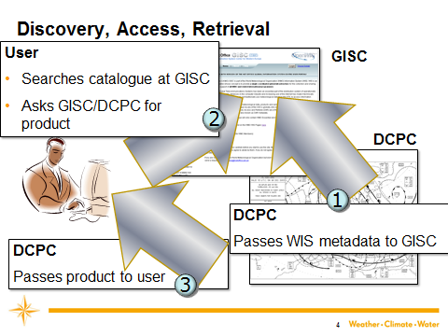
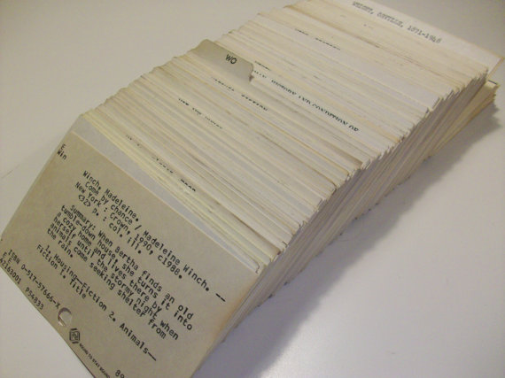
Metadata records
To do this…
… we need to know about the data sets
Notes:
WIS Discovery metadata records
Just like traditional library index cards, WIS Discovery Metadata records are there to help users of WIS find what information is available and how to obtain it. They are at the heart of the “Discovery, Access, Retrieval” service, and also provide information to allow GISC operators to manage the global flow of routine information through the WIS.

Slide 12
Metadata in WIS
For “global exchange” data:
GISC adds access from cache
GISC
National Centre or DCPC editor creates and maintains metadata records and states delivery methods
GISC
GISC
GISC
GISC
User chooses data and selects delivery method
Notes:
Metadata in WIS
Metadata records are created by the originator of information to be published on the WIS. The originator could be a National Centre or a Data Collection or Production Centre. As well as describing the information to be exchanged, the metadata record also states the delivery methods that are available for the information.
The GISC caches are only required to contain information that is designated for “global exchange”. This is supported by a specific entry in the WIS Discovery Metadata record.

Slide 13
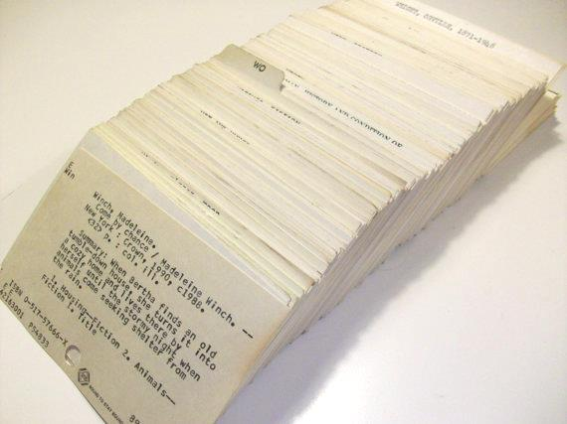
Contents of (WIS Discovery) metadata record
Dataset title
Dataset reference date
Dataset responsible party
Geographic location of the dataset
Dataset topic category
Dataset descriptive keywords
Abstract describing the dataset
Distribution format
Online resource
Dataset language
Dataset character set
Spatial resolution of the dataset
Additional extent information for the dataset (vertical and temporal)
Spatial representation type
Reference system
Lineage
“Other” constraints
Metadata file identifier
Metadata standard name
Metadata standard version
Metadata language
Metadata character set
Metadata point of contact
Metadata date stamp
ISO 19115
ISO 19139
Notes:
Contents of WIS Discovery Metadata records
WIS Discovery Metadata records must comply with the WMO Core Profile of the ISO 19115 Geographic Information – Metadata standard.
Although the ISO 19115 standard defines a wide range of types of information that could be included in a metadata record, the WMO Core Profile only requires a small proportion of this to be present. Provided all the components that are mandatory in the WMO Core Profile are present and have valid contents, the WIS Discovery Metadata record is considered complete even though it did not contain the majority of elements permitted by the ISO 19115 standard.
WIS Discovery Metadata records are used to control the operation of the WIS. It should, therefore, not be a surprise that some elements that are optional in the ISO 19115 standard must be included in a valid WIS Discovery Metadata record, nor that WMO has specified the permitted contents in some fields that in the ISO 19115 standard might allow a greater range of entries.
When exchanged between computers, the WIS Discovery Metadata records are in an XML representation that is defined in ISO 19139 - Geographic Information -- Metadata -- XML Schema Implementation.

Slide 14
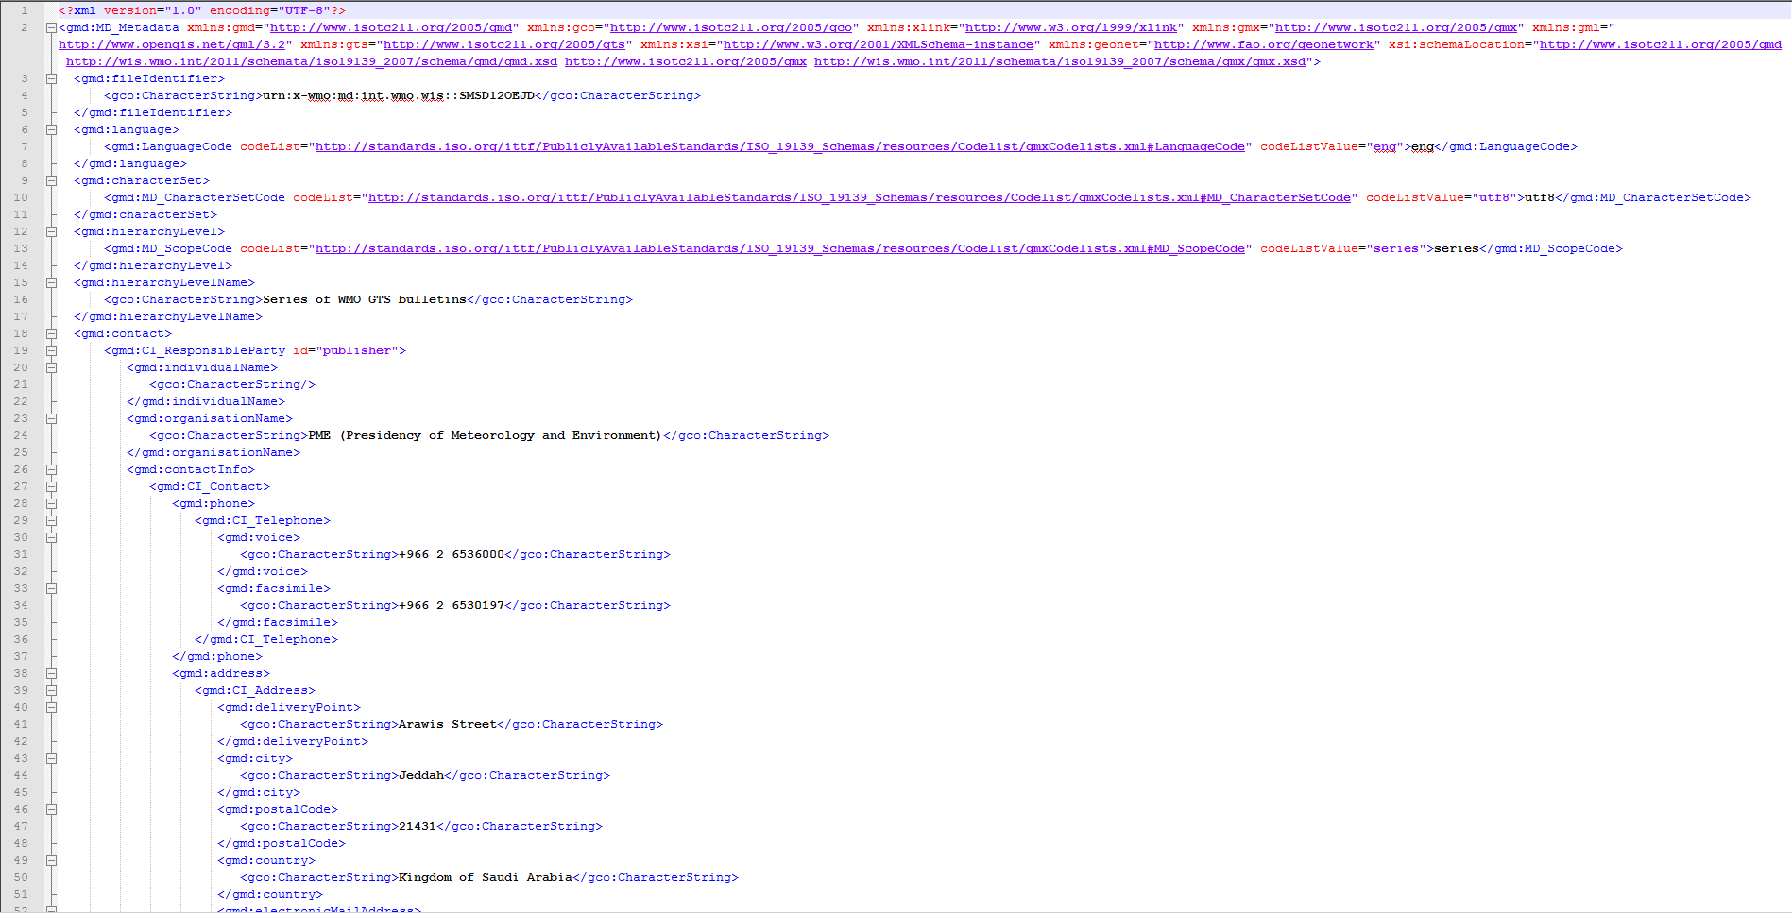
A metadata record
This is a metadata record in XML.
Only machines or software developers need to work with this.
Notes:
A WIS Discovery Metadata Record
Unless you are a software developer, you should not need to understand the XML version of a WIS Discovery Metadata record.
There is, however, one valid reason why an metadata editor may wish to edit an XML file directly – and that is to make their life easier. Many metadata records in WIS are very similar, such as those describing SYNOP reports. Copying and modifying an existing metadata record is a good way of creating good quality metadata records; not only does it create a uniform style and help ensure that all the required information is included, it is also a lot faster than creating a metadata record from scratch.
The metadata catalogues at the GISCs allow users to download the XML version of metadata records. Editors can, therefore, download existing metadata records to use as the starting point for a new record.
The WMO Core Profile of the ISO 19115 Geographic Information – Metadata standard requires that one of the metadata fields (fileIdentifier) is unique across the whole of the WIS. So, before uploading a previously copied metadata record back to a GISC for further editing, it is essential to change the value of the fileIdentifier. This is simple with a standard text editor (for example Windows Notepad) – just find the text fileIdentifier and change the value after the equals sign to the unique identifier that you have decided on (there are rules for this in the Manual on WIS). To do that you do not need to know how the XML works – you just need to be careful not to delete any of the text surrounding the identifier you are changing.
So, even if you are working with the XML file, you normally do not need to understand the XML.

Slide 15
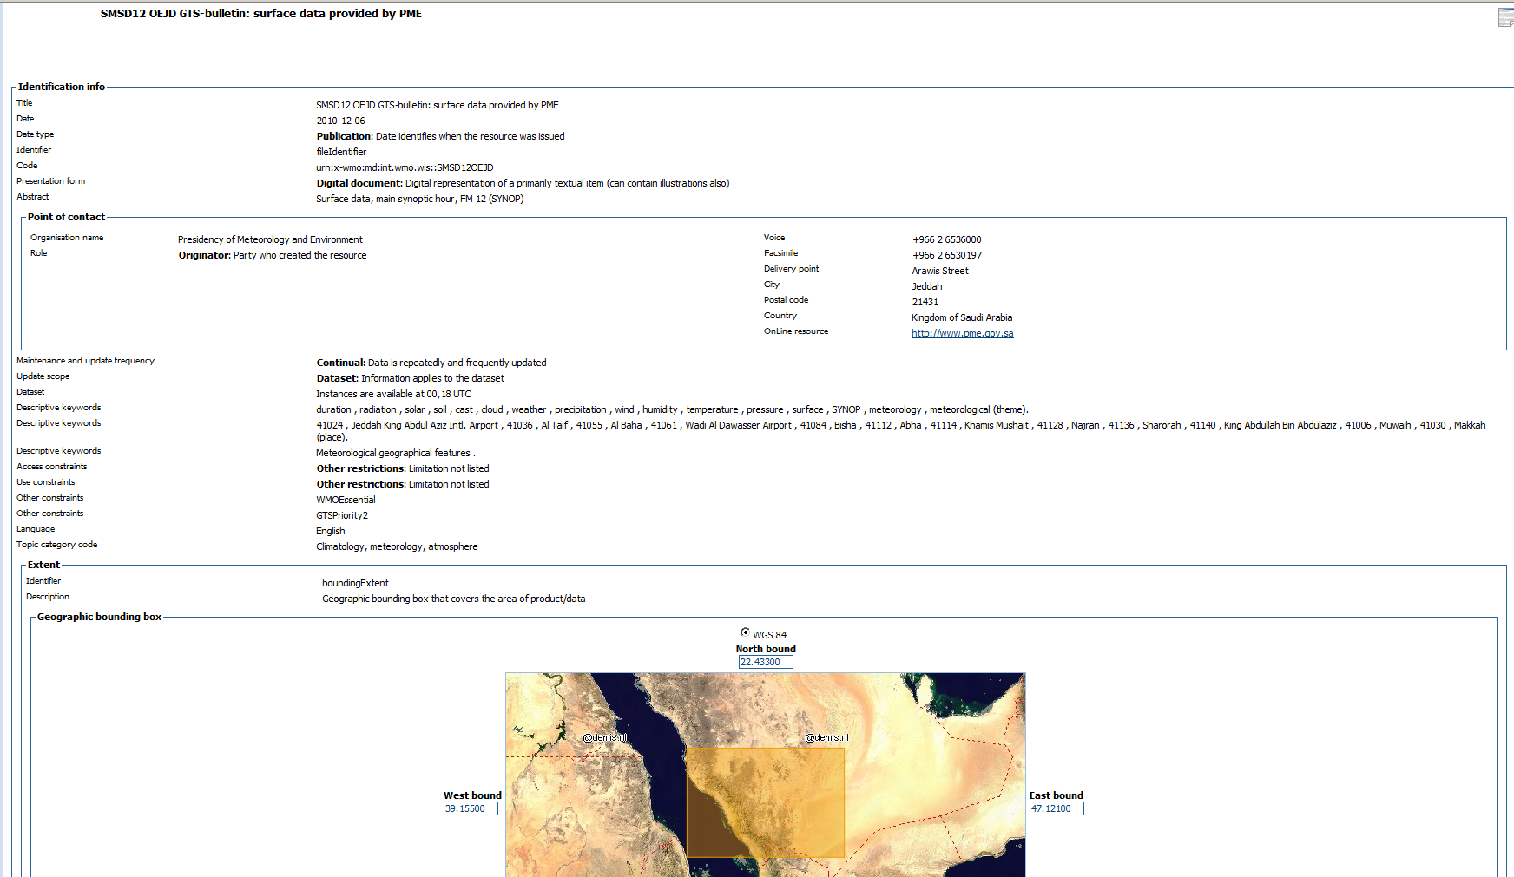
Human readable metadata record
Notes:
Human readable metadata records
When you look at a metadata record in the WIS metadata catalogue, the entries are displayed in a format that is designed for human use – normally as a simple table. GISCs also provide metadata editors that use a similar layout to allow authorized users to edit the content of a metadata record.
It is because of these tools offered by the GISCs that most users do not need to be able to interpret the XML – the computers do this for you.

Slide 16
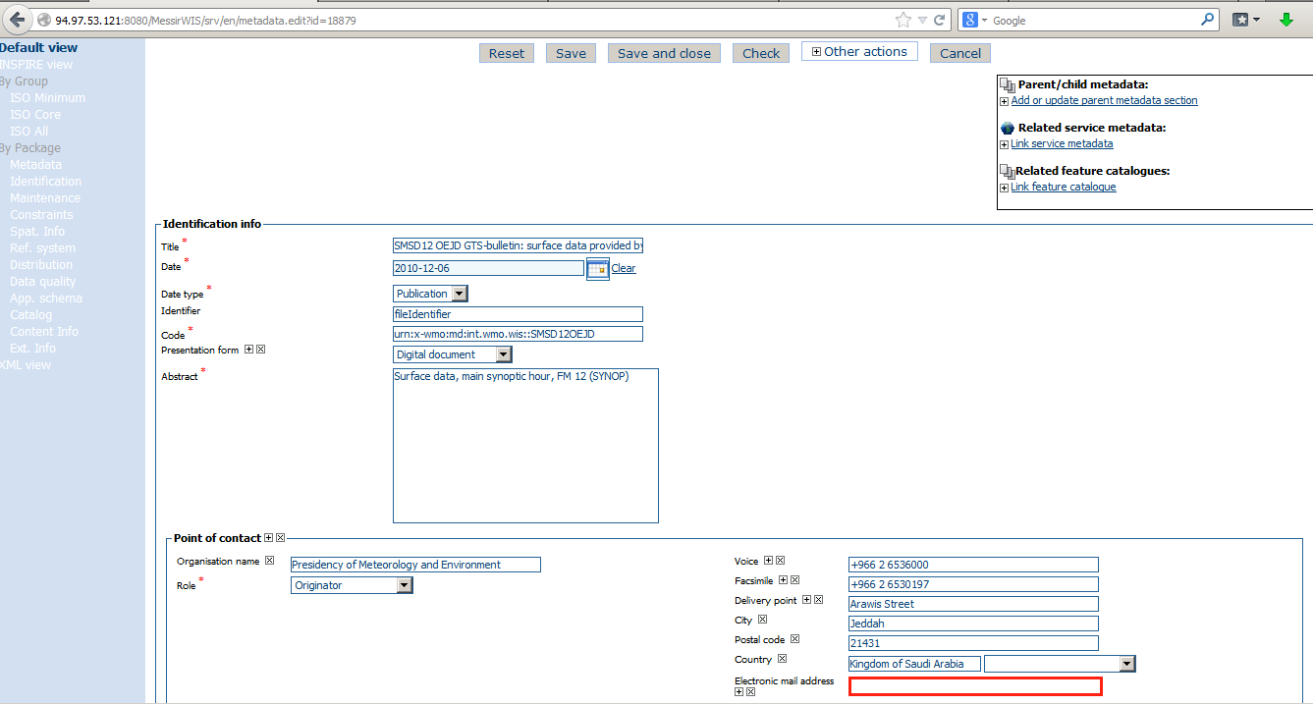
Editing metadata using a GISC interface
Create and edit records using a form
If you have a lot of metadata records for similar items, your GISC can help you automate creating the records.
Notes:
Editing metadata using a GISC interface
Although the editing interface for metadata is slightly different depending on the software used by the GISC, all GISCs provide metadata editing software that allows authorized users to create and update metadata records. As suggested earlier, a good starting point for creating a new record would be to find a metadata record that is similar to the one you want to create, download a copy and change the fileIdentifier, and then upload the changed record to the GISC for editing.

Slide 17
What to include in a metadata record
Dataset title
Dataset reference date
Dataset responsible party
Geographic location of the dataset
Dataset topic category
Dataset descriptive keywords
Abstract describing the dataset
Distribution format
Online resource
Dataset language
Dataset character set
Spatial resolution of the dataset
Additional extent information for the dataset (vertical and temporal)
Spatial representation type
Reference system
Lineage
“Other” constraints
Metadata file identifier
Metadata standard name
Metadata standard version
Metadata language
Metadata character set
Metadata point of contact
Metadata date stamp
A meaningful title – include the TTAAii CCCC or filename for GTS items
Notes:
What to include in a metadata record - title
Although you can include anything that is permitted in an ISO 19115 metadata record in a WIS Discovery Metadata record, the list of things that are required is much shorter, and limited to those items that are essential to allowing the information to be discovered, accessed or managed within the WIS.
Often, the first element of the metadata that a user will see would be the title of the information. This should be a very brief description of the information and include the main words that users might use in a search to find the information.
For example the title of a series of GTS SYNOP bulletins would include the “TTAAii CCCC” from the bulletin header, “SYNOP” and “surface”, for example:
“ISMC01 RJTD - Surface Synoptic Reports on main synoptic hours in Japan”

Slide 18
What to include in a metadata record
Dataset title
Dataset reference date
Dataset responsible party
Geographic location of the dataset
Dataset topic category
Dataset descriptive keywords
Abstract describing the dataset
Distribution format
Online resource
Dataset language
Dataset character set
Spatial resolution of the dataset
Additional extent information for the dataset (vertical and temporal)
Spatial representation type
Reference system
Lineage
“Other” constraints
Metadata file identifier
Metadata standard name
Metadata standard version
Metadata language
Metadata character set
Metadata point of contact
Metadata date stamp
To help users find datasets.
duration , radiation , solar , soil , cast , cloud , weather , precipitation , wind , humidity , temperature , pressure , surface , SYNOP , meteorology
41024 , Jeddah King Abdul Aziz Intl. Airport
Notes:
What to include in a metadata record – descriptive keywords
Descriptive keywords provide a means of setting a context for a phrase that is used in metadata. These are recorded in the metadata separately from the free-format text (such as the title or abstract). This allows more specific searching and also provides a means for automating the use of the WIS metadata catalogue.
Keywords are normally also included in the abstract part of the metadata record, and include terms such as duration , radiation , solar , soil , cast , cloud , weather , precipitation , wind , humidity , temperature , pressure , surface , SYNOP , meteorology. The station identifier and name are also included as keywords.

Slide 19
What to include in a metadata record
Dataset title
Dataset reference date
Dataset responsible party
Geographic location of the dataset
Dataset topic category
Dataset descriptive keywords
Abstract describing the dataset
Distribution format
Online resource
Dataset language
Dataset character set
Spatial resolution of the dataset
Additional extent information for the dataset (vertical and temporal)
Spatial representation type
Reference system
Lineage
“Other” constraints
Metadata file identifier
Metadata standard name
Metadata standard version
Metadata language
Metadata character set
Metadata point of contact
Metadata date stamp
Keywords under WMO_CategoryCode (Table 16)
ISO topic categories are too broad. This group of keywords allow meteorology to be sub divided, e.g.
synopticMeteorology
waterPollution
spaceWeather
Notes:
What to include in a metadata record – WMO_CategoryCode
The ISO 19115 standard allows information to be assigned to very broad categories – for example “climatologyMeteorologyAtmosphere” is a single classification as is “oceans” – almost all the information in the WIS would fall into one of these two categories – making them of very little use in helping to narrow down searches to information relevant to a particular discipline.
The WMO Discovery Metadata standard tackles this by introducing a group of keywords – at least one of which has to be used. These are defined in Table 16 of Appendix C of the Manual on WIS (WMO_CategoryCode) – see http://wis.wmo.int/style/WMOCodeLists_Style.xml#WMO_CategoryCode.
The November 2015 version of permitted WMO_Category_Code entries is:
Keyword Description
weatherObservations weather observations
weatherForecasts weather forecasts
meteorology Meteorology
hydrology Hydrology
climatology Climatology
landMeteorologyClimate land meteorology climate
synopticMeteorology synoptic meteorology
marineMeteorology marine meteorology
agriculturalMeteorology agricultural meteorology
aerology Aerology
marineAerology marine aerology
oceanography Oceanography
landHydrology land hydrology
rocketSounding rocket sounding
pollution Pollution
waterPollution water pollution
landWaterPollution land water pollution
seaPollution sea pollution
landPollution land pollution
airPollution air pollution
glaciology Glaciology
actinometry Actinometry
satelliteObservation satellite observation
airplaneObservation airplane observation
observationPlatform observation platform
spaceWeather space weather
AtmosphericComposition atmospheric composition
radiation radiation

Slide 20
What to include in a metadata record
Dataset title
Dataset reference date
Dataset responsible party
Geographic location of the dataset
Dataset topic category
Dataset descriptive keywords
Abstract describing the dataset
Distribution format
Online resource
Dataset language
Dataset character set
Spatial resolution of the dataset
Additional extent information for the dataset (vertical and temporal)
Spatial representation type
Reference system
Lineage
“Other” constraints
Metadata file identifier
Metadata standard name
Metadata standard version
Metadata language
Metadata character set
Metadata point of contact
Metadata date stamp
Keywords under WMO_DistributionScopeCode (Table 17)
Control information for the WIS
GlobalExchange
RegionalExchange
OriginatingCentre
Notes:
What to include in a metadata record
WIS uses keywords from Table 17 of the Manual on WIS (WMO_DistributionScopeCode – see http://wis.wmo.int/style/WMOCodeLists_Style.xml#WMO_DistributionScopeCode) to control the distribution of information within the WIS. Information marked for “GlobalExchange” are held for at least 24h in the cache of each GISC.
Permitted values are “GlobalExchange”, “RegionalExchange”, “OriginatingCentre”.
Metadata records describing information designated for “GlobalExchange” must also have a keyword from the “WMO_GTSProductsCategoryCode” list (see http://wis.wmo.int/style/WMOCodeLists_Style.xml#WMO_GTSProductCategoryCode). Permitted values are “GTSPriority1”, “GTSPriority2”, “GTSPriority3”, and “GTSPriority4”.

Slide 21
What to include in a metadata record
Dataset title
Dataset reference date
Dataset responsible party
Geographic location of the dataset
Dataset topic category
Dataset descriptive keywords
Abstract describing the dataset
Distribution format
Online resource
Dataset language
Dataset character set
Spatial resolution of the dataset
Additional extent information for the dataset (vertical and temporal)
Spatial representation type
Reference system
Lineage
“Other” constraints
Metadata file identifier
Metadata standard name
Metadata standard version
Metadata language
Metadata character set
Metadata point of contact
Metadata date stamp
Most people use the abstract to decide whether a dataset meets their needs. Repeat phrases from the title and keywords to help explain what the dataset contains.
Notes:
What to include in a metadata record – Abstract
Like the title, the abstract is aimed at human users of the WIS Discovery metadata. The abstract provides a description of the information being made available through the WIS. It is used to help users decide whether the information offered is of relevance to them. The abstract must be provided in English. The same content may also be provided in other languages provided that the English version is also included in the record.

Slide 22
What to include in a metadata record
Dataset title
Dataset reference date
Dataset responsible party
Geographic location of the dataset
Dataset topic category
Dataset descriptive keywords
Abstract describing the dataset
Distribution format
Online resource
Dataset language
Dataset character set
Spatial resolution of the dataset
Additional extent information for the dataset (vertical and temporal)
Spatial representation type
Reference system
Lineage
“Other” constraints
Metadata file identifier
Metadata standard name
Metadata standard version
Metadata language
Metadata character set
Metadata point of contact
Metadata date stamp
Mandatory for GTS
WMOEssential
WMOAdditional
WMOOther
noLimitation
Notes:
What to include in a metadata record – “Other constraints”
ISO 19115 provides several fields that allow description of constraints on the use of the information described in the metadata record. WIS uses one of these, the “Other constraints” field, to record the data policy that has to be applied to the information. WIS Discovery metadata records that describe information designated for global exchange have to include a statement of the data policy using the keyword list “WMO_DataLicenceCode” (see http://wis.wmo.int/style/WMOCodeLists_Style.xml#WMO_DataLicenseCode).
Permitted values are:
“WMOEssential” – information classed as “essential” in WMO Resolution 40 Cg-XII, Resolution 25 Cg-XIII or Resolution 60 Cg-17.
“WMOAdditional” - information classed as “additional” in WMO Resolution 40 Cg-XII, Resolution 25 Cg-XIII or Resolution 60 Cg-17.
“WMOOther” – information that has intellectual property constraints on its use, but is not included in Resolution 40, 25 or 60.
“noLimitation” – information that may be used in any way.
Your organization will have defined its own data policy, and you will need to consult with this in order to represent it correctly in the metadata records you create or update.

Slide 23
What to include in a metadata record
Dataset title
Dataset reference date
Dataset responsible party
Geographic location of the dataset
Dataset topic category
Dataset descriptive keywords
Abstract describing the dataset
Distribution format
Online resource
Dataset language
Dataset character set
Spatial resolution of the dataset
Additional extent information for the dataset (vertical and temporal)
Spatial representation type
Reference system
Lineage
“Other” constraints
Metadata file identifier
Metadata standard name
Metadata standard version
Metadata language
Metadata character set
Metadata point of contact
Metadata date stamp
No two records may have the same identifier. If you update the contents of a metadata record, keep the identifier the same. WIS will replace the old version with the new one.
The form is
urn:x-wmo:md:int.wmo.wis::SMSD12OEJD
Notes:
What to include in a metadata record – fileIdentifier
The WIS metadata catalogue is synchronized between all the GISCs. The fileIdentifier is key to ensuring that the GISCs are able to maintain consistency between their copies of the catalogue.
Metadata records are required for all sets of information exchanged through the WIS. Each record must have a fileIdentifier that is unique – no other record in the WIS metadata catalogue may have the same fileIdentifier – and if two records do have the same fileIdentifier the one with the later modification time is assumed to be a replacement for the earlier one.
It is, therefore, essential to use a systematic method for creating fileIdentifiers. There are two approaches used.
Information exchanged using the Global Telecommunications System
The form of the fileIdentifier for metadata records that describe information exchanged using the Global Telecommunications System (GTS) is specified in the Manual on WIS, section 8.1. It is derived from the Abbreviated Heading for the GTS message (TTAAiiCCCC), and only one metadata record is used to describe the series of these messages.
The fileIdentifier is then “urn:x-wmo:md:int.wmo.wis::TTAAiiCCCC”
(Note, the Manual on WIS also defines how to create the fileIdentifier for files exchanged on the GTS using file names with Pflag=“W”).
For information exchanged on the GTS, the fileIdentifier is used to match any data received with the associated metadata record.
Information not exchanged using the Global Telecommunications System
The Manual on WIS requires that all fileIdentifiers are globally unique, and suggests a method for ensuring uniqueness for those records that do not describe information exchanged using the GTS.
Standard practice is for an organization to base the fileIdentifier on its internet domain name in reverse order. For example, the German weather service (with domain dwd.de) would use “de.dwd.”. The centre then uses its own internal mechanisms to ensure uniqueness of fileIdentifiers for the metadata records it is responsible for. An example of a fileIdentifier used by the German weather service is:
“de.dwd.hydromet.regnie.daily.info_sf “

Slide 24
Publishing your metadata
Only users authorized by PR can update metadata records
Metadata are often published when you save them
  Prepare the contents in advance
  Allow time for entering the metadata
  You can edit the uploaded version to correct mistakes
Notes:
Publishing your metadata
WIS discovery metadata are published through the WIS metadata catalogue.
Metadata records are submitted to the WIS metadata catalogue through the principal GISC for centre publishing the information.
The process for publishing the metadata records varies between GISCs, and you will need to discuss with your GISC:
How to register as an authorized editor of metadata records (your Permanent Representative will need to support this request as you will be making decisions on behalf of the Permanent Representative)
How to use the GISC’s metadata record to upload or create metadata records, to edit those already in the system or to delete records
What procedures are in place to make sure that changes are only submitted to the WIS metadata catalogue when they are ready for publication.
Some GISCs may require that the metadata records are prepared outside the metadata editor provided by the operational WIS catalogue.

Slide 25
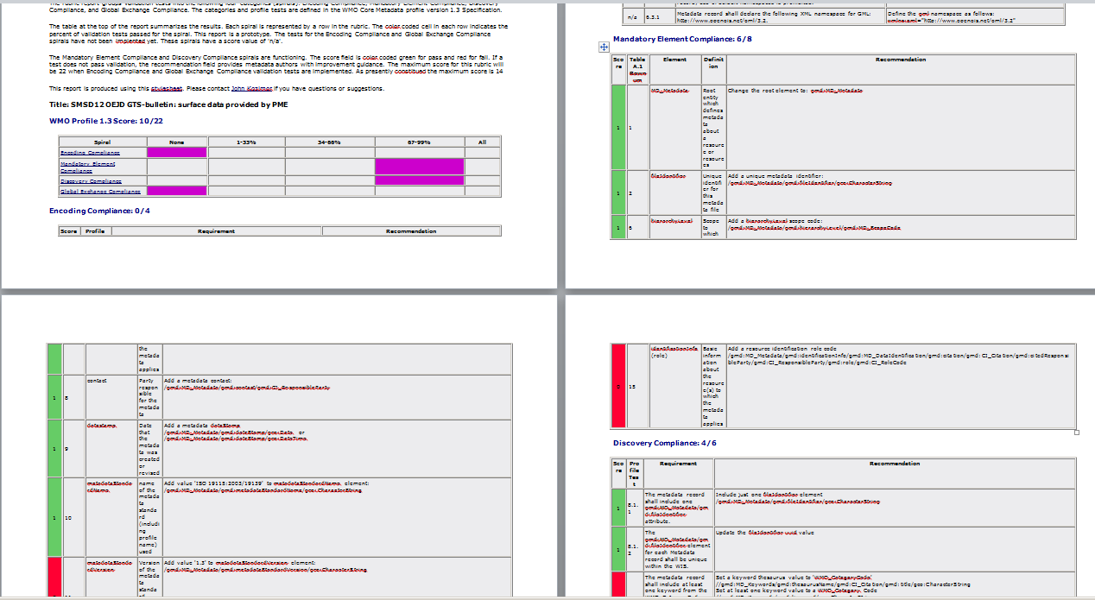
What makes good metadata?
Meets the technical requirements
Contains information users need to find data
All the is information available in English
  But you can add other languages to your own records
You can see how far your metadata meet the technical requirements at:
http://www.ngdc.noaa.gov/docucomp/validationServicesWmo
Notes:
What makes good metadata?
At a minimum, WIS discovery metadata records must meet the minimum standards required by the Manual on WIS. You can check this by using the validation tool that is linked from http://wis.wmo.int/page=WMOCoreMetadataTest (this tool was developed by NOAA).
Metadata records can meet the WIS technical requirements but still be useless in supporting users finding the information they need.
Check that your metadata record:
Contains information users need to find data
All the is information available in English (but you can add other languages to your own records if you wish)

Slide 26
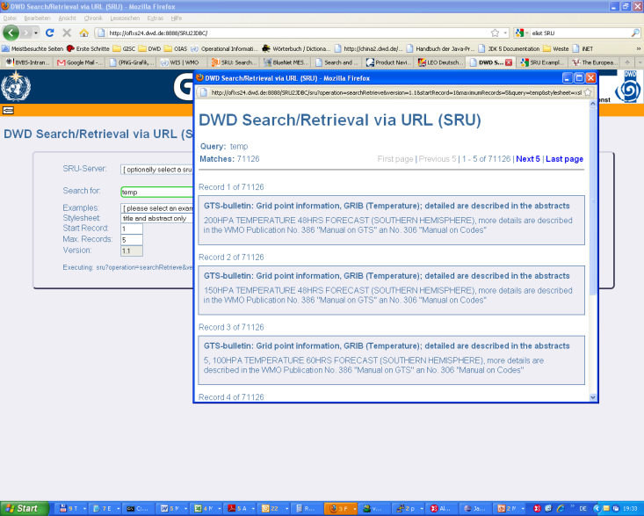
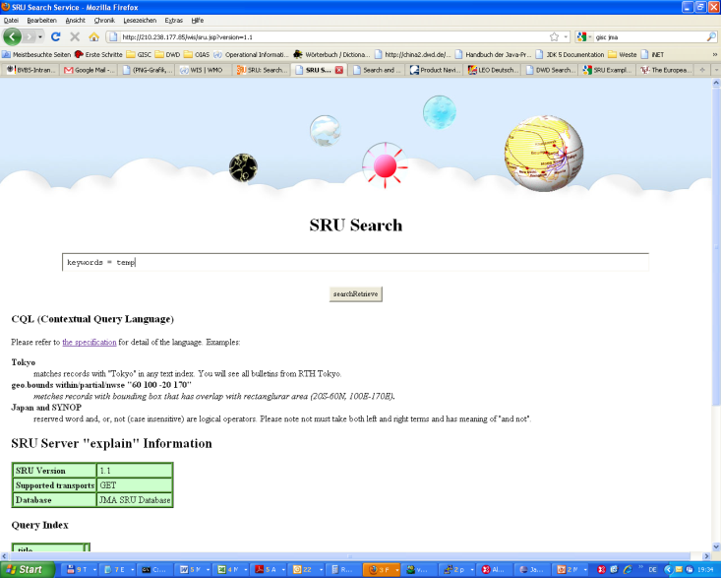
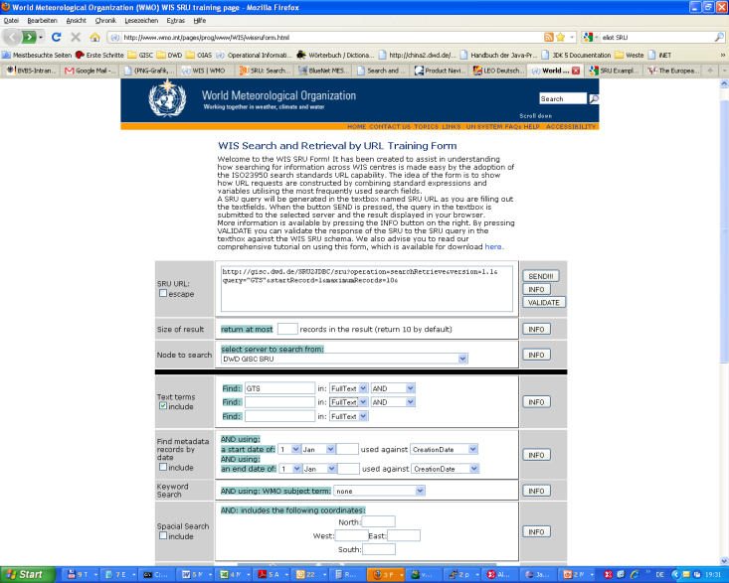
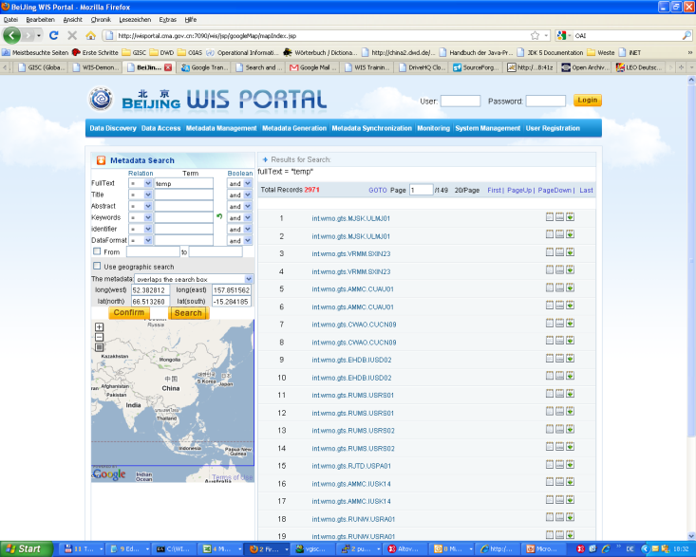
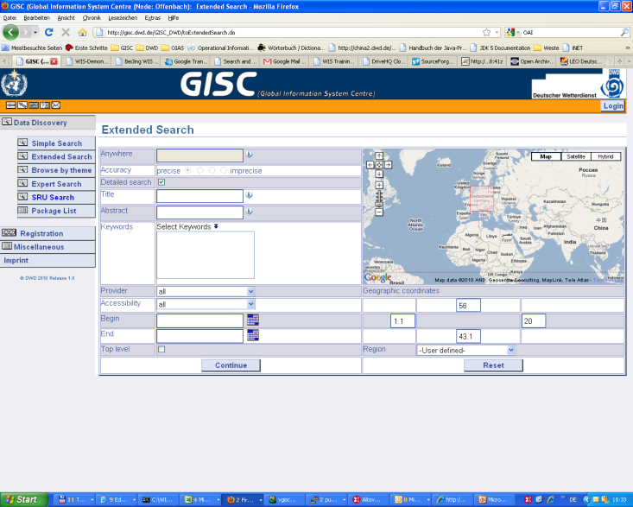
Tools to search metadata
Try searching at any of the GISCs listed as operational at http://www.wmo.int/giscs
Notes:
Tools to search metadata
The main tool used to search the WIS discovery metadata catalogue is the portal at any of the GISCs. Using those portals you can do a simple query to discover metadata records that contain a word or phrase, or you can make your query more specific by searching for words that only appear in the title, in the abstract or as a keyword. You can also combine these with searches for information within a specific area or time span.
There is a list of GISCs at http://www.wmo.int/giscs

Slide 27
Manage the data flow
Notes:
The role of WIS metadata in managing the WIS data flow

Slide 28
3. Manage the data flow - Performance
Ensure collection and distribution of data and products as per data policy
Publish data and products
Subscribe to data and products
Knowledge and Skills
Data formats and protocols
Licensing and data policies
Notes:
Manage the data flow – Performance requirements
The flow of information in the WIS is governed by specific elements of the WIS discovery metadata records. If these elements are not specified correctly, information will not be exchanged as expected.

Slide 29
Data policy
WMO Resolutions 40 (Cg-XII), 25 (Cg-XIII) and 60 (Cg-17)
WMOEssential – “free exchange”
WMOAdditional – encourage exchange but limitations on use
WIS Discovery metadata also has
WMOOther – not covered by Res 40 or 25 but has constraints
noLimitation – no restrictions on the use of the information
Notes:
Data Policy
Metadata records describing information exchanged on the GTS must specify the data policy in the “other constraints” section of the ISO 19115 metadata record.
The Data Policy keywords are drawn from the keyword list WMO_DataLicenseCode (http://wis.wmo.int/style/WMOCodeLists_Style.xml#WMO_DataLicenseCode)
Although the metadata records for all the information in the WIS may be viewed or downloaded by anyone, access to the actual information from the GISC cache is controlled by the data policy keyword and by the policy of the GISC.
Information that is marked as “WMOAdditional” or “WMOOther” may only be accessed by registered users of the WIS. Registration needs the support of the user’s Permanent Representative, and registered users are expected to limit their use of the information to that permitted by the stated data policy.
A user of the information is responsible for contacting the information owner for advice on what uses are permitted.

Slide 30
Data formats
Traditional Alphanumeric Codes
  Unable to represent new types of observation
  Too few station identifiers
  Migration was due to complete November 2014
Table Driven Code forms (GRIB, BUFR, CREX)
  Flexible
  Not widely used outside operational meteorology
From outside World Weather Watch
  XML, netCDF and others
Notes:
Data Formats
WIS permits any data format to be used, but information providers should bear in mind that the purpose of WIS is to make information more widely available. The information will only be available if users are able to read and use it. That means users must know the format of the information, and it is clearly preferable if the information is provided in a widely understood format. For information on the GTS it is preferable that the information is represented in one of the Table Driven Code Forms (BUFR, GRIB) or in an XML format based on WaterML2 or METCE.
The data formats available should be recorded in the metadata record (in the Distribution Format section).

Slide 31
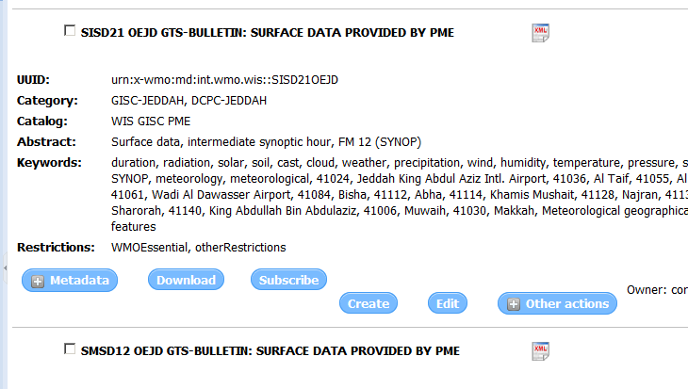
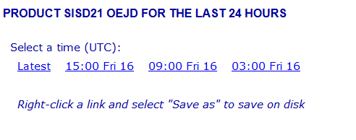
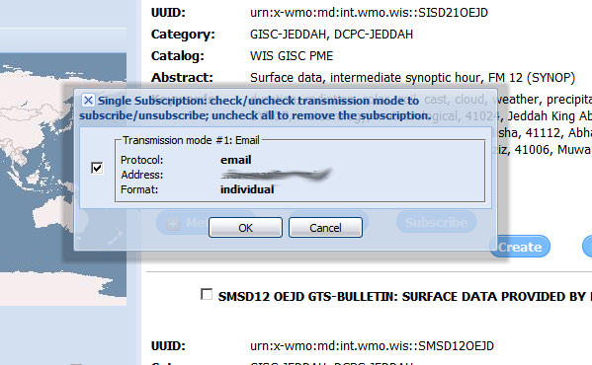
Subscribe to data products
Notes:
Subscribe to data products
Information that has been designated for global exchange is stored for at least 24h in the caches at the GISCs and can be downloaded immediately by authorized users.
In addition, registered users may also subscribe to the flow of information so that they are sent the information as soon as new versions become available on the GISC. The interface for how this is done differs between GISCs.

Slide 32
Exercises

Slide 33
Exercise 1
Using metadata
Use the search facility of your Principal GISC to find different types of information. View the metadata records. Download the XML of a record you think is effective.
Notes:
Exercise 1
Practise using the search facility at your principal GISC other GISCs as well to see how they use different approaches to search.
Search for a type of report (eg SYNOP), contents of a report (eg temperature), for information within a specific area or within a specific time span.
Consider what would make searching easier, and what made some metadata records easier to find than others.
Download a metadata record that you found particularly helpful in describing a type of information that your centre wishes to publish through the WIS

Slide 34
Exercise 2
Creating and editing metadata
Using the information you gathered before the training, and the tools provided by your principal GISC
  Create a metadata record for at least one of the sets of information published by your centre and publish it
  Edit an existing metadata record and publish the new version.
  Delete a metadata record that is no longer relevant
Notes:
Exercise 2 - Creating and editing metadata
Start with the XML you downloaded from Exercise 1 and change the fileIdentifier to one that is appropriate for information published by your organization.
Upload the metadata to a metadata editor and modify it to describe a set of information published by your centre. Publish it (if you are authorized to do so) or walk through the publication process with an expert from the GISC.
Edit an existing metadata record for your centre to improve it and publish the revised version (if you are authorized to do so).
Delete a metadata record that is no longer relevant (this could be the record you created first if you are not authorized to publish records – but before you delete it you might want to download and keep and XML version so that your centre does not need to repeat the work you have done).

Slide 35
Summary
Notes:
What you should have learned

Slide 36
4. Manage the data discovery - performance
Create and maintain discovery metadata records describing products and services
Add, replace or delete metadata records within the catalogue
Ensure that all information and service offerings from a WIS centre have complete, valid and meaningful discovery metadata records uploaded to the catalogue
Notes:
Manage the data discovery
You should have practised
Considering what to include when creating or editing a metadata record,
Using the tools and procedures to add, replace or delete metadata records at your GISC

Slide 37
Manage the data discovery - knowledge and skill
Metadata entry and management tools
Policies and standards
Discovery metadata concepts and formats
Written English
Notes:
Manage the data discovery – knowledge and skill
You should know:
What tools are available to you to manage metadata
The importance of data policy and where to go to find out more
The key components of a WIS discovery metadata record and how they are used
The importance of using clear English in metadata records.

Slide 38
3. Manage the data flow - Performance
Ensure collection and distribution of data and products as per data policy
Publish data and products
Subscribe to data and products
Knowledge and Skills
Data formats and protocols
Licensing and data policies
Notes:
Managing the data flow
You should know why it is important to record the data policy and the data format. You should also know the additional requirements for metadata to support exchange of information using the GTS (WMO_GTSProductCategoryCode and WMO_DistributionScopeCode).

Slide 39
Resources
Notes:
Resources
The following slide tells you of some support information provided by the WIS. Additional resources will be available from your GISC.
You will need to consult your organizations internal procedures and documentation to identify the internal processes you need to go through to release metadata records and to find out the information you need to complete the metadata records.

Slide 40

Resources
Manual on WIS (WMO-No 1060) Part 5 and Appendix 2: http://wis.wmo.int/wis-manual
Guide to the WIS (WMO-No 1061): http://wis.wmo.int/wis-guide
Draft guidance on WIS metadata: http://wis.wmo.int/page=WmoCoreMetadata
  Guidance prepared for Guide to WIS
    http://wis.wmo.int/file=3291
Table driven code form migration: http://www.wmo.int/pages/prog/www/WMOCodes.html#Codes
Data policy: WMO resolutions 25, 40 and 60: http://www.wmo.int/pages/about/exchangingdata_en.html
Notes:
WIS resources
The key information resource on WIS Discovery metadata is the Manual on WIS, Part 5 and Appendix C. Further guidance will be made available in the Guide to the WIS.
Draft guidance on WIS Discovery metadata is on the WIS wiki, and is evolving as the experts develop best practice.
Table driven codes are described on the WMO website.
Information on WMO data policies is available on the WMO website.

Slide 41
Thank you for your attention
wis-help@wmo.int
http://wis.wmo.int/page=TrainingAids

