Slide 1

Satcom Forum
(Madrid, 27-29 September 2016)
Global Cryosphere Watch (GCW)
Etienne Charpentier
Chief, Observing Systems Division, WMO
David Meldrum,
Scottish Marine Institute

Slide 2
GCW Mission
To provide authoritative, understandable, and useable data, information, and analyses on the past, current and future state of the cryosphere to meet the needs of WMO Members and partners in delivering services to users, the media, public, decision and policy makers.

Slide 3
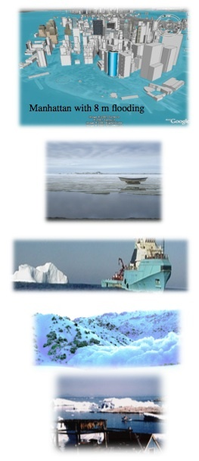
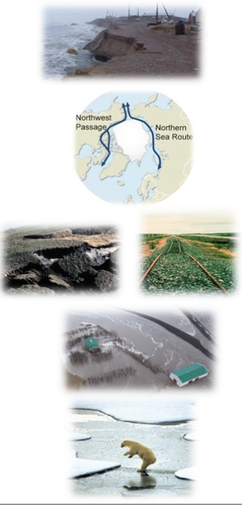
WMO needs to have a focus on global cryosphere issues to be able to provide authoritative information to meet Members’ responsibilities on regional and global weather, climate, water and related environmental matters….Cg-16
Changes in the cryosphere can have significant impacts on….
The Global Earth System:
Sea level rise
Climate
Ocean circulation
Atmospheric circulation
Regional and local impacts:
Natural resources and hazards
Ecosystems
Food production and fisheries
Infrastructure
Transportation
Recreation
GHG emissions
Notes:
Manhattan figure from http://freegeographytools.com/2007/high-resolution-sea-level-rise-effects-in-google-earth

Slide 4
GCW activities and added value
Observations
  CryoNet: Core network of surface observations
  Best practices & guidelines, intercomparisons
  Contributing to WMO’s space-based capabilities database OSCAR
Data sharing & exchange
  Developing GCW Data Portal with up-to-date information on the state of the cryosphere
          Producing unique hemispheric products, e.g., “snow anomaly trackers” for SCE and SWE in collaboration with partners
  Engaging in historical data rescue (e.g., snow depth)
  Building a glossary of cryospheric terms
Developing international training, outreach materials; co-sponsoring workshops

Slide 5
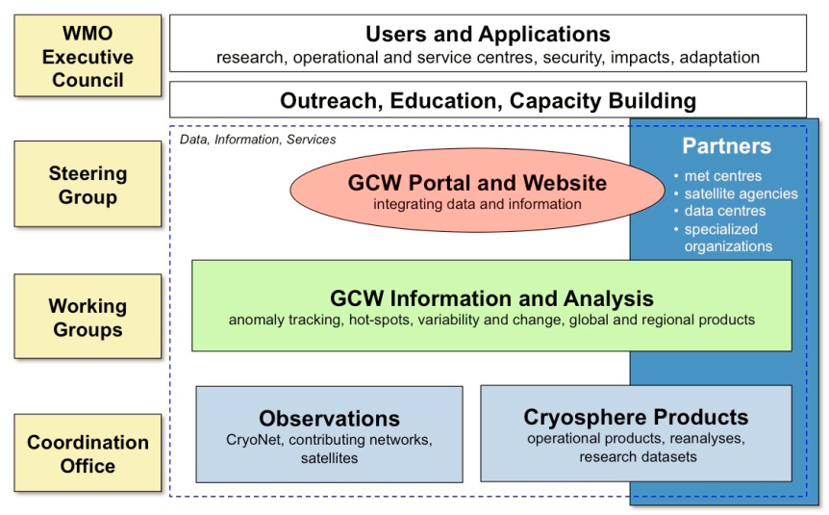
Organizational structure of GCW
Notes:
Observations WG: CryoNet Team, Best Practices Team, Solid Precipitation Team
Integrated products WG: Snow Watch Team
Information and Services WG: Portal Team, Terminology Team, Website and Outreach Team

Slide 6
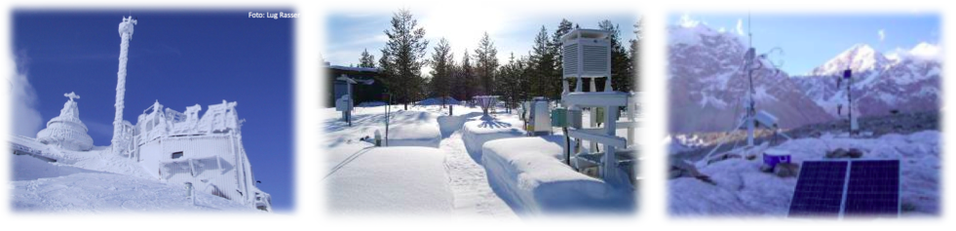
CryoNet – the core GCW Network
…an immediate priority in GCW development.
Establish the core network of GCW surface measurement sites – CryoNet.
CryoNet is one part of the whole GCW observing system, which is a component observing system of the WMO Integrated Global Observing System (WIGOS).
CryoNet covers all components of the cryosphere (glaciers, ice shelves, ice sheets, snow, permafrost, sea ice, river/lake ice) through an extensive approach of in-situ observations.
CryoNet is initially comprised of existing stations/sites, rather than creating new sites.
Notes:
6

Slide 7
CryoNet concept
See: http://globalcryospherewatch.org/cryonet/site_types.html
CryoNet STATIONS
measure at least one variable of a cryosphere component
(for example, snow, permafrost, sea ice, etc.)
have to fulfill CryoNet minimum requirements
must have ancillary meteorological measurements
have the target of long-term operation(primary) or long-term operational commitment with 10+ years record (reference)
Attributes: primary, reference Potential attributes: cal/val, research
CryoNet SITES
contain two or more stations (at least one is a CryoNet station)
with varying capabilities that are coordinated as a local cluster
must have a concept describing the scope of the research approach and the site management
Attributes: basic, integrated

Slide 8
CryoNet Station Minimum Requirements
1. Meeting Core CryoNet Measurement Requirements: The station shall measure at least one of the variables of one of the cryosphere components (i.e. snow, solid precipitation, lake and river ice, sea ice, glaciers, frozen ground and permafrost). The station location shall be chosen such that cryospheric measurements are representative of the surrounding region, and such representativeness shall be clearly described.
2. Commitment of Operational Continuity: The station shall be active. The responsible agencies shall be committed, to the extent reasonable, to sustaining long-term observations of at least one cryosphere component. There shall be a commitment to continue measurements for a minimum of four (4) years.
3. Metadata Up to Date and Availability: The station metadata, including all metadata describing the station characteristics and observing programme, shall be kept up-to-date and available in the GCW Portal as the interface to the WIGOS Information Resource (WIR).
4. Compliance with Agreed Regulatory Practice: The station observational procedures, the instruments and method of observations, quality control practices, etc., shall follow GCW endorsed regulations, manuals, guides and, to the extent possible, the recommended best practices.
5. Data and Ancillary Data Freely Available: Data shall be made freely available, and whenever possible in near real-time. In situ ancillary meteorological observations, as required by CryoNet practices shall also be available with documented quality.
6. Competency of Staff: Personnel shall be trained in the operation and maintenance of the station.

Slide 9
CryoNet Site Minimum Requirements
A site comprises at least one CryoNet station.
Integrated sites have technical supporting staff.
Integrated sites have training capability.
There is a long-term financial commitment.
Data are made freely available, and whenever possible in (near) real-time.

Slide 10
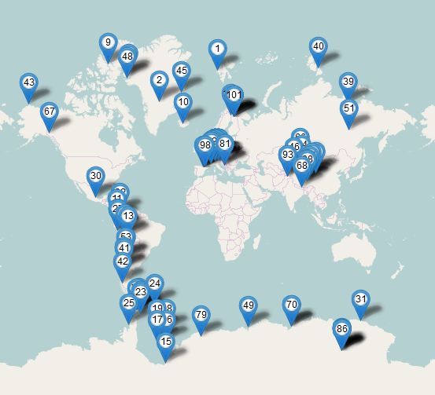
The CryoNet network – status
CryoNet Sites | CryoNet Stations | Contributing Stations
Pre-operational
27 | 9 | 1
Candidates
20 | 38 | 20

Slide 11
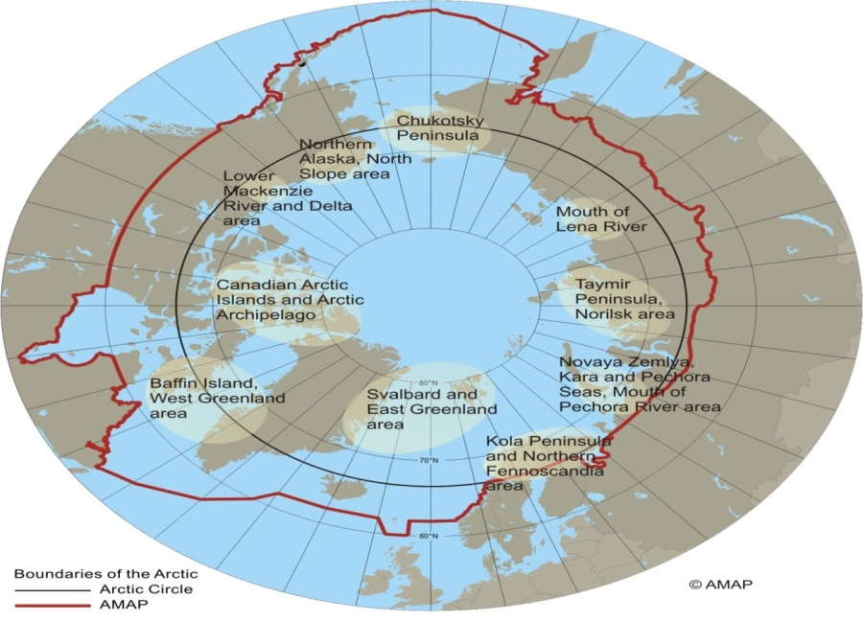
Proposed new Sites (Feb. 2016)
# | Name | Country | Type | SIce | R,Lice | Snow | Glacier | Permafrost
1 | Beliy | Russia | Arctic | * | * | * |  | *
2 | Svalbard | NO/RU | Arctic | * |  | * | * | *
3 | Tavan Bogd | Mongolia | HiM/Altai |  |  | * | *
4 | Chersky | Int’l/Ru | SubA |  |  |  |  | *
5 | PEEX | Int’l/ | SubA |  |  | (*) |  | *
6 | INTERACT | Int’l/ | SubA |  |  | (*) |  | (*)
7 | IMB | USA | Arctic | *

Slide 12
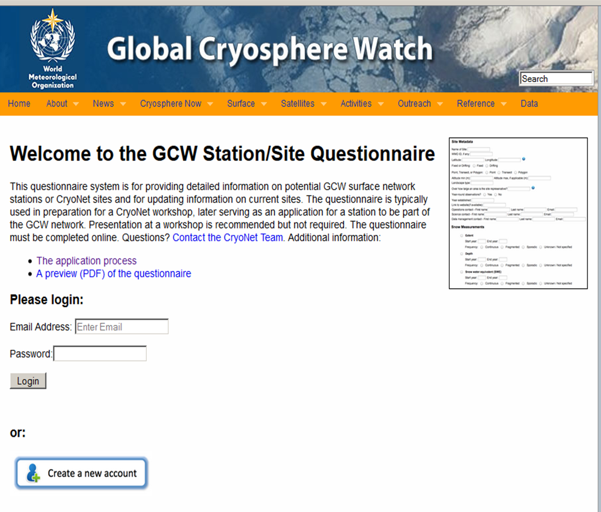
Submission of proposals for CryoNet

Slide 13
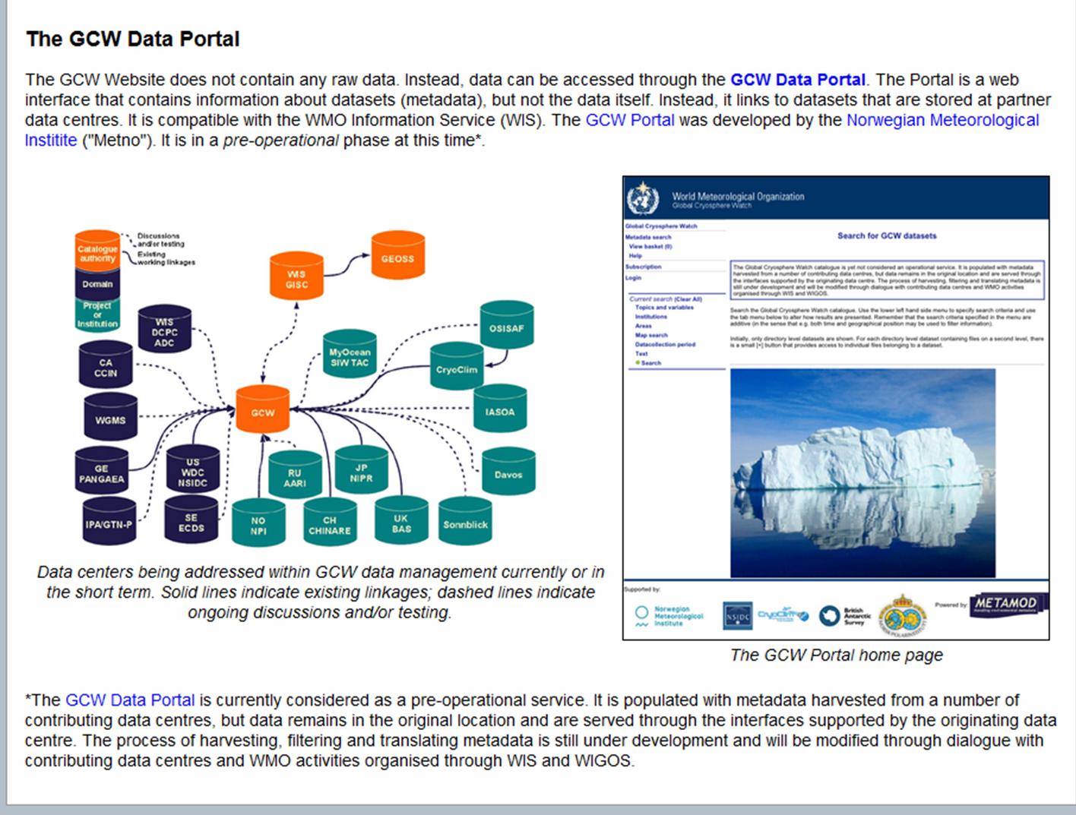
GCW Data Portal (pre-operational)

Slide 14
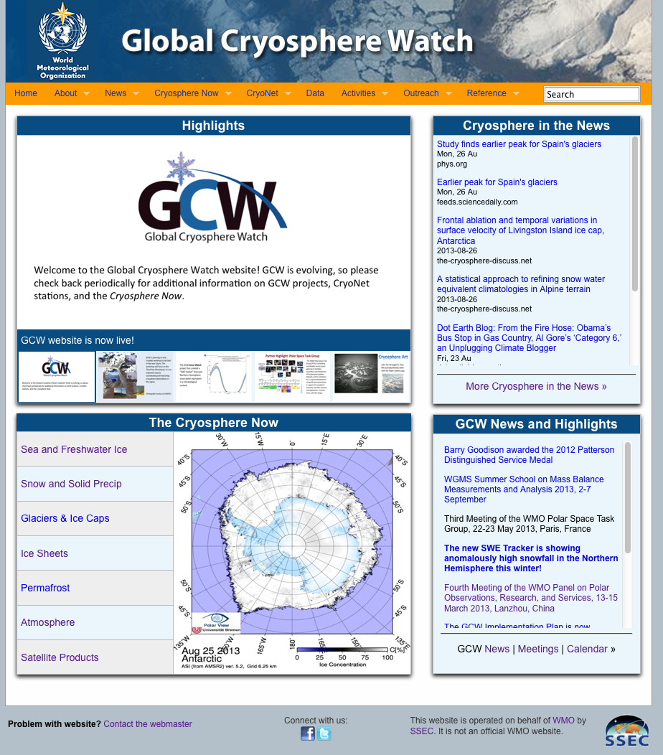
GCW Information Website
The website differs from the METNO GCW data portal in that it contains more dynamic information (news, state of the cryosphere plots, highlights, calendar), as well as background, higher-level information, GCW documents, and outreach material. It links to the METNO data portal.
http://globalcryospherewatch.org
Notes:
http://globalcryospherewatch.org/

Slide 15
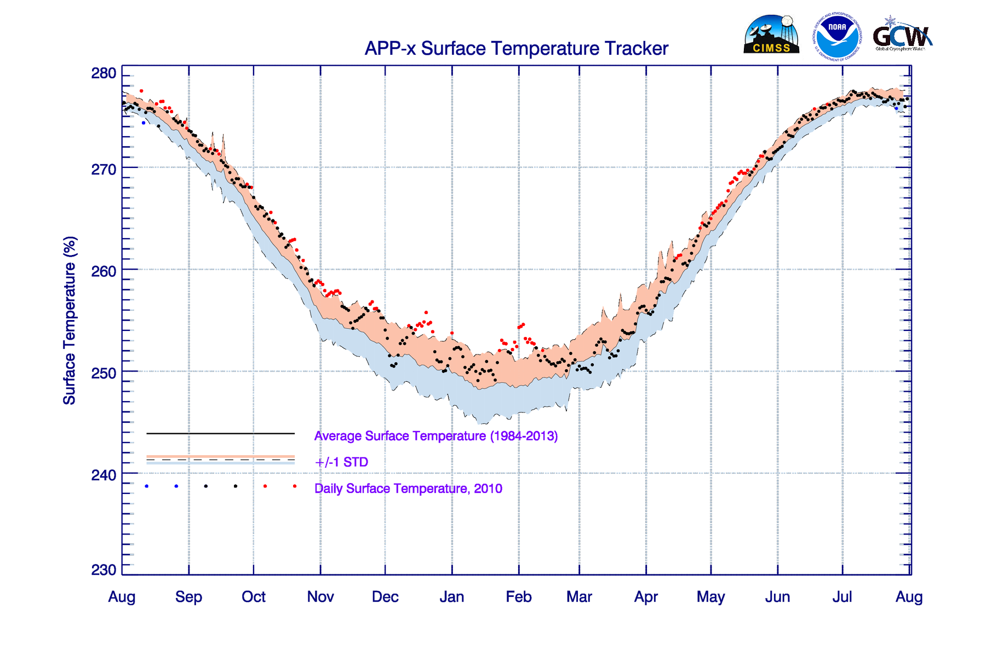
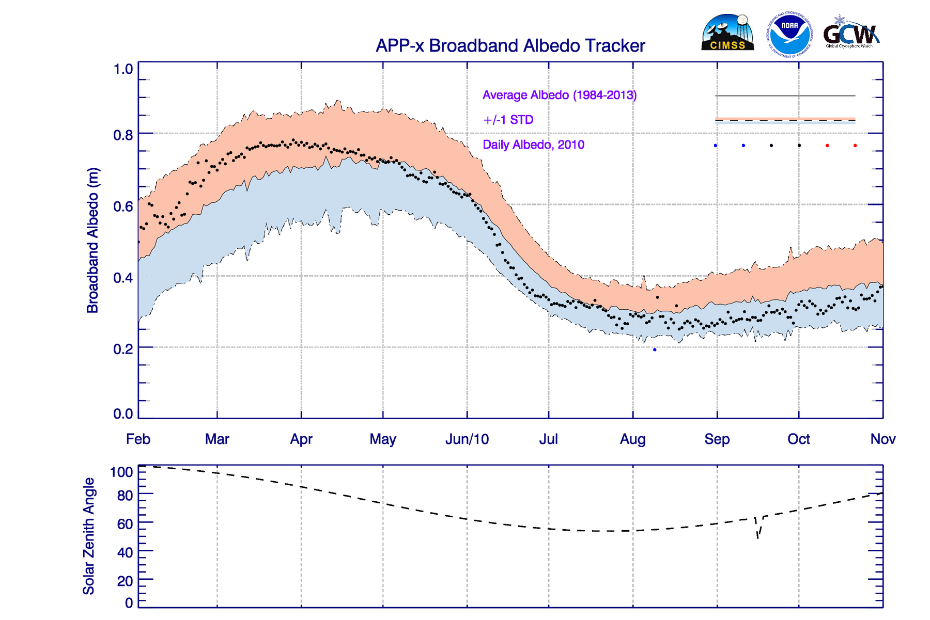
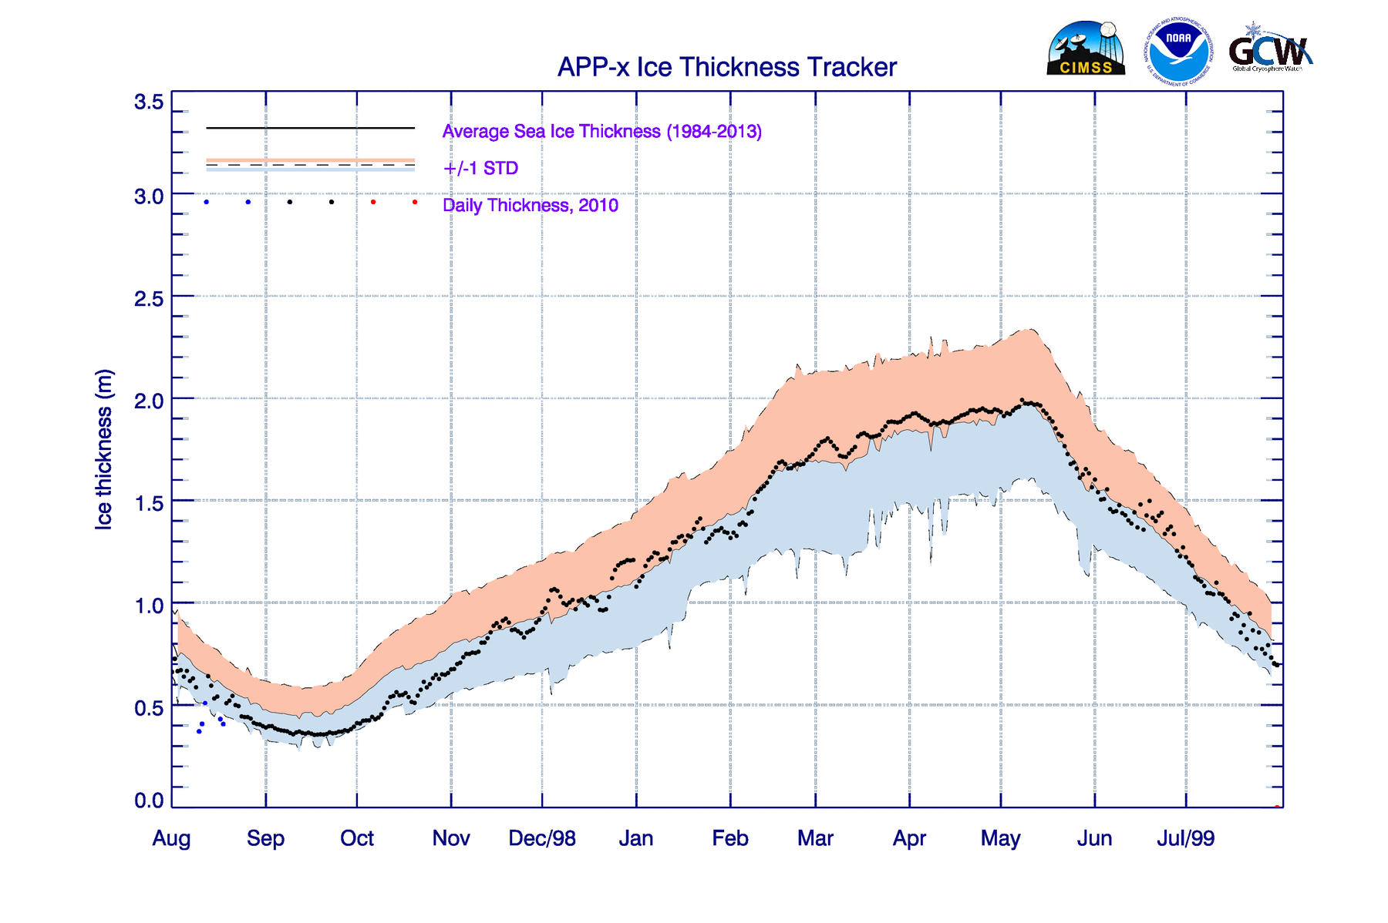
Snow Trackers (under development)
Surface T
Broadband Albedo
Ice Thickness

Slide 16
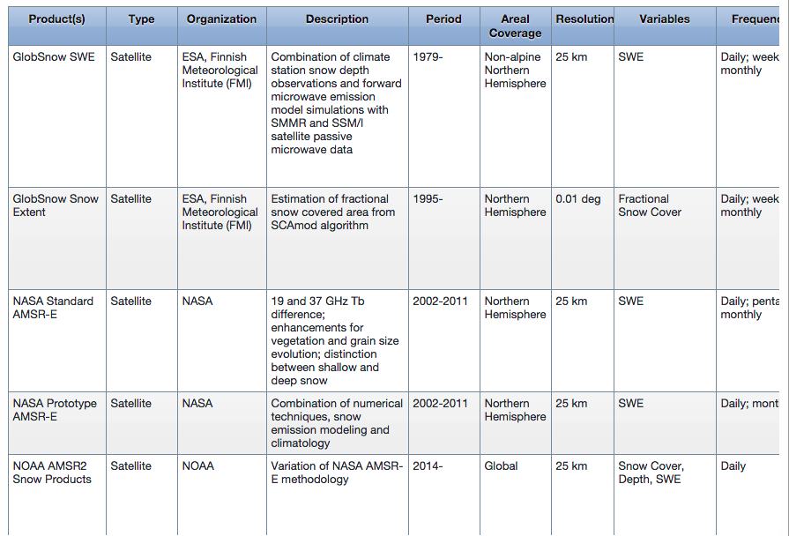
Snow Dataset Inventory
(satellite-derived, in situ, and analysis/reanalysis)

Slide 17
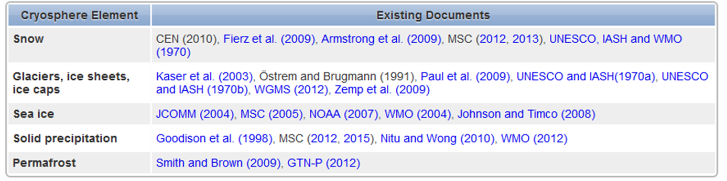
Measurement Standards and Best Practices
Step 1: Inventory of existing guidelines:
Step 2: GCW works through these documents, engages the community, and reaches a consensus on best practices for each variable.

Slide 18
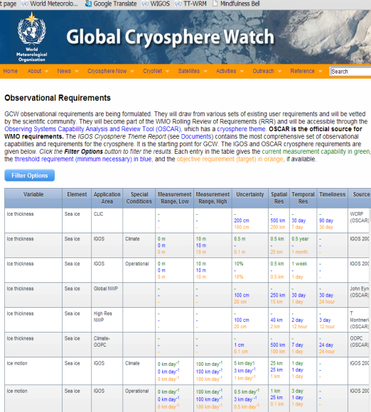
Requirements and Capability for observations
(in progress)
GCW Requirements
are being formulated
and documented
on the GCW website;
They will draw from various sets of existing user requirements and will be vetted by the scientific community;
Those requirements will become part of the WMO Rolling Review of Requirements (RRR);
Will be accessible through the Observing Systems Capability Analysis and Review Tool (OSCAR), the official source for WMO requirements, which has a cryosphere theme;
Need for a new application area “GCW or Polar Obs”.

Slide 19
Satcom issues for GCW & CryoNet
Geostationary satellites: – no coverage > 80°
    Ok for third pole region, high mountains
Polar orbiting satellites: good global coverage – best in polar regions - but small commercial incentive for satellite operators in polar regions
Particle flux at orbital altitude can impact satellite operations in polar regions
Very few manufacturers (if any) offer modems that will work reliably at temperatures below -40C
Static electricity in high winds (ref. Steve Colwell ppt yesterday)
Cost of telecommunication
Data processing for real-time distribution
Latency of data

Slide 20
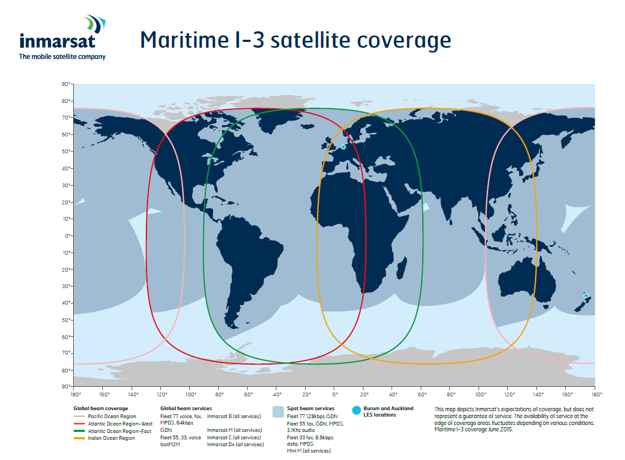
Geostationary – no coverage > 80°:
Inmarsat, Thuraya, Intelsat etc

Slide 21
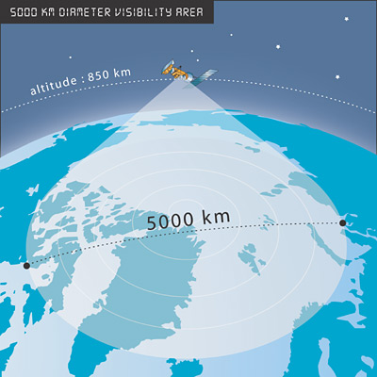
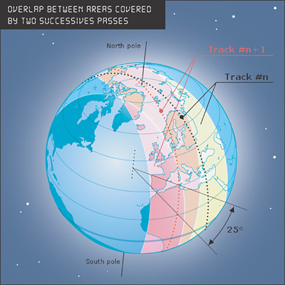
Argos – polar coverage, 6 satellites

Slide 22
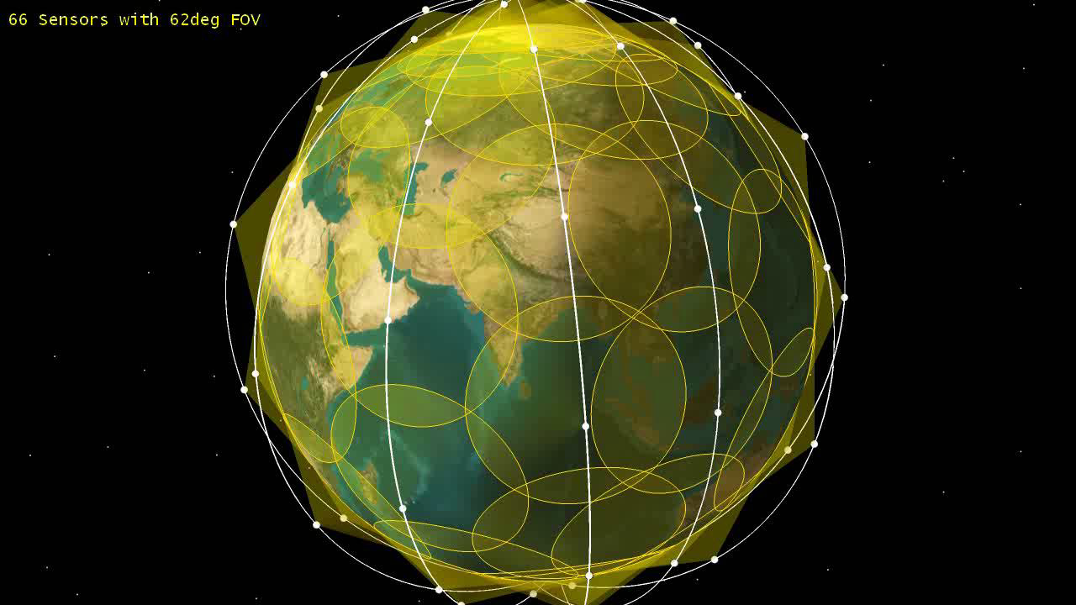
Iridium – polar coverage, ~66 satellites

Slide 23
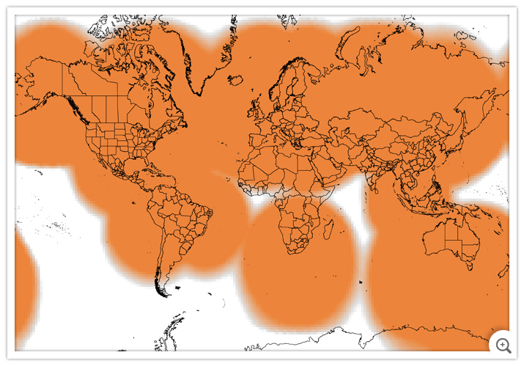
Globalstar simplex – limited polar coverage

Slide 24
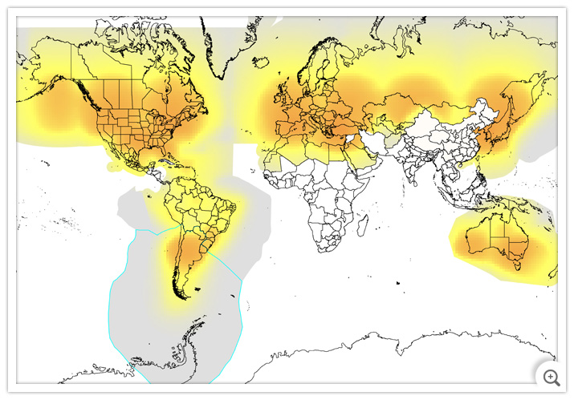
Globalstar duplex – poor polar coverage

Slide 25
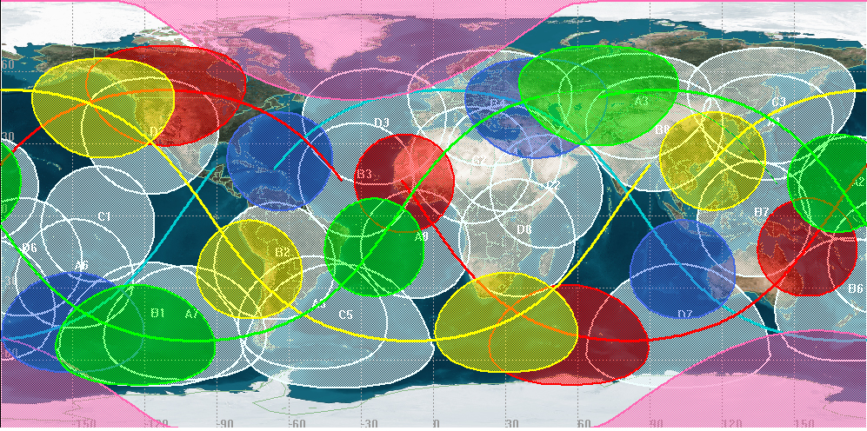
Orbcomm – poor polar coverage

Slide 26
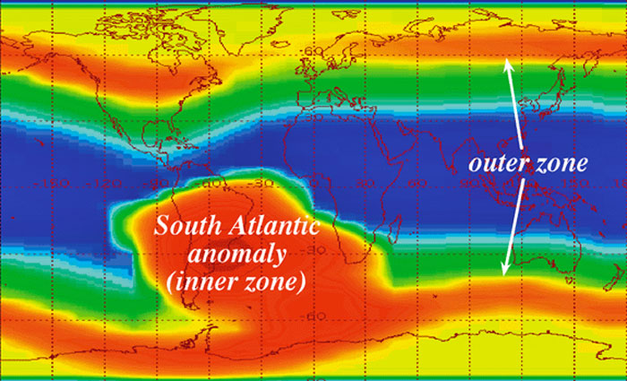
Particle flux at orbital altitude: can impact satellite ops in polar regions

Slide 27
Satcom issues for GCW & CryoNet
Geostationary satellites: – no coverage > 80°
Polar orbiting satellites: good coverage but small commercial incentive for satellite operators
Particle flux at orbital altitude can impact satellite operations in polar regions
Very few manufacturers (if any) offer modems that will work reliably at temperatures below -40C
Static electricity in high winds (ref. Steve Colwell ppt yesterday)
Cost of telecommunication
  Negotiating special rate for high value environment data
  Prohibitive monthly fee for low bandwidth application
Data processing for real-time distribution
Latency of data
  Negotiating priority for low latency in high impact weather situations for DRR applications

Slide 28
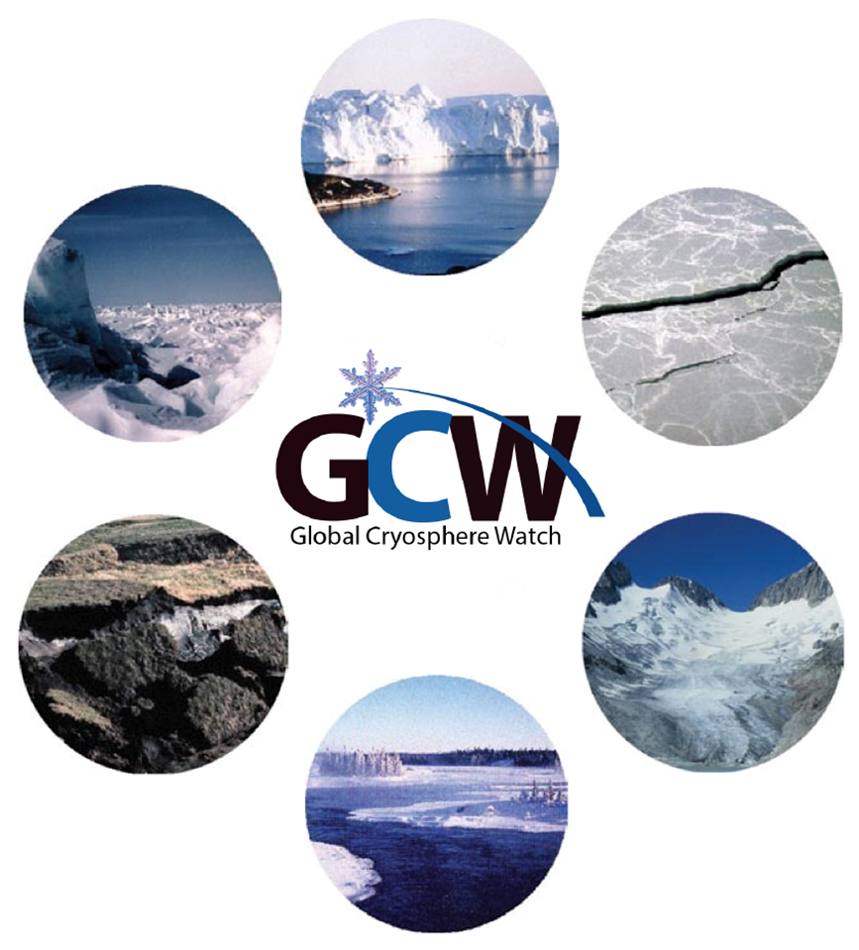
Questions?

Slide 29

Thank you

